Slide 1
A different approach to
Middleware

Slide 2
The IGUANA Integration Engine
Introduction
Eliot Muir, CEO
My role is 75% development
Based in Toronto, Canada

Slide 3





The IGUANA Integration Engine
About iNTERFACEWARE
Iguana – integration in healthcare.
Uses Lua and sponsor the LuaJIT project
In business since 1997
Over 600 customers, 10,000+ live sites

Slide 4
The IGUANA Integration Engine
The Integration Problem
Every IT system has incompatible data.
Development is required to share data.
Every site
Integration engineers have domain knowledge, but not highly technical (ex. Nurses etc.)

Slide 5
The IGUANA Integration Engine
ETL Problem
Extract
Transform
Load

Slide 6
The IGUANA Integration Engine
Traditional ETL
Heavy graphical GUIs
Schema and mapping
No programming required!

Slide 7
The IGUANA Integration Engine
Trouble is…
… it’s not that simple!

Slide 8
The IGUANA Integration Engine
Real world integration
Always require scripting
Work flow etc.
Traditional ETL engines have poor scripting environments

Slide 9
The IGUANA Integration Engine
4 years ago…
R&D began on a better scripting environment
Started with Python….1 month later…

Slide 10
The IGUANA Integration Engine
Tried out Lua
And did the same prototype in two days
Cleaner internals – easier to work with

Slide 11
The IGUANA Integration Engine
ETL software is specialized
Data in
Transform
Data out
… in a fraction of a second

Slide 12
The IGUANA Integration Engine
Limited Scope
Allows a different approach to building an IDE
Every time code or data changes
Re-execute transformation from start to finish
Visually show real time results in the UI

Slide 13
The IGUANA Integration Engine
Foundation
Web based IDE
C++ in the backend
Code Mirror for the colorized editor
jQuery + Javascript
Client-Server approach to building a web app

Slide 14
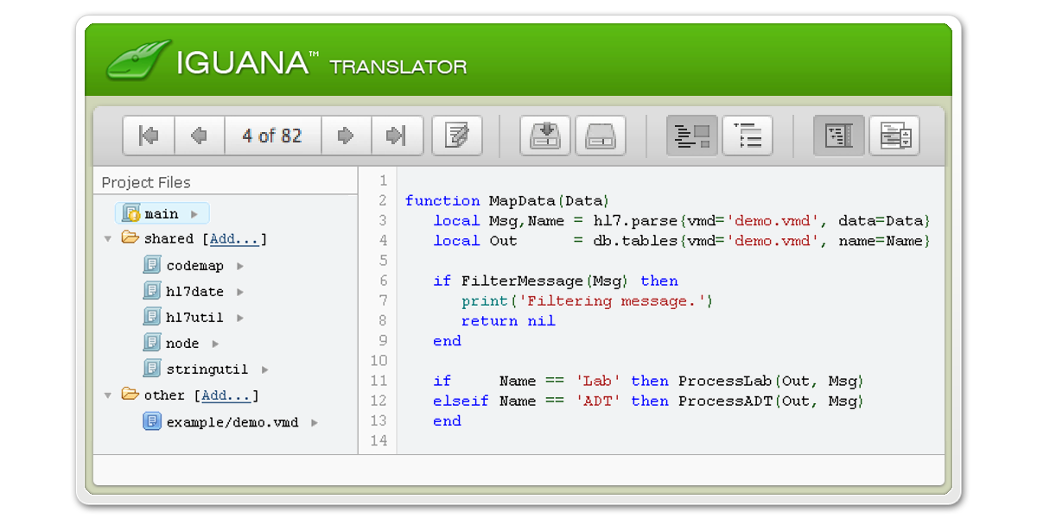
Best thing is to see in action…
Let’s do that now…

Slide 15
The IGUANA Integration Engine
Live Data Execution
Live data execution means APIs need sandboxing
Live vs. test mode
live=true, iguana.isTest()

Slide 16
The IGUANA Integration Engine
Minimizing Network Traffic
Early betas of translator IDE would exchange megabytes of JSON!
A lot of optimization work to limit the amount of data exchanged between the browser and the server

Slide 17
The IGUANA Integration Engine
What’s Next?
Tuatara (an obscure New Zealand lizard)
Possibly a free version of the IDE – just to give back to the Lua community
Looking at FFI library in LuaJIT for faster C++ bindings
Integration outside of just healthcare
Backward compatibility is key

Slide 18
The IGUANA Integration Engine
Like to play with Iguana?
If you would like to have a copy to use for debugging Lua code etc. for personal use we’re happy to give a non expiring copy of Iguana for this purpose.

Slide 19
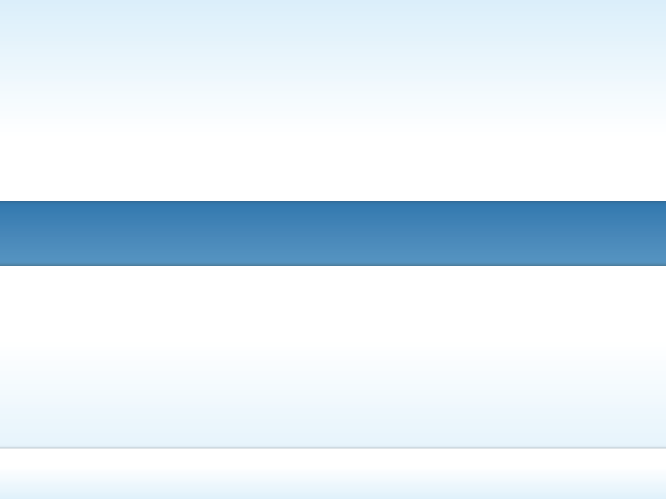
Any questions?
IGUANA
Eliot Muir
eliot.muir@interfaceware.com
Linked In: http://ca.linkedin.com/in/eliotmuir
CEO, iNTERFACEWARE

