Slide 1

Latin America and the Caribbean: Regional Preparatory Process for Rio+20
Joseluis Samaniego
Economic Commission for Latin America and the Caribbean
UN headquarters New York, NY
December 14, 2011

Slide 2
LAC Regional Preparatory Meeting
Interagency assessment of progress and gaps in the implementation of sustainable development since the Earth Summit in 1992
Submissions for the zero draft

Slide 3
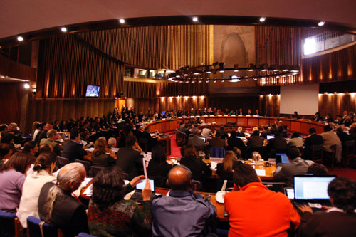
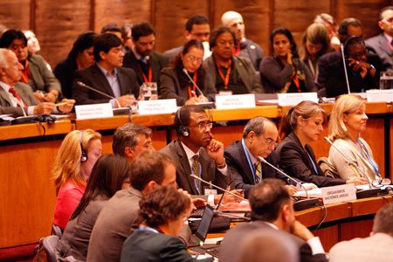
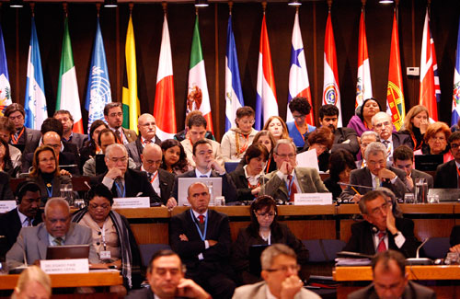
LAC Regional Preparatory Meeting
ECLAC headquarters, Santiago, Chile
September 7-9 2011
www.cepal.org/rio20

Slide 4
LAC Regional Preparatory Meeting
29 countries from the region
UN System entities, Intergovernmental organisations
Almost 100 representatives of Major Groups (civil society, private sector)
Conclusions available at www.cepal.org/rio20
Report forthcoming
IISD summary report available at: http://www.iisd.ca/download/pdf/enb2707e.pdf
Proposals:
Colombia and Guatemala: Sustainable Development Goals
Boliva: Rights of Nature
Cuba: Institutional Framework

Slide 5
Issues highlighted
Consensus on the need to change the model of development
Concerns on green economy (protectionism, conditionality, values/principles)
Need for active policies for a change in development model
Need for international cooperation, leadership from developed countries
Conceptual concerns vs. pragmatic approaches
No mention of green economy in outcome document, but consensus on need a for commitments to achieve (…) “change in patterns of production and consumption, in which the developed countries should play a leading global role”

Slide 6
Conclusions from the Latin American and Caribbean Regional Preparatory Meeting for Rio+20
The ministers and representatives of the Governments in Latin America and the Caribbean and affirmed the need for commitments to achieve:
A global institutional framework for sustainable development which is efficient and flexible and ensures the effective integration of its three pillars
A change in patterns of production and consumption, in which developed countries should play a leading role
Full implementation of the right to access to environmental information, participation and justice enshrined in Principle 10 of the Rio Declaration
Better ways of measuring countries' wealth that adequately reflect the three pillars of sustainable development

Slide 7
Conclusions from the Latin American and Caribbean Regional Preparatory Meeting for Rio+20 (cont.)
They affirmed the need for commitments to achieve:
The eradication of extreme poverty
A new, additional, stable and predictable financing for supporting implementation activities in developing countries
The fulfillment of mitigation and adaptation commitments in relation to climate change and the building of resilience to its impacts
Effective access to and transfer of safe and appropriate technologies
The promotion of a global intellectual property rights regime that facilitates the transfer of technologies
greater South‐South cooperation and exchange of successful experiences

Slide 8
Interagency assessment
Prepared under the coordination of ECLAC in close collaboration with 19 regional offices from various United Nations entities.
Progress and gaps
Guidelines for action
Preliminary version presented at Regional Preparatory Meeting. Final version to be launched during 2012

Slide 9
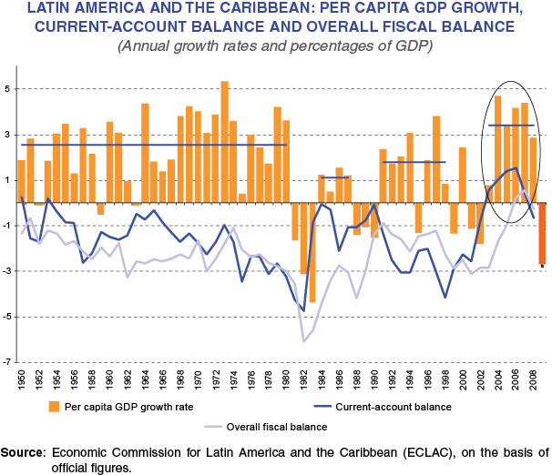
The situation in the region today is quite different from that which existed in 1992
In 1992, the region was emerging from a "lost decade" of low growth, high inflation and restrictions on the balance of payments related to foreign borrowing.
Currently, despite the recent global economic crisis, the region is achieving nearly a decade of relatively high growth.

Slide 10
Mixed progress has been observed in the sustainability of development
Indicator | 1990 | 2000 | 2005 | 2010
Population (thousands, at mid-year) | 443 032 | 521 429 | 557 038 | 590 082
Urban population (thousands, at mid-year) | 311 042 | 393 420 | 432 646 | 468 757
Poverty
- Proportion of total (percentages) | 48,3 | 43,8 (1999) | 34,1 (2007) | 32,1
- Number of people (millions) | 200 | 211 (1999) | 184 (2007) | 180
Human Development Index | 0,614 | 0,66 | 0,681 | 0,704
Income distribution (Gini coefficient x 100) | 53,8 (1989/92) | 55 (2002) |  | 52 (2006/09)
Population living in slum dwellings
- Proportion of total (percentages) | 33,7 | 29,2 | 25,5 | 23,5
- Number of people (millions) | 106,7 | 115,2 | 110,1 | 110,8
Population without access to energy
- Proportion of total (percentages) | 17,8 | 13,4 | 7,8 | 6,4 (2009)
- Number of people (millions) | 76 | 41 | 43 | 39 (2009)

Slide 11
Mixed progress has been observed in the sustainability of development
Indicator | 1990 | 2000 | 2005 | 2010
Surface area with forest cover (percentages) | 51,9 | 49,4 | 48,2 | 47,2
Proportion of protected land areas (percentages) | 10,5 | 16,2 | 20,3 | 20,8 (2009)
Supply of renewable energy (percentages) | 25 | 21,5 | 22,2 | 23,2 (2009)
Energy intensity of GDP (total energy consumption — in thousands of barrels of oil equivalent— per million dollars of GDP at constant 2000 prices) | 1,6 | 1,53 | 1,5 | 1,45 (2009)
Intensity of CO2 emissions (tons per 1,000 dollars of GDP at constant 2000 prices) | 0,67 | 0,63 | 0,61 | 0,59 (2007)
CO2 emissions per inhabitant (tons of CO2 per inhabitant, from the burning of fossil fuels and cement production) | 2,4 | 2,6 | 2,7 | 2,8 (2007)
Intensity of fertilizer use (tons per 1,000 hectares of farmland) | 11,6 | 17,3 | 21,3 | 23,3 (2008)
Consumption of ozone-layer-depleting substances (thousands of tons of ozone-depletion potential) | 74,6 | 31,1 | 14,5 | 5,3 (2009)

Slide 12
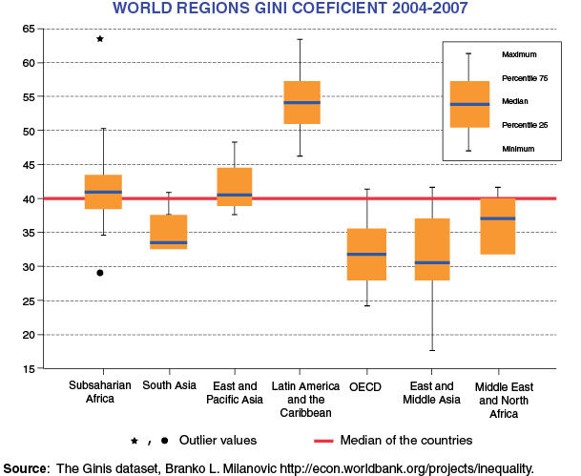
Inequality has slightly diminished over the last 20 years
Between 1990 and 2009, the Gini coefficient is a measure of the inequality of income distribution, showed an improvement, from 0.538 to 0.520.
However, this progress is relative, as the region still remains the most imbalanced in the world.

Slide 13
The past five years have seen significant progress in the control of deforestation
LATIN AMERICA AND THE CARIBBEAN: FOREST AREA AND ANNUAL RATES OF CHANGE 1990–2010, AND PERCENTAGE OF GLOBAL FOREST AREA (FAO data)
 | Forest area (thousand of hectares) |  |  |  | Annual rate of change
 | 1990 | 2000 | 2005 | 2010 | 1990-2000 |  | 2000-2005 |  | 2005-2010
 |  |  |  |  | Thousands of hectares/ y ear | % | Thousands of hectares/ y ear | % | Thousands of hectares/ y ear | %
Caribbean | 5902 | 6434 | 6728 | 6933 | 53 | 0,87 | 59 | 0,90 | 41 | 0,60
Central America | 25717 | 21980 | 20745 | 19499 | -374 | -1,56 | -247 | -1,15 | -249 | -1,23
Mexico | 70291 | 66751 | 65578 | 64802 | -354 | -0,52 | -235 | -0,35 | -155 | -0,24
South America | 946454 | 904322 | 882258 | 864351 | -4213 | -0,45 | -4413 | -0,49 | -3581 | -0,41
World | 4168399 | 4085168 | 4060964 | 4033060 | -8323 | -0,20 | -4841 | -0,12 | -5581 | -0,14
Percentage of global forest area | 25% | 24% | 24% | 24%
This progress can be seen especially in the Amazon. However, the annual rate of forest loss between 2000 and 2010 was 0.46%, more than three times the global annual rate (0.13%).

Slide 14
Regional emissions of ozone-depleting substances have declined steadily over the last 20 years
LATIN AMERICA AND THE CARIBBEAN: CONSUMPTION OF OZONE-DEPLETING
SUBSTANCES, 1990–2009
(Ozone-depleting potential (ODP) tons)
This reflects successful efforts made under the Montreal Protocol
Source: Economic Commission for Latin America and the Caribbean (ECLAC), on the basis of United Nations Millennium Development Goals indicators database based on figures from the Ozone Secretariat of the United Nations Environment Programme (UNEP) [online] http://ozone.unep.org/Data_Reporting/Data_Access/ [date of reference: May 2011].

Slide 15
International cooperation and improvements in the terms of international trade are not sufficient
OFFICIAL DEVELOPMENT ASSISTANCE GRANTED BY COUNTRIES OF THE DEVELOPMENT ASSISTANCE COMMITTEE, 1990-2008
(Percentages of gross national income of donor countries)
In 2010, ODA provided by developed countries amounted to 0.32% of their GNI, less than half of the percentage target agreed upon.
Source: United Nations, Achieving the Millennium Development Goals with Equality in Latin America and the Caribbean: progress and challenges (LC/G.2460), Santiago, Chile, Economic Commission for Latin America and the Caribbean (ECLAC), 2010.

Slide 16
Strengthening the environmental pillar
Since 1992, environmental legislation has strengthened and institutions dedicated to the environment have been created.
Sustainable development has been established as a concept in public institutions and policy.
There is still a lack of coordination and consistency in public-sector decision-making and policies. The absence of linkages between social, economic and environmental policies restrains progress on sustainability.

Slide 17
Strategic Guidelines for Sustainable Development
A. Align policies on social protection, human security, quality of life with environmentally sound economic activities
B. Increase the visibility of environmental and social costs of economic decisions
C. Develop better policies on a more informed, participatory basis
D. Building human and social capital for sustainability by strengthening education, science and technology

Slide 18
Submissions for zero draft
19 submissions from countries in the region
Other organisations including ECLAC, Caricom

Slide 19
ECLAC’s assessment of the main barriers to implementation (contained in submission to zero draft)
(i) failures in making the social and economic costs of environmental degradation visible and in establishing mechanisms for their internalization (as per Principle 16 of the Rio Declaration);
(ii) insufficient mainstreaming of sustainable development as a driving force in public policies and failures in coordinating and ensuring coherence between policy areas, nationally and internationally;
(iii) insufficient channels for public participation in decision making and for the effectiveness of access to justice and to information;
(iv) difficulties in spurring endogenous technologic development in key productive sectors, in addition to the existence of barriers in access to technology
(v) difficulties in financing.

Slide 20
ECLAC’s proposals (contained in submission to zero draft)
Rio+20 is an opportunity for countries to agree on schedules and timelines for:
Developing and mainstreaming the use of indicators of economic performance and accounting methods that take account of the environment and of the cost of environmental degradation, such as systems of integrated economic and environmental accounting.
Eliminating direct and indirect subsidies for activities that generate significant environmental or health costs, implementing transition schemes that protect the poor and other groups in vulnerable situations, and implementing fiscal and industrial policies to stimulate sustainable development;
Implementing fiscal or economic instruments to reduce environmental and health costs and to foster environmentally friendly consumer and producer preferences;
Incorporating environmental and health considerations into methodologies for analyzing public and private investment options, including the investments supported by global and regional financial development institutions;
Mainstreaming the use of Strategic Environmental Assessment for public investment and policy.

Slide 21
ECLAC’s proposals (contained in submission to zero draft)
Rio+20 is an opportunity to issue mandates for negotiating the adoption of:
Agreed and measurable sustainable development goals and targets.
Implementing changes in international governance in order to gain coherence at the international level (between organizations focusing on different issues and among international agreements) as well as to enable the negotiation of new international agreements where necessary. One possibility for enhancing coordination and coherence at the international level is to revise the role and functioning of the Economic and Social Council (ECOSOC), establishing sustainability as a guiding concept for its decisions.
Strengthen the development pillar of the United Nations
International agreements (at the global or regional level) to promote the enactment of legislation pertaining to Principle 10 of the Rio Declaration and its implementation, to be possibly, but not necessarily, based on the Aarhus Convention.
Global tax on international financial transactions

Slide 22
Common themes in regional submissions
Lack of definition of Green Economy
Public Participation
Sustainable Consumption and Production
Common but differentiated responsibilities
Concerns with Protectionism
Technology transfer
Financing – ODA commitments not met

Slide 23
References to Green Economy in submissions by LAC countries

Slide 24
References to Green Economy in submissions by LAC countries

