Slide 1
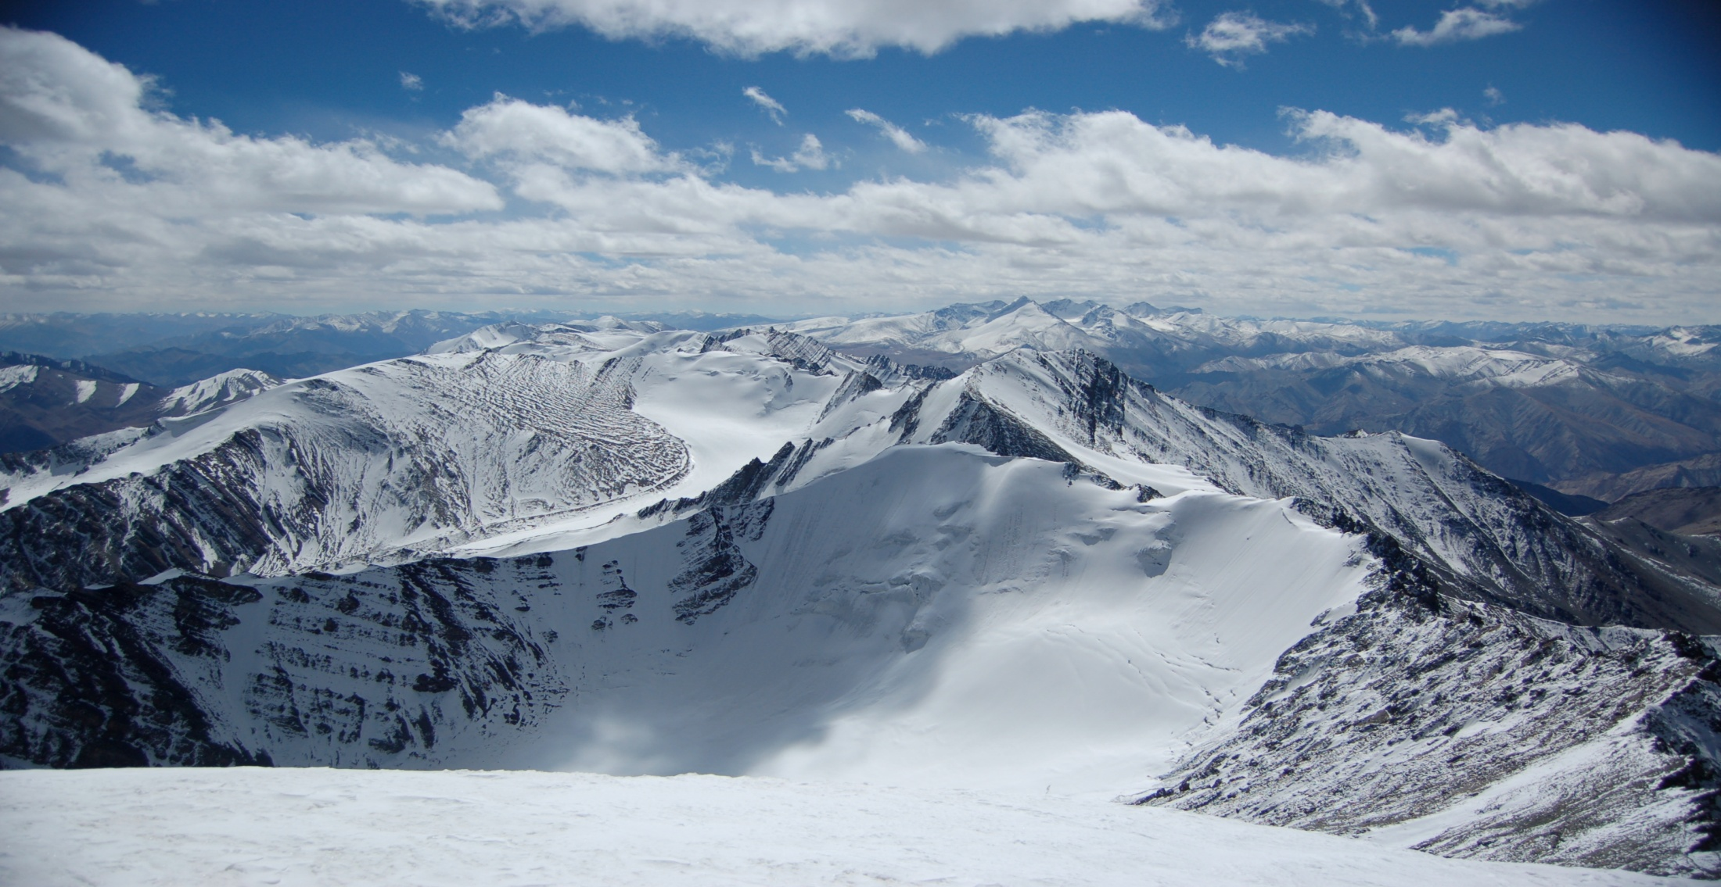
From Antarctica to Kashmir’s Siachen glacier
Scientific peacekeeping
Kate Harris
kjharris@mit.edu| www.kateharris.ca

Slide 2
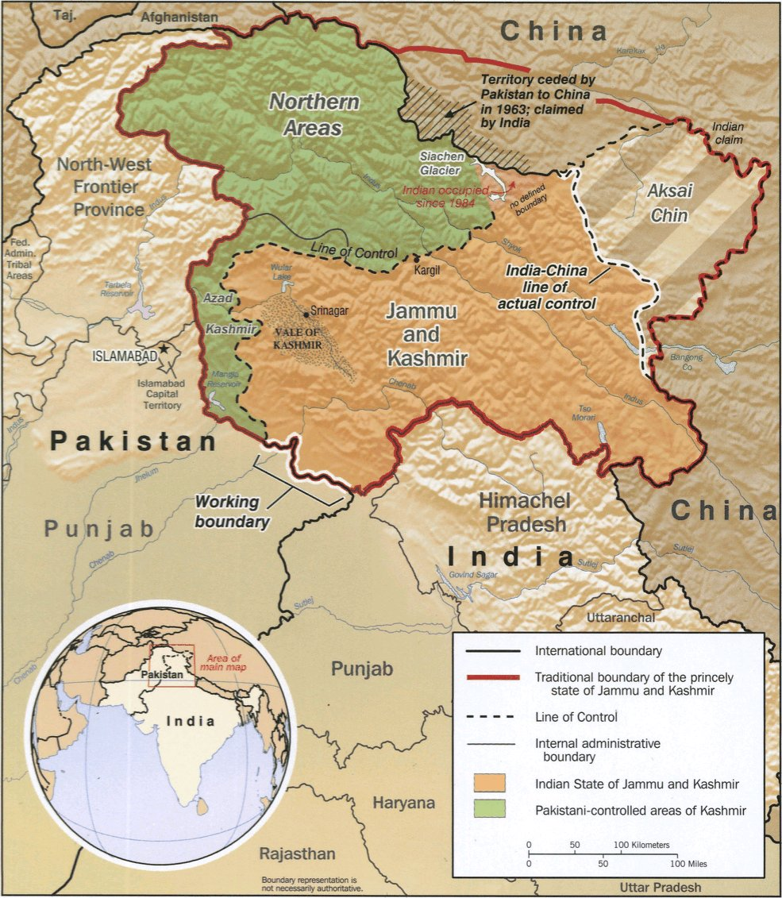
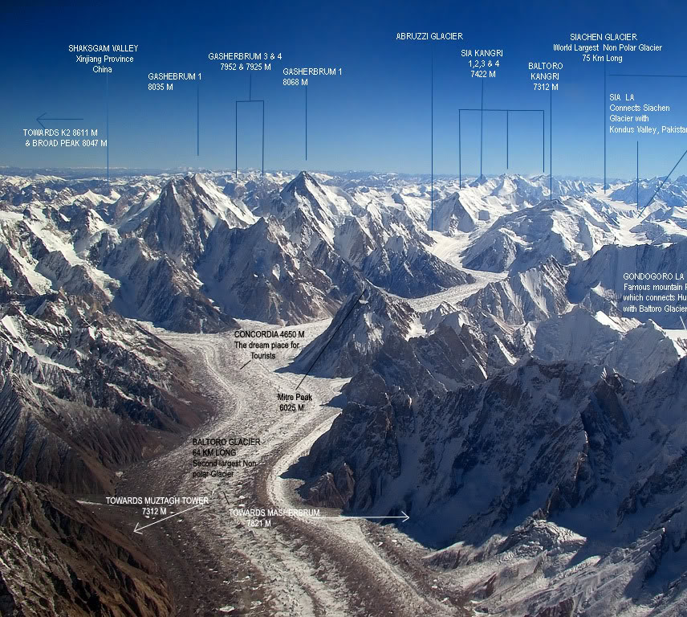
NJ9842: “Hence north to the glaciers”

Slide 3
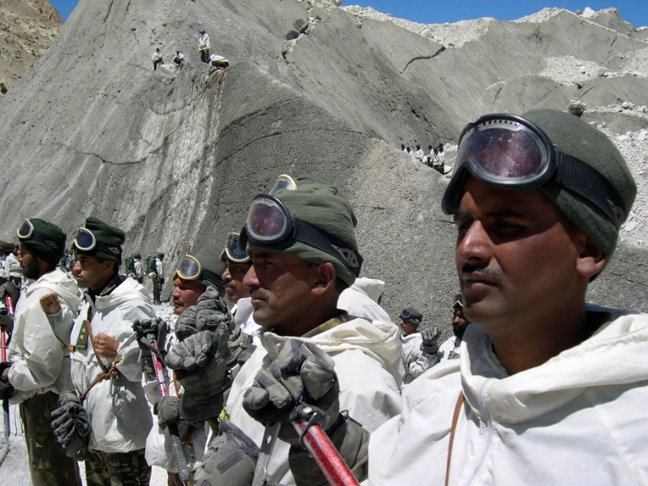
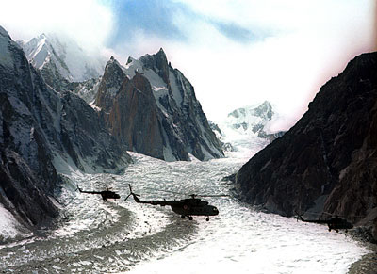
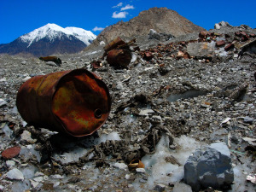
Soldierly life at staggering heights
Siachen: “the world’s highest and biggest garbage dump, from where nothing comes back.” – Indian army officials, The Tribune of India, 1998
Image credits: Iceberg Films

Slide 4
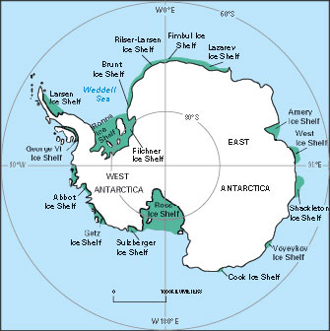
Applying Antarctic Treaty Principles to Siachen
Articles I, II, III, IV, V, VII, XI
research centers open to joint inspection
resolution of disputes through neutral, third-party means
ban on nuclear activity
deferral of sovereignty claims

Slide 5
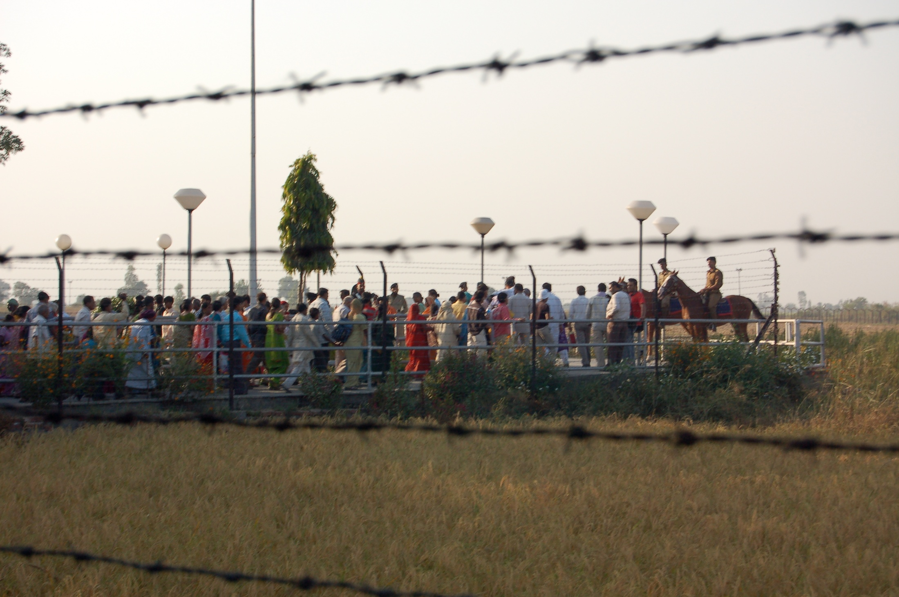
Science as tool for diplomacy on Siachen
“Article IV at least dampens the energy with which states pursue claims and fosters meanwhile an atmosphere of cooperation between claimant states that may ease future negotiations over sovereignty.” – Dr. C. Joyner

Slide 6
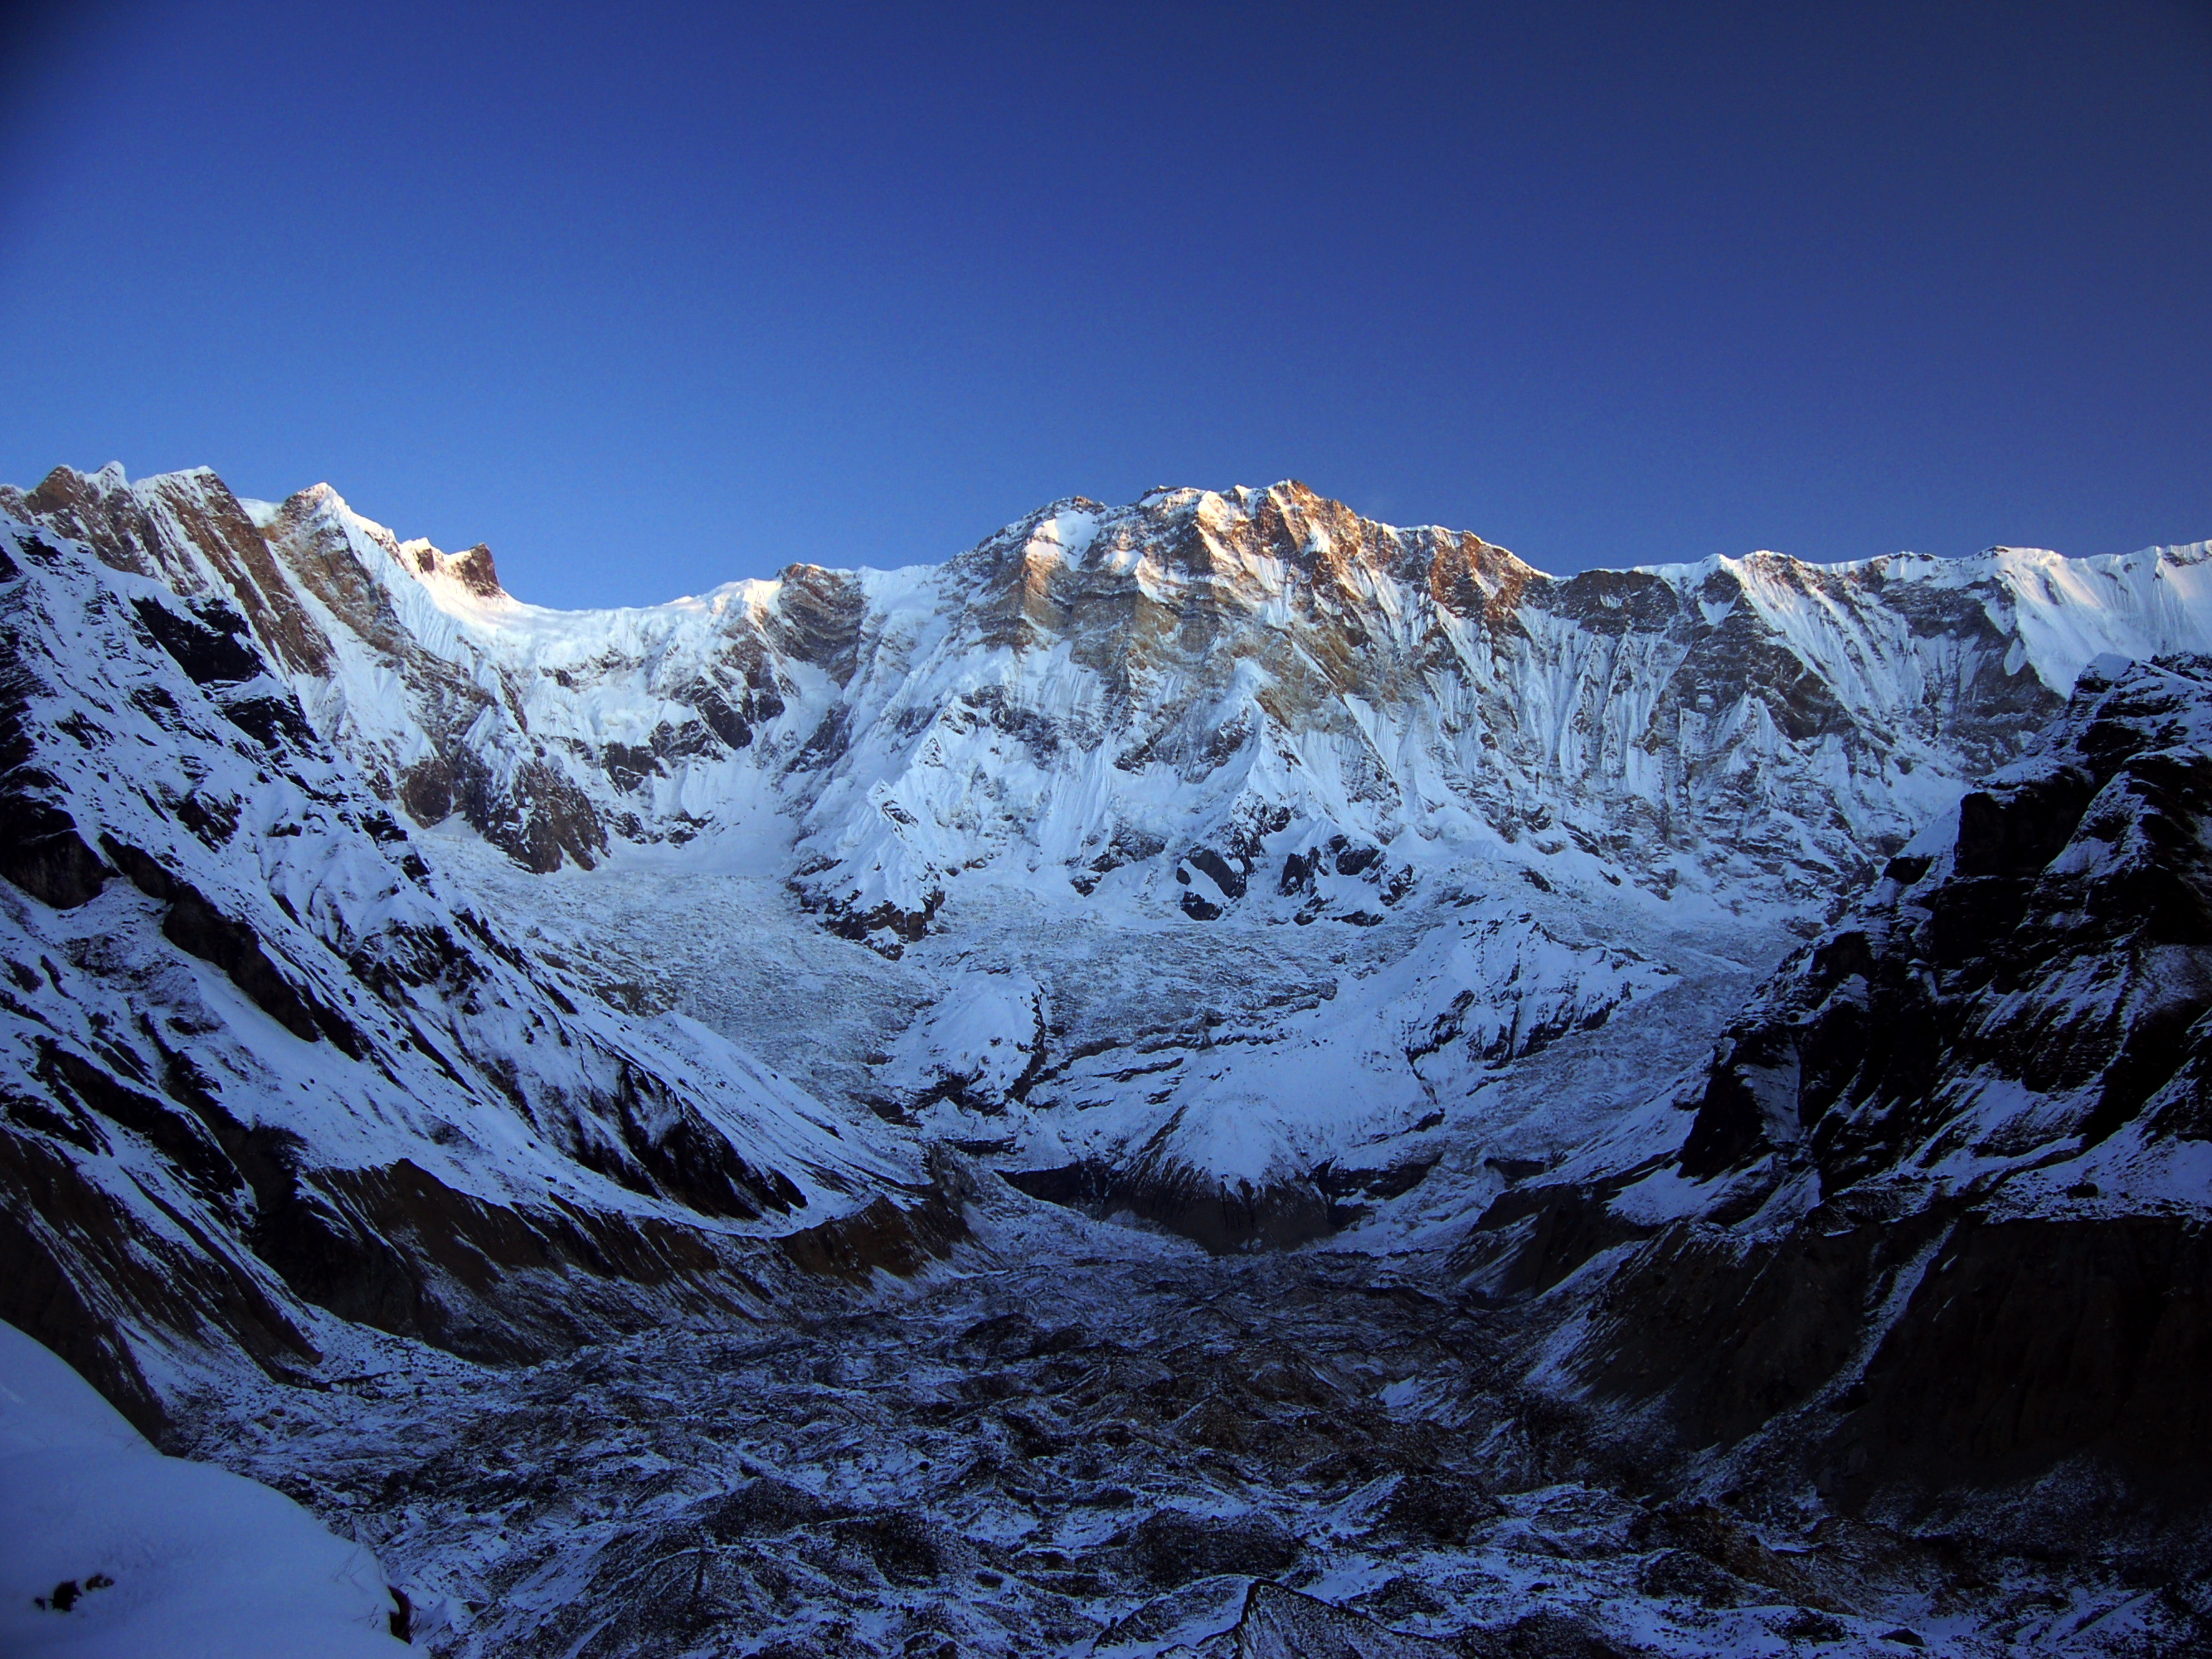
Scientific peacekeeping, from Antarctica to Kashmir
Many thanks to APECS, the Explorers Club, and the Antarctic Treaty Summit.
www.kateharris.ca

