Slide 1
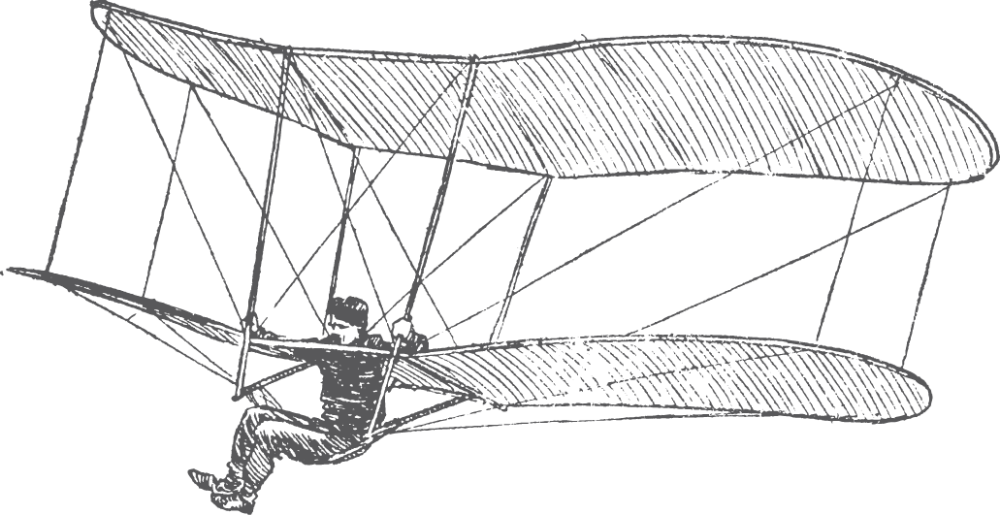
Design for Developers
Lisa Kurt
Emerging Technologies Librarian
University of Nevada, Reno
February 2012
Notes:
Design is so broad and there are so many ways to look at this
Focusing in on graphic design basics
Hard to narrow down 4 years of study to 20 minutes so I’m going to talk about getting starting, go-to resources thinking like a designer

Slide 2
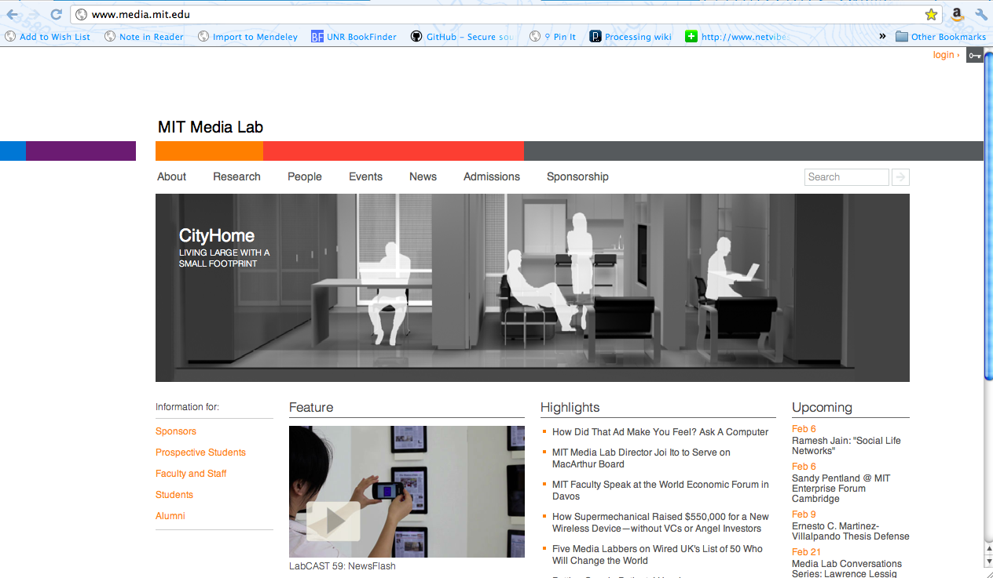
What is Design?
mantra: color. composition. typography.
Notes:
I know it when I see it
Typography, composition, alignment, color, etc.
Do your homework- look at “competitors” or similar businesses
Look and study designs you love and designs you hate- figure out what makes you react to them so strongly

Slide 3
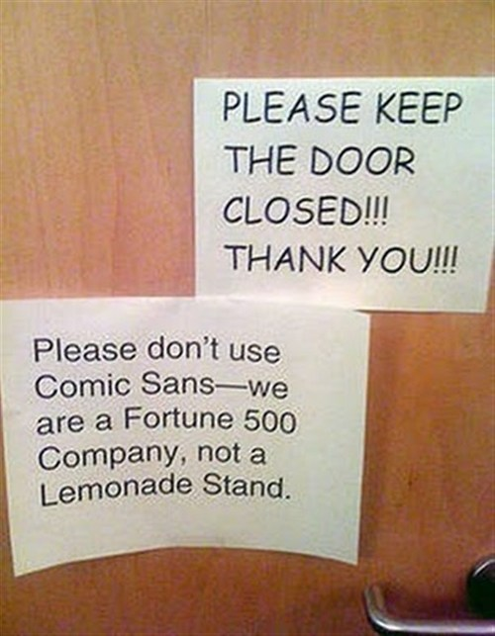
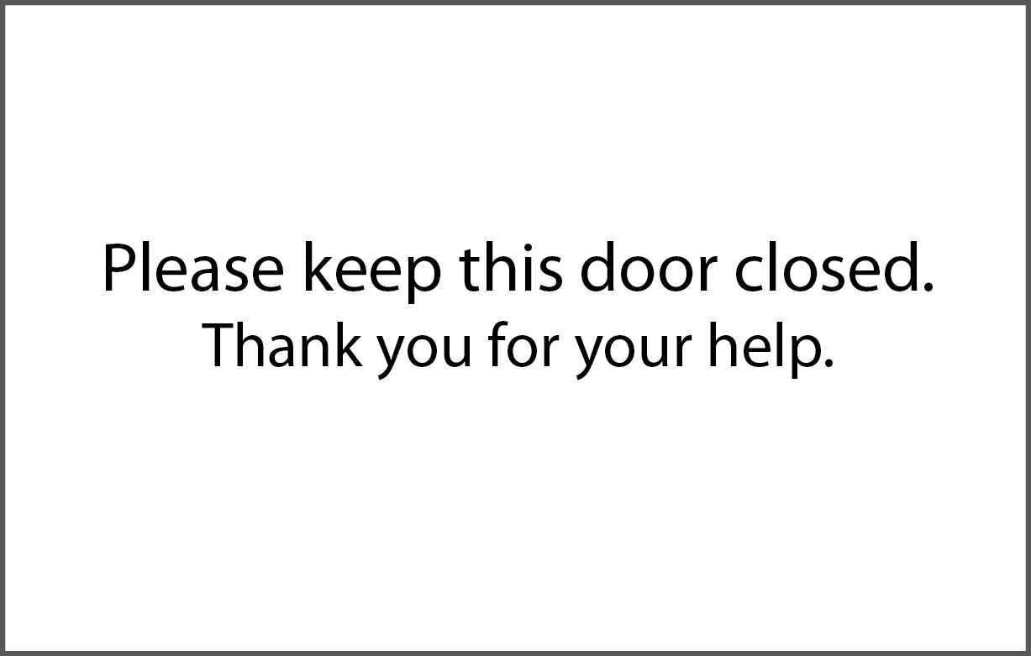
Why do we care?
Notes:
It is a method to communicate with others? Are we shouting? Rude? Or are we polite and inviting?
Opportunity
Give an experience
Or keep it simple and stick to concise
Choice is ours
Art more than a science though there are principles, elements, and rules…but some rules are made to be broken

Slide 4
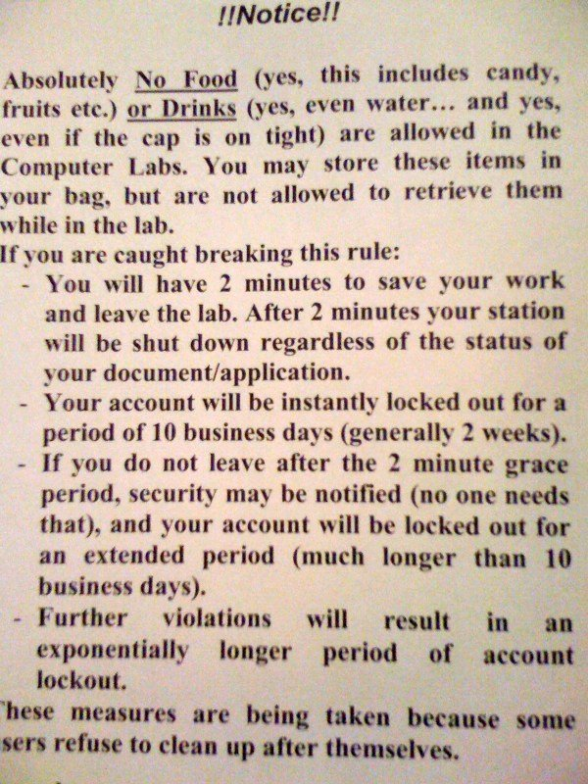
Step 1
Image courtesy of Amy Buckland aka jambina
Notes:
Scrap all of this. Think about the message? What do you want to say and how can you attempt to convince your users to believe you?
Are you earning credibility? Trust? What kind of atmosphere are you creating?

Slide 5
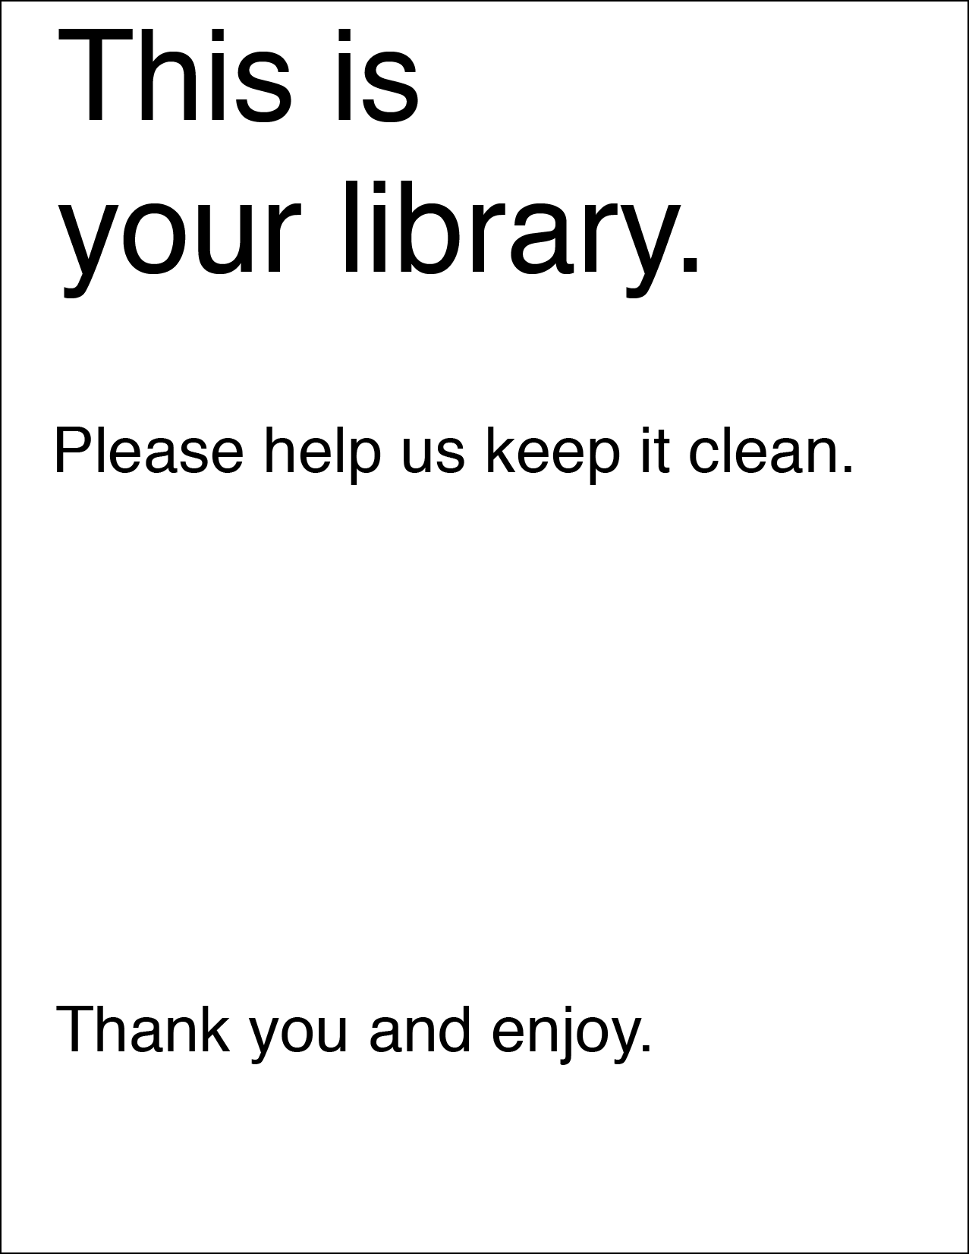
Step 2
Notes:
Good bones- maybe even has a bit of marketing/selling an image
Design is about restraint.
It’s what you stop yourself from doing that matters. We all have a cool typeface we want to use or a really neat picture but sometimes- you just gotta save that for another day and stick to basic. Remember your message- put yourself in your users shoes.

Slide 6
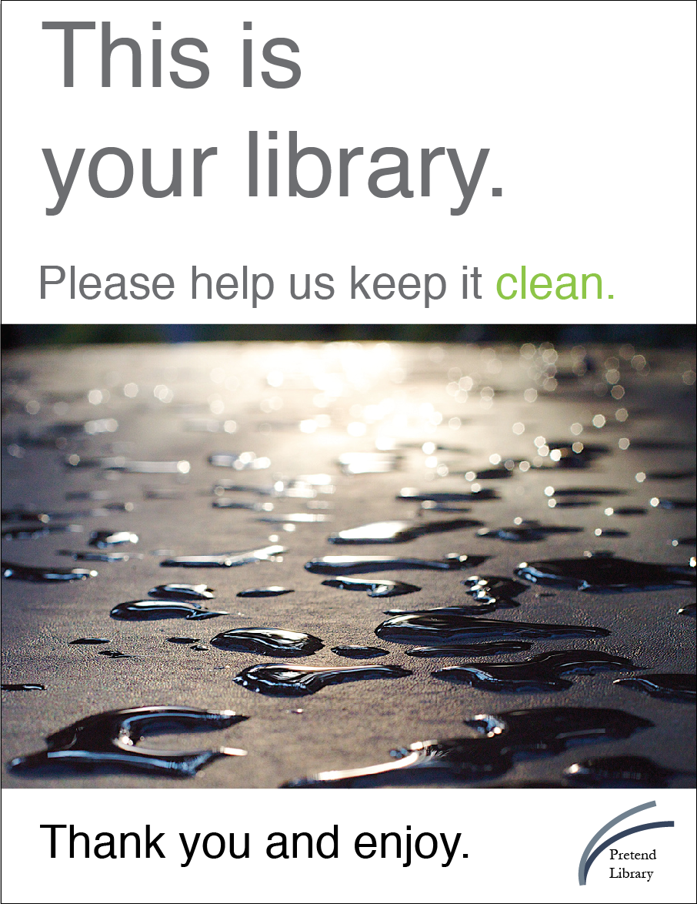
Step 3
Photo by Cogdogblog on flickr
Notes:
Cogdogblog
color. composition. typography.

Slide 7
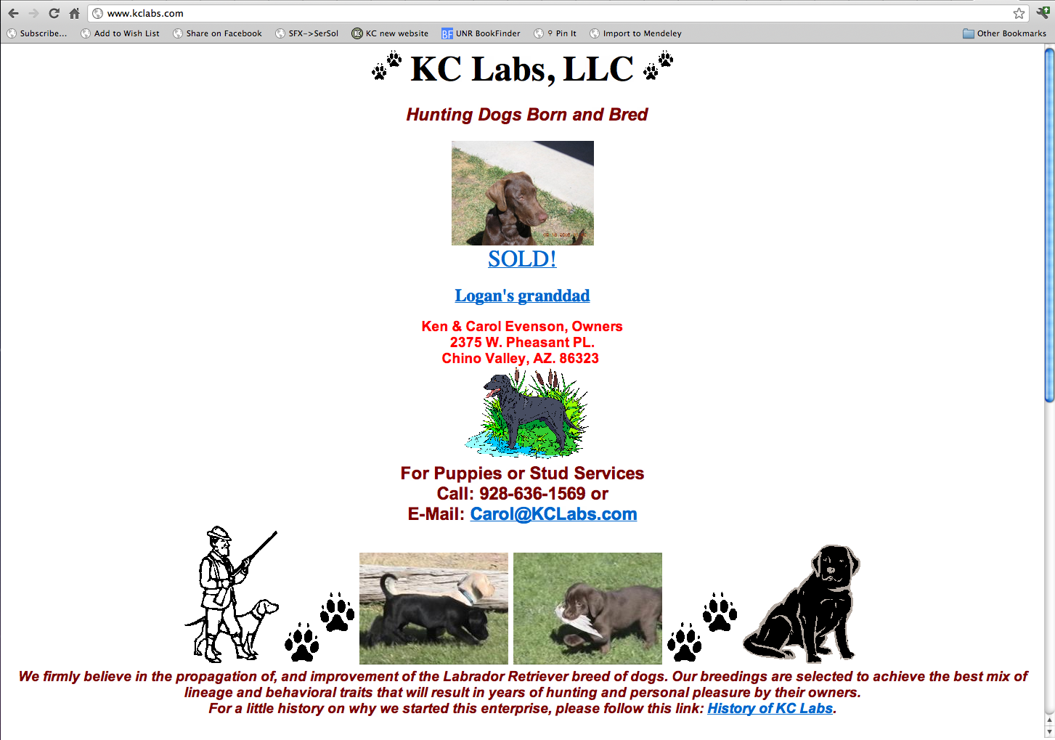
What about more complex designs?
Notes:
Like a website
Eye doesn’t really know where to go
Color uninteresting
Terrible typography – don’t use red letters until you know how to use red letters

Slide 8
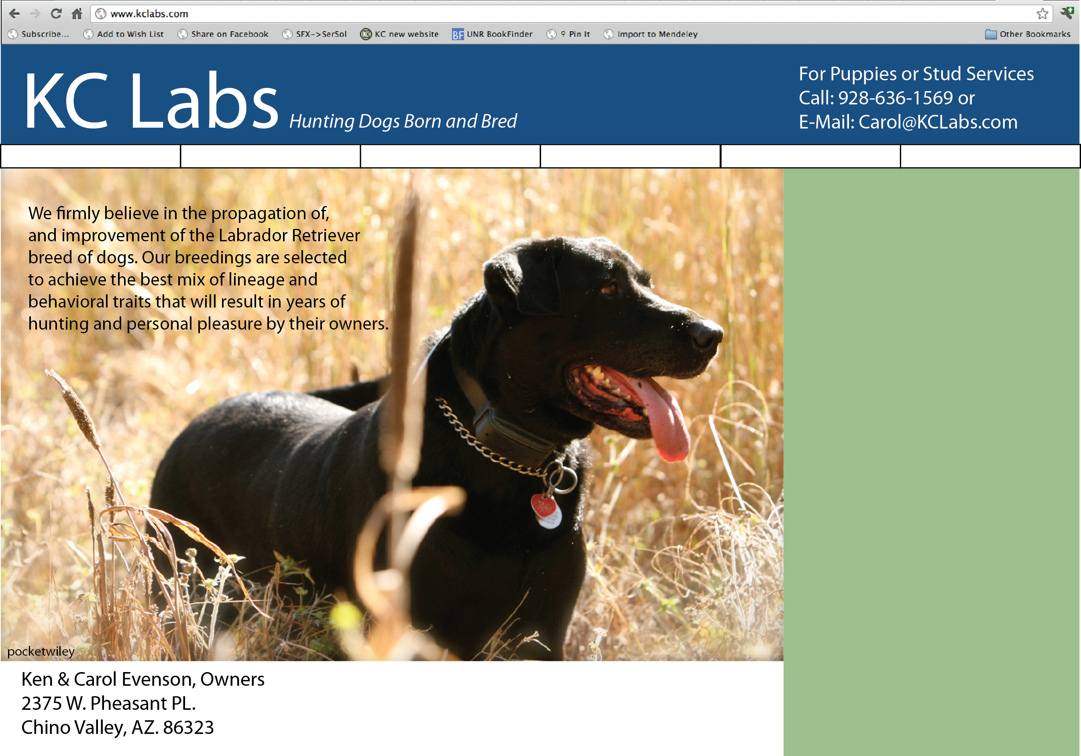
Step 1

Slide 9
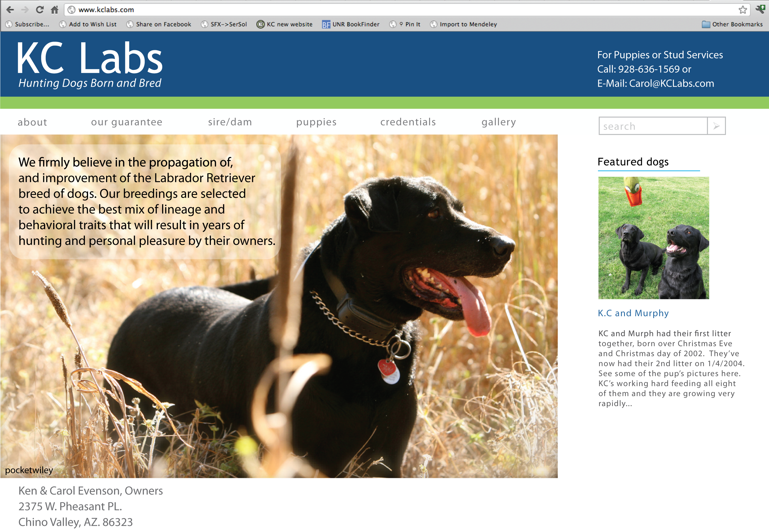
Step 2

Slide 10
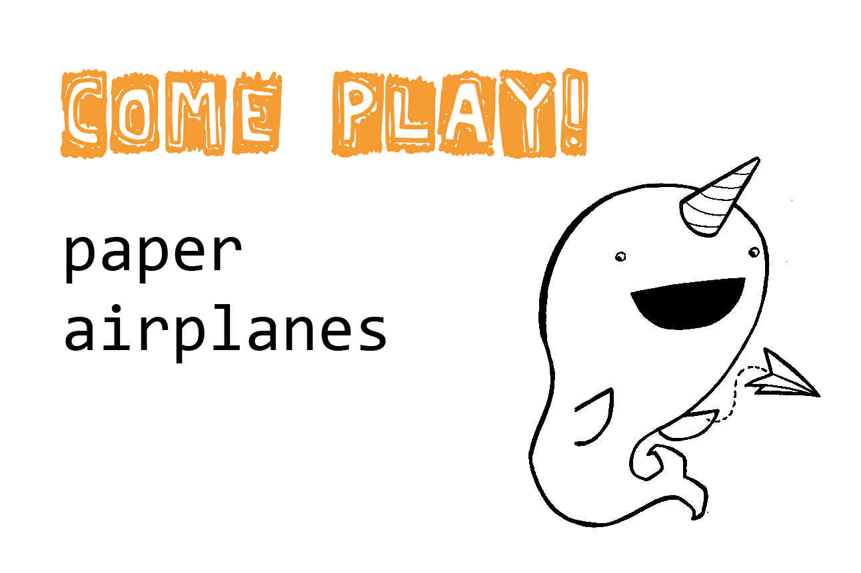
Have fun too!

Slide 11
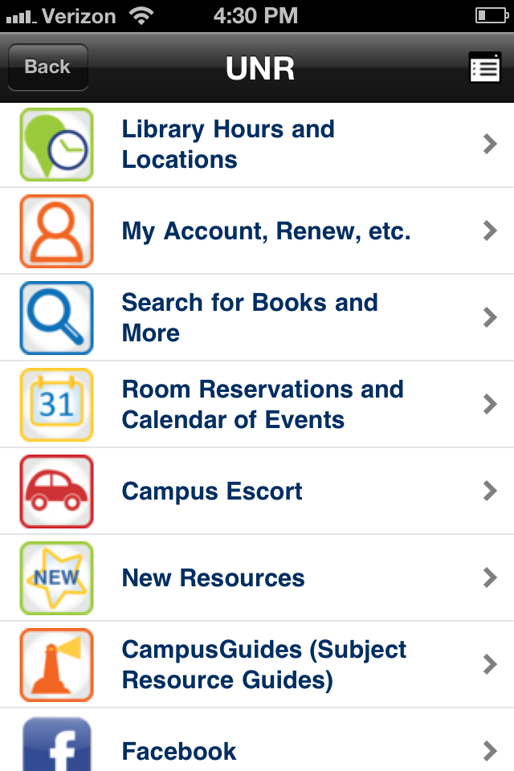
remember:
color
composition
typography
simplicity.

Slide 12

Thank you!
Lisa Kurt
Emerging Technologies Librarian
www.lisakurt.com
Twitter: @lisapisa77
lkurt@unr.edu

