Slide 1
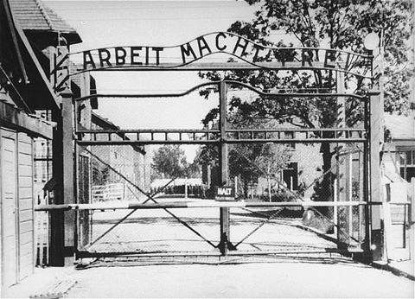
Auschwitz-Birkenau Uprising
By
Ari Bard

Slide 2
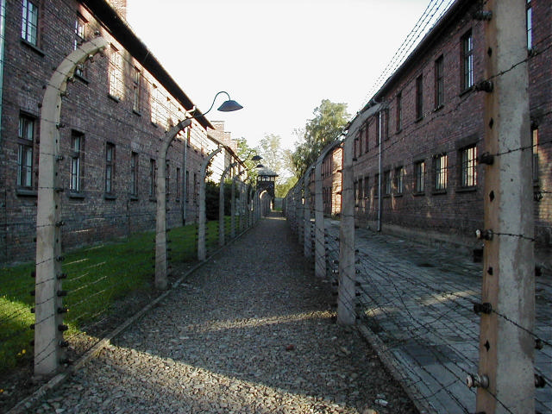
Background of Auschwitz-Birkenau
Auschwitz-Birkenau was considered the most notorious death camp in the Third Reich.
Auschwitz-Birkenau was established on May 26, 1940.
Auschwitz-Birkenau was liberated on January 27, 1945 by the Soviets.
Auschwitz:
Concentration Camp.
Birkenau:
Death Camp.
Approximately 2.1 to 2.5 million people were killed in gas chambers.
About 2 million of them were: Jews, Poles, Gypsies, and Soviet POWs.

Slide 3
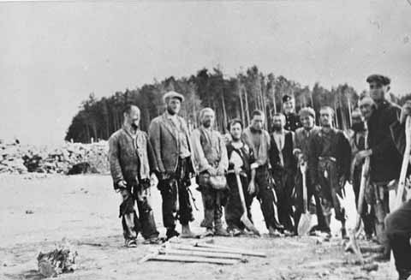
The Sonderkommando Jews
The Sonderkommando were groups of young male prisoners picked by the Nazis who had relatively good health whose job it was to dispose of corpses from the gas chambers and/or crematoria.
There were other groups of Sonderkommando Jews in these other camps: Treblinka, Belzec, Chelmno, and Sobibor.
The Sonderkommandos lived under better conditions; they received better/more food and water, and were given more comfortable sleeping conditions.
About 400 Sonderkommandos were at Auschwitz-Birkenau.

Slide 4
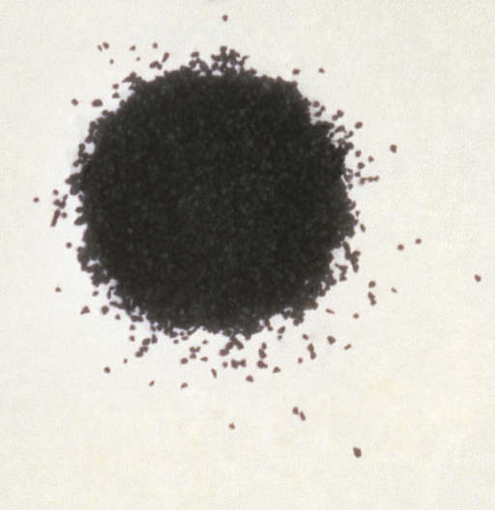
The Suppliers of the Gunpowder for the Revolt
Four women (Roza Robota, Ella Gartner, Esther Wajcblum, and Regina Safirsztain), working on a forced labor assignment at a nearby munitions factory, risked their lives, and the lives of others, to smuggle parts and gunpowder to the Sonderkommandos in Birkenau for the revolt.
Roza Robota passed the parts to Asir-Godel Zilber, who passed them on to Wróbel (a Sonderkommando), who passed them on to Filatov, and other experts (in making weapons) among the Russians, who turned the parts into bombs, dynamite, and grenades.
This process was long and dangerous.

Slide 5
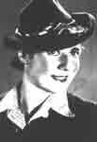
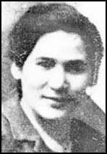
Pictures of Two of the Four Brave Women who Risked their Lives to Help Start a Revolt
Ella Gartner
Roza Robota

Slide 6
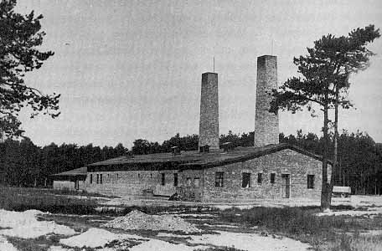
The Revolt At Auschwitz-Birkenau
The revolt was planned by four Polish Jews: Jankiel Handelsman, Josef Deresiński, Załmen Gradowski, and Josef Dorębus.
All of the planners died during the revolt, except for Jankiel Handelsman, who survived but was imprisoned in Block 11 at Auschwitz. He died there after having been tortured.
The Revolt at Auschwitz-Birkenau occurred on October 7, 1944.
The Sonderkommandos of crematorium IV found out that they were going to be killed soon (Sonderkommandos were usually killed within 5-6 months so there would be no witnesses to the Nazis’ crimes), so they planned a revolt.

Slide 7
The Revolt At Auschwitz-Birkenau
The Sonderkommandos of crematorium IV started the revolt.
They killed three SS guards at the crematorium, which started the revolt.
Later, the Sonderkommandos from crematorium II revolted.
They killed two SS guards at the crematorium.
Then they cut the wires surrounding the crematorium, and fled toward Rajsk, but were caught and killed..

Slide 8
The Revolt At Auschwitz-Birkenau Cont.
While some of the Sonderkommandos from crematorium IV set up the explosives near the ovens, the others repelled the SS soldiers attacks.
The Sonderkommandos from crematorium IV, were able to kill about 25 SS soldiers in the entire revolt.
The Sonderkommandos then blew up crematorium IV with their hand-made explosives.

Slide 9
The Result of the Revolt At Auschwitz-Birkenau
The entire plan of the revolt was to blow up all of the crematoria, but that did not work.
The Sonderkommandos from crematoria III, and V were not able to join the revolt soon enough before more SS reinforcements arrived.
The revolt ended up failing, and out of the 663 Sonderkommandos who revolted 451 of them lost their lives. The rest had been killed later by the Nazis.

Slide 10
The Result of the Revolt At Auschwitz-Birkenau Cont.
The Nazis found out about the four women who had smuggled in the gunpowder, and parts for the weapons that the Sonderkommandos used.
These four women were brutally tortured by the SS, but refused to give up the names of their co-conspirators.
On January 6, 1945, the Nazis publically hanged the four women.
Right when the trap door opened, Roza Robota shouted the famous line: “Be strong; have courage!”

Slide 11
Bibliography
Ainsztein, Reuben. Jewish Resistance In Nazi-Occupied Eastern Europe. London: Elek, 1974.
CBC Digital Archives. 3 April 2008.
<http://archives.cbc.ca/war_conflict/second_world_war/clips/1579-10643/> (30 May 2008).
Dkimages. < http://www.dkimages.com/discover/Home/Technology/Military-Technology/Weapons/Unassigned/General-06.html> (1 June 2008).
Encyclopedia of the Holocaust, “Auschwitz.”
Jewish Virtual Library. 2008. <http://www.jewishvirtuallibrary.org/images/Belzec3.jpg> (1 June 2008).
Jewish Virtual Library. 2008. <http://www.jewishvirtuallibrary.org/jsource/Holocaust/aurevolt.html> (1 June 2008).
“Krema IV and Krema V.” January 21, 2008. <http://www.scrapbookpages.com/Poland/Birkenau/Birkenau03B.html> (1 June 2008).

Slide 12
Bibliography Cont.
“Mizen: Digital Academy,” in Apple Learning Exchange. 2007. <http://edcommunity.apple.com/ali/story.php?itemID=13755&version=3571&pageID=8847> (1 June 2008).
Poland. < http://www.sn14.co.uk/Polland/picn0139_Auschwitz_ElectricFence.jpg> (1 June 2008).
“Resistance During The Holocaust,” in An End to Intolerance. 2005.
<http://www.iearn.org/hgp/aeti/aeti-1998-no-frames/resistance.htm> (23 May 2008).
“Resistance Movement At KL Auschwitz-Birkenau,” in The International Forum In
Commemoration of the 60th Anniversary of Auschwitz-Birkenau Liberation. 2005. <http://www.auschwitz.org.pl/new/let_my_people_live/forum/www.auschwitzanniversary2005.pl/index-eng47eb.html?s2=articles&s3=ruch_oporu> (20 May 2008).
Shields, Jacqueline. “Sonderkommando,” in Jewish Virtual Library. 2008.
<http://www.jewishvirtuallibrary.org/jsource/Holocaust/Sonderkommando.html> (28 May 2008).

