Slide 1
Rhyming Words
The it family

Slide 2
Choose a letter to make a word.
__it
h
p
k
f
s
w
b

Slide 3

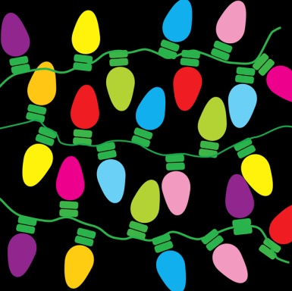
Try to spell the it family words
sit
kit
pit
lit
hit
fit

Slide 4
Match the pictures to the words
fit
lit
sit
hit
pit
kit

Slide 5
Rhyming Words
The in family

Slide 6
Choose a letter to make a word.
__in
w
k
f
p
t
b

Slide 7

Try to spell the in family words
kin
win
tin
bin
fin
pin

Slide 8
Match the pictures to the words
bin
fin
kin
win
tin
pin

Slide 9
Rhyming Words
The ig family

Slide 10
Choose a letter to make a word.
__ig
w
f
d
b

Slide 11
Try to spell the ig family words
wig
fig
dig
big

Slide 12
Match the pictures to the words
big
fig
wig
dig

Slide 13
Rhyming Words
The id family

Slide 14
Choose a letter to make a word.
__id
k
l
h
b

Slide 15

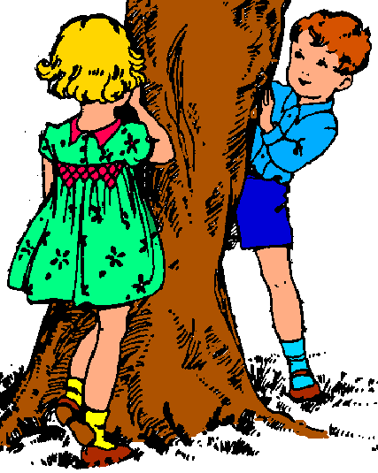
Try to spell the id family words
kid
lid
bid
hid

Slide 16
Match the pictures to the words
lid
kid
bid
hid

Slide 17
Rhyming Words
The ip family

Slide 18
Choose a letter to make a word.
__ip
t
l
z
r
s
d

Slide 19

Try to spell the ip family words
sip
dip
zip
tip
lip
rip

Slide 20
Match the pictures to the words
tip
lip
dip
zip
rip
sip

Slide 21
Rhyming Words
The ib family

Slide 22
Choose a letter to make a word.
__ib
r
n
d

Slide 23
Try to spell the ib family words
rib
nib
bib

Slide 24
Match the pictures to the words
bib
nib
rib

