Slide 1
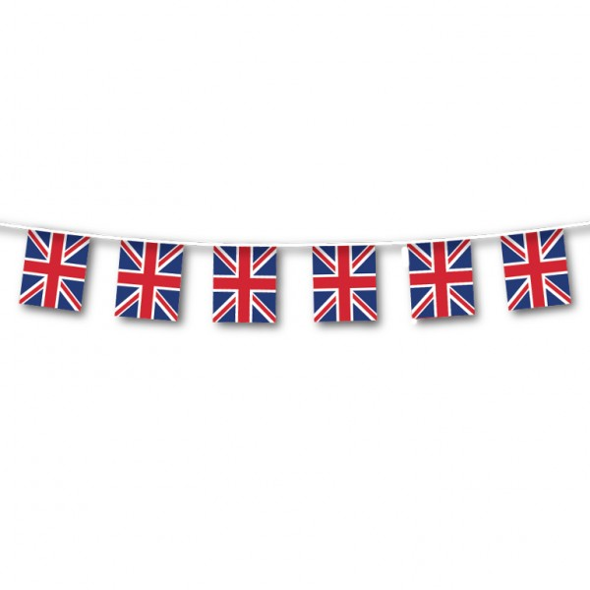
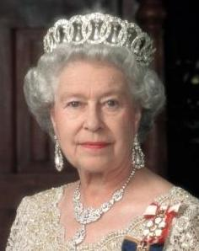
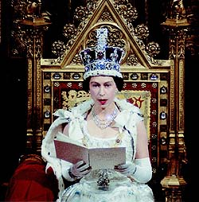
The Queen
through the
ages...

Slide 2
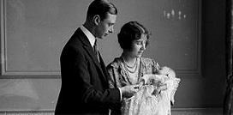
Born on 21st April 1926 to the Duke and Duchess of York...

Slide 3
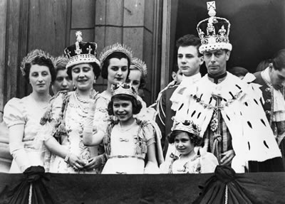
In 1937 Elizabeth went to the coronation of her parents King George VI and Queen Elizabeth. She was 11.

Slide 4
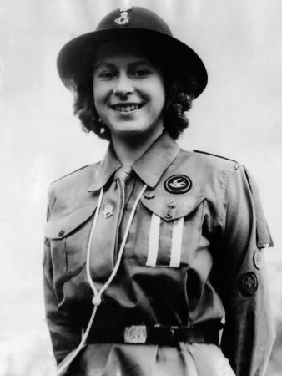
She also became a girl guide when she was 11.

Slide 5
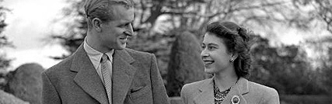
In 1947 Elizabeth got engaged, and then married, to Lieutenant Philip Mountbatten. He was then called the Duke of Edinburgh.

Slide 6
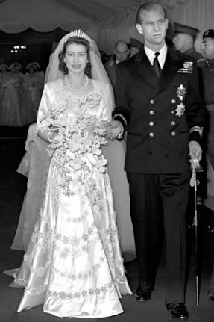
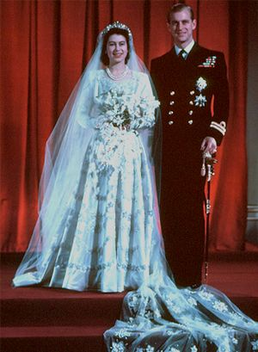

Slide 7
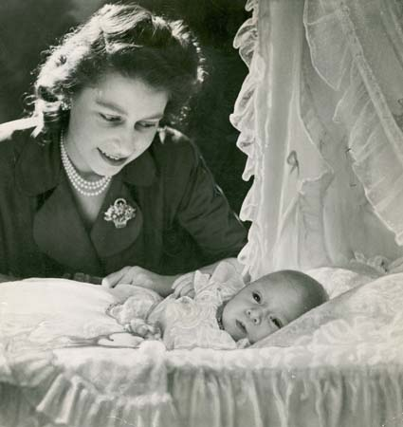
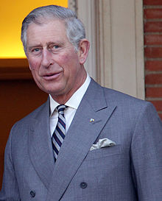
Elizabeth had her first child, Prince Charles, in November 1948.

Slide 8
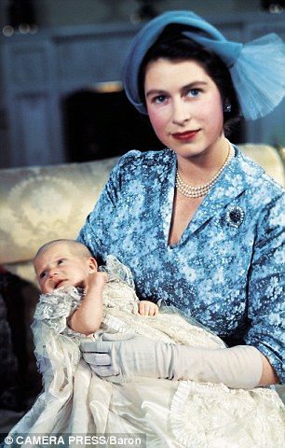
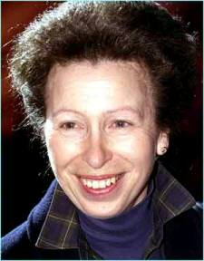
Princess Anne was born two years later in 1950.

Slide 9
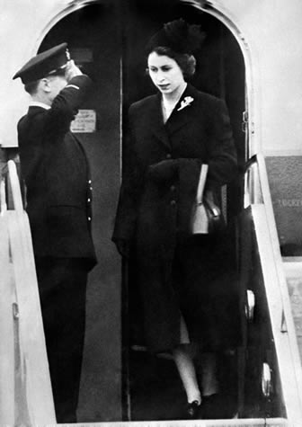
In 1952 Princess Elizabeth was on holiday with her family when she heard her father, the King, had died. She arrived back in England as Queen.

Slide 10
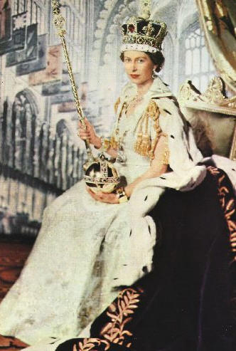
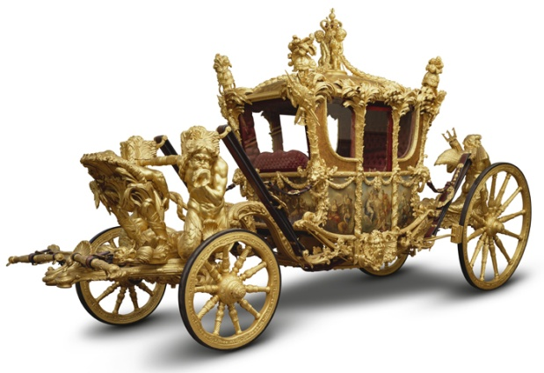
2nd June 1953 was the official coronation of Queen Elizabeth II.

Slide 11
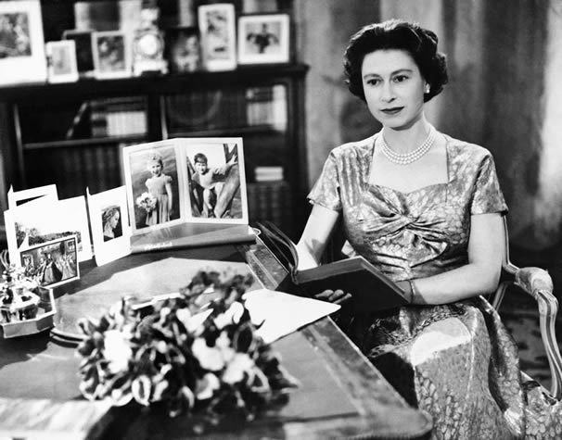
In 1957 the Queen gave her first televised Christmas message to the nation.

Slide 12
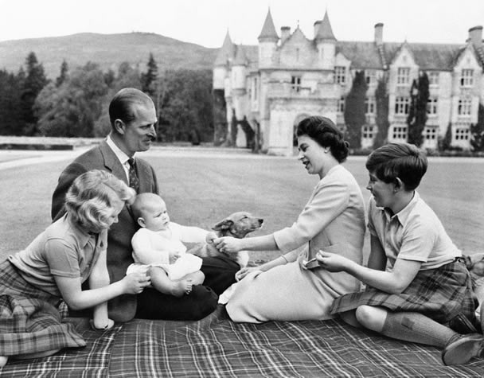
In 1960 Prince Andrew was born.

Slide 13
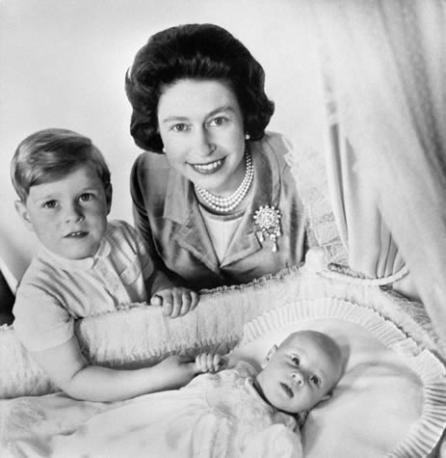
In 1964 Prince Edward was born.

Slide 14
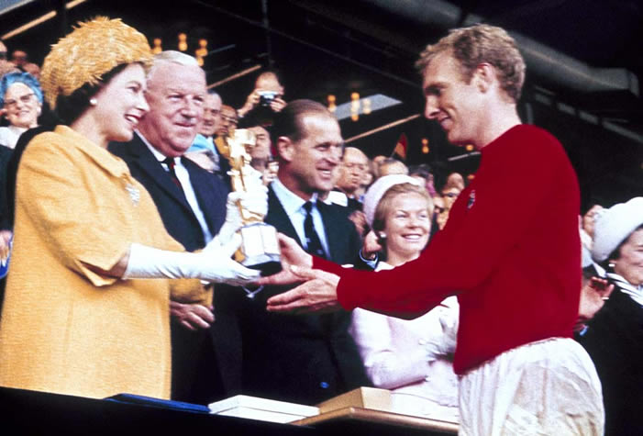
In 1966 Queen Elizabeth watched England win the world cup!

Slide 15
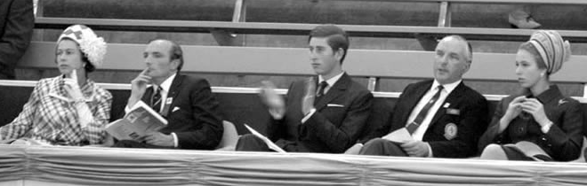
In 1970 Queen Elizabeth, Prince Charles and Princess Anne watched the first Commonwealth Games in Edinburgh.

Slide 16
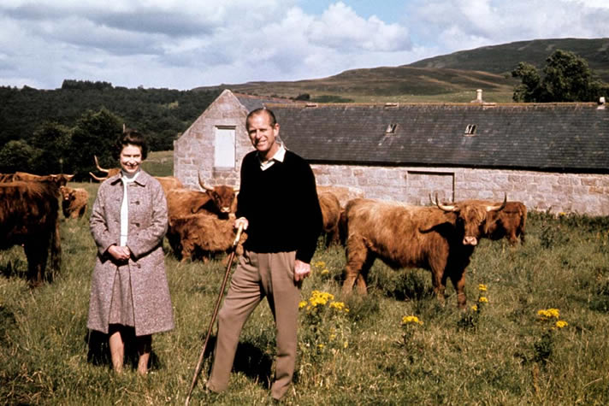
In 1972 Queen Elizabeth and Prince Philip celebrated 25 years of marriage.

Slide 17
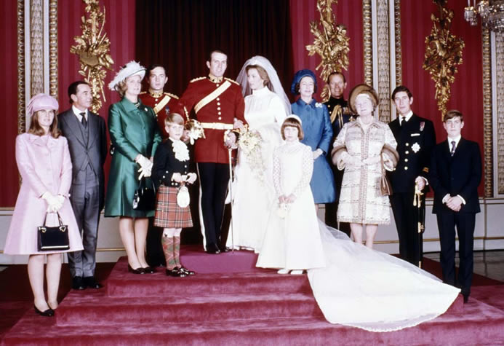
In 1973 Queen Elizabeth saw her daughter, Princess Anne, get married.

Slide 18
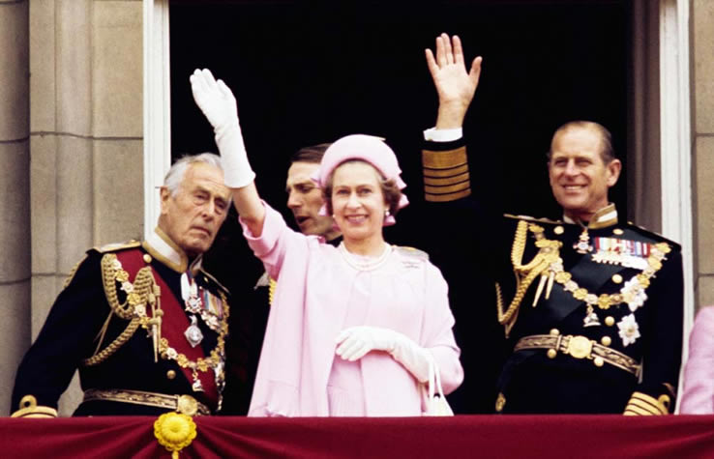
In 1977 the Queen celebrated her Silver Jubilee – on the throne for 25 years.

Slide 19
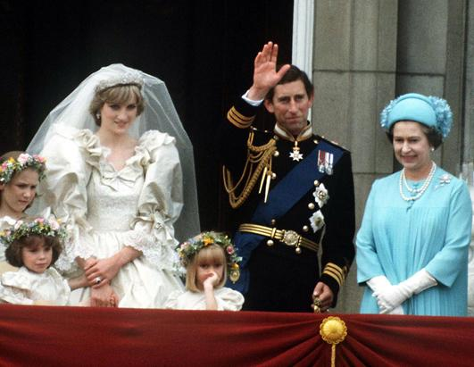
In 1981 the Queen attended the wedding of Prince Charles and Princess Diana.

Slide 20
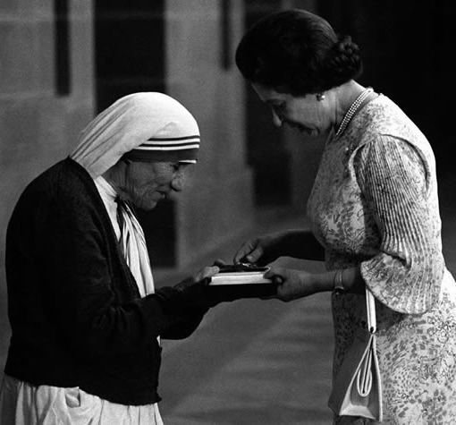
The Queen has met many famous people. This is her meeting Mother Teresa in 1983.

Slide 21
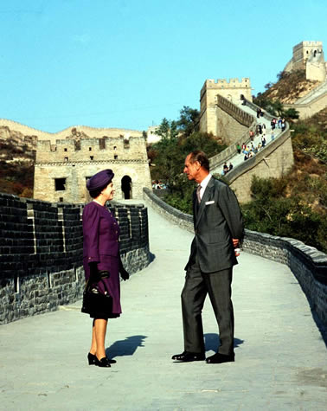
The Queen and Prince Philip toured around China in 1986.

Slide 22
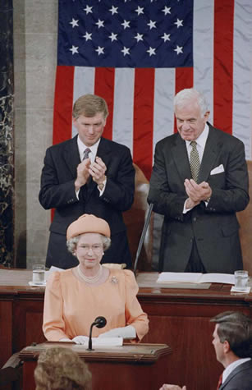
The Queen addressed the Congress in America in 1991.

Slide 23
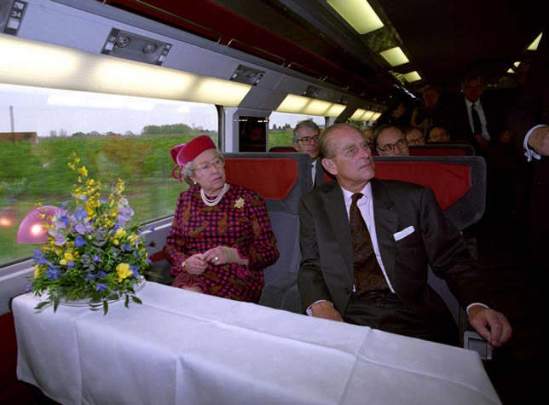
When Eurostar opened in 1994 Queen Elizabeth was on the first train!

Slide 24
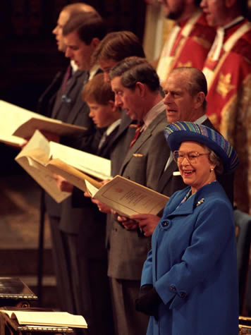
In 1997 Queen Elizabeth and Prince Philip celebrated 50 years of marriage.

Slide 25
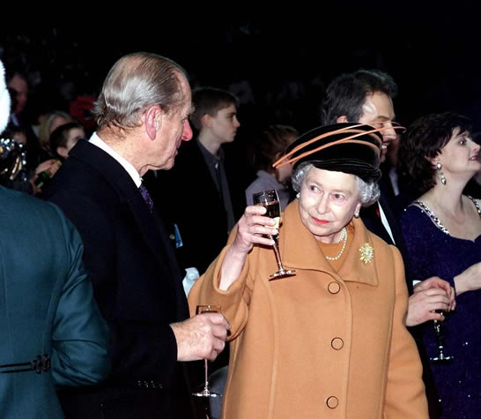
At the end of 1999 the Queen welcomed in the new millenium.

Slide 26
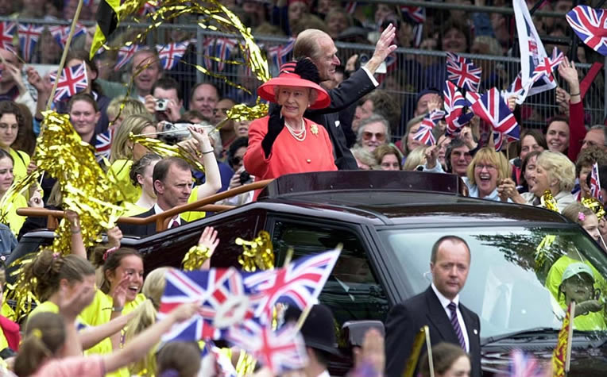
Golden Jubilee 2002

Slide 27
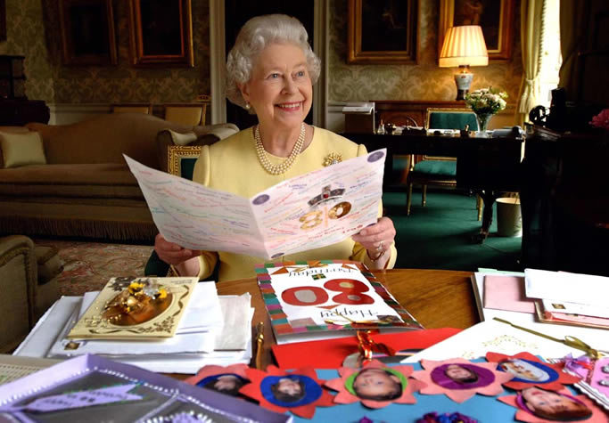
Queen Elizabeth turned 80 in 2006.

Slide 28
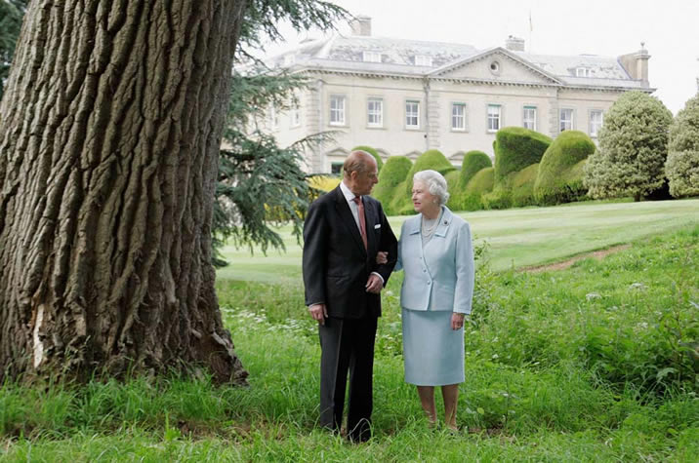
Married for 60 years in 2007.

Slide 29
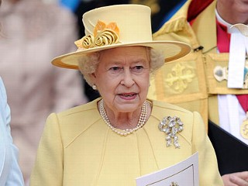
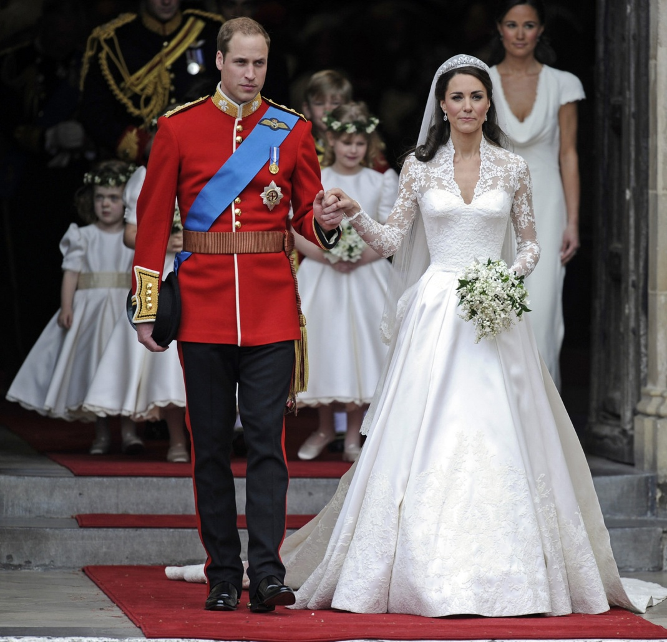
In 2011 Queen Elizabeth watched her grandson get married.

Slide 30
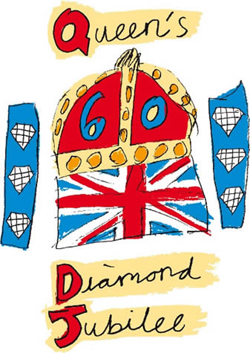
Diamond Jubilee 2012

