Slide 1


By Feeding Your Imagination
&
Paul Da-Costa-Greaves

Slide 2
OVERVIEW
All recipes are produced by Celebrity Chef
Paul Da-Costa-Greaves for Feeding Your Imagination.
Winners of numerous Taste Awards.
Seaweed has the same high fibre as vegetables, more protein than meat, and more calcium than milk.

Slide 3
BACKGROUND
Company started trading in 2007
Promotional campaign during 2009
Distributed by one major distributor
Available through independent delicatessens

Slide 4
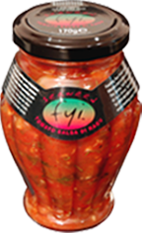
PRODUCTS
Seaweed & Tomato Salsa Ragu
A rich Seaweed, Tomato & Vegetable Sauce. Suitable for vegan & vegetarian.
'You can risk anything but temptation in this mouth lingering example that screams at you, subtle aroma’s that enlighten you, and taste that nourishes you.‘ Paul Da Costa Greaves
Awarded Silver - Great Taste Awards
Serving suggestion - delicious & versatile pasta sauce, or as a filling for the odd Jacket Potato.

Slide 5

PRODUCTS

Slide 6
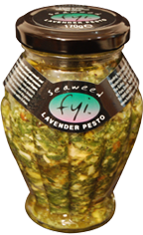
PRODUCTS
Seaweed & Lavender Pesto
A delicious blend of basil, pine nuts, sea lettuce & cheese. Suitable for vegetarian. Warning: contains pine nuts.
'Vibrant yet smooth, full of sunshine yet wonderfully balanced, with an intense passion that ensures the enduring character of sheer delight has just begun.‘ Paul Da Costa Greaves
Awarded Bronze – Taste of the West
Serving suggestion - gently pour over new season potatoes, pasta salads, or use for an added twist to crunchy garlic bread.

Slide 7
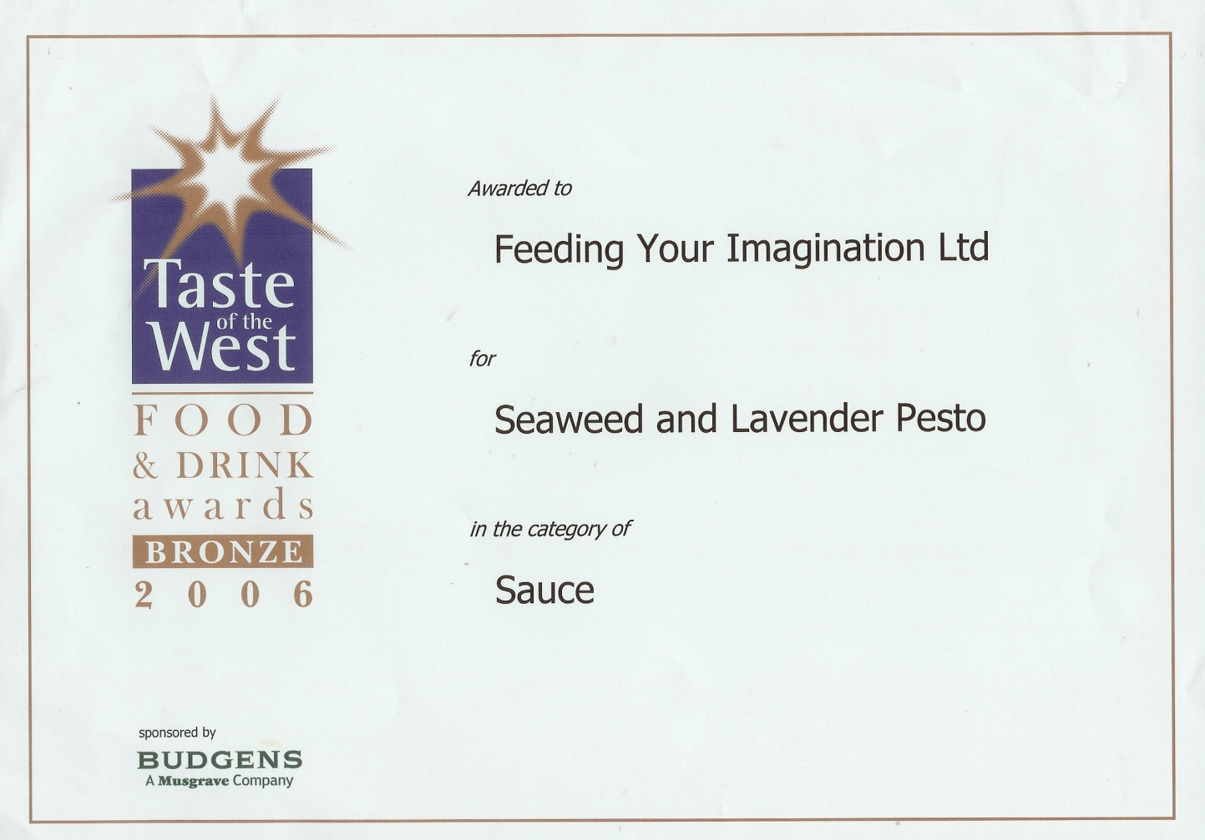
PRODUCTS

Slide 8
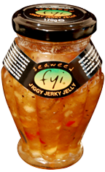
PRODUCTS
Seaweed Jiggy Jerky Jelly
Me jiggy jerk chunky kickin jellied chutney! – suitable for vegan & vegetarian. A sweet! yet robust chunky kickin chutney, set with nature’s agar agar. 'Slightly kickin, please don’t stop I like it & want more‘ Paul Da-Costa-Greaves 'Me tongue start tinglin, go on I dare yea, be me bit.. on da side!‘
Serving suggestion - Versatile, hot and slightly kickin! Gud wiv cheese, Ploughman's, to marinade, Cold meats, Sunday Roast. Or for a classy twist shove it on everything!

Slide 9
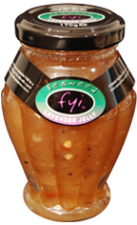
PRODUCTS
Seaweed & Lavender Jelly
A sweet yet sharp jelly, set with nature’s agar agar. Suitable for vegan & vegetarian.
'Flamboyant, aromatic, fragrant with a lively and vivacious style. Taste the sun, break free, and live a little, I wouldn’t want this any other way.‘ Paul Da Costa Greaves
Serving suggestion - versatile & yet so adaptable, wonderful on toasted bread or that warm croissant, FAB for a cheeseboard, mouth watering on the side with a good Sunday Roast. Puts a finishing twist to a sauce.

Slide 10
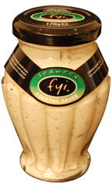
PRODUCTS
Seaweed Cocktail Sauce
A rich mayonnaise with seaweed, herbs & booze. Suitable for vegetarian. Sophisticated and complex from the start, classy but sharp, crisp full of character and yet intense to the point of a supreme creamy mouth full.
Paul Da-Costa-Greaves
Awarded Bronze - Great Taste Awards
Serving Suggestions:- A versatile seafood cocktail sauce, to uplift any cold shellfish, crab or even lobster! fabulous with raw veg as a yum yum dipping sauce for crudities!..

Slide 11

PRODUCTS

Slide 12
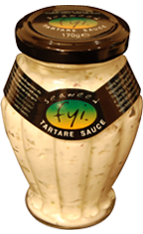
PRODUCTS
Seaweed Tartare Sauce
A rich mayonnaise sauce with seaweed & spices. Suitable for vegetarian. Close your eyes and experience the magical true taste of sea air, be silent and your heart will sing, be still and you will move forward on the tide of the spirit.
Paul Da-Costa-Greaves.
Awarded Silver - Great Taste Awards
Serving Suggestions:- Serve on the side with grilled fish, or as an uplifting dipping sauce for a sandwich or chip buttie! Perfect for fish ‘n’ chips..!

Slide 13

PRODUCTS

Slide 14

PRODUCTS
Seaweed Thai Style Salsa
A sweet spicy sauce with seaweed & vegetables. Suitable for vegan & vegetarian. Warning: contains walnut oil. 'Wow…An explosive burst of personality, ready or not this journey opens aromatic pleasures like angels dancing gently, strutting their stuff on your taste buds… Oh but what a mere tease as we drool for the spirits of delight.‘ Paul Da Costa Greaves
Awarded Bronze Great Taste Awards
Serving suggestion - Sweet dipping sauce for oriental spring rolls, fish cakes & dimsum. Great over cold pasta. As an alternative, ‘stir fry’ adding 2 parts salsa, 1 part chilli sauce, 1 part soy sauce, chopped coriander leaves & the zest of half a lime

Slide 15
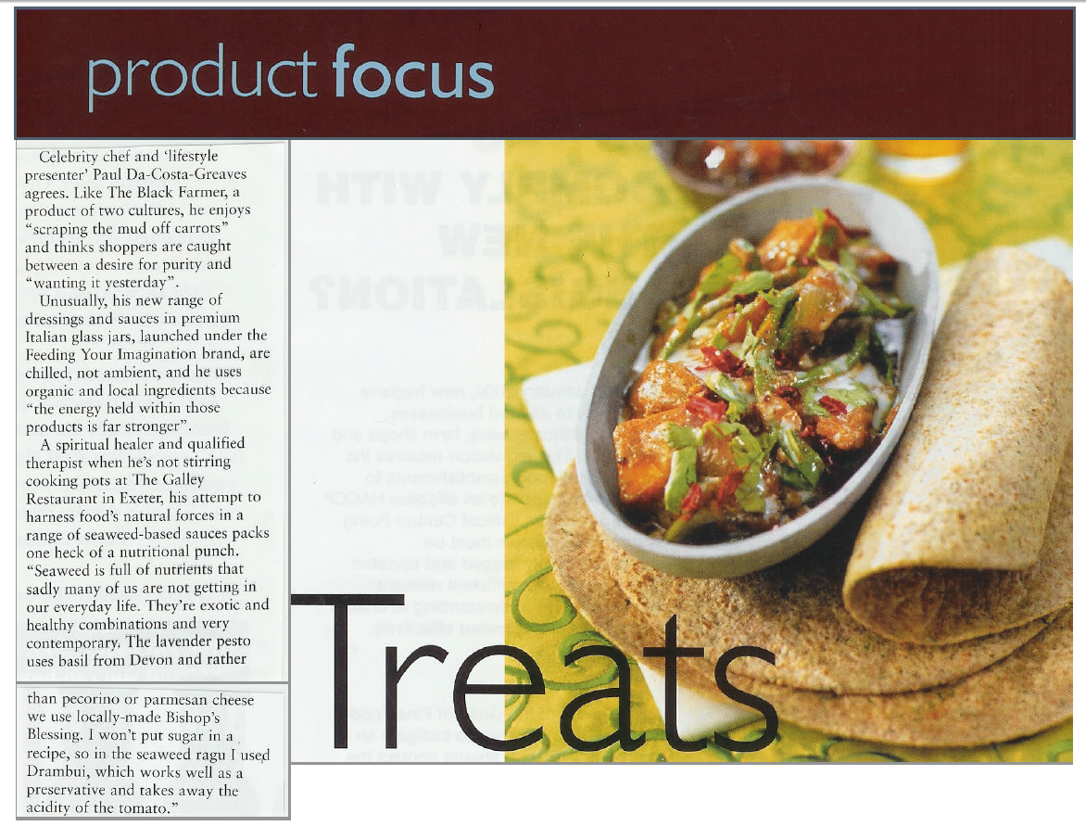
PROMOTION

Slide 16
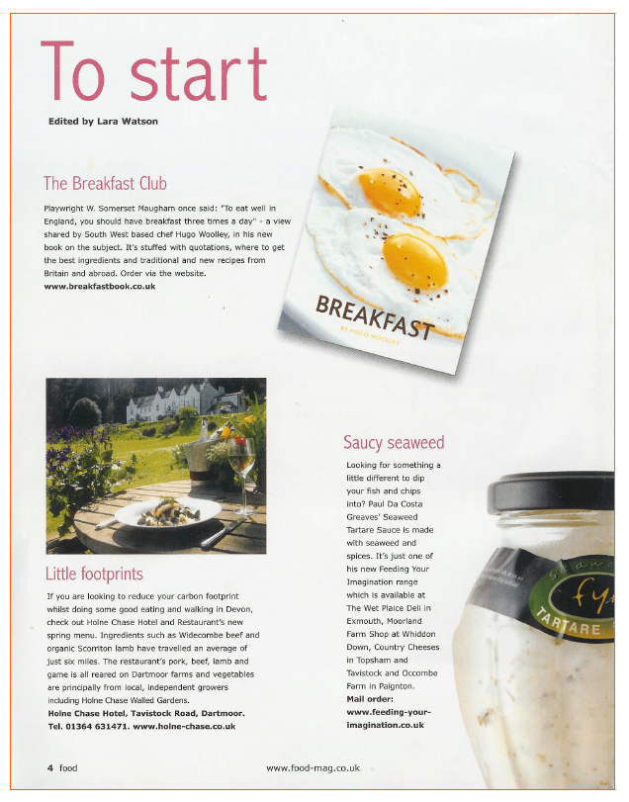
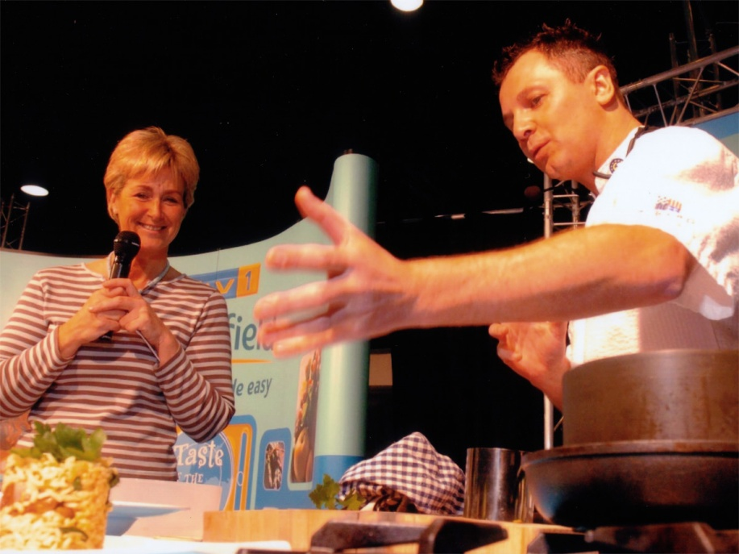
PROMOTION

Slide 17
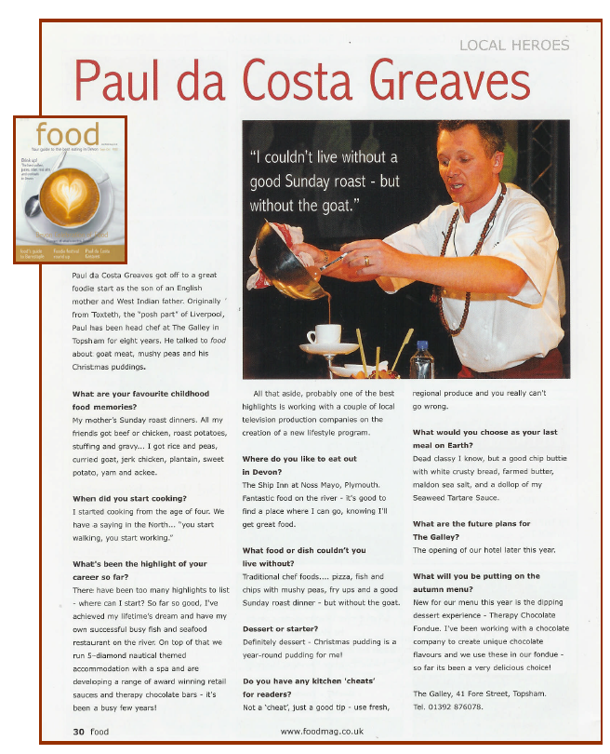

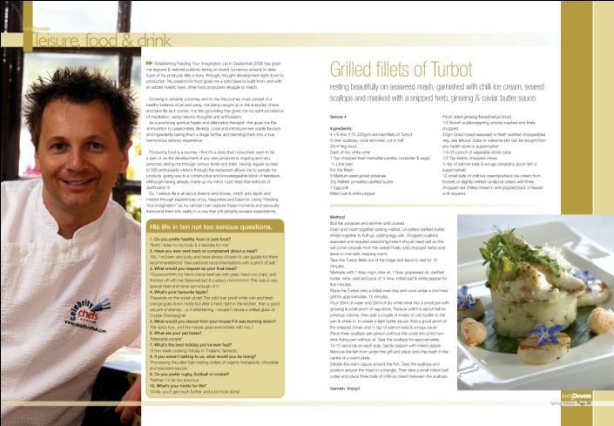
PROMOTION

Slide 18

PROMOTION

Slide 19
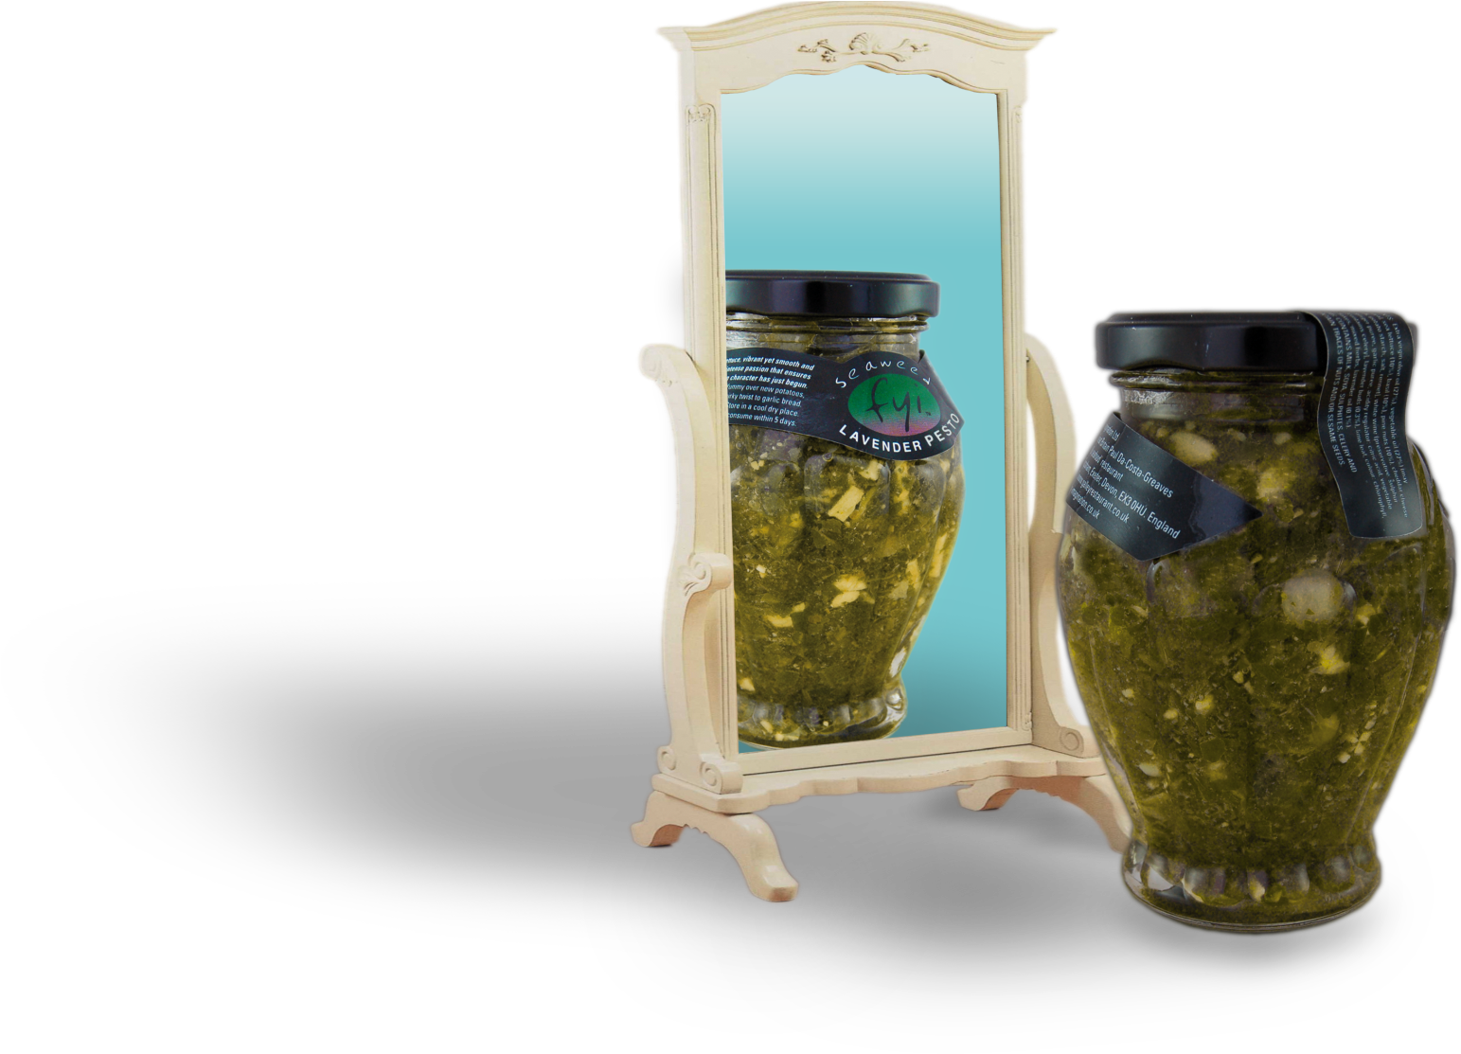

RECIPE IDEAS

Slide 20
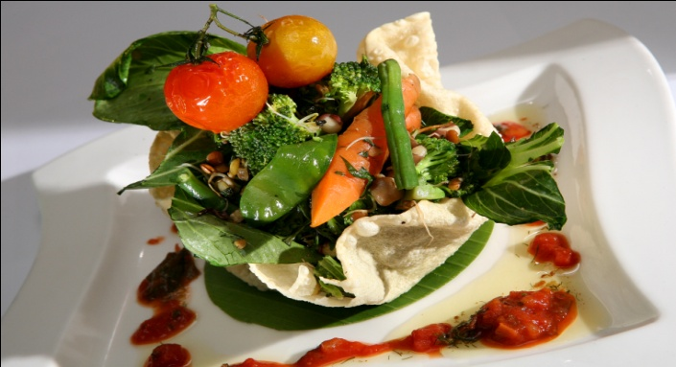
CALYPSO RAGU
This versatile Calypso experience tomato di ragu is an all rounder. Apart
from the obvious – using it over pasta, it’s great as a jacket potato filling,
a sound base for that vegetable lasagna/soya mince bolognaise, or follow
my classy brother and use it as a dip for nacho’s or a veggie burger!…
Serves 4 - Ingredients
4 puppodums (not cooked)
2-3 vine tomatoes per person
1/2 courgette, roughly cut
1 bunch washed top & tailed baby
Carrots - cut
1 tsp heaped garlic & ginger marinade -
(see enclosed recipe)
4oz/110gm oyster mushrooms
1 small packet of baby corn
2 baby pak or bok choy cut in half
1 handful mange tout
½ jar fyi Seaweed & Tomato Ragu
½ tsp Cajun spice
Milled salt & pepper
Olive oil for frying
Handful of mixed mung bean or bean sprouts
1 tbsp chopped herbs - see enclosed recipe
Method:-
Place the puppodums Into a deep pan or chip fryer. With metal tongs whoosh gently around in the oil so it
then expands (approx 5 sec’s), shake off excess oil then place puppodums over a mould. Press down quickly
and gently with a cloth to form a basket shape. Drain off onto kitchen paper and set aside until needed. Into
a clean small bowl, add the mushrooms, bok or pak choy, garlic and ginger marinade, Cajun spice, milled salt
& pepper and dash of olive oil. Mix well and leave to one side. Into pan of boiling water add the carrots,
baby corn, mange tout & courgettes, remove after 1 minute, drain well (do not cool), set aside until needed.
Onto a foiled baking tray, place the vine tomatoes and dribble over a little extra virgin or olive oil, season
and grill on medium heat for approx 10-15 mins depending on size. Then take your warm plates and place
the puppodums baskets in the centre. Open the tomato ragu and warm gently, keeping to one side. Into a
separate heated Wok or frying pan add a dash of olive oil then add your mushrooms, pak or bok choy,
chopped vegetables and herbs; sizzle, sizzle, for a couple of minutes, along with mung or mixed bean
sprouts, and chopped herbs. Scoop into puppodums baskets. Gently spoon the tomato ragu around the
plate or serve separately, garnish with grilled vine tomatoes. Enjoy.

Slide 21
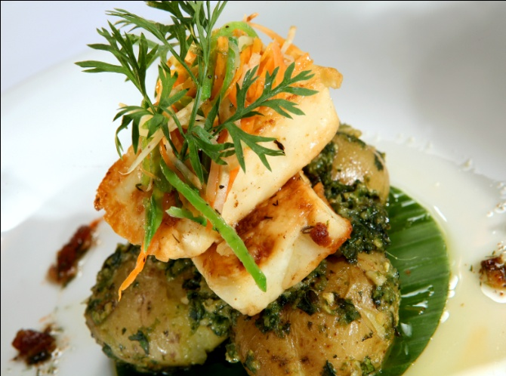
HALLOUMI & PESTO
Char-Grilled Halloumi Nestled UponTomato
Pesto & Lavender Crushed Potatoes. This
makes any dish come alive! The fyi seaweed
and lavender pesto is versatile with pasta,
fish, poured over new season potatoes, a
sandwich spread or filling/topping for garlic
bread. Alternatively why not use a couple
shakes of olive oil, fry off some crusty sliced
bread, top with chopped red onion and
tomato, finishing with the pesto, creating
Your very own style bruchetta.
Serves 4 – Ingredients
2 packets of Halloumi cheese, cut in
half and half again giving you 4 pieces
per packet (2 slices per person)
1 fresh lime, zested
Olive oil
1 tbsp of garlic & ginger marinade
1 tsp nasi goring (Indonesian dried
vegetables)
Milled sea salt
Milled black pepper
1 lb (450gm) washed new local
potatoes
6 tbsp of fyi Lavender & Seaweed Pesto
2 tbsp of fyi Seaweed & Tomato Ragu
1oz/25gm slightly salted butter melted
without sediment
25ml dry white regional wine
Pinch vegetable stock cube or vegetable
bouillon
Lime leaf
1 small sprig or piece of fresh rosemary
Method:-
Into medium sized bowl, marinade for ten mins the following: halloumi, 1 tbsp olive oil, garlic and
ginger, zest of lime, nasi goring, milled salt & pepper. Put the new potatoes into boiling salted
water and cook until tender. Remove from heat, drain and cool. Place a char-grill pan onto medium heat (if non available - a solid non-stick pan will do) place the halloumi into the heated pan and sizzle for approx 1 minute either side, remove halloumi and pop this back into its original marinade bowl. Add the wine along with clarified butter mix, remove and place onto foiled tray. Gently grill under a low to med heat for approx 8-10 mins (depending on the size) and until golden. Turn half way through cooking, gently place potatoes between palms of hands and crush. Placing into a non-stick saucepan, pour over some of the fyi Seaweed Pesto & fyi Tomato Ragu, place a sprig of fresh rosemary also into the pan, warm this through and gently spoon the mixture into the middle of a warmed serving plate. You can now delicately place two pieces of the halloumi cheese on top of the pesto, ragu and potatoes, garnish with fresh garden herbs and Enjoy.!

Slide 22
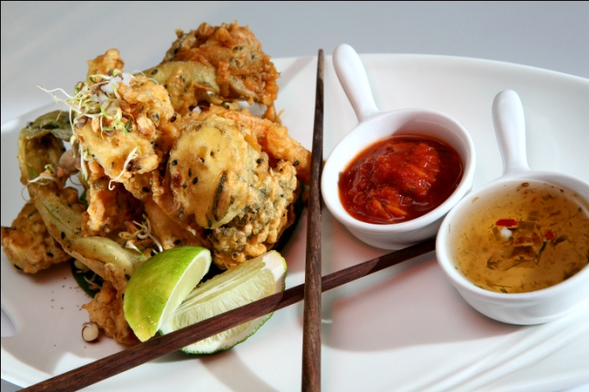
THAI STYLE TEMPURA
Sesame & Vegetable Tempura with Thai Style Dipping Sauce.
This versatile sweet dipping sauce can be dribbled over fish or meat, adds
a sharp, sweet twist to fish cakes - fried or oven baked, as a stir fry sauce,
dipping sauce, or even mixed into cold or warm pasta.
Serves 4 – Ingredients
Selection of cut vegetables of your choice allowing for approx 1 small handful per
person. Broccoli, cauliflower, field mushrooms, carrots, green beans, - etc/etc all
No bigger than approx 1 inch. Milled sea salt. Milled black pepper Vegetable or
rapeseed oil for frying. fyi Seaweed Thai Style Salsa, fyi Seaweed Tomato Ragu
– optional
For the batter
2 tbsp white sesame seeds
2 tbsp black sesame seeds
4 heaped tbsp plain flour for batter
Handful of plain seasoned flour for coating
the vegetables
2 heaped tbsp cornflour
Pinch of caraway seeds
25-50ml approx cold water
Lager/bitter – optional (if leaving out make
sure you then use sparkling water instead)
1 flat tsp turmeric powder
2 tbsp white wine vinegar
1 heaped tbsp nasi goring
2 whole eggs
Method:-
Into a bowl add both eggs, beer/lager (optional) white wine vinegar, cold water. Whisk together, then add the turmeric, caraway seeds, nasi goring & seasoning, along with sesame seeds. Finally add your plain flour - mix well. At this stage you need to thicken up the mixture, add a dash more liquid, either water or lager/beer, then add the cornflour. Check consistency - needs to be a little thicker than pancake batter. Into the extra seasoned flour, add the chopped vegetables and mix, shake off excess flour and place the vegetables onto a plate until needed.
When ready, pop the floured vegetables into the batter then remove, shake off excess batter and drop delicately (away from you!) into the hot oil. Deep fry until golden, remove onto dry cloth, place onto serving tray and garnish with chop sticks and fyi Seaweed Thai Style Salsa. This dish will also go well with some warm fyi Seaweed Tomato Ragu.

Slide 23
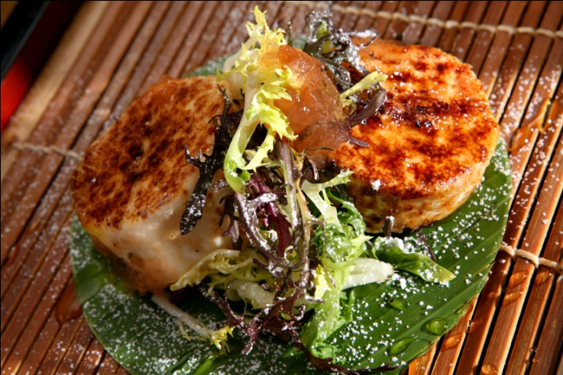
CHEESE & JELLY
Glazed Goats Cheese, with Endive, Honey & fyi
Lavender Jelly. Start your day with warm smelling croissants or
toast. This versatile fyi Lavender Jelly is great with various
cheeses and cold meats, bringing a dull gravy to life, use it also
as a marinade, or even a topping for ice-cream!
Serves 4 – Ingredients
4 young button goats cheese
4 tbsp demerara sugar
1/2 vanilla pod split
4 small clumps of washed endive & baby
lettuce
fyi Seaweed Lavender Jelly
Squeezy bottle of honey, preferably
Regional Icing sugar for dusting
Method:-
Split vanilla pod & mix with sugar, this allows flavours to be released to the sugar. Take out your plates and gently place a small handful of the washed endive in the centre. Dust with the icing sugar. Take the top of the young goats cheese and delicately sprinkle the sugar on top. Using the grill or blow torch caramelise the top of the cheese and place centre to the plate. Onto the glazed cheese, top with a small tsp of lavender jelly. .. You’ll either love it or hate it. Enjoy....

Slide 24
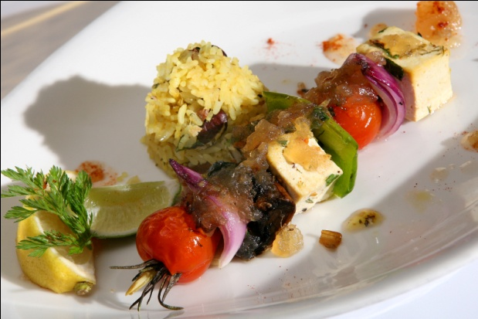
JIGGY JERK KEBABS
JIGGY JERK SPICED TOFU KEBABS
This versatile fyi Jiggy Jerk Jelly is also great with cold meats, cheeses, as a sandwich spread, a marinade or even pop a small spoon into gravy to uplift a dull sauce. I’ve melted this jelly with a little water to use as a warm sweet dressing for these fabulous kebabs…
Serves 2-4 – Ingredients
1 green pepper cut into cubes
2 heaped tbsp garlic & ginger marinade (see recipe enclosed)
2 packets natural or smoked tofu cut into inch cubes ready for kebab (not silken)
50ml water
12 cherry tomatoes
Handful of Oyster mushrooms
½ red onion cut large for kebab
4 large sprigs of rosemary
2 sticks lemon grass
Olive oil
½ Jar of fyi Seaweed Jerk Spiced Jelly
Milled sea salt
Milled pepper
Method:-
Cut the Lemon grass in half to be roughly the same length as the rosemary sprigs, place the cut ingredients into a bowl and dribble approx 4 tbsp’s of olive oil along with the garlic and ginger over the ingredients, mixing well.
Taking a piece of rosemary and a piece of lemon grass, put together and start to thread the ingredients to form a skewer, starting off with the tomato, mushroom, tofu, pepper & onion, repeat this twice, and do this for all 4 skewers, then place onto a foiled tray and sprinkle with milled salt & pepper, grill on medium heat for approx 10-15 minutes whilst turning. Into a small pan place ½ jar of the seaweed jerk spiced jelly along with 3-4 tbsp’s water and slightly warm. Remove skewers and serve 1-2 per portion, one in the centre and the other at an angle, dribble a little sauce and serve with braised rice. Alternatively, why not roast a sweet potato, scoop out the flesh, season, add 1 tbsp of the chopped herb recipe and pop your kebab beauty’s on top Enjoy!.....

