Slide 1

Identifying Surprising Events in Video & Foreground/Background Segregation in Still Images
Daphna Weinshall
Hebrew University of Jerusalem

Slide 2
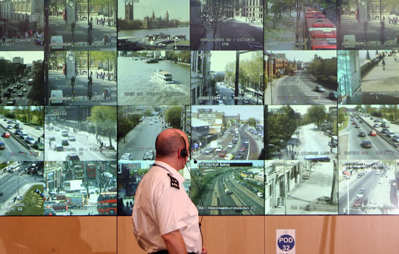
Lots of data can get us very confused...
Massive amounts of (visual) data is gathered continuously
Lack of automatic means to make sense of all the data
Automatic data pruning: process the data so that it is more accessible to human inspection

Slide 3
The Search for the Abnormal
A larger framework of identifying the ‘different’
[aka: out of the ordinary, rare, outliers, interesting, irregular, unexpected, novel …]
Various uses:
Efficient access to large volumes of data
Intelligent allocation of limited resources
Effective adaptation to a changing environment

Slide 4
The challenge
Machine learning techniques typically attempt to predict the future based on past experience
An important task is to decide when to stop predicting – the task of novelty detection

Slide 5
Outline
Bayesian surprise: an approach to detecting “interesting” novel events, and its application to video surveillance; ACCV 2010
Incongruent events: another (very different) approach to the detection of interesting novel events; I will focus on Hierarchy discovery
Foreground/Background Segregation in Still Images (not object specific); ICCV 2011

Slide 6
1. The problem
A common practice when dealing with novelty is to look for outliers - declare novelty for low probability events
But outlier events are often not very interesting, such as those resulting from noise
Proposal: using the notion of Bayesian surprise, identify events with low surprise rather than low probability
Joint work with Avishai Hendel, Dmitri Hanukaev and Shmuel Peleg

Slide 7
Our Approach
Identify high level events (e.g., activities in video) in input data
Establish a model to represent the events in a manner that allows meaningful inference (LDA)
Apply a measure to quantify the novelty and significance of each event (Bayesian surprise)

Slide 8
Bayesian Surprise
Surprise arises in a world which contains uncertainty
Notion of surprise is human-centric and ill-defined, and depends on the domain and background assumptions
Itti and Baldi (2006), Schmidhuber (1995) presented a Bayesian framework to measure surprise

Slide 9
Bayesian Surprise
Formally, assume an observer has a model M to represent its world
Observer’s belief in M is modeled through the prior distribution P(M)
Upon observing new data D, the observer’s beliefs are updated via Bayes’ theorem
⇒ P(M/D)

Slide 10
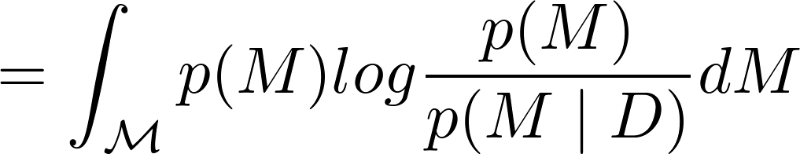
Bayesian Surprise
The difference between the prior and posterior distributions is regarded as the surprise experienced by the observer
KL Divergence is used to quantify this distance:

Slide 11
Bayesian Surprise
Note that the integration is over the entire model space
Surprise occurs when a different model is favored; this is different from low probability events
May be computed analytically when using probability distributions from the exponential family (e.g. Dirichlet distribution)

Slide 12
The model
Latent Dirichlet Allocation (LDA) - a generative probabilistic model from the `bag of words' paradigm (Blei, 2001)
Assumes each document is generated by a mixture probability of latent topics, where each topic is responsible for the actual appearance of words

Slide 13
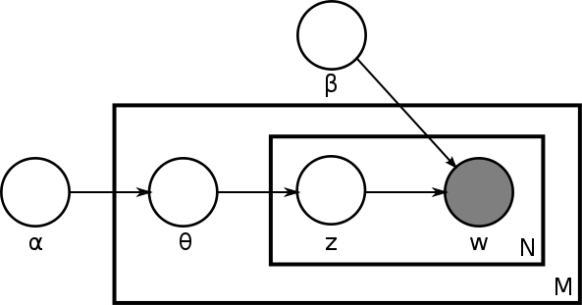
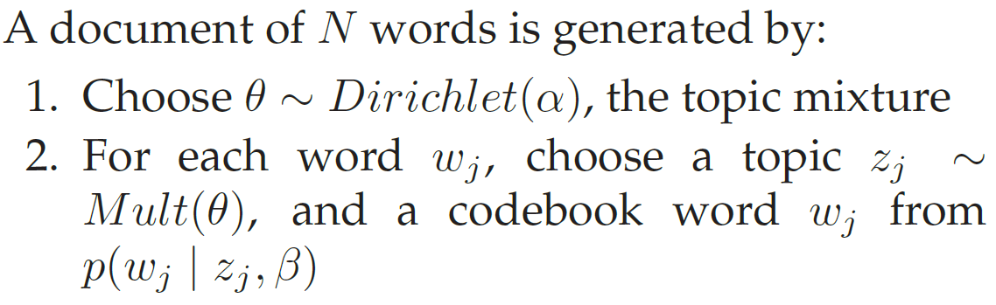
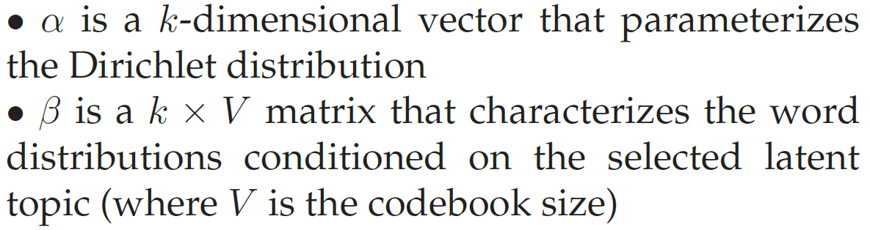
LDA

Slide 14
Bayesian Surprise and LDA
LDA is ultimately represented by α, the Dirichlet parameter, and β, the word distribution matrix.
A new measurement updates the model, to the posterior Dirichlet parameter, ᾱ. We use the same VB-EM algorithm employed in the parameter estimation stage to compute ᾱ, where β is kept fixed.
This change in α prior can be regarded as the surprise score for an event.

Slide 15
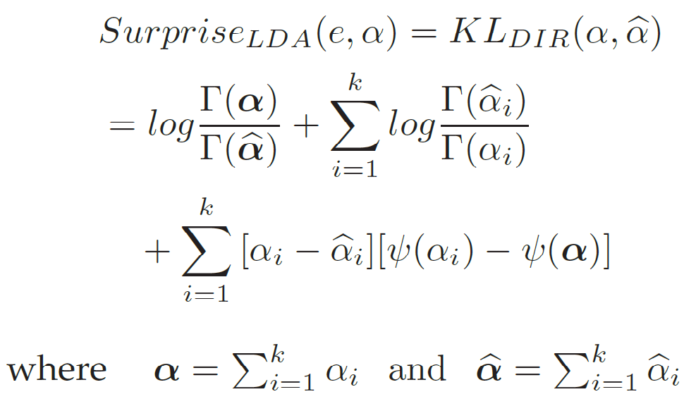
Bayesian Surprise and LDA
The surprise elicited by e is the distance between the prior and posterior Dirichlet distributions parameterized by α and ᾰ:
[Γ and ψ are the gamma and digamma functions]

Slide 16
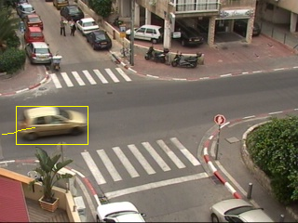
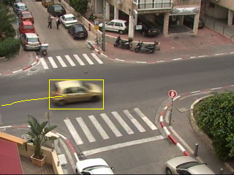
Application: video surveillance
Basic building blocks – video tubes
Locate foreground blobs
Attach blobs from consecutive frames to construct space time tubes

Slide 17
Trajectory representation
Compute displacement vector
Bin into one of 25 quantization bins
Consider transition between one bin to another as a word (25 * 25 = 625 vocabulary words)
`Bag of words' representation

Slide 18
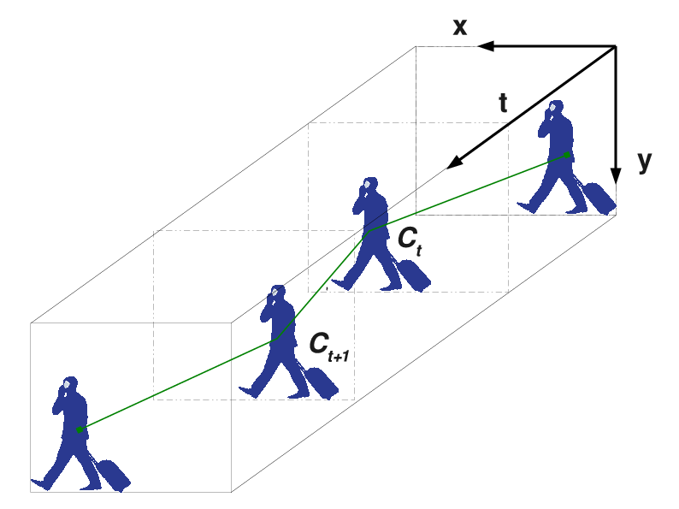
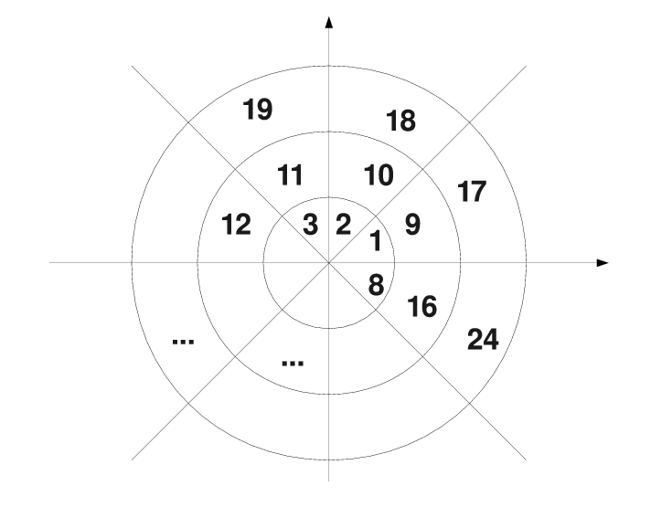
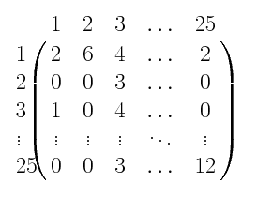

Slide 19
Experimental Results
Training and test videos are each an hour long, of an urban street intersection
Each hour contributed ~1000 tubes
We set k, the number of latent topics to be 8

Slide 20
Experimental Results
Learned topics:
cars going left to right
cars going right to left
people going left to right
Complex dynamics: turning into top street

Slide 21
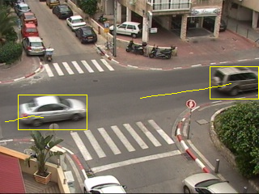
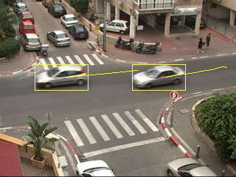
Results – Learned classes
Cars going left to right, or right to left

Slide 22
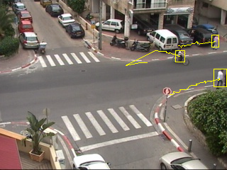
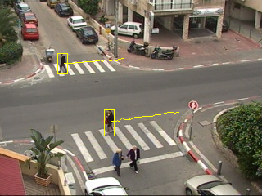
Results – Learned classes
People walking left to right, or right to left

Slide 23
Experimental Results
Each tube (track) receives a surprise score, with regard to the world parameter α; the video shows tubes taken from the top 5%

Slide 24
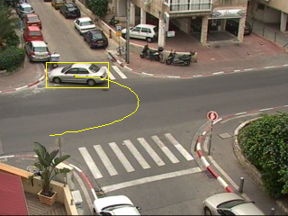
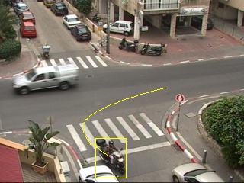
Results – Surprising Events
Some events with top surprise score

Slide 25
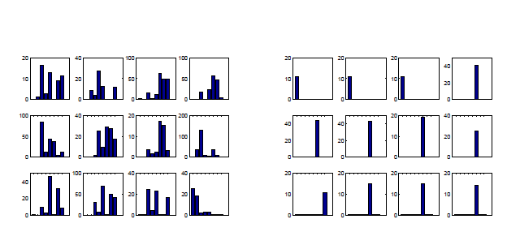
Typical and surprising events
Surprising events
Typical events

Slide 26
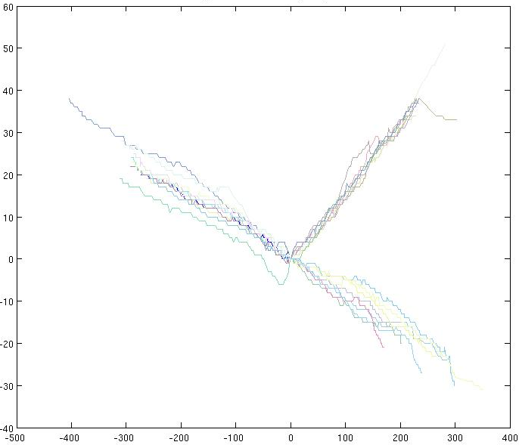
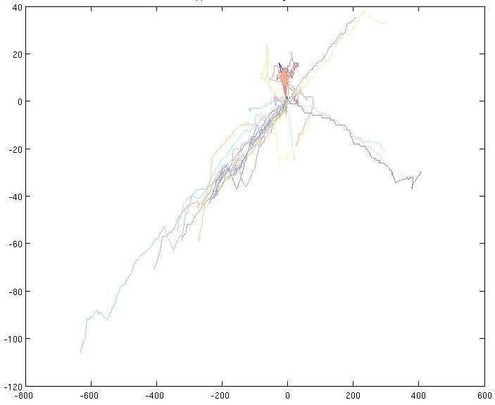
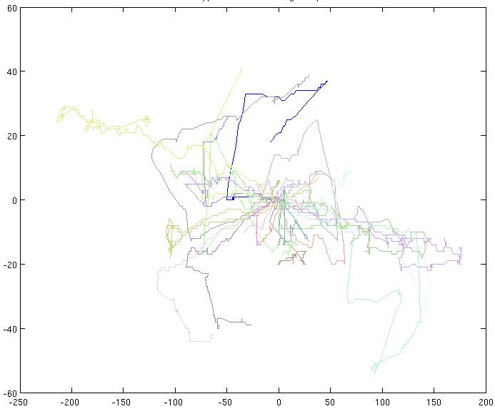
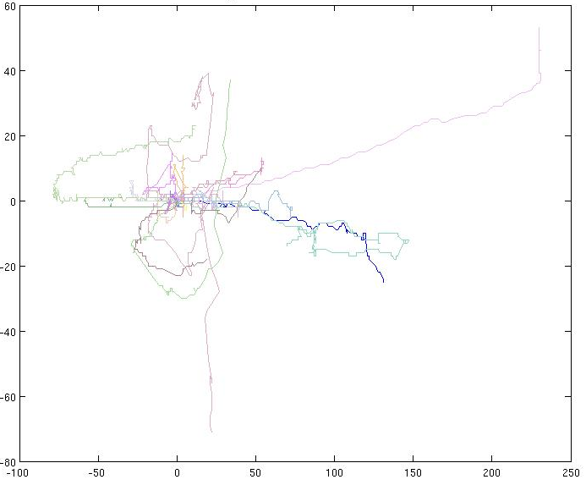
Surprise
Likelihood
typical
Abnormal

Slide 27
Outline
Bayesian surprise: an approach to detecting “interesting” novel events, and its application to video surveillance
Incongruent events: another (very different) approach to the detection of interesting novel events; I will focus on Hierarchy discovery
Foreground/Background Segregation in Still Images (not object specific)

Slide 28
2. Incongruent events
A common practice when dealing with novelty is to look for outliers - declare novelty when no known classifier assigns a test item high probability
New idea: use a hierarchy of representations, first look for a level of description where the novel event is highly probable
Novel Incongruent events are detected by the acceptance of a general level classifier and the rejection of the more specific level classifier.
[NIPS 2008, IEEE PAMI 2012]

Slide 29
Hierarchical representation dominates Perception/Cognition:
Cognitive psychology: Basic-Level Category (Rosch 1976). Intermediate category level which is learnt faster and is more primary compared to other levels in the category hierarchy.
Neurophysiology: Agglomerative clustering of responses taken from population of neurons within the IT of macaque monkeys resembles an intuitive hierarchy. Kiani et al. 2007

Slide 30
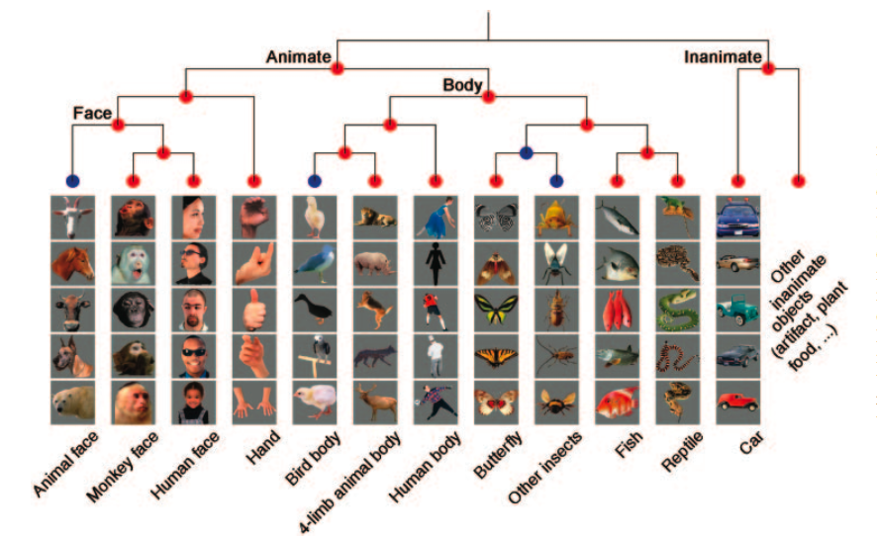

Slide 31
Focus of this part
Challenge: hierarchy should be provided by user
a method for hierarchy discovery within the multi-task learning paradigm
Challenge: once a novel object has been detected, how do we proceed with classifying future pictures of this object?
knowledge transfer with the same hierarchical discovery algorithm
Joint work with Alon Zweig

Slide 32
An implicit hierarchy is discovered
Multi-task learning, jointly learn classifiers for a few related tasks:
Each classifier is a linear combination of classifiers computed in a cascade
Higher levels – high incentive for information sharing
⇒ more tasks participate, classifiers are less precise
Lower levels – low incentive to share
⇒ fewer tasks participate, classifiers get more precise
How do we control the incentive to share?
⇒ vary regularization of loss function

Slide 33
How do we control the incentive to share?
Sharing assumption: the more related tasks are, the more features they share
Regularization:
restrict the number of features the classifiers can use by imposing sparse regularization - || • ||₁
add another sparse regularization term which does not penalize for joint features - || • ||_{1,2}
⇒ λ|| • ||_{1,2} + (1- λ )|| • ||₁
Incentive to share:
λ=1 ⇒ highest incentive to share
λ=0 ⇒ no incentive to share

Slide 34
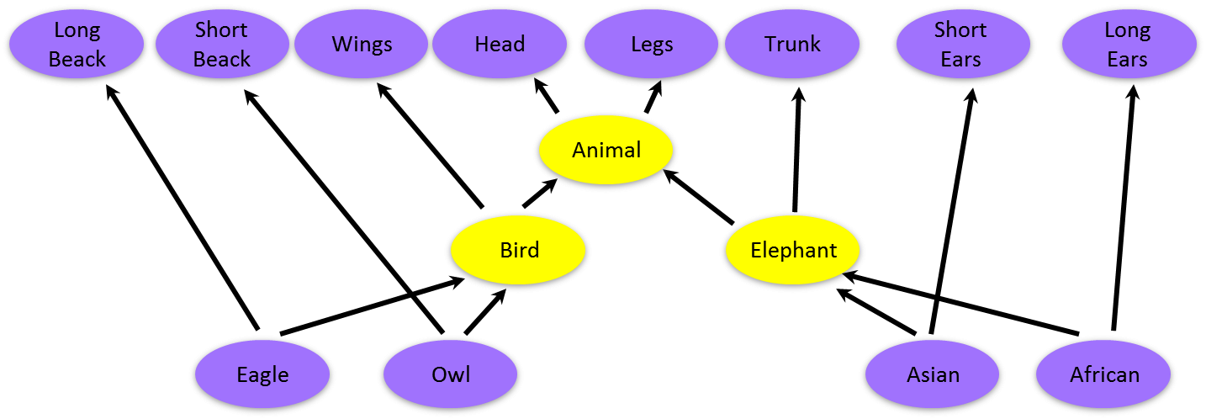
Example
African Elp | Asian Elp | Owl | Eagle
 |  |  |  | Head
 |  |  |  | Legs
 |  |  |  | Wings
 |  |  |  | Long Beak
 |  |  |  | Short Beak
 |  |  |  | Trunk
 |  |  |  | Short Ears
 |  |  |  | Long Ears
Matrix notation:
Explicit hierarchy

Slide 35
Levels of sharing
=
Level 1: head + legs
Level 2: wings, trunk
Level 3: beak, ears
+
+

Slide 36
The cascade generated by varying the regularization
Loss + || • ||₁₂
Loss + λ|| • ||_{1,2} + (1- λ )|| • ||₁
Loss + || • ||₁

Slide 37
Algorithm
We train a linear classifier in Multi-task and multi-class settings, as defined by the respective loss function
Iterative algorithm over the basic step:
ϴ = {W,b}
ϴ’ stands for the parameters learnt up till the current step.
λ governs the level of sharing from max sharing λ = 0 to no sharing λ = 1
Each step λ is increased.
The aggregated parameters plus the decreased level of sharing is intended to guide the learning to focus on more task/class specific information as compared to the previous step.

Slide 38


Experiments
Synthetic and real data (many sets)
Multi-task and multi-class loss functions
Low level features vs. high level features
Compare the cascade approach against the same algorithm with:
No regularization
L₁ sparse regularization
L₁₂ multi-task regularization
Multi-task loss
Multi-class loss

Slide 39
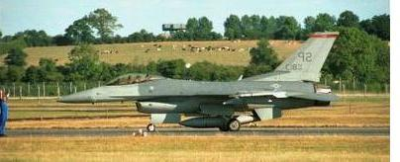
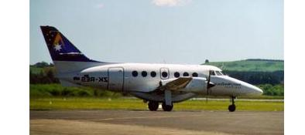
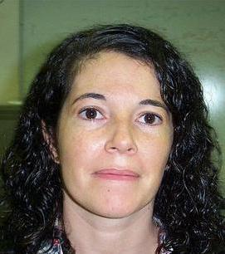
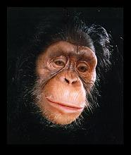
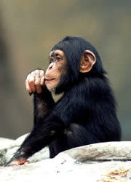
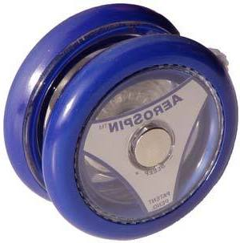
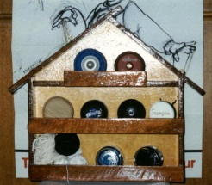
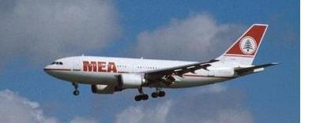
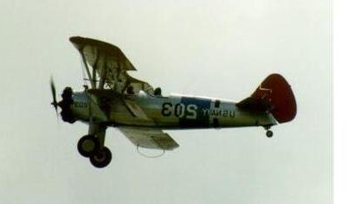
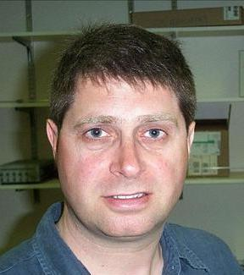
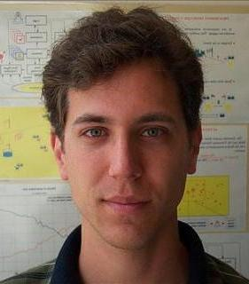
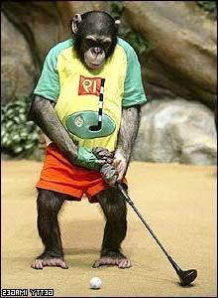
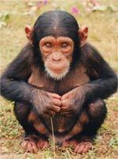


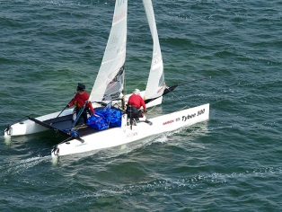

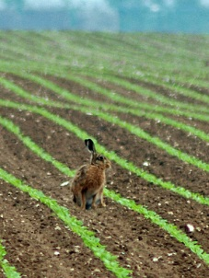
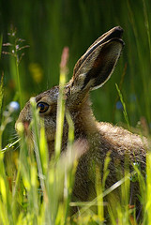
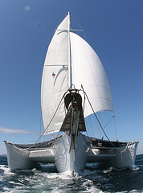
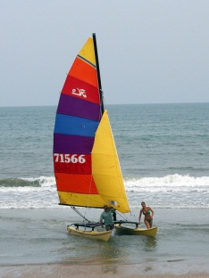
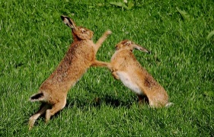
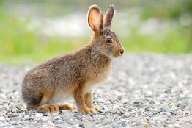
Real data
Datasets
Caltech 101
Caltech 256
Imagenet
Cifar-100
(subset of tiny images)
Notes:
Cifar comes with superclass labels which we ignore and hope to find implicitly

Slide 40
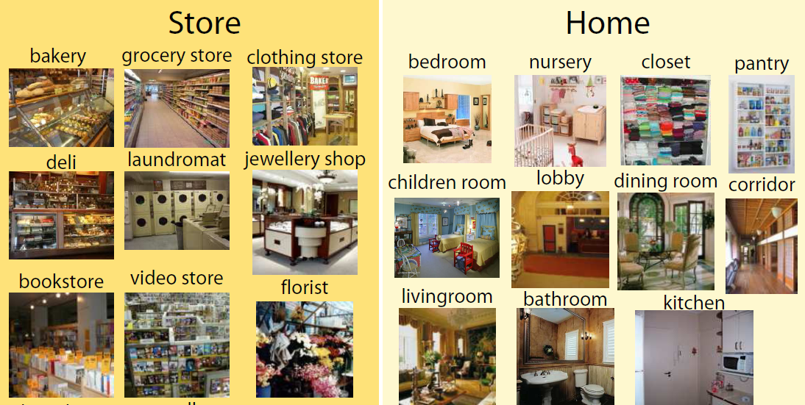
Real data
Datasets
MIT-Indoor-Scene (annotated with label-me)
Notes:
Cifar comes with superclass labels which we ignore and hope to find implicitly

Slide 41
Features
Representation for sparse hierarchical sharing:
low-level vs. mid-level
Low level features: any of the images features which are computed from the image via some local or global operator, such as Gist or Sift.
Mid level features: features capturing some semantic notion, such as a variety of pre-trained classifiers over low level features.
Low Level
Gist, RBF kernel approximation by random projections (Rahimi et al. NIPS ’07) | Cifar-100
Sift, 1000 word codebook, tf-idf normalization | Imagenet
Mid Level
Feature specific classifiers (of Gehler et al. 2009). | Caltech-101
Feature specific classifiers or Classemes (Torresani et al. 2010). | Caltech-256
Object Bank (Li et al. 2010). | Indoor-Scene

Slide 42
Low-level features: results
Multi-Task
Multi-Class
Cifar-100 | Imagenet-30
79.91 ± 0.22 | 80.67 ± 0.08 | H
76.98 ± 0.19 | 78.00 ± 0.09 | L1 Reg
76.98 ± 0.17 | 77.99 ± 0.07 | L12 Reg
76.98 ± 0.17 | 78.02 ± 0.09 | NoReg
Cifar-100 | Imagenet-30
21.93 ± 0.38 | 35.53 ± 0.18 | H
17.63 ± 0.49 | 29.76 ± 0.18 | L1 Reg
18.23 ± 0.21 | 29.77 ± 0.17 | L12 Reg
18.23 ± 0.28 | 29.89 ± 0.16 | NoReg

Slide 43
Mid-level features: results
Gehler et al. (2009), achieve state of the art in multi-class recognition on both the caltech-101 and caltech-256 dataset.
Each class is represented by the set of classifiers trained to distinguish this specific class from the rest of the classes. Thus, each class has its own representation based on its unique set of classifiers.
Caltech 101 Multi-Task
Caltech 256 Multi-Task
Average accuracy
Sample size

Slide 44
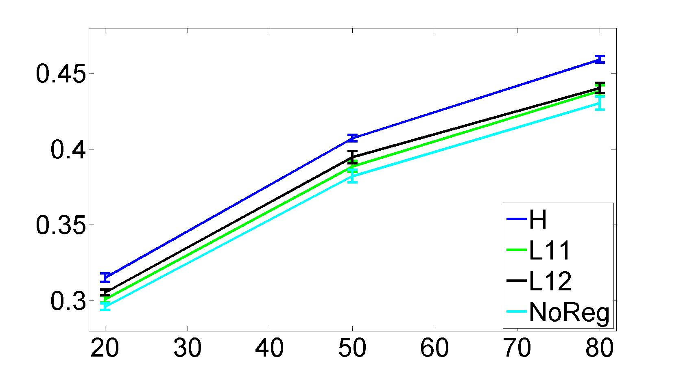
Mid-level features: results
Multi-Class using Classemes
Multi-Class using ObjBank on MIT-Indoor-Scene dataset
Caltech-256
42.54 | H
41.50 | L1 Reg
41.50 | L12 Reg
41.50 | NoReg
40.62 | Original classemes
Sample size
State of the art (also using ObjBank) 37.6% we get 45.9%

Slide 45
Online Algorithm
Main objective: faster learning algorithm for dealing with larger dataset (more classes, more samples)
Iterate over original algorithm for each new sample, where each level uses the current value of the previous level
Solve each step of the algorithm using the online version presented in “Online learning for group Lasso”, Yang et al. 2011
(we proved regret convergence)

Slide 46
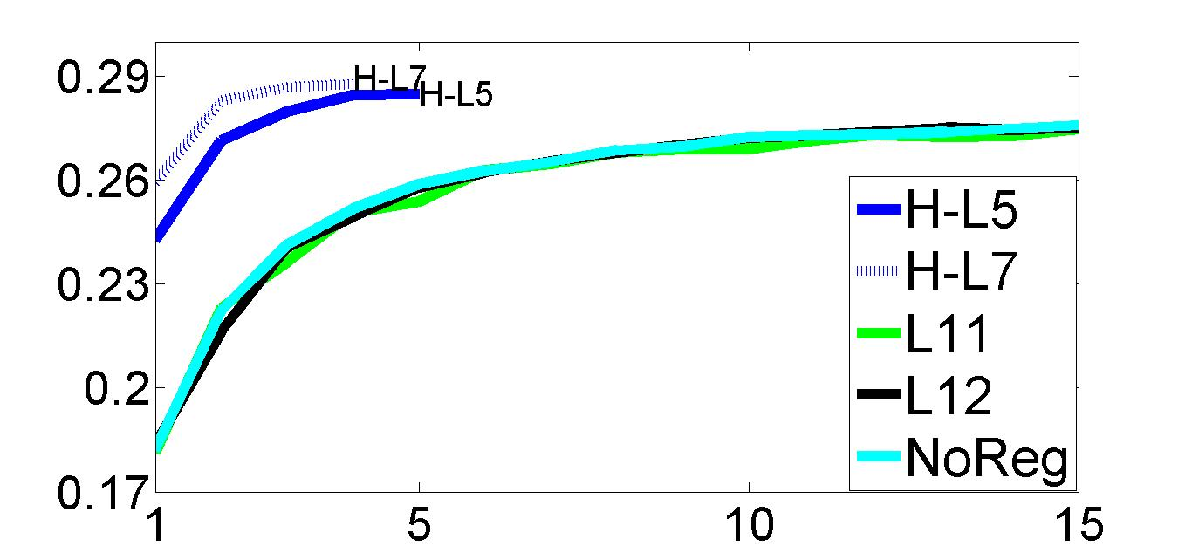
Large Scale Experiment
Experiment on 1000 classes from Imagenet with 3000 samples per class and 21000 features per sample.
accuracy
data repetitions
H | 0.285 | 0.365 | 0.403 | 0.434 | 0.456
Zhao et al. | 0.221 | 0.302 | 0.366 | 0.411 | 0.435

Slide 47
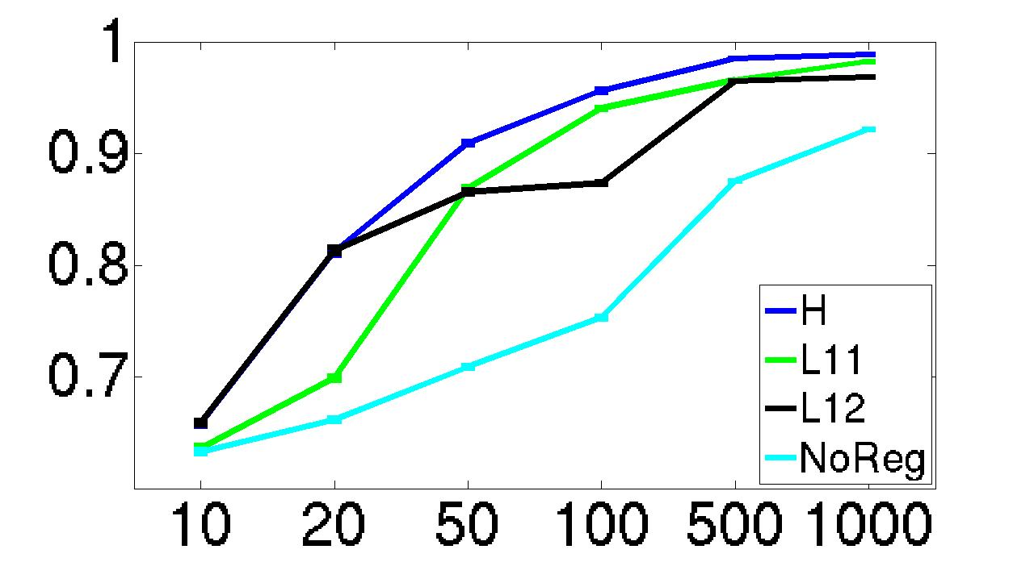
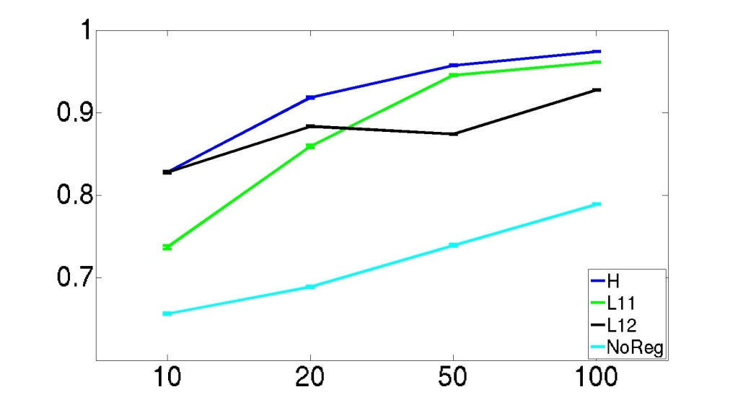
Online algorithm
Single data pass
10 repetitions of all samples

Slide 48
Knowledge transfer
A different setting for sharing: share information between pre-trained models and a new learning task (typically small sample settings).
Extension of both batch and online algorithms, but online extension is more natural
Gets as input the implicit hierarchy computed during training with the known classes
When examples from a new task arrive:
The online learning algorithms continues from where it stopped
The matrix of weights is enlarged to include the new task, and the weights of the new task are initialized
Sub-gradients of known classes are not changed

Slide 49
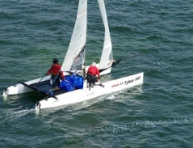






Knowledge Transfer
Task 1
Task K
MTL
1 . . . K
=
+
+
Online KT Method
Batch KT Method
K+1
K+1
K+1
K+1
α
π
α
π
α
π
=
+
+
=
+
+

Slide 50


Knowledge Transfer (imagenet dataset)
Large scale:
900 known tasks
21000 feature dim
accuracy
Medium scale:
31known tasks
1000 feature dim
accuracy
Sample size

Slide 51

Results with Cifar-100
Plotted values: accuracy of online method – accuracy of respective methods
4 new classes

Slide 52
Outline
Bayesian surprise: an approach to detecting “interesting” novel events, and its application to video surveillance; ACCV 2010
Incongruent events: another (very different) approach to the detection of interesting novel events; we focus on Hierarchy discovery
Foreground/Background Segregation in Still Images (not object specific); ICCV 2011

Slide 53
Extracting Foreground Masks
Segmentation and recognition: which one comes first?
Bottom up: known segmentation improves recognition rates
Top down: Known object identity improves segmentation accuracy (“stimulus familiarity influenced segmentation per se”)
Our proposal: top down figure-ground segregation, which is not object specific

Slide 54
Desired properties
In bottom up segmentation, over-segmentation typically occurs, where objects are divided into many segments; we wish segments to align with object boundaries (as in top down approach)
Top down segmentation depends on each individual object; we want this pre-processing stage to be image-based rather than object based (as in bottom up approach)

Slide 55

Method overview

Slide 56

Initial image representation
input
Super-pixels

Slide 57

Geometric prior
Find k-nearest-neighbor images based on Gist descriptor
Obtain non-parametric estimate of foreground probability mask by averaging those images

Slide 58

Visual similarity prior
Represent images with bag of words (based on PHOW descriptors)
Assign each word a probability to be in either background or foreground
Assign a word and its respective probability to each pixel (based on the pixel’s descriptor)

Slide 59

Geometrically similar images
Visually similar images

Slide 60

Graphical model description of image
Minimize the following energy function:
where
Nodes are super-pixels
Unary term – average geometric and visual priors
Binary terms depend on color difference and boundary length

Slide 61

Graph-cut of energy function

Slide 62

Examples from VOC09,10:
(note: foreground mask can be discontiguous)

Slide 63

Results

Slide 64

Mean segment overlap
CPMC: Generate many possible segmentations, takes minutes instead of seconds
J. Carreira and C. Sminchisescu. Constrained parametric min-cuts for automatic object segmentation. In Computer Vision and Pattern Recognition (CVPR), 2010 IEEE Conference on, pages 3241–3248. IEEE, 2010.

Slide 65


The priors are not always helpful
Appearance only:

Slide 66

Bayesian surprise: an approach to detecting “interesting” novel events, and its application to video surveillance; ACCV 2010
Incongruent events: another (very different) approach to the detection of interesting novel events; we focus on Hierarchy discovery
Foreground/Background Segregation in Still Images (not object specific); ICCV 2011

