Slide 1
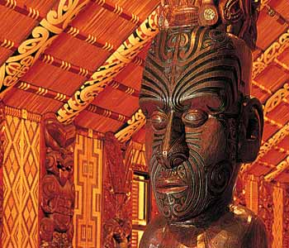
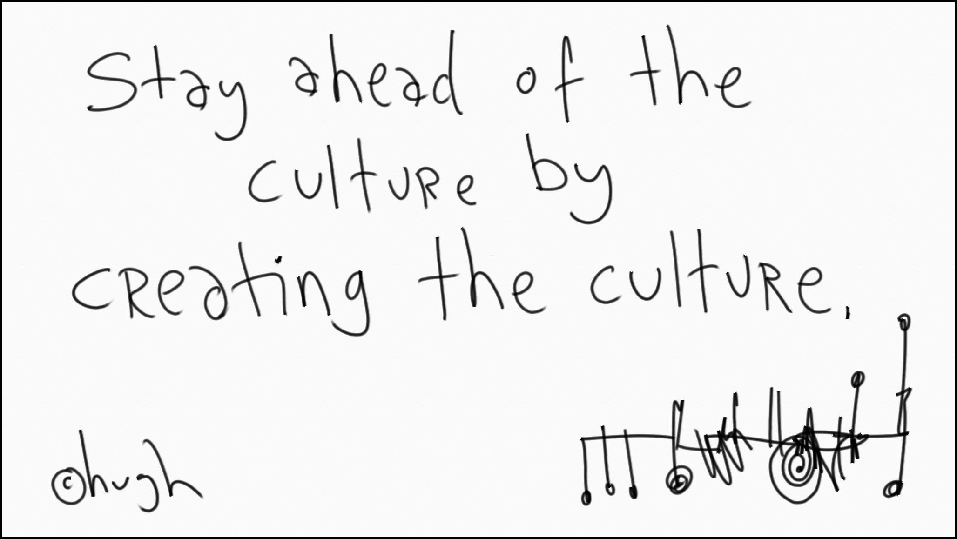
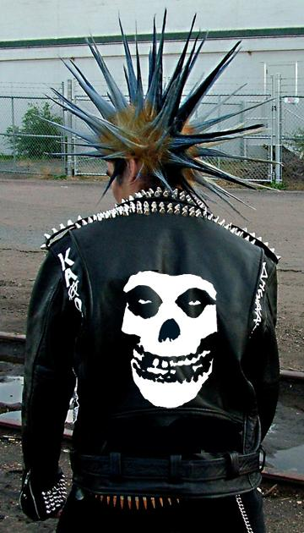

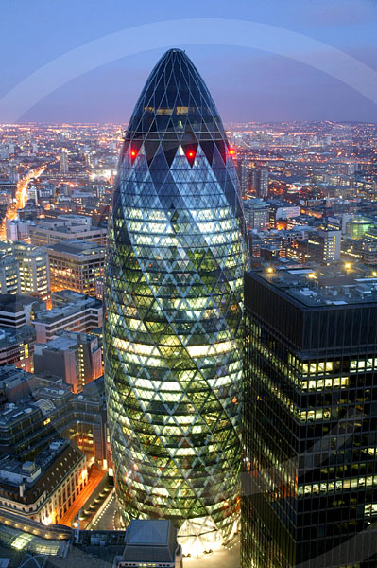



SCLY1
CULTURE AND IDENTITY

Slide 2
Aims
Review key concepts (2 mark questions)
To ‘unpick’ essay questions and consider what they are asking for...(24 mark questions)

Slide 3
Basic terms review
Culture and Identity key words
3 theories on Culture
Theories on Culture extension
Social Groups – Sexuality?
Identity and theories of identity
ESSAY WORKSHOP
Plenary

Slide 4
Remember these?
Norms mores values
Roles achieved and ascribed status
culture rules/laws
deviance sanctions
Write down as many definitions as you can

Slide 5
Key words from Topics
Culture
Socialization
Identity and Social Class
Gender and Sexuality
Ethnicity and Nationality
Age and Disability
Chapter 2: Culture and Identity

Slide 6
STARTER
3x3x3
3 perspectives
3 key terms
3 minutes

Slide 7
How did you do?
Functionalism | Marxism | Neo-Marxism

Slide 8
How did you do?
Functionalism | Marxism | Neo-Marxism
Value Consensus | Ideology | Hegemony
Social Solidarity | Ruling Class | Ideological State Apparatus
Social Cohesion | False Class Consciousness | Cultural dominance

Slide 9
Perspectives on Culture
Functionalist perspectives
Marxist theories of culture and identity
Neo-Marxist theories of culture
Mass Culture
Global Culture
Postmodernism
Rally Robin

Slide 10
Functionalist perspectives
Key Words
Social Order
Value Consensus
Social Solidarity
Social Institutions
Talcott Parsons
Socialization – Values and Norms – Social Institutions – Social Integration
Emile Durkheim
Collective Conscience – solidarity – anomie

Slide 11
Marxist theories
Key Words
Ideology
False Class Consciousness
Inequality
Karl Marx
Means of production- Alienation
Exploitation
Ruling Class Ideology
Mass Culture

Slide 12
Neo-Marxism
Greater interaction between classes than Marxism
Hegemony
Emergent Ideologies

Slide 13
Mass Culture
Ruling Class
Manufactured
Low quality
Predicatable

Slide 14





A global culture....?
Is there such a thing?

Slide 15
ESSAY RULES!
1. Introduction
2.
3.
4.
5.
6. Conclusion

Slide 16
Postmodernism
Pick and Mix
Hyper-reality
Metanarratives
Consumption

Slide 17
ESSAY RULES!
1. Introduction
2.
3.
4.
5.
6. Conclusion

Slide 18
Assessment Objectives
 | AO1 | AO2
First essay question: ‘Examine’ | 14 | 10
Second essay question: ‘Assess’ | 10 | 14

Slide 19
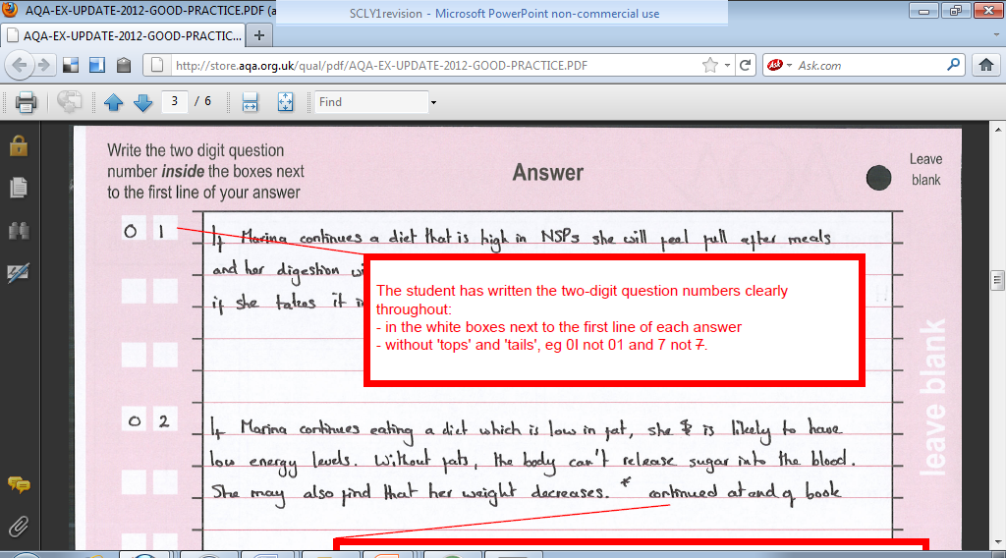
Filling out the question books

Slide 20
Essay Questions: Examine
Examine sociological explanations of the way ethnicity may shape our identity (Jun 2011 )
Examine the ways in which two of the following agencies may shape the process of socialisation; family; education; mass media; religion (Jun 2010)
3. Examine sociological contributions to our understanding of how identity is shaped by any two of the following: social class; disability; sexuality; age. (Jan 2010)
Examine sociological contributions to our understanding of youth culture (Jan 2009)
Examine the contribution of interactionist views to our understanding of identity. (Jun 2009)

Slide 21
Essay questions: Assess
Assess the view that social class in no longer a significant factor in shaping social identity (Jan 2011)
Assess sociological explanations of the role of culture in society (Jun 2011)
Assess the view that patterns of leisure and consumption are the main factors determining social identity (Jun 2010)
Assess the functionalist view that socialization is mainly concerned with the transmission of norms and values (Jan 2010)
Assess the view that gender identities are increasingly varied in today’s society (Jun 2009)
Assess the view that a mass culture exists in society today (Jan 2009)
Assess the functionalist view of culture

Slide 22
PLENARY
What skills have I developed today?
What ONE piece of new knowledge am I taking away with me today?

