Slide 1

The Equality Act 2010 and Accessibility of lifts for disabled users

Slide 2

The Equality Act 2010 and Accessibility of lifts for disabled users
There are over 10 million people with a limiting long term illness, impairment or disability in the UK.
In the UK, the most commonly-reported impairments are those that affect mobility, lifting or carrying
The prevalence of disability rises with age. Around one in 20 children are disabled, compared to around one in seven working age adults and almost one in two people over state-pension age in the UK.
Around a third of disabled people experience difficulties related to their impairment in accessing public, commercial and leisure goods and services

Slide 3
The Equality Act 2010
From the 1st October 2010 the Equality Act replaces the Disability Discrimination Act (1995), or DDA. This Act is an essential piece of legislation to be considered when specifying products for buildings.
The Equality Act 2010 is the law which bans unfair treatment and helps achieve equal opportunities in the workplace and in wider society. This includes the provision of services for those with disabilities.

Slide 4
The Equality Act 2010
Where does the Equality Act apply?
To all service providers and those providing goods and facilities. This includes, for example, those providing information, advice and day care or running leisure centre facilities
To all services, whether or not a charge is made for them
It also applies to private clubs and other associations with 25 or more members which have rules about membership and select their members

Slide 5
The Equality Act 2010
What changes are required?
Service providers are required to make changes, where needed, to improve service for disabled customers or potential customers
There is a requirement to make reasonable changes to the way things are done (such as changing policy), to the built environment (such as making changes to the structure of a building to improve access)
And to provide auxiliary aids and services (such as providing information in an accessible format, an induction loop for customers with hearing aids or additional staff support when using a service)

Slide 6
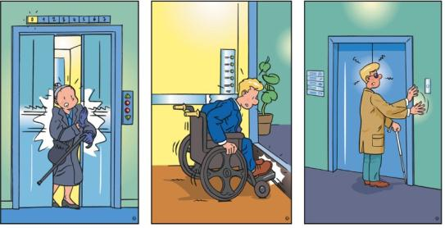
Accessibility at every stage
Making lifts accessible to all users
poses many different challenges and
depending on the type of building;
existing or new, the process used to
achieve this can also be different.
Guidance is available to assist you in making the right decision for your lift users regardless of the type of building or obstacles which seem difficult to overcome.

Slide 7

How does all this relate to lifts?
Since the early 1990’s a number of standards and guides were produced to assist those involved in specifying or providing lift services for users with disabilities.
The standards considered not just mobility impairment and users with wheelchairs but many other more common barriers or obstacles which might be encountered by users with different impairments that make using the lift more difficult than it might otherwise be if correctly designed.

Slide 8
Accessibility
UK Building Regulations
England Approved Document M
Scotland SBSA Technical Handbook 4.2
Northern Ireland – Dept Finance & Personnel Tech Booklet R
A conventional passenger lift should always be considered over a platform lift and that it is the most suitable form of access for moving people from one storey to another.
8 person lift car with dimensions of 1100mm(w) x 1400mm(d) is the minimum requirement
Lift to conform to the requirements of EN81-70: 2003

Slide 9
Accessibility
BS8300 Design of buildings and their approaches to meet the needs of disabled people – Code of practice
States a conventional passenger lift should always be considered. This endorses the technical guidance which define how to comply with Building Regulations
Enclosed platform lifts should only be used where conventional lifts cannot be installed (pit excavation or headroom constraints)
Recommends the use of larger lift car (2000mm(w) x 1400mm(d)) to aid turning of wheelchairs and walking aids
Gives advice on the design of the lift and ancillary items
States the lift must conform to the requirements of EN81-70

Slide 10
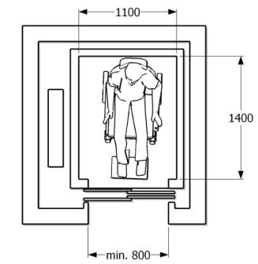
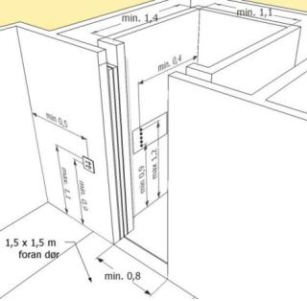
Accessibility
BS EN81-70:2003
Created by European Disability Forum, National Standardisation Institutes and the Lift Industry
Identifies the needs of accessibility for the disabled in lifts and will therefore form the basis for compliance
Requires its own section within the Owners manuals to provide information to adjust volumes and door dwell times etc
Recommends the need for a procedure for the safe rescue of disabled persons

Slide 11



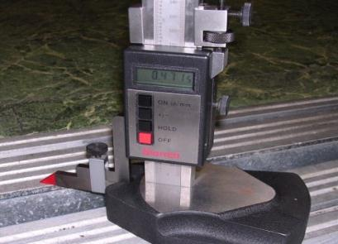


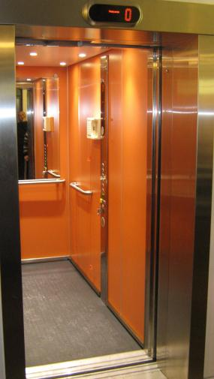
Accessibility
BS EN81-70:2003 Continued
The standard covers a number of areas
Door and lift car dimensions
Signalisation
Location of car and landings fixtures
Floor levelling
Voice annunciation
Information on how floor levels should be marked, the building’s floor numbering system may need to be changed to achieve this

Slide 12
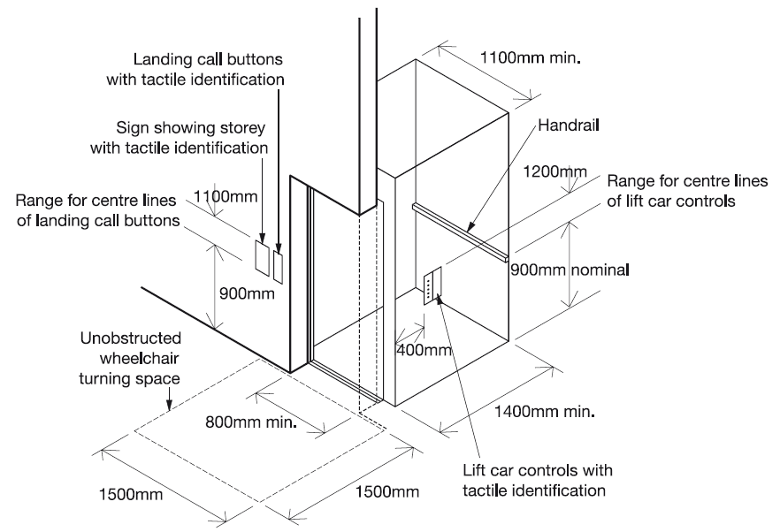
Accessibility

Slide 13
Case Study
We were asked to survey a lift which had recently been upgraded to meet EN81 – 82. Improvement of the accessibility of existing lifts for persons including persons with disability.
Our survey found the following code compliance issues with the lift and building
The indicator heights on the lift landing were incorrect
All lift lobby landings above the ground floor were not large enough for a wheel chair user to exit the lift

Slide 14
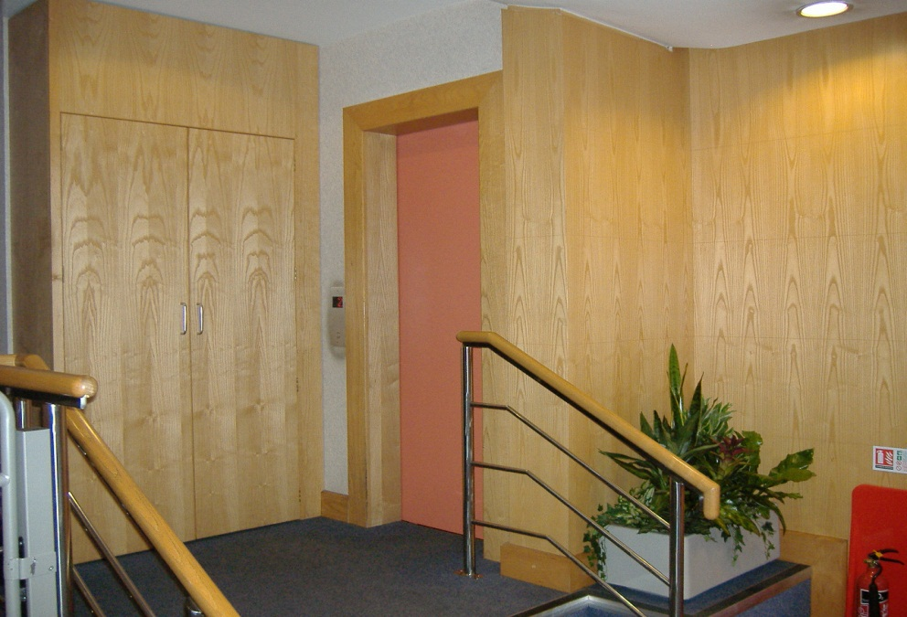
Case Study
The lift installation has been upgraded but still does not meet the specific requirement to achieve compliance.

Slide 15
Case Study
To make matters worse…
Two small steps prevent wheel chair access to the lift!
When the lift company was questioned, the following solution was offered …Install a second platform lift to over come the stairs!
It is essential that the access route to and from the lift is considered before a conversion of this type is carried out
Must remember to consider building fabric and access to the lift

Slide 16
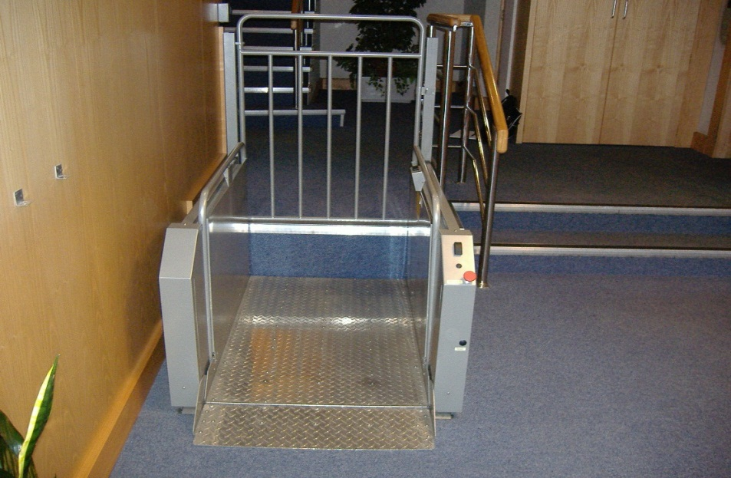
Case Study
The lift installation must not be taken in isolation as it is not suitable if access to the lift is prohibitive.

Slide 17
Equality Act 2010
The Equality Act 2010 requires that service providers must think ahead and take steps to address barriers that impede disabled people. In doing this, it is a good idea to consider the range of disabilities that your actual or potential service users might have.
You should not wait until a disabled person experiences difficulties using a service, as this may make it too late to make the necessary adjustment.

