Slide 1
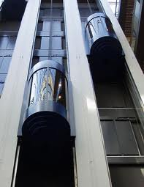
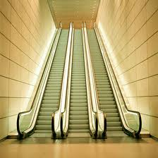
A very brief History of Lifts and escalators Followed by a selection guide to VT

Slide 2
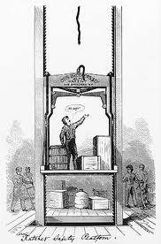
Lifts
The first reference in literature to a lift is in the works of the Roman architect Vitruvius, who reported that Archimedes (c. 287 BC – c. 212 BC) built his first lift probably in 236 BC.
Elisha Otis’s invention of the Safety Gear in 1852 marks the birth of lifts as we know them

Slide 3
Other important inventions
In 1874, J.W. Meaker patented a method which permitted lift doors to open and close safely.
In 1887, American Inventor Alexander Miles of Duluth, Minnesota patented a lift with automatic doors that would close off the lift shaft.
In 1888 Nikola Tesla invented the first practicable AC motor and with it the polyphase power transmission system. Tesla continued his work on the AC motor in the years to follow at the Westinghouse company.

Slide 4
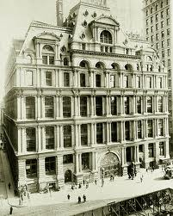
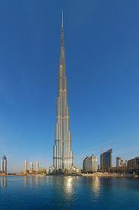
Lifts mean taller buildings!
The Equitable Life Building completed in 1870 in New York City was the first office building to have passenger lifts. They served 8 floors.
The Tallest building in the world is currently
The Burj Khalifa in Dubai with 160 floors.
Another successful Lerch Bates lift design!

Slide 5
Escalators
Jesse Reno, a graduate of Lehigh University, produced the first working escalator (he actually called it the "inclined elevator") and installed it alongside the Old Iron Pier at Coney Island, New York in 1896.
Piat installed its "stepless" escalator in Harrods Knightsbridge store on Wednesday, November 16, 1898 Customers were given Brandy to recover from the experience!

Slide 6
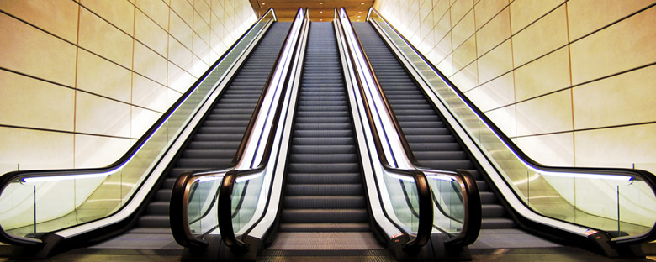
Escalators move people!
A single 1mtr wide escalator can move up to 4500 passengers in an hour
Can be used in stacks to cover up to 4 floors
Suitable for able bodied adults
Not unsupervised children, persons with disabilities or elderly persons.

Slide 7
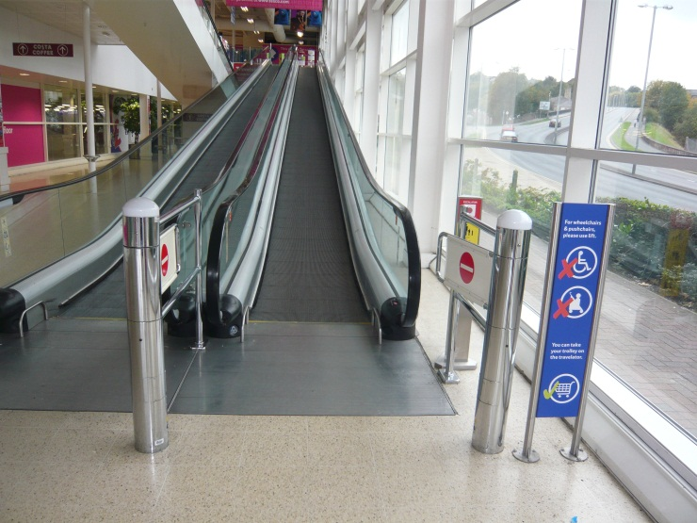
Moving Walks Move people and trolleys!
Available as flat walkways to reduce walking times
Or inclined at up to 12 degrees (10 degrees is best)
Can transport up to 3600 passengers per hour
Or 900 shopping trolleys with passengers
Not suitable for unsupervised children, the elderly and disabled

Slide 8
Paternosters
First built in 1884 by the engineering firm of J & E Hall Ltd of Dartford as the Cyclic Elevator, the name paternoster ("Our Father", the first two words of the Lord's Prayer in Latin) was originally applied to the device because the elevator is in the form of a loop and is thus similar to rosary beads used as an aid in reciting prayers.

Slide 9
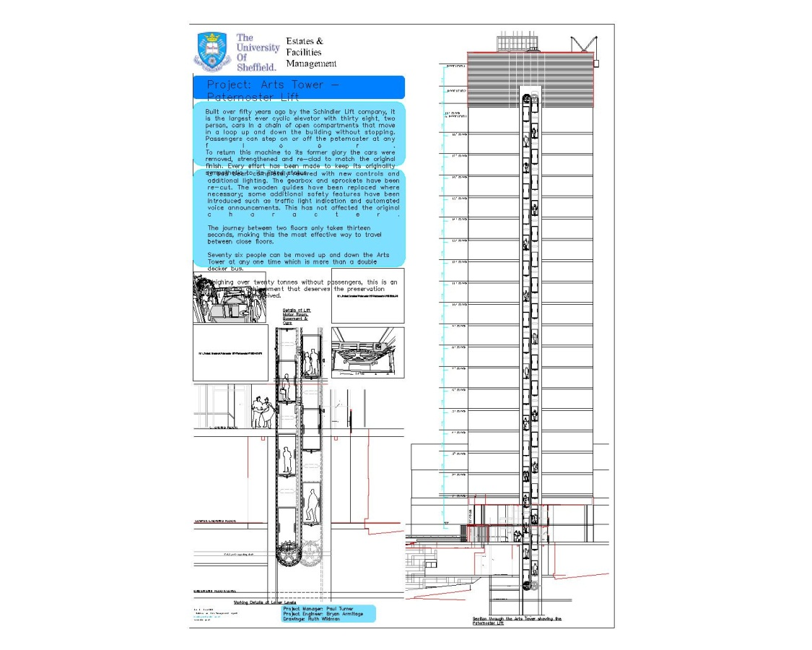
Paternosters
Can move up to 1400 passengers per hour
Best up to 6 floors
The Arts Tower serves 21 floors!
Not suitable for the elderly, disabled passengers or children
Must not be used to transport goods

Slide 10
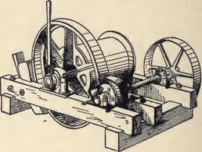
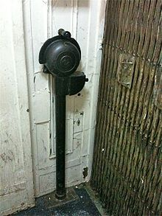
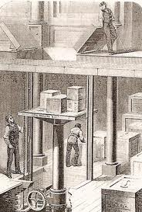
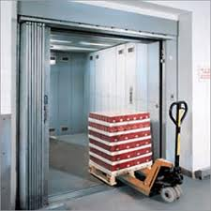
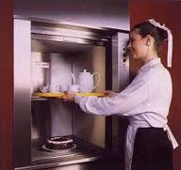
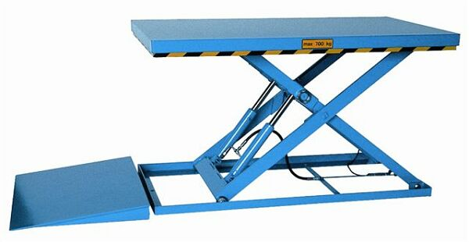
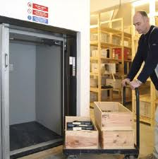
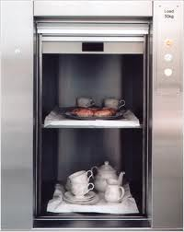
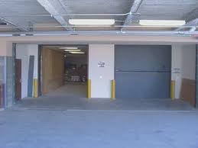
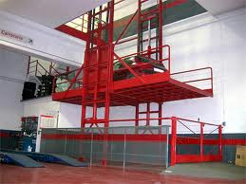
Moving Goods

Slide 11
Moving People - planning a VT system
How many people need to be transported in a 5 min period? Arrival rates as % of population
How long do passengers have to wait for a lift? AWT
How long do passengers take to get to their destination? ATTD
How many lifts are needed?
How big do the lifts need to be?
How fast do the lifts need to be?
How many journeys per year will the lifts make?

Slide 12
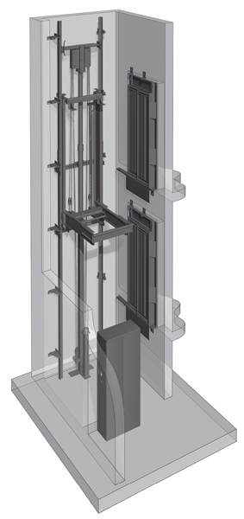
Choosing the Right Equipment
Hydraulic Lifts are best for:-
Heavy Loads > 2000kg
Low travel < 18metres
Low number of starts per hour max 120
Temperature stable environments
Slow travel speeds max 1 m/sec
Life expectancy < 20 years
Some Machine room less versions

Slide 13
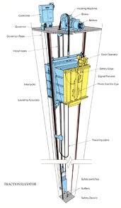
Choosing the right equipment
Traditional Electric lifts are best for:-
Busy lifts with >180 starts per hour
Fast performance up to 18m/sec, 1.2m/s² 2m/s³
Excellent ride quality < 10mg
Longer travel up to 150 m
Loads up to 5000kg
Life expectancy 25 to 40 years!

Slide 14
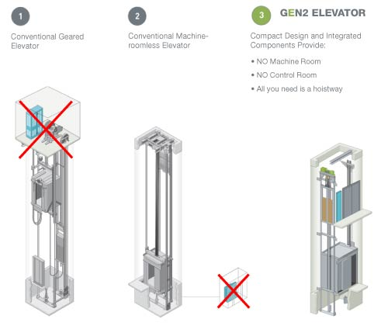
Choosing the right equipment
Machine Room Less (MRL) lifts
Do not need a machine room and so save space
Limited to about 40m travel
Limited to 180 starts per hour
Limited to 3.5m/s
Limited to 3000kg
Efficient gearless drives are best
Life expectancy <20 years
Beware of tied in maintenance!

Slide 15
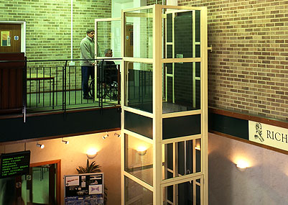
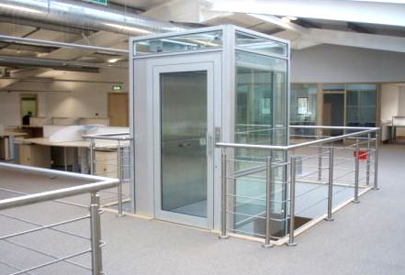
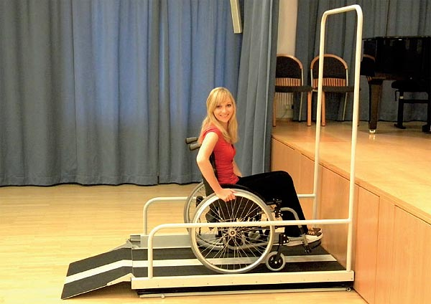
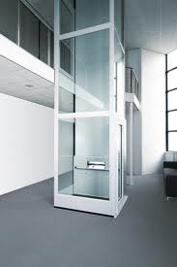
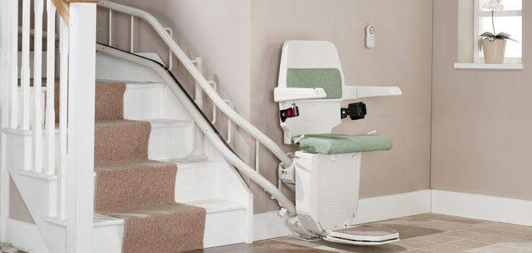
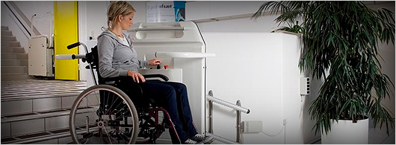
Moving People
But not with lifts!
Machinery Directive devices

Slide 16
Machinery Directive Devices
Slow- less than 0.15m/sec
Unsuitable for more than 10 to 30 operations per hour
Unsuitable for travel over 3 metres (NB approval required).
Require limited pit and headroom
Mostly designed for transporting disabled passengers and not goods.
Some designed for transporting goods but only trained operators as passengers.

Slide 17
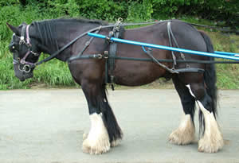

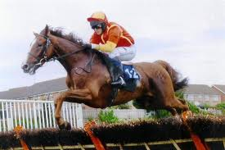
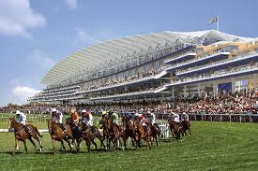
It’s all a question of
Horses
For
Courses!

Slide 18
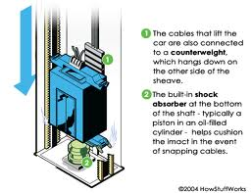
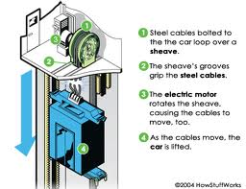
Questions so far?

