Slide 1
Using activity data to support your users
Tom Franklin University of Manchester and Franklin Consulting
tom@franklin-consulting.co.uk

Slide 2
What is activity data?
Short answer: Anything in a log file
Longer answer
Every log in
Every search
Every access of a resource
Every submission of a document
Every access of a web page
Any action in the VLE

Slide 3
BUT

Slide 4

It only matters if: We know who you are
www.youtube.com/watch?v=Fe1Ixd4xd8o

Slide 5
Not quite A proxy will do
Logged in users – we know who you are
IP address – we know you are the same person
But proxy servers will cause problems
What really matters is the ability to link activities together
Look at patterns of behaviour

Slide 6







Who is doing it?

Slide 7


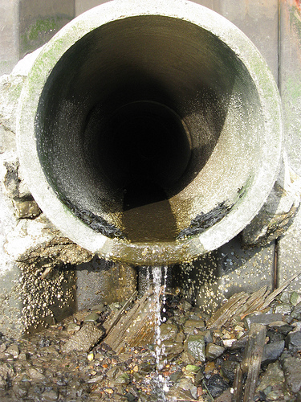
What is activity data useful for?
Student recruitment
Student retention
Research impact
Resource management
http://www.flickr.com/photos/joshmaz/2539433150/
http://www.flickr.com/photos/photoplod/5480574102/
http://www.flickr.com/photos/48722974@N07/4523952050/

Slide 8
Student recruitment
What are potential students doing on your website
Where do they go?
What are their routes?
Can you tie schools’ IP addresses to UCAS applications?
How can you use this information to
Support candidates while they are on the site?
Improve the usability of the site?

Slide 9

Student retention
http://www.itap.purdue.edu/tlt/signals/

Slide 10

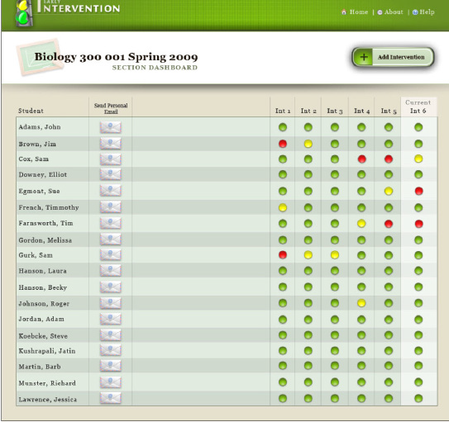
How are they doing?
http://www.itap.purdue.edu/learning/tools/signals/Faculty_Brochure.pdf
http://farm2.static.flickr.com/1075/565921252_bb01deaedb.jpg

Slide 11
Demonstrating value
Library Impact Data Project
Relationship between library use and results
Using a variety of data
Turnstile activity
Library management system
EZProxy service
Student record system
Relationship demonstrated (not causality)
http://library.hud.ac.uk/blogs/projects/lidp/

Slide 12
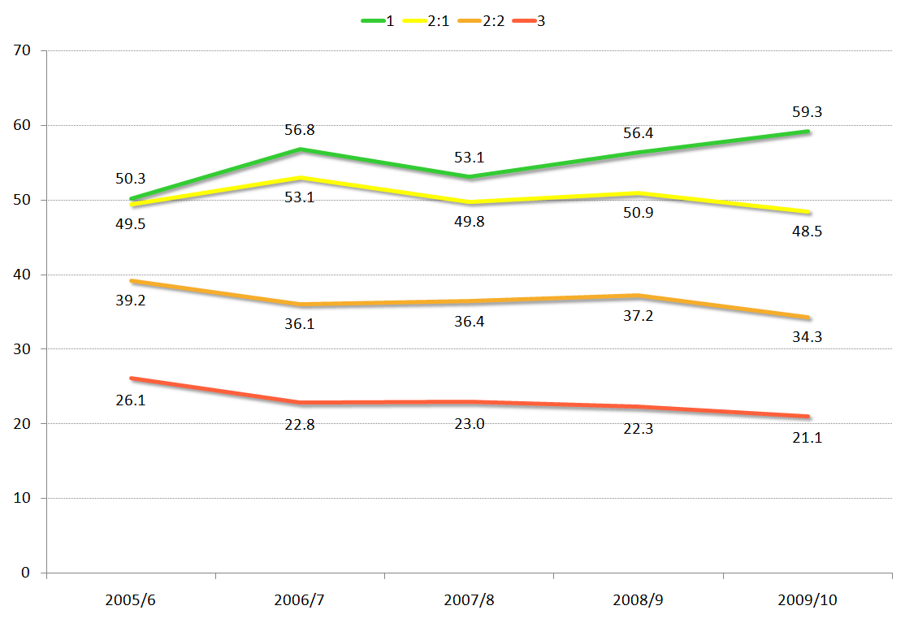
No of books borrowed across degree
Year of graduation
Book borrowing and degree classification
http://library.hud.ac.uk/blogs/projects/lidp/2011/07/15/huddersfield-borrowing-year-on-year/

Slide 13
Supporting students
Exposing VLE data
Identify patterns of behaviour associated with success
Identify students who are struggling
Change academics' attitudes towards the institutional VLE
http://vledata.blogspot.com/

Slide 14

Research impact
Beyond Google Analytics
Increase use of the institutional repository
Help people find the information that they need
People who accessed x also accessed y
People who searched for a accessed b
http://www.jmorganmarketing.com/wp-content/uploads/2010/07/impact_solution_logo.jpg

Slide 15

AEIOU
Across Welsh Repository Network
Recommender system – people who accessed x also accessed y
Increase number of articles accessed per session
Combine with similarity based recommendations
http://techcomtnd.blogspot.com/2010_08_01_archive.html

Slide 16

Resource utilisation
What resources are being used?
By whom?
What are the patterns?
Can you support users to make better use of resources?
Are the subscriptions optimal?
http://www.bbc.co.uk/news/uk-england-kent-12391221

Slide 17

So what could go wrong?
http://www.scenicreflections.com/download/231908/something,somewhere_went_terribly_wrong_Wallpaper/

Slide 18

Data protection
Consent
Data sharing
Anonymisation
Collection purposes
http://www.biz-online.com/wp-content/uploads/2009/01/data_protection-280x300.jpg

Slide 19

Licensing
Data sharing
Who with
For what purpose
Appropriate license
Anonymised data?
http://platformx.sourceforge.net/images/license.jpg

Slide 20
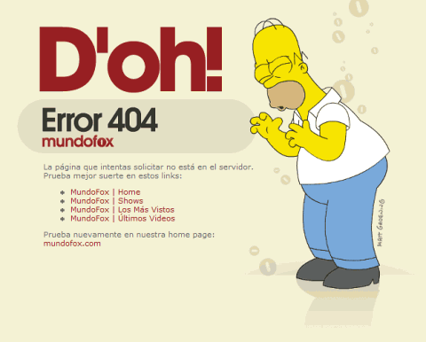

404
Data not being collected
Data not being retained
http://media02.hongkiat.com/error_404_01/24-7media.jpg
http://media.smashingmagazine.com/images/404-error-pages/simp.gif

Slide 21
Library Impact Data Project (LIDP)
Working with eight universities
Several dropped at start as not collecting the information
One dropped as not retained the information

Slide 22

Go home and prepare
Identify some real benefits that could be achieved
Look at the low costs of using the data you are collecting
Determine the benefits
Persuade your boss to fund it
Good luck
http://www.literalmom.com/.a/6a014e86614612970d01538f587561970b-800wi

