Slide 1
Glasgow University Staff Survey 2012 MVLS College Presentation
Ian Black, HR Director
University of Glasgow

Slide 2
Purpose of GU 2012 Staff Survey
1. To measure:
Staff Involvement
Staff Commitment
Staff Wellbeing
2. To determine:
Actions for building on favourable findings
Actions for addressing weaknesses
3. Where possible, to compare with 2009 survey findings
To look for continuous improvement
Restructure has limited 2009 ←→ 2012 comparison

Slide 3
GU Response Rates by College/US
Population as at March 2012
Base: 5,144; reduced from 6,056 to exclude: invigilators; adult education lecturers; tutors etc
Response: 1,780 (33%)
College | Response | Population | Resp. Rate
01.Arts | 147 | 369 | 40%
02.MVLS | 508 | 1739 | 29%
03.Science & Eng | 231 | 835 | 28%
04.Soc Sc | 196 | 532 | 37%
05.University Services | 643 | 1966 | 33%
99.Not Disclosed | 55 | - | -
University Total | 1780 | 5441 | 33%

Slide 4
GU Response Rates by Gender & Job Family
Category | Response | Population | Resp. Rate
Male | 694 | 2502 | 28%
Female | 966 | 2939 | 33%
Not Disclosed | 120 | - | -
University Total | 1780 | 5441 | 33%
1. R&T | 628 | 2116 | 30%
2. MPA | 740 | 1574 | 47%
3. Tech | 125 | 529 | 24%
4. Ops | 181 | 948 | 19%
5. Clinical | 30 | 274 | 11%
99.Not Disclosed | 55 | - | -
University Total | 1780 | 5441 | 33%

Slide 5
MVLS – Response by School etc.
School | Sample n | Population N | % response
RI Biodiv Animal Comp | 29 | 75 | 39
RI Cancer Sciences | 24 | 142 | 17
RI VC & Medical Sc | 40 | 170 | 24
RI Health & Wellbeing | 43 | 164 | 26
RI III | 55 | 278 | 20
RI Mol Cell & Syst Biol | 21 | 102 | 21
RI Neuro & Psych | 28 | 96 | 29
Sch Life Sciences | 24 | 92 | 26
Sch Medicine | 79 | 338 | 23
Sch Vet Med | 36 | 177 | 20
MVLS College Admin | 26 | 105 | 25
Not Disclosed | 103

Slide 6
College Response by Gender & Job Family
MVLS College | Response | Population | Resp. Rate
Male | 188 | 703 | 27%
Female | 302 | 1036 | 29%
Not Disclosed | 18 | - | -
MVLS Total | 508 | 1739 | 29%
R&T | 253 | 805 | 31%
MPA | 151 | 317 | 48%
Tech | 57 | 286 | 20%
Ops | 5 | 58 | -
Clinical | 29 | 273 | -
Not Disclosed | 13 | - | -
MVLS Total | 508 | 1739 | 29%

Slide 7
10 question items used as GU KPIs
KPI Question Item | Measure (%)
KPI 1: Understanding of team aims | VG + Good + Satis
KPI 2: Understanding of performance expectations | VG + Good + Satis
KPI 3: How often praised for a job well done | At least 6 monthly
KPI 4: How often do you discuss with manager how to improve working practices | At least annually
KPI 5: How often given performance feedback | at least annually
KPI 6: How good are communications within your work team | Ex + Good + Satis
KPI 7: how good are communications with other teams in School/RI/S | Ex + Good + Satis
KPI 8: How well are GU-wide changes communicated? | Ex + Good + Satis
KPI 9: I enjoy working in the University | Str Agree + Agree
KPI 10: I feel loyal and supportive to the University | Str Agree + Agree

Slide 8
Average of all GU KPIs 1-10
*Disability Reported or No Disability Reported
**Heterosexual/straight and LGBT, as worded in the questionnaire

Slide 9
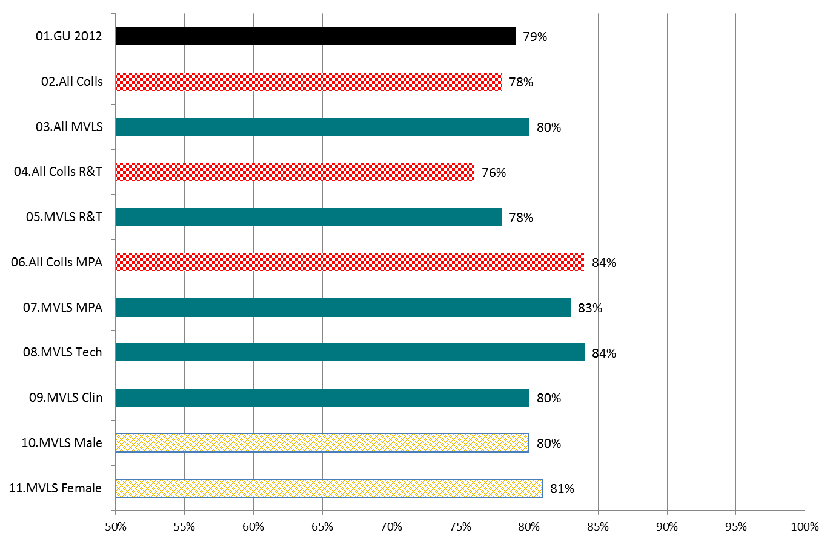
Average of all MVLS College KPIs 1-10

Slide 10
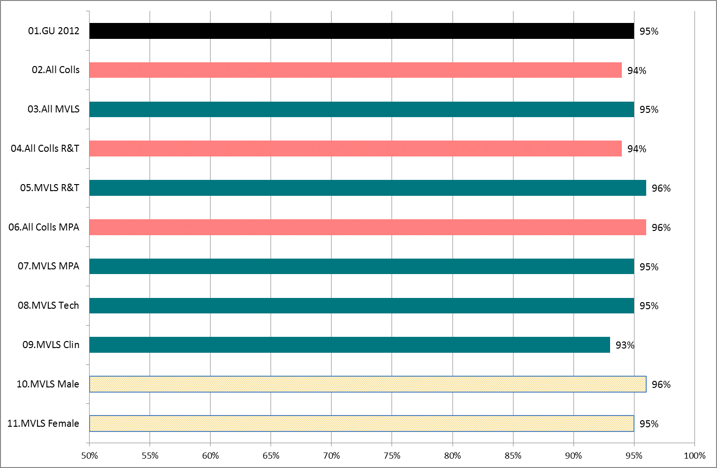
KPI 1: Understanding of team aims (VG + G +S)

Slide 11
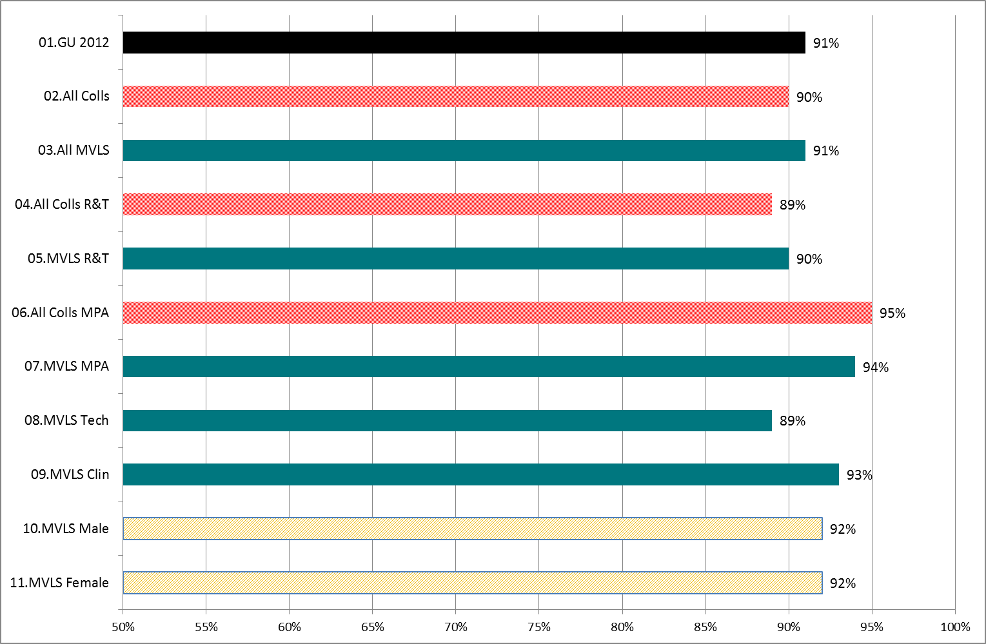
KPI 2: Understanding of performance expectations (VG + G +S)

Slide 12
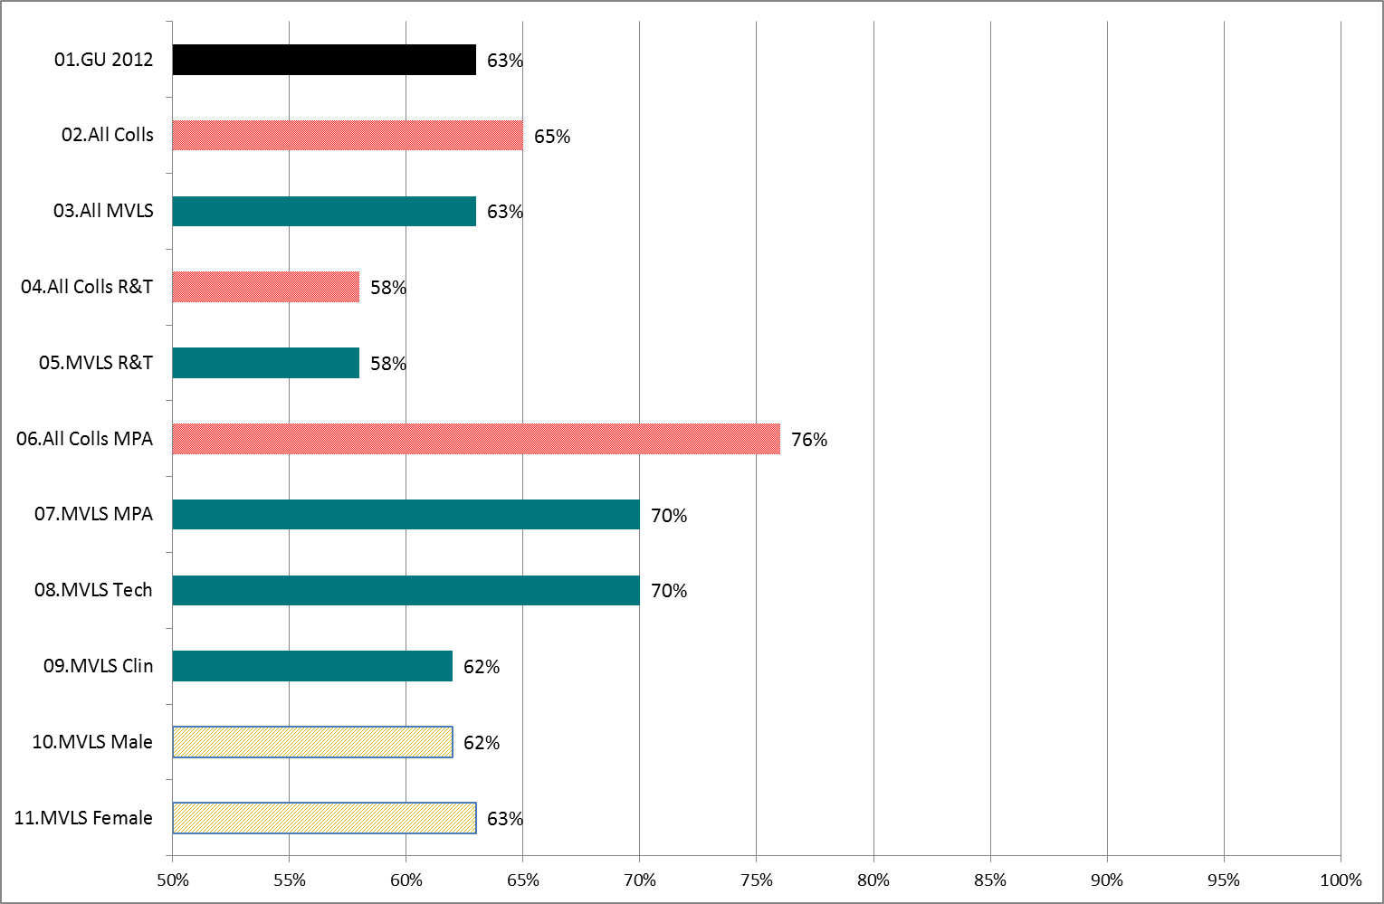
KPI 3: How often praised for a job well done (at least 6-monthly)

Slide 13
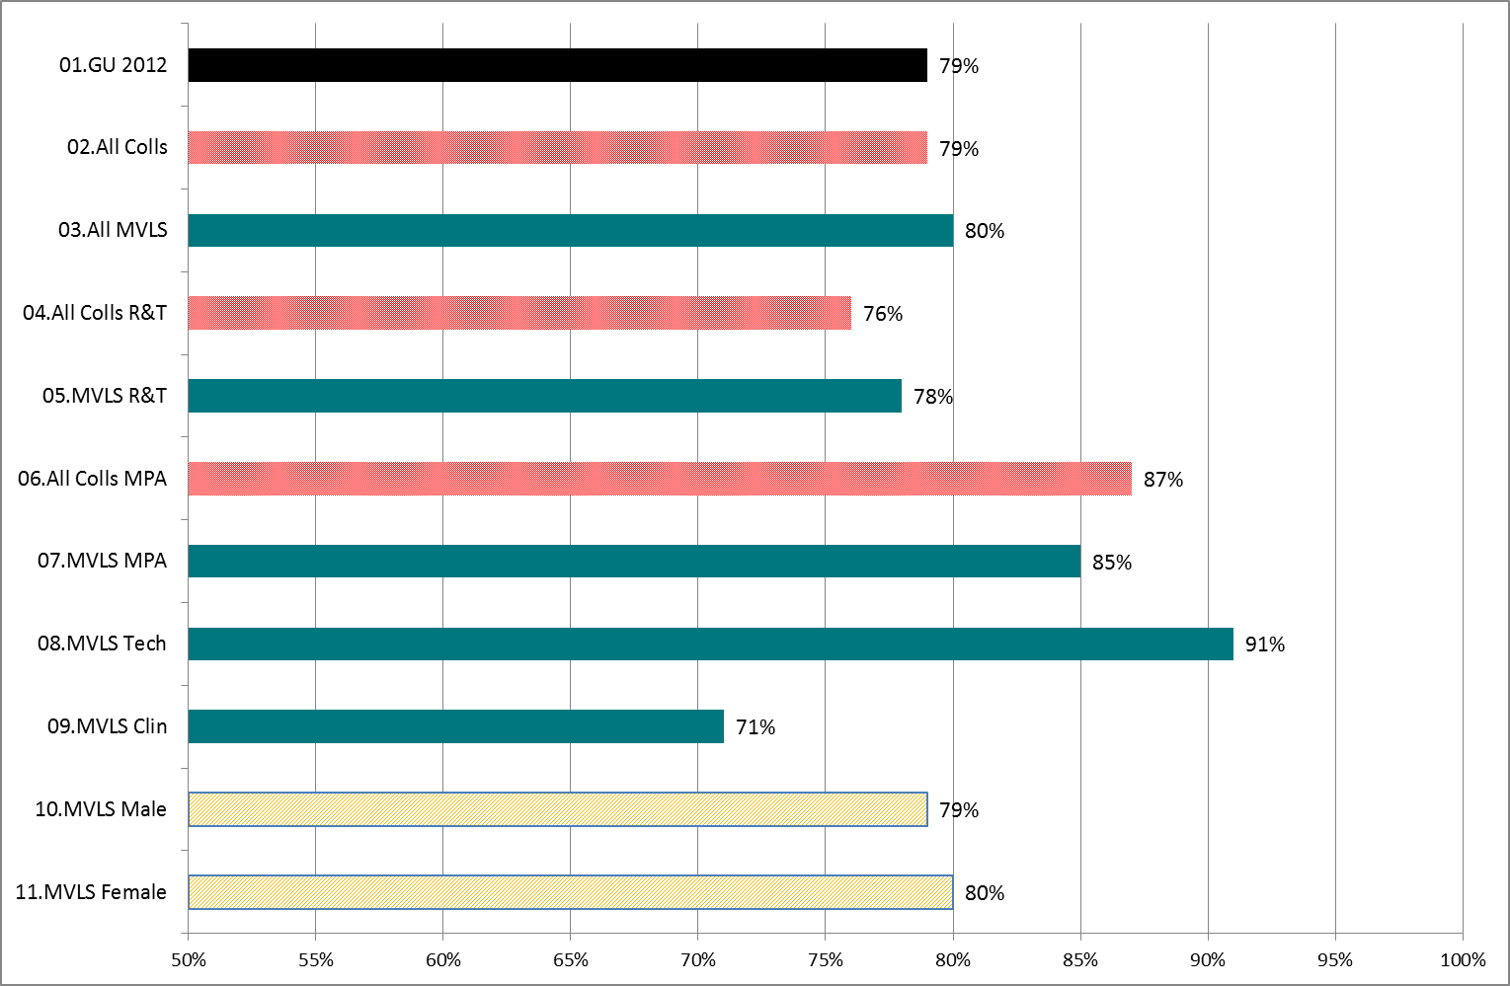
KPI 4: How often discuss working practice (at least annually)

Slide 14
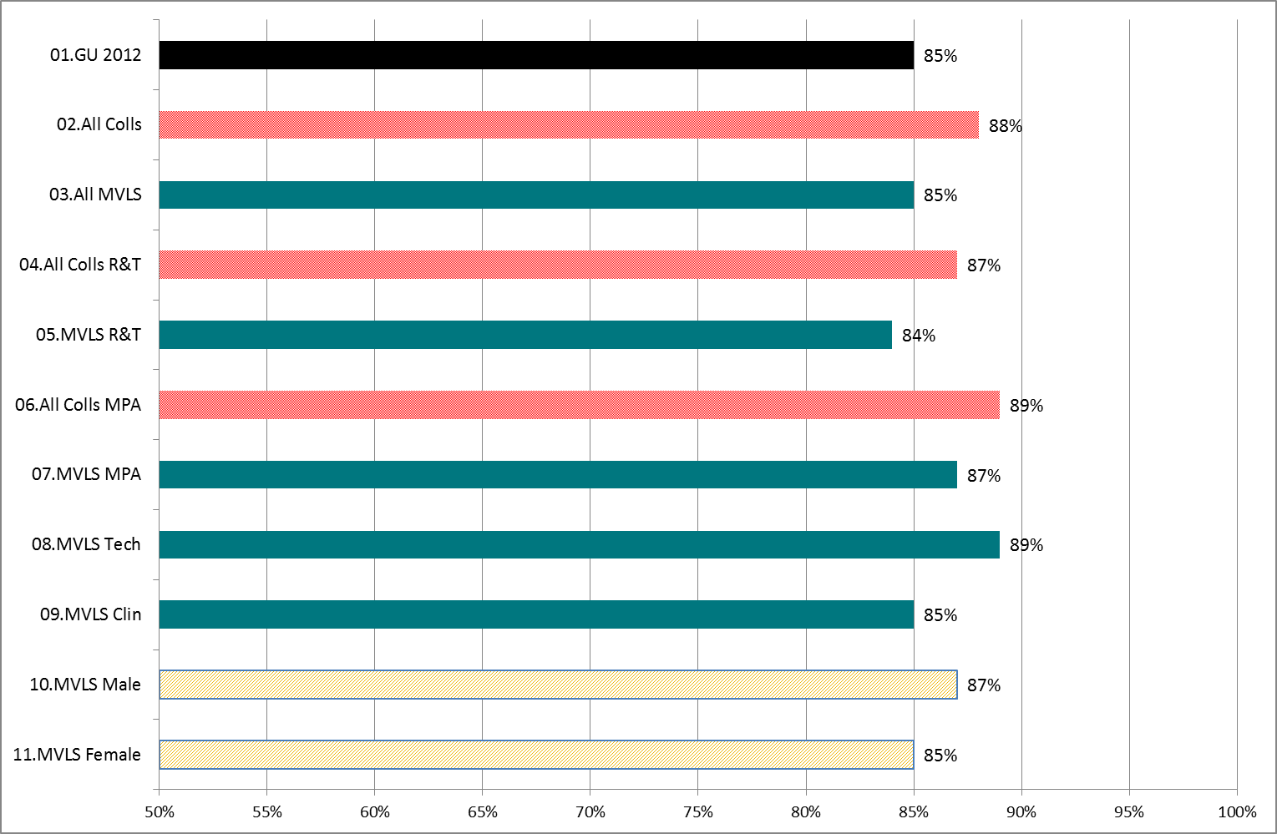
KPI 5: How often given performance feedback (at least annually)

Slide 15
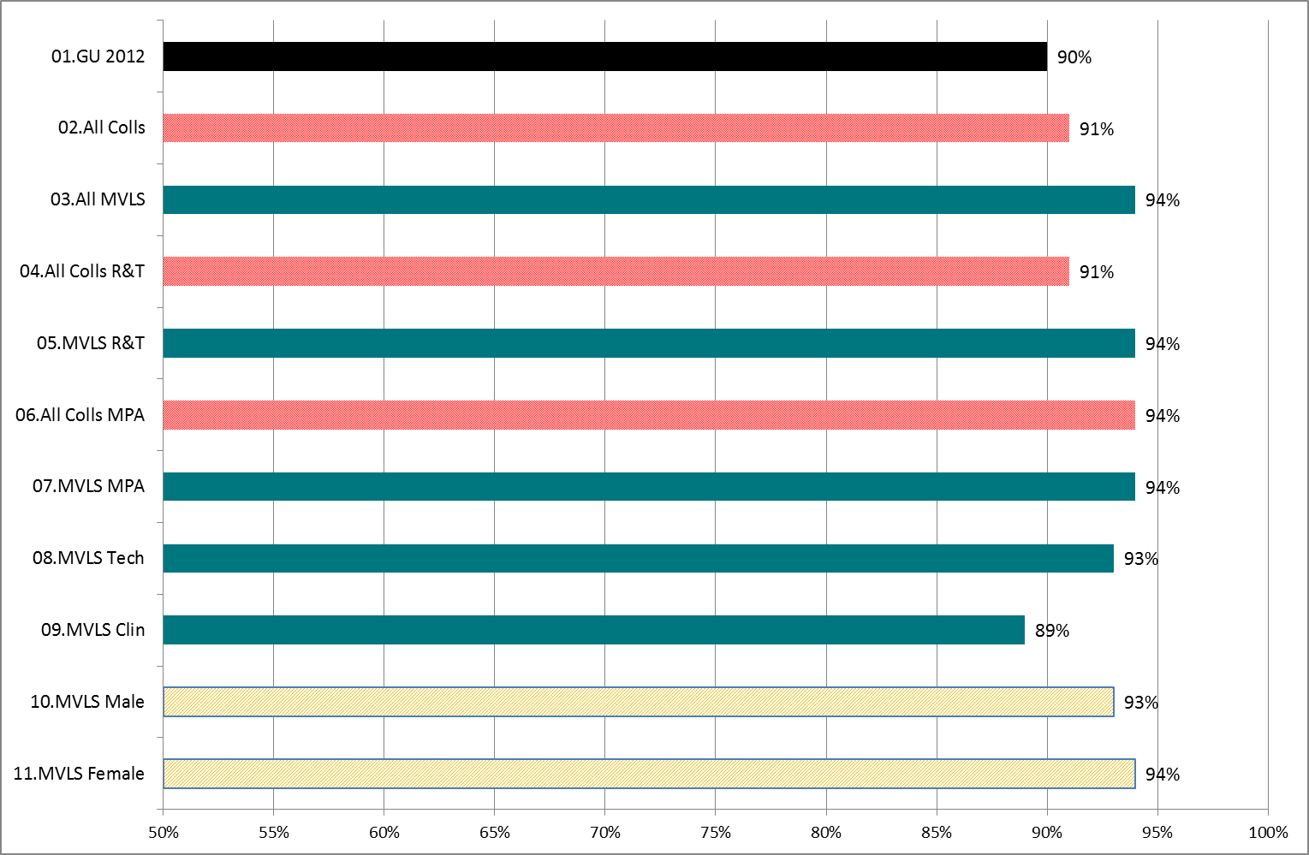
KPI 6: How good are communications within work team (Ex + G + Satis)

Slide 16
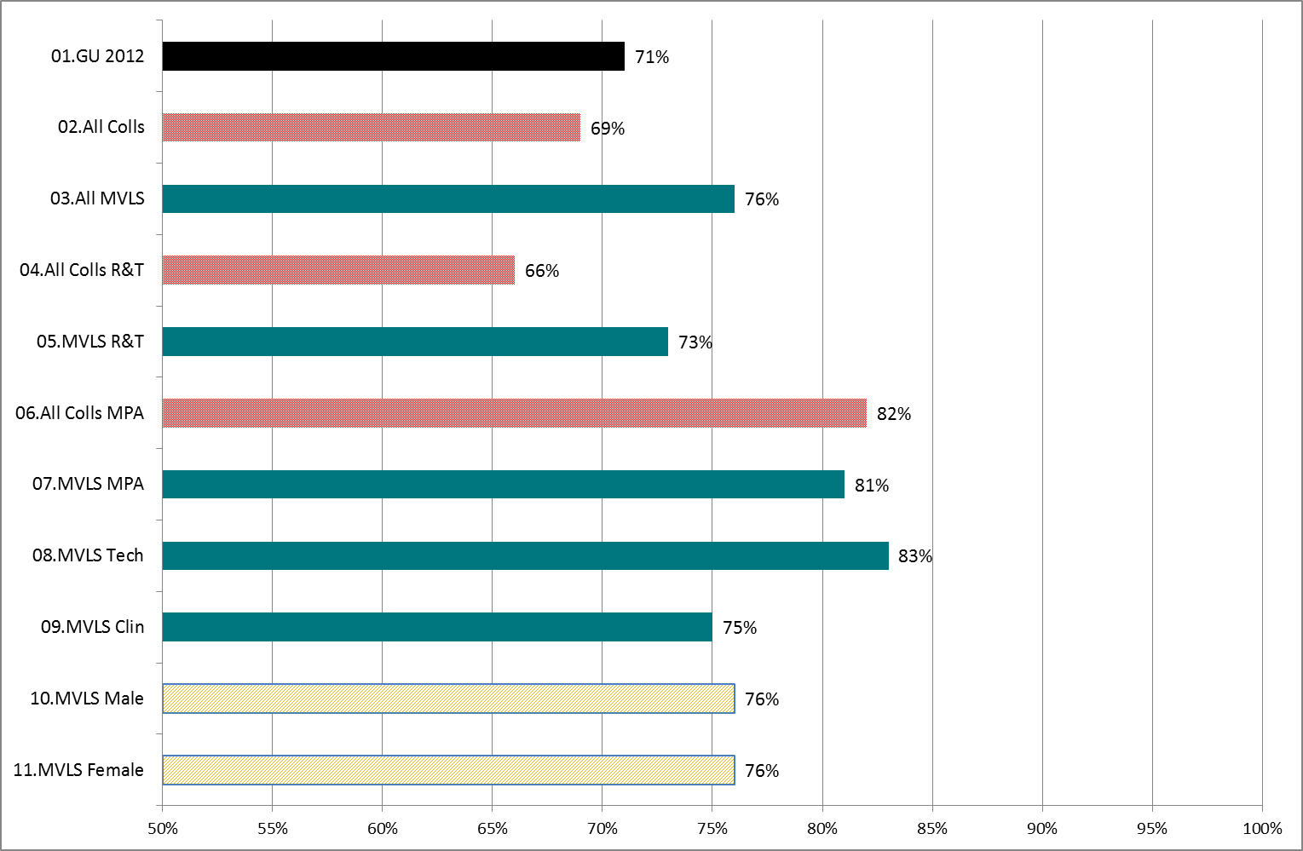
KPI 7: How good are communications with other School/RIs? (E+G+S)

Slide 17
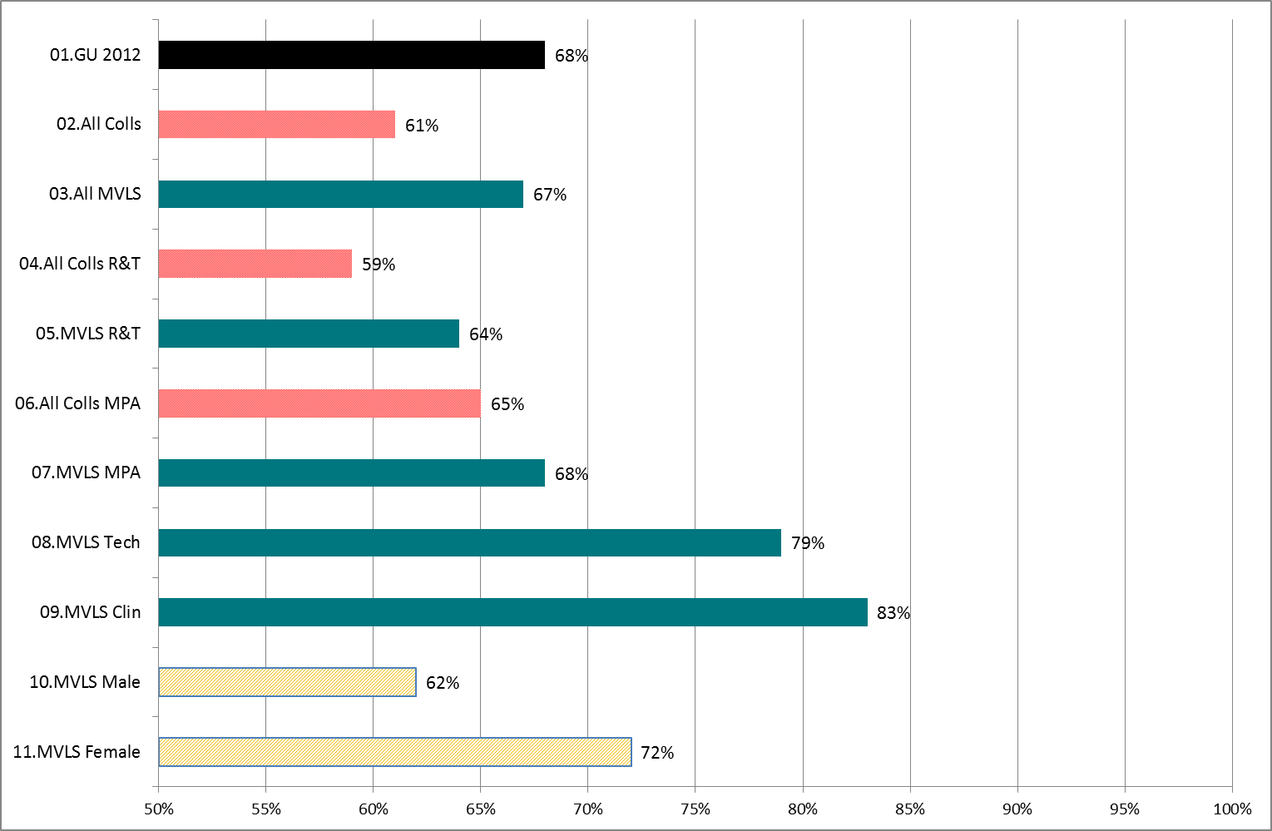
KPI 8: How well are GU-wide changes communicated? (Ex + G + Satis)

Slide 18
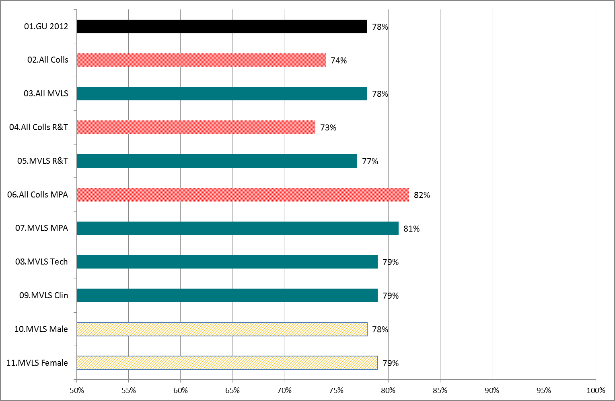
KPI 9: I enjoy working in the University (SA + A)

Slide 19
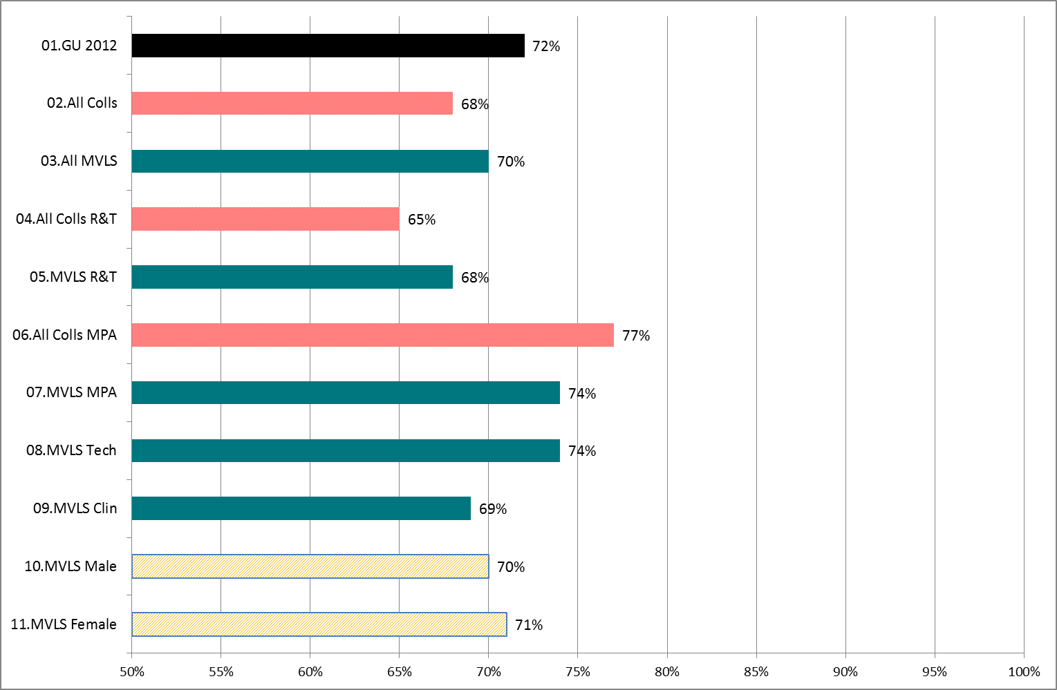
KPI 10: I feel loyal and supportive to the University (SA + A)

Slide 20
HSE Stress Measurement Tool - Findings

Slide 21
HSE UK benchmark for work-related stress
Classifications are derived from HSE survey of 136 UK organisations (2004-10), using their methodology
35 questions measure 7 key work design factors
scored 1-5; 5 is least stress
HSE “traffic light” scoring scheme for 7 factors
Colour | Comment | Range of UK benchmark
 | Doing very well - need to maintain performance | At or above 80th percentile
 | Good, but need for improvement. | 50th- 80th percentile
 | Clear need for improvement. | 20th – 50th percentile
 | Urgent action needed | Below 20th percentile

Slide 22
HSE benchmark factors for work-related stress
 | Red | Yellow | Aqua | Green
Factor (stressor) | Less than | Between | Between | Greater than
1. Demands: workload, work patterns and the work environment | 2.94 | 2.94 - 3.10 | 3.10 - 3.29 | 3.29
2. Control: how much say staff have in the way they do their work | 3.22 | 3.22 - 3.47 | 3.47 - 3.72 | 3.72
3. Support: encouragement, sponsorship, resources provided by:
a. The organisation and line management | 3.27 | 3.27 - 3.46 | 3.46 - 3.65 | 3.65
b. Colleagues | 3.63 | 3.63 - 3.78 | 3.78 - 3.89 | 3.89
4. Relationships: promoting positive working to avoid conflict and dealing with unacceptable behaviour | 3.61 | 3.61 - 3.85 | 3.85 - 4.04 | 4.04
5. Role: whether staff understand role within organisation and whether the organisation ensures they do not have conflicting roles | 4.04 | 4.04 - 4.18 | 4.18 - 4.31 | 4.31
6. Change: how organisational change (large or small) is managed and communicated in the organisation | 2.79 | 2.79 - 3.04 | 3.04 - 3.24 | 3.24

Slide 23
HSE Scores: GU2012 by GU2009, Gender, Job Family
Notes
Stress Factor | GU2012 |  | GU M | GU F | 1.R&T | 2.MPA | 3.Tech | 4.Ops | 5.Clinic
1.Demands | 3.04 |  | 3.03 | 3.10 | 2.65 | 3.18 | 3.43 | 3.62 | 2.82
2.Control | 3.26 |  | 3.28 | 3.27 | 3.27 | 3.27 | 3.26 | 3.22 | 3.21
3a.Managers' Support | 2.87 |  | 2.88 | 2.85 | 2.83 | 2.80 | 2.81 | 3.32 | 2.76
3b.Peer Support | 2.65 |  | 2.71 | 2.58 | 2.57 | 2.52 | 2.59 | 3.50 | 2.42
4.Relationships | 3.76 |  | 3.79 | 3.75 | 3.74 | 3.73 | 3.75 | 3.92 | 3.77
5.Role | 4.15 |  | 4.15 | 4.20 | 4.01 | 4.21 | 4.26 | 4.47 | 4.13
6.Change | 3.06 |  | 3.10 | 2.96 | 3.29 | 2.89 | 2.74 | 3.16 | 2.81

Slide 24
HSE Scores for MVLS College
Notes:
Stress Factor | GU2012 |  | All Colleges |  | 2.MVLS
1.Demands | 3.04 |  | 2.86 |  | 3.00
2.Control | 3.26 |  | 3.27 |  | 3.28
3a.Managers' Support | 2.87 |  | 2.80 |  | 2.79
3b.Peer Support | 2.65 |  | 2.54 |  | 2.54
4.Relationships | 3.76 |  | 3.75 |  | 3.75
5.Role | 4.15 |  | 4.10 |  | 4.13
6.Change | 3.06 |  | 3.07 |  | 2.98

