Slide 1
Introduction to LuaTeX

Slide 2
What is LuaTeX?
An extension of pdfTeX with Lua as an embedded scripting language
Incorporates a number of components:
FontForge font editor (OpenType font loading)
Aleph typesetting engine
METAPOST graphics engine
Poppler (PDF parsing library)
C libraries (PNG, ZIP support)
Plus lots of custom C code to bind together

Slide 3
Some key features of LuaTeX
Lua scripting language
Many more TeX internals now accessible
Access to fundamental structures: node lists
OpenType font support (via fontspec and luaotfload)
Unicode UTF-8 text input/output
epdf library (examining external pdf files)
OpenType math fonts/typesetting
Callback functions: TeX calling your Lua code
Networking functionality
Can extend through plugins (.dll, .so)

Slide 4
The Lua in LuaTeX
complex calculations in Lua, not TeX
pass data to/from LuaTeX engine
“events” in LuaTeX engine call your Lua code
Replace some internal TeX functions with Lua code
Replace file-searching routines with Lua code
Pre-process text for passing into TeX engine
Access to deepest typesetting structures: node lists
Build highly sophisticated PDFs
use external libraries for specialist tasks

Slide 5
The magic of \directlua {}
New primitive provided by LuaTeX
gateway to using Lua/TeX interface
Run Lua code embedded in your TeX document
or stored in external file
\directlua {} is expanded according to TeX rules
then code sent to the Lua interpreter
Watch out for catcodes!
http://wiki.luatex.org/index.php/Writing_Lua_in_TeX

Slide 6
Example of \directlua expansion
\documentclass[11pt,twoside]{article}
\begin{document}
\def\xx{Hello}
\def\yy{(}
\def\zz{)}
\newcommand{\helloTUG}[1]{
\directlua{
function Hello(str)
tex.print(str)
end
\xx\yy#1\zz
}}
\helloTUG{"Hello "}
\end{document}
TeX sees \xx\yy#1\zz and expands it:
\xx → Hello \yy → ( #1 → “Hello ” \zz → )
Lua sees Hello(“Hello ”) and executes
function Hello(str) tex.print(str) end
Lua calls tex.print(“Hello”) LuaTeX typesets some text.

Slide 7
LuaTeX can connect to networks
The luasocket TCP/IP networking library is built into the executable
luasocket features include
HTTP (e.g., web access)
SMTP (sending e-mails)
FTP (uploading and downloading files)
Pull files or data from a server via HTTP/FTP, make calls to databases, call to web services.

Slide 8
Making an HTTP call in LuaTeX
\directlua{
local ltn12 = require("ltn12")
local http = require("socket.http")
function grabtext(httplink)
local tab = {}
local res = http.request{url = httplink,
sink = ltn12.sink.table(tab)}
return tab
end
local t = grabtext("http://your_url_here")
tex.print(t[1])
}
Load the networking modules (luasocket)
Lua function to make an http request
HTTP request to download a text file
Typeset the downloaded file

Slide 9
Using external C/C++ libraries
many open source C/C++ libraries and applications
ImageMagick, GhostScript, FreeType etc
specialist text processing (e.g., XML)
provide your own interface to these libraries
more control, better integration than shell
returns objects/data to use in your Lua code
control/feed results to LuaTeX

Slide 10
Loading a C library with Lua
From version 0.46 LuaTeX supports the loading of external C libraries (Woo Hoo !!!)
.dll (Windows) or .so (Linux etc)
standard Lua rules for loading C libraries apply
Need to tell LuaTeX (kpathsea) where to locate your C library)
need a line in your texmf.cnf
the setting for this variable is CLUAINPUTS
CLUAINPUTS= your_path_to_DLLs

Slide 11
Loading a C library with Lua
\directlua {...
local obj=require(“mymodule")
-- access functions/objects
-- send data to LuaTeX
}
Lua eventually looks for a .dll/.so file
if found, Lua loads the .dll/.so
makes objects/functions available to Lua code
mymodule.dll

Slide 12
Wonderful world of nodes
Nodes are the internal representation of typeset material sitting in TeX’s memory
Many types of node including
glyphs, glue, penalties, kerns, whatsits
Joined together in a linked list
often deeply nested
Extensive features for manipulating node lists
process node lists through recursion

Slide 13
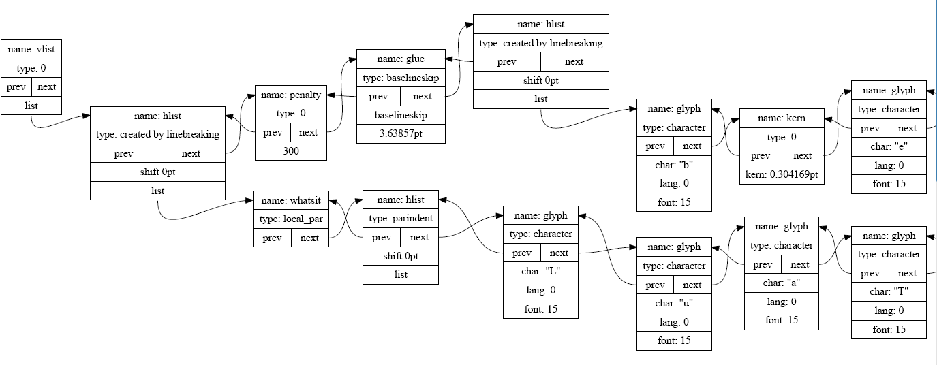
Wonderful world of nodes
Graphical representation of a node list
Processing node lists offers powerful document processing solutions

Slide 14
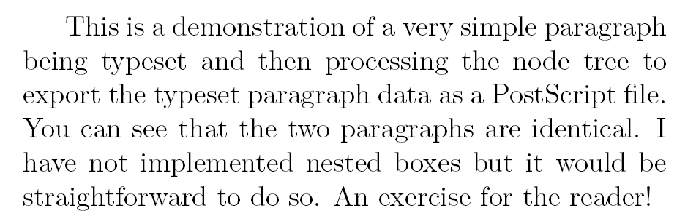
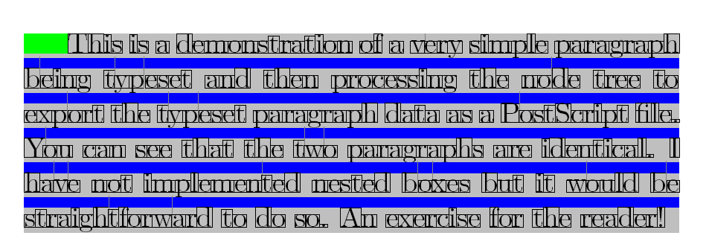
Example: from nodes to PostScript
Paragraph as typeset by LuaTeX
Same paragraph output by walking the node list and exporting PostScript code

Slide 15
Building a minimal LuaTeX installation

Slide 16
Why create your own installation?
Through the process of "rolling your own setup" you can learn a lot
Build a minimal environment for testing and development
fewer unknowns/dependencies
want a non-standard installation on server
you want to stay “bleeding edge” with latest updates
packages undergoing rapid development
Expand as your experience grows

Slide 17
Steps to creating a LuaTeX installation
Obtain a LuaTeX executable file
Appreciate kpathsea’s role
Set up a directory structure (TDS)
Install fonts, and other required files
Create a minimal texmf.cnf file
Hook LuaTeX into your computer environment
Build formats
Ready to go!

Slide 18
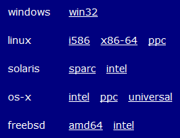
Obtaining a LuaTeX executable
Download binary releases via luatex.org.
Build it yourself from source code
some initial setup (especially Windows)

Slide 19
Building LuaTeX from source code
download a copy of the code repository
using SVN (Apache Subversion) client
Windows: TortoiseSVN is excellent SVN tool
building on Windows needs additional tools
MSYS (Minimal SYStem)
a Bourne Shell command line interpreter
MinGW (Minimalist GNU for Windows)
a minimalist development environment
compile LuaTeX using “build.sh” provided

Slide 20
kpathsea: an introduction
kpathsea is a C library for applications to locate files
“return a filename from a list of directories specified by the user” (texmf.cnf)
locates the files TeX is looking for
fonts, graphics, style files, format files etc
kpathsea included within
the TeX binary, or
a separate compiled library

Slide 21
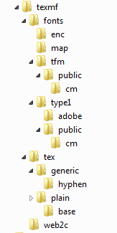
Set up the directory structure (TDS)
This is a minimal “plain” TeX setup
TeX requires many different files to process a document
Need to organise them into a manageable directory structure
Could create your own, but preferable to follow best practice
Use the TeX Directory Structure (TDS)
Even if you are building an experimental installation of LuaTeX
You’ll be glad you followed the rules!

Slide 22
Installing fonts, and other files required
But where do you get the files you need...?

Slide 23
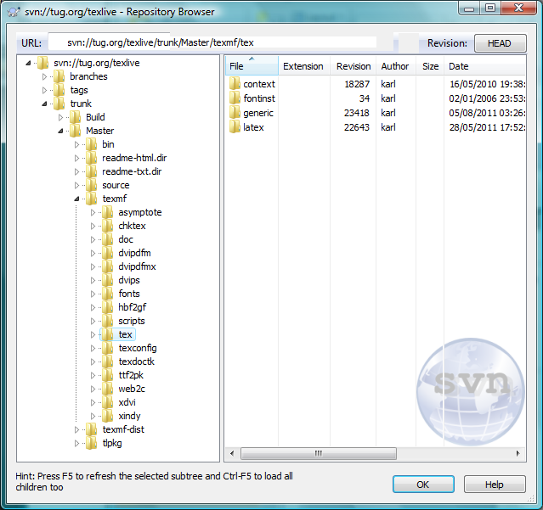
From TeX Live

Slide 24
Piecing it all together
At this point you have
a LuaTeX executable
a TeX directory structure
a lot of files
Is that all you need to do?
No, provide kpathsea with a starting point
set the TEXMFCNF environment variable
location of the vital texmf.cnf file
Also set up your computer’s PATH variable

Slide 25
Set environment variables
TEXMFCNF=<path to texmf.cnf>
Enable kpathsea debugging environment variables:
KPATHSEA_DEBUG_OUTPUT=/home/graham/kspsluatex.log
KPATHSEA_DEBUG=-1
value of -1 logs everything!

Slide 26
Minimal texmf.cnf for plain TeX
TEXMF=/home/graham/texmf
WEB2C=$TEXMF/web2c
TEXINPUTS = .;$TEXMF/tex//
TEXFONTMAPS = $TEXMF/fonts/map
TEXFORMATS=$TEXMF/web2c
TFMFONTS = $TEXMF/fonts/tfm//
T1FONTS = $TEXMF/fonts/type1//
ENCFONTS = $TEXMF/fonts/enc

Slide 27
Other kpathsea goodies
It sets some useful environment variables
defining paths of the executable:
SELFAUTOLOC → location
SELFAUTODIR → parent directory
SELFAUTOPARENT → grandparent directory
to find these values
\directlua{ tex.print(os.getenv("SELFAUTOLOC")) }

Slide 28
Building formats for LuaTeX
A format file is a compiled macro package
fast loading of macro packages
TeX’s “binary brain dump”
Created by putting TeX into a special “mode”
via the command line
Once built, re-use for processing your .tex files

Slide 29
Defining your format
Create a small file to pull in everything required to build the format
also can set defaults/options
I called mine “luaplain.ini”
\input plain
\directlua {tex.enableprimitives('', tex.extraprimitives())}
\dump

Slide 30
Enabling LuaTeX’s extra commands
The raw luatex executable understands a limited set of commands
TeX82 primitives plus \directlua{...}
“switch on” the other primitives
\directlua { tex.enableprimitives('', tex.extraprimitives()) }
Details in the LuaTeX Reference Manual

Slide 31
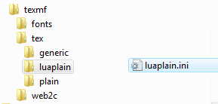
And finally...
Place luaplain.ini where LuaTeX can find it
Run the command line “luatex –ini luaplain.ini”
this creates luaplain.fmt
move luaplain.fmt to web2c
Create a folder for your format in the TDS tree

Slide 32
And really finally...
Use your format file luaplain.fmt to run luatex
luatex --fmt=luaplain myfile.tex

