Slide 1

Delusional Economics and the Economic Consequences of Mr Osborne
Fiscal Consolidation: Lessons from a century of UK macroeconomic statistics
Ann Pettifor, 24 February, 2012
Radical Statistics Conference, London
POLICY RESEARCH IN MACROECONOMICS

Slide 2


Slide 3
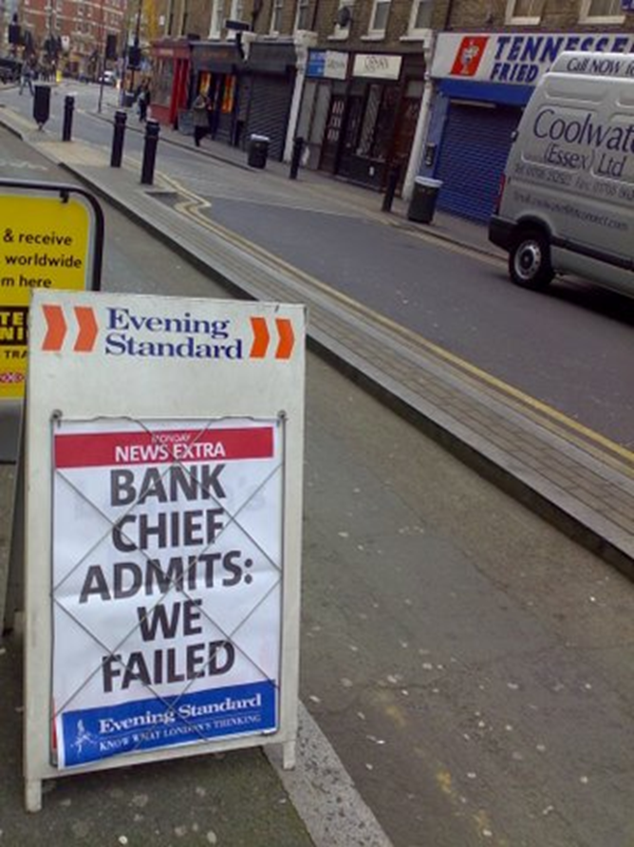

Slide 4


“The UK is in the midst of what is set to be the longest – and among the most costly – of its depressions in over a century.
The characteristic of this depression, compared with its predecessors, is the frightening weakness of the recovery phase.” Martin Wolf Financial Times 1 September, 2011

Slide 5
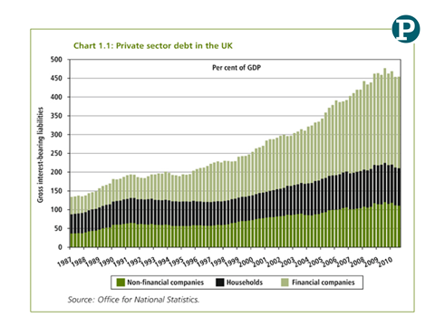

Slide 6
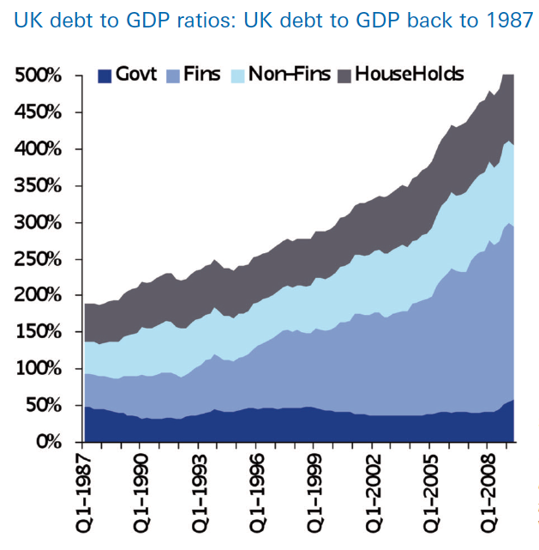

Slide 7
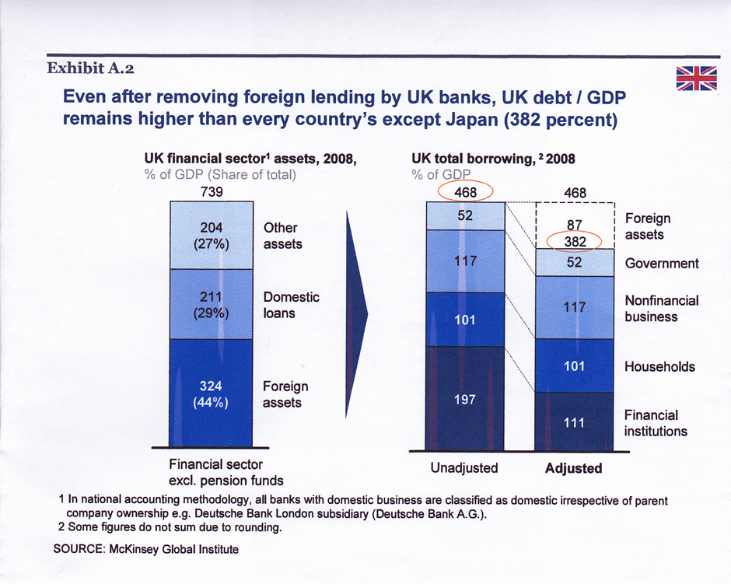

Slide 8
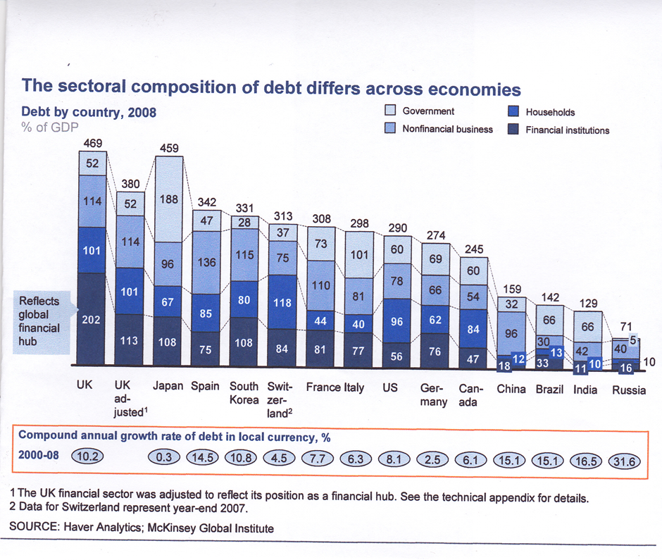

Slide 9

Consensus: There must be a ‘plan to cut the deficit’.

Slide 10
The question begged: will expenditure-cutting (and tax-raising) cut the deficit?

Slide 11
Debate not between cutters and postponers…
Not between deficit-cutting and stimulus….
But between expenditure-cutting and stimulus.

Slide 12

Because government not in a position to control its own deficit/surplus – unlike you or me.

Slide 13
You and I are small beer. If we want a surplus we cut our expenditure or raise our income. What we do is not important to the economy at large – unless everyone else does the same.

Slide 14
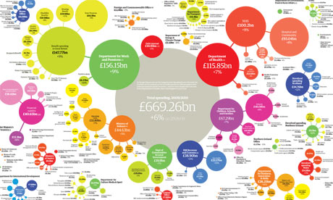
Government spending too important for that. The size of the budgetary outcome depends on plans of the entire economic system and its reactions to the government’s plans.

Slide 15
Fundamental error: it is not possible to assess the stance of fiscal policy from estimates of the public sector deficit.

Slide 16
An expansionary fiscal policy leads to growth in activity and employment, so that, in a recession, high public sector expenditure reduces debt, and hence the deficit.

Slide 17
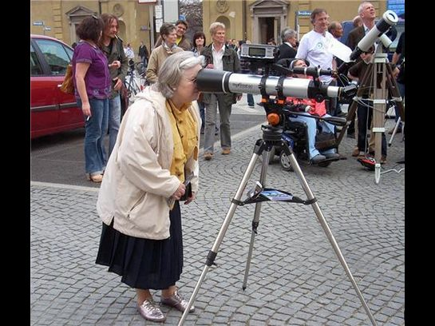

Slide 18

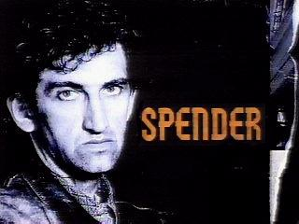
Who will cut the deficit?
OR

Slide 19
Major risk:
using
microeconomic reasoning
to predict
macroeconomic outcomes.

Slide 20
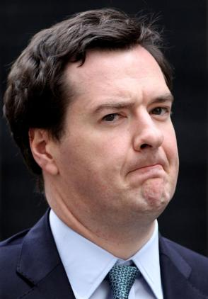
“ Britain has a £109bn a year structural deficit. Let me tell you what a structural deficit is. ……..It's like with a credit card. The longer you leave it, the worse it gets.”
Conservative Party Conference 4 October, 2010.

Slide 21
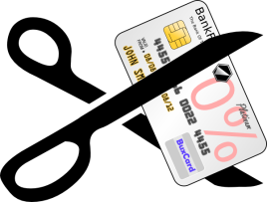
Differences between government budget and credit card balance:
Govt can cut spending, but can’t cut its deficit – credit card holder can.

Slide 22
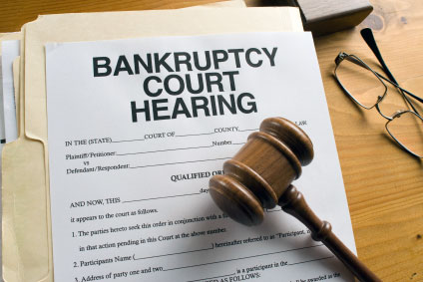
2. Government can’t go bankrupt – credit card holder can.

Slide 23

3. Government spending generates income (taxes) and saves on benefits and interest rates. Not so for credit card spender.

Slide 24
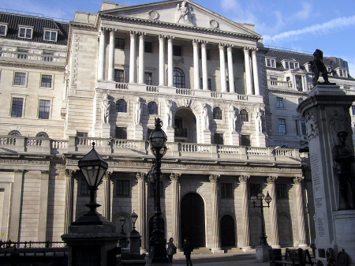
4. Government can conjure money out of thin air – ‘Quantitative Easing’.
Credit
card holder
can’t!

Slide 25
Delusional economists: “Banks don’t create credit.”
Keynes: lending creates deposits.
Monetarists: deposits create loans.

Slide 26
Orthodox mistake no 1: Money understood as a commodity….subject to ‘supply & demand’ ‘marginal utility’ etc…. ‘stock’ ‘velocity’… ‘circulate’

Slide 27
Orthodoxy:
“ We can only afford what is already in the bank in the form of savings/deposits/gold.”

Slide 28
“If you’re living high on that cheap credit hog/Don’t look for cure from the hair of the dog/Real savings come first if you want to invest”
The Hayek vs Keynes rap
“Fear the Boom and Bust”
http://www.youtube.com/watch?v=d0nERTFo-Sk&feature=player_embedded

Slide 29
Keynes: Credit creates economic activity
Economic activity generates income

Slide 30
Keynes: Income generates deposits/savings/tax revenues
With which to repay debt….

Slide 31
JM Keynes (and Adam Smith/John Law/Benjamin Franklin/Joseph Schumpeter/President Roosevelt/ JK Galbraith):
“Credit creates savings/
deposits”
Economic activity generates saving, it is not constrained by saving.

Slide 32
“What we can create,
we can afford.”
JM Keynes
“National Self-Sufficiency” The Yale Review, Vol 22, no4 (June 1933), pp.755-769

Slide 33
In monetary economies, the relevant consideration is the availability of finance, not savings, and there need be no constraint on finance

Slide 34
Credit, unlike gold or oil, not a commodity and so not subject to the laws of supply and demand. There need be no limit to its creation.

Slide 35
Because credit not subject to supply and demand, its price – or the rate of interest – necessarily a social construct, and should be low.

Slide 36

Therefore: employment not constrained by finance/income: income is only earned through employment.

Slide 37

Using QE, the BoE in 2009 created between £175 and £200 billion of new credit. It was not borrowed from anyone, nor was it raised in taxes. It was simply created ‘out of thin air’.
www.primeeconomics.org

Slide 38
This new money used to buy up gilts (government bonds) from investment banks.
The banks receive new money (deposits) brought into existence through QE.
www.primeeconomics.org

Slide 39
Between March 2009 and January 2010, the MPC authorised the purchase of £200 billion worth of assets, mostly gilts – UK Government debt.
www.primeeconomics.org

Slide 40
The MPC voted to begin further purchases of £75 billion in October 2011….
www.primeeconomics.org

Slide 41
and, subsequently, at its meeting in February 2012 the Committee decided to purchase £50 bn
to bring total asset purchases to
£325 bn.
www.primeeconomics.org

Slide 42

"The creation of new gilts by the government has actually - net - more than matched the pace of purchases by the Bank of England since we started buying in the early part of 2009".
David Miles MPC Member, 23 February, 2012.

Slide 43
Government deficit, therefore financed by domestic finance. Giving lie to: ‘International/markets/bond holder vigilantes threatening to raise interest rates’

Slide 44
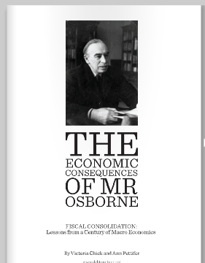
Research by PRIME economists : Fiscal consolidation (spending cuts) increases rather than cuts the level of public debt as a share of GDP….

Slide 45
Note:
Public expenditure is measured as the final consumption and fixed capital formation of central and local government; transfer payments are deliberately excluded;
public debt is measured as a share of GDP;
interest rate figures are for the yield on long-term government bonds; and
the unemployment rate is used as the measure of labour market performance

Slide 46
Annual Average % Change in Govt. Finances
Period | Expenditure | Debt
1909 -13 | 4.3 | -1.5
WW1 1913-18 | 62.7 | 17.4
1918-23 | -20.9 | 13.2
1923- 31 | 2.2 | -0.9
1931-3 | -5.4 | 5.0
1933-39 | 18.3 | -7.0
WWII 1939-44 | 38.1 | 10.6
1947-76 | 10.1 | -6.8%
1976-2009 | 7.6 | 0.4

Slide 47
Public Spending expands 1909 – 13
Year | Public Expen £ Million | Exp as % of GDP | Public Debt as % of GDP | Interest Rate | Real GDP growth | Unemploy ment rate
1909 | 197 | 9.2 | 33 | 3.0 | 3.3 | 7.7
1910 | 206 | 9.2 | 33 | 3.1 | 3.5 | 4.7
1911 | 211 | 9.1 | 30 | 3.2 | 2.3 | 3
1912 | 221 | 9.3 | 29 | 3.3 | -0.3 | 4
1913 | 233 | 9.3 | 27 | 3.4 | 5.2 | 3.6

Slide 48
Contraction: post-WW1 and the ‘Geddes Axe’, 1918-23
Year | Public Expen £ million | Money GDP £ mill | Expend iture as % of GDP | Public Debt as % of GDP | Interest Rate | Unemploy ment rate
1918 | 1850 | 5243 | 35.3 | 114 | 4.4 | 0.8
1919 | 968 | 6230 | 15.5 | 136 | 4.6 | 6
1921 | 648 | 5134 | 12.6 | 150 | 5.2 | 16.9
1923 | 483 | 4385 | 11.0 | 180 | 4.3 | 11.7

Slide 49
Public Spending expands: 1933-39
Year | Pub Expen £ Mill | Nom GDP | Expen as % of GDP | Public Debt as % of GDP | Interest Rate | Unemployment Rate
1933 | 514 | 4259 | 12.1 | 183 | 3.4 | 19.9
1935 | 591 | 4721 | 12.5 | 168 | 2.9 | 15.5
1937 | 782 | 5289 | 14.8 | 150 | 3.3 | 10.8
1939 | 1359 | 5958 | 22.8 | 141 | 3.7 | 9.3

Slide 50
Average over years | 1947-1976 | 1976-2009
Govt expend (%of GDP) | 22.7 | 22.5
Change in public debt (%) | -6.8 | +0.6
GDP (real growth) | 2.7 | 2.2
Unemployment | 2.3 | 7.7
Real interest rate | 0.9 | 2.5
The
Long
Expansion

Slide 51
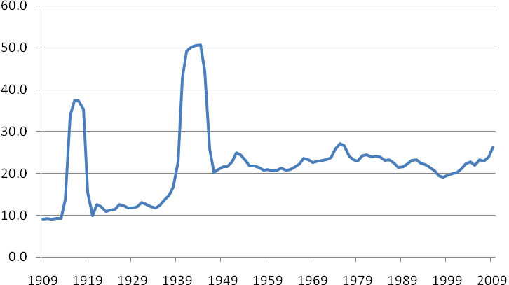
Public Expenditure as a percentage of GDP

Slide 52
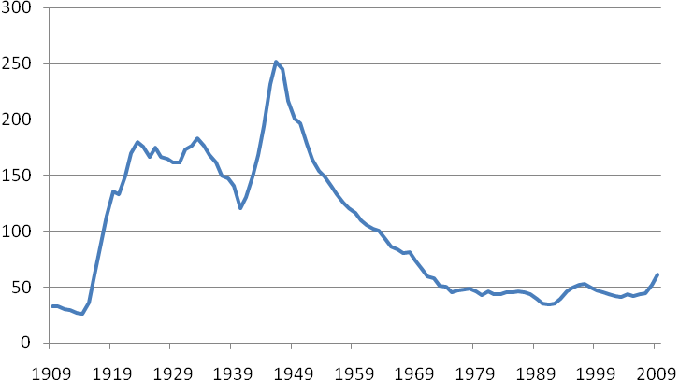
UK Public Debt as % of GDP

Slide 53

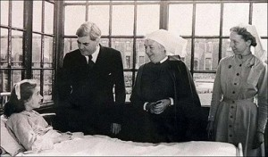
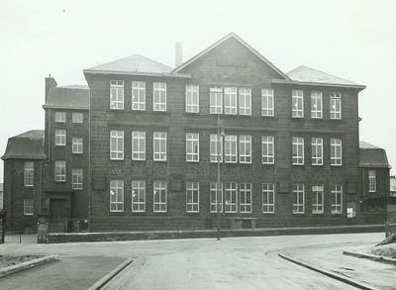
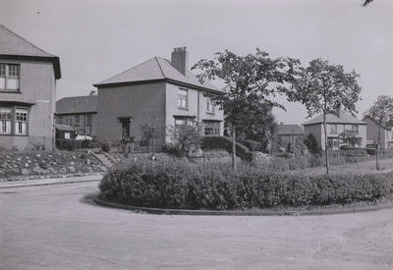
1946: Labour Govt Spending
NHS
Public Housing
Butler Education Act 1944

Slide 54
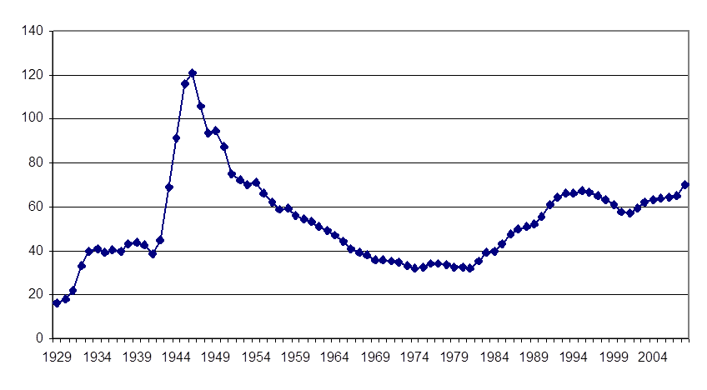
US Public Debt as % of GDP (Source Fed Reserve)

Slide 55


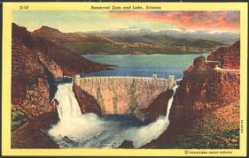


Slide 56
IMF World Economic Outlook, Sept 2011. Chap 1: Public debt as % of GDP 1950-2016.

Slide 57
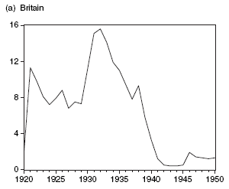
Outcome? unemployment rates
Notes:
In a sense these were his preventative measures, implemented as part of the cure.
Unemployment finally began to improve only after gold. UK 33 & US 34
Certainly they were necessary. But they were probably not sufficient – have Keynes’s explicit testimony in the GT.
Nonetheless the context for any new deal spending is this escape from gold and the new monetary environment.

Slide 58
Since government can’t control the deficit, trying to reduce the deficit is looking at the problem in the wrong way …..

Slide 59

The way to reduce a deficit in a time of unemployment, climate change and peak oil is to spend (preferably wisely on e.g. green technology) to promote energy security, climate security and job security.
The Green New Deal (new economics foundation)

Slide 60

Keynes looked through the telescope the right way round: ‘Look after the unemployment, and the budget will look after itself.’

Slide 61
Recommended Reading:
“The Economic Consequences of Mr Osborne” – Professor Victoria Chick (University College, London) and Ann Pettifor (PRIME). (www.primeeconomics.org)
“The Cuts Won’t Work” – Green New Deal Group (including Ann Pettifor) published by the new economics foundation. (www.neweconomics.org)

Slide 62
Keynes Betrayed – Geoff Tily. Palgrave Macmillan, 2010.
The Coming First World Debt Crisis – Ann Pettifor, Palgrave Macmillan, 2006.

