Slide 1
“Credit Card Maxed Out”? How UK debt statistics have been misrepresented
Howard Reed
Landman Economics
Radical Statistics Conference
24 February 2012

Slide 2
The Coalition story
UK deficit and debt out of control because of Labour overspending
Unsustainable by May 2010 – risking increase in government borrowing costs
Severe austerity – eliminating the “structural” deficit over the course of this parliament –only course of action left to the UK
This will enable sustainable private-sector growth

Slide 3
Austerity in one sentence
“If you have maxed out your credit card, if you put off dealing with the problem, the problem gets worse.”
(David Cameron, June 2011)
Notes:
Similar statements from Osborne and Clegg

Slide 4
Putting the record straight
Every part of the Coalition story is at least partially (and in many cases wholly) wrong
Austerity is a disaster
So why is the narrative so pervasive?

Slide 5
Labour overspending?

Slide 6
Labour overspending?

Slide 7
Labour overspending?

Slide 8
Overspending? No… tax revenue collapsed!
Current spending and tax revenue tracked closely prior to 2007-08
The Great Recession of 2008 caused a collapse in tax revenues
Labour was not overspending before 2007-08
Spending after 2007-08 was essential to avoid deepening economic depression (stablisers, stimulus)…

Slide 9
Unsustainable debt?

Slide 10
Unsustainable debt?

Slide 11
Unsustainable debt?

Slide 12
Debt interest payments

Slide 13
Is austerity the solution?
A simple formula:
D_{t+1}= ((r – g) × D_{t}) + d_{t}
Where:
D : debt/GDP ratio
r : real interest rate on debt servicing
g : real growth rate of GDP
d : deficit as proportion of GDP
t, t+1: years

Slide 14
Is austerity the solution?
D_{t+1}= ((r – g) × D_{t}) + d_{t}
Starting from a steady state of constant debt year-on-year, D will grow if:
The real interest rate rises
Growth falls
The deficit rises

Slide 15
An illustration: OBR govt debt/GDP forecasts (%)
Fiscal Year | June 2010 Budget | Nov 2011 Autumn statement
2011/12 | 67.2 | 67.5
2012/13 | 69.8 | 73.3
2013/14 | 70.3 | 76.6
2014/15 | 69.4 | 78.0
2015/16 | 67.4 | 77.7
2016/17 | - | 75.8

Slide 16
An illustration: OBR GDP growth forecasts (%)
Calendar Year | June 2010 Budget | Nov 2011 Autumn statement
2011 | 2.3 | 0.9
2012 | 2.8 | 0.7
2013 | 2.9 | 2.1
2014 | 2.7 | 2.7
2015 | 2.7 | 3.0
2016 | - | 3.0
Notes:
Growth is coming up hugely short.

Slide 17
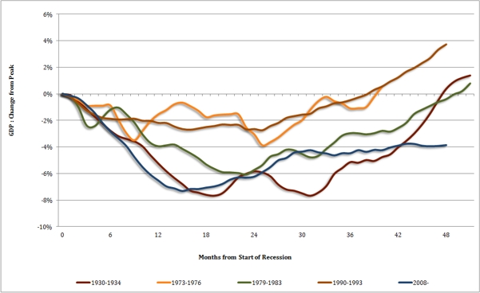
UK now doing worse than 1930s

Slide 18
A similar story in Europe
IMF forecasts for the Eurozone (% GDP growth):
Date | 2012 | 2013
Apr 2011 | 1.8 | -
Jun 2011 | 1.7 | -
Oct 2011 | 1.1 | -
Jan 2012 | -0.5 | 0.8

Slide 19
Costs of austerity
High unemployment – human costs now, and ‘scarring’ later
Spending cuts strongly regressive (see my paper with Tim Horton in last year’s RadStats conference papers)
Collapse in investment (both govt and private sector)
Increasing consumer debt

Slide 20
Stupidity or malice?
The economics don’t support the case for austerity
But I don’t think (Conservative) politicians are stupid – rather, they are using the crisis to advance a (pre-existing) small-state agenda

Slide 21
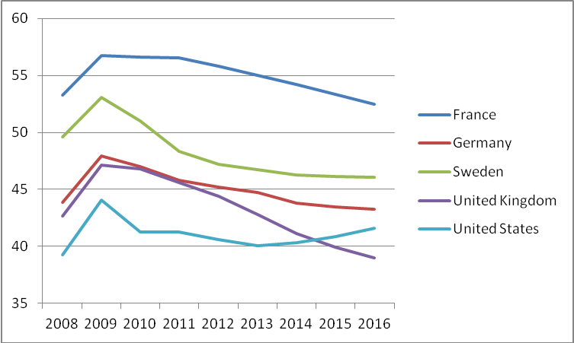
UK spending/GDP will fall below USA by 2015
Source: IMF referenced in Taylor-Gooby (2011)

Slide 22
How are they getting away with this?
‘maxed out credit card’ line seems logical at first glance (return of “handbag economics”)
The media are (mostly) sympathetic
Opposition within Parliament is weak
The crisis was “spun” as one of govt debt rather than one of unsustainable private sector growth model (out-of-control financial sector, extreme volatilty, bubbles, debt etc.)

