Slide 1


EPrints Preservation

Slide 2
The 3-stage repository model
Get Content
(Ingest)
Manage Content
Serve Content
Appraise & Select
Store
Index
Preservation - Check
Locate
Ingest
Retrieve
Preservation - Analyse
Preservation - Action
Dispose

Slide 3
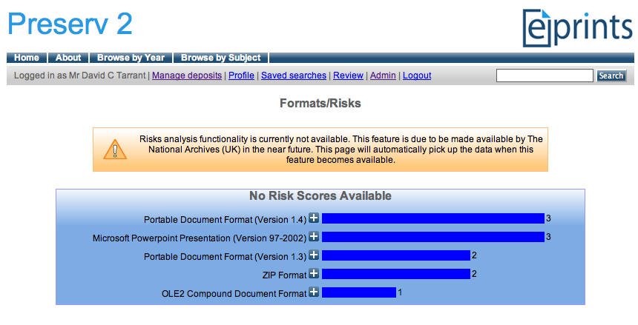
File Format Analysis
Preservation - Analyse
EPrints File Classification

Slide 4
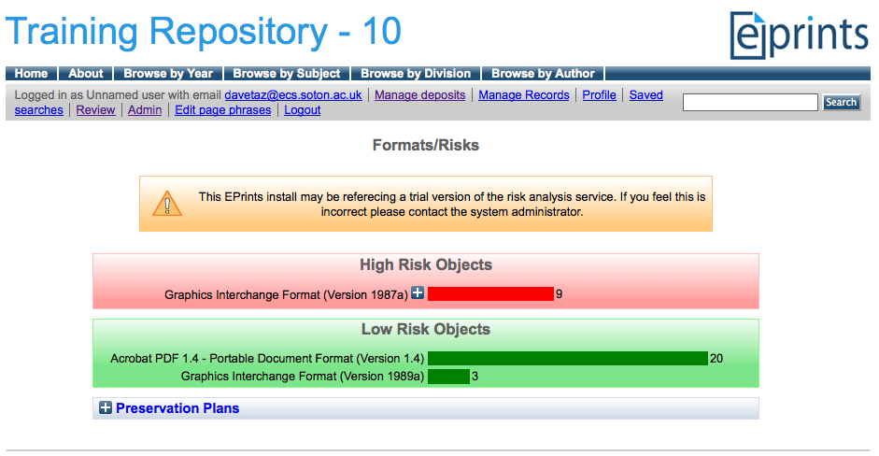
Risk Analysis In EPrints
Risk Analysis
Preservation - Analyse
EPrints File Classification + Risk Analysis

Slide 5
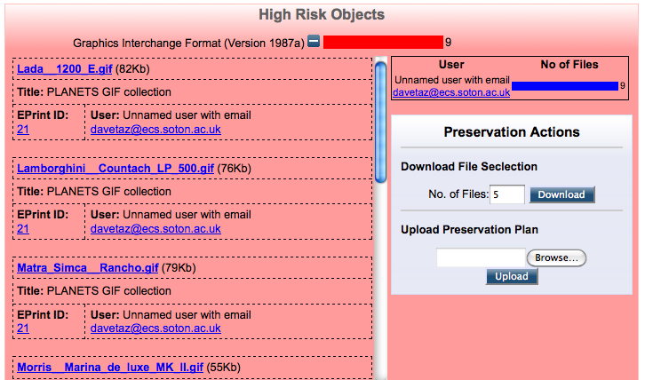
Risk Analysis In EPrints - Detailed View
Risk Analysis
Preservation - Analyse
EPrints File Classification + Risk Analysis

Slide 6
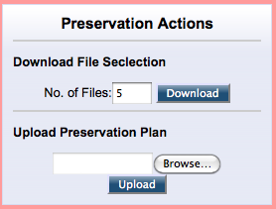
Collection Gathering
If more than 1 file requested:
Provide Newest and Oldest
If morn than 3 files requested:
Also provide Largest and Smallest
Then
Provide a random selection

Slide 7
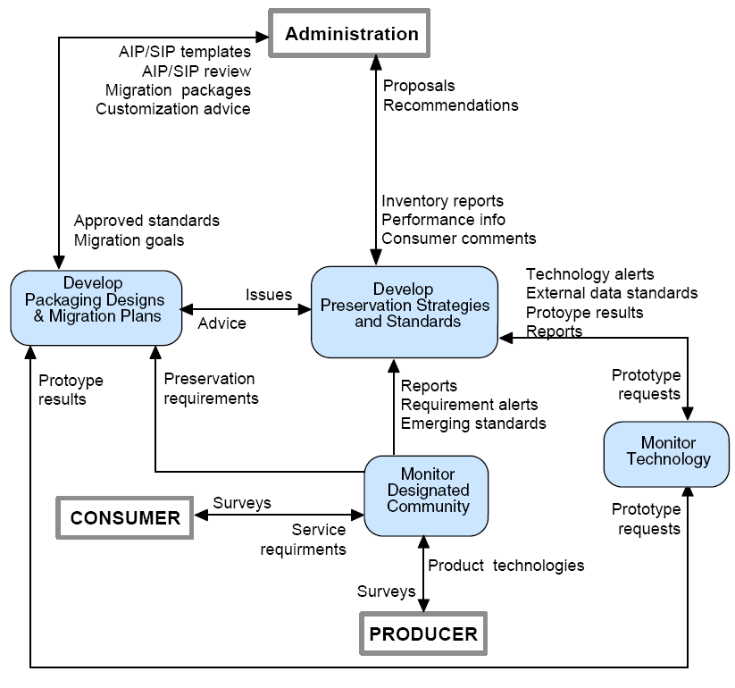
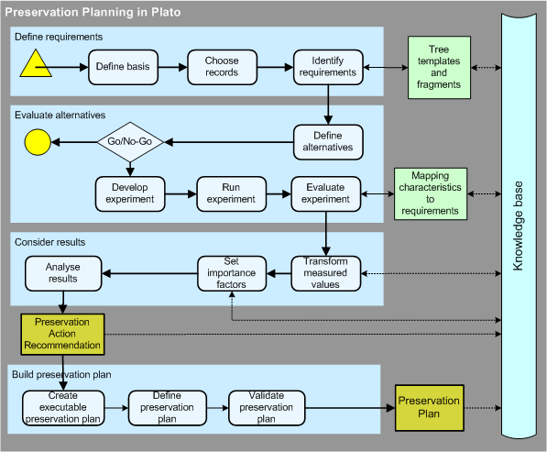
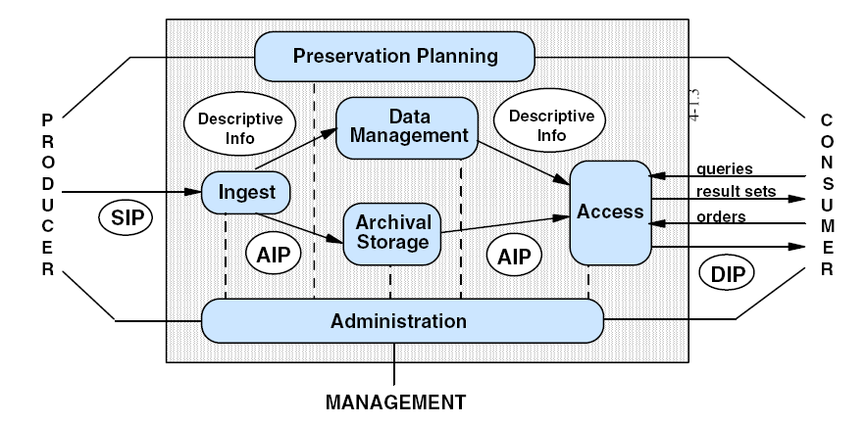


Preservation Planning
Notes:
7

Slide 8
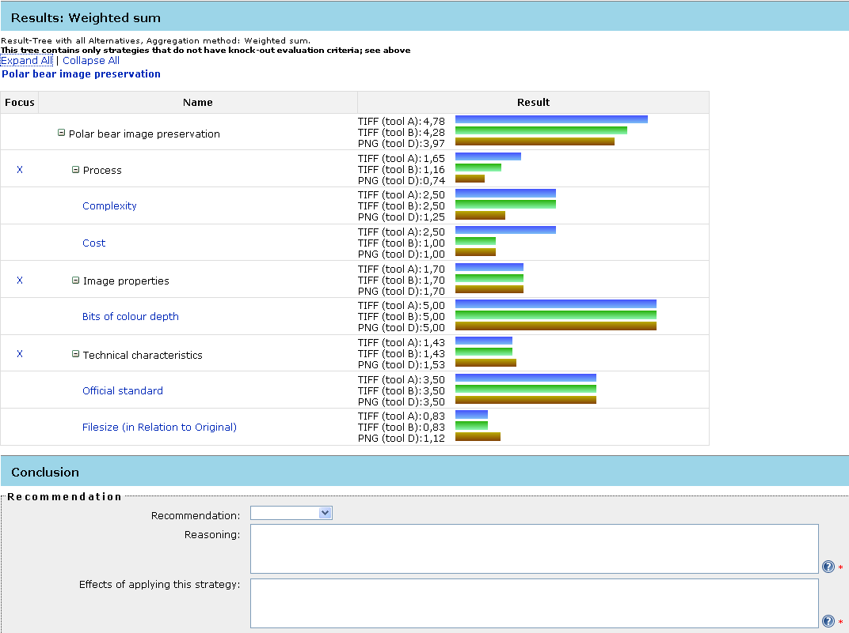

Slide 9
Preservation Planning with Plato
What Preservation Planning produces:
Basic Preservation Plan:
PDF: Preservation Plan.pdf
XML: Preservation Plan.xml
That was developed in a solid, repeatable and documented process
That is optimal for the needs of a given institution and for the data at hand

Slide 10
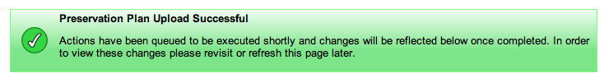
Uploading a Plan
Each set of “at risk” classified files can have a single related preservation plan.
Once uploaded, any defined actions will be performed on all files of that classification.

Slide 11
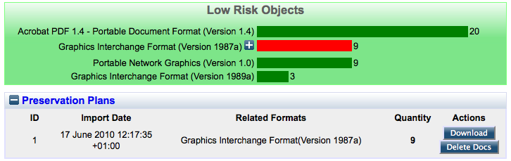
Plan Management
No plan can cause files to be deleted.
A plan controls any files it has created.
While these files exist, the plan cannot be deleted.

Slide 12
Viewing the Result
Previously high risk objects are still represented by a red bar, but are now in the low risk category.

Slide 13
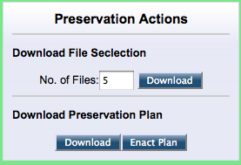
Preservation Actions Panel
Download plan for reviewing in planning software.
Re-enact plan

Slide 14

Viewing the Result
Before
After

Slide 15
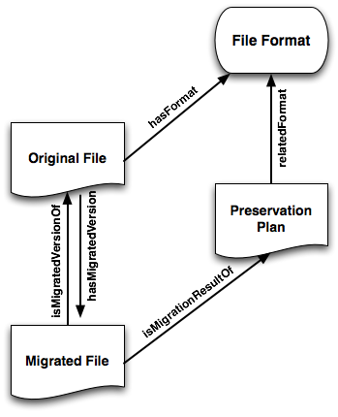
Provenance Information
Open Provenance Model (OPM) compliant
Stored in RDF triple form using the EPrints relation manager added in 3.2

Slide 16
Recap
Identification
DROID…
Characterisation
JHOVE, FITS…
Risk Assessment
Pronom, P2 Registry…
Planning
Plato
Action
Migration, Emulation

Slide 17
Recap
Identification
DROID…
Characterisation
JHOVE, FITS…
Digital Repository
Risk Assessment
Pronom, P2 Registry…
Planning
Plato
Action
Migration, Emulation

