Slide 1
Open Access: a new set of ACADEMIC values
Alma Swan
Key Perspectives Ltd
Truro, UK
Innovation Driven Entrepreneurship, Vilnius, Lithuania, 14-16 October 2010

Slide 2
Some context
Key Perspectives Ltd

Slide 3
Old paradigms of research dissemination
Use of proxy measures of an individual scholar’s merit is as good as it gets
The responsibility for disseminating your work rests with the publisher
The printed article is the format of record
Other scholars have time to search out what you want them to know
Key Perspectives Ltd

Slide 4
New paradigms of research dissemination
Rich, deep, broad metrics for measuring the contributions of individual scholars
Effective dissemination of your work is now in your hands (at last)
The digital format will be the format of record (is already in many areas)
Unless you routinely publish in Nature or Science, ‘getting it out there’ is up to you
Key Perspectives Ltd

Slide 5
Open Access
Immediate
Free (to use)
Free (of restrictions)
Access to the peer-reviewed literature (and data)
Not vanity publishing
Not a ‘stick anything up on the Web’ approach
Moving scholarly communication into the Web Age
Key Perspectives Ltd

Slide 6
Open Access – Why?
Science moves faster and more efficiently
Greater visibility and impact
Better monitoring, assessment and evaluation of research
Enables new semantic technologies (text-mining and data-mining)
Key Perspectives Ltd

Slide 7
Open Access: how
Open Access journals (www.doaj.org)
Open Access repositories
Open Access monographs
Key Perspectives Ltd

Slide 8
Open Access journals
Content available free of charge online
In many cases, free of restrictions on use too
Some charge at the ‘front end’
More than half do not levy a charge at all
Around 4700 of them
Listed in the Directory of Open Access Journals (DOAJ)
Key Perspectives Ltd

Slide 9
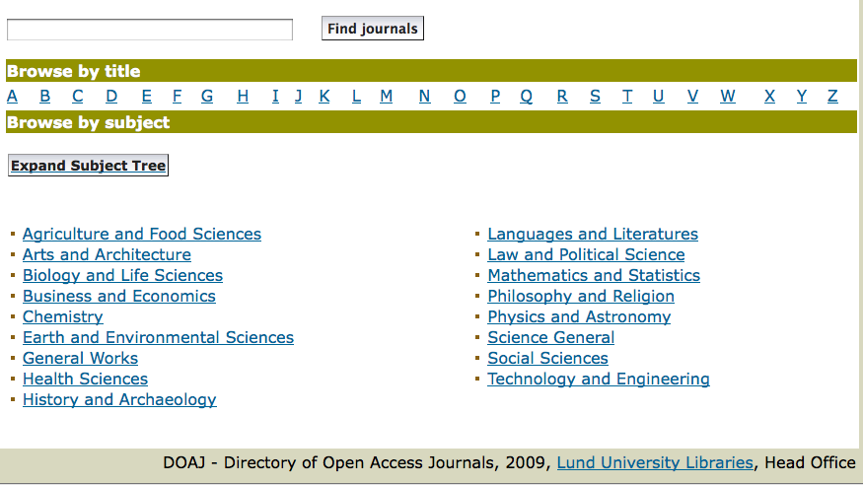
DOAJ categories
Key Perspectives Ltd

Slide 10
Open Access repositories
Digital collections
Most usually institutional
Sometimes centralised (subject-based)
Interoperable
Form a network across the world
Create a global database of openly-accessible research
Currently c1750
Key Perspectives Ltd

Slide 11
Where repositories are
Total at October 2010: 1750
Key Perspectives Ltd

Slide 12
How to make your work Open Access through a repository
Prepare your paper and submit it to your journal of choice for peer review
Make any changes required as a result of the peer review process
Submit the final version to the journal
Deposit that same final version to your repository through the normal deposit procedure that applies in your institution
N.B. Your repository staff may check journal copyright conditions on your behalf, or you may do so yourself using the SHERPA RoMEO service at http://www.sherpa.ac.uk/romeo/
Key Perspectives Ltd

Slide 13
What’s in it for authors?
Key Perspectives Ltd

Slide 14
Author advantages from Open Access
Visibility
Usage
Impact
Personal profiling and marketing
Research advantages
Key Perspectives Ltd

Slide 15
An author’s own testimony on open access visibility
“Self-archiving in the PhilSci Archive has given instant world-wide visibility to my work. As a result, I was invited to submit papers to refereed international conferences/journals and got them accepted.”
Key Perspectives Ltd

Slide 16
Professor Martin Skitmore School of Urban Design, QUT
“There is no doubt in my mind that ePrints will have improved things – especially in developing countries such as Malaysia … many more access my papers who wouldn’t have thought of contacting me personally in the ‘old’ days.
While this may … increase … citations, the most important thing … is that at least these people can find out more about what others have done…”
Key Perspectives Ltd

Slide 17
A well-filled repository
Key Perspectives Ltd

Slide 18
And it gets used
Key Perspectives Ltd

Slide 19
Key Perspectives Ltd

Slide 20
Impact
Range = 36%-200%
(Data: Stevan Harnad and co-workers)
Key Perspectives Ltd

Slide 21
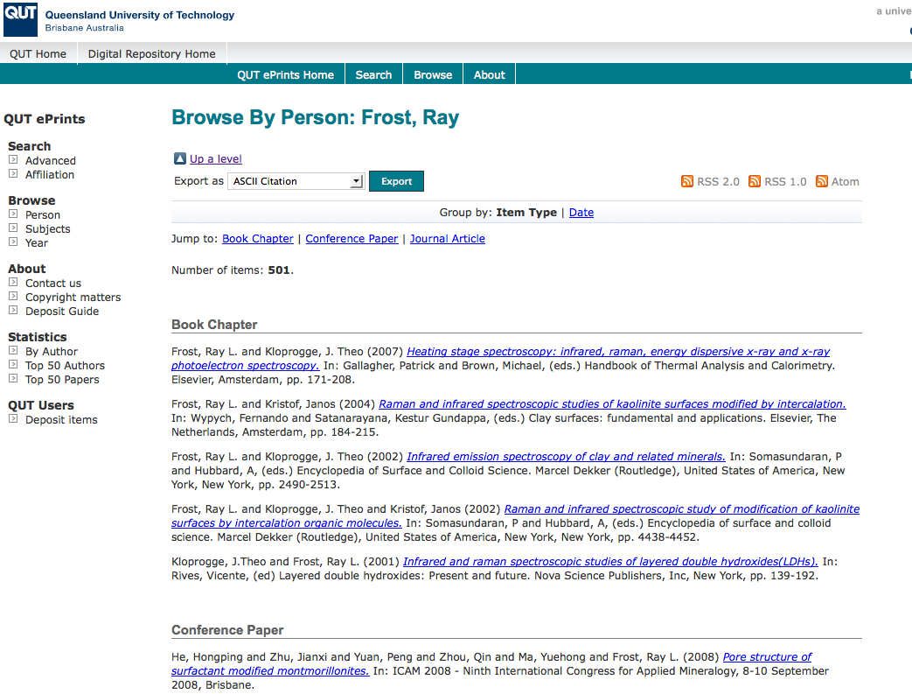
What OA means to a researcher
Key Perspectives Ltd

Slide 22
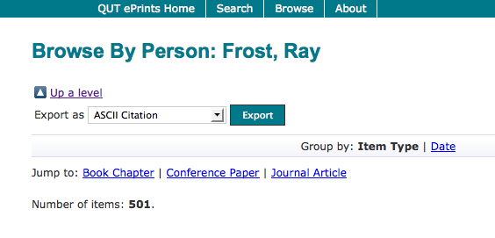
Key Perspectives Ltd

Slide 23
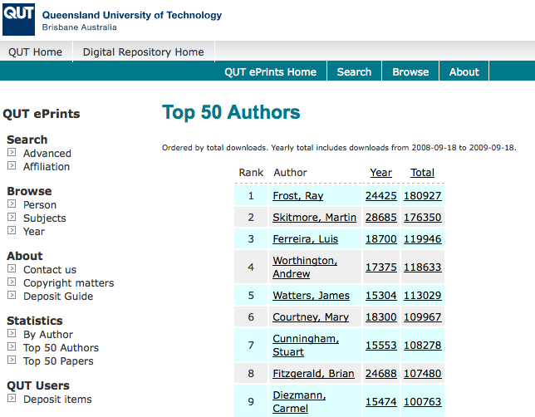
Key Perspectives Ltd

Slide 24
Top authors (by download)
Key Perspectives Ltd

Slide 25
Ray Frost’s impact
Key Perspectives Ltd

Slide 26
Top authors (by download)
Key Perspectives Ltd

Slide 27
Martin Skitmore (Urban Design)
Key Perspectives Ltd

Slide 28
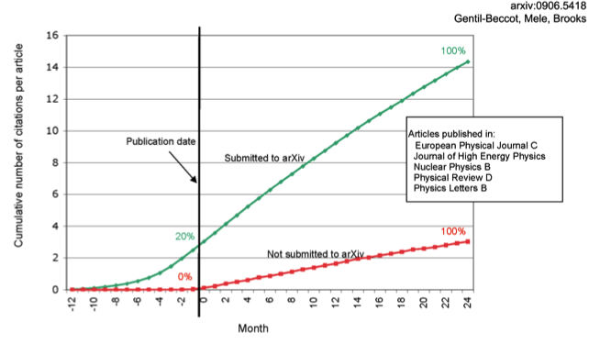
The early bird …
Key Perspectives Ltd

Slide 29
Engineering
Citations
Data: Gargouri & Harnad, 2010
Key Perspectives Ltd

Slide 30
Clinical medicine
Citations
Data: Gargouri & Harnad, 2010
Key Perspectives Ltd

Slide 31
Social science
Citations
Data: Gargouri & Harnad, 2010
Key Perspectives Ltd

Slide 32
Key Perspectives Ltd
Notes:
32

Slide 33
Download timeline
Key Perspectives Ltd

Slide 35
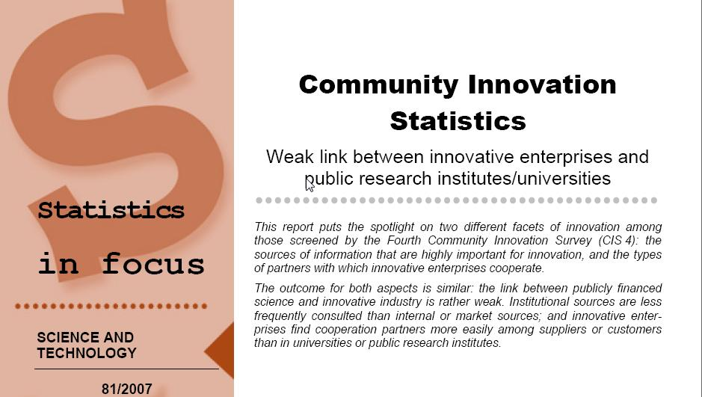
EU CIS studies
Key Perspectives Ltd

Slide 36
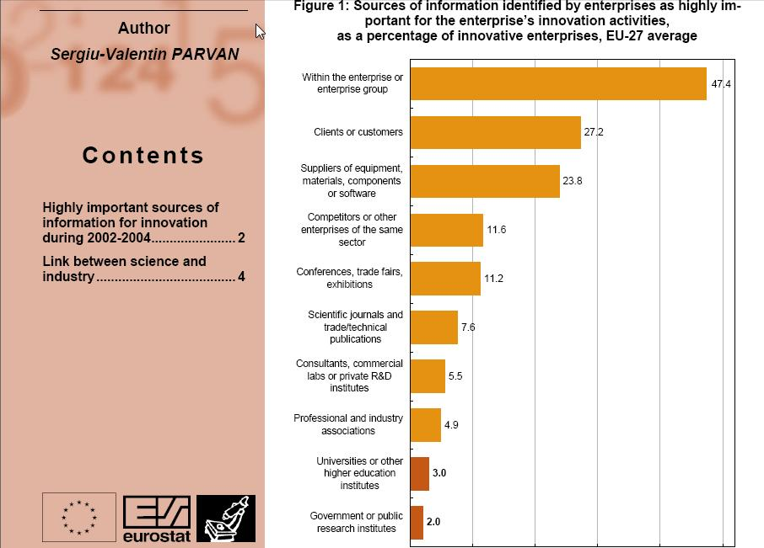
Key Perspectives Ltd

Slide 37
Dr Evonne Miller Senior Lecturer, Design, QUT
“Just last week, the General Manager of Sustainable Development from an Australian rural industry called me – based on reading one of my research papers in ePrints.
He loved what he read ..... and we are now in discussion about how we can help them measure their industry’s social impacts.”
Key Perspectives Ltd

Slide 38
Why an institutional repository?
Fulfils a university’s mission to engender, encourage and disseminate scholarly work
Complete record of its intellectual effort
Permanent record of all digital output
Research management tool
‘Marketing’ tool for universities
Provides maximum Web impact for the institution
Key Perspectives Ltd

Slide 39
Open Access mandatory policies
Key Perspectives Ltd

Slide 40
Resources
1. General, comprehensive resource on Open Access:
OASIS
(Open Access Scholarly Information Sourcebook)
www.openoasis.org
2. Resource for policymakers, institutional managers:
EOS
(Enabling Open Scholarship)
www.openscholarship.org
Key Perspectives Ltd

Slide 41
Thank you for listening
aswan@keyperspectives.co.uk
www.keyperspectives.co.uk
www.openoasis.org
Key Perspectives Ltd

