Slide 1

EPrints Preservation

Slide 2
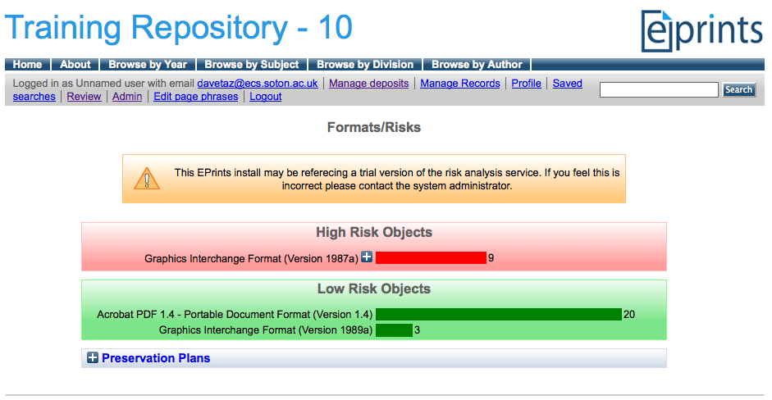
Risk Analysis In EPrints
Risk Analysis
Preservation - Analyse
EPrints File Classification + Risk Analysis

Slide 3
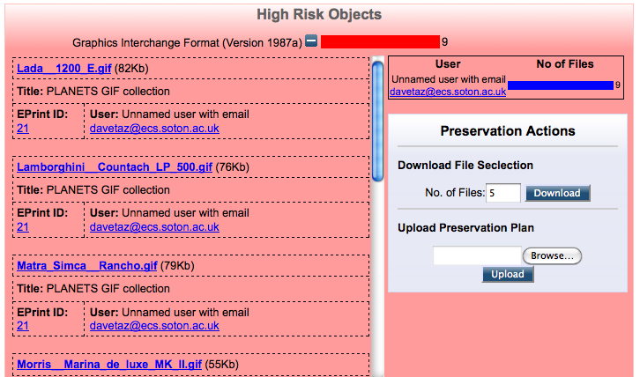
Risk Analysis In EPrints - Detailed View
Risk Analysis
Preservation - Analyse
EPrints File Classification + Risk Analysis

Slide 4
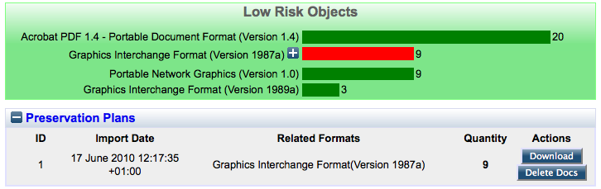
Plan Management
No plan can cause files to be deleted.
A plan controls any files it has created.
While these files exist, the plan cannot be deleted.

Slide 5

Viewing the Result
Before
After

Slide 6
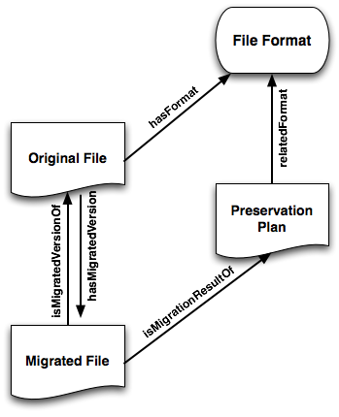
Provenance Information
Open Provenance Model (OPM) compliant
Stored in RDF triple form using the EPrints relation manager added in 3.2

Slide 7
Recap
Identification
DROID…
Characterisation
JHOVE, FITS…
Risk Assessment
Pronom, P2 Registry…
Planning
Plato
Action
Migration, Emulation

Slide 8
Recap
Identification
DROID…
Characterisation
JHOVE, FITS…
Digital Repository
Risk Assessment
Pronom, P2 Registry…
Planning
Plato
Action
Migration, Emulation

