Slide 1
KeepIt -------------------------------------- Kultur, eCrystals, EdShare (and NECTAR) – Preserve It!
David Tarrant
davetaz@ecs.soton.ac.uk
School of Electronics & Computer Science

Slide 2



Project Overview
Aim: To create a number of exemplar preservation repositories from which others can learn
Small number of very diverse repositories
Training
Deployment
Development

Slide 3
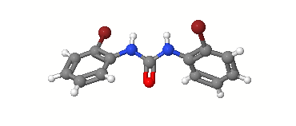



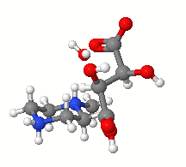


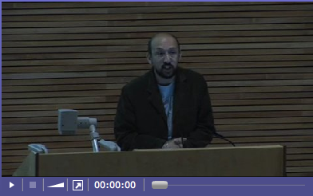



Repository Content

Slide 4


Preservation
Long Term
Reliable Storage
Risk Analysis
Mitigation / Action

Slide 5
Long Term Reliable Storage
Content specific storage
Hybrid storage solutions
Preservation aware storage
Object orientated storage
Smart storage
Simple storage based preservation services
(Hybrid) EPrints Storage Controller
EC2 based preservation services (act on S3)
Storage status reports

Slide 6



Long Term Reliable Storage
EPrints is expanding the number places
in which plug-ins can be utilised.
Import Plug-ins
Export Plug-ins
EPrints Core
Interfaces, Submission Manager
Database Controller
Storage Controller
CLOUD (Amazon S3)

Slide 7
Risk Analysis
File Formats
Significant Properties
Resolution policy
Risk analysis policies
Preservation registry (p2-registry)
File format plug-in toolset EPrints
Risk analysis for files in repository
An open preservation registry

Slide 8
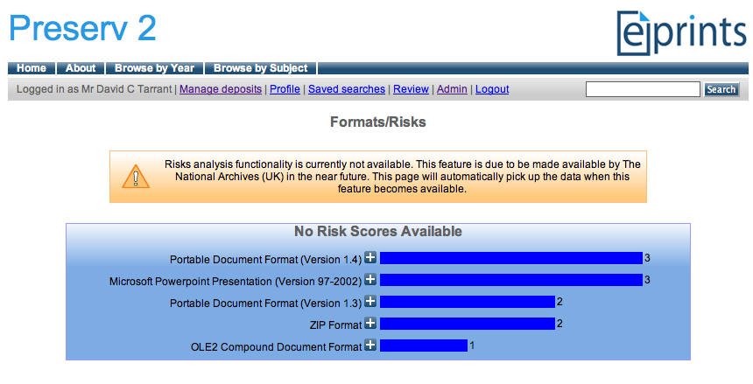
Risk Analysis
File format plug-in toolset EPrints

Slide 9
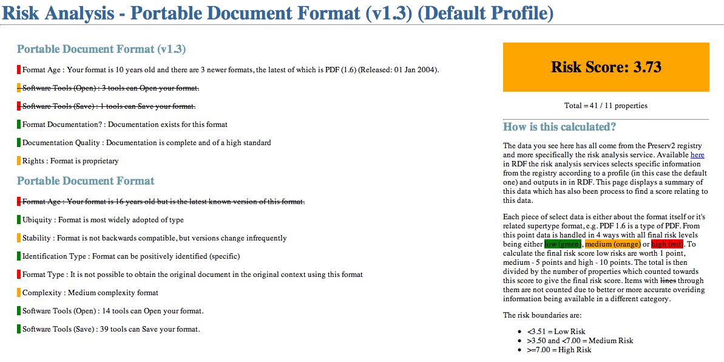
Risk Analysis
Preservation registry (p2-registry)

Slide 10
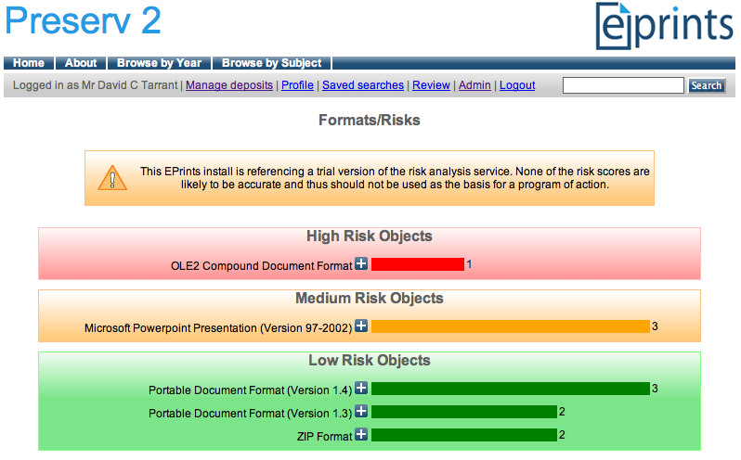
Risk Analysis
Risk analysis for files in repository

Slide 11
Mitigation / Action
Choosing storage platforms
Migration vs Emulation
The importance of policy
Migration pathways
Integration of simple migration services
Using smart storage and cloud based services
Risk Analysis -> Migration Integration

Slide 12
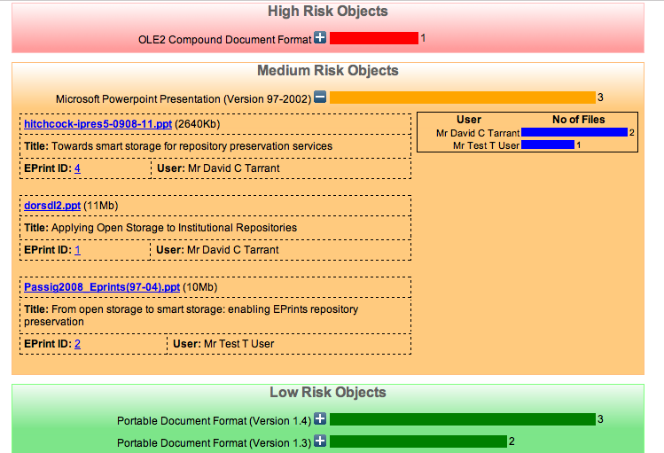
Mitigation / Action
Risk Analysis -> Migration Integration
Migration Tools
Tool Preservation Level
PPT -> PPTX
PPT -> PDF

