Slide 1
The Limits of Learning Design
Stephen Downes
February 22, 2012

Slide 2
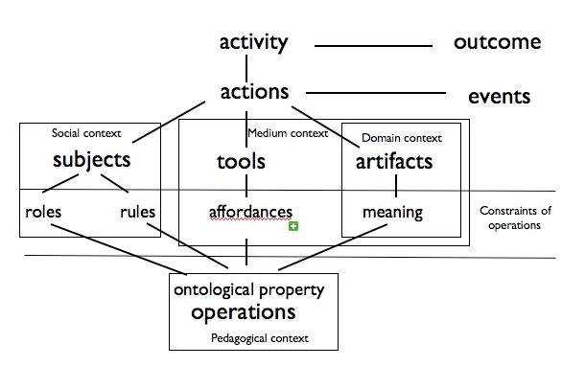
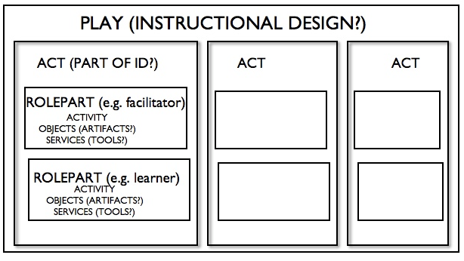
What is Learning Design?
Learning design - topic - types of LD
The concept of patterns (designs / models / rules / principles) in general: an abstract representation of something concrete.
Images: http://tihane.wordpress.com/2007/01/30/ims-learning-design/

Slide 3

Creating Abstractions
Were thought to be created by extrapolation or generalization (1,2,3, ... infinity)
But are in fact created through a process of subtraction. "An X is Y".
All language abstracts in this way.
All crows are black
This crow is black
This crow is black
This crow is black

Slide 4
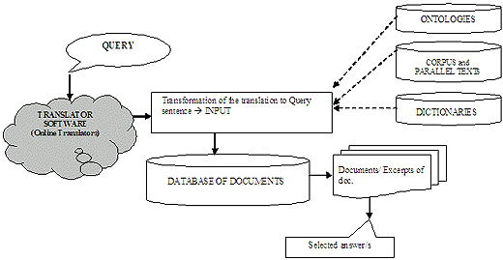
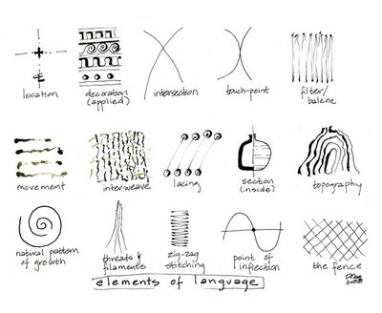
Elements of a Language
The elements of a language are whatever is left over after the subtraction
The grammar or syntax of the language is the set of rules for manipulating those elements.
Image: http://www.translationdirectory.com/articles/article2147.php
Image: http://kdokosart.blogspot.com/2008/06/elements-of-language.html

Slide 5
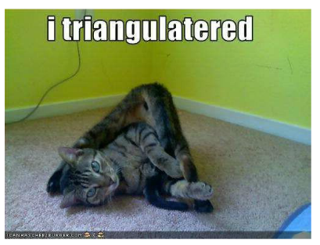
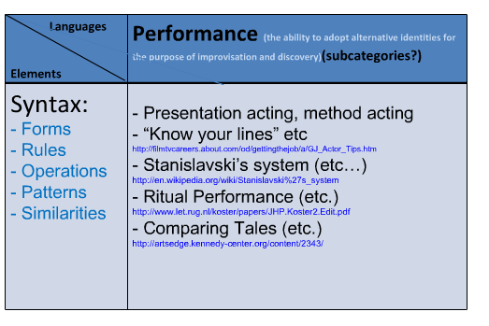
Purpose of a Language
Purposes of a language:
to describe / communicate
to explain
to reason
to define
All languages perform all of these functions (and more!)
Speaking in LOLcats
http://www.downes.ca/presentation/233

Slide 6
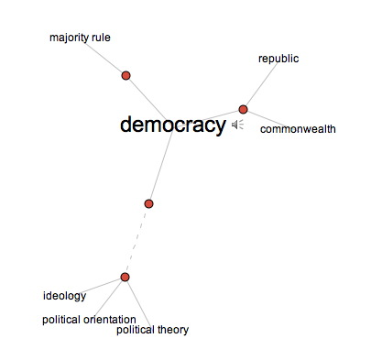
Frames
You can't create a language and say 'this is just to communicate'; the very act of creating a language invokes all four elements
George Lakoff: 'Frame'
Image: http://conversations.marketing-partners.com/tag/george-lakoff/

Slide 7
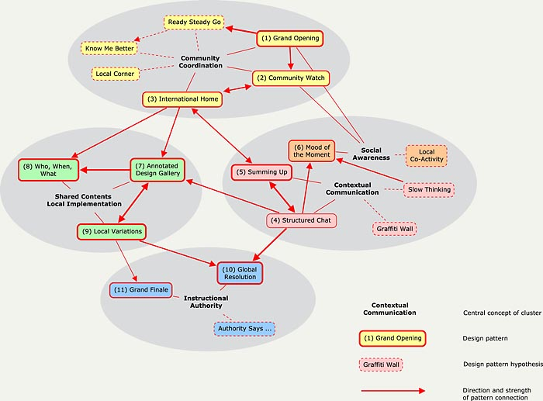
Learning Design as a Language
Also, you can't talk about LD by talking as though the language isn't there
LD is the language
Various pseudo-languages:
Pseudo-code
Globish
Image: http://www.ijdesign.org/ojs/index.php/IJDesign/article/view/276/273

Slide 8
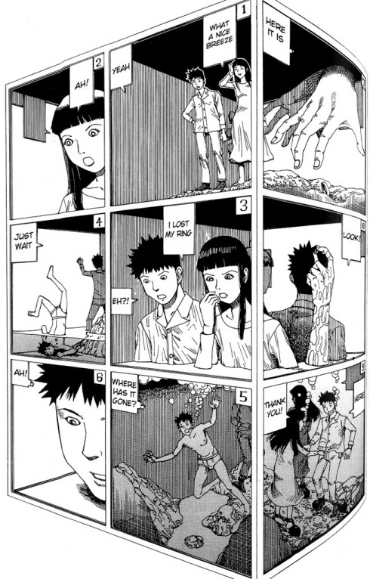
Levels of Abstraction
Languages are more or less abstract
Eg. greater or smaller set of elements
Greater or smaller set of rules / rule-base
Greater or Smaller expressivity
Image: http://didjelirium.wordpress.com/2011/02/19/abstraction-by-shintaro-kago/

Slide 9
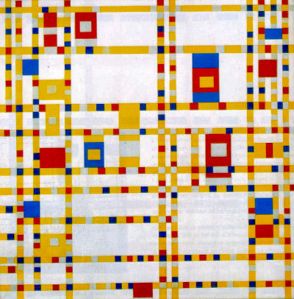
Formalism & Pure Abstraction
In science, there is a methodological principle to prefer pure abstraction - fewer elements, fewer principles:
numbers - math - counting
properties - sets - grouping
computability - boolean - inferring/moving
Image: http://www.artslant.com/ny/articles/show/15496

Slide 10
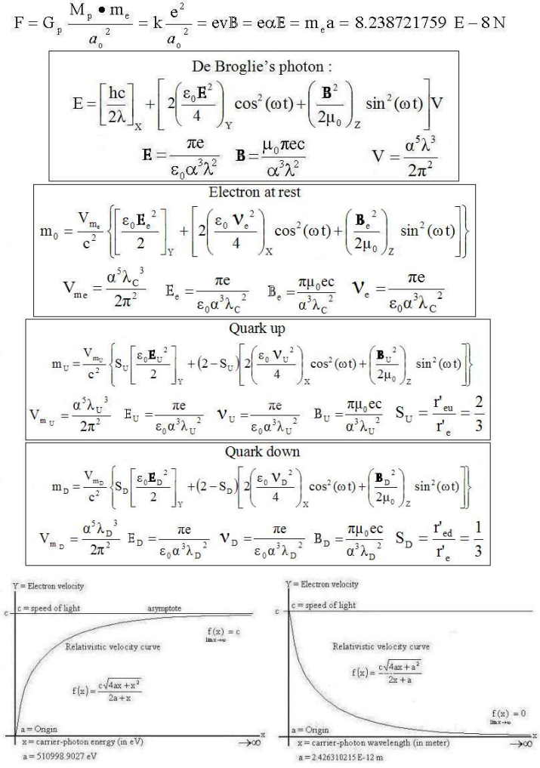
The World as Mathematical Entity
the world is fundamentally a mathematical entity
Image: http://brianclegg.blogspot.com/2010/02/maths-is-so-abitrary.html

Slide 11
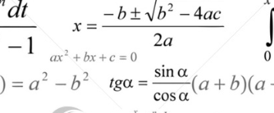
Interpretation
Pure Abstraction
Real world
interpretation
language
interpretation
This crow is black
All crows are black
natural language process -- rules – objects binary code

Slide 12
The Reusability Paradox
Reusability paradox - theory & practice
can we bridge this with a language?
practise ---- interpretation ---- language ------ interpretation ---- theory

Slide 13
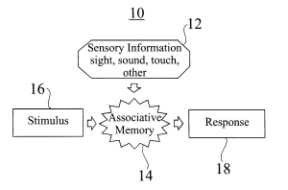
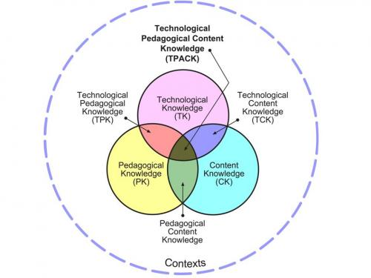
Key Questions for Learning Design?
Is there a functionally useful language that describes (teaching, learning, etc)?
Image: http://www.freepatentsonline.com/6604094.html
Image: http://robblogva.wordpress.com/2009/06/05/technology-for-language-learning-mini-workshop/

Slide 14
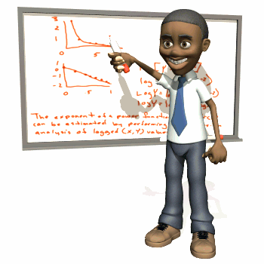
The Dilemma of Learning Design?
If there is such a language, then we can use computers to teach
If there is not, then we need teachers, but at a certain point, LDs become meaningless
(and one wonders, what is this that teachers do?)
Image: http://robertdaylin.wordpress.com/2008/10/23/ive-fallen-and-i-cant-get-up/

Slide 15
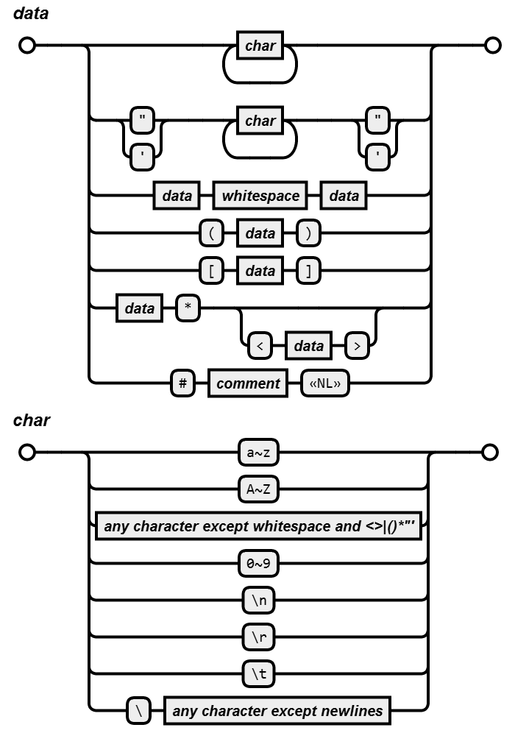
Analyzing a Learning Design Language
What are the elements and syntax of that language?
What will ground or give meaning to those elements (i.e., what is the interpretation)?
Image: https://github.com/atomble/syntax-diagram

Slide 16
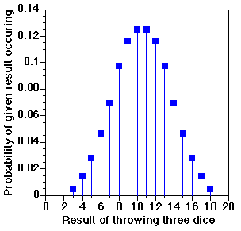
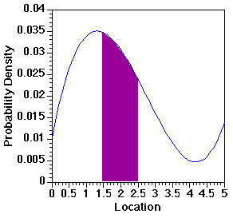
Primitives & Their Interpretation
If these are your primitives
what are these primitives?
what is their role?
Interpretation: the logical foundations for...
eg. probability
Image: http://www.cobalt.chem.ucalgary.ca/ziegler/educmat/chm386/rudiment/mathbas/probab.htm

Slide 17
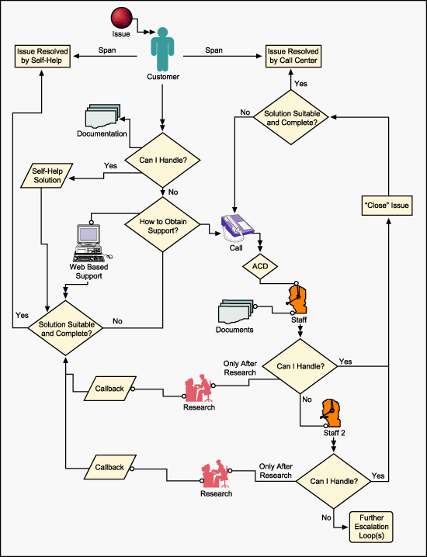
Locked into Processes
3 models: flowchart, rule-based, object-event based
Image: http://markbland.com/process.html

Slide 18
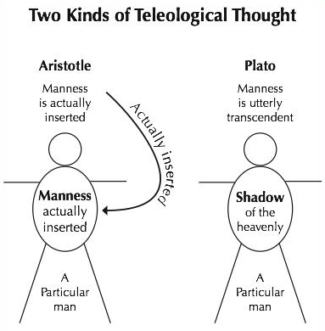
Locked into Directionality
Is there a directionality in the process?
Locked into objectives (?)
problem solving, discovery ... others?
development of capacities vs development of knowledge
Image: http://www.pastorshearer.net/Bible%20Studies/Calvinism%20studies/twoteleologies.html

Slide 19
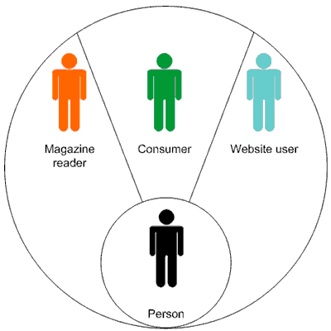
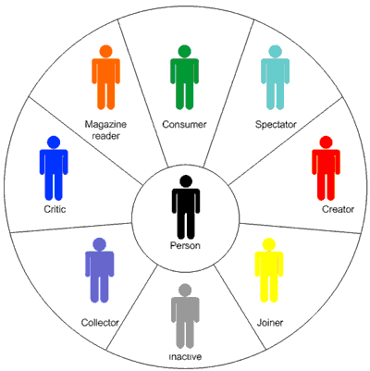
Locked into Roles / Entities
What are the primitive objects? What are their properties?
Locked into roles
e.g. conversational framework - teacher - student - other student
want to look at the substructure
Image: http://magia3e.wordpress.com/2007/12/21/whats-my-scene-user-roles-and-needs-in-social-computing/

Slide 20
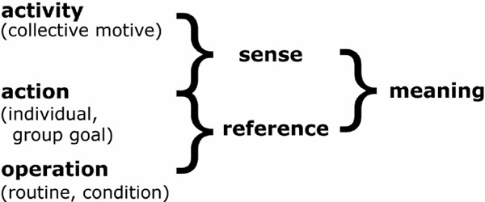
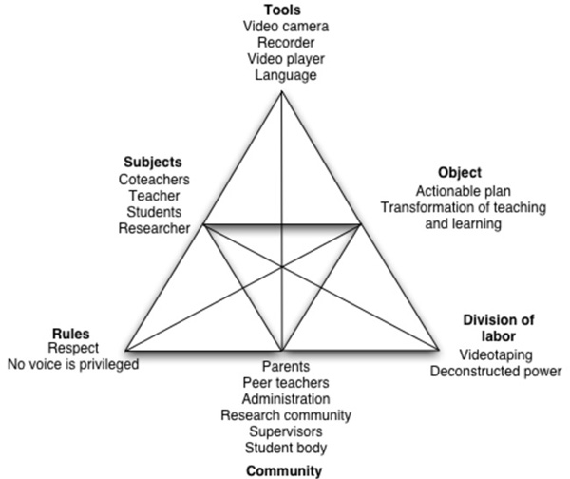
Meaning and Reference
Epistemology - what grounds your theories
Theories of truth and reference
other approaches:
coherence 'webs of belief‘
world as 'will and representation'
Image: http://www.qualitative-research.net/index.php/fqs/article/view/124/261

Slide 21
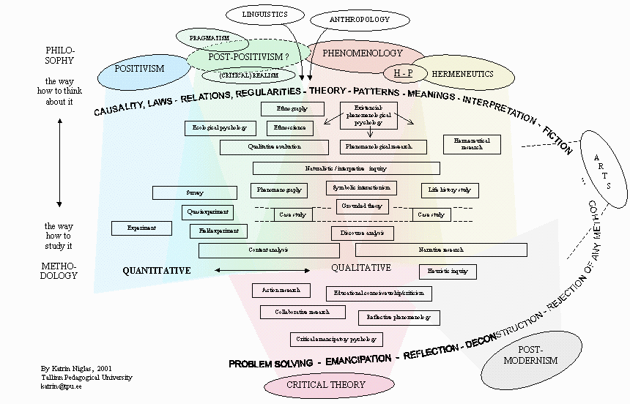
Hidden Positivism
Positivism: saying there is some set of facts - even e.g. the 'existing theories'
(Most people are positivists - it takes real guts to be a coherentist, or a relativist)
Image: http://www.leeds.ac.uk/educol/documents/00001840.htm

Slide 22
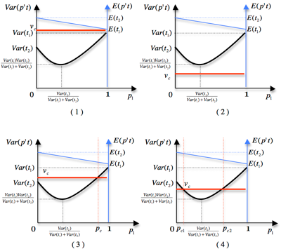
Theory-Neutrality
The general principle is - you don't want to build the interpretation into the language - keep the language 'stupid' - put semantics at the edges
That's why e.g. LD wanted to be 'theory-neutral'
Image: http://blog.lib.umn.edu/levin031/transportationist/2011/08/a-portfolio-theory-of-route-ch.html

Slide 23
The Nature of the Purely Abstract
but your primitives don't have to be pure basic abstracts...
We can ‘reach out’ from pure abstraction (via computability & decidability)
Language?
Design?
Predicate Calculus
Computation
Set Theory
Mathematics
The purely abstract
1011010101

Slide 24
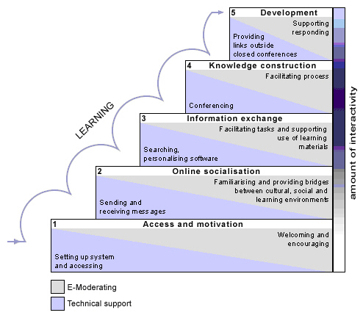
Cognitivism
Cognitivist theories - where the pure abstraction is based in the pure elements of thought
These elements are mapped to a ‘language of thought’ which is used to express abstractions
The theory-theory
Image: http://www.newcastle.edu.au/staff/teaching-in-the-online-environment/starting/course-design/course-design-models.html

Slide 25
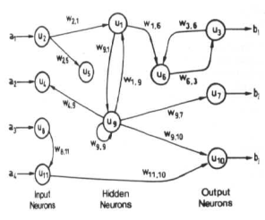
The Human Equation
Another version of the same framework
Image: http://www.doc.ic.ac.uk/~nd/surprise_96/journal/vol4/cs11/report.html
This crow is black
All crows are black
real world ---- interpretation ---- language ------ interpretation ---- HUMAN

Slide 26

The Non-Theory Theory
Non-theory-based theory
What do we believe are elements of the world? connections
What do we believe are the fundamentals of human thought? connections
Humans are fundamentally connective entities (and not cognitive entities)
Image: http://www.vegas-times.com/litf/wikis/connectivism/

Slide 27
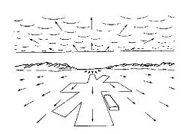
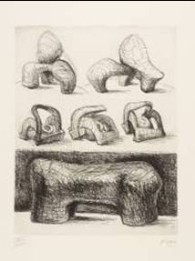
Direct Representation
In LEARNING no langauge per se in between them
It is a process of direct recognition (JJ Gibson)
real world ---- pattern recognition ---- HUMAN
Image: http://www.users.totalise.co.uk/~kbroom/Lectures/gibson.htm
Image: http://www.users.totalise.co.uk/~kbroom/Lectures/autism_files/frame.htm

Slide 28
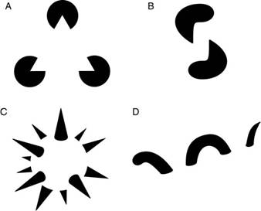
Language and Learning
We use language to talk about this, but we should not confuse the language with the learning process
How do people learn then?
How do you get a person to know 'x‘?
I said it takes courage to not be a positivist
Image: http://machineslikeus.com/the-constructive-aspect-of-visual-perception

Slide 29
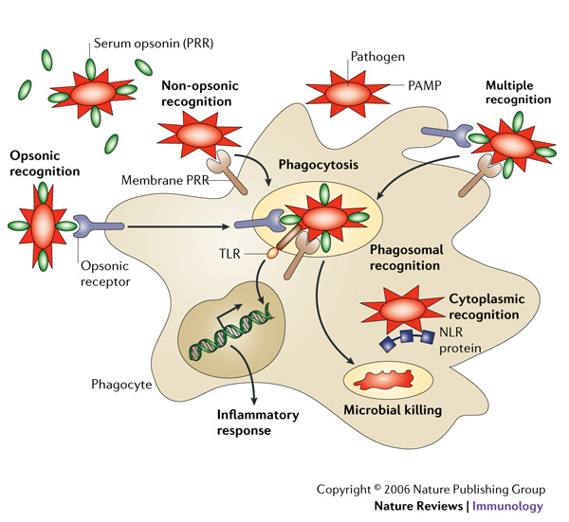
Pattern Recognition
To learn:
Not to remember a set of facts (and/or theories)
Becoming a good recognizer, a good pattern creator
These are based in the principles of effective networks
Image: http://www.nature.com/nri/journal/v6/n1/fig_tab/nri1745_F1.html

Slide 30

Direct Perception
Teaser argument to conclude:
How do we learn languages?
we don't create a language to learn a language
a language is learned via the direct recognition of the language
aka 'thinking in French' -- vs 'thinking in physics', etc.
Image: http://dogonablog.wordpress.com/2007/08/05/this-is-what-im-not/

Slide 31
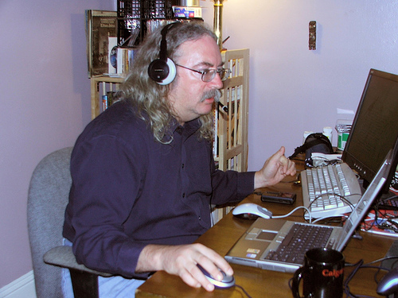
Stephen Downes
http://www.downes.ca
stephen@downes.ca

