Slide 1


Quantitative Easing and Recent Monetary Policy
November 30, 2009
Nottingham University
Richard Anderson
Economist, Federal Reserve Bank of St Louis
Leverhulme Visiting Professor, Aston University

Slide 2
Outline
Discuss “conventional” and “unconventional” monetary policy
Discuss Quantitative easing
Discuss U.K. Asset Purchase Facility and QE
Discuss Federal Reserve implementation of quantitative easing
Discuss “exit strategy”
Examine a simple putative long-run demand for the adjusted monetary base in the United States, 1919 – 2008.
Additional background on the financial crisis and US financial markets is available on my web page in two presentations from November 2008 at Aston University (research.stlouisfed.org/economists/anderson) or something close to that… try a Google search

Slide 3
Conventional and Unconventional Monetary Policy
Conventional:
“The key purpose of monetary policy is to preserve price stability.” [A. Meier, 2009, IMF]
Monetary policy implementation is via targeting a short-term interest rate (almost always, the overnight cost-of-carry on central government debt)
Mainstay of New Keynesian macro models (and RBC models)
Does this mix objectives and constraints?
Inflation of the 1970s: peak 24 (26?) percent Britain, 10-13 percent U.S.
Fiscal pressures on monetary policy

Slide 4
“Traditional” (Historical) Monetary Policy
Provide means of payment that is irrevocable/final, efficient, honest (above corruption or debasement)
Monitor/assure financial stability (avoid and/or temper financial panics)
Emphasis on CB’s balance sheet
Bank of England in the 19th century, especially beginning 1825
Specie or BOE notes as prime assets during panic: flight to quality and liquidity (counterparty risk, opaque balance sheets)
As country banks held fewer and fewer notes, burden on BOE increased
BOE policy: Halt panic at any cost, then lend only against good collateral to avoid itself failing [modern fiat money central banks cannot fail in that fashion]
Federal Reserve at its founding after Panic of 1907
Gold standard was to provide price stability (nominal anchor)

Slide 5
“Unconventional” Policy
Everything except conventional policy
Lending to banks against collateral [nice or not], foreign and domestic (Federal Reserve)
Equity interests in banks (ring-fencing assets on-balance sheet)
Purchasing private assets (with default risk)
Purchasing large quantities of government debt (no default risk)
Rather conventional when compared to BOE in 19th century…
Halt the panic
Extend credit against good collateral [usually]
Two years or so for things to get sorted

Slide 6
Large balance sheet changes are more “conventional” than one might think.
Goodfriend and King (JME, 1981) noted in a simple RE model that large balance sheet changes could be an effective monetary policy instrument so long as the central bank could credibly commit to the increases being temporary (rather than financing fiscal deficit)
A number of central banks have embraced this lesson

Slide 7
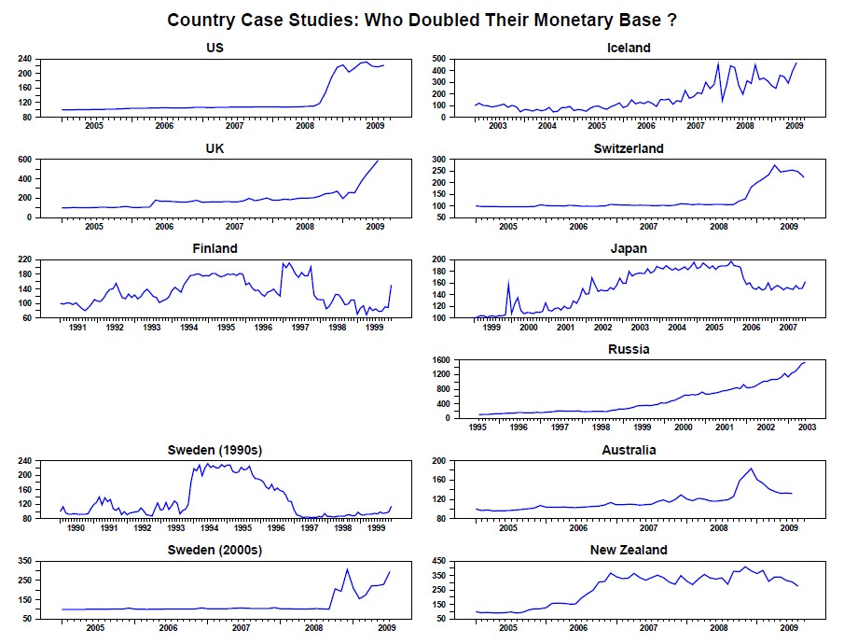
All are normalized to 100 at first observation

Slide 8
In some cases, these increases were accompanied by the policy rate nearing zero, but not all … the next slide shows policy rates
(be careful, scales differ on some panels)

Slide 9
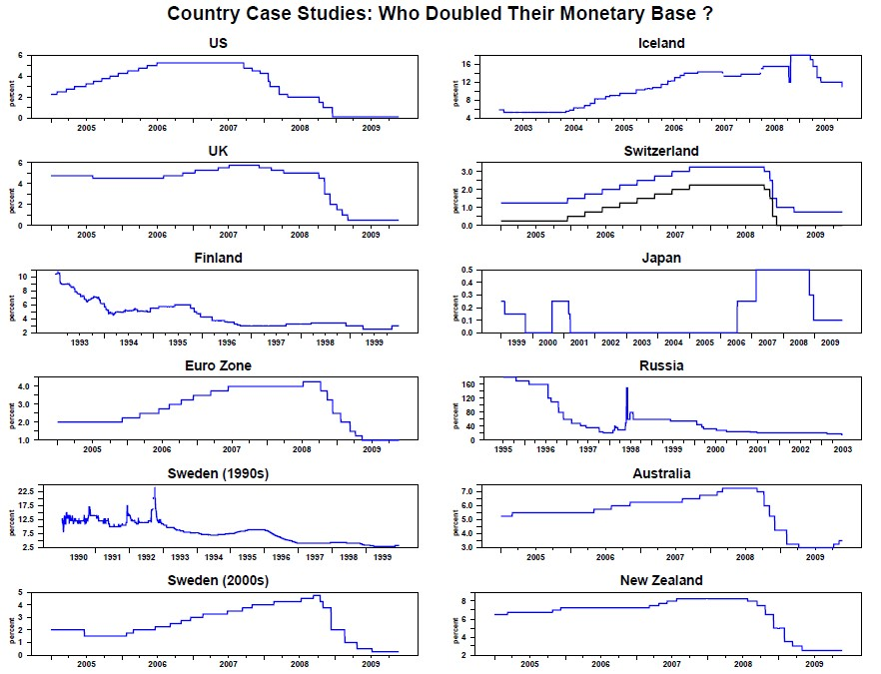

Slide 10
Countries with Major Increases in the Monetary Base
Countries with Major Increases in the Monetary Base
Country | Measure of Monetary Base | Reference Date Range | Starting quantity | Ending quantity | Reason | % Increase | Following Inflation
Argentina | Monetary Base | Dec 2001 – Jun 2008 | 11,981M | 102,223M | political meltdown, high inflation, and expansionary policy | 753.21% | 11.88%
Belgium | Currency and Liability to banking Institutions | Aug 2008 – Sep 2008 Dec 2008 – Jun 2009 | 90,431M 141,216M | 166,316M 102,704M | likely to be a quantitative easing related to the current global recession | 83.91% | N/A
Finland | Currency and Reserves of depository banks | Jul 1994 – Aug 1994 Dec 1998 – Jan 1999 | 9,658M 20,698M | 21,304M 3,844M | related to the 1990s Finnish banking crisis | 120.58% | 1.55%
Hong Kong | Monetary Base | Oct 2008 – Jul 2009 | 363.35B | 771.17B | likely to be a quantitative easing related to the current global recession |  | N/A
Iceland | Monetary Base | Q1 2006 – Q3 2007 | 35,825M | 111,175M | related to the Icelandic financial crisis, and the nationalization of failed banks | 210.33% | 8.13%
Ireland | Currency and Liability to banking Institutions | Jun 2008 – Mar 2009 | 38,194M | 125,349M | likely to be a quantitative easing related to the current global recession | 228.19% | N/A
Israel | Reserve Money (M0) | Jan 1997 – Dec 1997 | 28,095M | 56,659M | not clear | 101.67% | 4.39%
Japan | Reserve Money (M0) | Mar 2001 – Mar 2003 Mar 2006 – May 2006 | 68.64T 110.63T | 106.29T 93.04T | the Japanese quantitative easing | 54.85% | -0.27%
Netherland | Currency and Liability to banking Institutions | May 2008 – Oct 2008 | 59.74B | 113.53B | likely to be a quantitative easing related to the current global recession | 90.04% | N/A
New Zealand | Reserve Money (M0) | Jun 2006 – Oct 2006 | 5,333M | 10,661M | started paying interest on reserve to create a liquidity management regime | 99.91% | 3.24%
Country | Measure of Monetary Base | Reference Date Range | Starting quantity | Ending quantity | Reason | % Increase | Following Inflation
Qatar | Reserve Money (M0) | Oct 2007 – Jul 2009 | 14,379M | 41,107M | likely to be a quantitative easing related to the current global recession | 185.88% | 14.4%
Russia | Monetary Base | Apr 2006 – May 2007 | 2,864.8B | 5,350.8B | likely to be a budget stimulus plan (fiscal policy) | 86.78% | 10.93%
Sweden | Reserve Money (M0) | Oct 1993 – Mar 1994 May 1996 – Feb 1997 | 95.52B 156.68B | 204.69B 81.11B | related to the government bailout of early 1990s credit crunch | 114.29% | 2.07%

Slide 13
Overview of Recent U.K. and U.S. QE
Both the BOE and the Fed have purchased approximately one-quarter of their countries’ respective privately held, interest-bearing, central government debt
US: $2-1/2 T of $1T
UK: £180B of £600B
Both suggest longer-term market yields are 120 to 150 bps lower than they otherwise would be
Neither (?) has a model to support this conclusion

Slide 14
U.K.: Bank of England QE
January 2009: Chancellor of the Exchequer authorizes BOE to create Asset Purchase Facility
Purchase assets financed by issue of Treasury Bills.
To improve liquidity in financial markets
MPC reduced Bank Rate to 0.5 percent (frictionally above zero), risk that inflation might undershoot 2 percent target
First QE purchase: 1st week of March
Later in March: ₤75B gilts
₤12.9B gilts, ₤982M commercial paper, ₤128M commercial bonds
May: set target of ₤125B [August MPC: full ₤175B
Owned ₤93.3B gilts, ₤2.1B c.p., and ₤0.75 commercial bonds
November: ₤178.3B
Purchased ₤1.7B gilts 17 Nov 2009 approx 4.3% yield

Slide 15
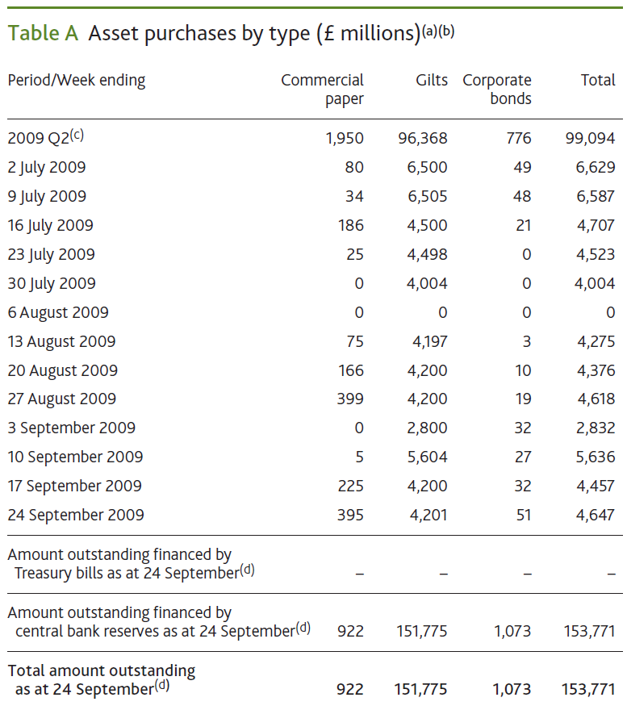

Slide 16
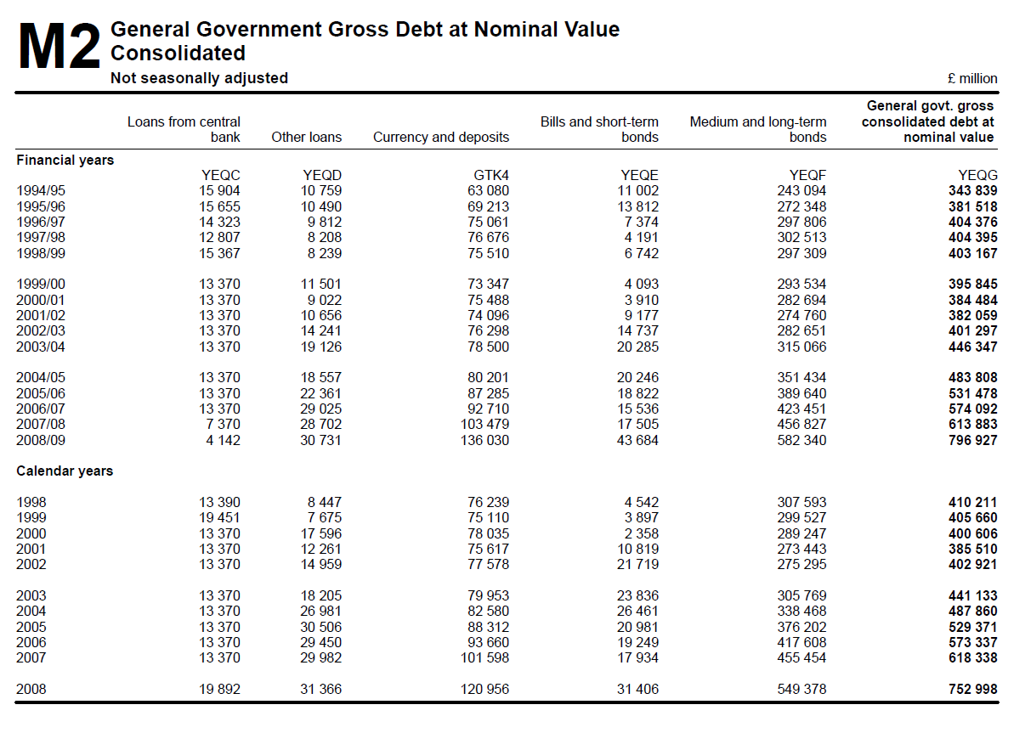

Slide 17
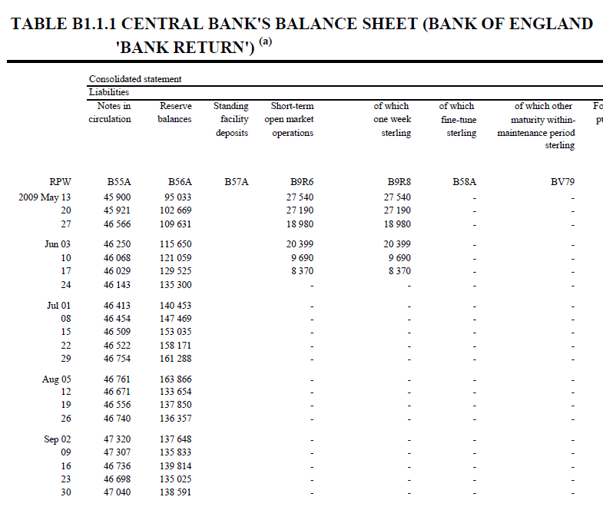

Slide 18
Calculated by author as the sum of currency in circulation plus deposits (current accounts) of banks at the BOE

Slide 19
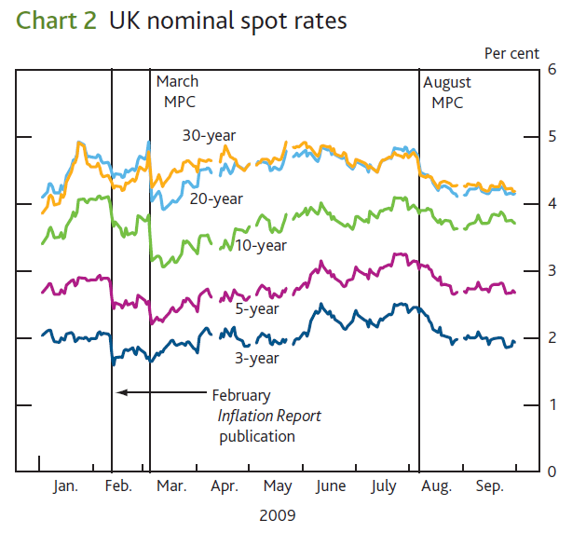

Slide 20
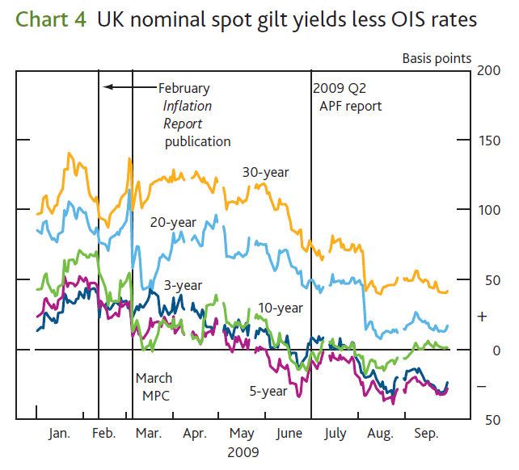

Slide 21
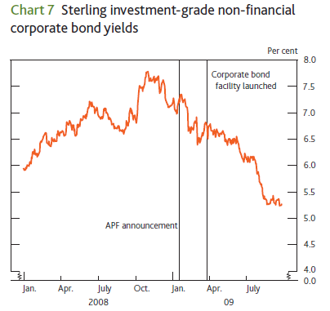

Slide 22
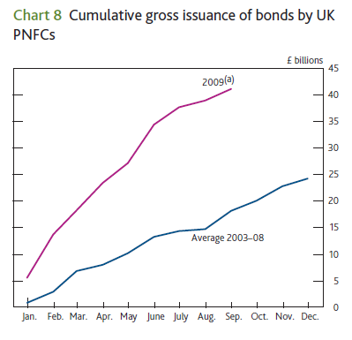

Slide 23
Federal Reserve
The Federal Reserve has pursued “unconventional” monetary policy since August 2007
Reduction in policy target rate (overnight interbank rate)
Direct lending and discounting
On balance sheet (TAF, TALF, central bank currency swaps)
Off balance sheet via special purpose entities
“Credit easing”
Focus on composition of assets, not quantity
“Quantitative Easing” since early 2009
large scale asset purchase program
“Agency” (housing GSEs) debt, MBS
Longer-dated Treasuries
Monetary base will be $2.4T 2010 Q1, with reserves balances > $1.4T (vs $10B in 2007 Q1)

Slide 24
Background in US financial instruments
Treasury securities (US Treasury)
Full faith and credit of US government
Bills (discount issues, no coupon, up to 52 weeks)
Notes (coupons, 1-10 year)
Bonds (coupons, >10 years)
Mortgage-backed securities (MBS)
Purchase mortgages, bundle into legal trust, sell shares in trust
Amortized (shorter McCauley duration)
Private issuers and federal government issuers
Private issues (investment banks as packagers)
First MBS issued privately 1970s
Few private issues until 1999-2000
Strong private issuance through 2007, few now

Slide 25
U.S. Mortgage-backed securities: Government issue
Government National Mortgage Association
(GNMA, Ginnie Mae)
Government agency
Issues backed by full faith and credit of the US government
Federal National Mortgage Association (FNMA, Fannie Mae); Federal Home Loan Mortgage Corporation (FHMLC, Freddie Mac)
Government-sponsored enterprises (GSEs)
Charter from the Congress
No explicit Congressional guarantee
Subsidies since Sept 2008
Almost equivalent to Treasury debt

Slide 26
Quantitative Easing I
New Keynesian models (sticky prices/wages, imperfect competition in product and labor markets, all financial assets perfect substitutes, inflation forecast-targeting monetary policy)
Policy rate at zero bound
Policy effect due to promise to maintain policy rate at zero for an “extended period”
What is an extended period?
When aggregate demand strengthens and forecasts suggest higher inflation, delay increasing policy rate => future higher actual inflation (above policy goal)
Sustaining the nominal rate and increasing future expected inflation => lowering future real rates => shifting spending forward
Balance sheet increases are a commitment mechanism to increase the cost of policymakers reneging on the “extended period” promise

Slide 27
Quantitative Easing II
But central bankers pledge no future higher inflation
What channel remains?
Credit channel (Bernanke and others)
In Bernanke’s writing, an amplifier to the interest rate channel, not a substitute or alternative
Bank lending channel
Operating in the US, loans readily available for good credit
Off-balance sheet bank lending (ABCP conduits) (Anderson & Gascon, FRB StL Review, 2009)
Strong bank lending 2008 Q4
Contraction in 2009 likely a good thing
Balance sheet channel
Massively alter the balance sheet of the private sector (because the elasticities of substitution among high-quality financial assets are large => small price impact)

Slide 28
Targeted Interest Rate and Monetary Base Growth

Slide 29
Up-to-date and easier to read versions are available in US Financial Data, a weekly web publication of the Federal Reserve Bank of St Louis
Composition of Federal Reserve Assets and Liabilities

Slide 30
The Federal Reserve Balance Sheet: Assets
Total assets: 2.164 Trillion (↑193 billion from 1 year ago / ↑1.28 trillion from 2 years ago)
Securities held outright: 1.69 Trillion Dollars (↑1.2 trillion)
U.S. Treasury securities: 775 Billion (↑298 billion)
Federal agency debt: 142 Billion (↑128 billion)
Mortgage backed securities: 774 Billion (↑774 billion)
Term Auction Credit: 139 Billion (↓162 billion)
Other loans: 109 Billion (↓260 billion)
Commercial Paper Funding Facility: 19 Billion (↓126 Billion)
Central Bank Liquidity Swaps: 33 Billion (↓466 billion)

Slide 31
The Federal Reserve Balance Sheet: Liabilities
Total Liabilities: 2.112 Trillion (↑182 billion from 1 year ago / ↑1.26 trillion from 2 years ago)
Federal Reserve Notes: 875 Billion (↑51 billion)
Deposits: 1.159 Trillion (↑153 billion / ↑1.133 trillion)
Depository institutions: 1.083 Trillion (↑657 billion / ↑1.063 trillion)
U.S. Treasury, general account: 31 Billion (↑11 billion / ↑26 billion)
U.S. Treasury, supplementary financing account: 30 Billion (↓529 billion)

Slide 32
Bank Lending Channel

Slide 33
Balance Sheet Channel

Slide 34
Household Balance Sheet (Billions of Dollars)
2007 Fourth Quarter
Real Estate |  | 20477.39 | Home Mortgage |  | 10485.21
Deposits |  | 7381.34 | Consumer Credit |  | 2551.95
Treasury |  | 252.31 | Bank Loan |  | 126.99
MBS |  | 689.82 | Other Loan |  | 126.99
Corporate Equities |  | 9453.03 | Security Credit |  | 325.53
Mutual Fund |  | 4575.24 | Other |  | 728.71
Pension |  | 13375.89
Other |  | 21767
Assests |  | 78228.75 | Liabilities |  | 14318.12
Net Worth |  |  |  |  | 63910.63
Perfect Substitutes !
2009 Second Quarter
Real Estate |  | 18272.03 | Home Mortgage |  | 10401.67
Deposits |  | 7760.17 | Consumer Credit |  | 2475.51
Treasury |  | 605.86 | Bank Loan |  | 118.53
MBS |  | 129.53 | Other Loan |  | 134.01
Corporate Equities |  | 6266.29 | Security Credit |  | 147.59
Mutual Fund |  | 3740.53 | Other |  | 790.67
Pension |  | 10656.29
Other |  | 19777.2
Assests |  | 67207.9 | Liabilities |  | 14067.98
Net Worth |  |  |  |  | 53139.92

Slide 35
How to End Quantitative Easing?
Many countries have done QE before (forthcoming FRBSTL Review article)
Best way (?): Cold turkey
How?
Sell assets to the public [potential losses]
RP assets to the public [losses]
Sequester in central bank “time deposits”
Sell central bank securities
Raise remuneration rate (Goodfriend, Woodford, FRBNY Review, 2002)

Slide 36
Demand for the Monetary Base
How far from a long-rate equilibrium are we?
What does demand for base money look like along a balance growth path?
Does a Stable Demand Relationship Exist?
What does “demand” mean when the quantity demanded always equals the quantity supplied?
Corollary: The private sector cannot change the size of the monetary base.
Identification is not possible.
Instability of money demand curves, it has been argued, is an issue of incorrect functional form.

Slide 37
Note added by author after lecture, 1
The slides after this one discuss seeking to estimate an empirical demand curve for the monetary base. The ideas are these:
a “demand” curve might be difficult to conceptualize because the private sector (banks, especially, for current accounts at the BOE) must hold whatever quantity of base money the central bank forces on them – they cannot alter the total with an action by the central bank
Money demand curves have a terrible reputation. They do not fit well statistically and they tend to shift a great deal. Perhaps this is due to using a poorly chosen functional form. We compare and contract three functional forms: in the first, the level of a long-term interest rate is on the right hand side (RHS) of the equation—the result is a nonlinear scatter plot plus an interest elasticity of money demand that increases in the level of the interest rate—What does this say? That the more you have already economized on cash balances, the easier it is to economize further. We find this backwards. In the second curve, the RHS includes the log of the interest rate—so, the interest elasticity of money demand is constant. The third includes the inverse of the interest rate- the scatter is more linear and, better, the interest elasticity of money demand is a decreasing function of the interest rate level—this says: as households and firms (including banks) have reduced the quantity of base money demanded, it becomes increasingly difficult to economize further (and further). This seems more sensible, to us.

Slide 38
Note added by author after lecture, 2
The current US monetary base is so large that the points fall far off the main locus. But there is one other episode with points far from the center: the 1930s, the Great Depression. Our hypothesis: financial markets became scared due to the high rate of firms defaulting on their debts and there was a “flight to quality” that caused the Federal Reserve to increase the monetary base.
We test our flight to quality story by locating a variable that perhaps measures concern with asset quality—here, the actual default rate on high-grade corporate bonds. We regress the log of the inverse of monetary base velocity (that is, said more simply, the log of the ratio of the monetary base divided by GDP) on this default rate variable and subtract the product of the regression coefficient times the default rate from the regression’s left-hand-side variable (that is, we filter out the effect of default rates). After we do this and redraw the chart, the outliers vanish—nice job!
So, is it possible that today people also are nervous regarding financial markets and quite willing to hold large quantities of base money (that is, currency and deposits at the central bank) at very low interest rates? Yes, it seems that way…

Slide 39
Note added by author after lecture, 3
We proceed by using a Box-Cox test to examine how well the three functional forms match the data. The Box-Cox equation is nice because as a single parameter (λ) moves between -1 and +1, it mimics the scatter we had on the previous slides: -1 matches the inverse rate, 0 matches the log interest rate (number 2), and +1 matches the level interest rate (example 1). The third wins because it is more linear.
But, now, we have a different problem—in equation 3 (the inverse one) the interest elasticity of money demand is a function of the level of the rate– the regression coefficient estimate is a constant but the elasticity is not. So, we draw some charts of how the interest elasticity varies with λ when the interest rate is held constant at each of three values: the minimum in the dataset, the maximum in the dataset, and the median. When the interest rate is at the median, the interest elasticity of monetary base demand changes very little as λ varies between -1 and +1. But if the interest rate is far from the median value, the interest elasticity changes dramatically as λ moves from -1 to 0 to +1. Lesson: Functional form matters!
The final slides estimate a 3-equation structural VAR model, in which the third equation might be a demand curve for the monetary base. Too much econometrics to explain here… but we like the result.

Slide 40
Data Selection 1919-present
Monetary Base: The Federal Reserve Bank of St. Louis’ adjusted monetary Base.
GDP: BEA’S annual GDP series (1929 -2008) is spliced with Balke and Gordon’s GDP series (1919 - 1946) via an index number method (splice using average of the period-by-period growth rates of the two series)
Interest Rates: Moody’s Aaa-rated corporate bond yields
Default rate: Moody’s series on defaults on investment grade corporate bonds.

Slide 41
Level of Bond Rate (Lucas, 1988) – poor model
Nonlinear
Interest elasticity is an increasing function of the level of the interest rate

Slide 42
Log Constant Elasticity Model (Cagan, 1956)
Less Nonlinear
Interest elasticity is constant

Slide 43
Log price model (inverse interest rate)
Almost linear
Interest elasticity is decreasing function of level of interest rate

Slide 45
Default on Investment-Grade Corporate Bonds

Slide 46
A Forecast of Monetary Base Velocity
Quantitative Easing!

Slide 47
A Forecast of Quarterly Monetary Base Velocity

Slide 48


Functional Form and Velocity Restriction
We applied Box-Cox transformation to the base money demand function, and the general functional form is:
We also imposed a restriction on monetary base velocity (γ = 1), and set λ0 = λ2 = 0; then the general functional form becomes:

Slide 49
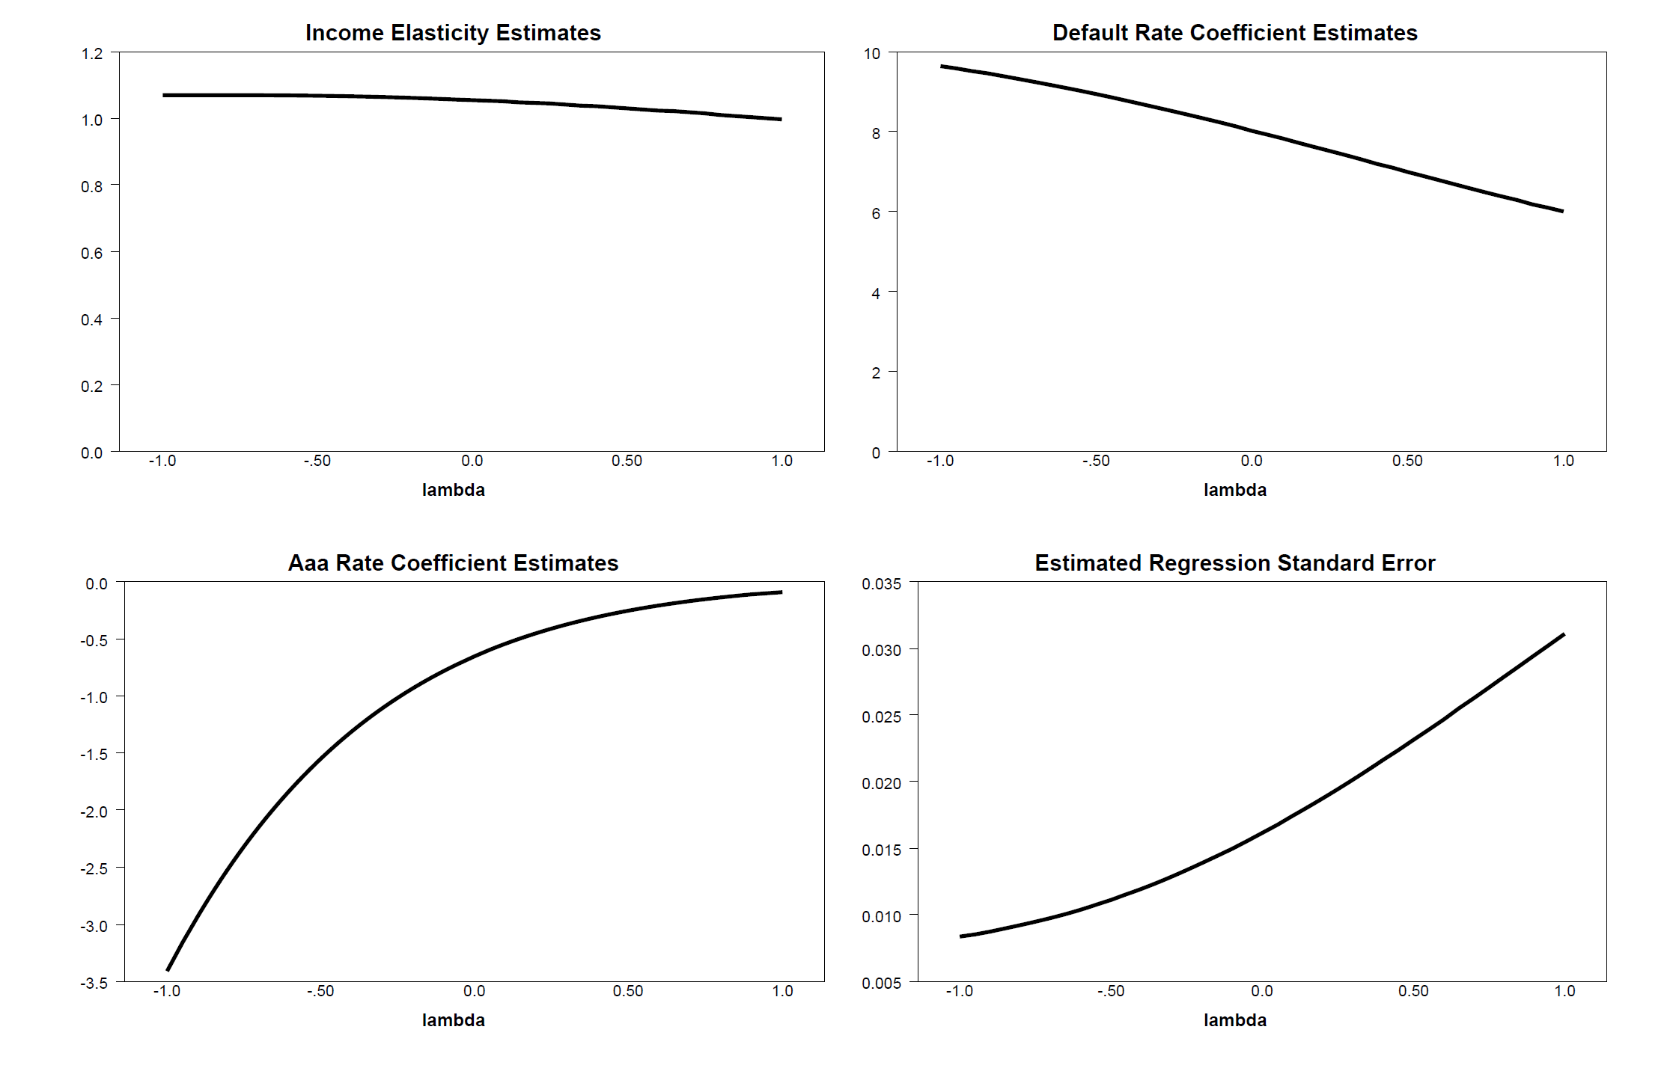
Box – Cox Transformation on Aaa Rate Variable

Slide 50
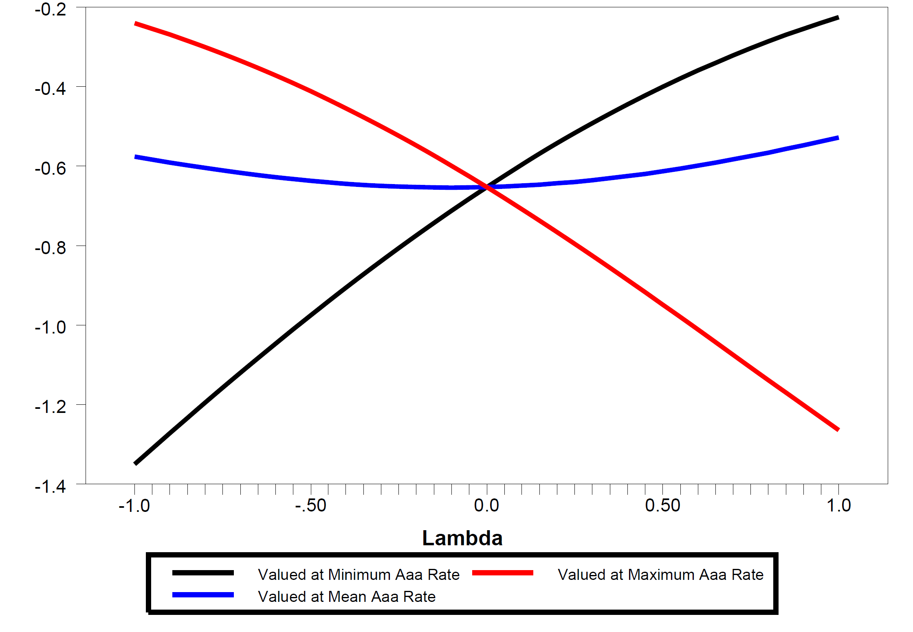
Interest Rate Elasticity Estimates

Slide 51
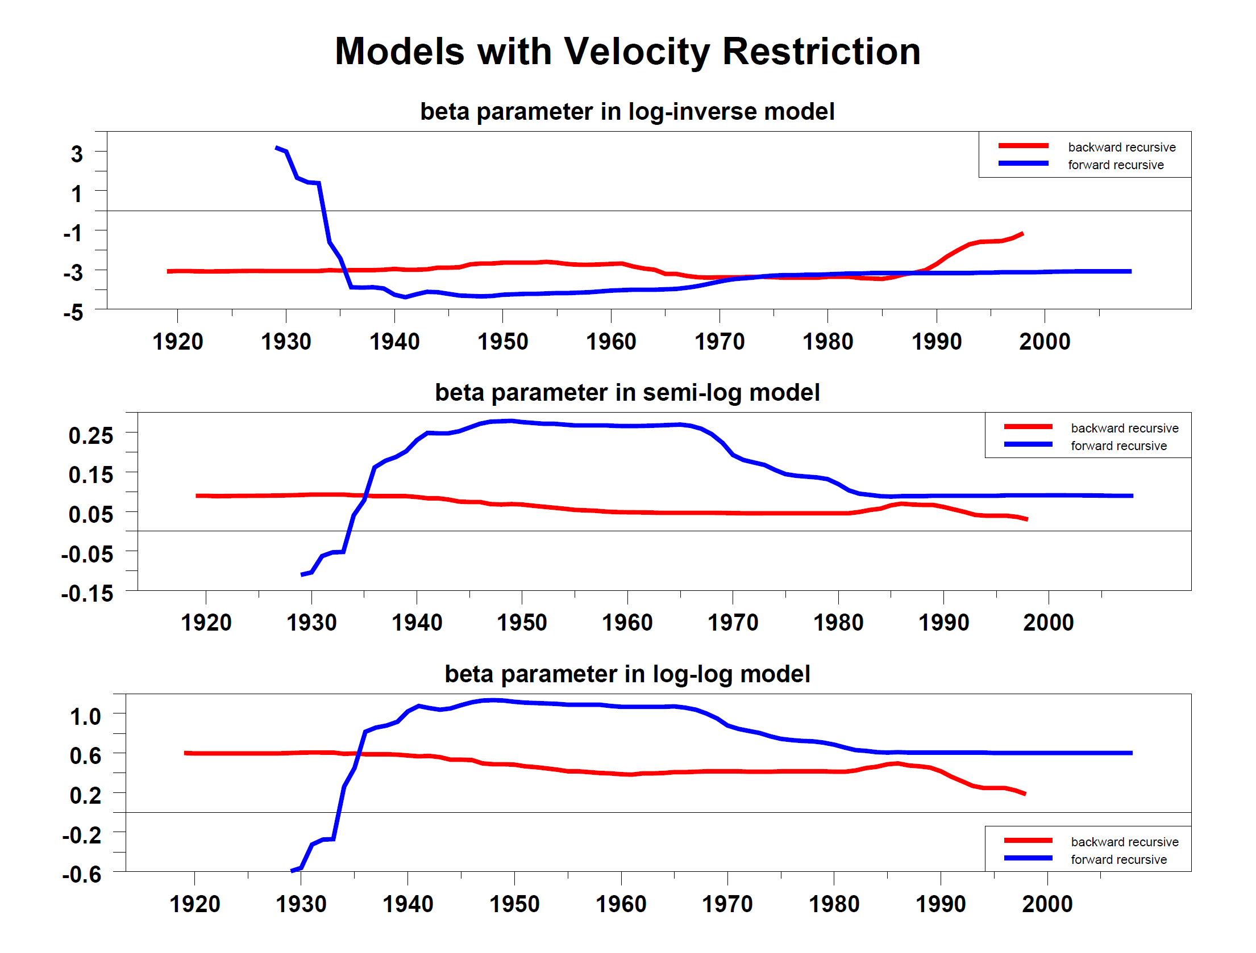
Forward and Backward Recursive Estimations

Slide 52
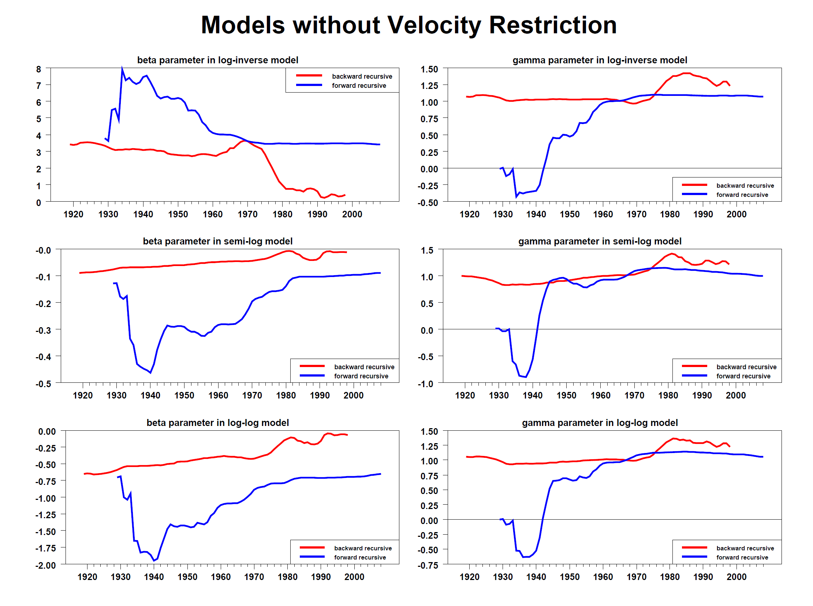
Forward and Backward Recursive Estimations

Slide 53
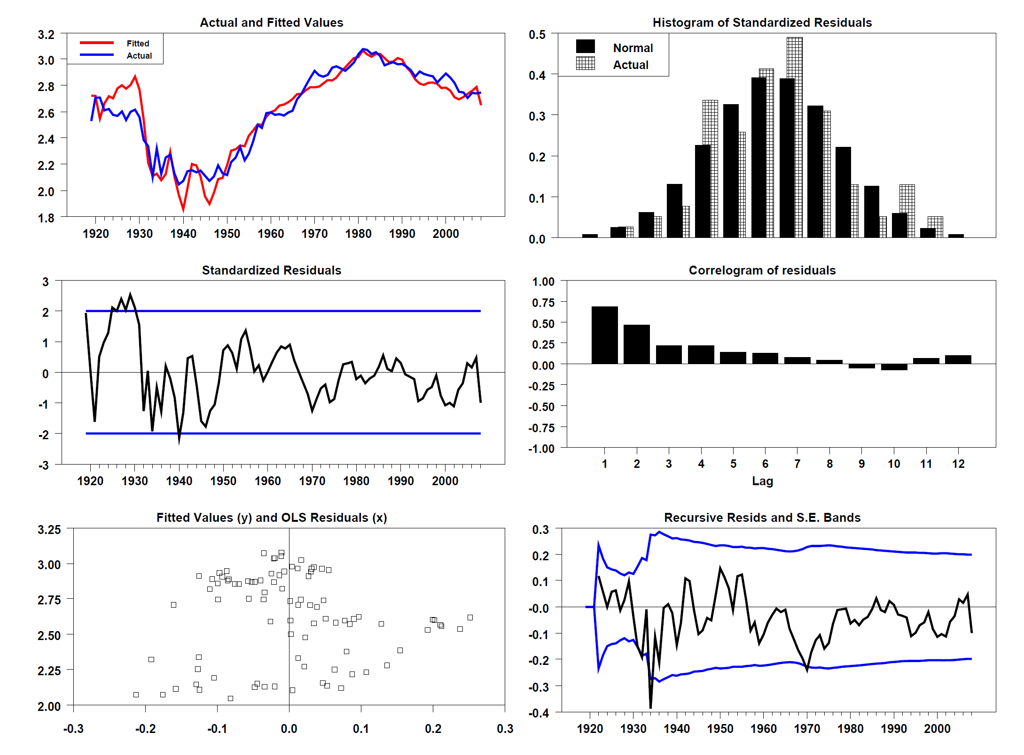
Residual Diagnostics for Log-Inverse Model with Velocity Restriction

Slide 54
SVAR Empirical Model
Three variable VAR: nominal GDP, Aaa bond rate, monetary base (plus default rate as exogenous)
One cointegrating vector (unitary income elasticity, ‘price’ of monetary base)
Order the equations such that the two equations with permanent shocks are at the top and the equation with the transitory shock is at the bottom.
Write the first two equations as a KPSW common-trends model. Identification as a Wold recursive system.
Estimate the coefficients of the third equation via instrument variables, using the residuals from the first two equations (consistent estimates of the permanent shocks) as instruments.

Slide 55
VECM Model
The Reduced-form VECM is:
After Imposing the restrictions, the VECM becomes:
where
defines the contemporaneous (simultaneous) relationships.

Slide 56
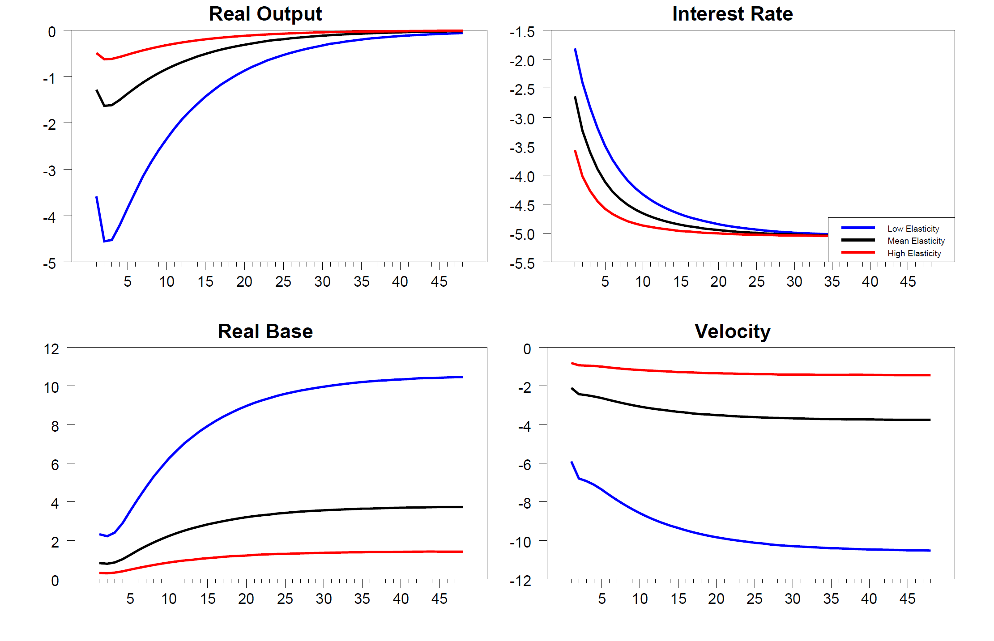
Impulse response functions, Inverse Interest Rate Shock Model with Velocity Restriction

Slide 57
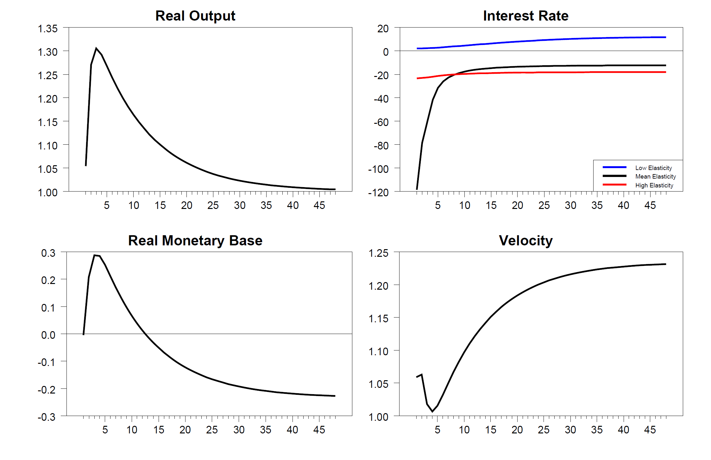
Impulse Response Functions, Real Output Shock Model with Velocity Restriction

Slide 58
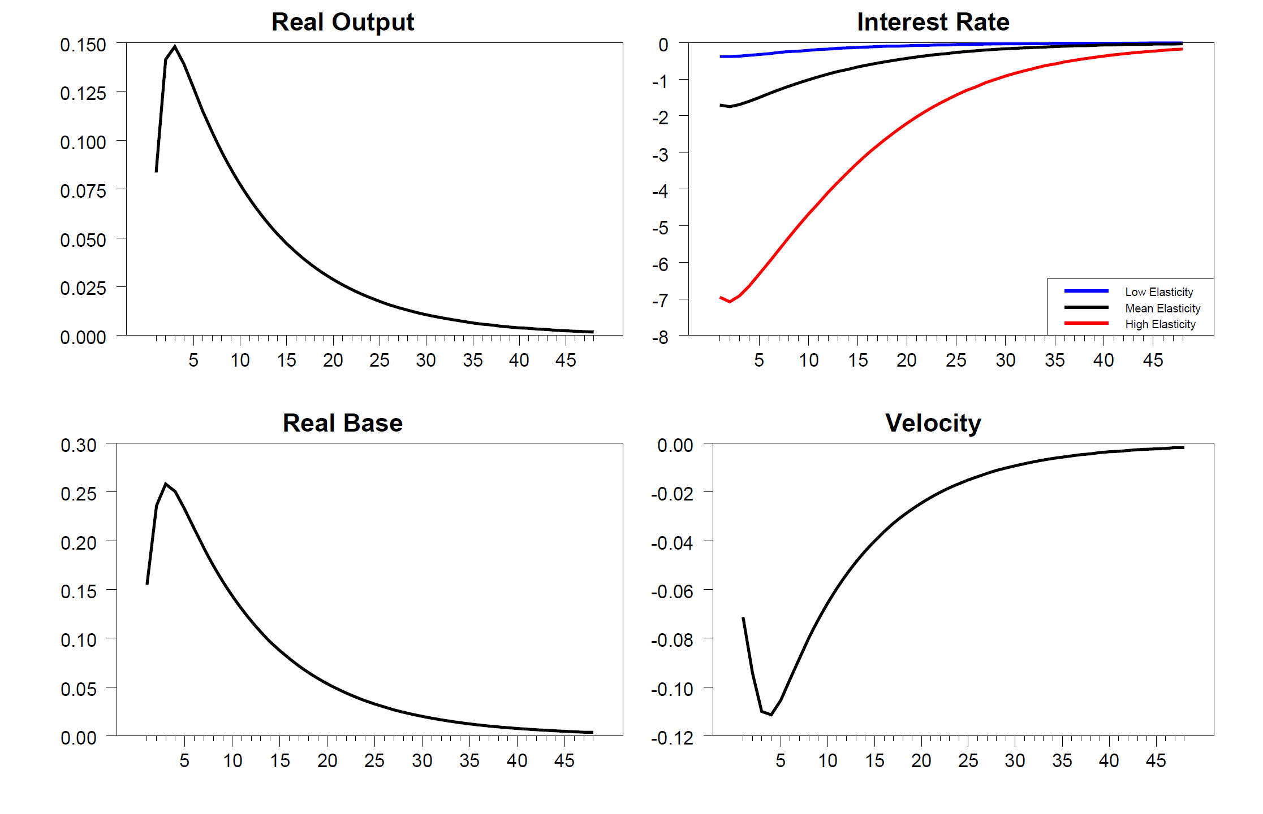
Impulse Response Functions, Real Monetary-Base Shock Model with Velocity Restriction

