Slide 1
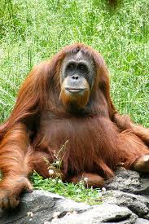
Xavier the Orang-utan
Once upon a time there was an orang-utan called Xavier. He was big and had bright orange hair, and sparkly brown eyes.
Hi havia una vegada hi va haver un orangutan anomenat Xavier. Era gran i tenia els cabells de color taronja brillant, i els ulls brillants color marró.

Slide 2
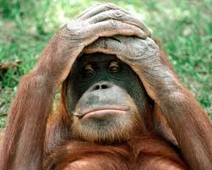
One day Xavier was moved to a new zoo, it was called Edinburgh Zoo (that’s in Scotland!). The people who came to the zoo all spoke funny! Xavier didn’t understand anything that they said.
Un dia, Xavier va ser traslladat a un nou zoològic, que es va cridar el zoològic d'Edimburg (que a Escòcia!). La gent que va arribar al zoològic tots parlaven divertit! Xavier no entenia res del que va dir.

Slide 3
Xavier tried asking the other orang-utans if they understood them, but they all talked in the same strange way. So Xavier still didn’t understand anyone and he began to feel lonely.
Xavier va intentar fer les altres orangutans si els entenia, però tots van parlar de la manera mateixa estranya. Així Xavier seguia sense entendre a ningú i va començar a sentir-se sol.

Slide 4
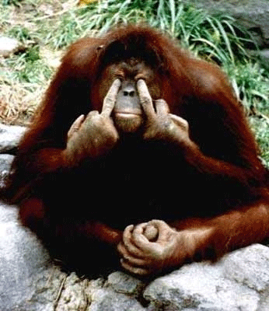
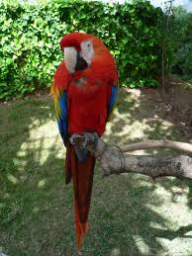
Xavier began to cry, when suddenly a parrot flew through the bars of his cage and landed by his feet, “What’s wrong? Why do you cry?” asked the parrot.
“Because I’ve got no one to talk to, no one understands me here, they all talk funny!” replied Xavier.
Xavier es va posar a plorar, quan de sobte un lloro va volar a través dels barrots de la gàbia i va aterrar als seus peus, "Què passa? Per què plores? ", Va preguntar el lloro. "Perquè no tinc amb qui parlar, ningú m'entén aquí, tothom parla divertit!“respondre Xavier.

Slide 5
“Well then how are you talking to me then? If you can’t understand anyone. Anyway what’s your name? asked the parrot.
“My names Xavier, what’s yours?”. “My names Roger”, said the parrot.
"Doncs llavors, com estàs parlant a mi llavors? Si no pots entendre ningú. De tota manera com et dius? -va preguntar el lloro. "El meu nom Xavier, el que és teu?". "El meu noms de Roger", va dir el lloro.

Slide 6

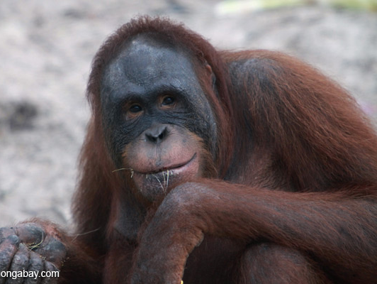

Xavier was very happy now he had someone to talk to, he was so happy he wanted to celebrate. He looked around to make sure there were no humans watching and pulled out his recorder, which he had hidden in the branches of the tree inside the cage. He started playing the most beautiful music on his recorder.
Xavier era molt feliç ara que hi havia algú amb qui parlar, estava tan feliç que volia celebrar. Va mirar al seu voltant per assegurar-se que no hi havia éssers humans observant i va treure el seu gravadora, que s'havia amagat en les branques de l'arbre, dins de la gàbia. Va començar a tocar la música més bella en la seva gravadora.

Slide 7
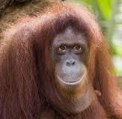
Roger began shouting out in joy, “Your fantastic!”, and all the other orang-utans started clapping, and hooting to the music. Now all the animals were very happy and Xavier no longer felt lonely.
Roger va començar a cridar d'alegria: "La seva fantàstic!", I tots els altres orangutans van començar a aplaudir, i esbroncades a la música. Ara tots els animals molt, molt feliç i Xavier ja no se sentia sola.

