Slide 1
From the Desktop to the Cloud -------------------------------------- Leveraging Hybrid Storage Architectures In Your Repository
David Tarrant, Tim Brody & Les Carr
davetaz / tdb2 / lac @ecs.soton.ac.uk
School of Electronics & Computer Science

Slide 2
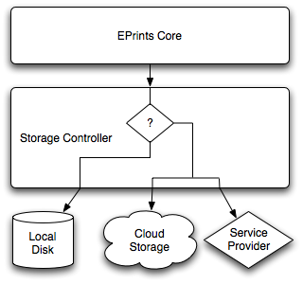
Hybrid Storage In EPrints
Using a single storage platform or solution has drawbacks.
Cost vs. Speed vs. Reliability
If repositories are to provide good preservation then they need to utilize and be able to migrate to new platforms.
In this presentation we look at backing your repository with a Hybrid storage solution.
Gives you the power to utilize the benefits of each solution without losing control of your digital objects.

Slide 3
Summary
Storage Ecosystem
Environmental study
Storage Controller
Interacting with your environment
Managing Stored Assets
Ensuring the future of your data

Slide 4
Storage ecosystem
Where can we store data?

Slide 5

Local Disk Storage
No local bandwidth costs
Hard to expand
Locally Managed
High overheads cost
Requires space and cooling
Tied closely to the software

Slide 6
Local Archival Storage
Specialist
Expensive to purchase
Locally Managed
Space and running costs
Expandable

Slide 7
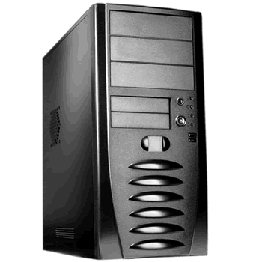
Cloud Storage
Scalable
Externally controlled
Known Costings
Unclear retention policy
Re-Useable (using simple APIs)
Global Scale

Slide 8
But Clouds Blow Away
In the last 10 months:
Yahoo Briefcase
XDrive
AOL Pictures
HP Upline
Sony Image Station
Source: Tom Spring - PCWorld

Slide 9
Why use Hybrid Storage
Use the best features of each storage type
Performance
Scaling-up bandwidth
Optimisation
Large-file handling
Multimedia streaming
Localised Delivery
Local delivery from the cloud

Slide 10
Storage Controller
Which storage should we use?

Slide 11
EPrints Storage Controller
The storage controller decides where to put a file.
Uses rule based policy defined by simple configuration file (XML)
Examples:
Large binary files of scientific data (raw machine result data) can be stored in a large disk (slower access) system and sent to a tape company for long term storage.
Processed results can be stored locally and in the cloud ready for rapid delivery to end points.

Slide 12
Architecture Diagram

Slide 13
Controller Ruleset (1)
<choose>
<when test="datasetid = 'document'">
<choose>
<when test="$parent{relation_type} = 'isVolatileVersionOf'">
<plugin name="Local"/>
</when>
<otherwise>
<plugin name="AmazonS3"/>
</otherwise>
</choose>
</when>
<otherwise>
<plugin name="Local"/>
</otherwise>
</choose>

Slide 14
Controller Ruleset (2)
<choose>
<when test="datasetid = 'document'">
<choose>
<when test="$parent{relation_type} = 'isVolatileVersionOf'">
<plugin name="Local"/>
</when>
<otherwise>
<plugin name="AmazonS3"/>
</otherwise>
</choose>
</when>
<otherwise>
<plugin name="Local"/>
</otherwise>
</choose>

Slide 15
Managing Stored Assets
How do I move data around?

Slide 16
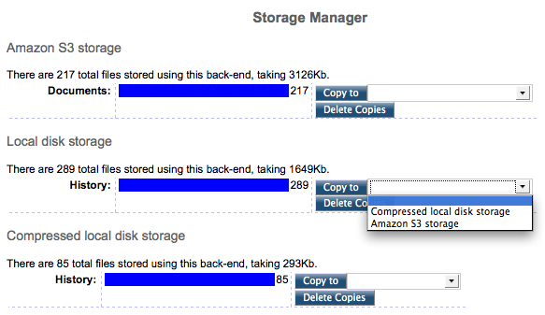
EPrints Storage Manager

Slide 17
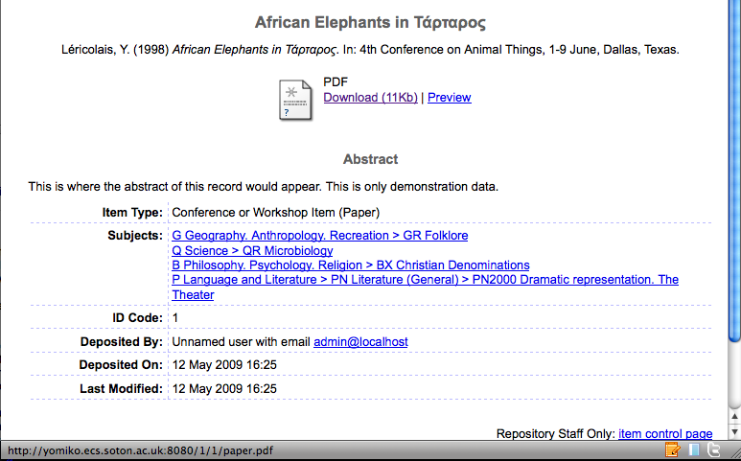
Amazon S3 Localisation (1)

Slide 18
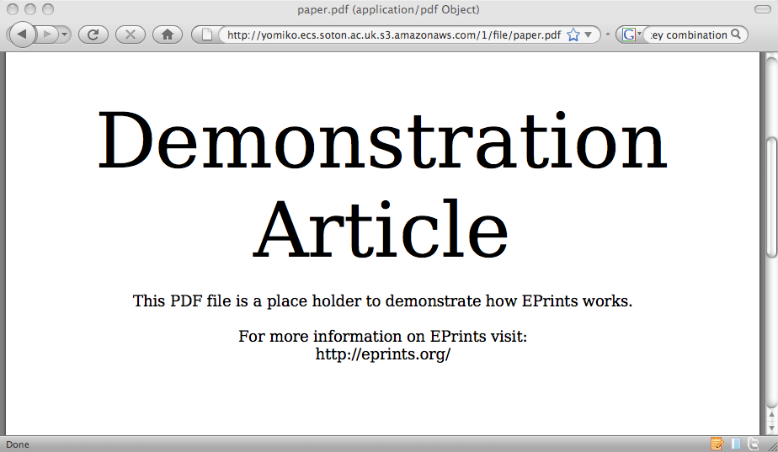
Amazon S3 Localisation (2)

Slide 19
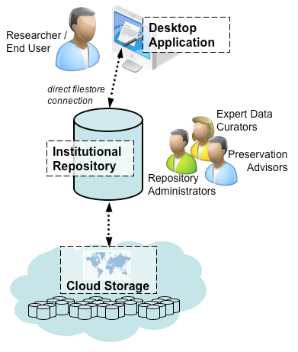
One More Thing
Full end to end integration is ready to go in EPrints 3.2
Come to our user group sessions to find out more on EPrints 3.2 and for demo’s.

Slide 20


Thank You
Storage Controller for EPrints with thanks to
David Tarrant, Tim Brody & Les Carr
davetaz / tdb2 / lac @ecs.soton.ac.uk
School of Electronics & Computer Science

