Slide 1

EPrints & Preservation
David Tarrant
University of Southampton (UK)
dct05r@ecs.soton.ac.uk
Preserv
.org.uk
Repository Preservation and Interoperability
Notes:
In this talk I’ve been asked to provide an update on the EPrints repository software
and thus I will start out will a bit of background on the aims of EPrints, how the software is developed, and what the overall aims of the development team are.
For those of you who don’t know me:
I’m currently a researche working on the Preserv2 project, about which I talk a little later in this presentation.
I work directly with the leader of the EPrints and Preserv2 projects, Les Carr and am currently tasked with the responsibility of investigation opportunities for preservation services within Digital Repositories. Working directly with the department which develops EPrints has led to an easy way to integrate the preservation services I have been developing directly into an already popular piece of repository management software.
Before we get to all of that I thought I’d recap why we are all talking about preservation how repositories already provide some basic form of preservation.
and what the EPrints repository software in trying to achieve.
Firstly why do we need a repository?

Slide 2

Grassroots Preservation
Small Science > Big Science
“The sum of the smaller parts adds up to a greater number than that of the bigger parts combined”
“Grassroots” preservation for Institutional and Small Business Outputs
Notes:
By grassroots preservation we are talking metaphorically about viewing output from small science being as important as that of Big Science.
For example in a big company, such as a media company or national library, preservation often gets large amounts of funding and is seen as a core activity for the future. This can be seen as a combine harvester type approach, where a single controlled process model for preservation is created.
However even if you add the output of the larger scientific institutions together you still fall way short of the number of records produced by all the smaller guys put together. These grass cuttings is what EPrints is aimed at collecting and ingesting into an institutional repository, about which policies can be made regarding preservation activities.
EPrints was thus initially designed to be simple and clear to use such that researchers would willingly submit their “important” outputs into a repository.
The focus was to also not just collect the documents but also their related metadata, such as authors, publication location, publication type etc.
With grass cuttings starting to be collected, at the end of the last meeting we asked the question about bringing these grass cuttings together to form a global collection, this idea I will come back to later, if in a slightly different manor.

Slide 3

: Core Objectives
Lower the barrier for depositors while improving metadata quality and ultimate collection value
Time saving deposits
Import data from other repositories and services
Autocomplete-as-you-type for fast data entry
Name authorities
Enter once, reuse often
Works with bibliography managers, desktop applications and new Web 2.0 mashups
RSS feeds and email alerts keep you up to date
Easily integrate reports, bibliographic listings, author CVs and RSS feeds into your corporate web presence
Used for corporate reporting and national Research Assessment
• Simple platform for open source contributions
Tightly-managed, quality-controlled code framework
Flexible plug-in architecture for developing extensions
Import
XML
BibTeX
PubMed
CrossRef
OAI-ORE
ACM Digital Library
EndNote
Spreadsheet
EPrints
OBJECT STORE
metadata + data
Fully searchable and scriptable
XML
Google Maps
ORE Resource Map
OAI-PMH
Simile Timeline
Bibtex Endnote PubMed
Export
Notes:
So a little about the structure and roots of EPrints.
This slide outlines a lot of the history and core concepts in EPrints which led to the software being developed in a plugin based fashion.
At the outset EPrints had the idea of Import and Export plugins which could be managed and controlled from the EPrints core.
This is the key concept which has now been taken much further in version 3.0,3.1 and on into 3.2.

Slide 4



: Architecture
EPrints is expanding the number places in which plug-ins can be utilised.
Import Plug-ins
Export Plug-ins
EPrints Core
Interfaces, Submission Manager
Database Controller
Storage Controller
CLOUD (Amazon S3)
Diagram Represents Proposed EPrints 3.2 Architecture
Notes:
So this slide shows the new plugin layer to handle multiple database storage engines which is incorporated in EPrints 3.0 as well as the new Storage Controller plugin layer which is being developed at part of EPrints 3.2.
The Storage Controller abstracts the storage layer into a set of simplistic API calls against which storage plugins can be developed to store the contents of your repository on storage platforms other than local disk, e.g. cloud storage and preservation specific storage solutions.
The Storage Controller also has a built in rules language which allows you to store objects in different or multiple places depending on a set of conditions such as file type or size.

Slide 5

The Storage Controller
Each item can be stored using a different storage plug-in (hence in a different place) dependant on file or metadata properties and values.
e.g. Large binary files of scientific data (raw machine result data) can be stored in a large disk (slower access) system and sent to a tape company for long term storage.
Processed results can be stored locally and on a honeycomb server where they are preserved.
Allows a repository to use a 3rd party storage platform
Direct deposition into a honeycomb etc
Great enabler for preservation
Let the repository control the deposit process.
Ensures that the complete object is preserved and not just the “harvested” bits
Notes:
We are quiet excited about the storage controller as we have tried to give as much power and flexibility to the users as possible.
For this reason the storage controller does not just allow a single storage plug-in to be used, you can use as many as you want simultaniously!
EPrints stores several files alongside the users deposited item, such as a full text index and thumbnail. These can also be stored in various different locations.
You can also separate you files depending on type and size, so large non changing binary files could go to be archived. The example I give here is relating to that of the eCrystals project where they collect gigabytes of raw results from scientific machines but they only store the small processed results in their repository.
The storage layer provides them with a mechanism of being able to store these large binary files by passing them out to a larger long term server or archive and still be able to reference them and locate them within their repository.
Preservation capabilities are also enhanced with the storage layer. We see harvesting as a secondary ideal when it comes to accurate preservation. If the repository is handling direct deposition into a preservation services provider the data that service receives is likely to be much more accurate than that output by a harvester.
To store an object in a preservation service or server the repository could just store it twice using 2 different storage plug-ins.

Slide 6

Open Storage for Repositories
Simple, open, managed storage.
Advanced features built in:
ZFS
Error and Bit Shift Correction
Metadata Layer
Simple API
Store
Retrieve
Delete
Simple to interface with Repository Software
RAID 6
Notes:
Preservation 101 – Why would you want to use a better storage service to store your objects on? A: Long term storage, reliable, distributed, resilient.
Not that Amazon S3 is promised to be long time, but it is distributed and reliable.
This slide basically outlines what Open Storage for Repositories should consist of, these aims align nicely with the Honeycomb ideas of which Sun Microsystems was working towards and still is to some extent.

Slide 7
The Preservation Process
Preservation - Check
Bit checking & checksum calculation
Preservation - Analyse
What is the type of file, is the file valid?
Is the file at risk of not having an editor/reader?
Is there a better format available? Lossless or Lossy?
Preservation - Action
File migration to avert risks found by analysis.
Movement of file to new storage.
Notes:
So what is preserv doing now.
Lets look at the Preservation process.
This slide gives a breakdown from my point of view of the preservation process. Each stage of which I’m going to address in the course of this talk.
We have already covered the first section on checking which should be managed by your storage platform.

Slide 8



Preservation - Analysis
Preservation - Analyse
What is the type of file, is the file valid?
Droid is a good classification tool for this.
Is the file at risk of not having an editor/reader?
Functionality is being developed in PRONOM technical registry.
Is there a better format available? Lossless or Lossy?
Planets registry of tools.
Notes:
Quick overview of some analysis and recommendation services and service providers.
Many people already know about the DROID tool from The National Archives (UK) which uses file signatures to classify your files by looking at their content.
Alongside DROID exists PRONOM which is the TNA’s registry of file formats and metadata relating to these files. This is soon going to be expanded with a risk analysis service which can provide you with a risk score for your files (as classified by DROID).
Lastly in the analysis stage exists the still evident need for a registry of tools which can be utilised to aid the preservation process, weather this be to perform further classification or identification of attributes such as significant properties, or to locate tools which can enable you to migrate/transform files which have been identified as at risk.

Slide 9
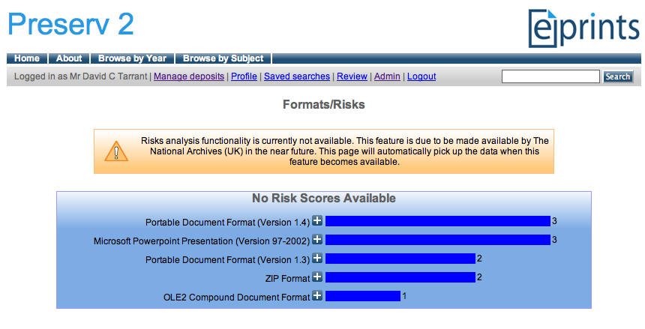
Preservation - Analysis
Preservation - Analyse
EPrints File Classification
Notes:
(not available yet in any EPrints distribution)
This slide shows the DROID output interface in EPrints where your repository manager is now aware of which objects are classified, in need of classification, or have encountered problems during classification.
So here I have ingested the classification document which DROID output from it’s classification process.

Slide 10
Risk Analysis
Preservation - Analyse
Is the file at risk of not having an editor/reader?
Functionality is being developed in PRONOM technical registry.
Simple SOAP web service
Takes file format identification id’s, hands back risk score.
Breakdown of risk score may also be available in future releases.
A stub you can download and run providing this functionality before the official release with mock up risk scores is available at http://preserv2.googlecode.com
Notes:
A little more on the risk analysis service which is soon going to be available via the PRONOM registry.
PRONOM is a web service you invoke with SOAP calls. For the purposes of risk analysis there is soon to be a service available which will provide you a risk score for each format as identified by DROID. This risk score is calculated from many factors using a formula as derived by The National Archives (TNA – UK) which provides a single figure between 0 and 3000. It is hoped that when this service is deployed publically that the breakdown of the risk score will also be available such that each repository will be able to apply their own formula dependant on their preservation policy.
Due to this functionality not being publically available yet, the preserv2 project has put together a piece of stub code which emulates this functionality. This is used here for the purposes of coding future interfaces against. At a later data the pointer in the interface can be changed to reference the actual distribution.

Slide 11
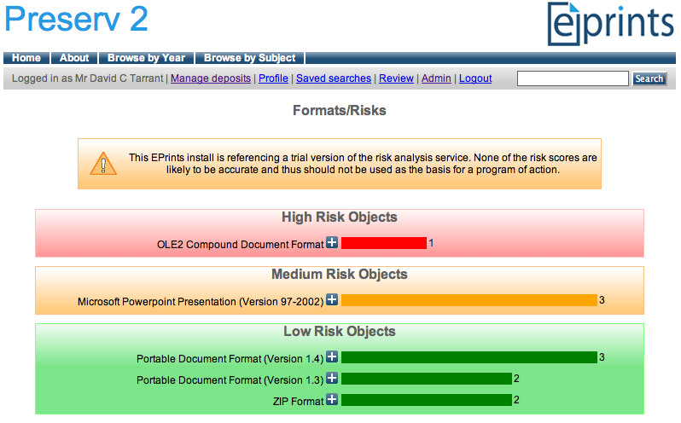
Risk Analysis
Preservation - Analyse
EPrints File Classification + Risk Analysis
Notes:
This slide shows the same screen in EPrints as a couple of slides before except this time we have switched on the risk analysis service.
This screen enables the repository administrators to view the risks related to the content within their repository in a simple traffic light based manner.

Slide 12
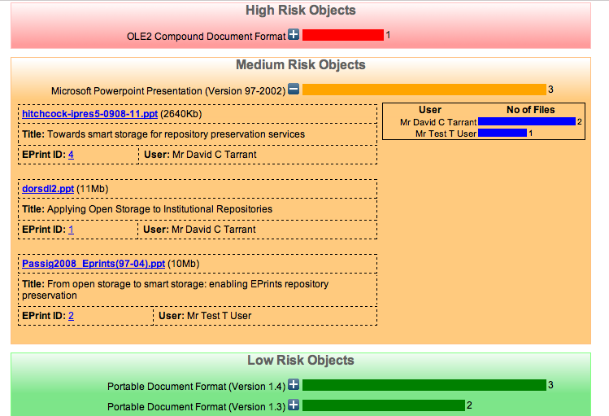
Risk Analysis
Preservation - Analyse
EPrints File Classification + Risk Analysis
Notes:
Expanding one of the boxes allows us to view the EPrints and files related to these EPrints which have been identified as at risk.
Managing file risks from within the repository has some advantages over this being an external process. Firstly if a new low risk file has already been generated we can use the internal metadata structure of the repository to state that a higher risk file has a safer copy, allowing us to keep the original and remove it from the high risk display. Secondly we can identify other patterns affecting the risks to files in the repository such as the depositing user, if a single user or machine in providing all of the high risk files this maybe more successfully dealt with externally to the repository preservation process.

Slide 13
Transformation?
Preservation - Action
Mock up Transformation Interface
Migration Tools
Tool Preservation Level
PPT -> PPTX
PPT -> PDF
Notes:
This slide shows the final part of development relating to this admin service.
Here I have mocked up a possible display of migration or transformation tool available for the at risk formats and their effectiveness or preservation level. The preservation level relates to the loss level of the new format compared to the old, so if all abilities and significant properties are preserved then we can say that this transformation is 100% effective.
For this functionality to be available we would look to develop a registry of tools and profile these tools such that these scores can be generated and displayed. These profiles could related directly to the risk scores stored within PRONOM and thus the same local profiling could be used to rate tools differently depending on the requirement of the individual repository. The Planets project (specifically in the context of the PLATO tool) is looking into how to enable this functionality and push the results into the PRONOM registry.
There is still more work to be done but this interface shows what can be done with the current tools as well as those which are in development.

Slide 14

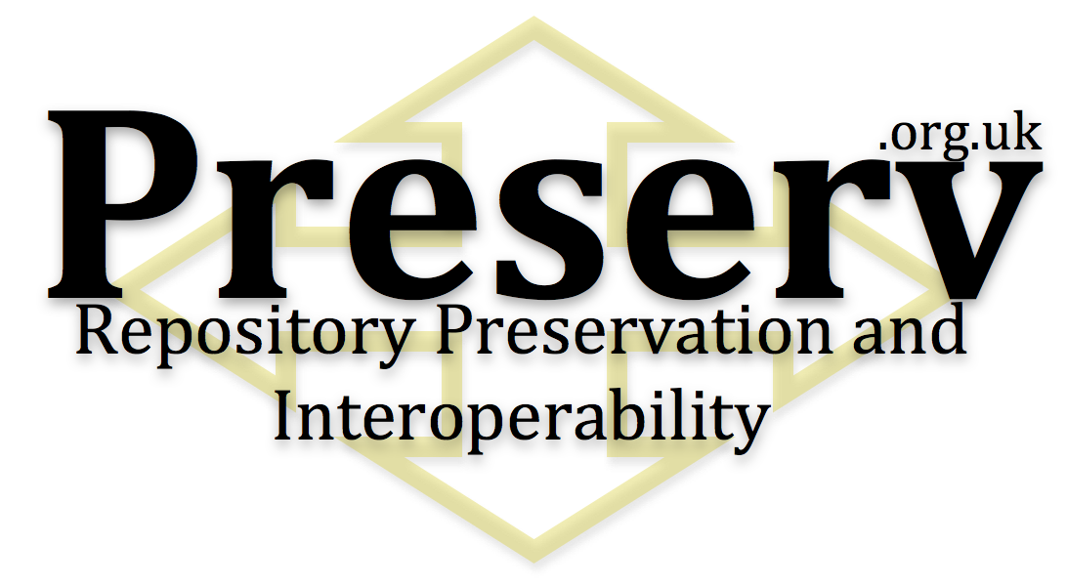

Many Thanks!
David Tarrant
Les Carr
Steve Hitchcock
Steve Hitchcock
Tim Brody
Adrian Brown
Neil Jefferies
Ben O’Steen
Sally Rumsey

