Slide 1




Knowledge and Understanding
of the World

Slide 2
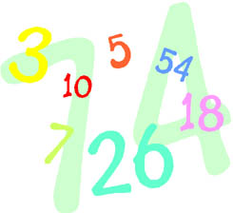

Problem Solving,
Reasoning and
Numeracy

Slide 3
Communication,
Language
and Literacy

Slide 4
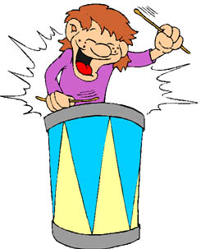
Creative
Development

Slide 5
Physical
Development

Slide 6
Personal,
Social and
Emotional
Development

