Slide 1
Attention, Please! Getting the Focus on Open Access
Alma Swan
Key Perspectives Ltd
Truro, UK

Slide 2
Attention, please!
Whose attention?
Attention to what?
How to get their attention?
Will you be able to keep it?
Key Perspectives Ltd

Slide 3
Advocate to whom?
Library colleagues
Researchers
Institutional managers
Different messages for each constituency
Sub-constituencies (e.g. disciplinary areas)
What are you going to say to whom?
Key Perspectives Ltd

Slide 4
Part One Open Access: very quick overview
Key Perspectives Ltd

Slide 5
Open Access
Journals
Repositories
What are the drivers?
Who is influencing progress?
What is influencing developments?
Key Perspectives Ltd

Slide 6
Open Access journals
Currently 4270 listed in the DOAJ (www.doaj.org)
Some are doing very interesting things
Peer review
Web 2.0-type systems
Fewer than 50% levy an article-processing charge (APC)
Vary with respect to permissions
What should you say about permissions?
Key Perspectives Ltd

Slide 7
Open Access repositories
Currently 1432+ worldwide
Key Perspectives Ltd

Slide 8
Repositories: where they are
Key Perspectives Ltd

Slide 9
Open Access repositories
Currently 1432+ worldwide
OAI-PMH compliant
Indexed by Google and Google Scholar (amongst others)
A tool for researchers, institutions and funders
Key Perspectives Ltd

Slide 10
What are the drivers?
Open Access
Research assessment
Research monitoring and management
Value for money and return on investment (ROI)
Joined-up institutions
Digital research data
Key Perspectives Ltd

Slide 11
Who is influencing progress?
Research funders
Institutional managers
Researchers (some)
Open Access advocates!
Key Perspectives Ltd

Slide 12
What is influencing developments?
Technology
Basic interoperability
More exciting things:
citation analysis (bibliometrics)
research analysis (scientometrics)
Experiments to change established practices:
peer review
dissemination (‘publishing’)
Research data policies
Key Perspectives Ltd

Slide 13
Part Two Advocacy to researchers
Key Perspectives Ltd

Slide 14
Promoting OA journals
Add DOAJ content to your library catalogue
Inform authors about article-processing charges (APCs)
Consider an institutional fund to help pay APCs
Encourage researchers to launch an OA journal
Encourage researchers to start a discussion with their societies about making their journals OA
Key Perspectives Ltd

Slide 15
Repositories: researcher issues and worries
Copyright, copyright, copyright
How long will all this take?
I already put my papers on my website
How will people know to look in my repository?
What is all this going to do to my society?
Won’t this bring down the publishing system?
I’m confused: what is the difference between OA journals and repositories?
Key Perspectives Ltd

Slide 16
What wins researchers over?
Time savings:
CVs
Reference lists
‘Reprint’ (e-print) distribution
Institutional regulations (mandates)
Funder regulations (mandates)
Self-interest:
Increased visibility for their work (Google, Yahoo)
Increased impact for their work
Key Perspectives Ltd

Slide 17
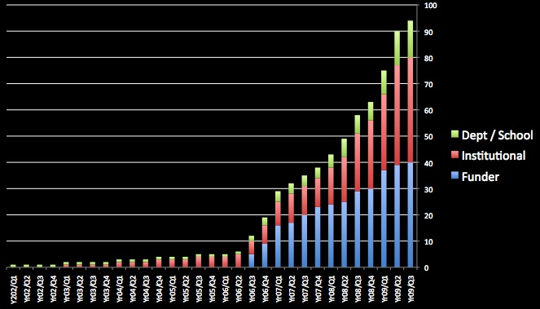
Mandates to date
Key Perspectives Ltd

Slide 18
Author readiness to comply with a mandate
5%
14%
81%
Key Perspectives Ltd

Slide 19
An author’s own testimony on open access visibility
“Self-archiving in the PhilSci Archive has given instant world-wide visibility to my work. As a result, I was invited to submit papers to refereed international conferences/journals and got them accepted.”
Key Perspectives Ltd

Slide 20
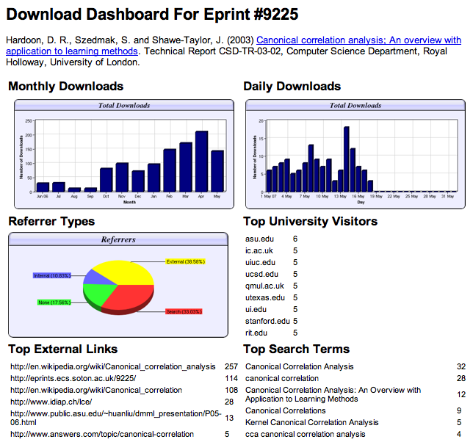

Slide 21
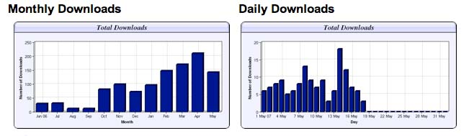
Download timelines
Key Perspectives Ltd

Slide 22
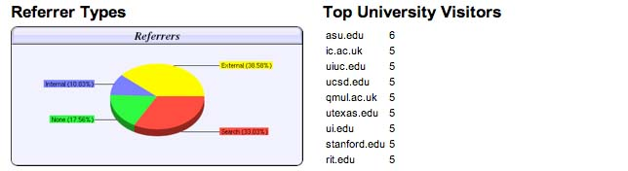
Referrers
Key Perspectives Ltd

Slide 23
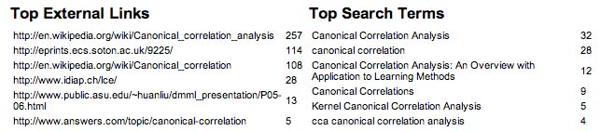
Links and search terms
Key Perspectives Ltd

Slide 24
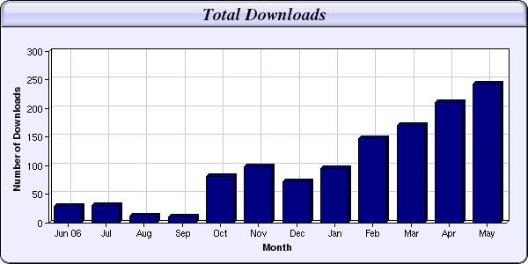
Every e-print tells a story…
NIPS Workshop linked to this eprint from its web page
Link placed on “Canonical correlation” page in Wikipedia
Key Perspectives Ltd

Slide 25
Citation impact
% increase in citations with Open Access
Range = 36%-200%
(Data: Stevan Harnad and co-workers)
Key Perspectives Ltd

Slide 26
Increased impact for a researcher
Key Perspectives Ltd

Slide 27
Key Perspectives Ltd

Slide 28
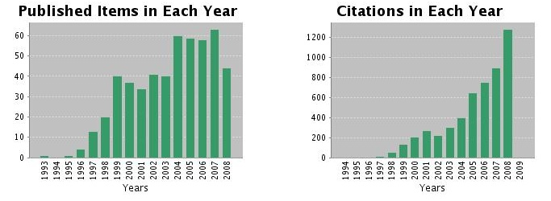
Ray Frost’s impact
Key Perspectives Ltd

Slide 29
What can the Library do to help in practical terms?
Use mandatory policies to underpin your advocacy where possible
Advocate the benefits to researchers
Provide copyright advice
Demonstrate how to deposit
Enrol administrative staff in departments, who may end up doing the depositing
Engage researcher ‘champions’
Engage Heads of Department/School
Instigate or encourage reward schemes
Key Perspectives Ltd

Slide 30
Examples of reward schemes
Strathclyde: champagne for 1000th deposit, 5000th deposit, etc.
Reward authors of ‘top’ articles (but be careful, as this can also disincentivise)
Pay for deposit (Minho)
QUT’s Faculty of Education offers campus bistro/café vouchers for:
top 50 depositors, top 50 downloaded papers, etc.
adding the repository ID to their email signature
Key Perspectives Ltd

Slide 31
QUT Faculty of Education: vouchers for deposit and
Effect of introducing the deposit voucher scheme:
July 2008: 28 deposits
August 2008: 85 deposits
September 2008: 111 deposits
Key Perspectives Ltd

Slide 32
QUT Faculty of Education: eprint signatures
"In the final week of the ePrints Extravaganza, all staff or students who have an e-Print link on their email signature, will be eligible for a Beadles Drink Voucher. To claim your voucher, email clisra@qut.edu.au by 19 September 2008 and include “My e-Print link” in the subject line. CLI staff will be able to see your email signature at the bottom of this email. An example of a link is below.”
Centre for Learning Innovation, Queensland University of Technology, Victoria Park Road, Kelvin Grove, 4059 Email: XXXX Phone: 0000 Publications: http://eprints.qut.edu.au/view/person/Researcher_Name.html
“eprint buddies”: incentive for encouraging others to add the signature to their emails
Key Perspectives Ltd

Slide 33
Part Three Advocacy to institutional managers
Key Perspectives Ltd

Slide 34
Managerial issues and worries
Cost (surprise!)
What is the benefit to this university?
How does it align with the university’s strategy?
How difficult will it be?
Copyright
The publishing system
Am I alone? Are you asking me to put my head above the parapet?
Key Perspectives Ltd

Slide 35
What wins institutional managers over?
Moral argument (public money, public good)
Enlightenment about what can be done better in the Age of the Web
Practical and pragmatic institutional reasons
Visibility
Impact
Rankings
Key Perspectives Ltd

Slide 36
Repository business issues and costs
Yes, there is a cost (so you must make the case on a cost/benefit basis)
Average set-up cost is about €10K
Average resourcing is 0.5 – 2.0 FTEs
Make a case aligning the repository with the institution’s mission
Inform managers about the changing scholarly communication system
Position the Library as a strategic partner in achieving institutional aims
Swan, A. (2008) The business of digital repositories.
In: A DRIVER's Guide to European Repositories (Amsterdam, 2007), Amsterdam University Press http://eprints.ecs.soton.ac.uk/14455/
Key Perspectives Ltd

Slide 37
Why an institutional repository?
Helps to fulfil a university’s mission to engender, encourage and disseminate scholarly work
Forms a complete record of its intellectual effort
Forms a permanent record of all digital output
Provides maximum Web impact for the institution
Maximises the impact of the institution’s research (usage and citations)
Enables better research monitoring and management
Opens up economic (funding) opportunities
Key Perspectives Ltd

Slide 38
Why an institutional repository?
Helps to fulfil a university’s mission to engender, encourage and disseminate scholarly work
Forms a complete record of its intellectual effort
Forms a permanent record of all digital output
Provides maximum Web impact for the institution
Maximises the impact of the institution’s research (usage and citations)
Enables better research monitoring and management
Opens up economic (funding) opportunities
Key Perspectives Ltd

Slide 39
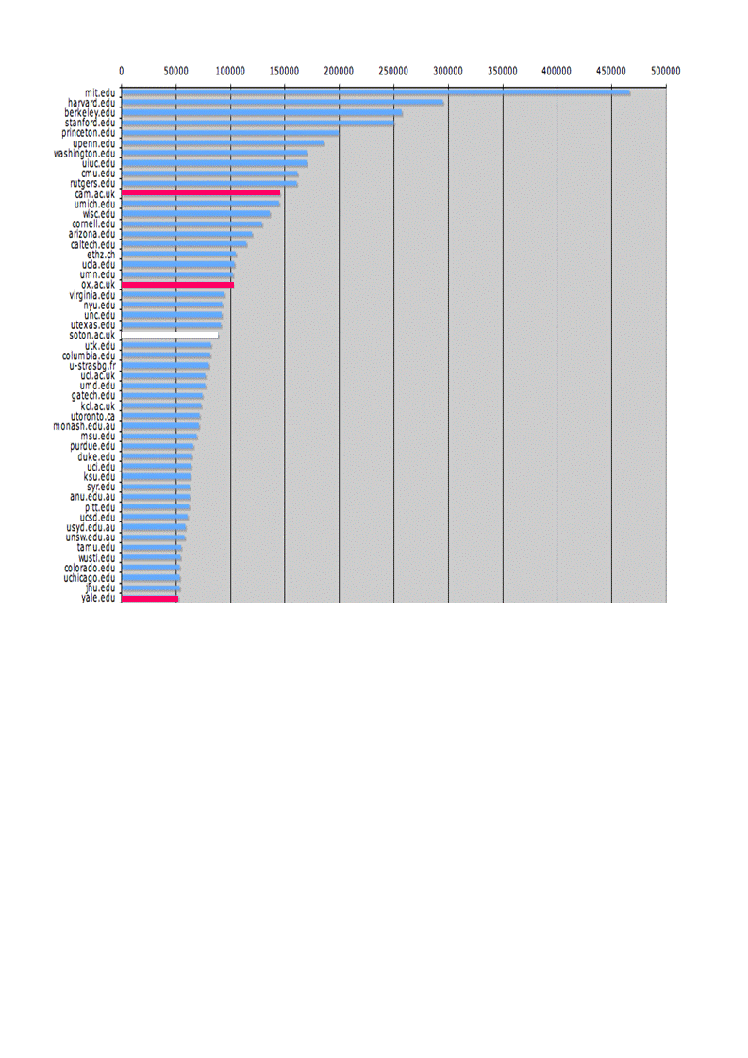
Web impact: “The U.Southampton conundrum”
The G-Factor (universitymetrics.com)
Key Perspectives Ltd

Slide 40
Key Perspectives Ltd

Slide 41
Why an institutional repository?
Helps to fulfil a university’s mission to engender, encourage and disseminate scholarly work
Forms a complete record of its intellectual effort
Forms a permanent record of all digital output
Provides maximum Web impact for the institution
Maximises the impact of the institution’s research (usage and citations)
Enables better research monitoring and management
Opens up economic (funding) opportunities
Key Perspectives Ltd

Slide 42
Citation impact
% increase in citations with Open Access
Range = 36%-200%
(Data: Stevan Harnad and co-workers)
Key Perspectives Ltd

Slide 43
A well-filled repository
Key Perspectives Ltd

Slide 44
Usage impact
N.B. Downloads are a good predictor of citations
Key Perspectives Ltd

Slide 45
But most repositories have problems
Collecting content
‘Self-archiving’ rate is still low
Overall Open Access rate is 15-20%
Mandatory policies are needed to boost this
Key Perspectives Ltd

Slide 46
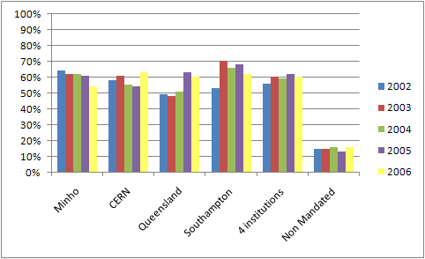
Do mandates make a difference?
Source: Gargouri & Harnad, 2009
Key Perspectives Ltd

Slide 47
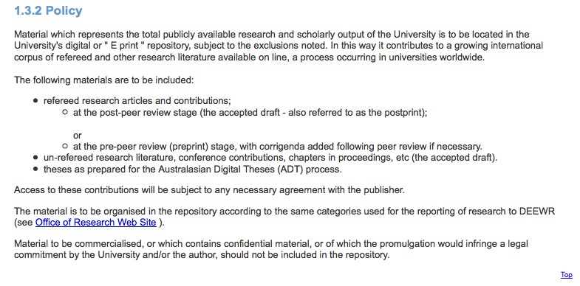
QUT’s policy on the repository
Key Perspectives Ltd

Slide 48
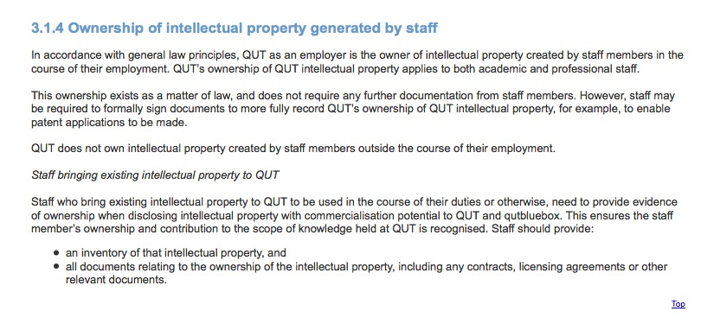
QUT’s policy on IP
Key Perspectives Ltd

Slide 49
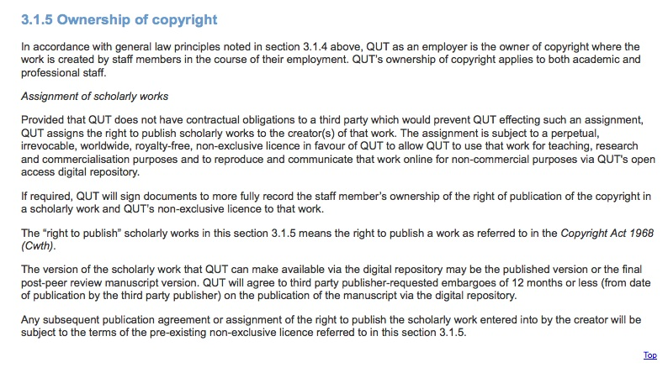
QUT’s policy on copyright
Key Perspectives Ltd

Slide 50
Lost citations, lost impact
Only around 15% of research is Open Access…
… so 85% is not
… and we are therefore losing 85% of the 50% increase in citations (conservative end of the range) that Open Access brings (= 42.5%)
Key Perspectives Ltd

Slide 51
What this means to the University of Utopia: citations
2004-8: 5000 articles
Number of citations: 15000
If all had been OA, there would have been (42.5% more) 21375 citations
Key Perspectives Ltd

Slide 52
What this means to the University of Utopia: money
Since the University of Utopia invests € 0.5 bn in research per annum …
…this means lost impact (the 42.5%) worth € 0.21 bn to the university in one year
Or, the University of Utopia would need to spend € 0.21 bn MORE per year to get the same extra impact that Open Access provides (for free)
Key Perspectives Ltd

Slide 53
Why an institutional repository?
Helps to fulfil a university’s mission to engender, encourage and disseminate scholarly work
Forms a complete record of its intellectual effort
Forms a permanent record of all digital output
Provides maximum Web impact for the institution
Maximises the impact of the institution’s research (usage and citations)
Enables better research monitoring and management
Opens up economic (funding) opportunities
Key Perspectives Ltd

Slide 54
Measure and manage research
Who is producing what?
How much collaborative work is being done?
With which other institutions?
Which research groups are performing best?
Is our engineering department as good as theirs?
Where is our research being published / performed / installed?
How much impact it is having (by measuring citations and other things)?
What ROI are we getting?
Key Perspectives Ltd

Slide 55
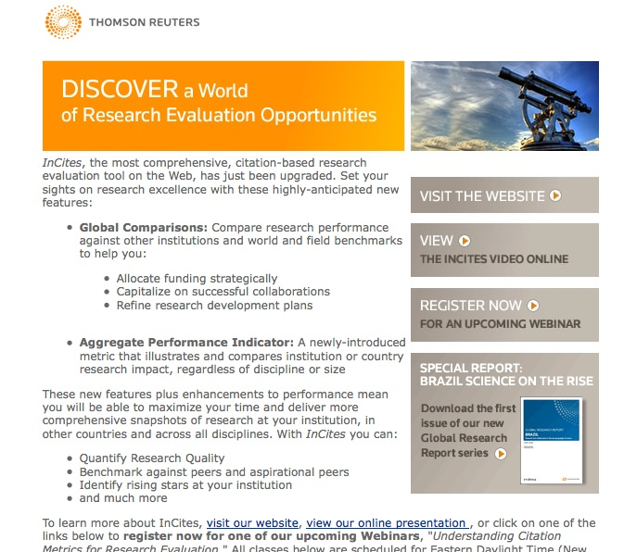
Key Perspectives Ltd

Slide 56
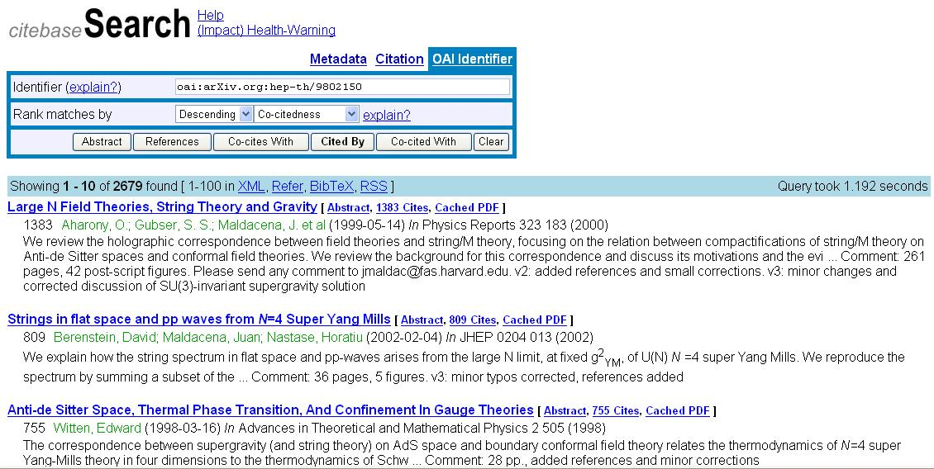
CiteBase: a tool for research management
Key Perspectives Ltd

Slide 57
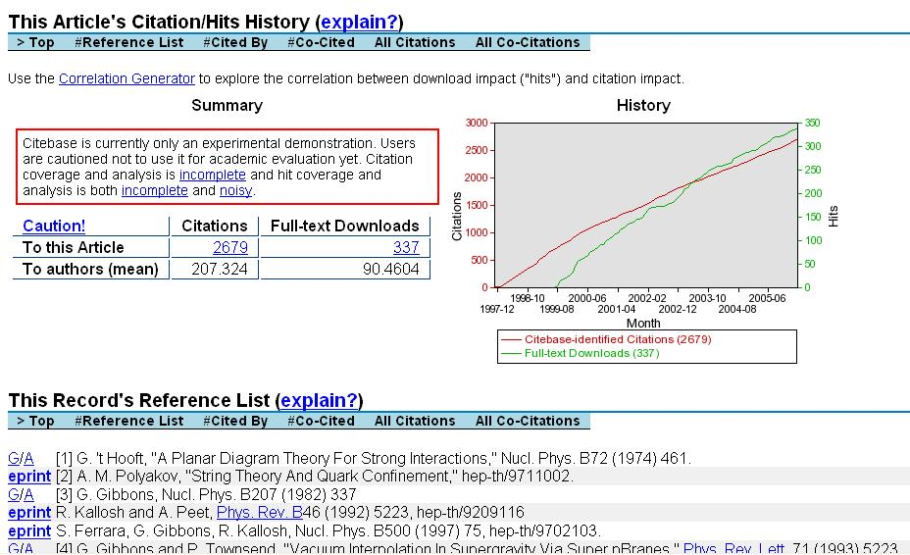
Key Perspectives Ltd

Slide 58
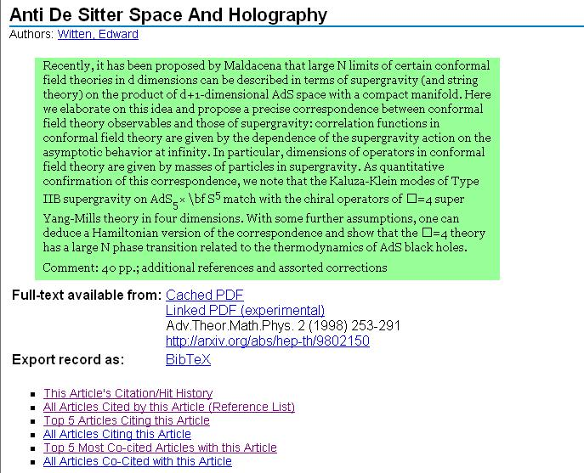
Key Perspectives Ltd

Slide 59
Key Perspectives Ltd

Slide 60
Why an institutional repository?
Helps to fulfil a university’s mission to engender, encourage and disseminate scholarly work
Forms a complete record of its intellectual effort
Forms a permanent record of all digital output
Provides maximum Web impact for the institution
Maximises the impact of the institution’s research (usage and citations)
Enables better research monitoring and management
Opens up economic (funding) opportunities
Key Perspectives Ltd

Slide 61
What is going wrong?
Australian Government Productivity Commission report on Public Support for Science & Innovation: “lack of effective linkages between research organisations (universities) and firms”
EU Innovation Reports: SMEs find it hard to get access to the basic research information they need to innovate
Key Perspectives Ltd

Slide 62
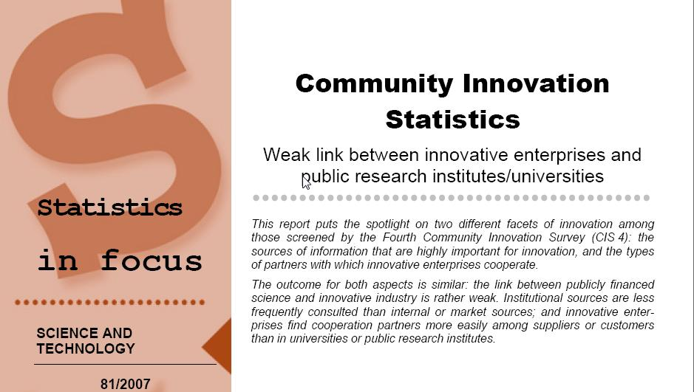
EU CIS studies
Key Perspectives Ltd

Slide 63
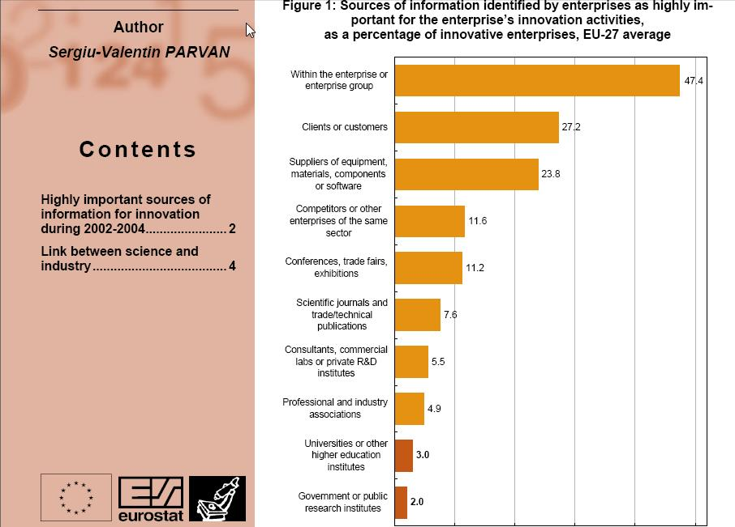
Key Perspectives Ltd

Slide 64
EU CIS studies, continued …
“Institutional sources are less frequently consulted than internal or market sources; and innovative enterprises find cooperation partners more easily among suppliers or customers than in universities or public research institutes.”
Key Perspectives Ltd

Slide 65
Total Research Income: QUT and sector
Data: Tom Cochrane
Deputy Vice-Chancellor, QUT
Key Perspectives Ltd

Slide 66
Part Four Advocacy to library colleagues
Key Perspectives Ltd

Slide 67
OA and the Library
Raises the profile of the Library in the institution
Reinforces the notion of the Library as a expert resource
Calls upon librarianship skills
Open Data will be a transformative principle in librarianship of the future
Key Perspectives Ltd

Slide 68
Promotional activities
Posters, leaflets, postcards, bookmarks, etc
Email campaign
Seminars – involve external speakers and key academic ‘champions’
Articles for campus newspaper
Events: repository launch, repository milestones, etc, etc
Key Perspectives Ltd

Slide 69
What to anticipate
Lack of awareness
‘Copyright terror’
Lack of the ‘author’s final version’
Publisher embargoes
Duplication (or perceived duplication) of effort (i.e. material already on websites; other campus profiling services, etc)
Problems retaining copyright
Key Perspectives Ltd

Slide 70
Resources and help
OASIS: Open Access Scholarly Information Sourcebook www.openoasis.org
EOS: Enabling Open Scholarship www.openscholarship.org
Key Perspectives Ltd

Slide 71
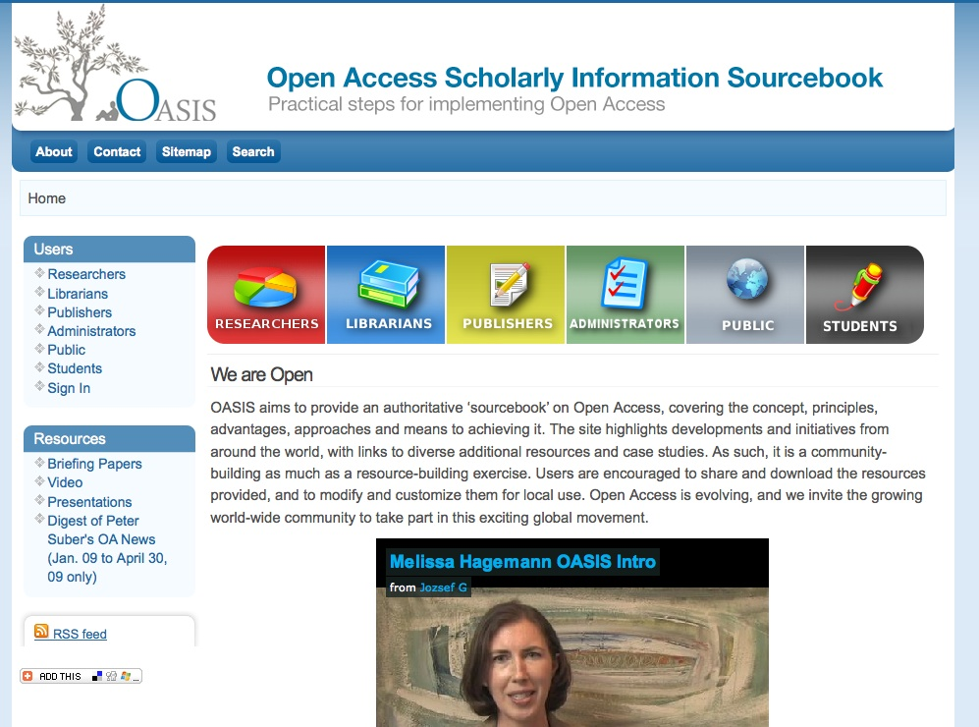

Slide 72


Slide 73
Thank you for listening
aswan@keyperspectives.co.uk
www.keyperspectives.co.uk
www.keyperspectives.com
Key Perspectives Ltd

