Slide 1
Preservation as a Process of a Repository
David Tarrant
University of Southampton (UK)
dct05r@ecs.soton.ac.uk
Preserv
.org.uk
Repository Preservation and Interoperability

Slide 2
A Few Definitions
Repository: A repository is a place where data is stored and maintained.
Wikipedia
IR: A repository captures and preserves the intellectual output of an institution.
The Case for Institutional Repositories – Raym Crow (SPARC 2002)
IR: In my view, a university-based institutional repository is a set of services that a university offers to the members of its community for the management and dissemination of digital materials created by the institution and its community members. It is most essentially an organizational commitment to the stewardship of these digital materials, including long-term preservation where appropriate, as well as organization and access or distribution.
Institutional Repositories: Essential Infrastructure For Scholarship In The Digital Age - Clifford A. Lynch
Service: A service is something provided directly to a user or 3rd party agent.
David Tarrant, 2008
Process: A process is something which is invisible to the user or agent.
David Tarrant, 2008
Notes:
The reason to include definitions is to set the background of this presentation in the correct context. There are many definitions of each of these terms in various different communities including our own where people see the word Repository encompassing more or less than it should (by my definition).
Specifically on this slide I want to introduce the definitions used throughout for Service and Process. Here a service provides something tangible and a process can invoke or call upon many services or processes in order to complete and is not singular in its workflow progression.
In a repository Ingest is a process which comes in many forms, as is preservation.

Slide 3
The Library
The Library
A building to store books in.
A means by which new books/publications can be acquired.
An indexing system to give order.
Provides a mean by which books can be found.
Provides a way to borrow & return books.
A preservation process, e.g. rebind books when they get damaged/worn.
…
Notes:
So lets introduce this model of what the repository is from the point of view of the Library (the one which actually holds books and printed material).
For a library to exist and the continue to run efficiently an infrastructure has to exist complemented by a series of processes which are either internal or may provide services to the users of the library.
The key thing to point out here is that preservation is an active but unseen process in a library which keeps the materials in good order and available for loan.

Slide 4
The Digital Library
The Library
A building to store books in.
A means by which new books/publications can be acquired.
A indexing system to give order.
Provides a mean by which books can be found.
Provides a way to borrow & return books.
A preservation process, e.g. rebind books when they get damaged/worn.
…
The Digital Repository
A server to store resources on.
A way to ingest new resources.
A database of resources and metadata.
A search engine and dissemination pages.
Open access and downloads.
A preservation process, e.g. check that the file on the server can still be read/accessed.
…
“In my view, a university-based institutional repository provides a set of services. The repository itself consists of a set of PROCESSES …”
Notes:
So lets look at the Digital Repository.
We see here that the mapping between the library and the digital library can be mapped as a one-to-one and thus the same sort of services and processes exist.
This DOES NOT mean that you can simply map what is done in the library on to the digital repository as the digital repository introduces a set of new opportunities as well as a new set of problems.
The key point from this slide is the slight change in the Clifford Lynch definition of the IR. It is important to realise that the IR doesn’t just offer a set of services but has to include an underlying set of processes for the management of the resources contained in the Repository.
So lets look at which processes exist according to current models…

Slide 5
Processes
Service: A service is something provided directly to a user or 3rd party agent.
Process: A process is something which is invisible to the user or agent.
There are lots of Processes
Processes happen in parallel
Processes happen in different orders
Notes:
The reason to include definitions is to set the background of this presentation in the correct context. There are many definitions of each of these terms in various different communities including our own where people see the word Repository encompassing more or less than it should (by my definition).
Specifically on this slide I want to introduce the definitions used throughout for Service and Process. Here a service provides something tangible and a process can invoke or call upon many services or processes in order to complete and is not singular in its workflow progression.
In a repository Ingest is a process which comes in many forms, as is preservation.

Slide 6
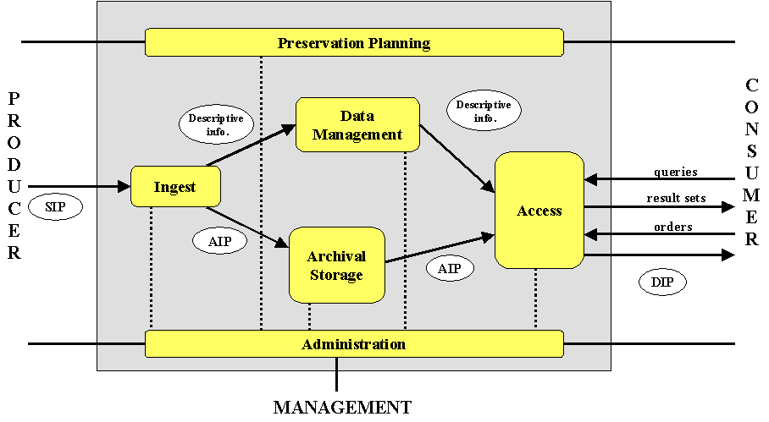
Processes and OAIS
Many existing models contain this notion of processes and services, just not necessarily in a modern light. This doesn’t however mean they are “wrong” or “right” they are just guiding principals.
Index
Ingest
Store
Retrieve
Locate
Notes:
I figured I’d start with the OAIS model and look at how processes map onto this model.
The processes are outlined in red.
This is not an attempt to change the model, just a means of outlining some of the key processes related to a repository.
Note that putting preservation on this model is challenging as thus as a process has been left out. Essentially the OAIS model sees preservation planning as something which interacts with all of your repository which is confusing to implement for a developer where you are trying to develop a modular system.

Slide 7
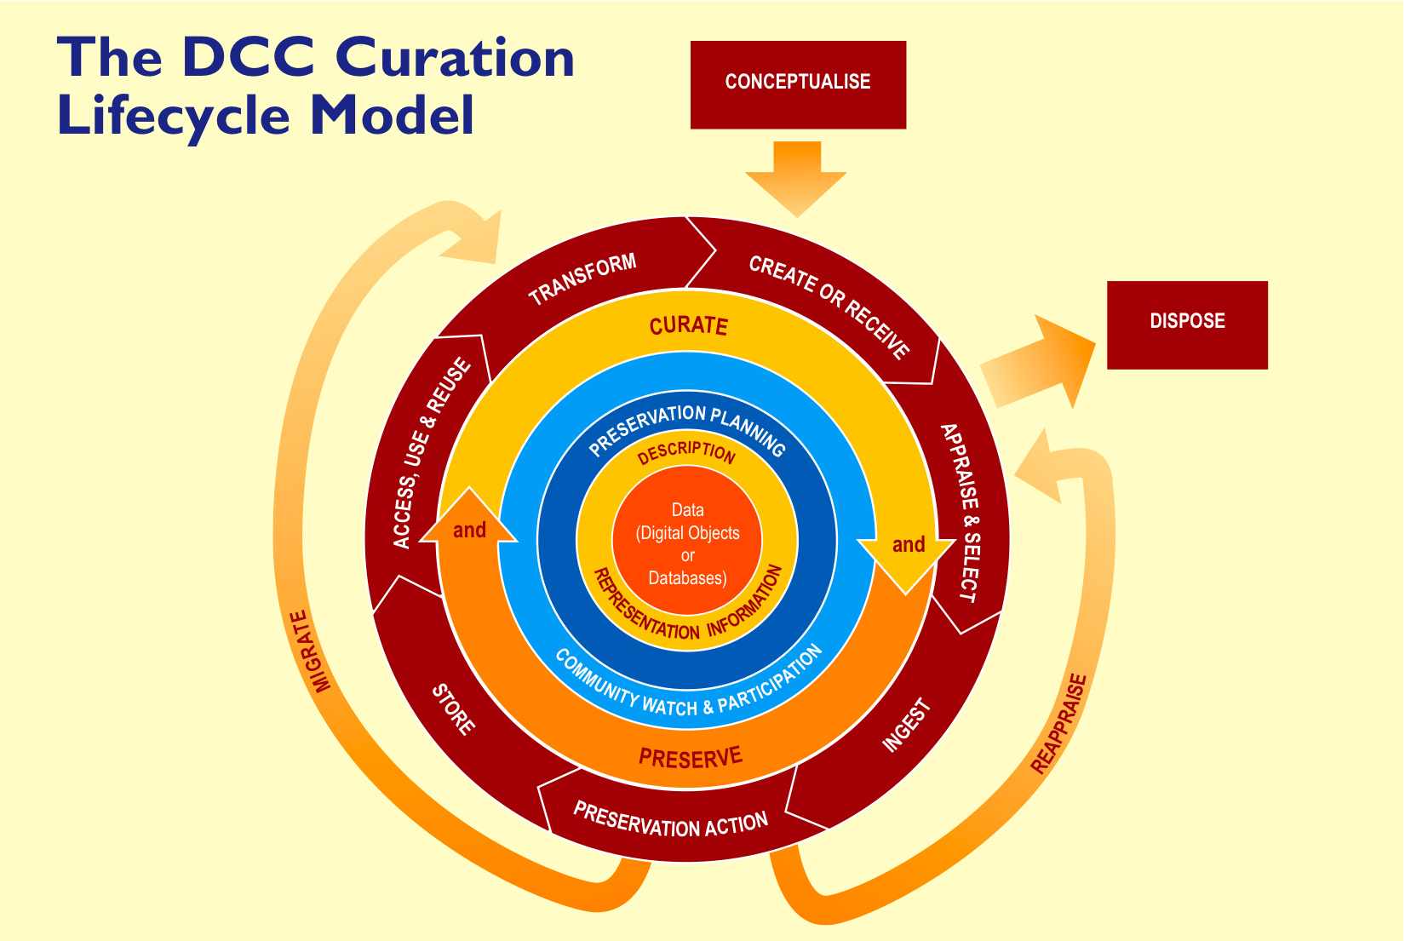
Processes in the DCC Model
Locate
Retrieve
Store
Ingest
Index
Notes:
Another model which has emerged is the DCC life cycle model. Here they have a set of processes outlined in their own dark red and I’ve mapped the ones which I had on the OAIS model onto this.
In the DCC model we have the same order of processes as the OAIS model which some extra processes added which outline in a little more detail where preservation may fit in.
This model is also a good guide, however it could also be drawn with the processes in many different orders where ingest is done before appraise and select for example. This is the case at Oxford University.

Slide 8
The 3 Stage Model
Manage Content
Get Content
(Ingest)
Serve Content
Appraise & Select
Store
Index
Ingest
Locate
Retrieve
Preservation - Check
Preservation - Analyse
Preservation - Action
Dispose
Notes:
So lets go back to the Wikipedia definition of the repository “A place where data is stored and managed” and I’ve added the provision to this.
So this three stage repository model has three outfacing processes and many internal processes which the users may not see which enable the management of the content. For the purposes of this talk I’ve separated out preservation into 3 categories as this is what I shall be focusing on later. Preservation can be viewed as a single process and indeed should as one part without another is not providing a complete process. This split simply allows me to implement a modular system.

Slide 9




Breaking up the Repository
Store
Index
Preservation Storage
Local
Local Storage
Federated
Locate
Retrieve
Semantic Web
Manager
Subject Specific
Ingest
Appraise & Select
Web Based x 3
Preservation - Check
SWORD
Preservation - Analyse
Preservation - Action
OAI-ORE
Dispose
The manager may provide capability to perform one or more of the processes. Typically the manager is all that is used.
Notes:
Ok so lets look at the Processes in a little more depth and start to introduce services.
By looking at it in this way we can begin to break up the repository into a set of components with a repository manager in the middle which knows how to manage the processes, taking content from them or serving content to them.
So what is the manager?
Examples of managers include the core of EPrints, Fedora and DSpace. Although these managers often come packaged with these processes built in we can still view the repository in a modularised manor.

Slide 10
Repository Management Software
A set of Pipes/Workflows* which know how to translate inputs into outputs.
Examples:
OAI-ORE which contains Files and Metadata is split by the management software into File/Metadata storage and indexes.
A request for a set of objects related to a single author is translated into a query to an index and a retrieve from the storage.
*Depending on your own definition you could also add “Middleware”
Notes:
This is my simple definition of a manager with some examples given.

Slide 11

:Storage Controller
EPrints Storage Controller works!
Local Storage Plugin (legacy)
Honeycomb Storage Plugin
Amazon Cloudfront (coming soon)
Honeycomb Stats
- 4MB/s ingest*
- 200MB/s retrieve
*USB2.0 max speed
Index
Store
Locate
Retrieve
Local Storage
Manager
Appraise & Select
Cloud Storage
Preservation - Check
Preservation - Analyse
Honeycomb
Preservation - Action
Dispose
Notes:
Right so lets move on to the bulk of this presentation and look at some new code and modules.
I want to start with the storage layer within EPrints which is my repository of choice. At the last PASIG I outlined the idea of an abstracted storage layer for your repository which allows you to store your resources on any supported storage server. Support is simply provided by a plugin within EPrints which supports the calls of Store, Retrieve and Delete.
The EPrints Storage controller provides a means by which you can store your resources in different storage services dependant on your own storage policy/rules. Cut short you can store everything on one storage service, everything in more than one (mirrors), publications locally and datasets remotely. or any combination you can think of.
On this slide I outline the figures from the ECystals repository in Southampton which is now storing their datasets on a Honeycomb server. Note that by using the storage abstraction layer does not degrade the performance of the services. The USB drive was the bottleneck on ingest with the network the bottleneck on retrieve.
Next we are going to be working on an Amazon Cloudfront plugin for your distributed worldwide storage.
More about this can now be found via the EPrints and Preserv wiki pages. Preserv basically started this project which EPrints has now commited to take on for a future release of EPrints.

Slide 12
The Preservation Process
Preservation - Check
Bit checking & checksum calculation
Preservation - Analyse
What is the type of file, is the file valid?
Is the file at risk of not having an editor/reader?
Is there a better format available? Lossless or Lossy?
Preservation - Action
File migration to avert risks found by analysis.
Movement of file to new storage.
Notes:
So what is preserv doing now.
Lets look at the Preservation process.
This slide gives a breakdown from my point of view of the preservation process. Each stage of which I’m going to address in the course of this talk.

Slide 13



Preservation - Analysis
Preservation - Analyse
What is the type of file, is the file valid?
Droid is a good classification tool for this.
Is the file at risk of not having an editor/reader?
Functionality is being developed in PRONOM technical registry.
Is there a better format available? Lossless or Lossy?
Planets registry of tools.
Notes:
Quick overview of some analysis and recommendation services and service providers.
Many people already know about the DROID tool from The National Archives (UK) which uses file signatures to classify your files by looking at their content.
Alongside DROID exists PRONOM which is the TNA’s registry of file formats and metadata relating to these files. This is soon going to be expanded with a risk analysis service which can provide you with a risk score for your files (as classified by DROID).
Lastly in the analysis stage exists the still evident need for a registry of tools which can be utilised to aid the preservation process, weather this be to perform further classification or identification of attributes such as significant properties, or to locate tools which can enable you to migrate/transform files which have been identified as at risk.

Slide 14


Preservation - Analysis
Key
Preservation - Analyse
Pipe / Workflow
What is the type of file, is the file valid?
Droid is a good classification tool for this.
Service
DROID
OAI-PMH Translator
OAI-PMH
Classification
File
Scheduler
Droid Classification Ingest
Calendar Server
Web Server
Web Pipe
Notes:
The focus of this slide is on the DROID classification service (services are in green), downloaded and unmodified from the TNA website.
By using a series of pipes (which are in Purple) we can link services together to provide the file classification functionality to our repository, the three pipes on this slide are available from preserv2.googlecode.com.
Why the Calendar Server?
This enables not only the scheduling of classification event but also the logging back to the calendar server of the history, e.g. how long the event took, were there any errors? It also enables events to be scheduled using your favourite desktop calendar application.
Why the Web Server?
This stores to DROID Classification File prior to it being ingested into the repository. It is at this point you can decide to trust the output of the service you have invoked. For example you could request a classification event to happen and many services could pick up the fact that you want this event performed. If the service is able to process your request you could have many outputs from many services of which you could import one or more based upon how much you trust the service in question.
(note: in the case of the last example you may want to make the default policy for the calendar server one such that you can only write new events and not overwrite the current ones)

Slide 15
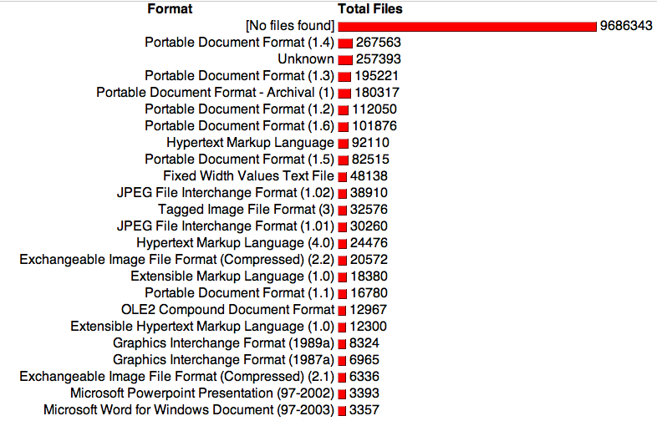
Preservation - Analysis
Preservation - Analyse
PRONOM-ROAR (Preserv 1)
http://roar.eprints.org
Notes:
Once the classification of your files has been performed we can collate the results in various places.
PRONOM-ROAR (shown here) is a web service which harvests and classifies (using DROID) content from various repositories to create preserv profiles.
This was one of the big outputs of Preserv1 but repository managers didn’t use it as more than a guide due to the experimental and limiting factors imposed in the was the service works and the positioning of the system components.

Slide 16
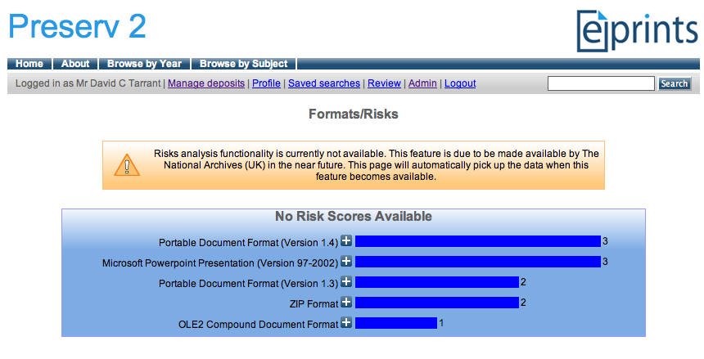
Preservation - Analysis
Preservation - Analyse
EPrints File Classification
Notes:
(not available yet in any EPrints distribution)
This slide shows the DROID output interface in EPrints where your repository manager is now aware of which objects are classified, in need of classification, or have encountered problems during classification.
So here I have ingested the classification document which DROID output from it’s classification process.

Slide 17
Risk Analysis
Preservation - Analyse
Is the file at risk of not having an editor/reader?
Functionality is being developed in PRONOM technical registry.
Simple SOAP web service
Takes file format identification id’s, hands back risk score.
Breakdown of risk score may also be available in future releases.
A stub you can download and run providing this functionality before the official release with mock up risk scores is available at http://preserv2.googlecode.com
Notes:
A little more on the risk analysis service which is soon going to be available via the PRONOM registry.
PRONOM is a web service you invoke with SOAP calls. For the purposes of risk analysis there is soon to be a service available which will provide you a risk score for each format as identified by DROID. This risk score is calculated from many factors using a formula as derived by The National Archives (TNA – UK) which provides a single figure between 0 and 3000. It is hoped that when this service is deployed publically that the breakdown of the risk score will also be available such that each repository will be able to apply their own formula dependant on their preservation policy.
Due to this functionality not being publically available yet, the preserv2 project has put together a piece of stub code which emulates this functionality. This is used here for the purposes of coding future interfaces against. At a later data the pointer in the interface can be changed to reference the actual distribution.

Slide 18
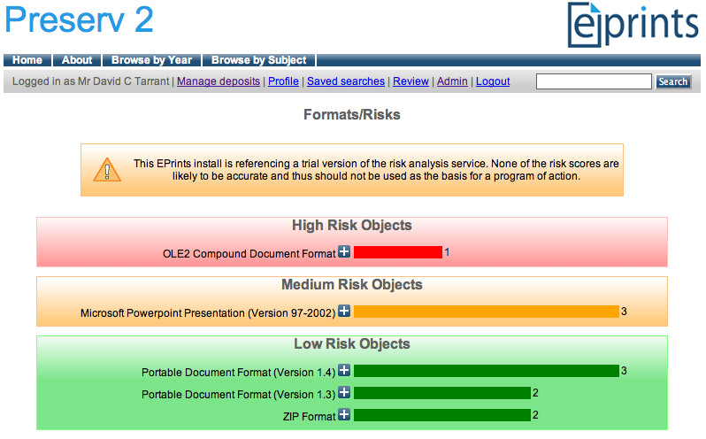
Risk Analysis
Preservation - Analyse
EPrints File Classification + Risk Analysis
Notes:
This slide shows the same screen in EPrints as a couple of slides before except this time we have switched on the risk analysis service.
This screen enables the repository administrators to view the risks related to the content within their repository in a simple traffic light based manner.

Slide 19
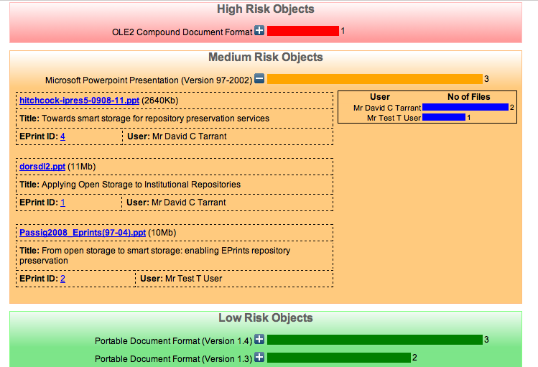
Risk Analysis
Preservation - Analyse
EPrints File Classification + Risk Analysis
Notes:
Expanding one of the boxes allows us to view the EPrints and files related to these EPrints which have been identified as at risk.
Managing file risks from within the repository has some advantages over this being an external process. Firstly if a new low risk file has already been generated we can use the internal metadata structure of the repository to state that a higher risk file has a safer copy, allowing us to keep the original and remove it from the high risk display. Secondly we can identify other patterns affecting the risks to files in the repository such as the depositing user, if a single user or machine in providing all of the high risk files this maybe more successfully dealt with externally to the repository preservation process.

Slide 20
Transformation?
Preservation - Action
Mock up Transformation Interface
Migration Tools
Tool Preservation Level
PPT -> PPTX
PPT -> PDF
Notes:
This slide shows the final part of development relating to this admin service.
Here I have mocked up a possible display of migration or transformation tool available for the at risk formats and their effectiveness or preservation level. The preservation level relates to the loss level of the new format compared to the old, so if all abilities and significant properties are preserved then we can say that this transformation is 100% effective.
For this functionality to be available we would look to develop a registry of tools and profile these tools such that these scores can be generated and displayed. These profiles could related directly to the risk scores stored within PRONOM and thus the same local profiling could be used to rate tools differently depending on the requirement of the individual repository. The Planets project (specifically in the context of the PLATO tool) is looking into how to enable this functionality and push the results into the PRONOM registry.
There is still more work to be done but this interface shows what can be done with the current tools as well as those which are in development.

Slide 21
Summary – 1/2
Manage Content
Get Content
(Ingest)
Serve Content
Processes, Services and Glue
Storage Controller provides an API you can glue to.
Enabling preservation for any repository model by writing small bits of glue.
Portable services are more powerful, faster and cheaper.
Make use of existing and supported software where possible.
Notes:
So to summarise I have looked in this presentation at the basic principals surrounding running an institutional repository.
The simplistic 3 stage model encapsulates all the processes and services needed to run a complete repository and in the context of this presentation I have looked in depth at the preservation process.
By outlining the difference between processes and services we can see which services enable the basic bit level preservation which can be used as part of the repository “store” process. In EPrints we implemented a Storage Controller which can then be hooked up to preservation storage solutions such as the late Honeycomb server.
For the preservation analysis and action sub processes I looked at some the services which are available for use now or being developed and showed how these can be simply integrated to achieve some of our preservation goals.
Droid is an example of such as service which can be downloaded and executed next to your objects. This is an example of a portable service and I have attached some appendix slides at the end of this presentation to demonstrate some of the places where you could locate your DROID classification service.

Slide 22

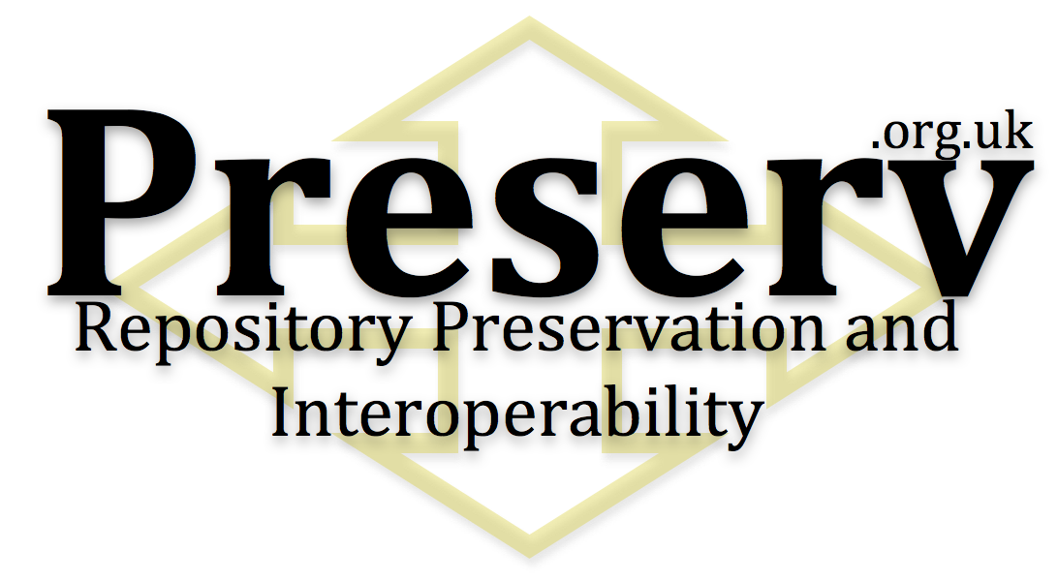
Summary – 2/2
+
EPrints will provide one of the first platforms for the development of preservation services where direct interaction takes place between the Repository Software and Preservation Services.
Notes:
So finally, in the last PASIG I outlined how I would use EPrints to demonstrate some of the new preservation functionality and I think over the last 6 months a lot of improvements have been made in a way which can be pushed out into other repository platforms.

Slide 23


Many Thanks!
David Tarrant
Steve Hitchcock
Neil Jefferies
Ben O’Steen
Sally Rumsey
Adrian Brown
Notes:
Cheers for reading!

Slide 24
Appendix Slides

Slide 25
Other options for DROID Positioning
Store
Retrieve
Preservation Storage
OAI-PMH
Local Storage
Manager
Ingest
Preserve - Analyse
Web Based x 3
DROID
DROID Classification
This is not the recommended solution as DROID is a 3rd party service for your repository.
All other services are provided by your repository.
Notes:
Within the repository! Bad!

Slide 26
DROID Alongside Your Resources
Calendar Server
Store
Retrieve
Smart Storage
Preservation - Check
OAI-PMH
Scheduler
DROID
OAI-PMH Translator
Classification
File
Ingest
Web Pipe
Web Based x 3
DROID Classification
Web Server
Notes:
Inside the storage, good ☺.
Note that all the external parts from the main presentation are also in this model, so DROID is portable with no loss in external linking.

