Slide 1
A Workflow Pipeline for Scientific Data Analysis
Nicholas Schwarz Software Services Group
Faisal Khan Advanced Engineering Support Division
John Hammonds Advanced Photon Source
Claude Saunders

Slide 2
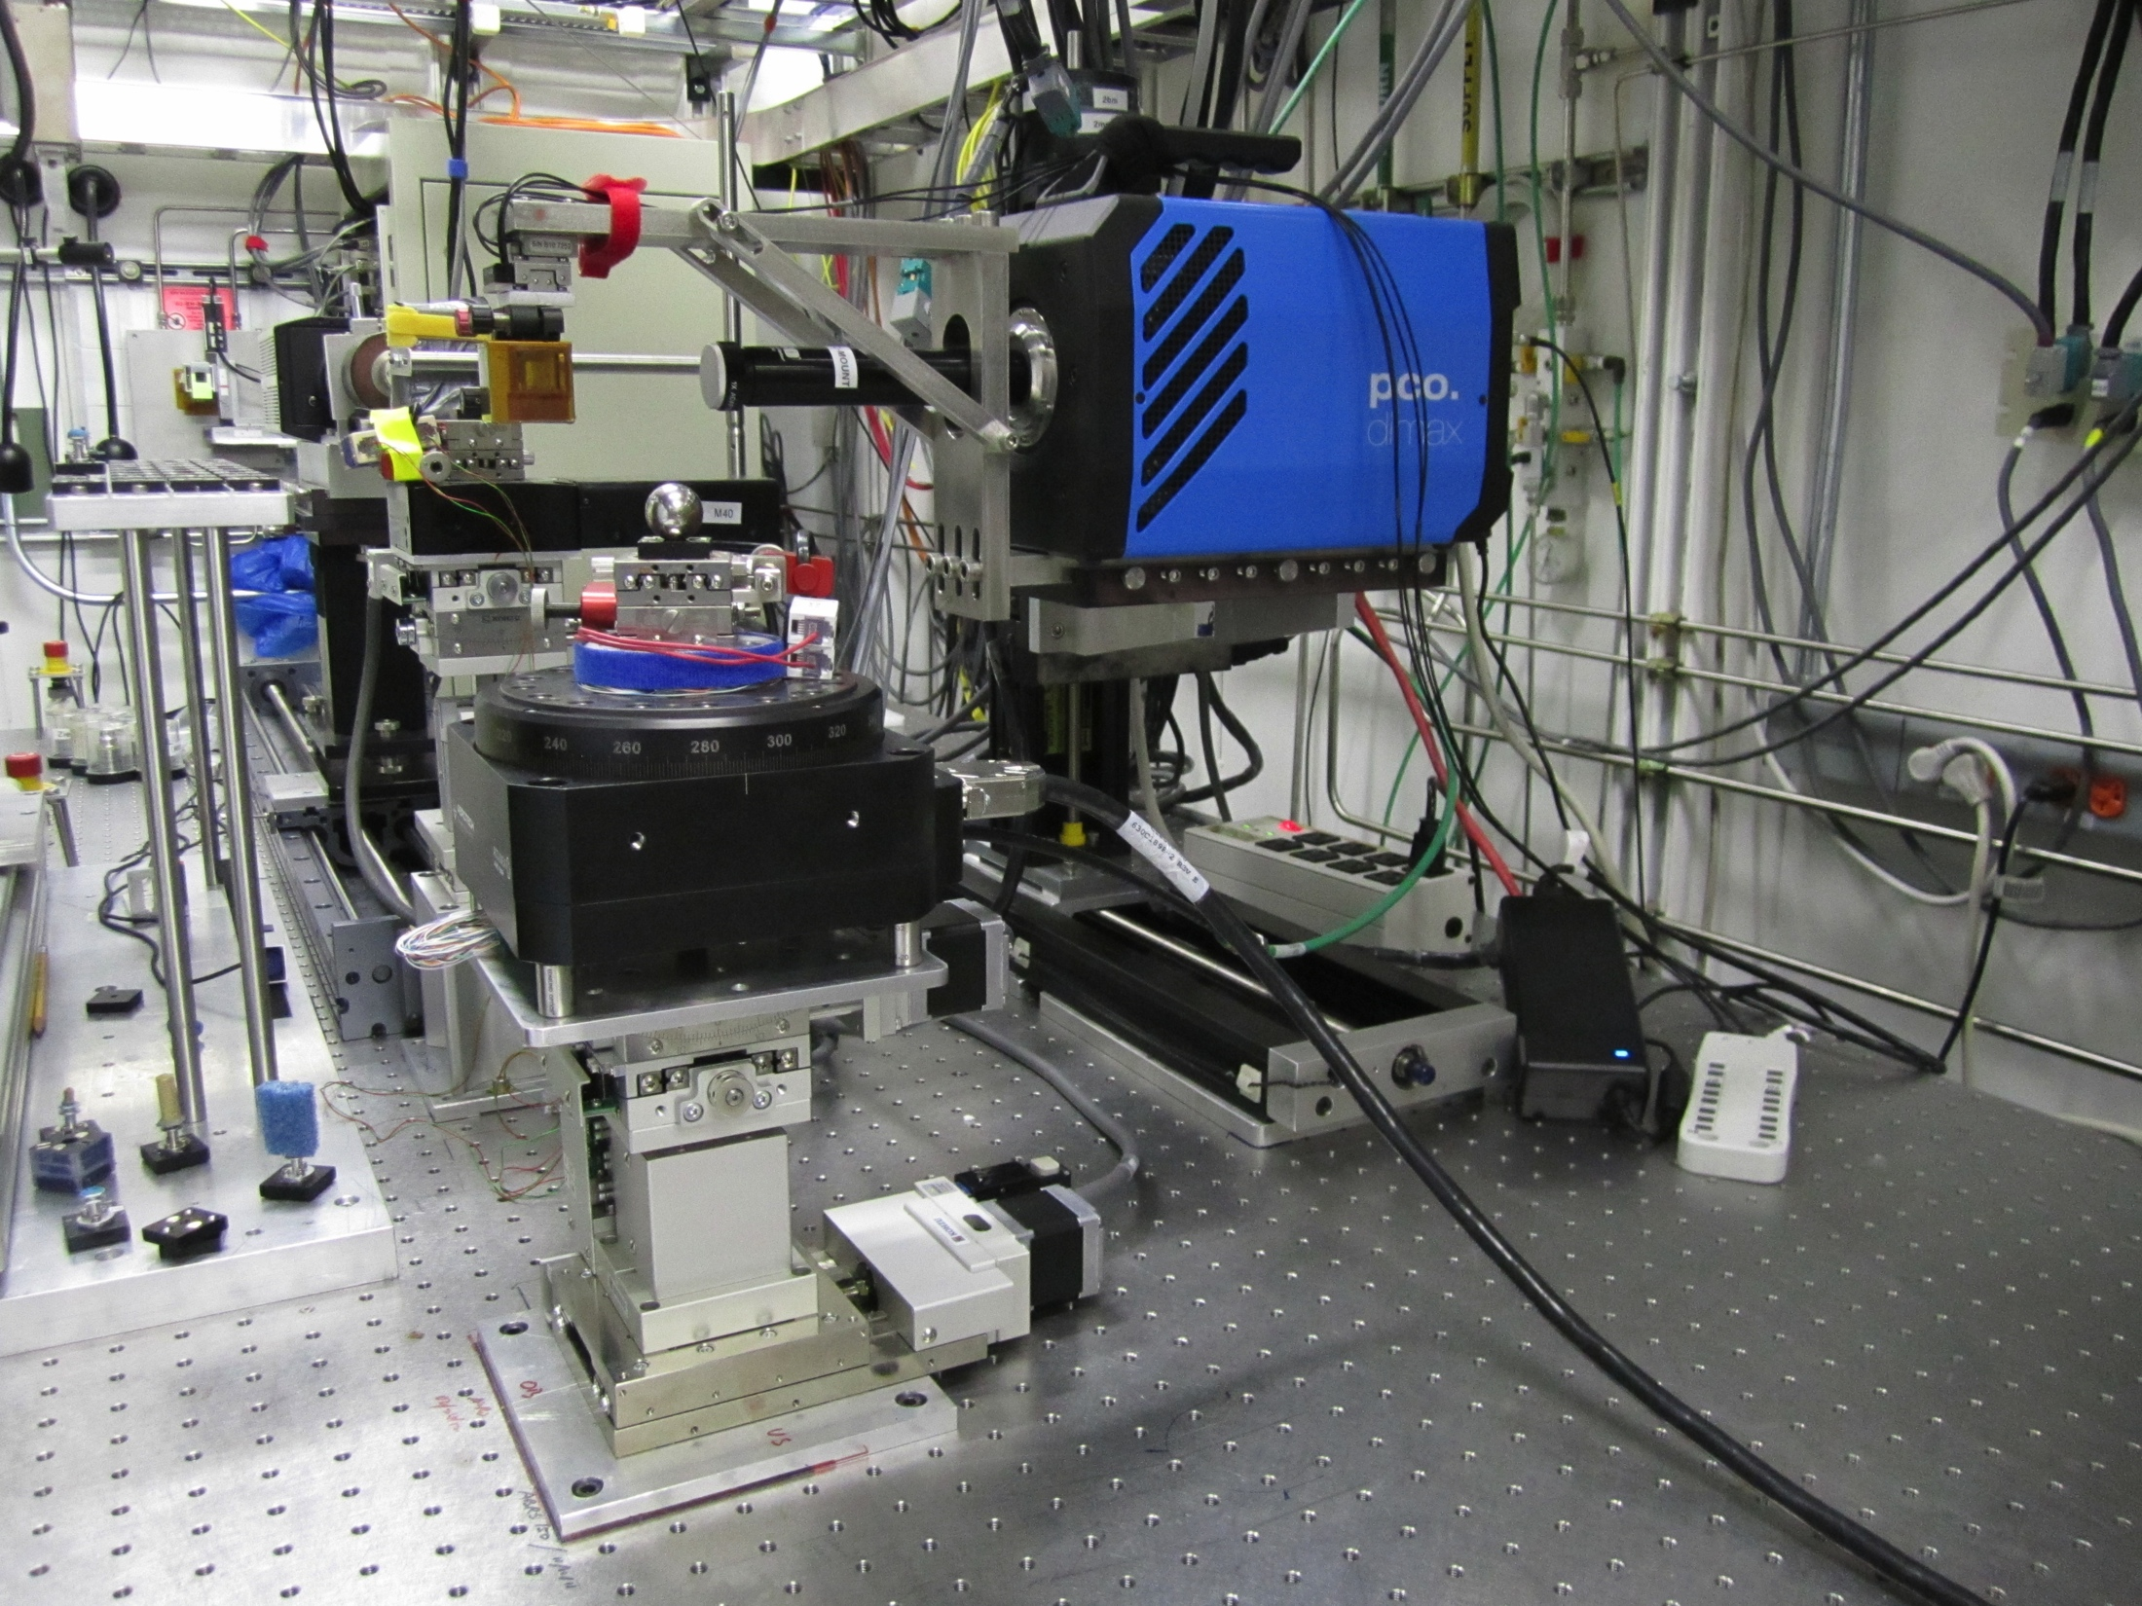
Why?
Facilities and beamline scientists are faced with an avalanche of data
Sources
Increased detector resolution and speed
Production and high-throughput beamlines
Automated software, sample changers, etc.
Prompt feedback
The ability to easily and robustly handle this increase in data is key to scientific discovery and insight

Slide 3
How?
stage /
actor
queue
stage /
actor
queue
stage /
actor
Workflow pipeline for scientific data analysis
Industry standard messaging system for reliable task sequencing and triggering (JMS ActiveMQ)
Generic actors handle common tasks such as file transfers
Technique-specific analysis code is implemented or called from custom actors (Java, C++ or Python)
Experimental metadata and provenance information stored with raw and analyzed data in a single HDF5 file

Slide 4
Message Broker
Queues exist on a message broker
Broker runs on a server
Persistence
Queues and messages are saved to disk in case of failures
Redundancy
Failover message brokers run on a single server
Multiple redundant servers
Out-of-the-box functionality / industry-standard
server
server
broker
broker
queue
queue
queue
queue
queue
queue
message

Slide 5
Message Format
correlationID | UUID to correlate messages that belong to the same job
pipelineID | Identifies a specific instance of the Pipeline
jobName | User-specified name
route | Describes the series of steps taken through the Pipeline, i.e., the series of stages that should be run
routeIndex | Current index in the route
inputFileURI | Input file path for each actor in the route
outputFileURI | Output file path for each actor in the route

Slide 6
Pipeline Stages
Stages are broken into two separate classes:
Director
interface with the message broker
update provenance
Actor
run analysis
save results
report status
Message
Pipeline Stage
Message
Director
Actor
Analysis Application

Slide 7
Director
Director
topic
JMS Control Topic Consumer
JMS History Message Producer
queue
queue
JMS Job Message Consumer
JMS Job Message Producer
queue
Update HDF5 provenance
Execute Actor
Director
Broker interface
Handle job messages
Control messages
Update history
Maintain provenance
Execute Actor

Slide 8
Actor
Actor
Called by Director
Abstract interface for concrete implementation
Execute job / analysis
Report status
Analysis
External application
Internal code
Read input data from HDF5
Write output data to HDF5
Actor
Status execute(hdf5Entry,
inputURI,
outputURI)
Status abort()
Analysis
HDF5
Do Analysis
HDF5
inputURI
hdf5Entry
Report Status
outputURI

Slide 9
Sequence
Broker
Director
Actor
Analysis
message from queue
update provenance
execute(hdf5Entry,
inputURI, outputURI)
run(hdf5Entry,
inputURI, outputURI)
analysis
status
status
update provenance
next message

Slide 10
Manufacturing Traveler
Single HDF5 file takes role of “manufacturing traveler”
Used to track all steps of a manufacturing process
DataExchange: www.aps.anl.gov/DataExchange
/exchange_1
/data
/exchange_2
/data
/mesaurement
…details…
/tomography_reconstruction
/input “/exchange_1”
/output “/exchange_2”
…reconstruction specific parameters…
/xpcs
…
Scientific data are stored in
/exchange_n groups
Each scientific analysis process
identifies its own input(s) and
output(s), and its own process
specific parameters

Slide 11
Provenance
Metadata about the sequence of processes applied to the file
A record of data movement and processing stored in a separate HDF5 group
/provenance
/next “process_2”
/process_1
/status RUNNING
/reference “/provenance/gridftp”
/message “”
/process_2
/status PENDING
/reference “/tomography_reconstruction”
/message “”
/gridftp
/source URI:AreaDetectorSystem
/destination URI:Cluster

Slide 12
Implementation
Languages
Java – ActiveMQ
C++ – ActiveMQ CPP
Python – STOMP
Heterogeneous
Different stages may use actors written in different languages
Reusable “generic” actors
Run command line scripts
gridFTP
Launch Hadoop jobs
Monitor SGE

Slide 13
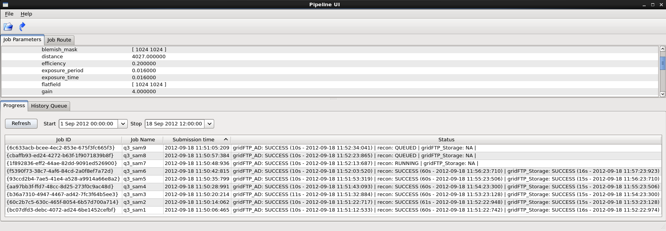
Client
Launch jobs
View job parameters
Edit job route
View job status
Kill jobs / Remove old jobs
View raw JMS messages
History queue
Control topic
C++ and Qt
Linux, OS X, and Windows builds

Slide 14
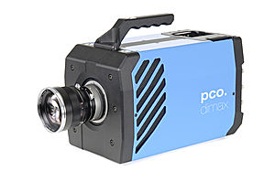
Tomography
Area Detector
APS 2-BM-B
2K x 2K per frame
1,500 projections per fly scan
~13 GB per sample
10 TB raw detector data per day
40 TB reconstructed data per day
queue
gridFTP
HDF5
lustre
queue
reconstruction
(GPU cluster)
HDF5
HDF5
clutch
queue
gridFTP
HDF5
HDF5
Broker
Actor
Data Location

Slide 15
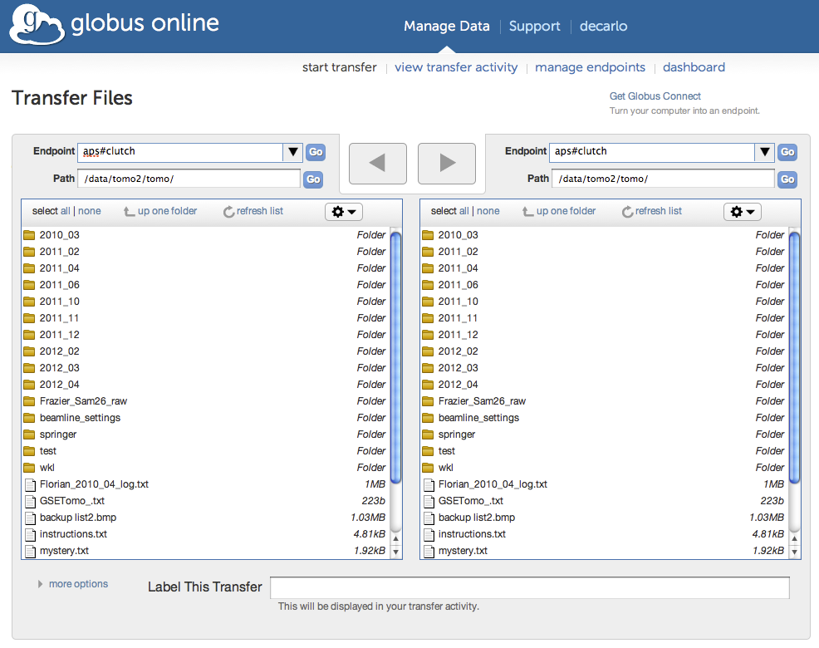
Tomography

Slide 16
X-ray Photon Correlation Spectroscopy (XPCS)
Area Detector
APS 8-ID-I
1K x 1K per frame
10,000 frames per experiment
2 TB raw detector data per day
Evaluating different ways of getting data into HDFS: stream, HDF5 plug-in
HDF5
RAW
queue
gridFTP
lustre
HDF5
HDF5
queue
XPCS analysis
(Hadoop)
HDFS
RAW
RAW
Broker
Actor
Data Location

Slide 17
Thank you

