Slide 1
Modelling the economic implications of open access for individual institutions
Alma Swan
Key Perspectives Ltd
Truro, UK
SPARC Digital Repositories Conference, Baltimore, 7-10 November 2010

Slide 2
Economic implications of OA
John Houghton and colleagues (2009)
Identified the activities in the scholarly communication system
Attached costs to each, and thus to the system
Modelled the economic benefits of new, alternative scholcomm scenarios
Australia, UK, Netherlands, Denmark and US federal agencies
Individual universities (Swan, 2010)
Key Perspectives Ltd

Slide 3
Scholarly communication process
Key Perspectives Ltd

Slide 4
The scholarly communication process (Björk, 2007)
Fund R&D and communication
Perform research and communicate results
Publish scientific/scholarly works
Facilitate dissemination, retrieval and preservation
Study publications and apply knowledge
Key Perspectives Ltd

Slide 5
‘Houghton Model’
Available to download online
Anyone can use their own data to populate it
Models three alternative Open Access communication scenarios (plus other scholarly communication-related issues)
Models the end-point (an Open Access world)
Key Perspectives Ltd

Slide 6
Rationales and assumptions
Obvious direct cost savings (subscriptions, ILL, PPV)
Open Access makes it easier to find and retrieve the material a researcher needs to:
READ
WRITE papers
Carry out PEER REVIEW work
Open Access obviates the need to spend time seeking permissions or dealing with copyright and licensing issues
etc (no duplication, blind alleys …)
Key Perspectives Ltd

Slide 7
Three scholarly communication scenarios
Self-archiving in repositories (‘Green’ Open Access)
In parallel with subscription journals
Instead of subscription journals, via repositories with overlay services
Open Access journals (‘Gold’ Open Access publishing)
Key Perspectives Ltd

Slide 8
National pictures (Houghton et al, 2009, 2010)
Annual € savings from moving to: | UK | Netherlands | Denmark | US federal agencies
OA journals (‘Gold’ OA) | 480 million | 133 million | 70 million | Value of benefit amounts to some 4x to 25x the cost
OA repositories with subscriptions (‘Green’ OA) | 125 million | 50 million | 30 million
OA repositories with overlay services | Circa 480 million | Circa 133 million | Circa 70 million
Key Perspectives Ltd

Slide 9
Individual universities
Results reported for 4 institutions with research income varying from 2 million GBP to 200 million GBP p.a.
2 further institutions modelled by request
Series of workshops around UK: further c20-25 universities modelled
Key Perspectives Ltd

Slide 10
Universities differ
Do things differently in libraries
Buy journals in different ways
Run more or less elaborate repositories
Employ different numbers of people
Pay people different salaries
Key Perspectives Ltd

Slide 11
Data required: research-related
Research income per annum (institution)
Number of researchers
Average researcher salary
Publications per annum (institution)
Time spent reading and writing articles
Time spent serving as editors and on editorial boards
Time spent peer reviewing articles
Key Perspectives Ltd

Slide 12
Data required: library-related
Number of subscriptions:
Print-only
Electronic-only
Dual mode
Cost of subscriptions
Handling time for journals/books
Key Perspectives Ltd

Slide 13
Data required: Repository-related data
Operational cost of repository per annum
Time taken to deposit
Average salary of depositor
Number of items produced by the institution per annum
Key Perspectives Ltd

Slide 14
Savings from OA via repositories
GBP per annum
Key Perspectives Ltd

Slide 15
Savings from OA via OA journals
Key Perspectives Ltd

Slide 16
Societal value
Key Perspectives Ltd

Slide 17
University UK: Annual savings from OA
£ per annum
Key Perspectives Ltd

Slide 18
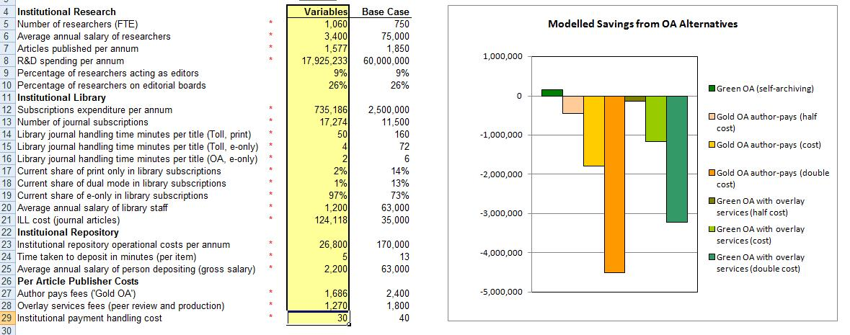
Key Perspectives Ltd

Slide 19
Key Perspectives Ltd

Slide 20
Key Perspectives Ltd

Slide 21
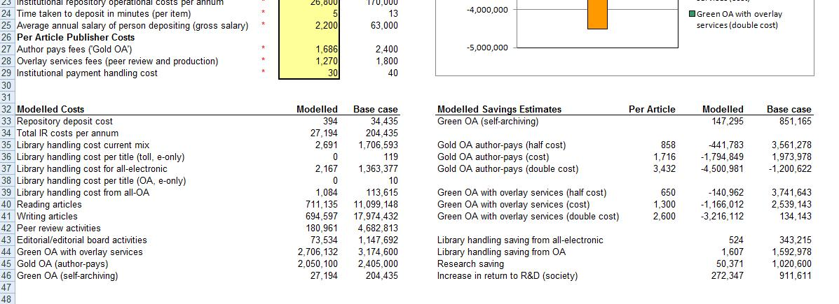
Key Perspectives Ltd

Slide 22
Key Perspectives Ltd

Slide 23
Key Perspectives Ltd

Slide 24
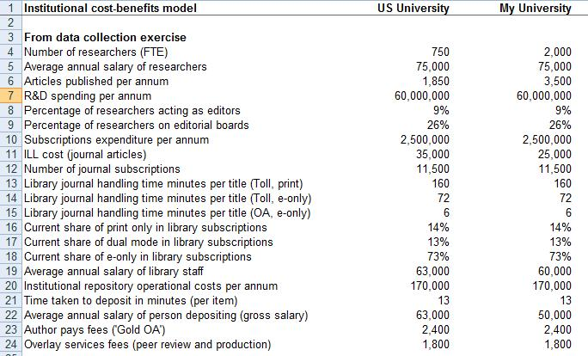
Key Perspectives Ltd

Slide 25
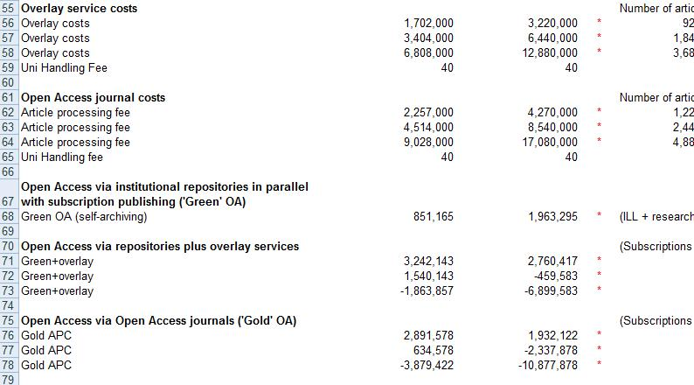
Key Perspectives Ltd

Slide 26
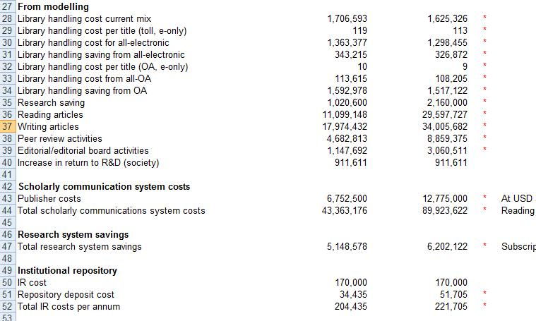
Key Perspectives Ltd

Slide 27
Caveats
This is an economic model ...
Contains an FEC (overhead) element
Did you estimate anything?
Did you use default values?
Co-authorship
Journal charging policies
Key Perspectives Ltd

Slide 28
Models for downloading
Main modelling page:
http://www.cfses.com/EI-ASPM/
US institutional model:
http://www.cfses.com/EI-ASPM/Institutional%20EI-ASPM%20Cost%20Model%20%28USA%29.exe
Key Perspectives Ltd

Slide 29
a.swan@talk21.com
www.openoasis.org
www.openscholarship.org
www.keyperspectives.co.uk
Key Perspectives Ltd

