Slide 1
Applying Open Storage to Institutional Repositories

Slide 2
It helps to be open…
IRs are largely charecterised by “Openness”
Open Source Software
Open Access (Initiative)
…
Open Storage

Slide 3
About Preserv…
How can we facilitate effective preservation survives for digital repositories?
Preserv2 is a Project, not a service provider.
Notes:
Preserv2 is a JISC funded project, running until march 09.

Slide 4
Independence is also good…
No single vested interest in…
Repository Software
EPrints and Fedora are represented in the project
Storage
Working with Sun among others via the CRIG
Preservation Tools
TNAs Pronom Droid, Some connections with Planets
Preservation Service Providers

Slide 5
www
Notes:
This is where we work… on the web

Slide 6
Taking the Bull by its Horns
We can focus on building & testing an infrastructure that connects up components.
The aim is to serve repository managers not by answering their preservation questions one at a time or per object.
All approach, manual curation does not scale!

Slide 7
Interoperability
OAI is one enabler to Interoperability
OAI-PMH
oai_dc
mets
rem_atom
…

Slide 8
What OAI did for Repositories
Provided a standardised way to share information pertaining to Objects in a Repository.

Slide 9
Interoperability
OAI is one enabler to Interoperability
Messaging
Web Service
OAI-PMH
oai_dc
mets
rem_atom
…

Slide 10
ORE
OAI-ORE Serialisation
REM_ATOM / REM_RDF
REM
Description + Aggregation
DC
FOXML
METS
PDF
EPXML

Slide 11
What ORE does for Repositories
Reveals the first class objects/resources in the repository.
More than just the metadata is guaranteed to be described in a Resource Map (REM)

Slide 12
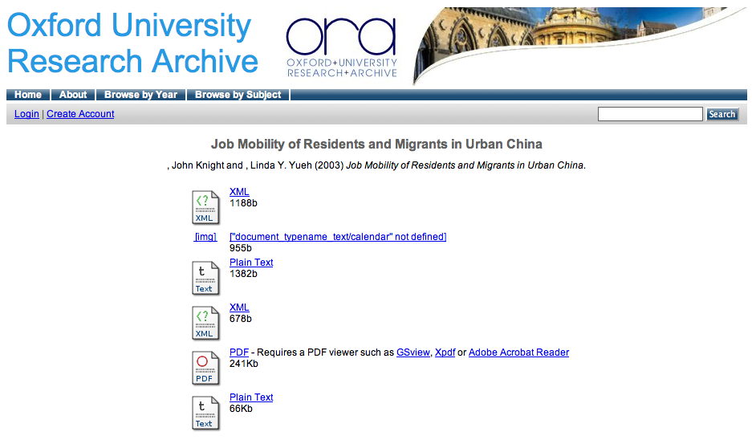

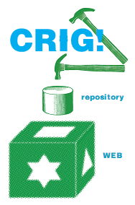
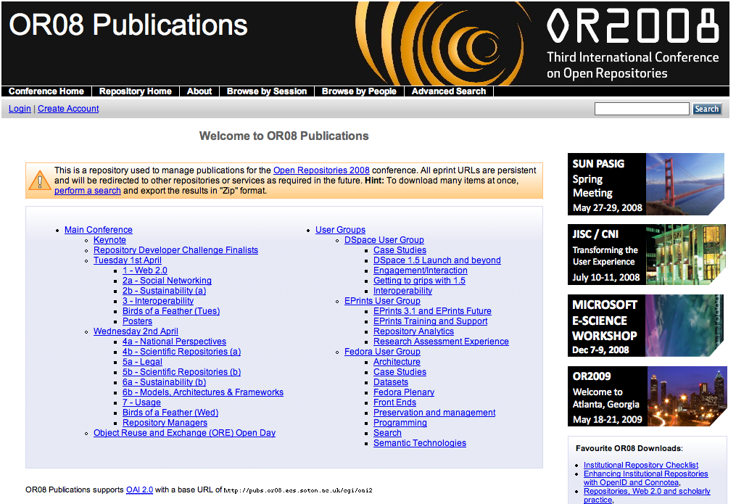
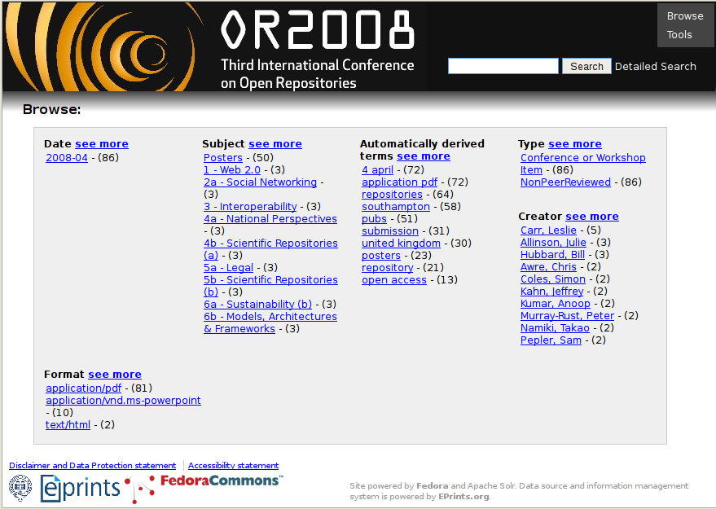

Mining with ORE
OAI-ORE
EPrints & Fedora
Preserv
.org.uk
Repository Preservation and Interoperability
Which is which?

Slide 13
Open Storage
Reliable
Self Checking and Self Healing file System
Resiliant
Must have the capability to be robust in the case of part failure
Simple & Expandable
Must be made of parts which are easy to expand / upgrade way into the future.
Open
Any software developed to enable all of the above must be open, same with any hardware specifications.

Slide 14

Open Storage (2)
Objects are addressable via HTTP
http://url/uuid
Each object should be heavily tied to its UUID; you should be able to find the UUID from the object.

Slide 15
Repositories and Open Storage
Repository Software
Storage Plugin
Open Storage
Notes:
Red nodes are Resource Maps, Blue nodes are Resources.

Slide 16
Services over Storage
Ingestor
Repository Software
Index & Search Service
Dynamic Open Storage
Preservation Storage

Slide 17
Summary
Objects, including REMs are stored in Open Storage.
Web Services like OAI-PMH will still be used.
The repository software can be removed, replaced and more easily upgraded.
Enables preservation as you can let a 3rd party have some say in the management of your objects.

Slide 18
Open Storage & The Cloud
Open Storage provides a controlled web based environment in which objects can be stored.
Still in the Cloud
Reliable, Resilient, Expandable.

Slide 19
Unlocking the Repository
Repository as a service rather than software running on a local ‘box’
Facilitates a greater number of services to operate directly with your resources
LOCKSS
Format Classification
Format Migration

Slide 20

“The coolest thing to do with your data will be thought of by someone else!”

Slide 21
One more thing…
Smart storage.
Utilising the masses of processor power in the storage cloud to benefit your repository.
Storelets on Honeycomb

Slide 22

Thanks

Slide 23
Questions
But how do I control access to my objects?
Use n storage plugins and n indexers and then perform federated search.
Authentication
Use Open Auth
Local Login Servers
Eduroam
Complete control costs $$$

Slide 24
Questions
Q: What happens if you inherit a single hard disk with a series of files on it but don’t know any of the file identifiers. You have ORE maps for the resources. How do you identify the files which go with the URIs?
A: When droid or an identification tool classifies the file It outputs XML which contains a binary stream of the start n bytes of the file it relates to, or a hash of the file. Smart storage!

