Slide 1
Why the University of Ghent’s research should be Open Access
Alma Swan
Enabling Open Scholarship
(www.openscholarship.org)
Publish or Perish: Tools and Best Practices conference, University of Ghent, 28 October 2009

Slide 2
Open Access
Immediate
Free (to use)
Free (of restrictions)
Access to the peer-reviewed literature (and data)
Not vanity publishing
Not a ‘stick anything up on the Web’ approach
Moving scholarly communication into the Web Age
OpenScholarship.org

Slide 3
OpenScholarship.org

Slide 4
Why Open Access
Greater impact from scientific endeavour
More rapid and more efficient progress of scholarship
Novel information-creation using new and advanced technologies
Better assessment, better monitoring, better management of research
OpenScholarship.org

Slide 5
Open Access for authors (researchers)
OpenScholarship.org

Slide 6
Impact
Range = 36%-200%
(Data: Stevan Harnad and co-workers)
OpenScholarship.org

Slide 7
Open Access: how
Open Access journals (www.doaj.org)
Open Access repositories
OpenScholarship.org

Slide 8
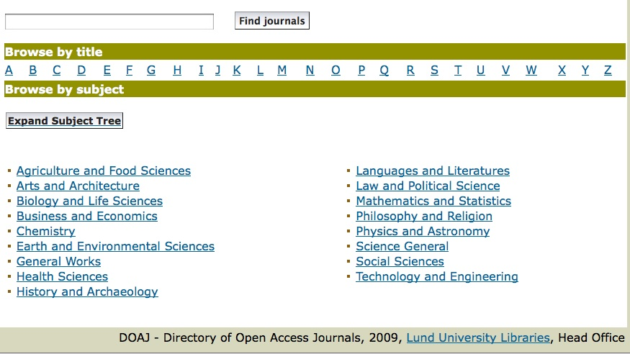
Fields in which OA journals are published
OpenScholarship.org

Slide 9
Open Access repositories
Digital collections
Interoperable
Form a network across the world
Create a global database of openly-accessible research
Currently >1400
OpenScholarship.org

Slide 10
How to make your work Open Access through a repository
Prepare your paper and submit it to your journal of choice for peer review
Make any changes required as a result of the peer review process
Submit the final version to the journal
Deposit that same final version to your repository through the normal deposit procedure that applies in your institution
N.B. Your repository staff may check journal copyright conditions on your behalf, or you may do so yourself using the SHERPA RoMEO service at http://www.sherpa.ac.uk/romeo/
OpenScholarship.org

Slide 11
A well-filled repository
OpenScholarship.org

Slide 12
And it gets used
OpenScholarship.org

Slide 13
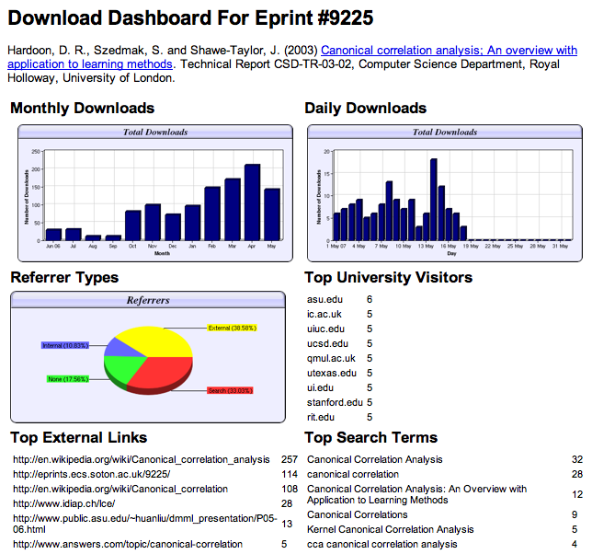

Slide 14
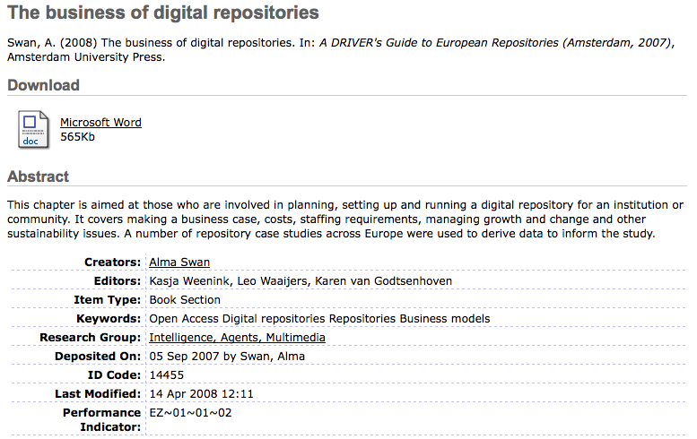
OpenScholarship.org
Notes:
14

Slide 15
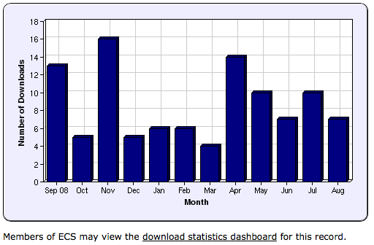
OpenScholarship.org
Notes:
15

Slide 16
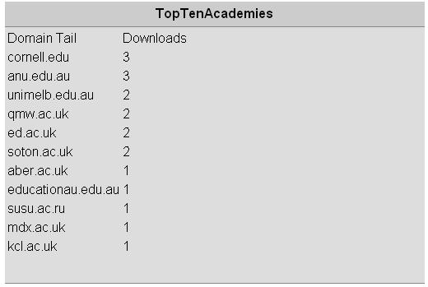
N.B. Downloads are a good predictor of eventual citations
OpenScholarship.org
Notes:
16

Slide 17
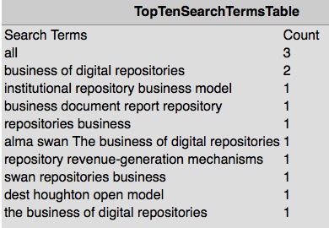
OpenScholarship.org

Slide 18
Impact
Range = 36%-200%
(Data: Stevan Harnad and co-workers)
OpenScholarship.org

Slide 19
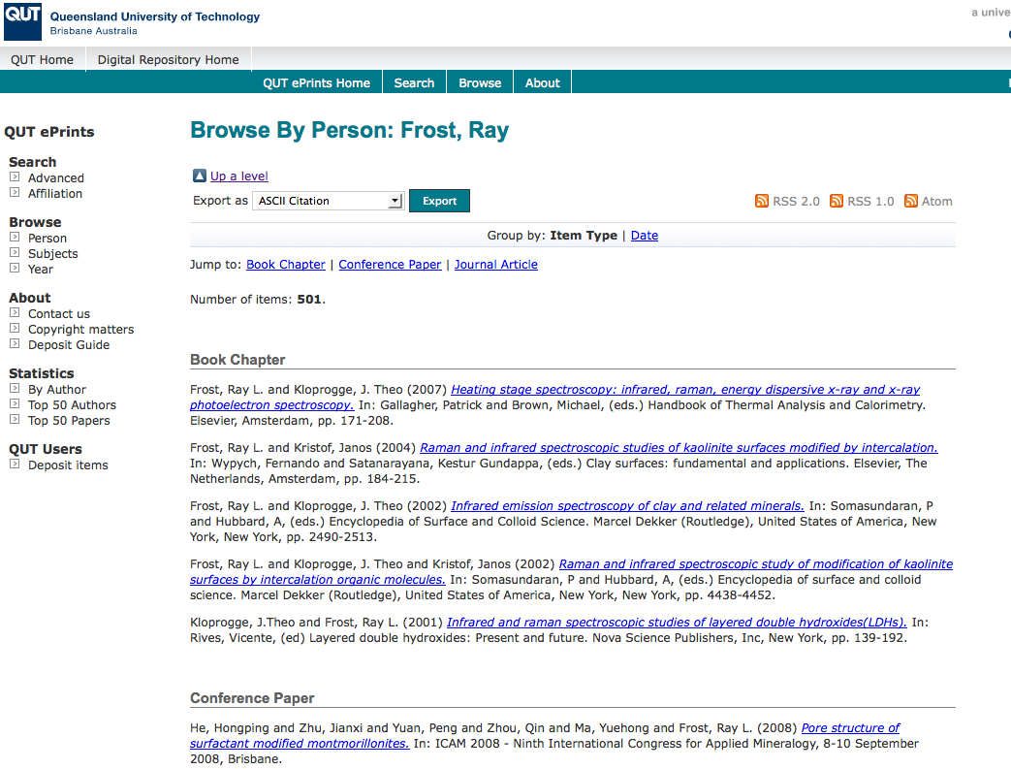
What OA means to a researcher
OpenScholarship.org

Slide 20
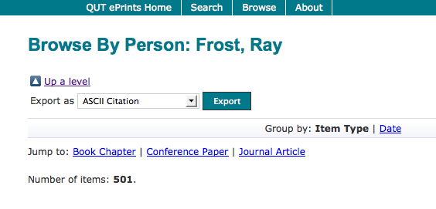
OpenScholarship.org

Slide 21
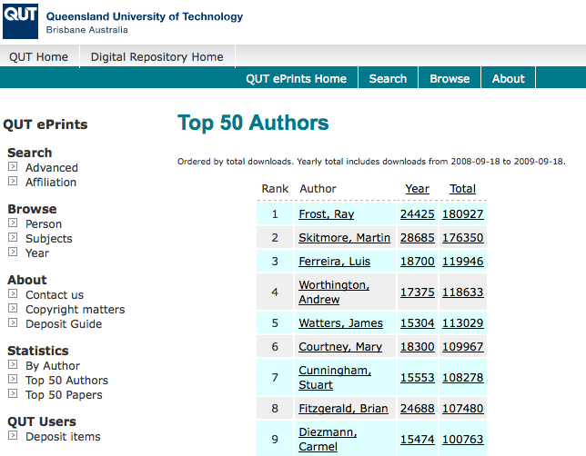
OpenScholarship.org

Slide 22
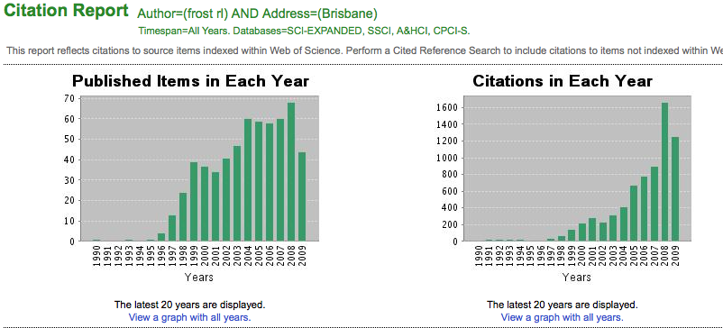
Ray Frost’s impact
OpenScholarship.org

Slide 24
6367
full-texts
OpenScholarship.org

Slide 26
Newest 50 full-text deposits
OpenScholarship.org

Slide 27
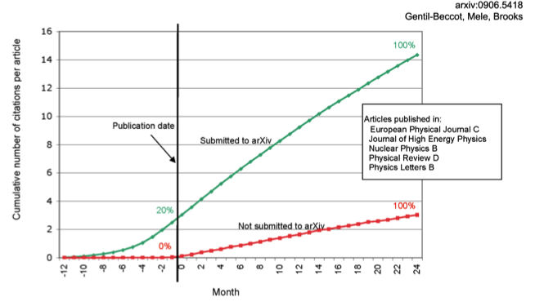
The early bird …
OpenScholarship.org

Slide 28
Open Access for institutions
OpenScholarship.org

Slide 29
What is a university for?
OpenScholarship.org

Slide 30
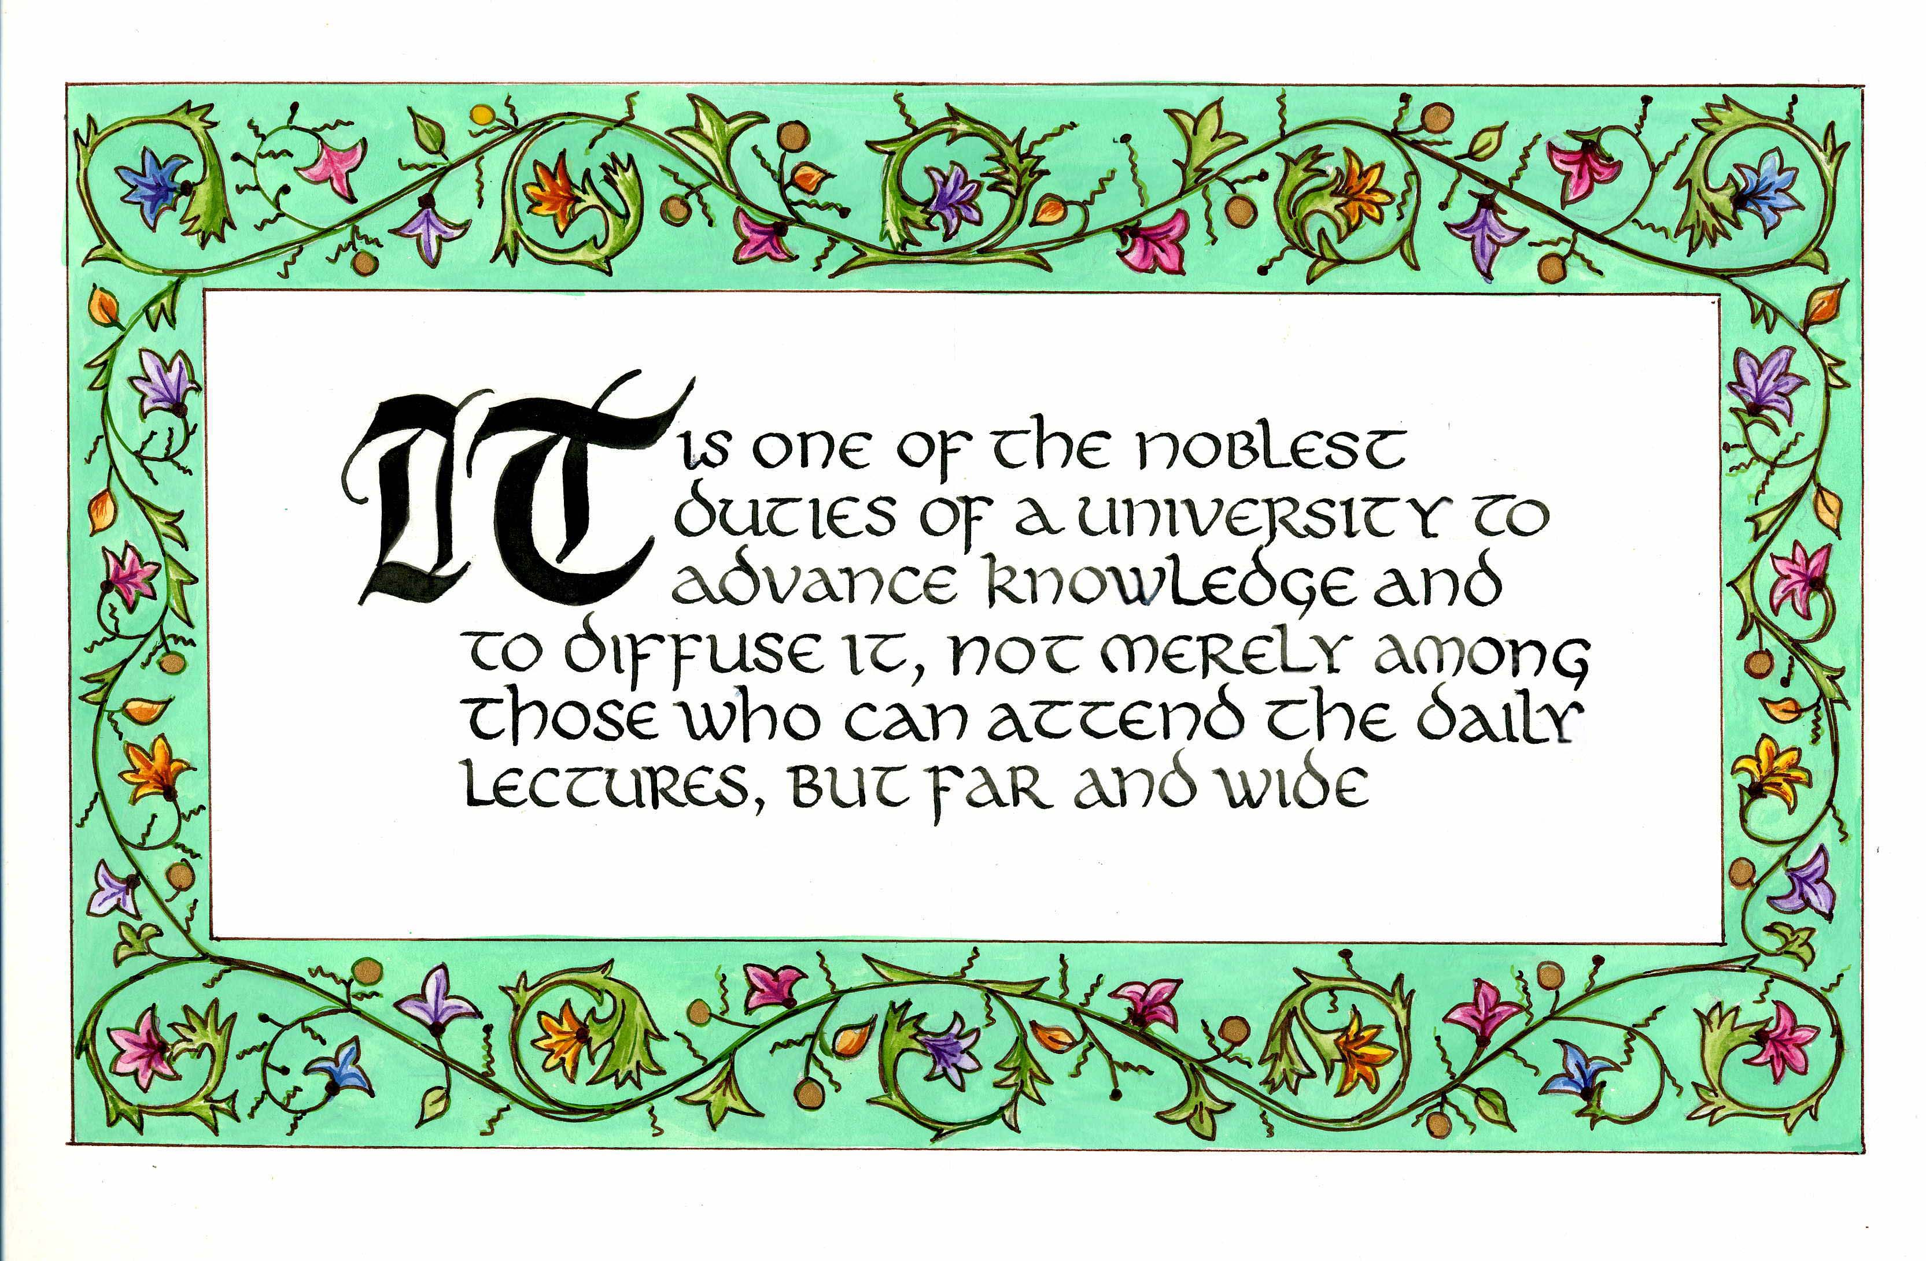
Daniel Coit Gilman First President, Johns Hopkins University (1878)
OpenScholarship.org

Slide 31
University of Edinburgh Strategic Plan 2008-12
“The mission of our University is the creation, dissemination and curation of knowledge.”
OpenScholarship.org

Slide 32
An institutional repository …
Fulfils a university’s mission to engender, encourage and disseminate scholarly work
Complete record of its intellectual effort
Permanent record of all digital output
Research management tool
Marketing tool for universities
Provides maximum Web impact for the institution
OpenScholarship.org

Slide 33
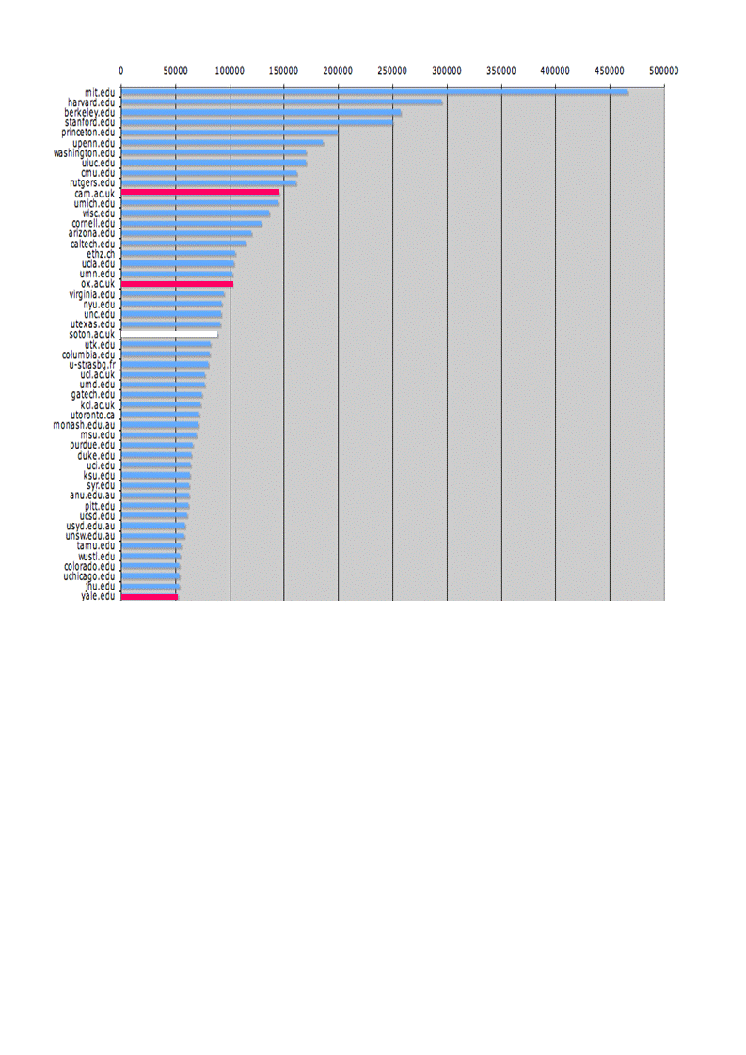
The U.Southampton conundrum
The G-Factor (universitymetrics.com)
OpenScholarship.org

Slide 34
OpenScholarship.org

Slide 35
Impact
Range = 36%-200%
(Data: Stevan Harnad and co-workers)
OpenScholarship.org

Slide 36
Lost citations, lost impact
Say, Open Access brings 50% more citations
Only around 15% of research is Open Access
….. so 85% is not
University X is therefore losing 85% of the 50% increase in citations (conservative end of the range) that Open Access brings (= 42.5%)
OpenScholarship.org

Slide 37
What this means to the University of Ghent
2008: 4680 articles
Number of citations: 11596
If all had been Open Access, there would have been (42.5% more) 16524 citations
OpenScholarship.org

Slide 38
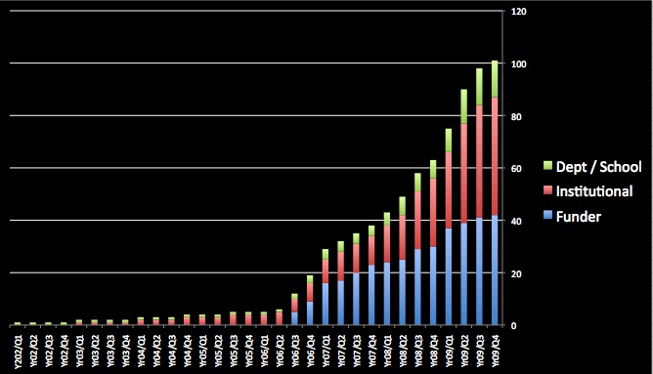
Open Access policies
OpenScholarship.org

Slide 39
Repositories… “are vital to universities’ economies and to the UK economy as a whole.”
Professor J Drummond Bone
Past President, Universities UK
OpenScholarship.org

Slide 40
OECD
“Governments would boost innovation and get a better return on their investment in publicly funded research by making research findings more widely available …. and by doing so they would maximise social returns on public investments.”
OECD Report on Scientific Publishing, 2005
OpenScholarship.org

Slide 41
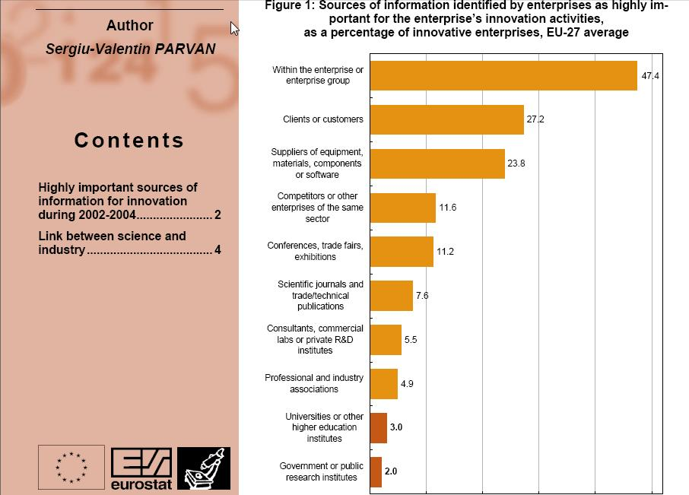
OpenScholarship.org

Slide 42
EU CIS studies, continued …
“Institutional sources are less frequently consulted than internal or market sources; and innovative enterprises find cooperation partners more easily among suppliers or customers than in universities or public research institutes.”
OpenScholarship.org

Slide 43
Total Research Income: QUT and sector
Data: Tom Cochrane
Deputy Vice-Chancellor, QUT
OpenScholarship.org

Slide 44
Thank you for listening
aswan@talk21.com
www.openscholarship.org
www.openoasis.org
OpenScholarship.org

