Slide 1


Digital Preservation for Digital Repositories
David Tarrant
University of Southampton (UK)
dct05r@ecs.soton.ac.uk
Preserv
.org.uk
Repository Preservation and Interoperability
Notes:
In this talk I’ve been asked to provide an update on the EPrints repository software
and thus I will start out will a bit of background on the aims of EPrints, how the software is developed, and what the overall aims of the development team are.
For those of you who don’t know me:
I’m currently a researcher/ occasional PhD student working on the Preserv2 project, about which I talk a little later in this presentation.
I work directly with the leader of the EPrints and Preserv2 projects, Les Carr and am currently tasked with the responsibility of investigation opportunities for preservation services within Digital Repositories. Throughout the course of this presentation you should get the feel for the fact that although I have some direct involvement in EPrints, this is not the only piece of repository software in my world.
Before we get to all of that I thought I’d recap why we are all talking about preservation
how repositories already provide some basic form of preservation.
and what the EPrints repository software in trying to achieve.
For this I thought I’d reference some material which Les Carr presented at the previous PASIG meeting in November.
Firstly why do we need a repository?

Slide 2

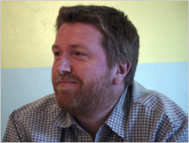
Notes:
Institutions and other scientific bodies move at a very fast rate and new projects are popping up in new areas all the time, often with one person involved in 2 or 3 of them, with this fast moving effort research can often get lost.
Les is no exception here.

Slide 3

Notes:
I’m guessing this slide says it all.
Within EPrints and Preserv2 we often talk about Grass Roots preservation.

Slide 4

Grassroots Preservation
Small Science > Big Science
“The sum of the smaller parts adds up to a greater number than that of the bigger parts combined”
“Grassroots” preservation for Institutional and Small Business Outputs
Until now EPrints has mainly been focused on encouraging acquisition of Data.
How do we create our Global Collection?
Notes:
By grassroots preservation we are talking metaphorically about viewing output from small science being as important as that of Big Science.
For example in a big company, such as a media company or national library, preservation often gets large amounts of funding and is seen as a core activity for the future. This can be seen as a combine harvester type approach, where a single controlled process model for preservation is created.
However even if you add the output of the larger scientific institutions together you still fall way short of the number of records produced by all the smaller guys put together. These grass cuttings is what EPrints is aimed at collecting and ingesting into an institutional repository, about which policies can be made regarding preservation activities.
EPrints was thus initially designed to be simple and clear to use such that researchers would willingly submit their “important” outputs into a repository.
The focus was to also not just collect the documents but also their related metadata, such as authors, publication location, publication type etc.
With grass cuttings starting to be collected, at the end of the last meeting we asked the question about bringing these grass cuttings together to form a global collection, this idea I will come back to later, if in a slightly different manor.

Slide 5

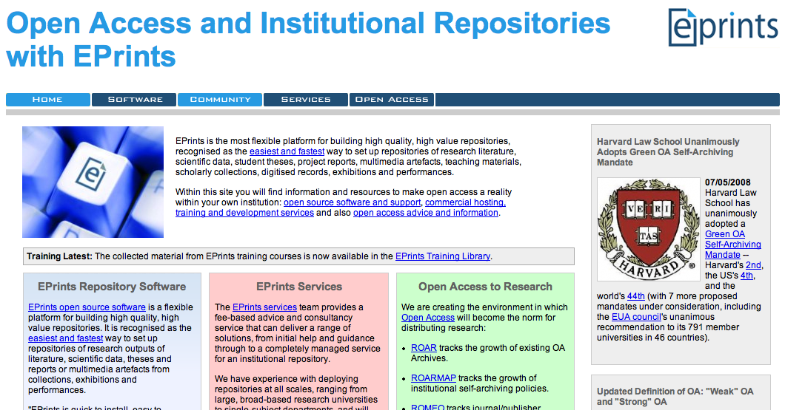



: History of…
Proposed as a ‘build your own repository’
solution
Enable institutions and groups to participate in
OAI metadata sharing initiative.
First released April 2000 (to co-inside with OAI-PMH)
Version 3.1 release at recent Open Repositories Conference 2008
Used by over 240 registered repositories
(32169 Records)
(58130 Records)
(49132 Records)
Number of Records captured from the Registry of Open Access Repositories (ROAR) http://roar.EPrints.org
Notes:
EPrints history then:
EPrints was the first piece of repository software and resulted from the Open Access Initiative movement, of which Southampton did, and still does play a key role.
As a result the first release of EPrints was in April 2000 which co-insided with the OAI-PMH launch. Over the years we have seen a great number of changes to the functionality and power of EPrints. The development of a highly customisable architecture enables EPrints to fulfill the role of an object repository and not just one designed for publication data.
With the more recent 3 and 3.1 releases we see a more streamlined deposit process and simpler ways to customise your repository without even having to know how to write XML.
As a starting point for recognising a global collection we also started the Registry of Open Access Repositories (ROAR) and this now lists around 1000 repositories running a variety of different repository softwares.
On this slide are listed the top 3 EPrints based repositories, note how the top one is not Southampton for a start and also has almost twice the number of publications. This is followed by a German aerospace company, and then Southampton.

Slide 6
: Management
Open source (GNU license)
EPrints development model is more centralised than DSpace / Fedora
Faster turnaround on development cycles
More focused
Easier quality management
Better for Support Model
EPrints Services:
Repository hosting, bespoke development & training
Sustain the development team
Notes:
A little about the development of EPrints:
The first point should be obvious with a project which encourages Open Access.
EPrints is open source under the GNU license.
EPrints consists of a small development team, currently 2 core programmers + contributors + the services team. This keeps the project very focused and makes quality management a lot easier, we have one developer who essentially writes lots of new features and a second who fixes all the old features this new feature break.
This aside having a centralised development model also means that we have a very strong support team who know the software inside out.
We also encourage users to submit their own code and add-ons back to us, allowing them to potentially be incorporated into the main software releases.
The Support team + a few others also double up as a services team which offer hosting, specialised development and on site training. Activities which help to sustain the development team.

Slide 7
: Core Objectives
Lower the barrier for depositors while improving metadata quality and ultimate collection value
Time saving deposits
Import data from other repositories and services
Autocomplete-as-you-type for fast data entry
Name authorities
Enter once, reuse often
Works with bibliography managers, desktop applications and new Web 2.0 mashups
RSS feeds and email alerts keep you up to date
Easily integrate reports, bibliographic listings, author CVs and RSS feeds into your corporate web presence
Used for corporate reporting and national Research Assessment
• Simple platform for open source contributions
Tightly-managed, quality-controlled code framework
Flexible plug-in architecture for developing extensions
Import
XML
BibTeX
PubMed
CrossRef
OAI-ORE
ACM Digital Library
EndNote
Spreadsheet
EPrints
OBJECT STORE
metadata + data
Fully searchable and scriptable
XML
Google Maps
ORE Resource Map
OAI-PMH
Simile Timeline
Bibtex Endnote PubMed
Export
Notes:
I’ve already outlined that EPrints aims to encourage self deposition by making this process as easy as possible whilst maintaining a high quality of metadata.
The key here is to understand how EPrints is put together. Locally we refer to EPrints as having a CORE and lots of plug-ins.
Some like to refer to these plug-ins as modules.
Here you can see listed some of the Import and Export plug-ins, not all are listed, but from the top 2 points we outline the key ways in which EPrints is not just a fixed repository but can also become a flexible data source for the authors, thus they can get something back.
For example if they list the places in which their papers have been presented, e.g. the conference, we can plot these on a google map, with or without the arrows to show a researchers journeys around the world.
Obviously they can also get a list of their or even their friends publications, I was thinking a facebook application could also work here to keep track of your friends research output.
So that’s the History and Background mostly covered.
Now for some new stuff, ok not quiet but some new questions.
Where does preservation fit in and what about this global collection?
Only a subset of the Import and Export plug-ins are listed

Slide 8

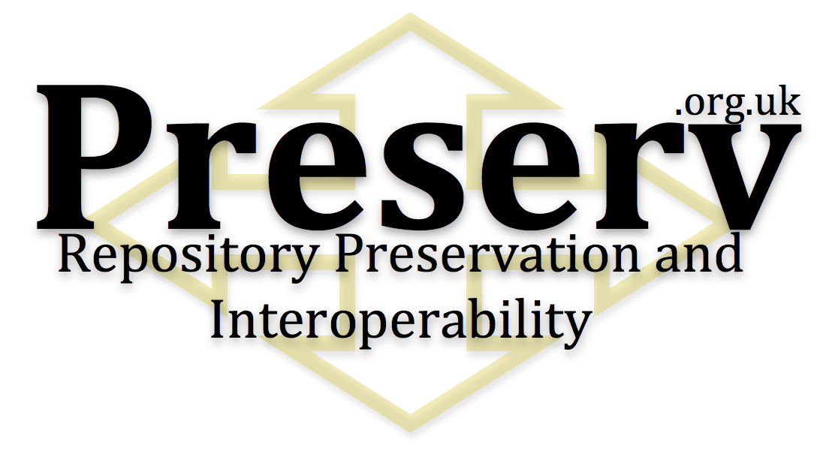
Digital Preservation
"It is important to build the concept of preservation from the outset. In the digital era, the 'outset' for most new research and educational materials will be the institutional repository."
Notes:
Firstly Preservation.
Now I’m taking a slight detour here so bear with me.
I mentioned right at the beginning of the presentation that I am currently tasked with the responsibility of investigation opportunities for preservation services within Digital Repositories. Thus my main focus is currently with this project.
Preserv (preserve: not pre-serve) no idea where the “e” went.
Preserv is a UK based project funded by the Joint Information and Systems Committee.
We are looking specifically at Preservation, and Preservation Services for Digital Institutional repositories.

Slide 9




Digital Preservation
Long term reliable storage
Open Storage
Maintaining readability
Migration / Emulation
Interoperability for multiple usage scenarios
Notes:
Preserv has 3 main partners however we are growing sub-partners who are helping at various stages with integration and testing (more on this later)
The British library act as advisors to the project and in the world of grass cuttings they are a national library who have a responsibility for the preservation of all British publications, so they are the combine harvesters in our world of lawn mowers.
Among the aims of the preserv project I have picked out these 3 on the left, each of which I will attempt to fit in within this presentation with some explanation.
As a brief overview:
Long term storage is about still having the content in years to come, not corrupted and the raw bit stream is still in tact.
Readability is about being able to take this bit stream and actually view it as it was intended. Maintaining the ability to render the object.
Finally interoperability is important to have where there is the potential for a piece of software (such as a repository software) to disappear, what happens to all the objects?
I’ll start with the first point. Long term storage.

Slide 10
Long Term Storage
Reliable
Self Checking and Self Healing file System
Resiliant
Must have the capability to be robust in the case of part failure
Simple & Expandable
Must be made of parts which are easy to expand / upgrade way into the future.
Open
Any software developed to enable all of the above must be open, same with any hardware specifications.
Notes:
Long term storage is the essential first stage of preservation.
Here are listed 4 critical components of what I believe to be good long term storage solutions.
Reliable: Must be able to self heal it’s file system, check for bit errors and correct them. This should not require human intervention at any point.
Resilient: The system should be able to cope well with predicted failure and typical life cycles of components. Google has been doing a lot of work in the life cycles of hard disks under all types of conditions. Any long term storage should expect a level of failure and be able to cope with it.
Simple and Expandable: If parts fail 20 years in the future you will not be able to get an identical replacement. The system should be able to handle different off the shelve storage hardware.
Open: We will still need specialist software to help manage all of this data and it is critical that this software be completely open such that it can be maintained by the community of users. This should happen from the start such that this community has time to build.
Now can we think of any companies out there which are looking at this type of Open Storage product…?
No… me neither

Slide 11
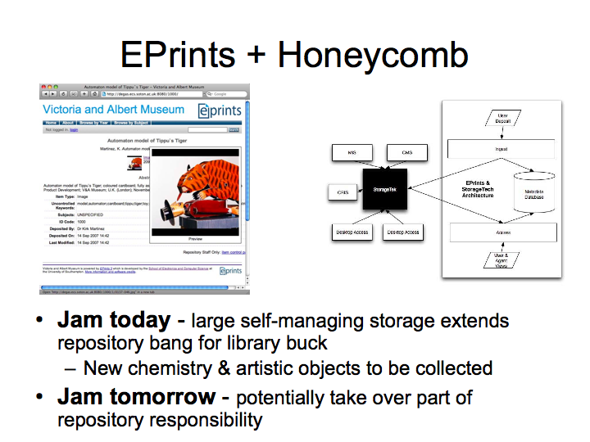
November 07
Notes:
… OK … so maybe there is one or two …
So where were we in November with this idea?
Well in Les’s usual manor he managed to get from Grass to Jam.
Here we stated that EPrints would be willing to investigate using the honeycomb as a replacement store for an EPrints repository, loads of resilient storage online strait away.
The later potential is for this Open Storage (Honeycomb) to take over part of the repository responsibility.
Combining Preserv and EPrints aims I see it as slightly more than that.

Slide 12
: Core Objectives
Lower the barrier for depositors while improving metadata quality and ultimate collection value
Time saving deposits
Import data from other repositories and services
Autocomplete-as-you-type for fast data entry
Name authorities
Enter once, reuse often
Works with bibliography managers, desktop applications and new Web 2.0 mashups
RSS feeds and email alerts keep you up to date
Easily integrate reports, bibliographic listings, author CVs and RSS feeds into your corporate web presence
Used for corporate reporting and national Research Assessment
• Simple platform for open source contributions
Tightly-managed, quality-controlled code framework
Flexible plug-in architecture for developing extensions
Import
XML
BibTeX
PubMed
CrossRef
OAI-ORE
ACM Digital Library
EndNote
Spreadsheet
Flexible plug-in architecture for developing extensions
EPrints
OBJECT STORE
metadata + data
Fully searchable and scriptable
XML
Google Maps
ORE Resource Map
OAI-PMH
Simile Timeline
Bibtex Endnote PubMed
Export
Notes:
So to recap, I’ve now briefly outlined the Preserv project and also the history of EPrints.
And both have ended up mentioning the need for Open Storage. So where does it all fit together?
Let’s go back briefly to this slide and highlight the architecture of EPrints.
“A Flexible plug-in architecture for developing extensions.”
Well I’m pleased to announce not 1 but 2 new layers in EPrints where new plug-ins are now possible to include.
In EPrints 3.1 we introduced a new database controller enabling EPrints interface with other databases other than mysql. This was released along with an oracle module.

Slide 13





: Architecture
EPrints is expanding the number places in which plug-ins can be utilised.
Import Plug-ins
Export Plug-ins
EPrints Core
Interfaces, Submission Manager
Database Controller
Storage Controller
Honeycomb
Diagram Represents Proposed EPrints 3.2 Architecture
Notes:
I’m pleased to announce that we have already written and am testing the Storage Controller module for EPrints 3.2.
This advanced new layer completely abstracts all the storage calls within EPrints and gives the users complete control over the storage of every single object.
Thus this new architecture has 4 pluggable layers which sit around the repository software which handles your deposit and review process.
As you can see I’ve given some examples of what you can plug into these 2 new layers, some obvious and some not so obvious.
NOTE: STORING INTO FEDORA ASSUMES THAT FEDORA IS ONLY USED AS THE DISSEMINATOR AND NOT USED TO CHANGE THE RECORDS AS DUE TO VERSIONING ISSUES THIS WOULD CAUSE THE METADATA AT EACH LAYER TO BE INCONSISTANT, THIS IS STRICKLY USED AS AN EXAMPLE.

Slide 14

The Storage Controller
Each item can be stored using a different storage plug-in (hence in a different place) dependant on file or metadata properties and values.
e.g. Large binary files of scientific data (raw machine result data) can be stored in a large disk (slower access) system and sent to a tape company for long term storage.
Processed results can be stored locally and on a honeycomb server where they are preserved.
Allows a repository to use a 3rd party storage platform
Direct deposition into a honeycomb etc
Great enabler for preservation
Let the repository control the deposit process.
Ensures that the complete object is preserved and not just the “harvested” bits
Notes:
We are quiet excited about the storage controller as we have tried to give as much power and flexibility to the users as possible.
For this reason the storage controller does not just allow a single storage plug-in to be used, you can use as many as you want simultaniously!
EPrints stores several files alongside the users deposited item, such as a full text index and thumbnail. These can also be stored in various different locations.
You can also separate you files depending on type and size, so large non changing binary files could go to be archived. The example I give here is relating to that of the eCrystals project where they collect gigabytes of raw results from scientific machines but they only store the small processed results in their repository.
The storage layer provides them with a mechanism of being able to store these large binary files by passing them out to a larger long term server or archive and still be able to reference them and locate them within their repository.
Preservation capabilities are also enhanced with the storage layer. We see harvesting as a secondary ideal when it comes to accurate preservation. If the repository is handling direct deposition into a preservation services provider the data that service receives is likely to be much more accurate than that output by a harvester.
To store an object in a preservation service or server the repository could just store it twice using 2 different storage plug-ins.

Slide 15

Open Storage for Repositories
Simple, open, managed storage.
Advanced features built in:
ZFS
Error and Bit Shift Correction
Metadata Layer
Simple API
Store
Retrieve
Delete
Simple to interface with Repository Software
RAID 6
Honeycomb
Notes:
Above and beyond those points raised before which are the key ones in Long Term Storage, Open Storage should be easy to use.
A simple API will mean it is easy to integrate with repository softwares. And going beyond this we envisage that is the Open Storage service could take in and maintain metadata in the same resilient way then some of the Open Storage solutions can also be plugged into the database controller.

Slide 16
Preserv
Preserv Project Structure (May 2008)
.org.uk
Repository Preservation and Interoperability
Content
Policy
Repository Software
Services
EPrints
Fedora
DSpace
TNA API - PRONOM
File Format Identification
Significant Properties
Migration Tools
(Performance Metrics)
Services Registry
Scheduler (Oxford)
Services & Invocation API
Storage Controller
EPrints
Fedora
Interoperability
OAI-ORE Specification & Mapping
Physical Storage
Local Disk
Remote Server
Cloud Service
Honeycomb
EPrints
Fedora
Application Program Interface (API) + XML
Relation Exclusivity (1 to 1, 1 to Many)
Notes:
This slide is here to briefly outline how Open Storage fits into Preserv
Preserv’s work package is all about constructing a framework for preservation and to keep this as simple to use and plug into as possible.
On the left here I essentially expanded out the old Repository box such that it now separates into 2 separate layers with the storage controller layer in the middle.
In Preserv we are looking at the wider view of integrating all repositories into this framework idea and I’m very happy to be working closely with fedora who already have an abstracted storage layer.
We are also looking at plug-ins and modules for all types of physical storage.

Slide 17
Preserv
Preserv Project Structure (May 2008)
.org.uk
Repository Preservation and Interoperability
Content
Policy
Repository Software
Services
EPrints
Fedora
DSpace
TNA API - PRONOM
File Format Identification
Significant Properties
Migration Tools
(Performance Metrics)
Services Registry
Scheduler (Oxford)
Services & Invocation API
Storage Controller
EPrints
Fedora
Interoperability
OAI-ORE Specification & Mapping
Physical Storage
Local Disk
Remote Server
Cloud Service
Honeycomb
EPrints
Fedora
Application Program Interface (API) + XML
Relation Exclusivity (1 to 1, 1 to Many)
Notes:
Opening up the diagram, Preserv also includes a big section on integration and support for preservation services.
Here we envisage a similar framework of utilising a common API and a series of XML schemas to support preservation activities within a digital repository.
A few examples are given and I’m going to briefly recap and expand a little on the PRONOM registry provided by our Preserv partner The National Archives.

Slide 18


Characterisation & Migration Services
The online registry of technical information. PRONOM is a resource for anyone requiring impartial and definitive information about the file formats, software products and other technical components required to support long-term access to electronic records and other digital objects of cultural, historical or business value.
Free PRONOM tools and services to support digital preservation, including DROID, the automatic file format identification tool, together with links to relevant external tools and services.
Under Investigation: Significant Properties Registry, Migration Tools Registry, Risk Analysis and Feedback.
Notes:
The National Archives runs and maintains the PRONOM technical registry which currently contains information pertaining to file format identification, using DROID (the tool which actually parses the file) and PRONOM the file format identification is able to provide exact version information rather than just the fact that the file is a doc file. E.G. It will tell you it is a word 2000 doc file.
The TNA is now looking to expand the technical registry to include:
Information about the Significant Properties of these file formats…
A Migration Tools registry
And ratings on how each migration tool performs when converting a file based upon the significant properties that file contains.
This part of the project has another partner (planets) who are a EU funded project looking at preservation.

Slide 19
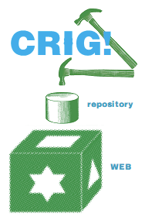
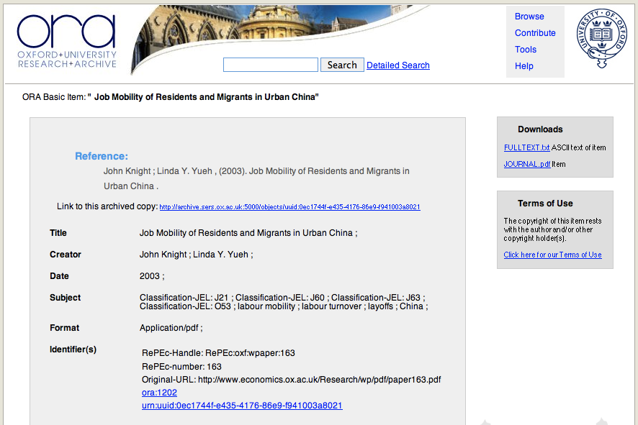
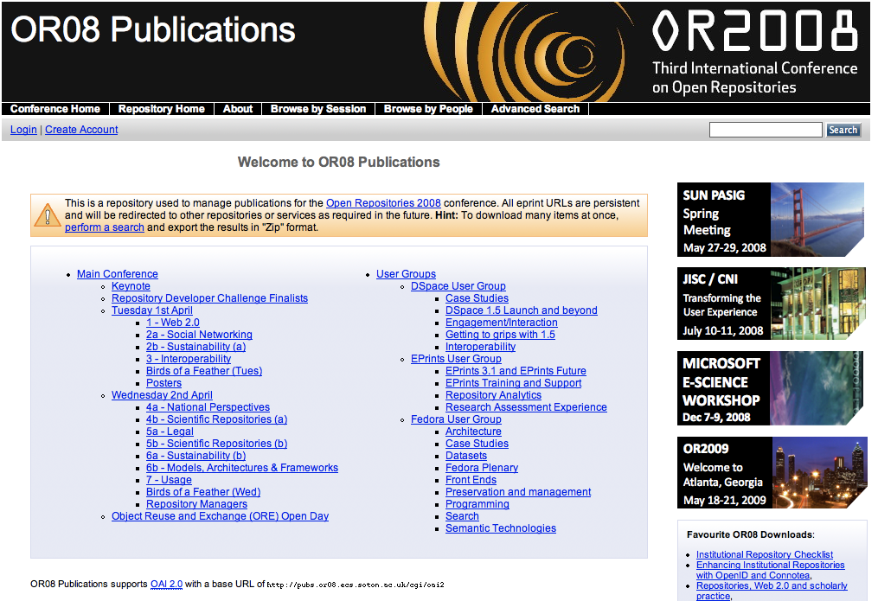
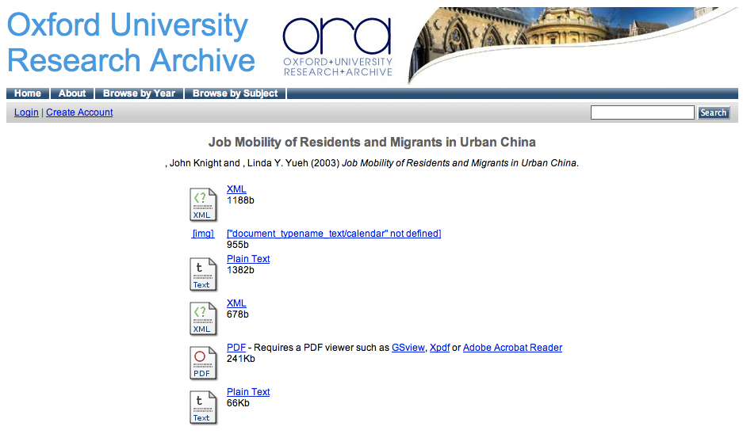
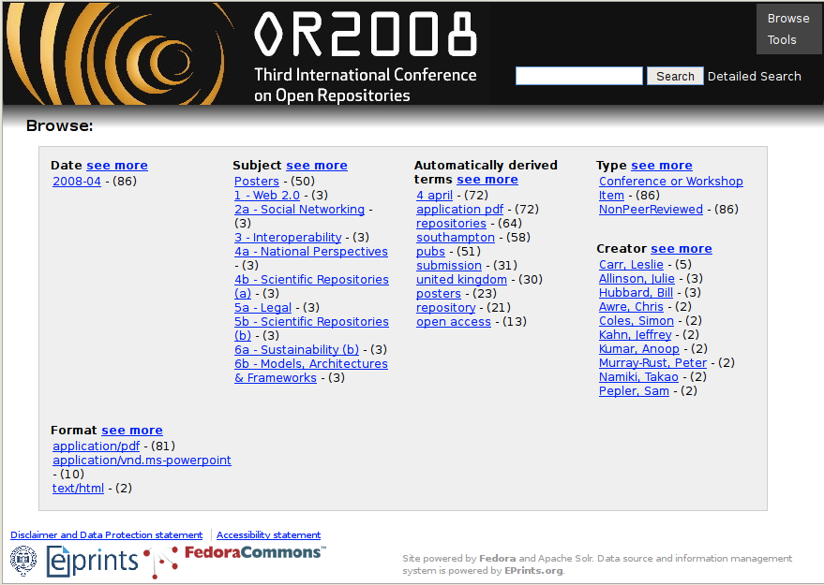

Interoperability in Action
OAI-ORE
EPrints & Fedora
Preserv
.org.uk
Repository Preservation and Interoperability
Which is which?
Notes:
Briefly onto interoperability and why it is so important…
At the recent Open Reposities 2008 conference (http://or08.ecs.soton.ac.uk) a developers challenge was run with the aim to develop an application which combines at least 2 different types of repository platforms in a single application or demonstrate these 2 platforms working together. For this challenge the Preserv team (new and old – Myself, Ben O’Steen & Tim Brody) used the unreleased OAI-ORE standard to enable complete transportation of an object set (objects and all related metadata) from one repository software to another.
On this slide you can see the Open Repositories Conference repository in both EPrints and Fedora (left to right) and the Oxford Research Archive in Fedora and EPrints (top to bottom). Many thanks to the CRIG (Common Repository Interoperability Group) for setting up this challenge.
We hope to continue to the work further such that we can involve Dspace and also attempt to build a framework where multiple repository softwares can be run over a single dataset in a side by side fashion, this would also enable you to swap out your repository software.

Slide 20
Digital Preservation
+
EPrints will provide one of the first platforms for the development of preservation services where direct interaction takes place between the Repository Software and Preservation Services.
Notes:
So where does this all fit together!
EPrints will be one of the first platforms to look at building a framework for the interaction with preservation services and allow users to make policy about how they wish to use these services. Development is still in the early stages with preservation action services but the storage controller makes the process of long term storage in Open Storage servers a lot simpler.

Slide 21
One More Thing…
Smart Storage
Storage which has the capability to perform actions directly upon the objects stored within it.
Autonomous classification and migration of objects
No reliance on repository software for
processor time, yet same results.
Services
TNA API - PRONOM
File Format Identification
Significant Properties
Migration Tools
(Performance Metrics)
Physical Storage
Scheduler (Oxford)
Services & Invocation API
Honeycomb
…
Interoperability
OAI-ORE Specification & Mapping
Notes:
Briefly… One more thing
Smart storage.
You will notice that the preserv project structure from earlier contained an arrow linking the preservation services box directly to the Physical Storage.
Often these platforms such as the Honeycomb or Amazon Cloud services have lots of wasted CPU cycles which could be busy doing stuff, and we believe that some baseline activities such as classification and migration of object can be undertaken within this Open Storage platform. This frees up the repository for ingest and dissemination which are the primary activities a repository should be undertaking.
With the storage able to directly perform this operation it is no longer just Open Storage but Smart Storage.

Slide 22
Many Thanks!
Christopher Gutteridge
Tim Brody
Steve Hitchcock
Neil Jeffries
Ben O’Steen
Adrian Brown
Notes:
I hope this talk has provided some insight into 2 big projects and also given you a general update on one key aspect of the current EPrints development.
I’d like to thank my partners and co-workers and any questions please feel free to contact me at the address provided on these slides.

Slide 23
Questions…?
?
http://www.preserv.org.uk
David Tarrant
University of Southampton (UK)
dct05r@ecs.soton.ac.uk

