Slide 1
Big Pharma, Little Science? A bibliometric perspective on big pharma’s R&D decline
Ismael Rafols^{1,2,*}, Michael M. Hopkins¹, Jarno Hoekman³,
Josh Siepel¹, Alice O'Hare¹, Antonio Perianes-Rodríguez⁴ and Paul Nightingale¹
¹ SPRU – Science and Technology Policy Research, University of Sussex, Brighton, England
² INGENIO (CSIC-UPV), Universitat Politècnica de València, València, Spain
³ Eindhoven Centre for Innovation Studies (ECIS), Eindhoven University of Technology, Eindhoven, The Netherlands
⁴Carlos III University of Madrid, Department of Library and Information Science, SCImago Research Group, Madrid, Spain

Slide 2
Pharma Specialisation (Aggregate)

Slide 3
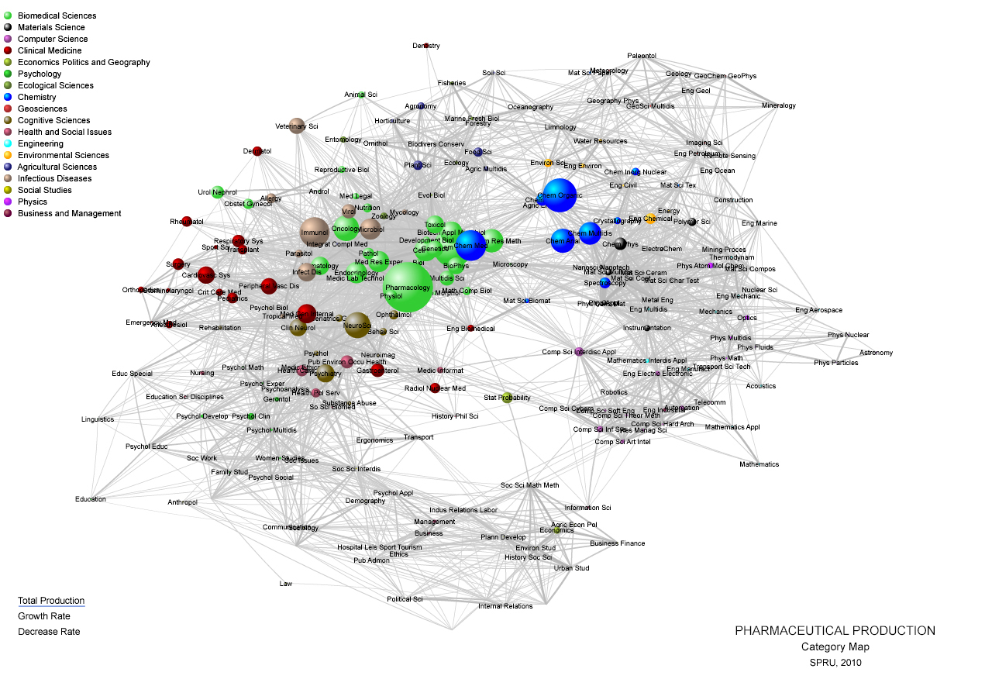

Slide 4
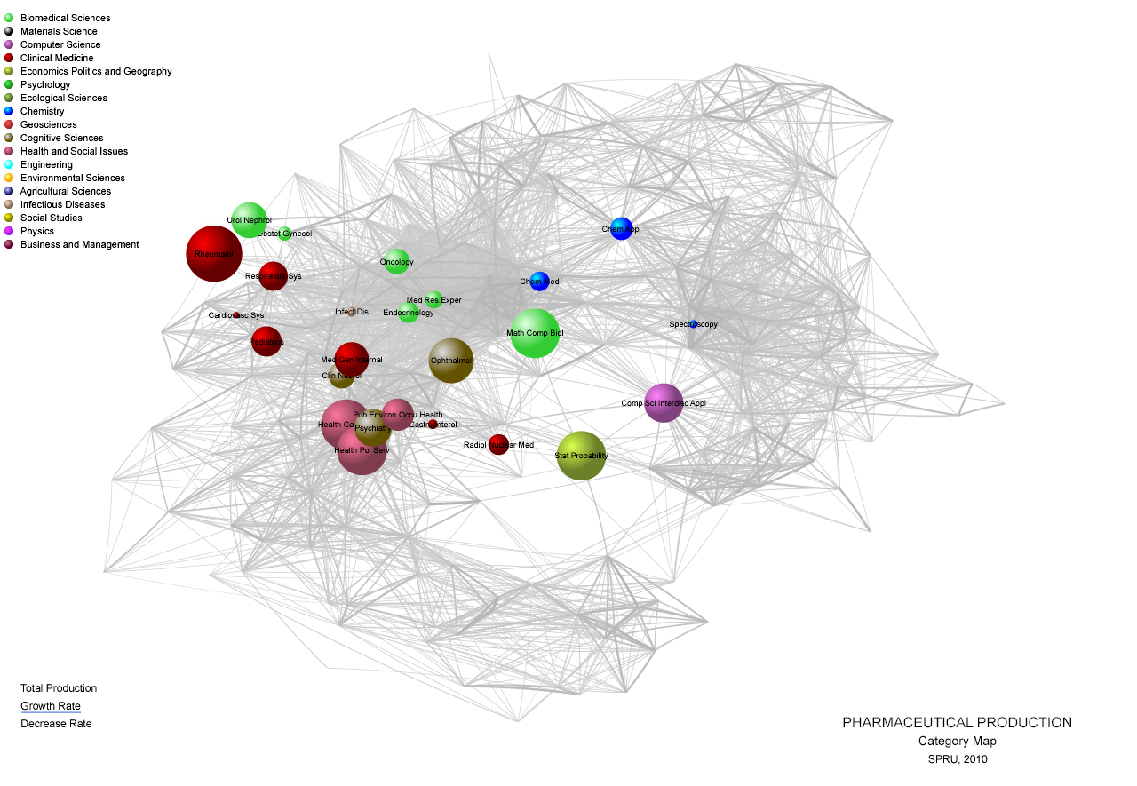

Slide 5
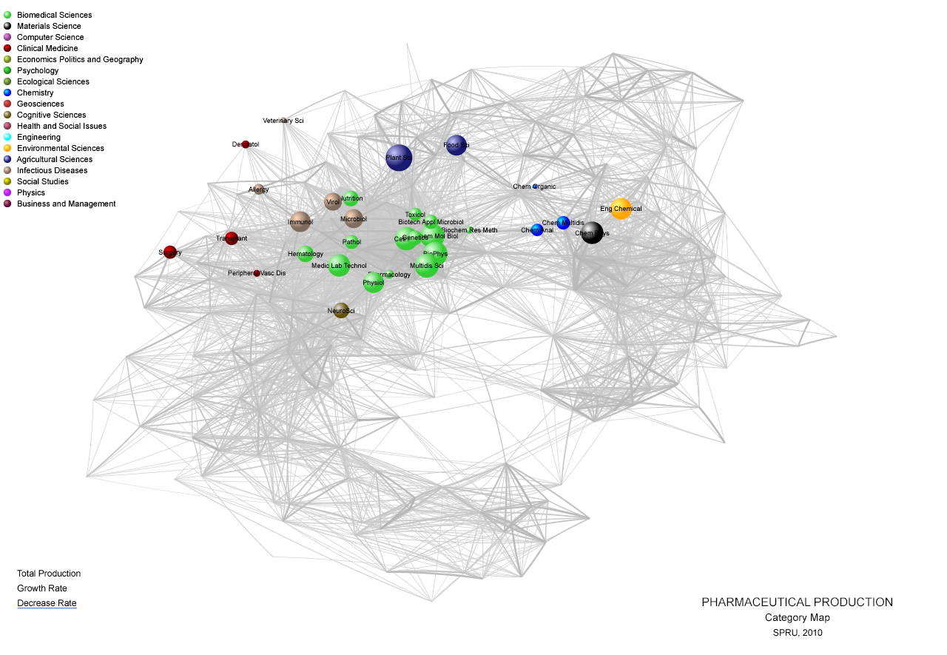

Slide 6
Specialisation by firm

Slide 7
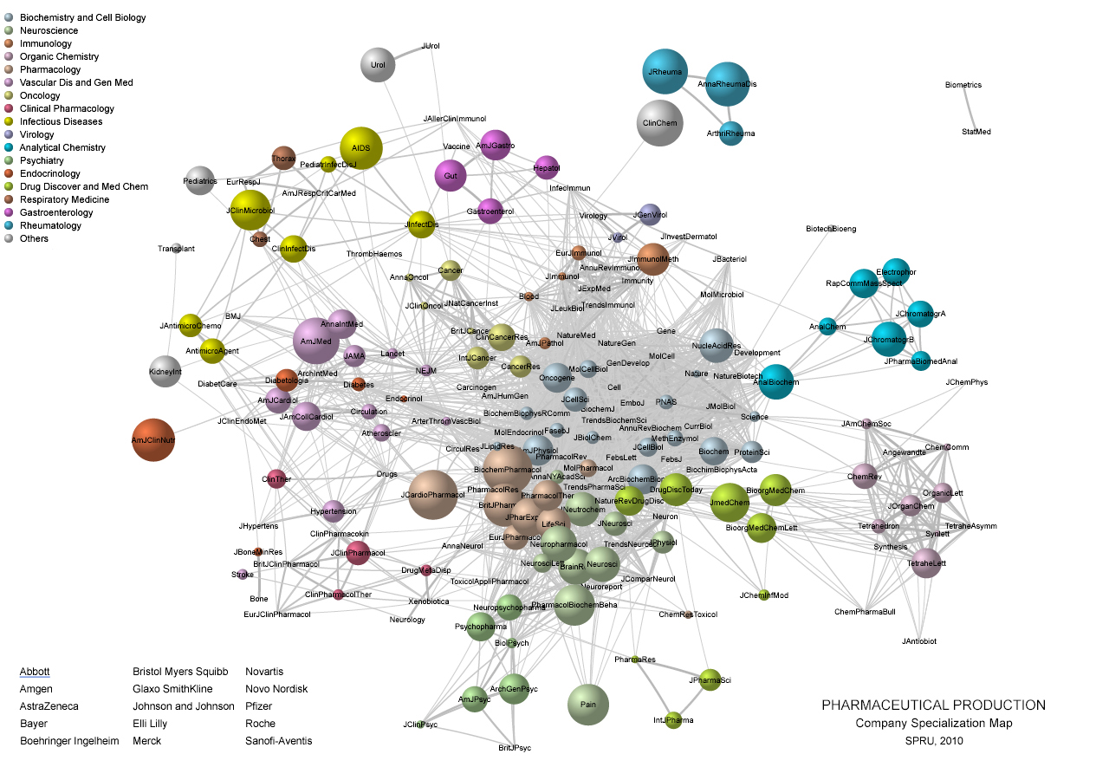

Slide 8
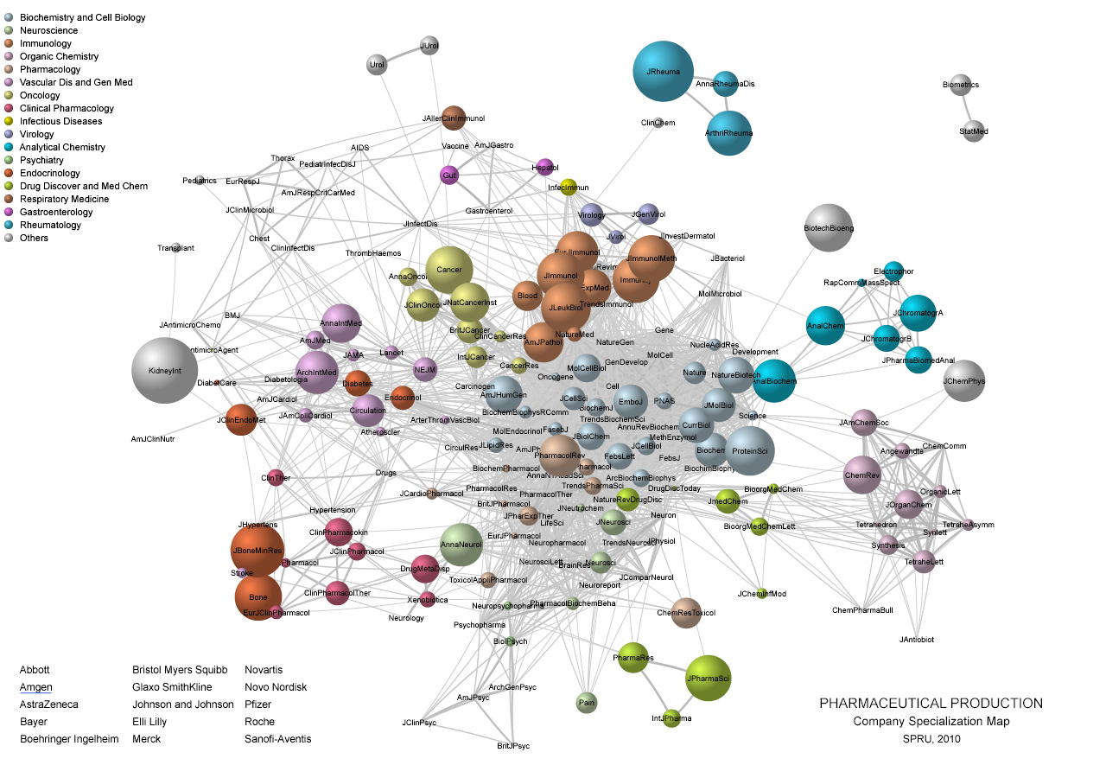

Slide 9
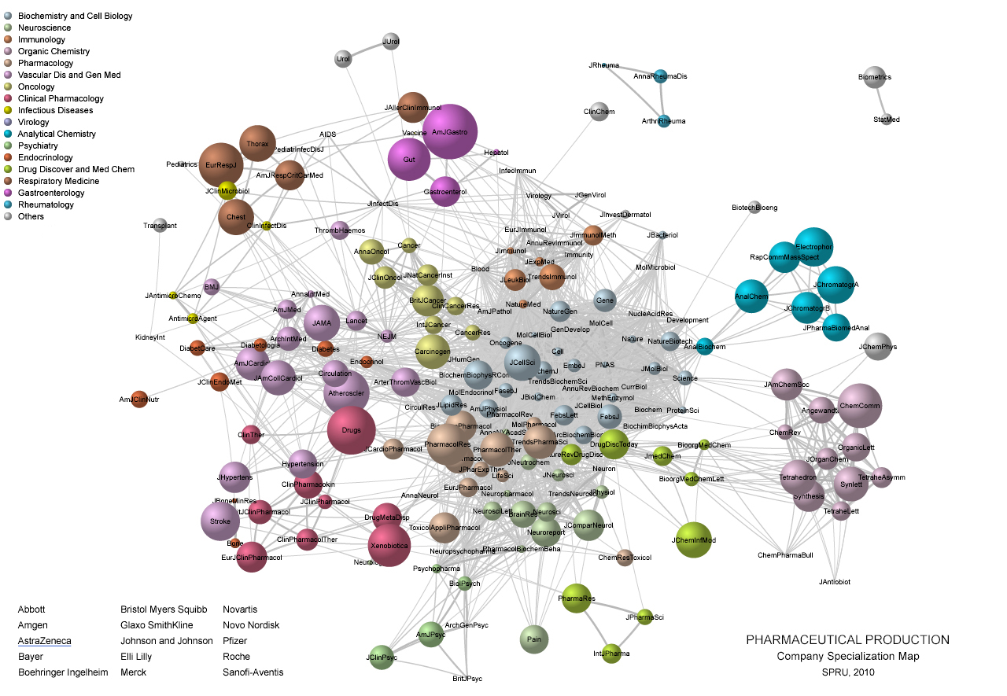

Slide 10
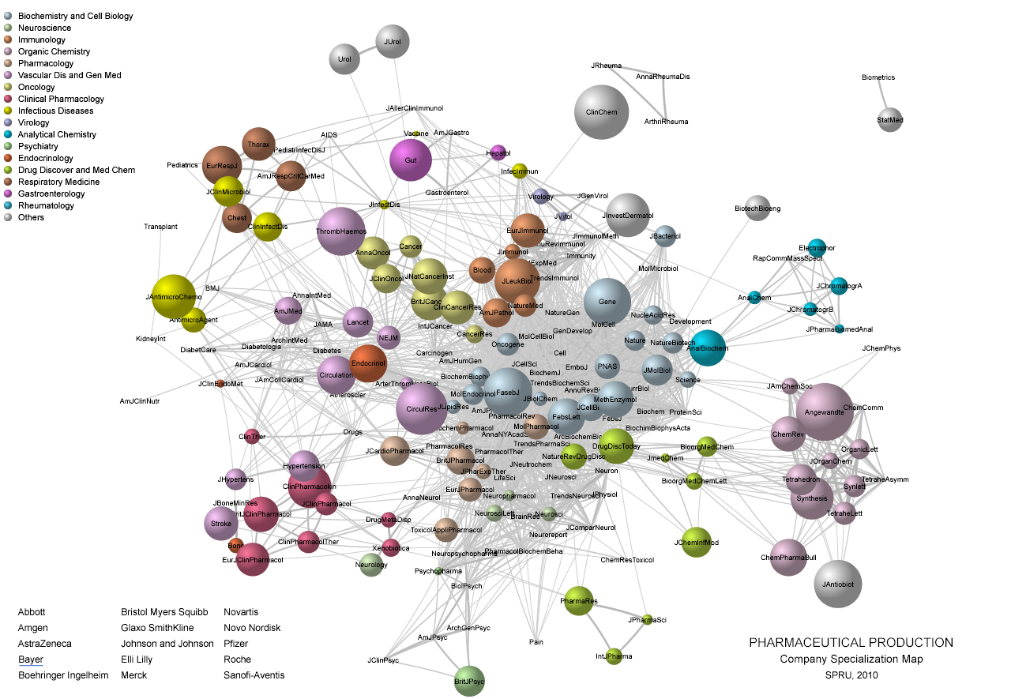

Slide 11
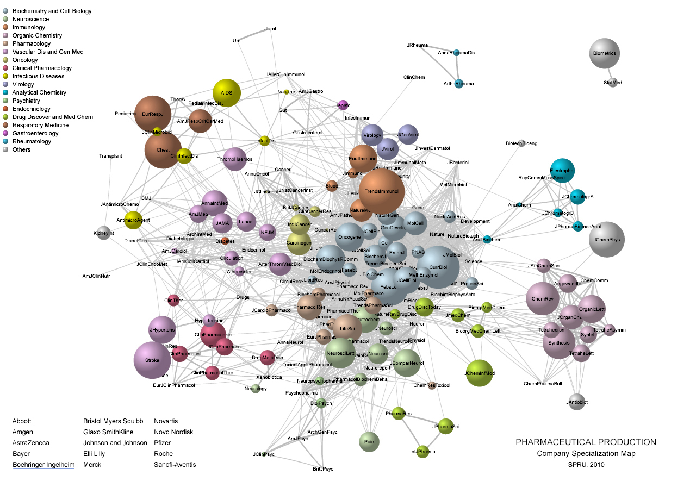

Slide 12
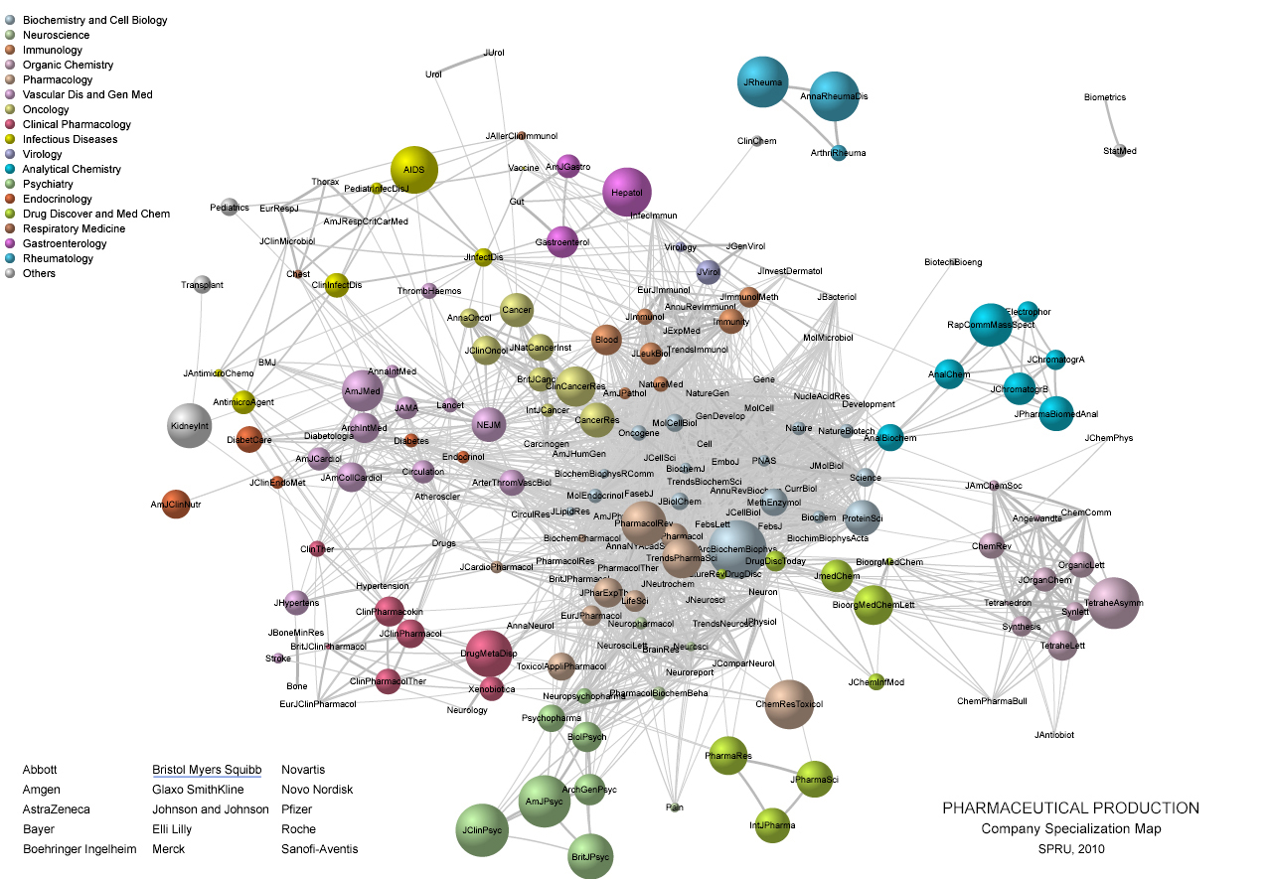

Slide 13
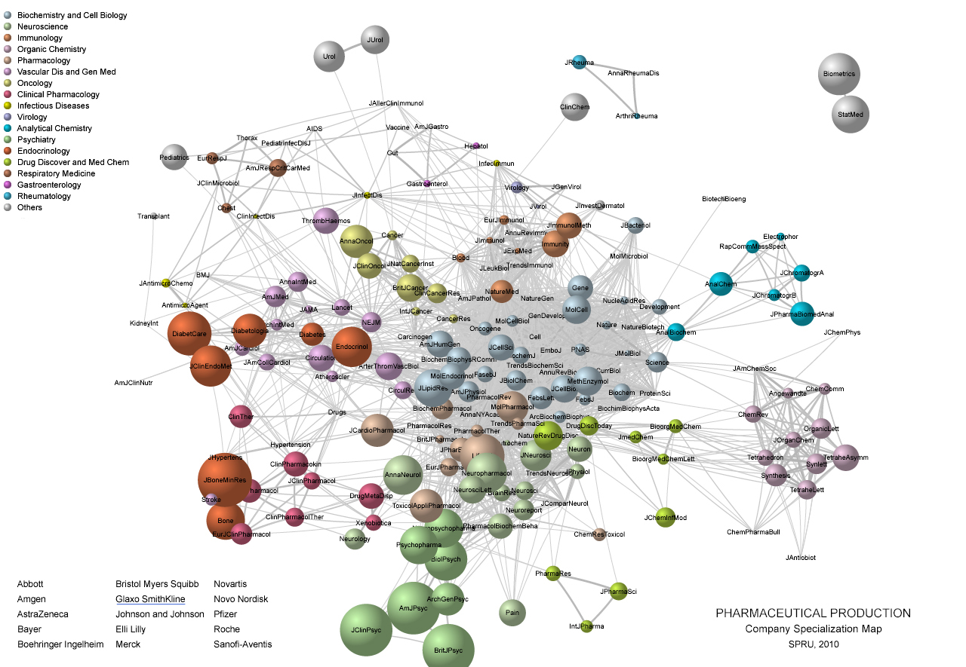

Slide 14
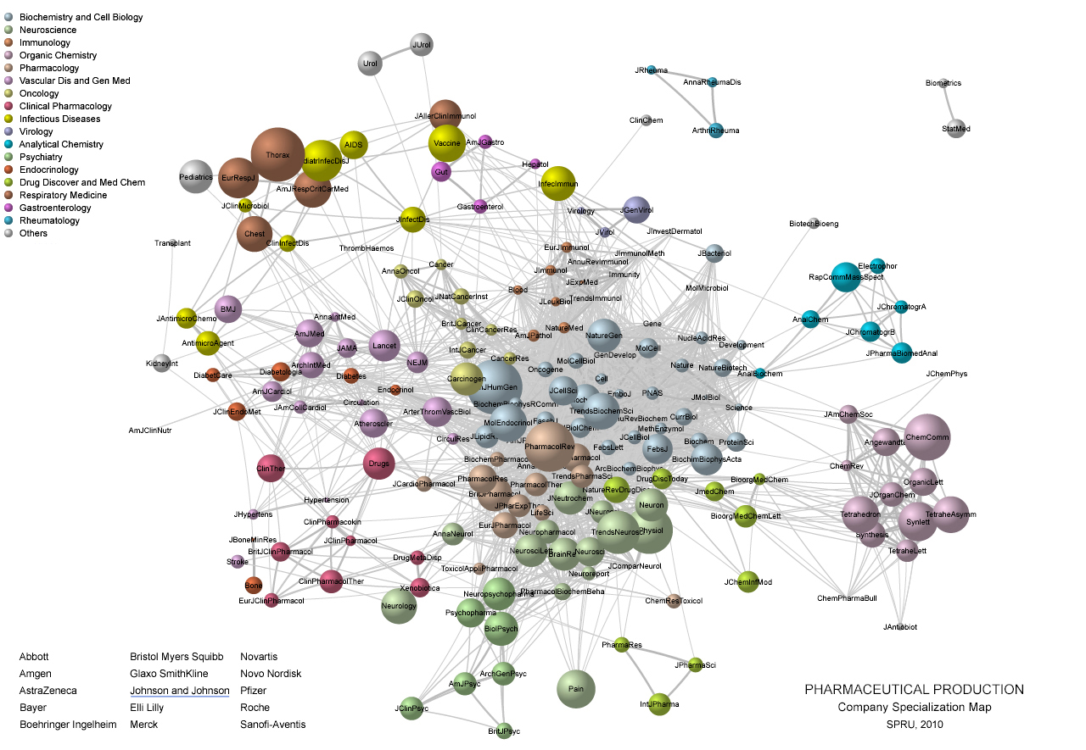

Slide 15
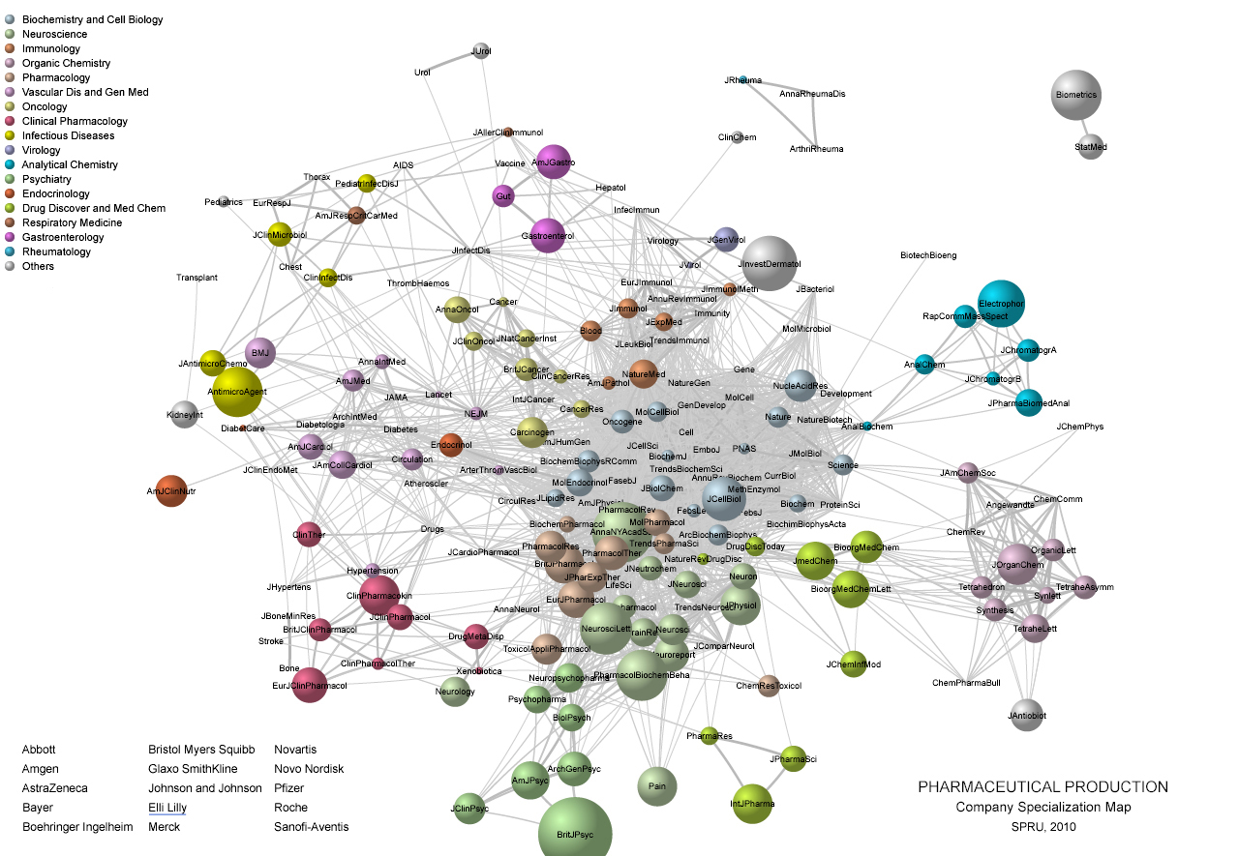

Slide 16
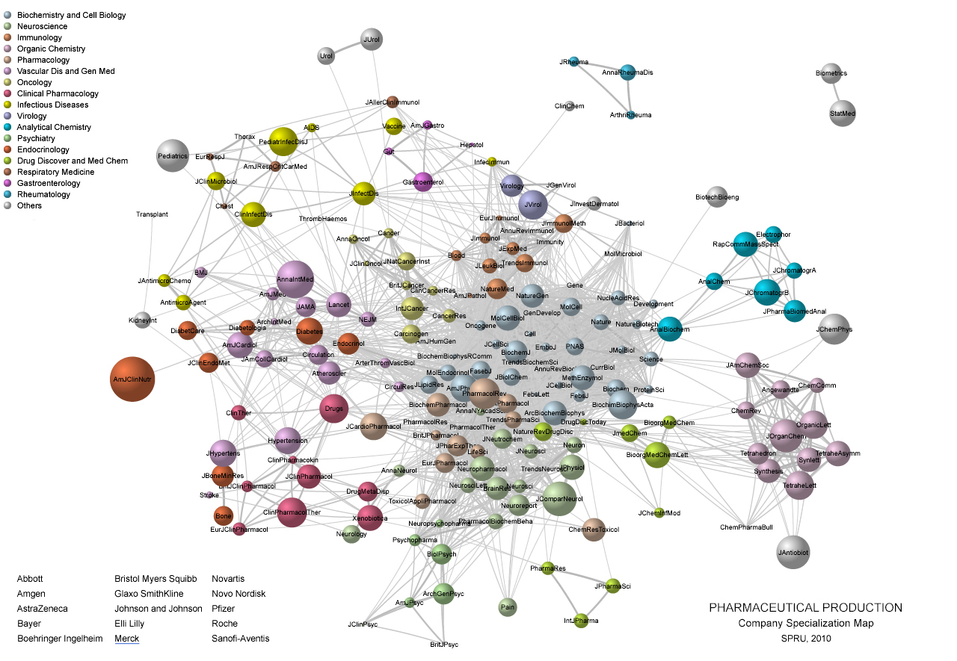

Slide 17
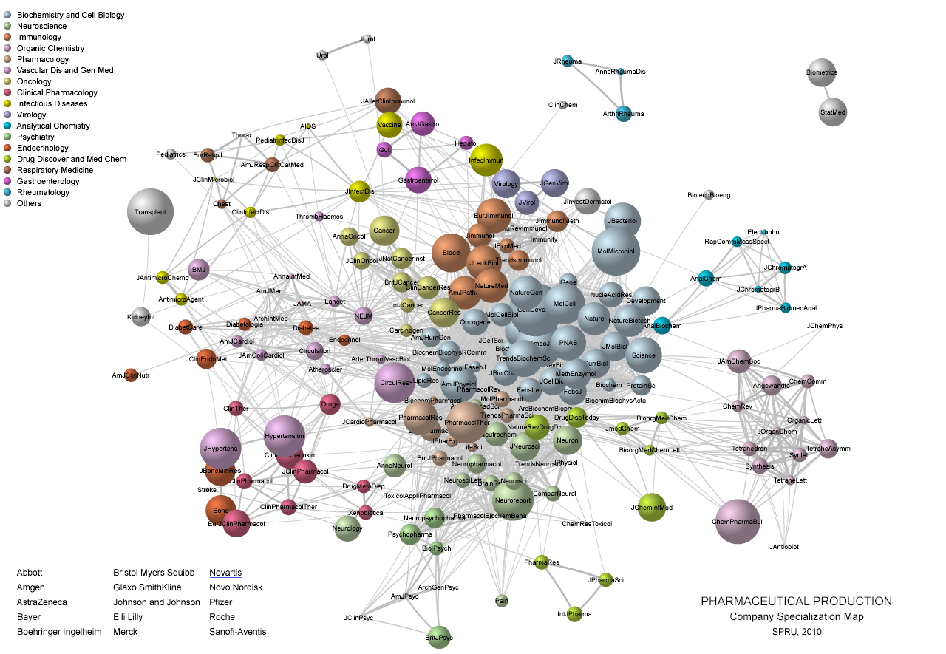

Slide 18
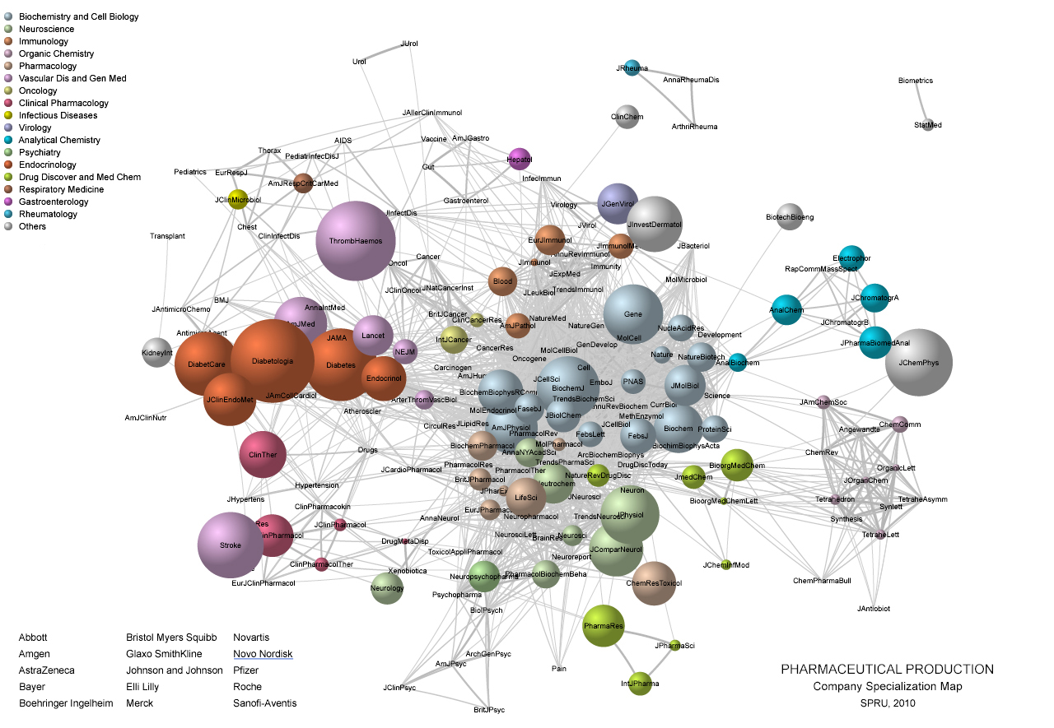

Slide 19
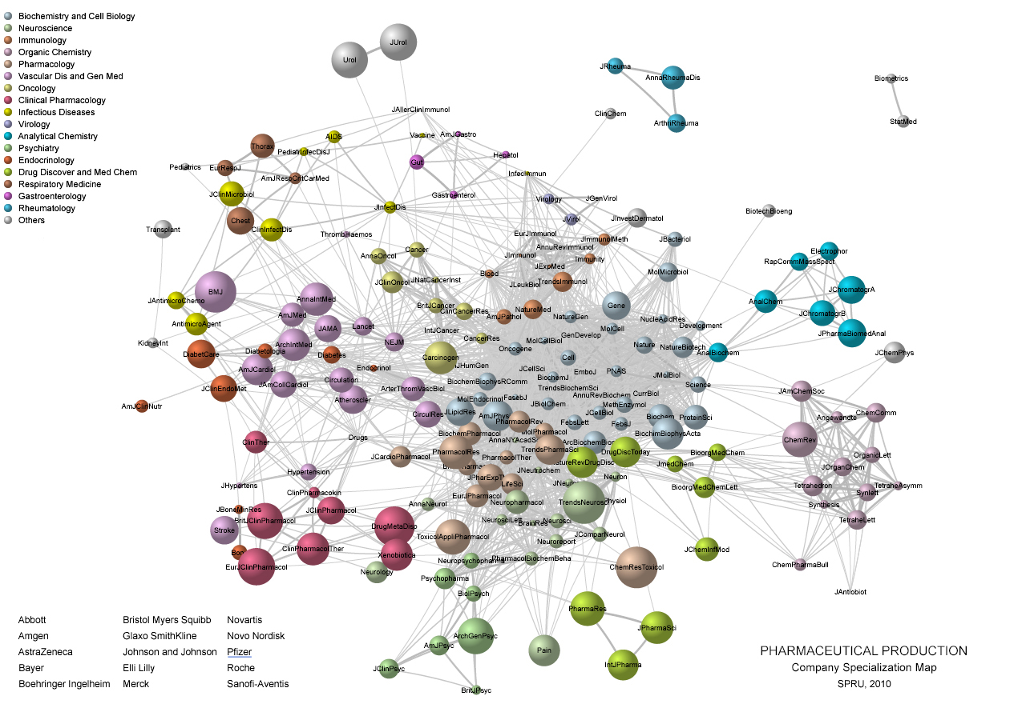

Slide 20
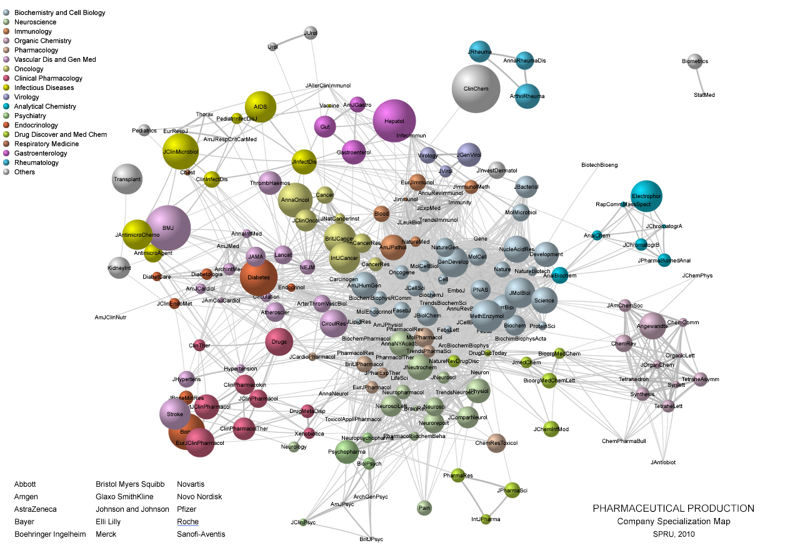

Slide 21
