Slide 1
Truth or Consequences: The case for evidence-based ontologies in an Ecology of Knowledge Representation
Alan Rector BioHealth Informatics Group University of Manchester rector@cs.manchester.ac.uk
http://www.cs.manchester.ac.ui/~rector
Copyright University of Manchester 2012 Licensed under Creative Commons Attribution Non-commercial Licence v3

Slide 2
“Ontologies”: What are they for?
To use in information systems
The claim is that “ontologies” are key components of modern biomedical information system
If so, it follows that…
The criteria for “ontologies” should be The consequences for Information Systems
Their fitness for the purposes of their roles in information systems
Whether or not they lead to errors
Their faithfullness to the information to be represented
The repeatability of their use in information systems
Their role in the broader ecology of knowledge in info systems

Slide 3
About this talk
What have been doing recently – my motivations
What is an ontology – narrow sense & broad sense
The word has drifted until it can mean anything or nothing:
I will try to define Ontology_{NarrowSense}
Some example conundrums to illustrate methods of argument
How we should make decisions “ontologies”
What counts as arguments?
What counts as evidence?
Some areas where ontologies need to interwork with other knowledge representation in an “ecosystem”
Conclusion

Slide 4


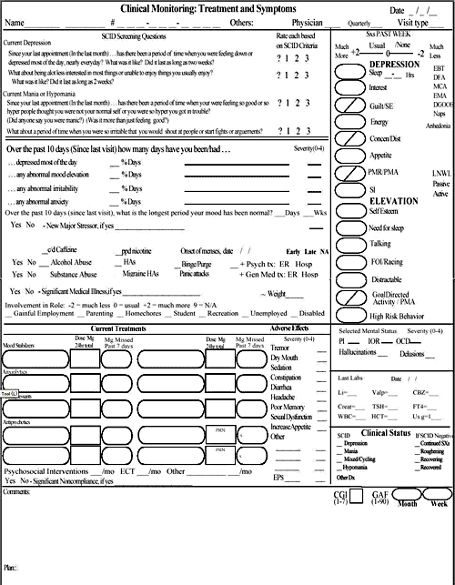
Problems I am trying to solve
How to generate complex forms for patient situations with multiple diseases and considerations
“An elderly man with confusion, rapid breathing, and extensive bruising as seen by the Emergency room Medic”
Pneumonia v alcohol v liver disease v head injury v diabetic coma…
Probably more than one
Without combinatorial explosion & assuring correctness
A typical hospital has several thousand forms many of which take over a person-year to develop; A typical patient may need several.
… and they don’t begin to cover what’s needed – THE bottleneck
Too many
Too big
Too complicated & repetitive

Slide 5
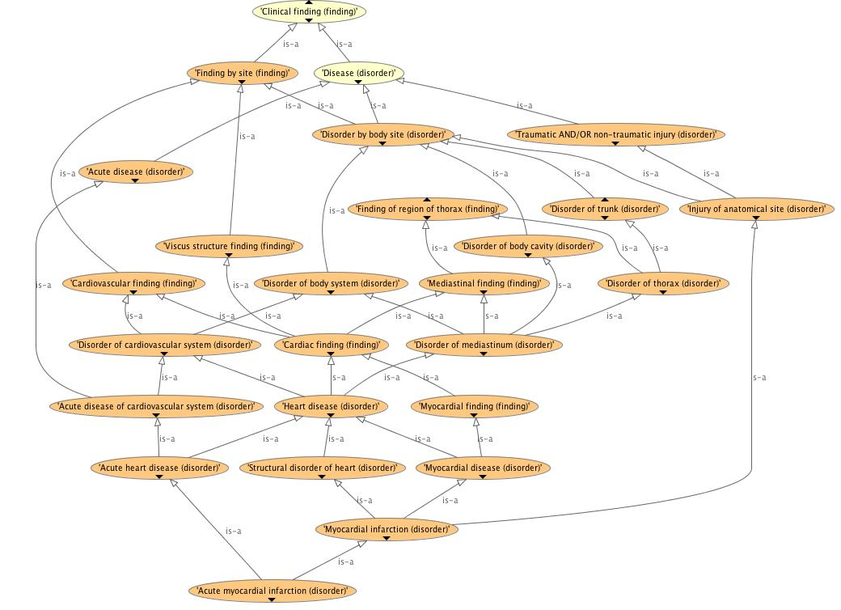
Problems I am trying to solve (II) How to tell if SNOMED is safe to use (or any other big terminology – 50K..500K classes )
Is it correct clinically? Formally?
Will “users” understand it sufficiently to use it correctly?
End users? Knowledge & software engineer users?
(See JAMIA, J Biomed Informatics, & KCAP papers on my website http://cs.man.ac.uk/~rector)
Why isn’t Myocardial Infarction a kind of Ischemic Heart Disease?
Why isn’t Subdural hematoma a kind of Intracranial bleed?
Why isn’t Chronic duodenal ulcer a kind of Chronic disease?
Why is Thrombophlebitis of breast a kind of Disorder of leg? Why is Thrombosis of ankle vein a Disorder of pelvis?

Slide 6
Problems I am trying to solve (III)
How to reconcile ICD’s traditional classification and legacy with new requirements
Retain stability with previous versions
A classification – not an ontology
Fixed depth; mutually exclusive and exhaustive at every level
Every patient event counted exactly once at every granularity
Overcome major problems
Shorten 20-year revision cycle & support Social Computing approaches
Support multiple views & new requirements
Multi-layered structure
Ontology layer – hopefully reconciled with SNOMED
Foundation layer – lots more around the “skeleton” of the ontology
“Linearizations” – traditional classifications linked to Foundation layer

Slide 7
Problems I am trying to solve (IV)
How to create an “Ontology of Clinical Research” that fits into standards
Must ultimately integrate with UML to specify a “system”
System of which it is part must carry many arbitrary “rules” and “calculations”
Mix of formal and text
Eg
Criteria for inclusion and exclusion of patients
Algorithms for calculation of statistics
System must provide a way of
Indexing and discovering trials as a whole based on its characteristics
Represent or link to detailed trial protocols
Complex contingent transition networks / plans
Recording “journeys” of individual patients through those protocol
Which may or may not conform to the protocols
And can describe the reasons for deviations from protocol

Slide 8
What is an ontology? Historical defintions…
Ontology_{Philosophy}
The study of “being” – of “What there is”
The study of “universals” – “What is necessarily true”
As opposed to: “Particulars” – What happens to be true in this world/time-place
… but not all of the study of knowledge
Ontology_{Information systems}
Gruber’s fancy word to describe “static knowledge base”
Gave it a fancy definition: “A conceptualisation of a domain”
A fancy word for a common terminology used in a set of data structures and/or applications
What we can implement in OWL

Slide 9
… What do we mean by “ontology_{NarrowSense}”? * One part of study of knowledge * One part of knowledge representation * The source of the entities/terminology
Philosophy of Knowledge
Particulars
Particulars
Particulars
Ontology_{Philosophy}
(Universals)
Pathways/ workflows
Probablities / Bayes networks
Probablities / Bayes networks
Probablities / Bayes networks
Protocols
Knowledge Representation
Data structures
Heuristics
possibilities
Rules
Facts
associations
Thesauri
Lexicons
Schemas
Classifica-tions
Ontology_{InformationSystems}
(definitions & indefeasible statements

Slide 10
Two Hypotheses / Doctrines
Weak version
Ontology_{Philosophy} has useful insights for Ontology_{InformationSystems}
It would be surprising if 2500 years of thinking had nothing to offer
Strong version
Ontology_{Philosophy} should set the criteria for Ontology_{InformationSystems}
It would be surprising if thinking from before information systems could be accepted uncritically for information sytems
Can we find empirical evidence? ` Can we find a rational basis of argument?
What would count as evidence? Arguments?
Can we refine the hypotheses?

Slide 11
“Ontology_{InformationSystems}” for purposes of this talk
That part of knowledge representation that can be expressed as positive universal statements in logic: “∀x . C(x) … → …”
Often in the form hierarchies of statements: “Cs are kinds of Ds” == “All Cs are Ds”
One important subset: what can be expressed in OWL
Other important subsets: Less expressive but easier computationally (EL++, CQs, …)
Linked to language for communication with human users
Forms part of a system of “Knowledge Representation”:
Physical symbol systems that model our knowledge of some topic (after Newell & Simon)
As models, always have limitations
Notes:
References:
¹ See Herb Simon and Allen Newell. Numerous publications. Most accessible is probably Simon’s Sciences of the Artificial.
See also
Newell, Allen; Simon, H. A. (1976), Computer Science as Empirical Inquiry: Symbols and Search, "Communications of the ACM", Communications of the ACM 19 (3): 113–126, doi:10.1145/360018.360022

Slide 12
Exclude artefacts that are not “ontologies” …but have hierarchies & look a bit like them
Classifications & Groupings – ICD, DRGs, etc.
Designed for counting / remuneration
Thesauri, Library catalogues, SKOS networks (also MindMaps, etc.)
Desgned for navigation by human users
Lexicons & other Linguistic resources
Designed for language processing (WordNet, UMLS SN, etc.)
Although may be linked to “ontologies” to form “terminologies”
Data schemas, structures & databases (UML, etc.)
Information on particulars and how to store it
Other logico/mathematical modelling techniques
Bayesian networks, neural networks, equation systems,…

Slide 13
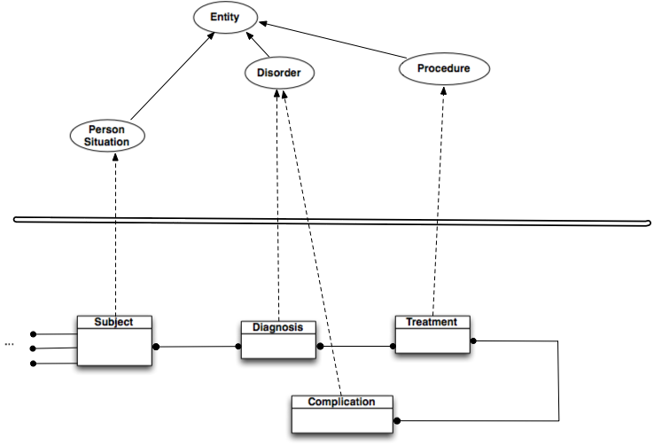
Most common use case:
Ontology
Data structure

Slide 14
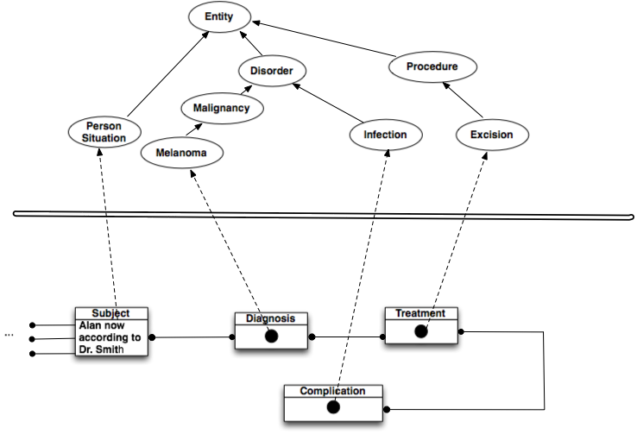
Most common use case:
“Ontology”
Data structure

Slide 15
Why I use DLs/OWL for Ontologies in Information Systems
Composition “Burn that has_site some (Foot that has_laterality some Left) & has_penetration some Full_thickness & has_extent …& … & … & …”
Avoid combinatorial explosion –
Smaller terminologies that say more
Support for expressions as well as names (“post-coordination”)
Express context
The “size of elephants” vs the “size of mice”
Coordinate hierarchies and index information, e.g. hierarchies for:
“Cancer”,”Family history of cancer”, “Treatment of cancer”, “Risk of cancer”, “Data structure for cancer”, “Data entry form for cancer”, “Pointer to rules for Cancer”, …
How else to get it correct?
Quality assurance
Computational tractability
A standard
Notes:
8K-35K kinds of burns, depending on number of dimensions and number of levels in each

Slide 16
Composition: Building with “Conceptual Lego” Parallel families of hierarchies
Species
Genes
Protein
Function
CFTRGene in humans
Disease
Protein coded by (CFTRgene & in humans)
Membrane transport mediated by (Protein coded by (CFTRgene in humans))
Disease caused by (abnormality in (Membrane transport mediated by (Protein coded by (CTFR gene & in humans))))

Slide 17
I use OWL/DLs for many things, but…
Not everything written in OWL is an ontology
Not every ontology need be, or can be, written in OWL.
OWL is a logic language – a subset of First order Logic
Designed to make it easy to represent (aspects of) ontologies
But can be used for other things.
Has many limitations
First order, binary-relational, tree-model property, …
And many serious flaws
Handling of meta-data, relation to RDF, …
But it is a standard and computationally tractable
Usually worth using a standard for that part of a task that it covers
But using it where it doesn’t work, doesn’t work.

Slide 18
Before going further:
Some history & evolution of meaning of the word “ontology”

Slide 19
Early Knowledge representation
Mid 1980s, AI toolkits (KEE, ART, KnowledgeCraft…)
Tripartite “Knowledge based systems”
Static knowledge base – Semantic Networks & frames
Included both “universal” and “particular” knowledge
Rules
Dynamic knowledge base
Plus Metadata, attached procedures, event driven Uis, …
Addressed good questions in knowledge representation, and gave some good answers, even if sometimes limited
Heuristic
Programming languages rather than logics

Slide 20
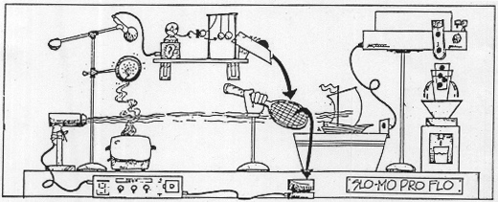
… some systems resembled Rube Goldberg machines
Neither complete, decidable nor provably sound
But good enough that still asked: “Why can’t we get back to 1985?”
Serious question from Zak Kohane, top HI researcher, PhD in AI from MIT.

Slide 21
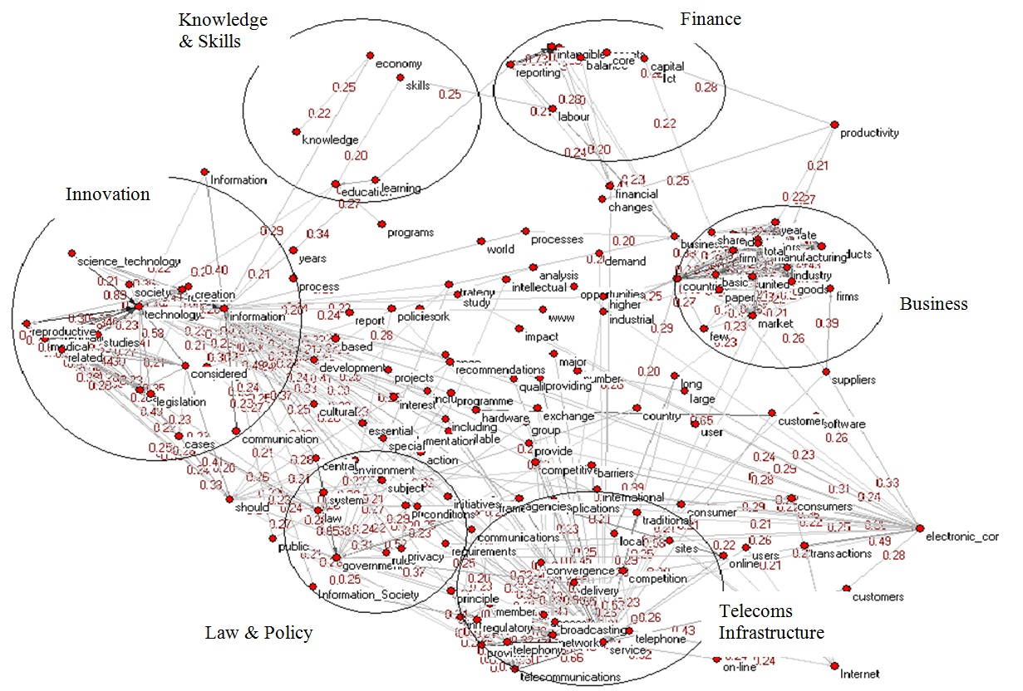
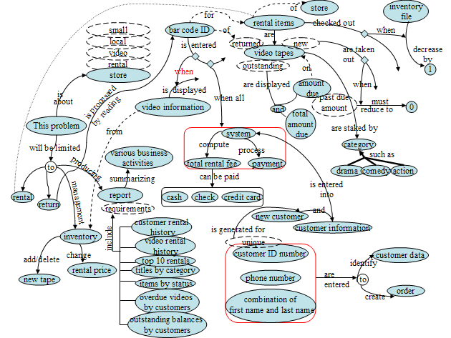
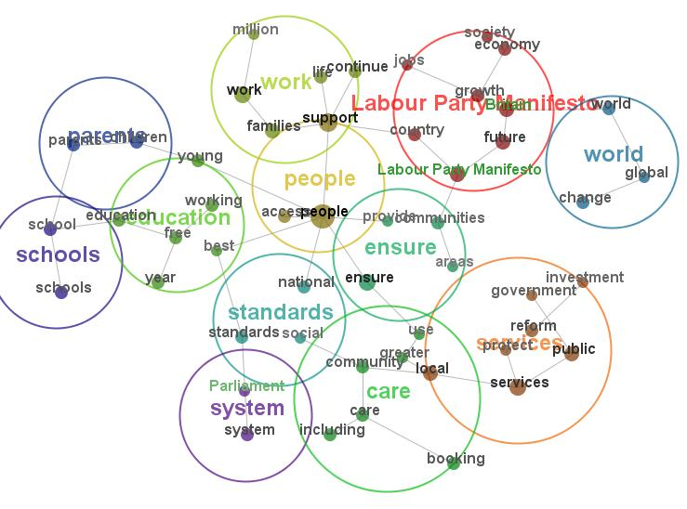
Knowledge Based Systems co-evolved with semantic networks & frames
“Frame” coined by Minsky for computer vision but rapidly adopted by knowledge representation
Convenient way to represent Object-Attribute-Value triples & semantic networks
Protégé-frames / OKBS is modern descendant

Slide 22
Key event 1: Logicians asked ‘What’s it mean?’
Questions about Semantic Networks and Frames
Wood: What’s in a Link; Brachman What IS-A is and IS-A isn’t.
First Formalisation (1980)
Bobrow KRL,
Cognitive Science Vol 1 Issue 1 Page 1
Brachman: KL-ONE
Went on to be the ancestor of DLs
…of rather its failure stimulated the development of DLs
All useful systems are intractable (1983)
Brachman & Levesque: A fundamental tradeoff (AAAI 1983)
Hybrid systems: T-Box and A-Box
Focus on Terminology (T-Box) – Universal knowledge
Became what I now call Ontology_{InformationSystems}
All tractable systems are useless (1987-1990)
Doyl and Patil: Two dogmas of Knowledge Representation AI vol 48 pp 261-297 (1991)

Slide 23
Emergence of DLs and “Tbox” reasoning
‘Maverick’ incomplete tractable in practice Tbox/logic systems (1985-90)
GRAIL, Krep (SNOMED), LOOM, Cyc,…,
The German School: Description Logics (1988-98)
Complete decidable algorithms using tableaux methods (1991-1992)
Detailed catalogue of complexity of family – “alphabet soup” of logics
Horrocks (& Nowlan): practically tractable even if worst case intractable
Emergence of the Semantic Web & OWL
Development of DAML (frames), OIL (DLs) → DAML+OIL → OWL→ OWL2
Emergence of Tractable Subsets of DLs/OWL– EL⁺⁺, Conjunctive queries, … (2005..current)
Roughly what GRAIL and SNOMED had been doing but logically proven
Missed completely by early DL developers

Slide 24
…but Description logics are very different from frames (even though intended to formalise them)
Frames are systems of Templates Description logics/OWL are sets of Axioms
Failures to realise the difference led to confusion
Most SW Engineering paradigms use templates
OO Programming (e.g. Java objects)
UML Class diagrams, Model Driven Architectures (MDA/OMG)
Many general knowledge representations use templates
Frames (Protégé frames)
Cannonical Graphs in Sowa’s Conceptual Graphs
RDF(S) (as usually used)
F-Logic, …
Protocols, guidelines, …

Slide 25
Axioms & Templates: Fundamentally different
Axioms restrict
The more you know the less you can say
If there are no axioms, you can say anything
“Sanctioning” hard - Hard to ask “what can be said here?”
Global – any change can affect anything anywhere
Violations of axioms → unintended inferences (often of unsatisfiability)
Over-riding impossible - monotonic
Open world - Must be closed for instance validation of missing values
Inferentially rich; most semantics internal & standard, composition natural
Templates permit
The more you know the more you can say
If there is no field/slot in the template you just can’t say it
“Sanctioing easy” – Easy to ask “what can be said here?”
Local – changes affect only a class & its descendants
Violations of templates → validation errors
Over-riding natural – usually non-monotonic
Closed world - Instance validation natural & local
Inferentially weak; most semantics external in queries, no composition

Slide 26
Key event 2: Borrowing of the word “ontology” for InformationSystems
Most notably by Tom Gruber
But “in the air”. UML and Model Based Architectures on the rise.
Victim of our own success
“Ontology” ~ “Good”
But did not initially differentiate “ontologies” from “Knowledge Representation” or “information modelling”
Confused the universal & particular any world & this world things in the world & information about them
…and invited philosophers to both clarify and confuse
… and then became identified with T-Boxes, DLs/OWL
At least by some communities
… and distored to do many things for which never intended

Slide 27
…but there is much more to knowledge representation than ontologies / DLs
DLs / OWL / T-Boxes represents “universal knowledge”
Univeral, two valued, monotonic, first-order…
Most knowledge is not “universal” (“particular”)
About this “world”, rather than all “worlds”
Much knowledge is not first order, monotonic or even logical
Probabalistic, possibilistic, fuzzy, associationist, navigational, linguistic, procedural, heuristic, defeasible, higher order, epistemic, …
So the question is:
How do “ontologies” fit into the rest of knowledge representation?

Slide 28
Deeply intertwined with thinking about how “Ontologies_{InformationSystems}” should be built
How do ontologies relate to the rest of Knowledge Representation (& Information systems)
Examples from use for Terminology conundrums & approaches to evidence

Slide 29
What matters & what doesn’t: How do we know if it is correct?
If I ask questions, do I get the correct answers?
Inferences and responses to queries
As judged by domain experts
As tested by empirical studies
As tested by results when used in applications
Some errors are obvious in applications
Omissions:
Myocardial infarction should be kind of Ischemic heart disease
Queries for Ischemic Heart disease are expected to return Myocardial Infarctions
Rules for Ischemic Heart Disease should apply to Myocardial infarctions
Definition: “Infarction” == “Cell death due to ischemia”
Omitted in prior versions of SNOMED
Commissions
Injuries to arteries of the ankle are not disorders of the pelvis
Schema error in SNOMED
Thrombophlebitis of breast is not a disorder of the lower extremity
Simple accident in anatomy compounded by same schema error in SNOMED

Slide 30
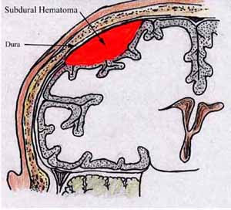
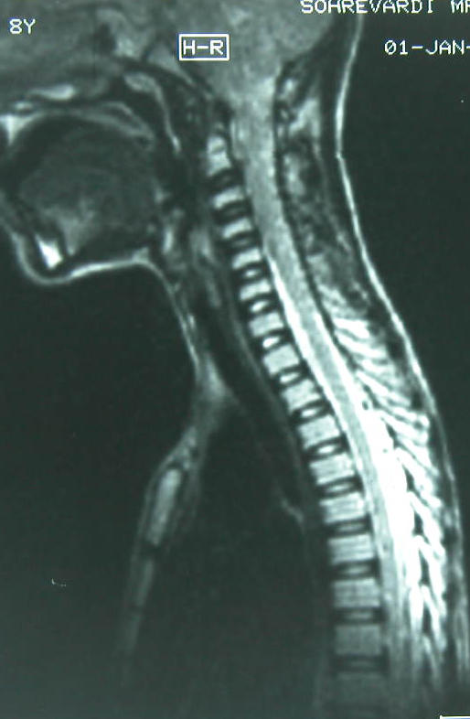
Some seem natural from the language but Can lead to dangerous mis-interpretations in applications
In SNOMED, “Subdural Hematoma” is not a kind of intracranial bleed.
One of 1000 most common entries in hospital systems
Life threatening & requires immediate action
Literally, there are “spinal subdural hematomas”
The dura covers both brain and spinal cord
Roughly .5% of all Subdural hematomas
Always specified as “Spinal subdural hematoma”
Strong evidence that when doctors write/code “Subdural hematoma” they mean “intracanial”
Failing to represent this is life-threatening

Slide 31
Labelling needs to be at multiple levels to avoid confusion
Fully specified names
Need an entities for
“Subdural hematoma, spinal AND/OR intracranial”
“Intracranial subdural hematoma”
“Spinal subdural hematoma”
Preferred named
“Subdural hematoma” → “Intracranial subdural hematoma”
Text definitions
To be completely unambiguous – but don’t count on their being read
Synonyms
Search terms (hidden labels)

Slide 32
Other labels make little difference
Most ontology formalisms require a single root node
Labelled in different systems: “Top”, “Entity”, “TopThing”, “Thing”, “Concept”, “Category”, “Class”, “MetaClass Class”, “U”…
Main consideration is that it not conflict with the name for something else
But content of root note is almost always nil
Label rarely affects consequences
Other cases where arguments are about words rather than the entities themselves
“Neoplasm”
We need a nodes for “Proliferation or tumour, benign or malignant” “Malignant proliferation or tumour”
But which should be “neoplasm”?

Slide 33

And some really are about conventions: 2 hands & 2 Feet? 4 hands? 4 feet?

Slide 34
Some artefacts present special problems: Recent example: What do SNOMED &/or ICD disease codes represent? (Thanks to Stefan Schulz)
A “disorder”? (or “dispositiion”)
“Condition” interpretation
“having a disorder”?
“Situation” interpretation
“Situation of having a disorder” / “Patient having the disorder at a given place and time as observed by a given clinician”
It does make a difference
For codes representing compound diagnosis, e.g. “Fracture of Radius and Ulna”
For complications: “Diabetic retinitis”
How to decide?

Slide 35
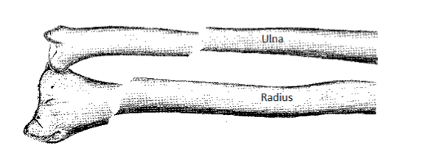
Consider: Fracture of Radius & Ulna (Forearm) – a single code in ICD and SNOMED
“Condition interpretation”
Nothing can be both a “fracture of radius” and “fracture of ulna”
“Situation interpretation”
A patient can simultaneously have both a “fracture of radius” and “fracture of ulna”

Slide 36
What might count as evidence? What is the question?
Should responses to queries for patients with “Fracture of Radius” include patients with “Fracture of the radius & ulna”?
Most doctors say “yes”
Both SNOMED and ICD are hierarchies classify:
“Fracture of Radius” and Ulna as a kind of “Fracture of Radius”

Slide 37
What do we ask the questions for? What is the right answer for these purposes?
Deciding patients’ treatment
As antecedents of rules
Counting patients’ by causes of illness & death (morbity & mortality)
To contribute to vital statistics
Counting patient episodes for remuneration & Health Care Planning
To manage the healthcare system
Counting patient events for research into cause and effect
As nodes in a causal network
As part of the inclusion/excluson/outcome criteria for clinical studies

Slide 38
A further example
Should “Diabetic kidney disease” be classified under Diabetes? Kidney disease? Both? Neither?
Should queries for patients with “Diabetes” include those coded only for “Diabetic kidney disease”
Can anyone have “Diabetic kidney disease” without having “Diabetes”?
Many similar cases examined and experiments performed
Conclusion: “having a condition” (“Situation interpretation”)
Best fit for both:
Current practice
Intended consequences
The reality of clinical practice
Safety in clinical decision support
Can fit into an ontological framework, but not in the obvious way

Slide 39
Conundrum 2: What do biomedical experts mean by is_part_of?
In medicine, function is often more important than structure (except for surgeons & anatomists)
“A fault in the part is a fault in the whole” Conclusion or Criterion?
Is the radio part of the electrical system of my car?
Are T cells part of the immune system?
Is there any structure that can be called the “endocrine system”
Is the brain part of the skull? The pericardium part of the Heart?
Accidents & abnormalities often ignored
e.g. “Finger” defined as part of hand
Even if amputated, crushed, or congenitally missing
Even though rarely arises congenitally someplace else

Slide 40
What answers do we want to our questions
What are the parts of the hand?
What is in that path bottle that is/was “John’s finger”
What are the disorders of the hand
Fracture of finger? Amputation of Finger? Missing finger?
Mitochondrial disease (that includes mitochondria in cells of the hand)?
Is pericarditis a heart disease?
Clinically yes, contrary to FMA
Is a brain disease a disease of the skull?
Clinically no, consistent with FMA
A real problem for Foundational Model of Anatomy
If used “as is” gives some answers inappropriate clinically
Even when ontologically and anatomically correct

Slide 41
Conundrum III: When to argue Some choices make little difference (as long as we adhere to standards)
Logical / mathematical equivalence, e.g.
Should location be specified using Rectangular or Polar coordinates?
Choose according to ease of use & calculation
Not something to argue about in principle
Should we use metric or imperial units?
Approximations fit for purpose
Euclidean geometry to survey my property
Spherical geometry to navigate around the world
Newtonian laws of motion to calculate planetary motions
Relativity to calculate motion at cosmic distances at LHC
But standards do matter
A Mars probe was lost because of confusion between metric and imperial units!

Slide 42
Example of logical approximations: Entity-Quality vs Entity-Quality-Value
Red_Ball == Ball & bears some Red_quality
Red_Ball == Ball & has_quality some (Colour & has_value some Red_value)
What difference does it make?
Assume Red_quality == (Colour & has_value some Red_value)
For inference, usually very little
For asking what can say be said, a lot
Easy to ask what qualities and values apply where in 2.
Does this matter to systems? Which systems? For what tasks?
1) can be seen as an approximation of 2) but not vice versa

Slide 43
Conundrum IV: How strong can ontological commitments before they become problems?
Mutually exhaustive & pairwise disjoint
Few biological classifications are exhaustive – diseases, organisms, etc.
without =“residual categories”: “other”, “not elsewhere classified”, etc
Even some disjoints can be awkward
Hybrids, chimeras, …
Need even Continuant and Occurrent be exhaustive ?
E.g. Are time and space best represented as neither?
Many biomedical ontologies do not implement disjointness, e.g. SNOMED, GO
Requires a surprising amount of extra work; easy to make errors
But not doing so sacrifices much consistency checking
No class can be inferred to be inconsistent in FoL, OWL, or related formalisms without negation and/or disjointness

Slide 44
Conundrum V: Hypotheticals, counter-factuals & imaginary constructs
Unicorn == Horse that has_part exactly 1 Horn Unicorn → Bottom (or has_status mythological)
To say/infer something does not exist, I must first define it
To say nothing, leaves the question formally open
But we don’t want to clutter our ontologies
Or close them impractically
Higgs Boson, Gene for obesity, for high cholesterol?...
Lots of information to be recorded before confirmed to exist
Art and Architecture ontology (includes Archeology)
Full of mythological creatures as topics of art
If there is information about it, I need to represent it in my ontology_{InformationSystems}

Slide 45
Ontologies & the Ecology of Knowledge Representation
We need both dictionaries & encyclopedias

Slide 46
Ontologies as “Conceptual coat-racks”
The framework on which to hang other knowledge
The source definitions, values and value-sets
To use in other formalisms about
“may” – diabetes may cause renal disease
“probably”/”usually” – Appendicitis usually causes pain in the right lower quadrant
“facts” – Metformin is licensed for treatment Diabetes type 2
Mathematical formulatations – sets of partial differential equations, etc.
There are many other knowledge representation formalisms

Slide 47
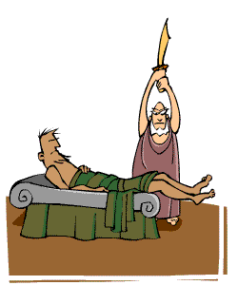
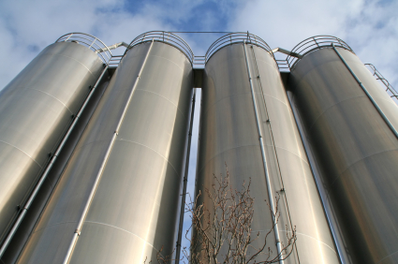
To integrate or interoperate?
Four choices
Integrate other methods into ontologies
Risks “mission creep” & loosing ontologies’ unique value
Risks ignoring well developed work in other discplines
Make ontology implementations “friendly” to hybrid systems
Define interfaces & formulations for convenient interworking
Leverages other work, but requires compromise and new understanding
Force knowledge representation onto an ontological procrustean bed?
Keep each form of knowledge in its own silo?

Slide 48
What do we need to interoperate with? Where is the added value?
The rest of the ontology & semantic web community
IAOA, Ontolog, ontology summits, Linked Open Data, …
Data structures, UML & Model Driven Architectures
Key parts of today’s software engineering
Made much easier by some choices than other
Reifying relations, E-Q-V rather than E-Q
An urgent problem
Clinical decision support, Trial Protocols, and Biological pathways
Not primarily ontological but need ontologies
A mission critical challenge – if we are irrelevant here, then we are irrelevant to healthcare
Probabilities and Bayesian Networks
Highly developed theory and community
How best to leverage & interact
A grand challenge
Question answering
Did Watson need an “ontology”? What kind?

Slide 49
One Example of making ontologies friendly to other formalisms: UML & frames: Easier if we reify relations
Simplified sketch:
CLASS: MyAssociation → Association → hasTopic some Class1 → hasObject some Class2 → Key: (hasTopic, hasObject)
Most of the benefits of UML models but retains composition
At the cost of an extra level of nesting (to be hidden)
(close to “DRL-lite” Berardi et al 2005)
Loss of some power of ontologies for property paths, transitivity etc
May need to filter out a few unwanted inferences

Slide 50
Side benefit Take advantage of good diagramming tools
Top
Plus a bit of effort to sort out the multiplicities ad cardinalities
If we use subproperties & property paths & a bit of external checking, we can produce a bridging property, which can be transitive
has_cause ⊑ inv(hasTopicC) o hasObjectC
Domain Entity
Association
Pneumonia
hasTopicC
Cause
hasObjectC
Bacterium

Slide 51
Other side benefits
Natural representation for “sanctioning”
Just ask for minimal set of associations with a given topic
Natural approach to reconciling with frames
Link provides attachment point for second order information on strengths of association/probabilities
Natural representation for “some”/“may”
“Pneumonia may be caused by Bacteria”
E.g. Pneumonia may be caused by Bacteria?
Causal_link_bacteria_pneumonia == Causal_link & has_topic some Pneumonia & has_object some Bacteria
It’s logic / OWL – but is it ontology
An interface between Ontology & KR?

Slide 52
Related issue - Value sets: Mission critical for medical applications
Three cases
Value types – often specialist – validated lexically
Strings numbers, date-time, quantities, …
Biological units per f(weight, height, lab test value)
Fingers, +..++++, grade i..iv, …
Enumerated lists of entities from some domain
Pain radiates to: Left/Right Shoulder, Left/Right Arm, Abdomen, Back, Left Axilla
But NOT their subclasses
Systematic lists
Regions of skin of the face excluding the eyelid
to a designated granularity
NB Often non-monotonic
More specific over-rides more general
Is this ontology? How can ontology add value?

Slide 53
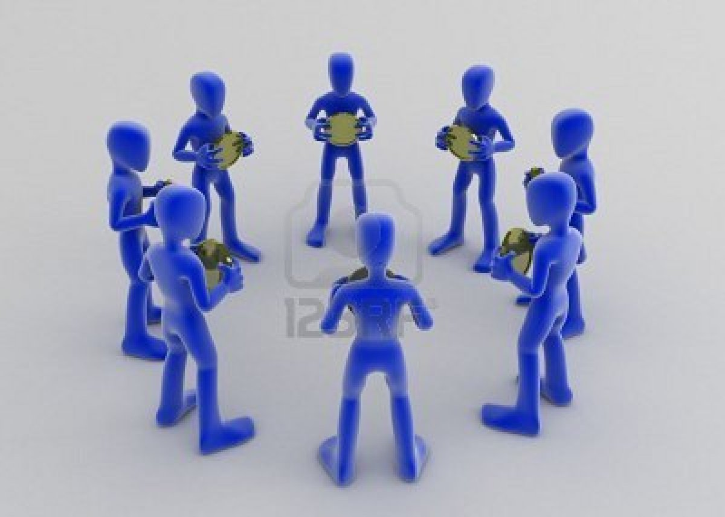
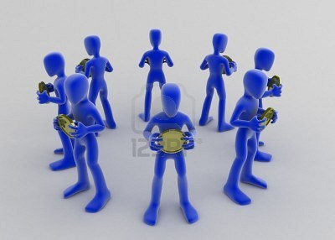
The choice:
“Ontology” too often faces in
Can we Face outwards?

Slide 54
Summary: Ontologies_{InformationSystems} & Ontologies_{Philosophy} in an Ecology of Knowledge Representation

Slide 55
Ontologies_{BroadSense} vs Ontologies_{NarrowSense}
“Ontologies” often used just to mean “Knowledge Representation”
Can we recapture the narrow sense?
Do we need a new phrase? A campaign for the narrow sense?
The key to effective information systems is effective factoring of problems
Over-broad usage of “ontology” obscures distinctions
Mission creep for ontologies leads to poor factoring & poor systems

Slide 56
Summary: Ontologies_{NarrowSense}
Ontologies are just a small part of knowledge representation
Most knowledge is not universal
Ontologies_{InformationSystems} should be judged on their consequences for Information Systems
Do they lead to the right answers? Wrong answers? Appropriate / Inappropriate decisions?
2500 years of thinking should not be ignored, but…
Test each principle from Ontology_{Philosophy} empirically before acceptance in information systems
All Ontologies_{InformationSystems} are models (Physical symbol systems)
All are imperfect: There is no one way, although there are wrong ways
Tests are ultimately empirical: fitness for purpose, inferences, queries, inter-rater reliability,…
Language matters if leads to misinterpretation
But can be a distraction
Axioms and Templates are different
Reconciliation a “grand challenge”
Time to look outwards
Become part of a larger ecology of knowledge representation – many challenges

Slide 57
END - Outcuts

