Slide 1
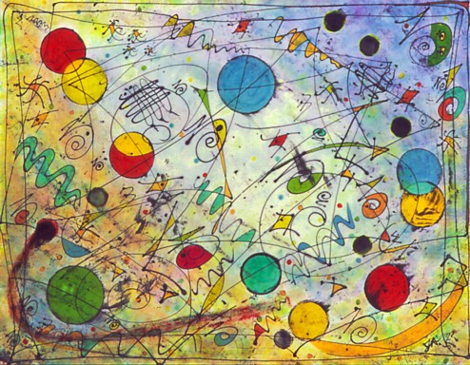
Doing Business in
Interstellar Space
John D Barrow

Slide 2
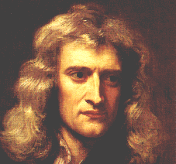
Newtonian Absolute Space and Time
Unaffected by events
Time
Space
‘slice’
Fixed and unalterable absolute space
and linear time
+ Newton’s laws (“F = ma and all that ”)

Slide 3
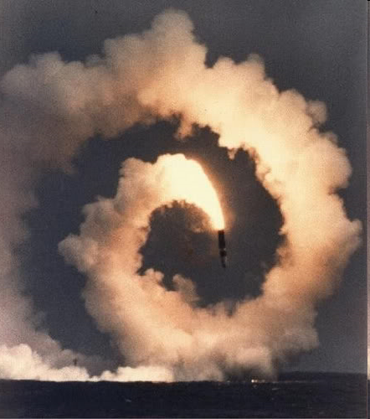
Newton’s Laws Are Un-Copernican
Newton’s laws only hold for special observers
who do not rotate or
Accelerate with respect to the fixed stars
There are special classes of observers for whom the laws of Nature look simpler!!

Slide 4

A Missed Opportunity For Many!
Einstein’s newspaper ad
Notes:
Got his teaching diploma in 1901, unable to find work he went to work in the swiss patent office, got his PhD in 1905

Slide 5
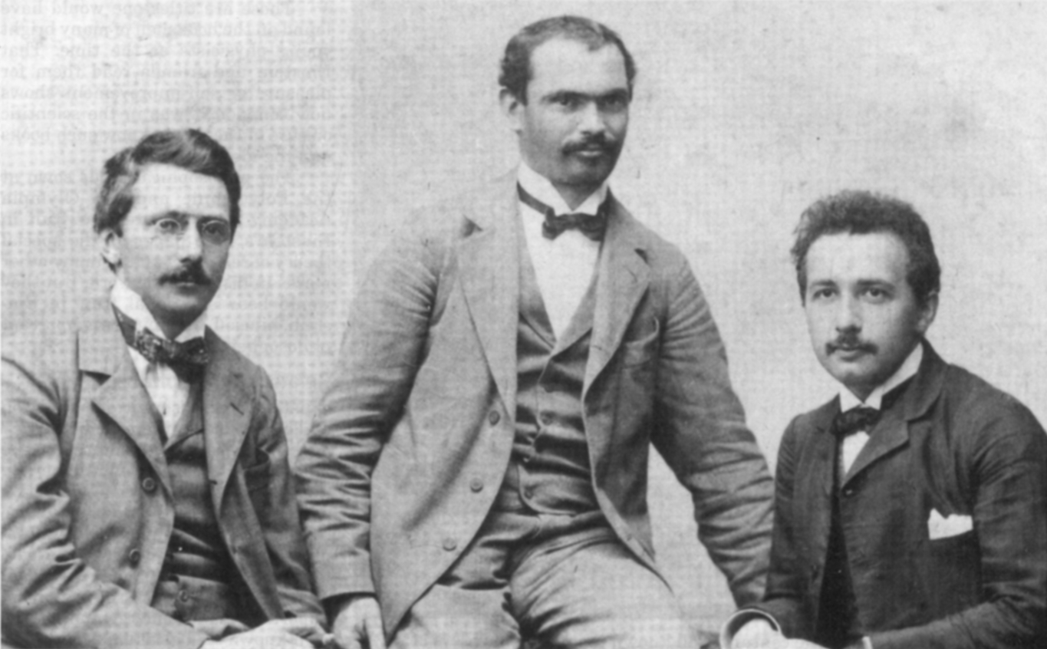
Habicht, Solovine and Einstein, 1903

Slide 6
Spacetime
time
space

Slide 7
Spacetime
time
space
Slice how you like !

Slide 8
Universal Speed of Light
The speed of light is finite
The Universe ≠ The visible universe

Slide 9
Our Past Light-cone
time
Our world line
13.7 Gyr
incoming
light rays
space
?
?
?
?
?
?
Cosmic
rays
1 Myr
Last scattering of background photons
1 sec
Last scattering of background neutrinos
10⁻⁴³ sec
Last scattering of background gravitons
t = 0

Slide 10
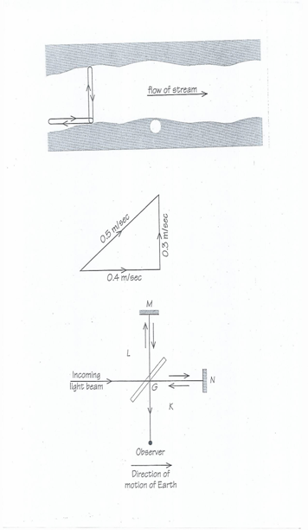
The Michelson-Morley Experiment
(1881)
The Mysterious Aether
Isn’t There
After All
90m
0.4 m/s
90m
Einstein Restores the Vacuum
Swim at 0.5 m/s in still water
Current flow is 0.4 m/s
Takes 600s = 300s +300 s across and back
Takes 900s + 100s = 1000s up and downstream
300s = 90m/0.3ms⁻¹; 900s = 90m/(0.5-0.4 ms⁻¹); 100s = 90m/(05+0.4 ms-1).
Notes:
If river flows at 0.4 m/s swimmer at 0.5 m/s in still water and each leg is 90m the over and back takes 600 s = 2x300s but up and downstream takes 900s up and 100s = 1000s total

Slide 11
Relative velocities
What is the speed of bullet
relative to ground ?
bullet
U
car
V
Newton: U + V
Einstein: (U + V)/(1 +UV/c²)
So for light with v = c in vacuum:
(U + c)/(1 + Uc/c²)= c(U + c)/(c+U) = c
Speed of light in vacuum is the same for all observers

Slide 12
The Relativity of Length
Length of a rod sharing our motion: L
Length of a rod moving with constant speed V relative to us
L’ = L(1 – V²/c²)^{1/2} < L
‘Lorentz-Fitzgerald Contraction
There is no absolute standard of length

Slide 13
The Relativity of Time
Time interval on a clock sharing our motion: T
Time interval on a clock moving with
constant speed V relative to us
T’ = T/(1 – V²/c²)^{1/2} =γT > T
Time dilation: there is no absolute standard of time
Gamma factor γ = 1/(1 – V²/c²)^{1/2} describes speed V

Slide 14
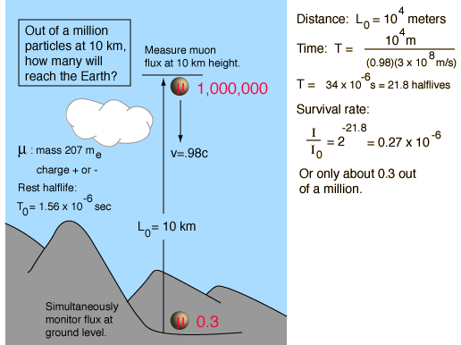
Muons
Without Relativity
But we see about 49,000 out of a million in practice ?!

Slide 15
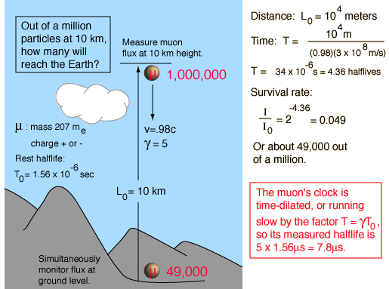
Muons again… this time
With relativity
Our view
49,000 out of a million should reach the ground!

Slide 16
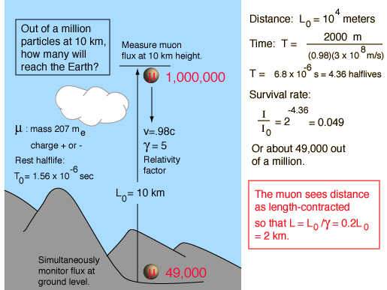
The Muons’ View

Slide 17
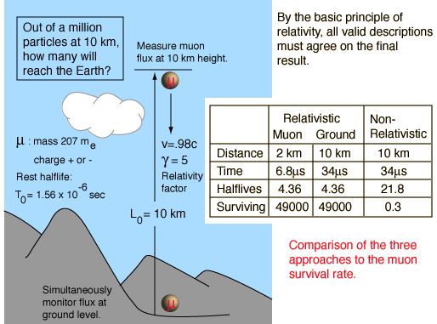
A comparison of the different views

Slide 18
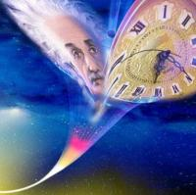
Clocks Go Slow in Strong Gravity Fields
Mass
M
r
Fast
clock
Slow
clock
Δt(r) = Δt(r = ∞) × √(1 – GM/rc²)

Slide 19
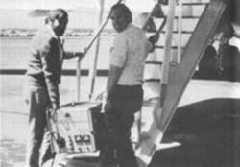
Hafele-Keating Experiment
Oct 1971 Joseph Hafele and Richard Keating flew portable caesium atomic clocks around the Earth on commercial jets
Eastward trip of 65.4 hrs (41.2 hrs in flight) and westward trip of 80.3 hrs (48.6 hrs in flight)
Clock Gain (nanosecs)
Eastward:144 + 14 gravitational -184 + 18 sp rel = -40 + 23 (obs -59+10)
Westward:179 + 18 gravitational + 96 + 10 sp rel = 275 + 21 (obs 273 + 7)

Slide 20
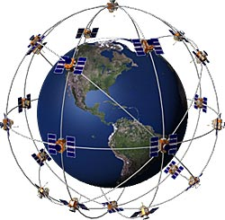
G P S
Constellation of 24 satellites in US system
At least 3 satellites to get a 2-d position
At least 4 to get 3-dim location
Accurate to about 10m

Slide 21
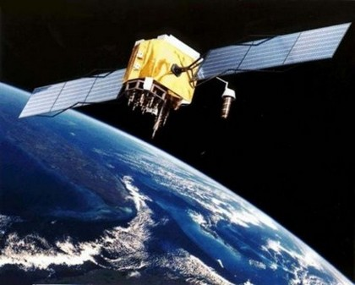
Without Relativity You Are Lost
24 GPS satellites orbit the Earth at altitude 26,600 km (15,960 miles) at a speed of 14,000 km/hr (8,424 mph)
SR time dilation makes satellite clock run slow relative to Earth by 7200 nanosec per day
Satellite is in weaker gravity field (g = GM/r² is smaller) by about 4%. So satellite clock runs fast by 45,900 nanosec per day. This is the bigger effect.
Overall: relativity makes satellite clock fast by about 38,700 nanosec per day. Means navigational errors here of 10 km per day if uncorrected!
The satellite clocks are pre-set
to be running slow on launch so
that they run at the correct rate
in their final orbit as well as other
anomalies and orbit drift.

Slide 22
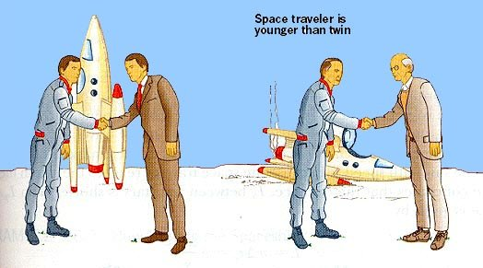
The Twin Paradox
Two identical twins: one stays on earth, one takes a space trip.
The one who makes the trip and feels the accelerations and forces
Has the slower clock and ages less than the stay at home twin.
On return to Earth the travelling twin is younger than his
stay at home brother!
“Paradox” because of
apparent symmetry
But their histories feel
different: the twin who
feels the forces will be
Younger.
Notes:
startswithabang.com

Slide 23
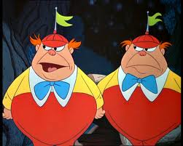
Backwards and Forwards Time Travel
The travelling twin has time-travelled into the future to encounter his twin brother later in his brother’s life.
This is routine in relativity physics.
Time travel into the past is not!

Slide 24
An Example
D = 2.67 light yrs
Speed of rocket v = 0.66c
(1-v²/c²)^{1/2} = 0.75
Stay-at-home twin notes see distance 2.67 lyr each way
and journey time of 2.67/0.66 = 4 yrs in each direction
So stay-at-home twin will have aged 8 yrs when his brother
returns to Earth
Travelling twin sees journey distance contracted by
(1-v²/c²)^{1/2} = 0.75 so is 2.67 × 0.75 = 2 lyr each way
This takes a time 2/0.66 = 3 yr in each direction
So when the travelling twin returns home and is reunited
With his brother he will have aged only 6 years.

Slide 25
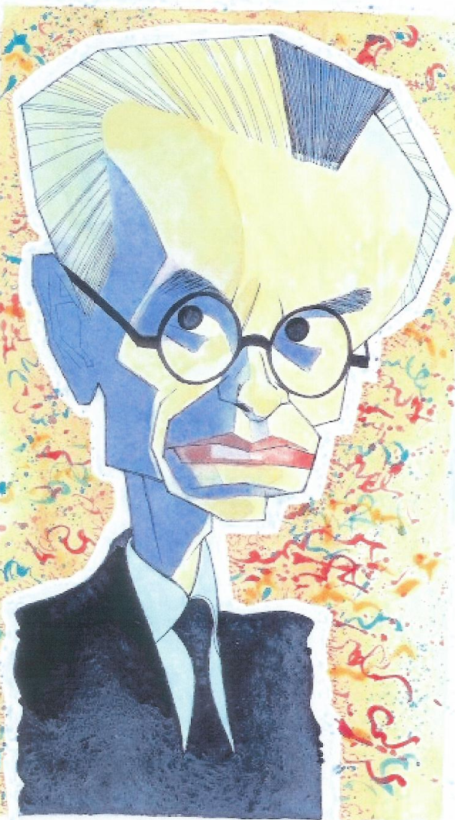
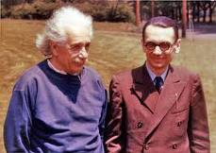
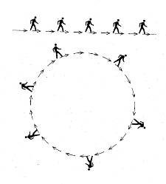
Gödel's Rotating Universe
Allows backwards time travel
to occur !
1949
Can it occur in a ‘realistic’
Universe?

Slide 26
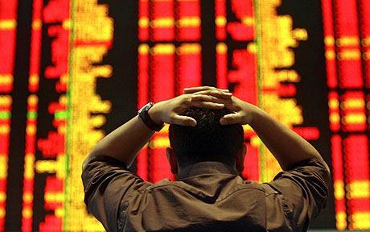
Time Travel and Interest Rates
Travel back to 2011 from 3011 and invest £1 at 4%
(1 + 0.04)¹⁰⁰⁰ = £ 108 million billion !!
If rates are negative, travel to the future to purchase
then return and sell
All + or – interest rates will be driven to zero by time travellers

Slide 27
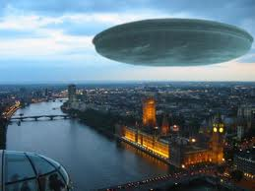
Interstellar Trading
Time dilation effects
Earth
Alpha
of relativity included
Ignore gravitational effects and accelerations
P(E) price of Earth goods on Earth
P(A) price of Alpha goods on Earth
P*(E) price of Earth goods on Alpha
P*(A) price of Alpha goods on Alpha
R: interest rate on Earth
R*: interest rate on Alpha

Slide 28

Making A Profit
C + Q*(A)P*(A) = cost of ship plus quantity Q*(A) bought on Alpha
On Earth trade them for quantity of Earth goods
Q*(E) = Q*(A)P(A)/P(E)
Return to Alpha sell at P*(E) to receive
Q*(A)P(A)P*(E)/P(E)
Round-trip lasts 2N yrs on a non-travelling clock
Profitable if
Q*(A)P(A)P*(E)/P(E) > [C + Q*(A)P*(A)](1 + R*)^{2N}

Slide 29
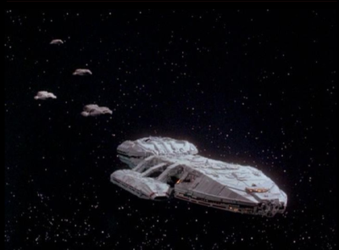
Don’t Use the Traveller’s Frame
Journey takes only T = 2N(1- v²/c²)^{1/2} years
Profitability criterion in the traveller’s would be different:
Q*(E) + P(E)P*(E)/P(E) > [C+Q*(E)P(E)](1+R*)^{T}
This is not the correct criterion though
An investor could have bought a bond on Alpha and let it mature instead of sending goods to Earth
The value of the bond on the ship’s return doesn’t depend on the time elapsed on the spaceship

Slide 30
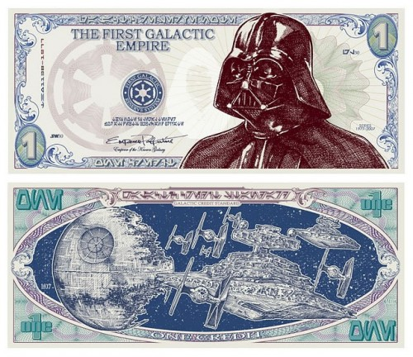
The Effects of Competition
If interstellar trading is competitive then
profits will be driven to zero:
P*(E)/P*(A) = [P(T)/P(T)](1 + R*)^{2N}

Slide 31
Krugman’s Laws of Interstellar Trade
1. When trade takes place between planets in the same
Frame of reference, the interest costs on goods in transit
should be calculated using time measured by clocks in
the common frame, and not by clocks in the moving frames
of the trading spaceships.
2. If traders hold assets on two planets in the same
frame of reference, then competition will equalise the
Interest rates on the two planets.

Slide 32
Proof of Krugman’s Second Law
Transaction 1
Buy goods on Alpha
Ship to Earth
Sell the goods
Invest proceeds in Earth bonds for K years
Then sell and buy Earth goods and ship to Alpha
Transaction 2
Hold bonds on Alpha for 2N + K years
The return on these two transactions must be the same
(1 + R*)^{2N+K} = [P*(E)/P*(A)](1 + R)^{K}
But the competition condition is P*(E)/P*(A) = [P(T)/P(T)](1 + R*)^{2N}
⇒ R = R*

Slide 33

“Bankers Are on Another Planet”

