Slide 1
What’s misssing? DLs, OWL & the Ecology of Semantic Systems or “Ontologies don’t make the tea” or “There’s more to KR than ontologies, or even logic”
Alan Rector BioHealth Informatics Group University of Manchester rector@cs.manchester.ac.uk
Copyright University of Manchester 2012 Licensed under Creative Commons Attribution Non-commercial Licence v3

Slide 2
What I have been doing recently…
Clinical systems and Ontology Driven Software (Commercial Collaborations)
Flexible questionnaire manager – Clinical Informatics CIS Glasgow
Context Sensitive Clinical Documentation – Siemens Health Services (US)
Medical Terminologies
ICD-11, SNOMED, OCRe. (& Bio: GO, PATO, …)
Analysis & QA – esp SNOMED
Design & tools - latest revision of WHO’s Internationa Classification of Diseases (ICD-11)
Using in software and data models with other standards – Ontology for Clinical Research (OCRe)

Slide 3


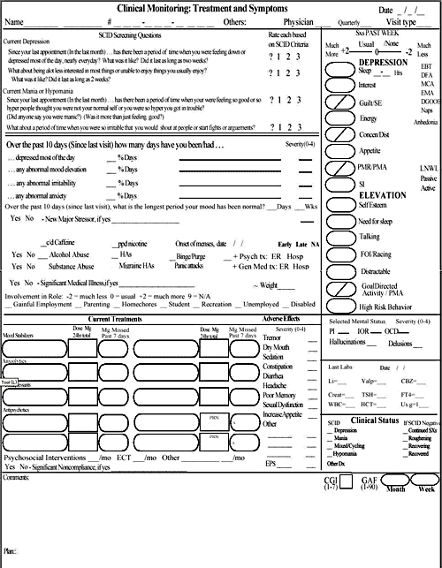
Problems I am trying to solve
How to generate simple forms for complex patients- multiple diseases and considerations
“An elderly man with confusion, rapid breathing, and extensive bruising as seen by the Emergency room Medic”
Pneumonia v alcohol v liver disease v head injury v diabetic coma…
Probably more than one
Without combinatorial explosion & assuring correctness
A typical hospital has several thousand forms each of which take ~ 3+ person-months to develop; A typical patient may need several.
… and they don’t begin to cover what’s needed – THE bottleneck
Too many
Too big
Too complicated & repetitive

Slide 4
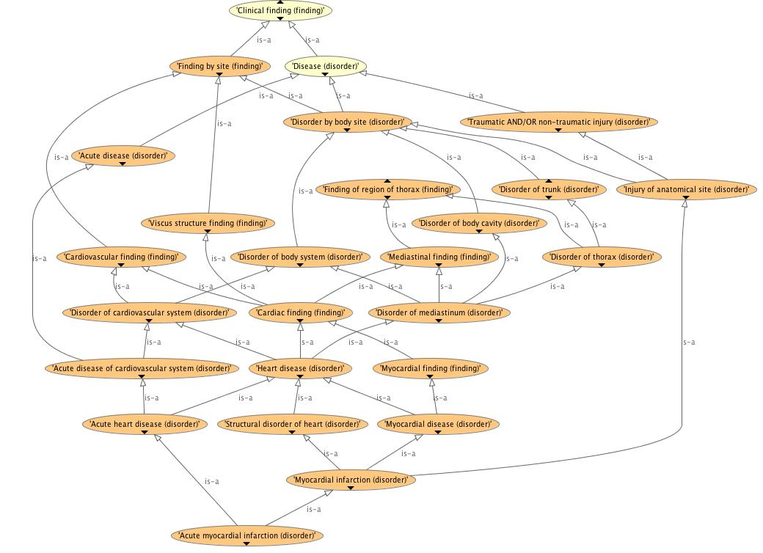
Problems I am trying to solve (II) How to tell if SNOMED is safe to use (or any other big terminology – 50K..500K classes )
Is it correct formally? Clinically? Practically?
Will “users” understand it sufficiently to use it correctly?
End users? Knowledge & software engineer users?
(See JAMIA, J Biomed Informatics, & KCAP papers on my website http://cs.man.ac.uk/~rector)
Why isn’t Myocardial Infarction a kind of Ischemic Heart Disease?
Why isn’t Subdural hematoma a kind of Intracranial bleed?
Why isn’t Chronic duodenal ulcer a kind of Chronic disease?
Why is Thrombophlebitis of breast a kind of Disorder of leg? Why is Thrombosis of ankle vein a Disorder of pelvis?

Slide 5
Problems I am trying to solve (III)
How to reconcile ICDs traditional classification and legacy with new requirements
Retain stability with previous versions
A classification – not an ontology
Fixed depth; mutually exclusive and exhaustive at every level
Every patient event counted exactly once at every granularity
Overcome shortcomings of previous versions
Shorten 20-year revision cycle & support Social Computing approaches
Reconcile with modern knowledge
Support multiple views & new requirements
Multi-layered structure
Ontology layer – hopefully reconciled with SNOMED
Foundation layer – lots more around the “skeleton” of the ontology
“Linearizations” – traditional classifications linked to Foundation layer

Slide 6
Problems I am trying to solve (IV)
How to create an “Ontology of Clinical Research” that fits into standards
Must ultimately integrate with UML
Must carry many arbitrary “rules” and “calculations”
Mix of formal and text
Eg
Criteria for inclusion and exclusion of patients
Algorithms for calculation of statistics
Must provide a way of
Indexing and discovering trials as a whole based on its characteristics
Represent or link to detailed trial protocols
Complex contingent transition networks / plans
Recording “journies” of individual patients through those protocol
Which may or may not conform to the protocols
And can describe the reasons for deviations from protocol

Slide 7
Wherever posssible I use public/standard tools
Ontology development environments
Protégé-OWL / CO-ODE …
Patterns, scripts, & queries
OPPL, Ad hoc-ery, (SPARQL-OWL eagerly awaited)
Modules, Version management
OWL API Module exrtraction, OWL-Patch
Ontology driven architectures
HOBO – locally developed – see URIs at end
Visualisation
OWL Viz, Inferred ancestors views
OWL API & compliant Reasoners (OWL or EL++)
SNOROCKET, ELK, FaCT++, JFACT, Pellet, …
Ontology exploration
Local extensions to OWL API & FaCT++/JFaCT

Slide 8
Why I use DLs/OWL
Composition “Burn that has_site some (Foot that has_laterality some Left) & has_penetration some Full_thickness & has_extent …& … & … & …”
Avoid combinatorial explosion –
Smaller terminologies that say more
Support for expressions as well as names (“post-coordination”)
Coordinate hierarchies and index information, e.g. hierarchies for:
“Cancer”,”Family history of cancer”, “Treatment of cancer”, “Risk of cancer”, “Data structure for cancer”, “Data entry form for cancer”, “Pointer to rules for Cancer”, “Trials for cancer”, “Genetic markers for cancers”,…
Express context
The “size of elephants” vs the “size of mice”
Factoring / “normalising” knowledge
Indexing by inferred subsusmption lattice
How else to get a complex lattice correct?
Explicitness
Cuts costs by shortening meetings
Notes:
8K-35K kinds of burns, depending on number of dimensions and number of levels in each

Slide 9
Composition: Building with “Conceptual Lego” Parallel families of hierarchies
Species
Genes
Protein
Function
CFTRGene in humans
Disease
Protein coded by (CFTRgene & in humans)
Membrane transport mediated by (Protein coded by (CFTRgene in humans))
Disease caused by (abnormality in (Membrane transport mediated by (Protein coded by (CTFR gene & in humans))))

Slide 10
… but lots of information I need doesn’t fit description logic reasoning
For clinical systems key information
“Particular” rather than “universal”
Some/may/probably rather than “all”
Requires defaults and exceptions
Requires strengths of association / uncertainty
Acts as dynamic template for Java objects
Requires calculations, attached procedures, …
For standards
Must interface with UML, rules, calculations,…
For QA (e.g. SNOMED)
Requires queries combining Lexical, Syntactic, “Exploration”, Linguistic, and Semantic information

Slide 11
Key nonstandard approaches (i)
Ontologies/DL models as indexes for “payloads” of information
Use the set of most specific “payloads” of a given type for this class (according to the inferred subsumption lattice)
More specific over-ride less specific
Standard “Touretzky distance” metric
If ontology normalised, usually a singleton
If not, invoke some conflict resolution strategy
e.g union, merge, prioritise, ask user, …
Payloads can be many things
Screen specs, associations, strengths, rules, triggers, web links, templates …
An old idea – a “baby thrown out with bathwater”
A standard “default logic” for DLs would be nice, but…
This works now, is fast, & covers our use cases
Provides “Fractal tailoring” with existing tools e.g. Assembling forms…

Slide 12
Example of ontologies as indexes: Fractal tailoring of widget payloads for clinical systems
Confusion
Confusion
Confusion in Elderoy
Confusion in Elderly
Rapid Breathing
Rapid Breathing
Elderly patient with rapid breathing and confusion for ER Medic
ER Medic
ER Medic
Elderly patient with rapid breathing and confusion for ER Medic?

Slide 13
Many payloads are implemented as “annotations”
Many ontologies exist to index annotations (GO, ICD11, OCRe, Our commercial applications…)
Content
Text definitions
Mappings to other terminologies and identifiers
Treatments, pointers to rules, calculations, etc.
Links to evidence, …
Editorial
Authorship
Versioning
...
Escapes
Particular, strength, …
… but OWL/DLs provide no structure for annotations

Slide 14
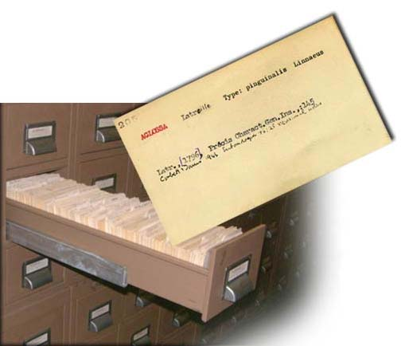
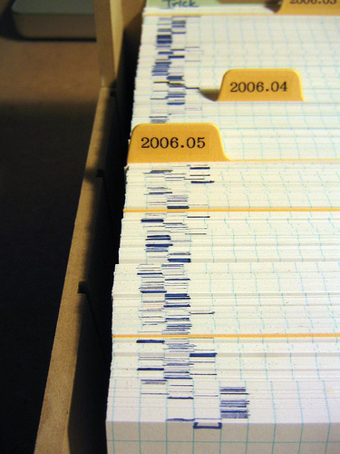
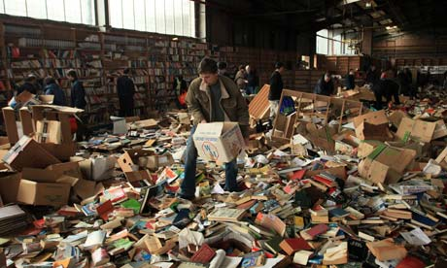
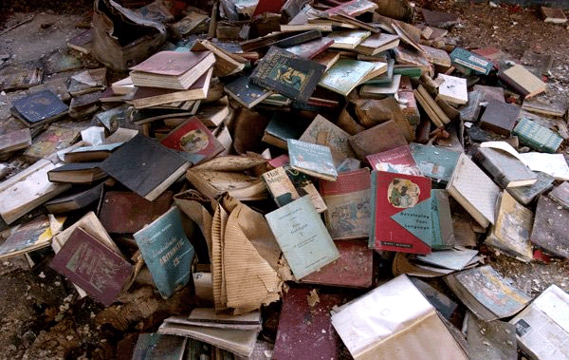
If I go to the trouble to index it…
Do I leave it like this?

Slide 15
Is this sensible?
Use DLs to Provide
A rigorous logical model for the index
…but
No model for
The information indexed
…or for the
Metadata required for processing it
…or for the
Editorial data required to authenticate it

Slide 16
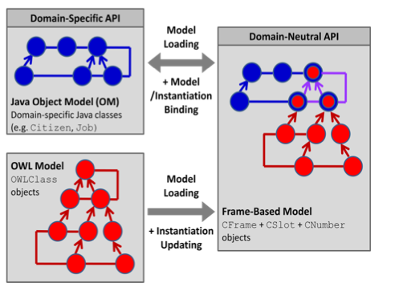
Key nonstandard approaches (II) Ontologies as templates to extend Java objects dynamically
Ontology Binding Interface (OBI)
HOBO Framework
(See Pulestin et al, OWLED 2012 & http://owl.cs.manchester.ac.uk/research/topics/hybrid-modelling)

Slide 17
… but DLs/OWL models are sets of axioms rather than templates
Hence the need to derive “frames” from DL axioms
A common confusion and error
A key barier to integrating DLs/OWL into SW Engineering & Standards
Most SW Engineering paradigms use templates
OO Programming
UML Class diagrams, Model Driven Architectures (MDA/OMG)
Frames
Cannonical Graphs in Sowa’s Conceptual Graphs
RDF(S) (as usually used)

Slide 18
Axioms & Templates: Fundamentally different
Axioms restrict
The more you know the less you can say
If there are no axioms, you can say anything
Hard to find what is permitted to say
Violations of axioms → unintended inferences (often of unsatisfiability)
Global
Over-riding impossible - monotonic
Open world - Must be closed for instance validation
Often impossible in practice (or require nonstandard “constraints”)
Templates permit
The more you know the more you can say
If there is no field/slot in the template you just can’t say it
Represents what it is permitted to say directly (“sanctioning” easy)
Violations of templates → validation errors
Local
Over-riding natural – usually non-monotonic
Closed world - Instance validation natural

Slide 19


Templates are fundamental to Knowledge Acquisition: No one likes staring at a blank page
Or screen

Slide 20
(Unconstrained development is hard)
Most KB development in two stages
“Gurus” set up schemas/templates
Domain experts fill in domain information
Most domain experts expect prompts/forms based on the schemas/templates (“Sanctioning”)
The of properties that apply to each class
The permitted values for that property for that class
The template for annotations for the class
Immediate notification if they make an error
…they don’t expect / won’t tolerate
Delayed feedback… especially as incomprehensible inferences &/or misclassifications
Number 1 reason given for avoiding OWL and using frames or similar

Slide 21
Templates also intuitive for instance validation / value sets
Straightforward query
Does the instance satisfy the constraints
Closed world
Easy to indicate missing values
Unknown values from existential quantification don’t count
Quick
Fits into notion of “Contraints”
Motik et al, 2007
But notion of “constraint” not fully integrated into a system of templates
And not part of any standard

Slide 22
Axioms & templates: Four approaches
The axioms determine the “ontology” / terminology for use in the templates (Traditional model for medical terminologies)
Leaves the “binding problem” – which entities to use where
“Value sets” & the “Ontology Binding Interface”
Transformation (The HOBO approach)
Generate templates following inferred axiom structure
Integrity Constraints – Motik et al. 2007 –
Only part of the solution – instance validation, etc.
But room for extension
Reify associations – make DL models “UML like”
…

Slide 23
Reifying associations (properties)
Close to “DRL lite” (See Berardi et al. 2005, …)
Treat all associations as classes
Only properties are subproperties of hasTopic and hasObject
Simplified sketch:
CLASS: MyAssociation ⊑ Association ⊑ hasTopic some Class1 ⊑ hasObject some Class2 ⊑ Key: (hasTopic, hasObject)
Most of the benefits of UML models but retains composition
At the cost of an extra level of nesting (to be hidden)
Concept ≡ C1 & (A some C2) ➔ Concept ≡ C1 & inv(has_topic) some (A that has_object C2)

Slide 24
Close to UML Take advantage of good diagramming tools
Top
Plus a bit of effort to sort out the multiplicities ad cardinalities
If we use subproperties & property paths & a bit of external checking, we can produce a bridging property, which can be transitive
has_cause ⊑ inv(hasTopicC) o hasObjectC
Domain Entity
Association
Pneumonia
hasTopicC
Cause
hasObjectC
Bacterium

Slide 25
Reifying associations: An approach to “particulars”
Natural representation for “some”/“may”
FAQ: “How do I say ‘may’ in OWL” –
E.g. Pneumonia may be caused by Bacteria?
As useful an approximation as the usual FoL for “some” ∃xy. C(x) & D(y) & p(x,y)
( Reified associations slightly weaker: do not assert existence of any instances)
Natural attachment point for strengths of association
FAQ: “How do I represent probabilities in OWL”
Attach them to the associations
Natural representation for “sanctioning”
Just ask for minimal non-redundant set of associations with a given topic
Number 1 complaint from users converting from Protégé frames to Protégé OWL – “Where is the list of properties”

Slide 26
Value sets: Mission critical for medical applications … but obvious DL solutions do not work
Three cases – plus boolean combinations
Value types – often specialist – validated lexically
Strings numbers, date-time, quantities, …
Biological units per f(weight, height, lab test value)
Fingers, +..++++, grade i..iv, …
Enumerated lists of entities from some domain
Pain radiates to: Left/Right Shoulder, Left/Right Arm, Abdomen, Back, Left Axilla
But NOT their subclasses
Systematic lists
Regions of skin of the face excluding the eyelid
to a designated granularity
Special cases different from general
Often require over-riding

Slide 27
Value sets: Awkward or impossible to express as DL queries: Choices
Use “Most specific” strategy & Knowledge Exploration
Most specific value set for a given association with a given topic
And any other qualifications
Represent all values as individuals
But this sacrifices most of benefits of ontology and inference
Baby gone with bathwater
Represent values as the classes, per se.
Create a second layer of meta-individuals (puns?) for classes
Can form queries easily
But complicated
Any errors lead to “Unsatisfiable ontology”

Slide 28
… and beware of brittle reasoning performance
Restrictions that are very efficient in an isolated models may stop classifier if included deeply nested in expressions
Which is where you find value sets
A reason for not using DL reasoning for value sets
Or for finding a way to partition the reasoning

Slide 29
DLs & Templates: Two bad non-solutions
Use universal constraints for “may” or “sanctioning”
Satisfiable (trivially) if empty, but
Eventually usually produce unexpected inferences
Use universal restrictions to indicate template structrure (including domain & range constraints in data models)
Infection ⊑ has_cause only Micro_organism Pneumonia ⊑ Infection Radiation_pneumonia ⊑ Pneumonia & ⊑ has_cause some Radiation ∴ Radiation ⊑ Micro_organism
Instead of a simple range error you get a misclassification / unintended inference
Non-local, hard to explain, hard to fix, computationally expensive
And still hard to find as sanction using standard DL queries.

Slide 30
Key approaches III: Hybrid queries and visuation methods
What does it mean to Quality Assure the Content of an ontology?
That all expected inferences are made
That only acceptable inferences are made
How do we know what is expected and acceptable? How do we know what’s there?
Compare labels/names and inferences against experts, external sources, and consequences in applications
Requires
Visualisation up the hierarchy as well as down
Mixed queries – lexical, syntactic, “exploration”, DL (& linguistic)

Slide 31
Visualisation for QA: Look up the hierarchy as well as down
Most subsumption lattices fan in upwards
Easy to see unintended inferred subsumptions
Within the given signature
Experts have no trouble deciding which things they don’t want
… and often even spot what’s missing
Example…

Slide 32
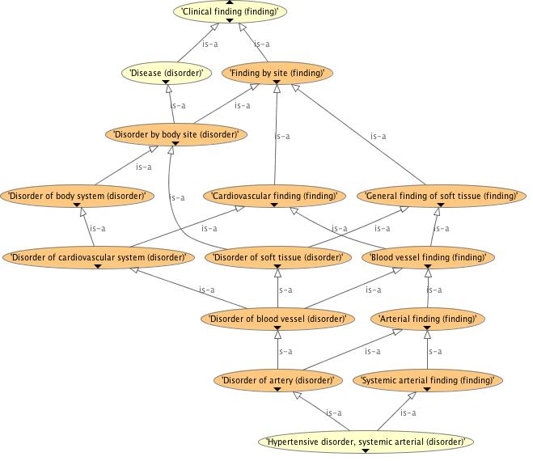
OwlViz Upwards for Hypertension

Slide 33
Check for the desired result

Slide 34
Combining lexical, exploratory, syntactic and semantic search
Hard to spot what is missing
Hypertensive disorders included some complications as well as kinds of hypertension. Did it contain them all?
Using OPPL2
?C:CLASS=MATCH(“.*[Hh]ypertensive.*”) ← Lexical SELECT ?C SubClassOf Finding ← Semantic WHERE FAIL ?C SubClassOf “Hypertensive disorder” ← “Exploratory” (Closed world)
Syntactic queries (Missing from OPPL so far)
Replace all occurrence at any level of nesting of “Hypertension” with “Hypertension OR is_caused_by SOME Hypertension”
Or vice versa
Find all occurrences at any level of nesting of an DL/OWL entity, expression, …

Slide 35
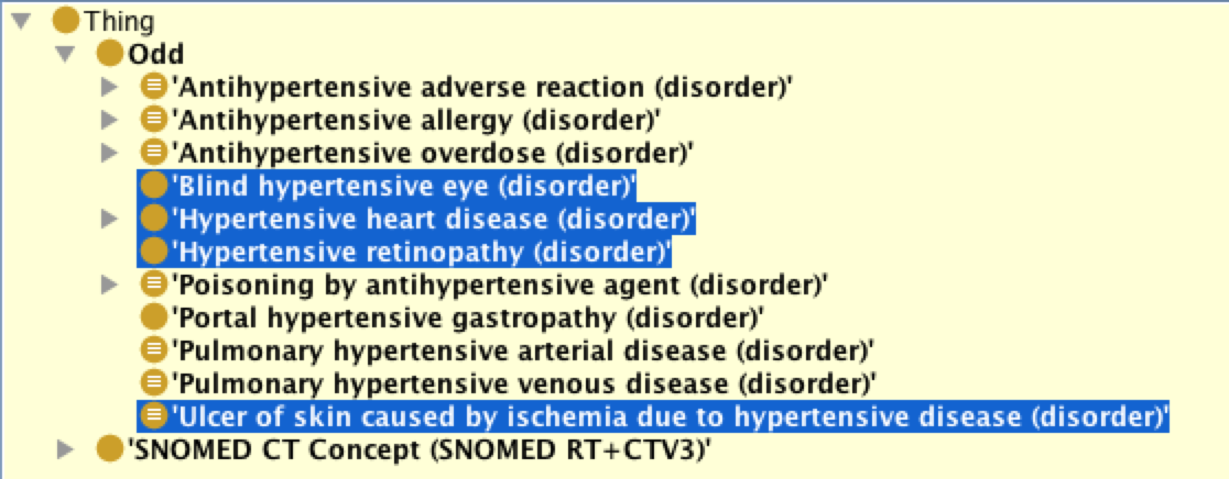
Lexical Search is only heuristic Many false positives
Only the highlighted classes are really “hypertensive disorders:
Others just contain the string “hypertensive”
But if I can reduce the search space from 300,000 to 11, it helps

Slide 36
Understanding this ontology Knowlede Exploration: What do I know about this class/concept (Needed in many applications)
Semantic Information that is present but hard to get
What’s a non-redundant set of what’s known about this class?
What are the least named subsumers for this expression?
What are the non-redundant “interesting” inferred restrictions of this class in this ontology?
What’s asserted / inferred about this class?
What is not provable in this ontology
Difference operator between query results
What’s the canonical form for this class?
What practical notions of “canonical” are possible?
What’s the difference between these two classes?

Slide 37
Too much information makes it hard to find errors: Hide uninteresting redundancy (How to define “uninteresting” /”Redundant))
Heart
Located in mediastinum, thoriax, trunk, body, anatomical structure…
Made of muscle, tissue, substance, …
Pneumococal pneumonia
Caused by pneumococcus type a, pneumococcus, bacteria, micro-organism, organism, …
A Grice maxim: Say only the most specific
Basic rule of pragmatics
Needn’t be unique, only covering,
Noise reduces utility

Slide 38
Beware! Literal logical may not be clinically correct
There are subdural hematomas that are not in the head
But they are very rare, and always described as “spinal”
SNOMED is literal logically right but clinically wrong
Use in a rule would be life threatening
Some think “Post operative MIs” are not caused by ischemia
But again, always qualified
“Myocardial infarction” on its own always means “ischemic”
SNOMED has probably used an old name
Modern name is “Infarction equivalent” or “Infarction-like event”

Slide 39
A bonus would be: Linguistic knowledge
Find all names containing a synonym of “heart”
E.g. Cardio, Cardiac, Cardial, …
Exist standard “stemming” programs to find the lists
Or put more linguistic information into annotations
Or generate back natural language
Does the OWL/DL say what the expert thought it said?
http://www.swatproject.org

Slide 40
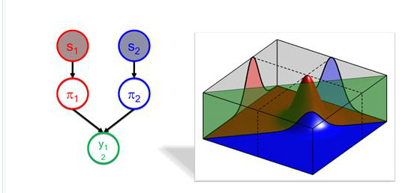
Things we need (i): Probabilities and DLs
Many of my collaborators use adaptive Bayesian networks
Major breakthroughs in last 10 years
Faster algorithms
Use of distributions instead of point probabilities
Specify initial models
Well developed and mature theory
E.g. See Chris Bishop http://research.microsoft.com/en-us/um/people/cmbishop/m

Slide 41
Interwork or Integrate?
Statisticians are not about to abandon 25 years of development … nor are logicians
Can DLs & Bayes Models to work together?
use DLs to structure the models according to context?
Different models for the elderly, adult, child, newborn, …
…and then use Bayesian statistics to propagate probabilities?
Plausible
…but some nasty problems to get models that are both logically satisfiable and statistically consistent
And computationally efficient
A Grand Challenge

Slide 42
Things we need (ii): Standard Rule, Query & Transformation Languages
To use queries as the antecedent of rules
For “knowledge exploration”
To create user facing languages/UIs
From “approximations” by domain experts to rigorous forms
Specialist UIs / Languages for specific applications (“Intermediate representations”)
Need to transform ontologies
To experiment with alternative representations
Often vast differences in efficiency and predictability
(OPPL and work on patterns a start, but only start)

Slide 43
Things we need (iii)
Rich meta data and (limited) higher order reasoning
Metadata for payloads needs tobe modeled
One route to calculations, alternative reasoning schemes
Multi-level reasoning
Queries we need to be able to form:
Two drugs of the same type
Prevalence, incidence, etc. of diseases
Property of disease itself, not the instances
Size of a class
“Ipsilateral” / “Contralateral”
Same side, different sides
Key concept in many medical rules

Slide 44
Broader perspective: We use DLs, but most people don’t (& we have problems) Some reasons why
Can’t say what they need to say!
Or find the information they need
Not integrated with software engineering tools
Especially UML/Model Based Architectures
Lack of tooling & specialist user-facing representations
Even where solutions are known, implementations are hard to find
Users need higher level of abstractions – OWL/DLs is low level
Inference still unstable and unpredictable
Although improving

Slide 45
Some notable oddities
OWL/DLs hardly mentioned in the Ontology Summit 2012 Communique
http://ontolog.cim3.net/OntologySummit/2012/communique.html
OWL is not in the list of “well known vocabularies” for Linked Open Data
www4.wiwiss.fu-berlin.de/bizer/pub/LinkedDataTutorial/
Although the use of owl:sameAs is “borrowed”
Deep Knowledge Representation/Project HALO 2012 challenge questions do not mention OWL (& are not answerable with OWL alone)
sites.google.com/site/2nddeepkrchallenge/
There remain as many (or more) users of Protégé-frames as Protégé-OWL
There is no routine adequate transformation betwen OWL & UML
Little discussion of the fundamental differences
Few OWL ontologies follow OWL-DL semantics (even if they claim to)

Slide 46
“Why can’t we get back to 1985?” Lessons from history
Serious question from Zak Kohane,
top researcher in Medical informatics / Medical AI (PhD in AI MIT)
In mid 1980s, AI toolkits (KEE, ART, KnowledgeCraft…)
Hybrid & Heuristic –
Rules
Forward chaining/OPS5, backward chaining/Prolog,
Frames
Metadata
Attached procedures, event driven GUIs, …
Addressed the right questions, even if some answers limited

Slide 47
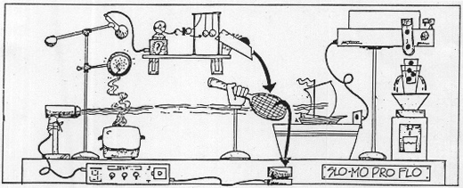
… some systems resembled Rube Goldberg machines
Neither complete, decidable nor probably sound
…but did useful work!

Slide 48
Two key events
Development of description logics
With enormous progress in past 20 yrs
… but despite being originally called “Frame languages” had almost nothing to do with “frames”
And focused on universal rather than existential restrictions
Better answers to narrower questions
No answers to the easy questions I have unless answers to the hard questions I don’t have
Borrowing of the wod “Ontology” by Gruber & others
Brought recognition & popularity
“Ontology” ≡ “Good”
… but confused the universal & particular any world & this world
…and invited philosophers to both clarify and confuse

Slide 49
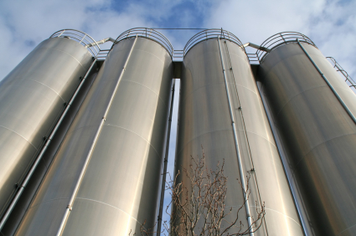
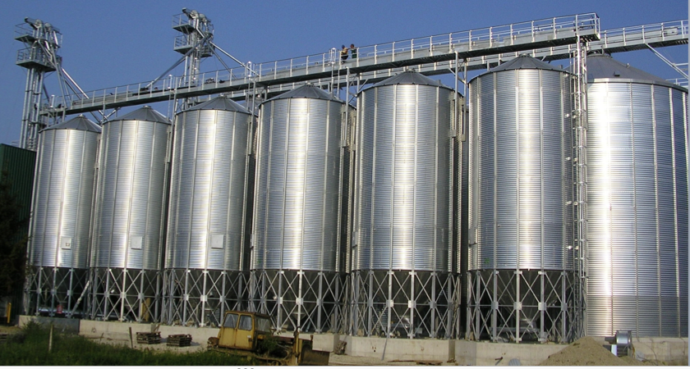
Contributed to a siloing of KR

Slide 50
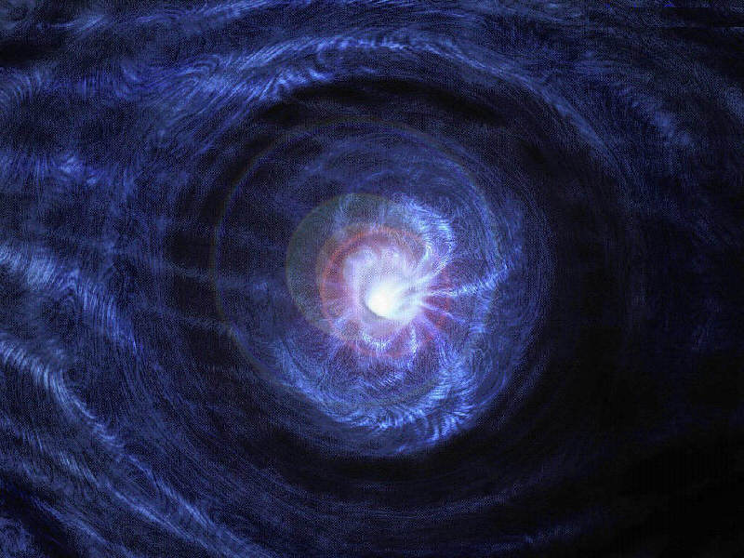
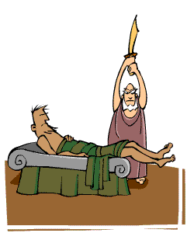
… and drew lots of KR down vortices
Or forced it onto procrustean beds
If it doesn’t fit DLs… <my representation>

Slide 51

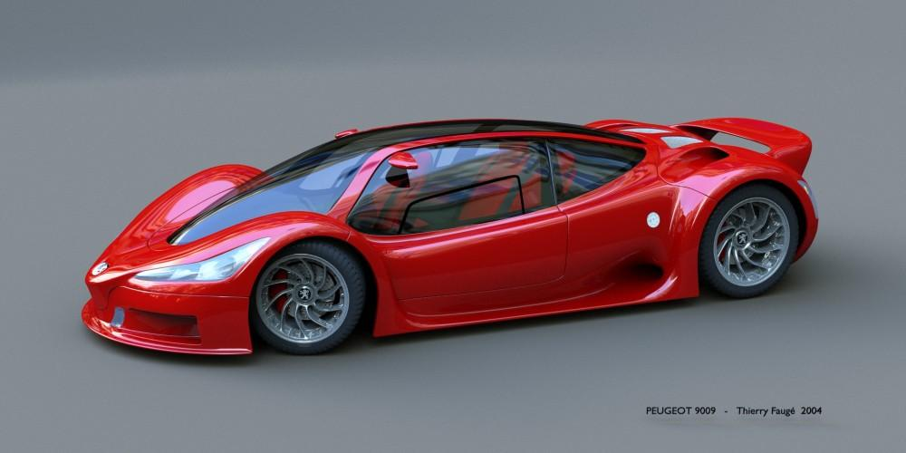
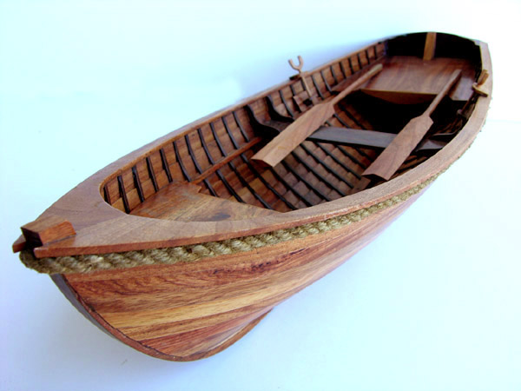
… Didn’t solve many problems people had (and have)
How do I use it?
If it’s so wonderful why won’t it do what I want?
It’s high tech & gorgeous – but I need to cross a river

Slide 52
And was brittle and ineffeficient (Violated basic rules of good SW Engineering)
Predictabiity
EL⁺⁺ great when it is enough.
What hybrids are possible? Other profiles?
Resource constrained reasoning
Response > myTimeThreshold ~ undecidable
Graceful failure; useful error reporting
“Unsatisfiable ontology” = “memory exception, core dumped”
Do use the best justifications
But also Find heuristic “debug modes”, e.g.
Classify first with all individuals represented as classes
Try various modules to isolate errors
…
What in my ontology is causing poor performance?
Alternative reasoners – “horses for courses”
Standard APIs

Slide 53
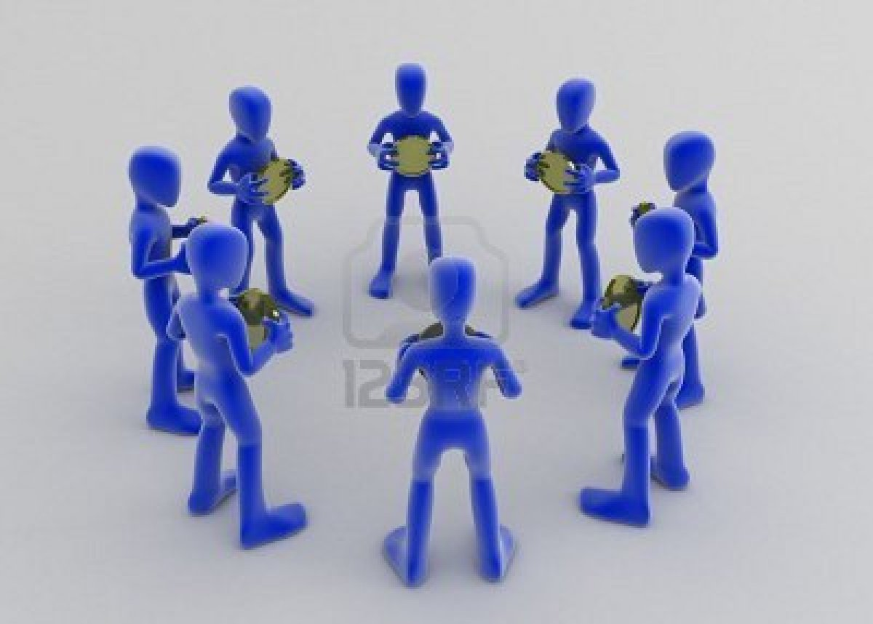
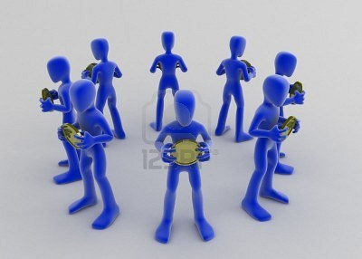
Where to
Don’t face in
Face out

Slide 54
Face out: My priorities
Template / axiom issue
For UML, Java object, Frames, Value sets
STANDARD RELATIONSHIP TO UML FOR MODEL DRIVEN ARCHITECTURES!
(and RDFs?)
Interworking with modern Baysian networks
Theoretical frameworks for hybrid systems
Multilayered DLs, DLs+
E-connections plus
“Rich annotations”
…
Query, Scripting, and Rule language standards

Slide 55
Face out: Make DLs part of a KR “Ecology”
Focus on use
The questions users have rather than the ones we can answer
Take “annotations” seriously
Interact effectively with other KR communities
Don’t be afraid of heuristic solutions or approximations
Factor the problem: Identify where DLs add value (& don’t)
Are DLs all of the answer? Part of the answer? Not relevant?
Extend DLs / OWL where practical & sensible
Make it easier to get the information that’s there implicitly
Layered models, metadata, constraints, modules…
Fit DLs/OWL into hybrid systems where not
Software engineering/UML, possibilities, probabilities, terminology binding and value sets,…
Make it easy to build user facing & problem-specific UIs / intermediate representations
Transformations, scripts, …
Make it available in standard tools, APIs, Services…

