Slide 1

Safe and Secure Software Systems An Automated Reasoning Perspective
Andrew Ireland
Dependable Systems Group
School of Mathematical & Computer Sciences
Heriot-Watt University
Edinburgh

Slide 2
Setting the Scene
Inaugural lecture?
Achievements and research vision
Blend of technical and big picture coupled historical perspective
First things first – software and automated reasoning?

Slide 3

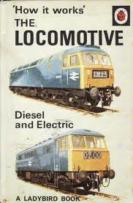



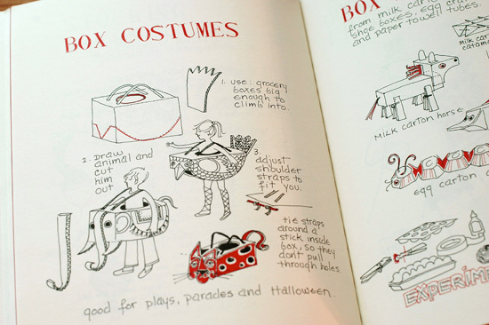
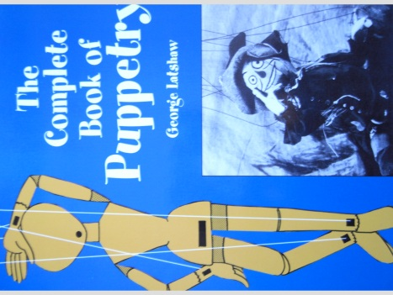
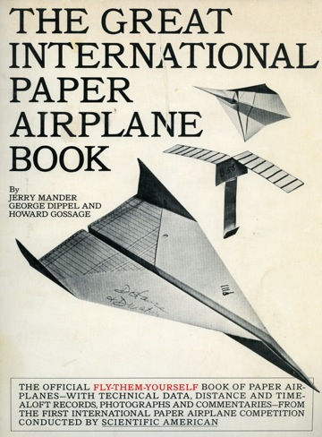

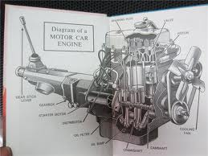
and How it Works’
Making Stuff

Slide 4

Making Software Stuff - Data
Numbers:
$0, 1, 2, 3, 4, 5, 6, 7, 8, 9, 10, …$
Lists:
$\left[0, 1, 2, 3, 4, 5, 6, 7, 8, 9\right]$
$\left[0, 2, 4, 6, 8\right]$
…

Slide 5
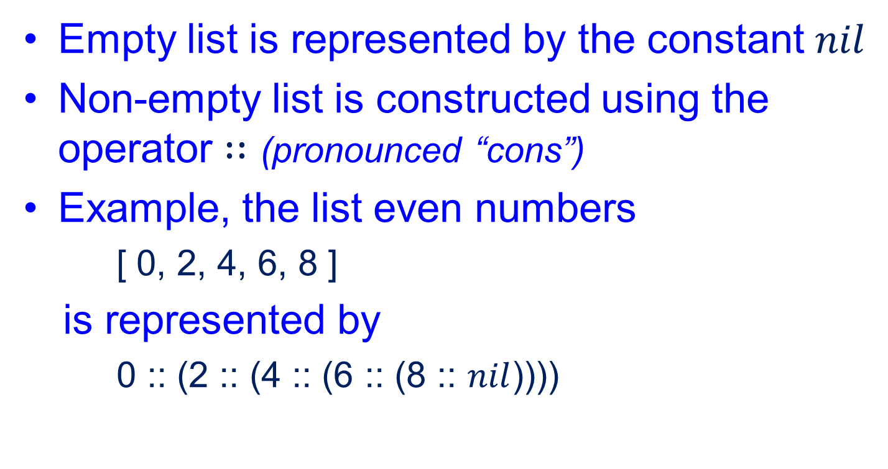
Making Software Stuff - Data
Empty list is represented by the constant $nil$
Non-empty list is constructed using the operator $∷$ (pronounced “cons”)
Example, the list even numbers
[ 0, 2, 4, 6, 8 ]
is represented by
0 :: (2 :: (4 :: (6 :: (8 :: $nil$))))

Slide 6
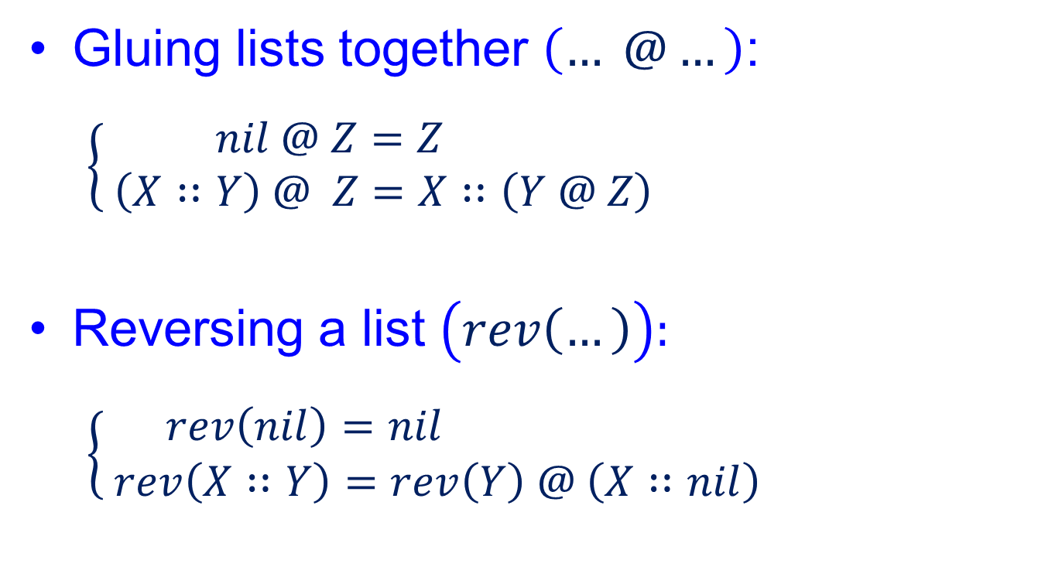
Making Software Stuff – Programs
Gluing lists together $\left(… @…\right)$:
$$\left\{ \begin{aligned} nil @ Z=Z \\ \left(X∷Y\right) @ Z=X∷\left(Y @ Z\right)\end{aligned}\right.$$
Reversing a list $\left(rev\left(…\right)\right):$
$$\left\{ \begin{aligned}rev\left(nil\right)=nil \\ rev\left(X∷Y\right)=rev\left(Y\right) @ \left(X∷nil\right)\end{aligned}\right.$$

Slide 7


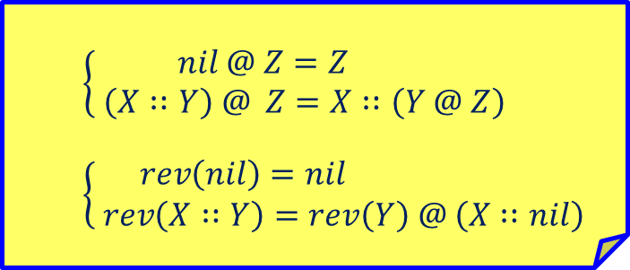


Program Execution
program
data
$$\left\{ \begin{aligned} nil @ Z=Z \\ \left(X∷Y\right) @ Z=X∷\left(Y @ Z\right)\end{aligned}\right.$$
$$\left\{ \begin{aligned}rev\left(nil\right)=nil \\ rev\left(X∷Y\right)=rev\left(Y\right) @ \left(X∷nil\right)\end{aligned}\right.$$
$$\left[1, 2, 3\right]$$
$$rev\left(\left[1, 2, 3\right]\right)$$
$$=\left[3, 2 ,1\right]$$

Slide 8



How It Works
$rev\left(1∷2∷3∷nil\right)$
$rev\left(2∷3∷nil\right)@\left(1∷nil\right)$
$\left(rev\left(3∷nil\right)@\left(2∷nil\right)\right)@\left(1∷nil\right)$
$\left(\left(rev\left(nil\right)@\left(3∷nil\right)\right)@\left(2∷nil\right)\right)@\left(1∷nil\right)$
$\left(\left(nil @\left(3∷nil\right)\right) @\left(2∷nil\right)\right)@\left(1∷nil\right)$
$\left(\left(3∷nil\right)@\left(2∷nil\right)\right)@\left(1∷nil\right)$
$\left(3∷\left(nil @\left(2∷nil\right)\right)\right)@\left(1∷nil\right)$
$\left(3∷\left(2∷nil\right)\right)@\left(1∷nil\right)$
$3∷\left(\left(2∷nil\right)@\left(1∷nil\right)\right)$
$3∷\left(2∷\left(nil @\left(1∷nil\right)\right)\right)$
$3∷\left(2∷\left(1∷nil\right)\right)$
$$rev\left(\left[1, 2, 3\right]\right)$$
$$=\left[3, 2 ,1\right]$$

Slide 9
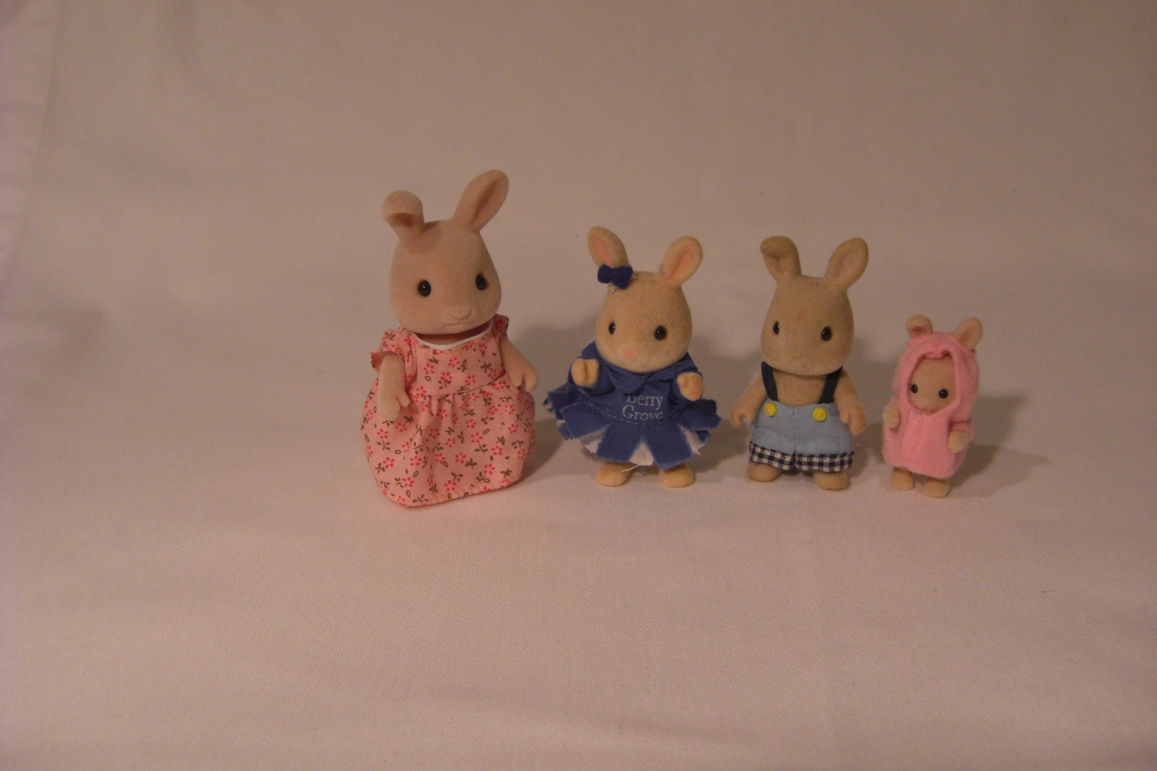
A Practical Example
$$rev\left(rev\left(\left[ \right]\right)\right)$$

Slide 10
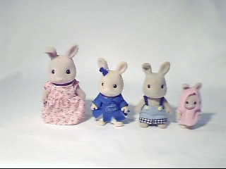

Slide 11
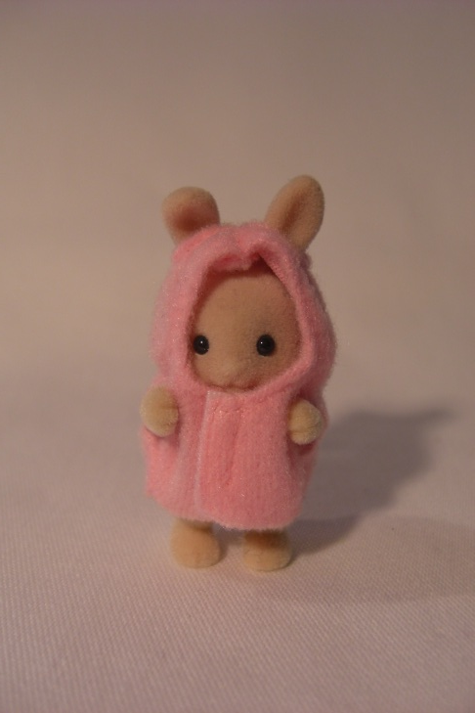
Proving Stuff
Proof = Guarantee + Explanation
Proving the conjecture:
Automated Reasoning:
building software systems that construct proofs
All Sylvanians are tiny,
Coral is a Sylvanian
Givens
therefore
Coral is tiny
Goal
Coral is tiny?
(conjecture)

Slide 12
Proof as Guarantee
Givens
Goal

Slide 13
Proof as Guarantee
Givens
Goal

Slide 14
Proof as Guarantee
Givens
Goal

Slide 15
Proof as Guarantee
Givens
Goal

Slide 16
Proof as Guarantee
Givens
Goal

Slide 17
Proof as Guarantee
Givens
Goal

Slide 18
Proof as Guarantee
Givens
Goal

Slide 19
Proof as Guarantee
Givens
Goal

Slide 20
Proof as Guarantee
Givens
Goal

Slide 21
Proof as Guarantee
Givens
Goal

Slide 22

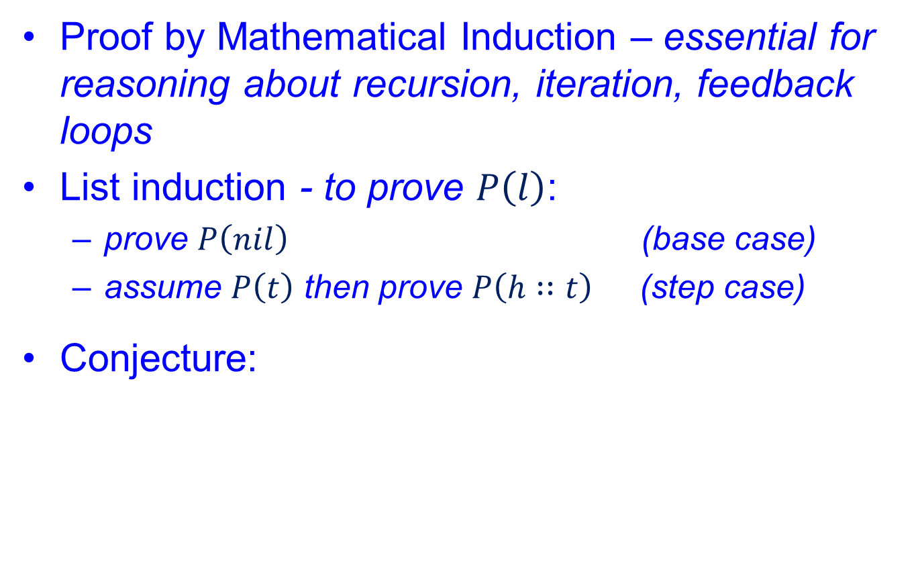
Proof as Guarantee
Proof by Mathematical Induction – essential for reasoning about recursion, iteration, feedback loops
List induction - to prove $P\left(l\right)$:
prove $P\left(nil\right)$ (base case)
assume $P\left(t\right)$ then prove $P\left(h∷t\right)$ (step case)
Conjecture:
$∀l:list\left(τ\right). rev\left(rev\left(l\right)\right)$ $=l$

Slide 23






Proof as Guarantee
Given:
$rev\left(rev\left(t\right)\right)$ $=t$
Goal:
$rev\left(rev\left( h∷t \right)\right)$ $=h∷t$
$$rev\left(X∷Y \right) ⇒ rev\left(Y\right) @ \left(X∷nil\right)$$
$rev\left( rev\left(t\right) @\left(h∷nil\right) \right)$ $=h∷t$
$$rev\left( Y @ \left(X∷nil\right)\right)⇒X∷rev\left(Y\right)$$
$h ∷rev\left( rev\left(t\right) \right)$ $=h∷t$
$$\left( X∷ Y=X∷ Z \right)⇒ \left(Y=Z\right)$$
$rev\left( rev\left(t\right) \right)$ $=t$

Slide 24


Proof as Explanation
Given:
$rev\left(rev\left(t\right)\right)$ $=t$
Goal:
$rev\left(rev\left( h∷t \right)\right)$ $=h∷t$
$rev\left(rev\left( h∷t \right)\right)$ $=h∷t$

Slide 25
Proof as Explanation
Given:
$rev\left(rev\left(t\right)\right)$ $=t$
Goal:
$rev\left(rev\left( h∷t \right)\right)$ $=h∷t$

Slide 26

Proof as Explanation
Given:
$rev\left(rev\left(t\right)\right)$ $=t$
Goal:
$rev\left(rev\left( h∷t \right)\right)$ $=h∷t$
$$rev\left(X∷Y \right) ⇒ rev\left(Y\right) @ \left(X∷nil\right)$$

Slide 27
Proof as Explanation
Given:
$rev\left(rev\left(t\right)\right)$ $=t$
Goal:
$rev\left(rev\left( h∷t \right)\right)$ $=h∷t$
$$rev\left(X∷Y \right) ⇒ rev\left(Y\right) @ \left(X∷nil\right)$$
$rev\left( rev\left(t\right) @\left(h∷nil\right) \right)$ $=h∷t$

Slide 28
Proof as Explanation
Given:
$rev\left(rev\left(t\right)\right)$ $=t$
Goal:
$rev\left(rev\left( h∷t \right)\right)$ $=h∷t$
$$rev\left(X∷Y \right) ⇒ rev\left(Y\right) @ \left(X∷nil\right)$$
$rev\left( rev\left(t\right) @\left(h∷nil\right) \right)$ $=h∷t$

Slide 29

Proof as Explanation
Given:
$rev\left(rev\left(t\right)\right)$ $=t$
Goal:
$rev\left(rev\left( h∷t \right)\right)$ $=h∷t$
$$rev\left(X∷Y \right) ⇒ rev\left(Y\right) @ \left(X∷nil\right)$$
$rev\left( rev\left(t\right) @\left(h∷nil\right) \right)$ $=h∷t$
$$rev\left( Y @ \left(X∷nil\right)\right)⇒X∷rev\left(Y\right)$$

Slide 30

Proof as Explanation
Given:
$rev\left(rev\left(t\right)\right)$ $=t$
Goal:
$rev\left(rev\left( h∷t \right)\right)$ $=h∷t$
$$rev\left(X∷Y \right) ⇒ rev\left(Y\right) @ \left(X∷nil\right)$$
$rev\left( rev\left(t\right) @\left(h∷nil\right) \right)$ $=h∷t$
$$rev\left( Y @ \left(X∷nil\right)\right)⇒X∷rev\left(Y\right)$$
$h ∷rev\left( rev\left(t\right) \right)$ $=h∷t$

Slide 31


Proof as Explanation
Given:
$rev\left(rev\left(t\right)\right)$ $=t$
Goal:
$rev\left(rev\left( h∷t \right)\right)$ $=h∷t$
$$rev\left(X∷Y \right) ⇒ rev\left(Y\right) @ \left(X∷nil\right)$$
$rev\left( rev\left(t\right) @\left(h∷nil\right) \right)$ $=h∷t$
$$rev\left( Y @ \left(X∷nil\right)\right)⇒X∷rev\left(Y\right)$$
$h ∷rev\left( rev\left(t\right) \right)$ $=h∷t$
$$\left( X∷ Y=X∷ Z \right)⇒ \left(Y=Z\right)$$

Slide 32

Proof as Explanation
Given:
$rev\left(rev\left(t\right)\right)$ $=t$
Goal:
$rev\left(rev\left( h∷t \right)\right)$ $=h∷t$
$$rev\left(X∷Y \right) ⇒ rev\left(Y\right) @ \left(X∷nil\right)$$
$rev\left( rev\left(t\right) @\left(h∷nil\right) \right)$ $=h∷t$
$$rev\left( Y @ \left(X∷nil\right)\right)⇒X∷rev\left(Y\right)$$
$h ∷rev\left( rev\left(t\right) \right)$ $=h∷t$
$$\left( X∷ Y=X∷ Z \right)⇒ \left(Y=Z\right)$$
$rev\left( rev\left(t\right) \right)$ $=t$
Rippling = difference identification + difference reduction

Slide 33
Proof Plans
A proof plan represents a common pattern of reasoning, e.g. rippling
Proof plan = tactic + strategy
Proof plans:
Automate the search for proofs - via proof planning
Promote strategy reuse
Guarantee Explanation

Slide 34
Proof Planning
Conjecture
Theory
Method
Strategies
Tactic
[ tailored for
conjecture ]

Slide 35
Proof Planning
Critic
Conjecture
Theory
Method
Strategies
Critics provide flexibility during the search for proofs

Slide 36

Productive Use of Failure
D
Missing Properties
(Lemmas)
Conjecture
Generalization
Ripple
method
Case Splits
Induction Rules

Slide 37
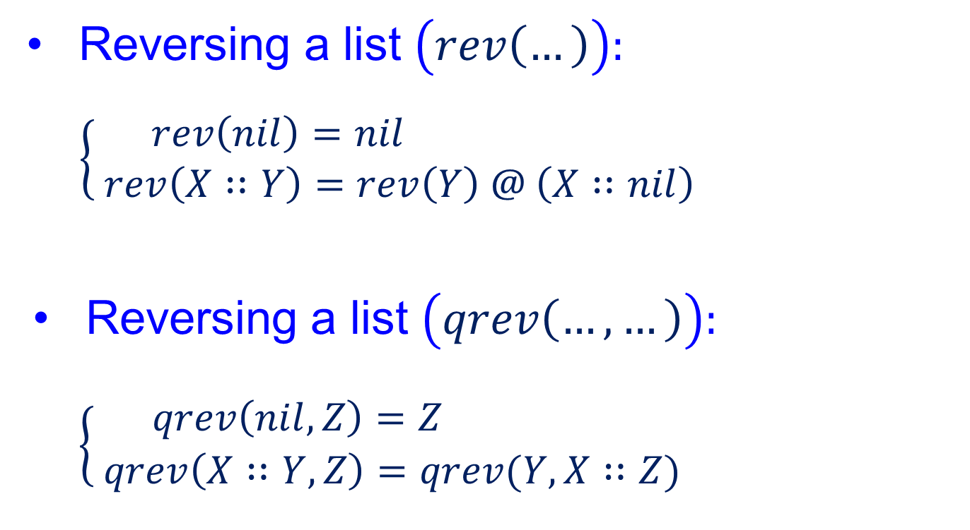
Making Software Stuff
- Faster!
Reversing a list $\left(rev\left(…\right)\right):$
$$\left\{ \begin{aligned}rev\left(nil\right)=nil \\ rev\left(X∷Y\right)=rev\left(Y\right) @ \left(X∷nil\right)\end{aligned}\right.$$
Reversing a list $\left(qrev\left(…,…\right)\right):$
$\left\{ \begin{aligned}qrev\left(nil, Z\right)=Z \\ qrev\left(X∷Y,Z\right)=qrev(Y,X∷Z)\end{aligned}\right.$

Slide 38
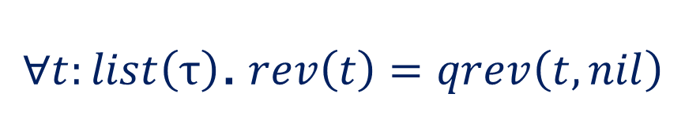
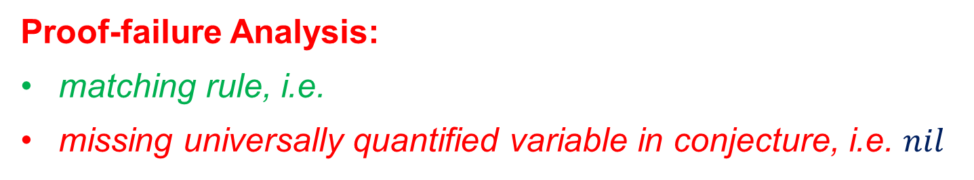

Conjecture Generalization Critic
$∀t:list\left(τ\right)$.$rev\left(t\right)=qrev\left(t,nil\right)$
Given:
$$rev\left(t\right)=qrev\left(t, nil\right)$$
Goal:
$$rev\left( h∷t \right)=qrev\left( h∷t , nil\right)$$
$rev\left(t\right) @\left(h∷nil\right)$ $=qrev\left( h∷t , nil\right)$
blocked
Proof-failure Analysis:
matching rule, i.e.
missing universally quantified variable in conjecture, i.e. $nil$
$$\begin{aligned} \\ qrev\left( X∷ Y ,Z\right)⇒qrev(Y, X∷ Z )\end{aligned}$$

Slide 39






Conjecture Generalization Critic
$∀t:list\left(τ\right)$.$rev\left(t\right)=qrev\left(t,nil\right)$
$∀t,l:list\left(τ\right)\text{.} F\left(rev\left(t\right),l\right)=qrev\left(t, G\left(l\right)\right)$
$$∀t,l:list\left(τ\right)\text{.} rev\left(t\right)@l=qrev\left(t, l\right)$$
$$x@y$$
$$?$$
$$F\left(x,y\right)=$$
$$?$$
$$G\left(x\right)=$$
$$x$$
Given:
$$∀l′:list\left(τ\right)\text{.} F\left(rev\left(t\right),l′\right)=qrev\left(t, G\left(l′\right)\right)$$
$$∀l^{′}:list\left(τ\right)\text{.} rev\left(t\right)@ l′=qrev\left(t, l′\right)$$
$$rev\left(t\right)@ h∷l=qrev\left(t, h∷l\right)$$
Goal:
$$F\left(rev\left( h∷t \right),l\right)=qrev\left( h∷t , G\left(l\right)\right)$$
$$rev\left( h∷t \right)@l=qrev\left( h∷t , l\right)$$
proof planning
$$rev\left(t\right)@ h∷ l =qrev\left(t,h∷ l \right)$$

Slide 40

Conjecture Generalization Critic
$$∀t,l:list\left(τ\right)\text{.} rev\left(t\right)@l=qrev\left(t, l\right)$$
$$F\left(x,y\right)=$$
$$x@y$$
$$G\left(x\right)=$$
$$x$$
Given:
$$rev\left(t\right)@ h∷l=qrev\left(t, h∷l\right)$$
$$rev\left(t\right)@ h∷l=qrev\left(t, h∷l\right)$$
Goal:
$$rev\left( h∷t \right)@l=qrev\left( h∷t , l\right)$$
proof planning
$$rev\left(t\right)@ h∷ l =qrev\left(t,h∷ l \right)$$
$$true$$
http://www.rippling.org/

Slide 41
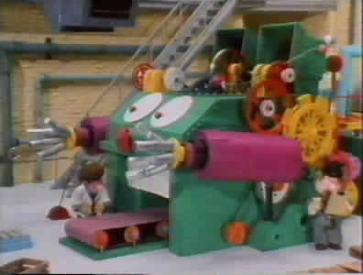
Related PhD Projects
Proof planning for imperative program development (Jamie Stark)
Reuse of proof plans
Loop invariant discovery
Program synthesis, i.e.
“... develop a program and its proof
hand-in-hand, with the proof ideas
Leading the way!” (Gries, 1981)
Bertha

Slide 42
Related PhD Projects
Using Proof in Transformation Synthesis for Automatic Parallelisation - EPSRC GR/L42889 (Andrew Cook)
Verification & synthesis of performance enhancing eureka steps, e.g. transformations that facilitate the parallelization of software
Reasoning About Correctness Properties of a Coordination Programming Language (Gudmund Grov)
HUME: a novel programming language
Verification and transformation of HUME programs to improve resource usage (space and time guarantees)

Slide 43
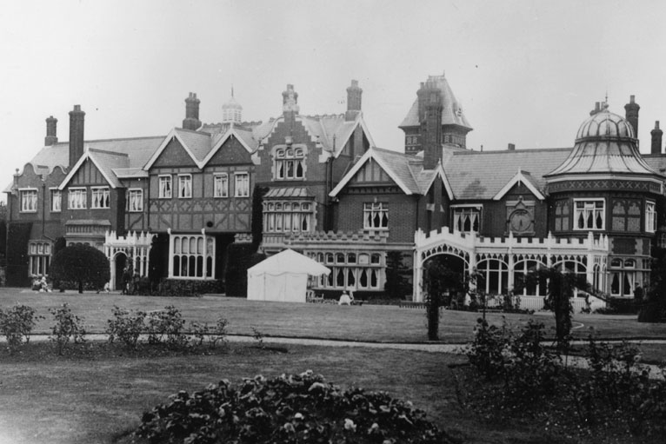
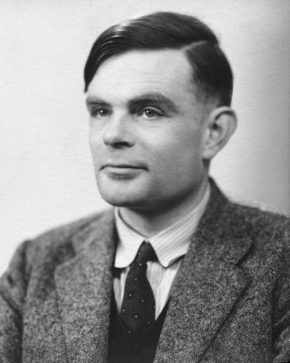
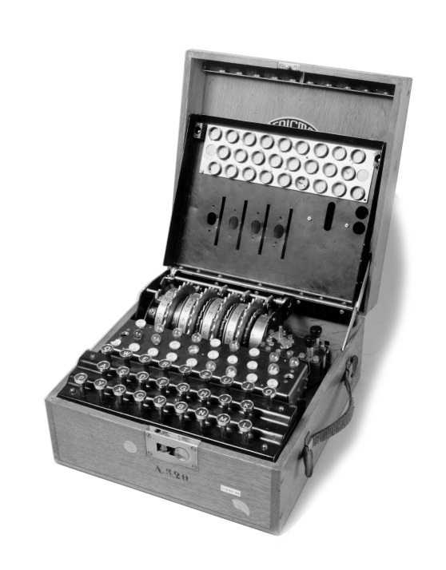
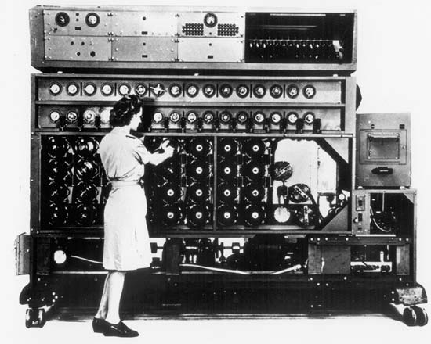
Alan Turing: 1912-1954

Slide 44
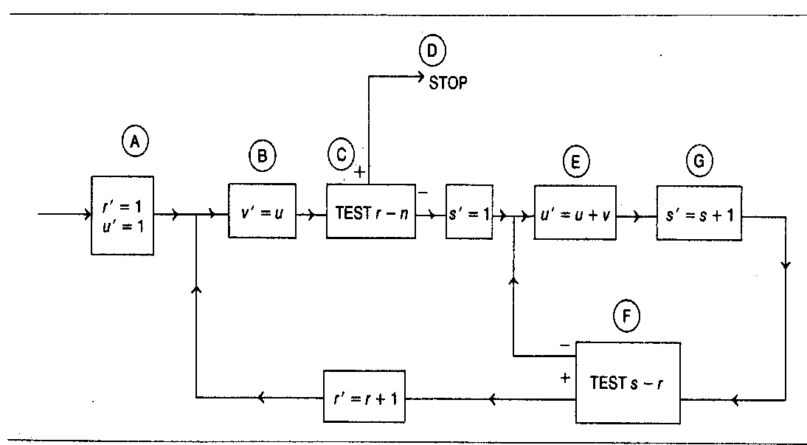
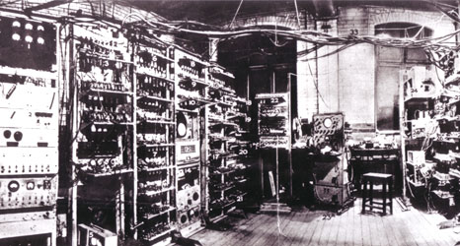
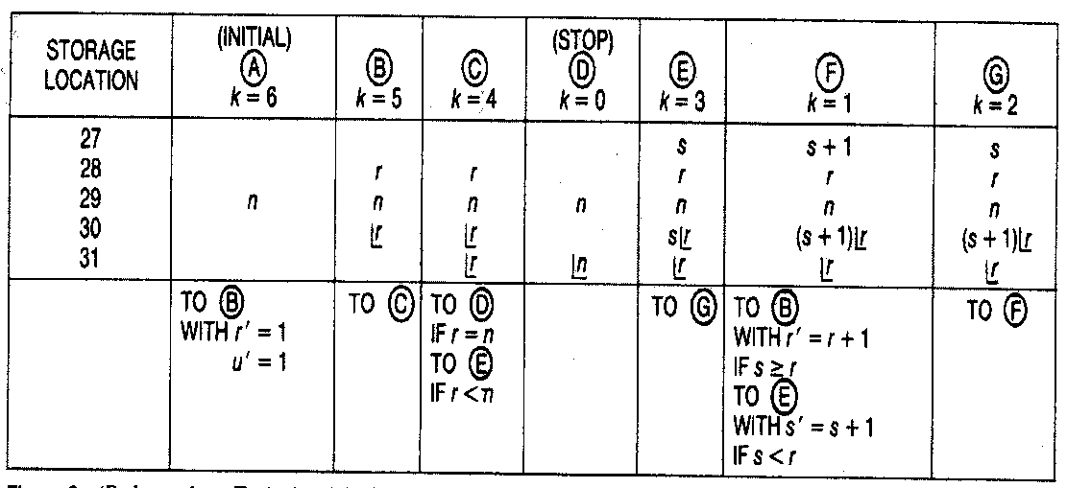
Birth of the ‘Modern Computer’
Software Verification
Manchester’s Small Scale Experimental Machine A.K.A. “The Baby” (1948)
Turing, A. M. 1949.
“Checking a Large Routine.”
In Report of a Conference on High Speed Automatic Calculating Machines, Univ. Math. Lab., Cambridge, pp. 67-69.

Slide 45
And 63 Years Later …?
A wealth of new logics and automated reasoning techniques
Computers are faster and memory is cheap
Verification tools are typically highly integrated and automatic
Significant industrial scale success stories within niche markets, e.g. Microsoft, Praxis, D-RisQ, …
Now it matters!

Slide 46
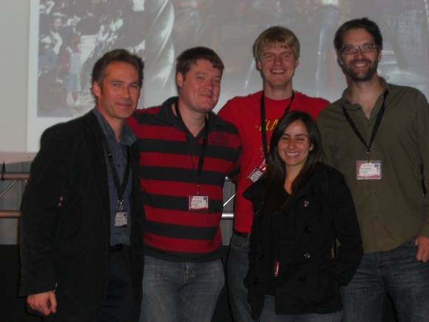
Now it Matters!
Software is woven into almost all aspects of our daily lives – from communications, entertainment and consumer electronics, to finance, defence and national infrastructure
A key differentiator in commercial products is embedded software – dependability is crucial to commercial success, where software correctness is a key ingredient
Cyber Security carries significant risks for economic growth and society in general – a priority area for UK Government
Software testing is not enough to guarantee safe and secure software systems – correctness-by-construction is called for, underpinned by a range of formal notations and automated reasoning technologies
International Verified Software Initiative – coming together of academia and industry

Slide 47
SPARK Programming Language
SPARK is an Ada subset that eliminates potential ambiguities and insecurities (Altran Praxis)
Expressive enough for industrial applications, but restrictive enough to support rigorous analysis, i.e. correctness-by-construction
Applications: e.g. air traffic control (iFACTS), avionics (Eurofighter Typhoon), security (Mondex), …
Focus on exception freedom proof, e.g. proving code is free from arithmetic overflows, buffer overflows, division by zero, ….

Slide 48
Arithmetic Overflow
Consider converting 64-bits of data into 16-bits:
Overflow Error

Slide 49
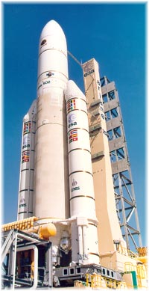
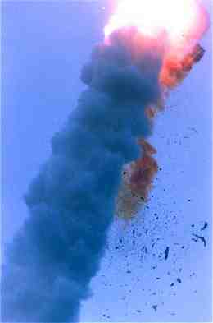
The Cost of Failure
Developed by European Space Agency
Unmanned rocket with a cargo of scientific satellites ($500 million)
In 1996, just 39 seconds into its maiden flight an overflow error occurred resulting the Ariane 5 control software initiating a self-destruction operation!
Ariane 5

Slide 50
Verifying SPARK Code
SPARK
code
SPARK
Examiner
VCs
SPADE
Simplifier
Proofs

UnprovenVCs
Cmds
SPADE
Proof Checker
Annotations
VCs = Verification Conditions (conjectures)
Our focus was on the problems the SPARK tools failed on:
Verifying loops (iteration)
Loop invariant discovery – productive use of failure

Slide 51
Proof Planning for SPARK
SPARK
code
SPARK
Examiner
VCs
SPADE
Simplifier
Proofs

UnprovenVCs
SPADEase
Cmds
SPADE
Proof Checker
Annotations
Bill J. Ellis (RA + PhD)
EPSRC Critical Systems programme (GR/R24081)
EPSRC RAIS Scheme (GR/T11289)
http://www.macs.hw.ac.uk/nuspade

Slide 52
SPADEase
Unproven
VCs
subtype AR_T is Integer range 0..9;
type A_T is array (AR_T) of Integer;
...
procedure Filter(A: in A_T; R: out Integer)is
begin
R:=0;
for I in AR_T loop
if A(I)>=0 and A(I)<=100 then
R:=R+A(I);
end if;
end loop;
end Filter;
subtype AR_T is Integer range 0..9;
type A_T is array (AR_T) of Integer;
...
procedure Filter(A: in A_T; R: out Integer)is
begin
R:=0;
for I in AR_T loop
--# assert R >= 0 and R <= I*100
if A(I)>=0 and A(I)<=100 then
R:=R+A(I);
end if;
end loop;
end Filter;
R >= ? and R <= ?
Abstract Predicates
Program
Analyzer
Proof
Planner
Annotations
--# assert R >= 0 and R <= I*100

Slide 53
SPADEase Impact?
“… It increases the proportion of SPARK-generated verification conditions that can be proved automatically without introducing any new opaque, black-box processes. …”
Peter Amey
Chief Technical Officer
Praxis High Integrity Systems

Slide 54
SPADEase Impact?
“… The separation of proof planning from proof checking also acts as a talent multiplier by allowing proof experts to spend their time creating new and reusable methods and approaches rather than working on individual proofs.”
Peter Amey
Chief Technical Officer
Praxis High Integrity Systems

Slide 55

Going Beyond Exception Freedom
Reasoning about the functional correctness of pointer programs – proving that the code does the right thing
Separation Logic:
Adapted the rippling proof plan
Extended work on automated invariant discovery
Ewen Maclean, Gudmund Grov (RAs), Richard Addison (MEng)
EPSRC funding: EP/F037597 and Platform Grant EP/J001058
www.macs.hw.ac.uk/core
Tech Talks at Google via

Slide 56
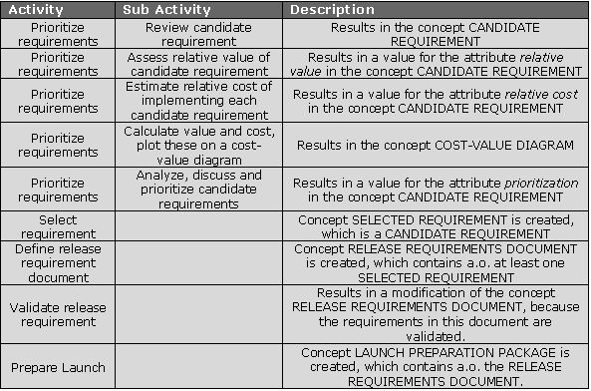
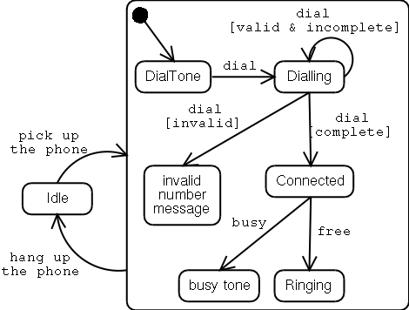
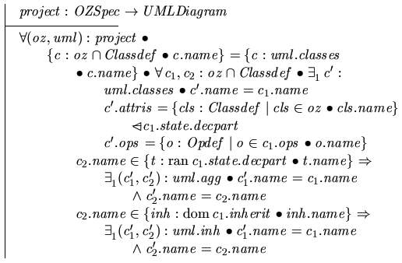
Beyond Code Level Analysis
Sensor:= Brakes.Activate;
Active:= False;
end if;
else
Alarm.Enable;
end if;
else
if Alarm.Enabled then
Alarm.Disable;
end if;
end if;
end if;
else
if Reset.Enabled then
Alarm.Disable;
Brakes.Deactivate;
Speed:= 0;
Active:= True;
end if;
end if;
end Control;
end ATP;
Requirements
Formal Design Models
Code
Rajiv Murali (PhD)
EPSRC & BAE Systems
Teresa Llano (PhD)
EPSRC & BAE Systems

Slide 57
Reasoned Modelling
Reasoning
Modelling
Combine common patterns of reasoning with common patterns of modelling (design)
Abstract away from low-level proof-failures, and automatically provide high-level guidance to designers
Accessibility and productivity – allow creative designers to make better use of their time

Slide 58
Reasoned Modelling
Reasoning
Modelling
Gudmund Grov, Teresa Llano (PhD), Alison Pease
Collaboration with Edinburgh University & Imperial College:
System Design, Cognitive Modelling, AI Problem Solving
Event-B (Rodin toolset) – Bosch, Siemens, SAP, …
Funding: EPSRC EP/F037058, EP/J001058, BAE Systems
www.macs.hw.ac.uk/remo/

Slide 59
A Longer-term Vision
Software System Design Environments
Reasoning
Modelling
Embed Reasoned Modelling within conventional design tools

Slide 60
Knowledge Transfer
ITI Techmedia (Scottish Enterprise)
Software Integrity Engineering Programme
Ewen Maclean, Gudmund Grov, Andrew Cook (RAs)
BAE Systems (Warton)
A case study in reasoned modelling
Teresa Llano (RA)
Altran Praxis
Critical Blue
BAE Systems
Bill Ellis (PhD)
Andrew Cook (PhD)
Ben Gorry (PhD)

Slide 61
Conclusion
Unsafe and insecure software can have a massive impact on economies and society in general
Automated reasoning has an unique role to play in the development of safe and secure software
As the sophistication and reach of software systems increases, so will the importance of automated reasoning
As computer scientists we are challenged by a grand opportunity!

Slide 62
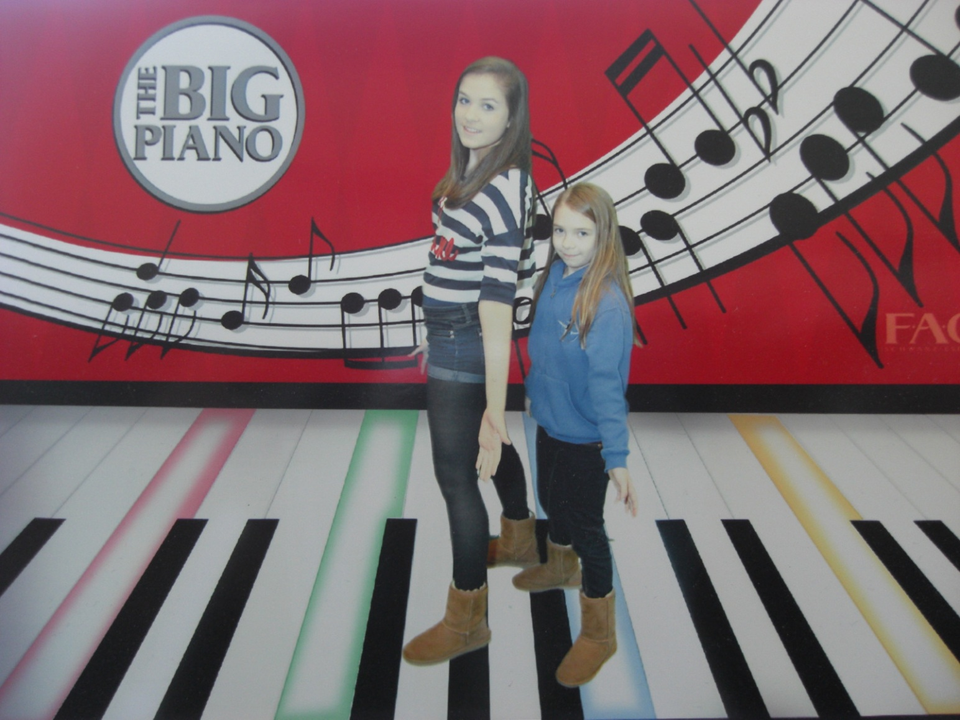
Thank You!

