Slide 1

THE PURSUIT OF HAPPINESS
Glenn Wilson PhD, Gresham College, London

Slide 2
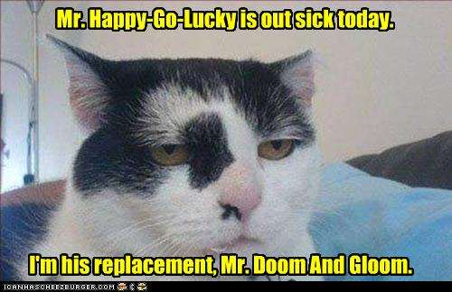

Slide 3

HAPPINESS IS PART GENETIC
Twin studies reveal that genes account for around 50-60% of variation in happiness.
This is partly mediated by personality traits such as emotional stability, extraversion and conscientiousness.

Slide 4
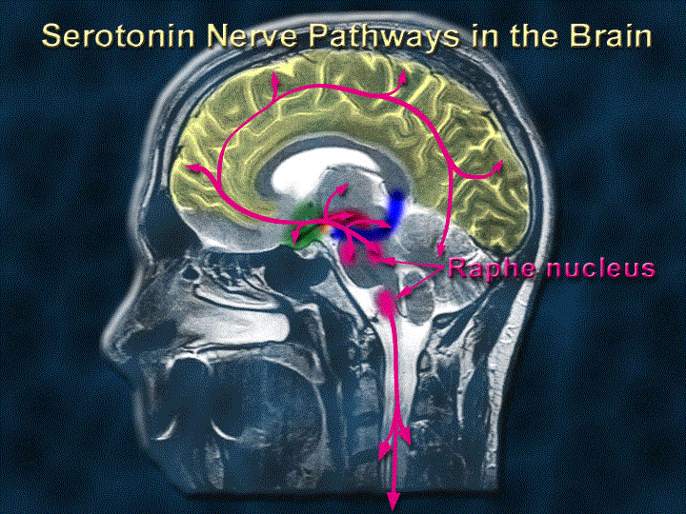
SEROTONIN TRANSPORTER GENES
One particular gene implicated in self-reported happiness is the serotonin transporter 5-HTT. Individuals with two copies of the long (more efficient) version were happier than those with two short copies.
Serotonin is the neurotransmitter that is boosted in many anti-depressant drugs.

Slide 5
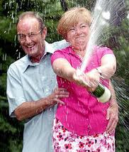
CAN HAPPINESS BE BOUGHT?
Once survival needs are met, increases in wealth do not yield greater happiness.
Lottery winners experience temporary euphoria but end up getting less pleasure out of mundane events. Habituation fairly quickly sets in.
The more a person has, the more they tend to want – hence no gain in satisfaction.

Slide 6
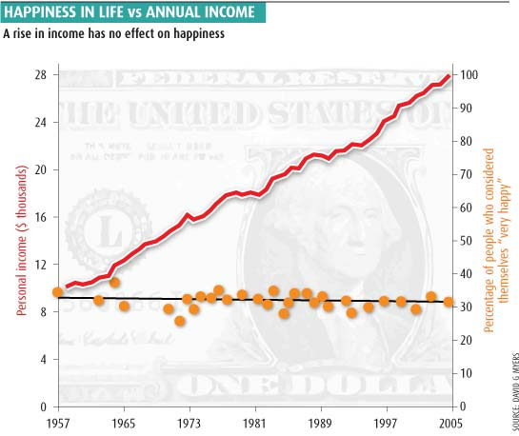

Slide 7
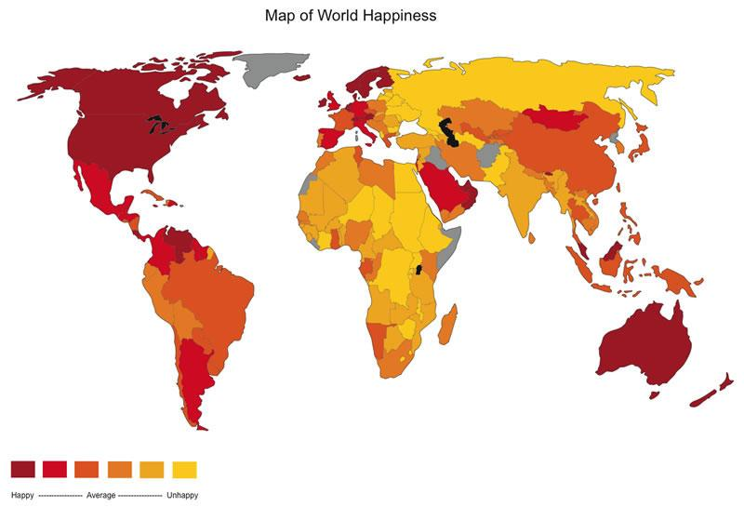
(After Adrian White, Univ. Leicester.)

Slide 8
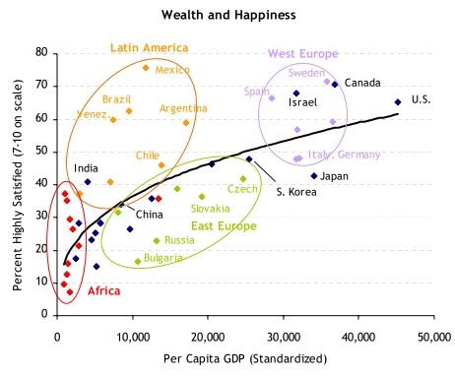

Slide 9

RETAIL THERAPY?
Shopping sprees provide a short buzz and raise brain serotonin.
However, they reflect emotional instability (often PMT) and may later be regretted.

Slide 10
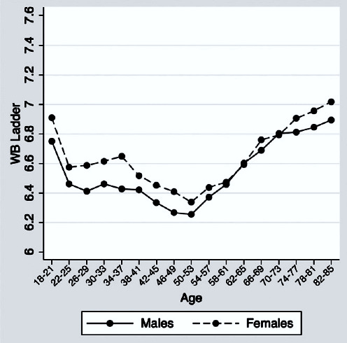
THE MID-LIFE CRISIS
“Well-being” declines until middle age, then picks up again sharply.
Women are happier than men when young and in old age.
Data from US Gallup poll of 340K people (Stone et al, 2010)

Slide 11
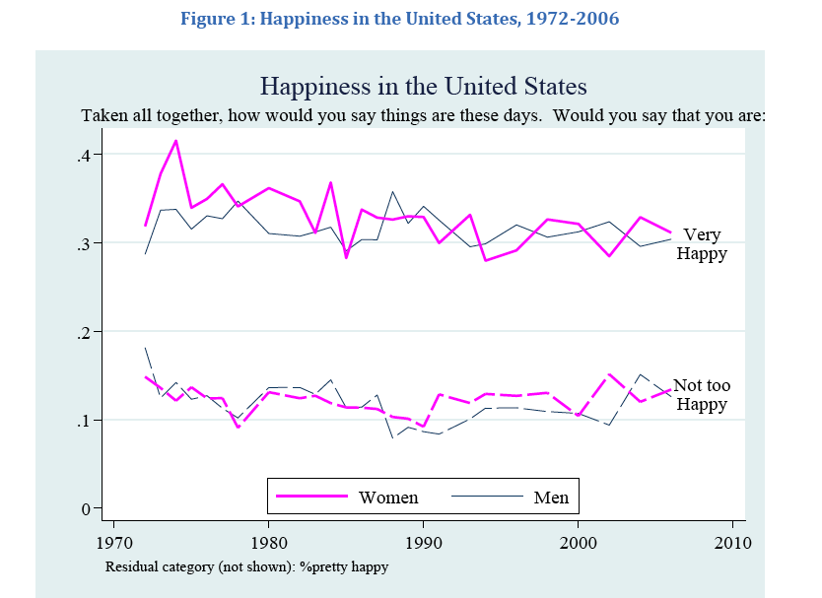
WOMEN ARE NOT GETTING HAPPIER

Slide 12
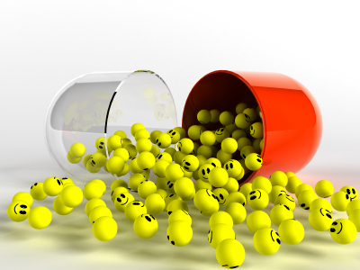
BOTTLED HAPPINESS?
Alcohol & drugs give short-term euphoria but there is usually some pay-back to be suffered.
Anti-depressants like Prozac at best help with depression; they are not effective as “happy pills”

Slide 13
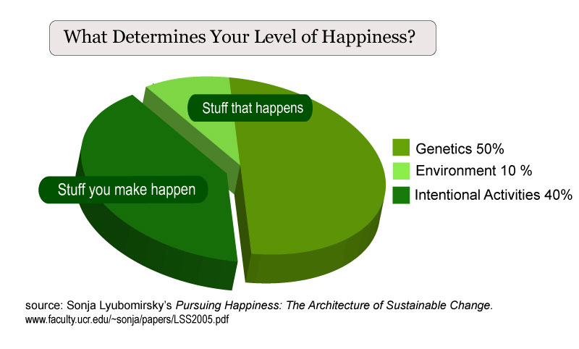

Slide 14

ALWAYS LOOK ON THE BRIGHT SIDE
Destructive thought patterns need to be identified and replaced with more optimistic ones.
Self-talk should be positive. Don’t “beat yourself up” unnecessarily. Say to yourself “yes, I can”.

Slide 15

NOT TO WORRY
There is no point in worrying about things you cannot alter. If you can alter them then go ahead and do so immediately, otherwise accept them and move on.
Important to keep a sense of proportion. Will it matter in 10 years time?
Others are surely worse off than ourselves.

Slide 16

SENSE OF HUMOUR
Being able to laugh is an important buffer against adversity and antidote to depression.
Ken Dodd, OBE (one boiled egg) claims happiness as “the greatest gift that I possess” and always seeks to impart it to audiences.
Unfortunately, comedians are not themselves immune to depression; their suicide rate may even be elevated.

Slide 17
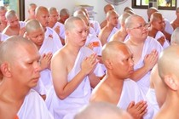
LIFE GOALS AND VALUES
People with a strong direction or meaning to their life inclined to be more satisfied.
This could be a faith or philosophy, or derive from art, science or career aspirations.
Religious people are happier only in societies that are stressed and impoverished. In affluent countries, religion is less prevalent and the non-religious are just as happy (Diener, 2011).

Slide 18
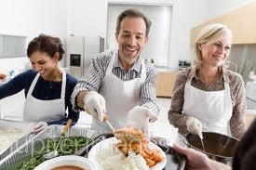
THE BIG SOCIETY
Helping others through volunteering, charity and community work raises happiness in oneself.

Slide 19
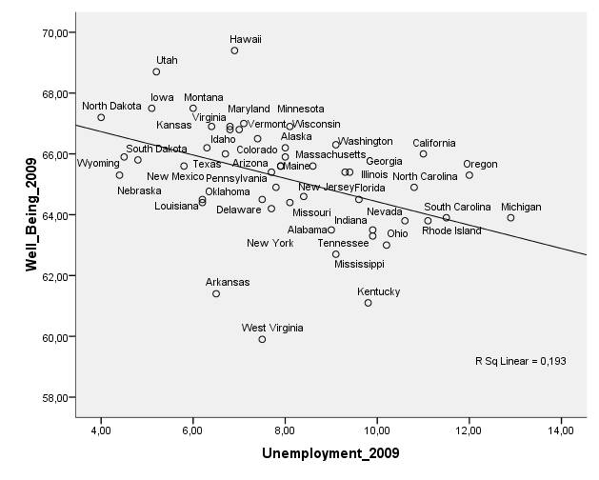
UNEMPLOYMENT IMPAIRS HAPPINESS
Employment is a major source of identity & self-esteem.
Self-employed are even happier – doing work they enjoy?
Commuting lowers life satisfaction but not so much as to offset having a job.

Slide 20

HEALTH & HAPPINESS
Health generally facilitates happiness but people with permanent disability largely adapt to their situation. Even those with “locked-in syndrome” often claim to be happy and have no desire for euthanasia (Bruno et al, 2010).

Slide 21

COMMUNING WITH NATURE
We feel happiest when immersed in the environment to which we are adapted and which is best for our survival (trees, flowers, water, blue sky). Urban dwellers are more prone to stress and mood disorders. “Green exercise” (gardening, golf, etc.) is especially beneficial.

Slide 22
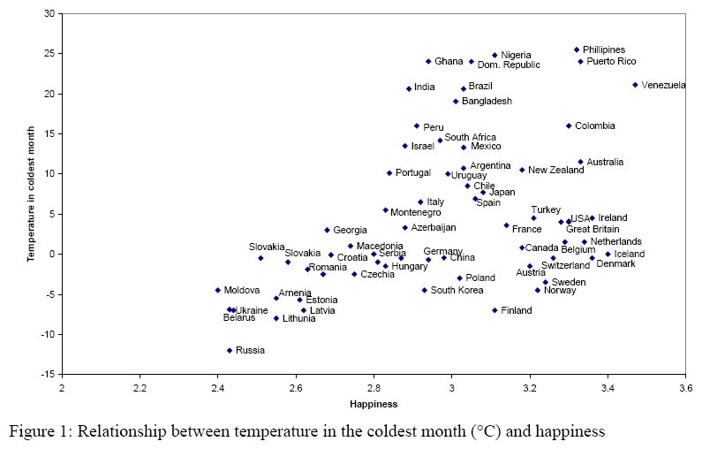
HAPPINESS AND CLIMATE
Habituation ensures that the relationship between warmth and happiness is not clear-cut. Soviet countries are both cold and relatively unhappy but happy countries may be warm (Venezuela) or cold (Iceland).

Slide 23

HAPPY HOLIDAYS?
Anticipation of a holiday raises happiness but the early part of a holiday is often stressful. Not all holiday-makers are happier on returning than those who stayed home.
Benefits that are reported are usually short-lived, fading away within 4-8 weeks.
Multiple short breaks may therefore be better than one long holiday.

Slide 24
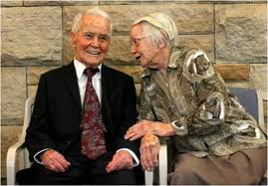
INTIMATE RELATIONSHIPS
Good relationships with a small number of intimate contacts count for more than being widely popular.

Slide 25
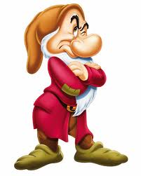

THE CAUSE & EFFECT PROBLEM
Many standard of living variables are inter-related: education, occupational status, wealth, health, employment, optimism, intimate relationships, etc. These all promote happiness but also derive from it (e.g. happy people keep their friends & jobs better than those who are miserable).

Slide 26
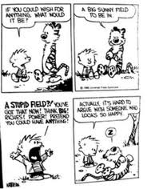
MEANINGS OF HAPPINESS
Happiness may be too broad a concept to deal with and should be divided into various types.
Mogilner et al (2011) found that happiness in young people is associated with excitement; in older people it equates more to peace and contentment.

Slide 27
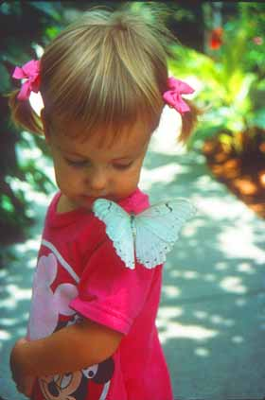
SHOULD HAPPINESS BE PURSUED?
“Happiness is like a butterfly. The more you chase it, the more it eludes you. But if you turn your attention to other things, it comes and sits softly on your shoulder”.
(Henry David Thoreau)

