Slide 1
The Hidden Face of British Gardening
Roderick Floud
Provost, Gresham College

Slide 2
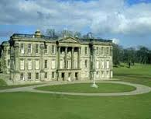
Calke Abbey
CALKE ABBEY

Slide 3
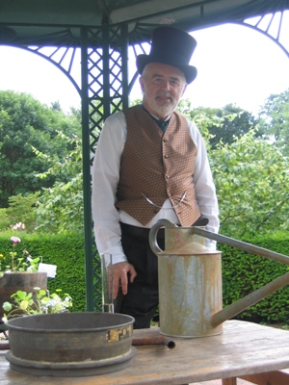
THE VICTORIAN GARDENER

Slide 4
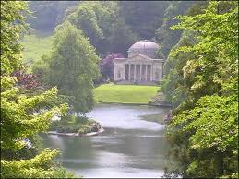
STOURHEAD

Slide 5
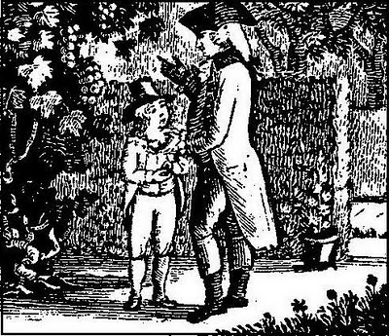
THE GARDENER’S BOY

Slide 6
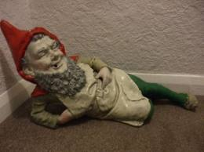
VICTORIAN GARDEN GNOME

Slide 7
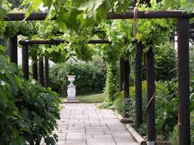
FISHBOURNE ROMAN PALACE

Slide 8
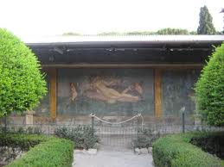
POMPEII – THE HOUSE OF THE PAINTERS

Slide 9
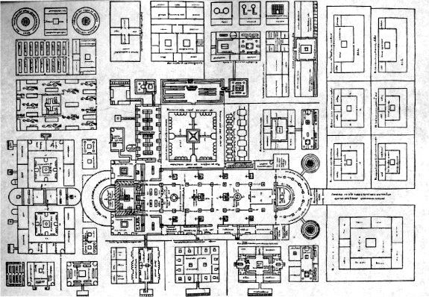
MONASTERY OF ST. GALL, France

Slide 10
CONTENTS
Gardening and the Garden Industry today.
The growth of the industry since 1660.
Nurseries and the plants they sold.
A royal garden and its plants.
Gardens in the 19th century.

Slide 11
Contents
Gardening and the Garden Industry today.
The growth of the industry since 1660.
Nurseries and the plants they sold.
A royal garden and its plants
Gardens in the 19th century.

Slide 12
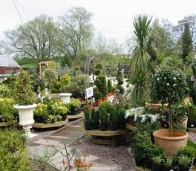
GARDEN CENTRE TODAY

Slide 13
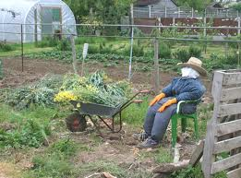
HOUSEHOLD PRODUCTION – THE ALLOTMENT

Slide 14
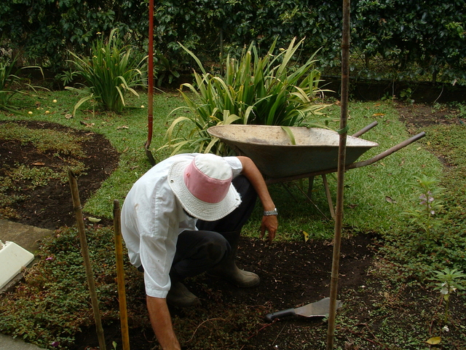
THE PAID GARDENER TODAY

Slide 15
GARDENING TODAY – THE ECONOMIC IMPACT
FACTOR OF PRODUCTION |  | MINIMUM VALUE | AVERAGE VALUE | MAXIMUM VALUE
LABOUR |  | £84 billion |  | £270 billion

Slide 16
GARDENING TODAY – THE ECONOMIC IMPACT
FACTOR OF PRODUCTION |  | MINIMUM VALUE | AVERAGE VALUE | MAXIMUM VALUE
LABOUR |  | £84 billion |  | £270 billion
LAND (Annual value) |  | £200 million |  | £23 billion

Slide 17
GARDENING TODAY – THE ECONOMIC IMPACT
FACTOR OF PRODUCTION |  | MINIMUM VALUE | AVERAGE VALUE | MAXIMUM VALUE
LABOUR |  | £84 billion |  | £270 billion
LAND (Annual value) |  | £200 million |  | £23 billion
CAPITAL (Annual value) | Garden centres: Tools, books, gnomes etc |  | > £5 billion ?
TOTAL |  | > £89 billion |  | > £298 billion

Slide 18
CONTENTS
Gardening and the Garden Industry today.
The growth of the industry since 1660.
Nurseries and the plants they sold.
A royal garden and its plants.
Gardens in the 19th century.

Slide 19
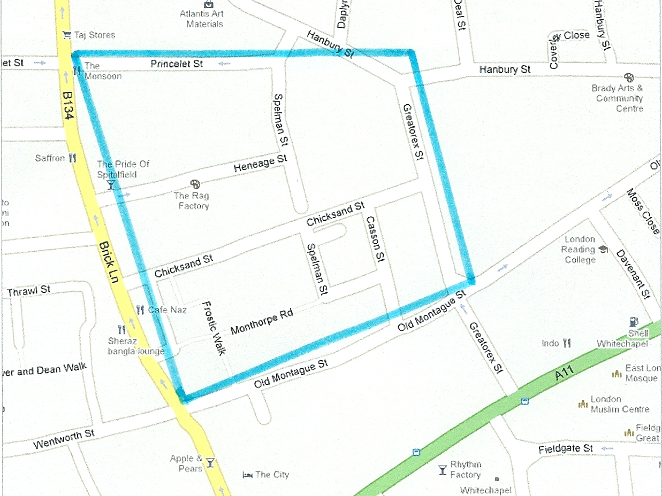
SITE OF THE WHITECHAPEL NURSERY OF CAPTAIN LEONARD GURLE

Slide 20
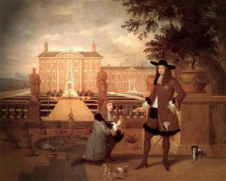
JOHN ROSE PRESENTING A PINEAPPLE TO CHARLES II

Slide 21
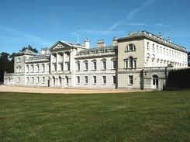
WOBURN ABBEY

Slide 22
CONTENTS
Gardening and the Garden Industry today.
The growth of the industry since 1660.
Nurseries and the plants they sold.
A royal garden and its plants.
Gardens in the 19th century.

Slide 23
THE MOST EXPENSIVE PLANTS : 1650-1900
YEARS | PLACE SOLD | PLANT | NOMINAL PRICE | REAL PRICE (2009 prices) | % of GDP per capita
1650-1699 | London | Nectarine “Elruge” | 8/- | £55.62 | 4%
1700-1749 | London | Tulip Tree (25’) | £21-0-0 | £2975.35 | 182%
1750-1799 | York | Kalmia Latifolia & Magnolia Virginiana | 15/- | £75.72 | 6%
1800-1849 | Norwich | Peach, Nectarine and Apricot | 9/9 | £39.52 | 1%
1850-1899 | Borrowash | Larix Kaempferi (7’) & Castanea Chrysophylla | £10-10-0 | £678.09 | 27%

Slide 24
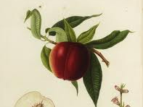
NECTARINE ELRUGE

Slide 25
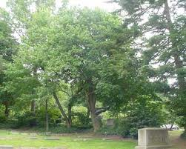
MAGNOLIA VIRGINIANA

Slide 26
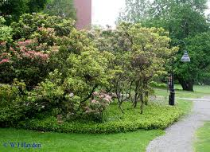
KALMIA LATIFOLIA

Slide 27
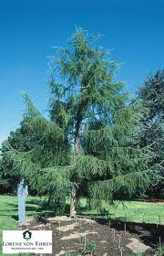
LARIX KAEMPFERI

Slide 28

CASTANEA CHRYSOPHYLLA

Slide 29
CONTENTS
Gardening and the Garden Industry today.
The growth of the industry since 1660.
Nurseries and the plants they sold.
A royal garden and its plants.
Gardens in the 19th century.

Slide 30
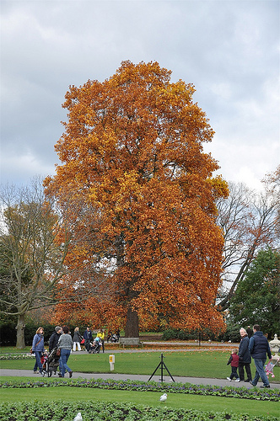
TULIP TREE, KEW GARDENS

Slide 31
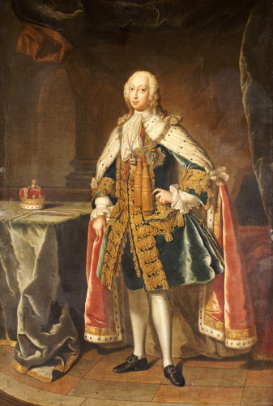
FREDERICK, PRINCE OF WALES

Slide 32
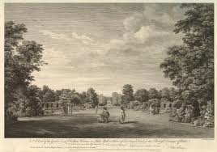
GARDEN OF CARLTON HOUSE

Slide 33

FREDERICK, PRINCE OF WALES and AUGUSTA, PRINCESS OF WALES

Slide 34
AVERAGE (median) PRICE OF PLANTS SOLD
DECADE | MEDIAN REAL PRICE (2009 PRICES)
1730s | £7.08
1750s | £4.04
1760s | £9.23
1770s | £3.10
1830s | £3.02
1860s | £6.46
1870s | £9.22
1880s | £5.91
1890s | £8.63

Slide 35
CONTENTS
Gardening and the Garden Industry today.
The growth of the industry since 1660.
Nurseries and the plants they sold.
A royal garden and its plants.
Gardens in the 19th century.

Slide 36
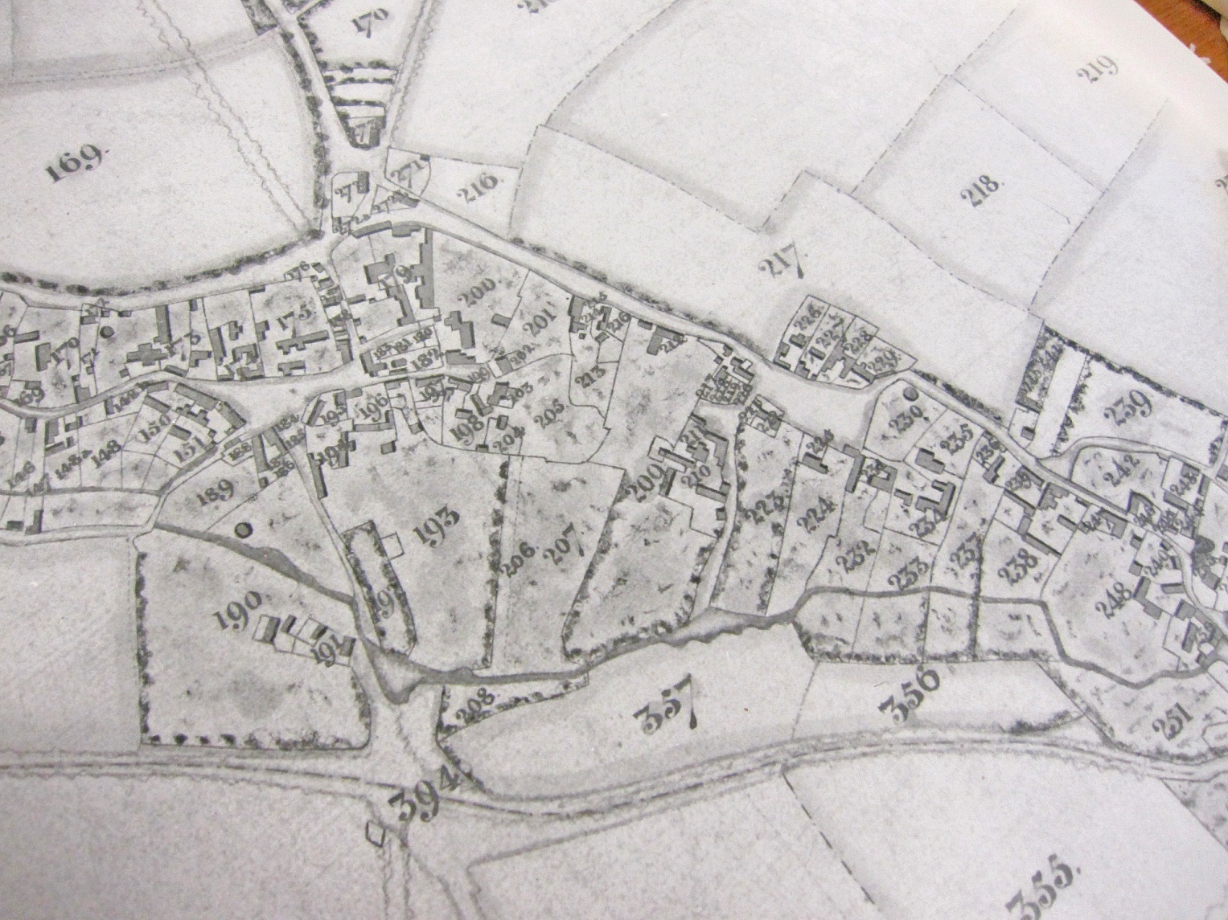
COTTAGE GARDENS IN HADDENHAM, BUCKS
C.1830

Slide 37
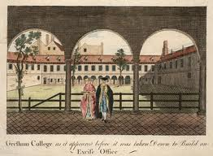
THE GARDEN OF GRESHAM COLLEGE

Slide 38
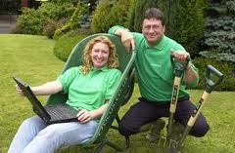
ALAN TITCHMARSH and CHARLIE DIMMOCK

Slide 39
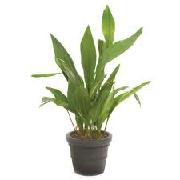
ASPIDISTRA

Slide 40
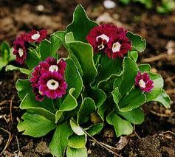
AURICULA

