Slide 1
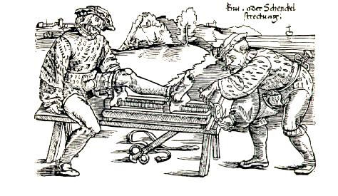
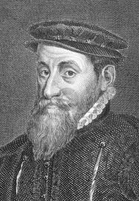
Apprenticeship in early modern London: The economic origins and destinations of City apprentices in the 16th and 17th centuries
Dr Chris Minns
Dr Patrick Wallis

Slide 2
I need not have bynne prentisse for that I was free by my Father's coppye: albeit my Father Sir Richard Gresham being a wyse man, although I was free by his coppye, it was to no purpose, except I was bound prentisse to the same; whereby to come by the experience and knowledge of all kinds of merchandise.

Slide 3

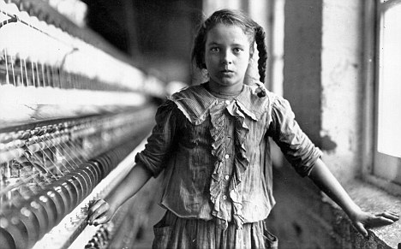
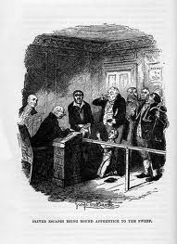
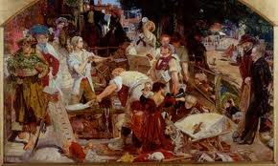
Apprenticeship Myths & Assumptions

Slide 4


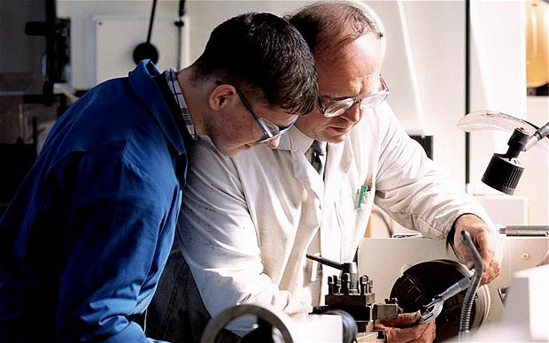
What was apprenticeship?
Notes:
YAP_BANNER1.jpg rochestergeneral.org
apprentices.jpg matcmadison.edu 560 × 341 - Apprentices The Institutional Research Effectiveness (IRE)
apprenticeship_1819891b.jpg telegraph.co.uk

Slide 5
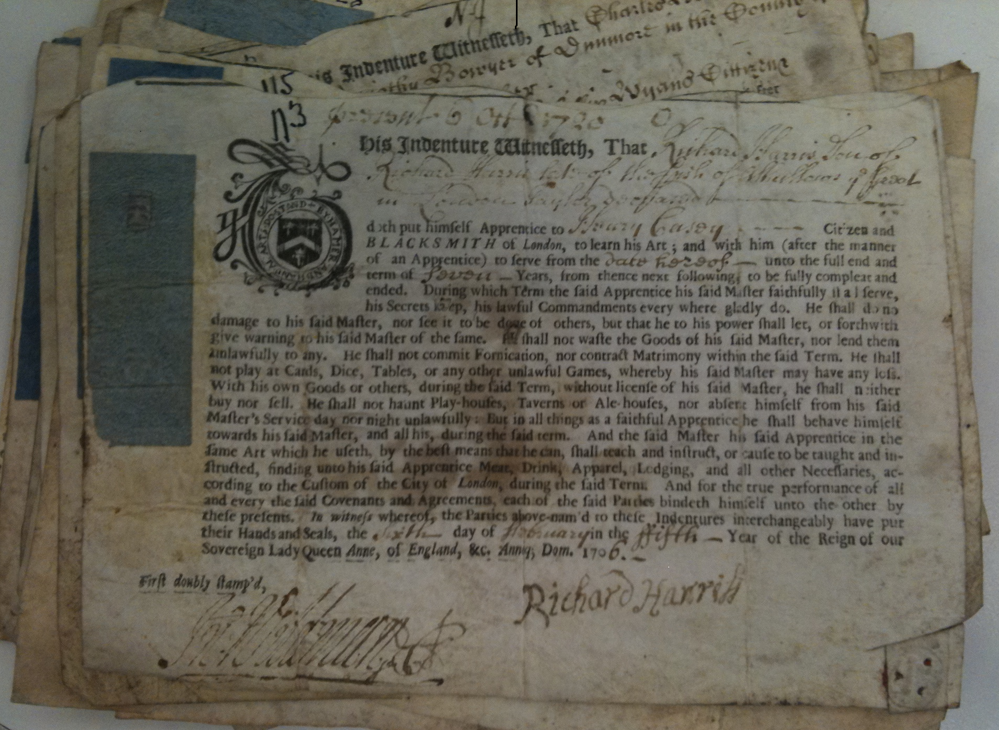
What was apprenticeship?

Slide 6
Why is apprenticeship economically important?
Notes:
YAP_BANNER1.jpg rochestergeneral.org
apprentices.jpg matcmadison.edu 560 × 341 - Apprentices The Institutional Research Effectiveness (IRE)
apprenticeship_1819891b.jpg telegraph.co.uk

Slide 7
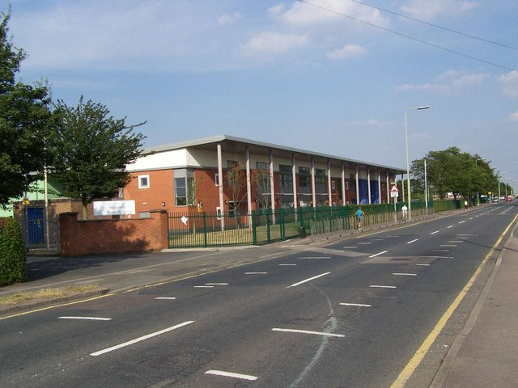

Why is apprenticeship economically important?
Notes:
Chase Terrace Technical College
The school, formerly known as Chase Terrace High School, has been rebuilt as a state-of-the-art technology college after being destroyed in an arson attack.
http://www.geograph.org.uk/photo/208525
British Gas – over 1,000 apps a year

Slide 8



Why is apprenticeship economically important?
Notes:
Chase Terrace Technical College
The school, formerly known as Chase Terrace High School, has been rebuilt as a state-of-the-art technology college after being destroyed in an arson attack.
http://www.geograph.org.uk/photo/208525
British Gas – over 1,000 apps a year

Slide 9

Why is apprenticeship economically important?
Notes:
Chase Terrace Technical College
The school, formerly known as Chase Terrace High School, has been rebuilt as a state-of-the-art technology college after being destroyed in an arson attack.
http://www.geograph.org.uk/photo/208525
British Gas – over 1,000 apps a year

Slide 10
Why is apprenticeship economically important?
Notes:
Chase Terrace Technical College
The school, formerly known as Chase Terrace High School, has been rebuilt as a state-of-the-art technology college after being destroyed in an arson attack.
http://www.geograph.org.uk/photo/208525
British Gas – over 1,000 apps a year

Slide 11
Why is apprenticeship economically important?
Notes:
Chase Terrace Technical College
The school, formerly known as Chase Terrace High School, has been rebuilt as a state-of-the-art technology college after being destroyed in an arson attack.
http://www.geograph.org.uk/photo/208525
British Gas – over 1,000 apps a year

Slide 12
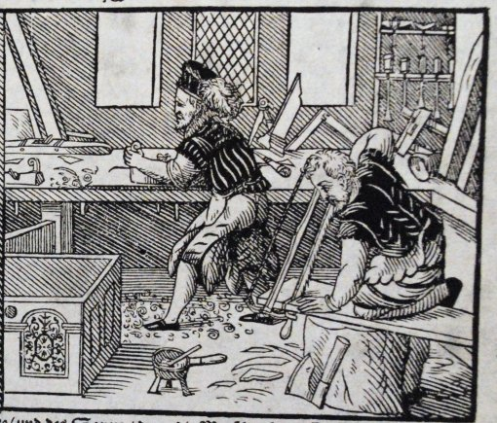
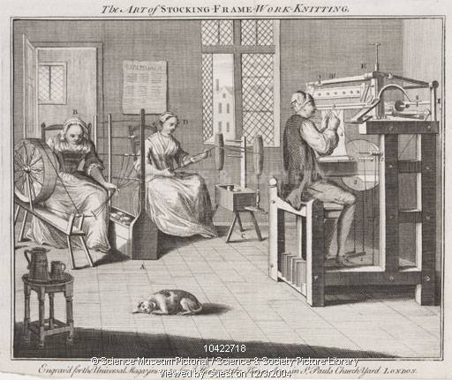
Why is apprenticeship economically important?
Notes:
Chase Terrace Technical College
The school, formerly known as Chase Terrace High School, has been rebuilt as a state-of-the-art technology college after being destroyed in an arson attack.
http://www.geograph.org.uk/photo/208525
British Gas – over 1,000 apps a year

Slide 13
Where did London apprentices come from? City Apprenticeship Rates, 1600-25

Slide 14
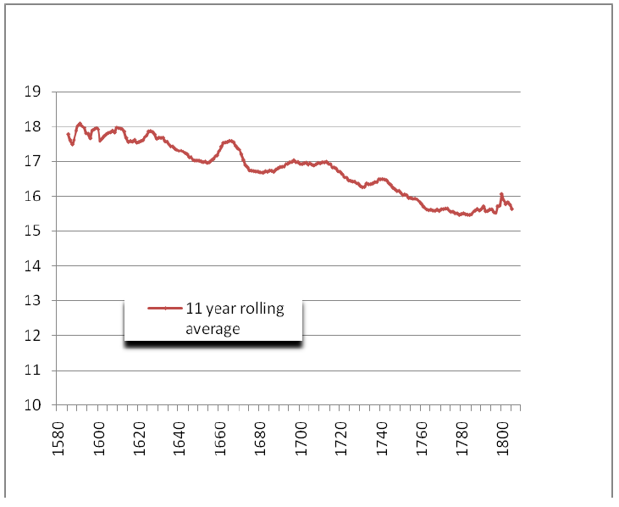
The age of City apprentices

Slide 15
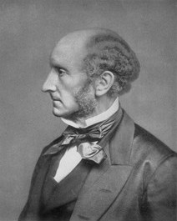
John Stuart Mill
Jobs prior to industrialization were “almost equivalent to an hereditary distinction of caste”, “each employment being chiefly recruited from the children of those already employed in it”

Slide 16
Master-apprentice connections (%)

Slide 17
Father occupations, Londoners

Slide 18
Father occupations, migrants

Slide 19
Then |  | Now
Annual income, labourer | £12 | Median Annual income | £26,000
Premium | £5 | Tuition fees (one year) | £9,000
 | 42 |  | 35

Slide 20
Friends as agents?
Daniel Clarke (Tring) sought an apprenticeship for son Francis with help of “friends,” seeking a “freeman & one that dealt considerably in his way of trade & was a fair dealing man”

Slide 21
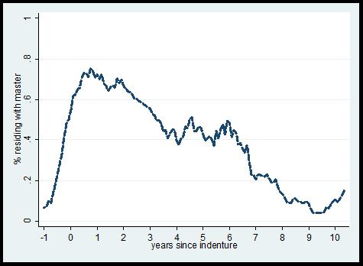
Attrition, London apprentices

Slide 22
Apprentices arrive slowly…
Notes:
Bristol shows a broadly similar shape. Are variations which interest us: one point is that apprenticeship clearly varies between these cities.
Identify several points from these figures:
Apprentices arrive slowly. Some arrive before – proabbly on trial period. But many drift in.
=>It seems likely this is a device to reduce the effective term to something below seven years – these guys get on the books before they actually get into the workshop.
More data on this in tables 3 & 4.
22

Slide 23
…many quit early…
Notes:
Bristol shows a broadly similar shape. Are variations which interest us: one point is that apprenticeship clearly varies between these cities.
2. Large numbers quit between their first and third years.
Some of these apprentices are moving legitimately to other masters: essentially shifting their contract. We try various ways of doing this, but this only seems to account for between 10 and 20 % of the total. Quite a lot would appear to be leaving the city and service.
23

Slide 24
… the rest stay on…
Notes:
If they make it to the 4th year, they then generally stay to the end. So there is a period of sorting/quiting that tails off.
24

Slide 25
…and then leave when they should.
Notes:
3. The term still matters. Those who do stay, leave when they should: they don’t continue to work for their old master. Service was not a stage in an ongoing employment relationship.
25

Slide 26
Benjamin Bangs
Bound in Longham, Norfolk, 5 years for a fee of £5
Master insolvent after 1 year
Bangs moves to London, and finds a new master “who upon seeing me, was very willing to take me.”

Slide 27
Benjamin Bangs
After three years “I understood my business pretty well, and was a little ambitious in my mind to become Master of it; therefore after I left him, I got into the company of the best Workman.”

Slide 28
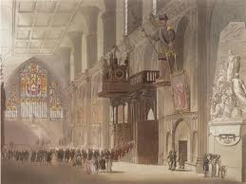
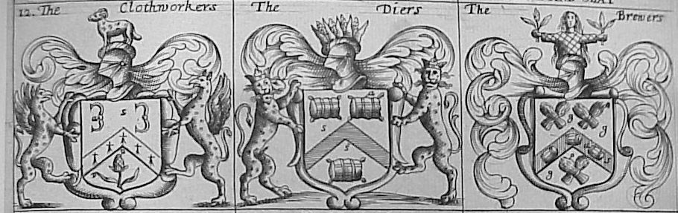
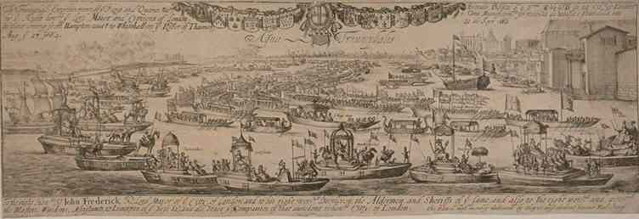
What about the City and Guilds

Slide 29
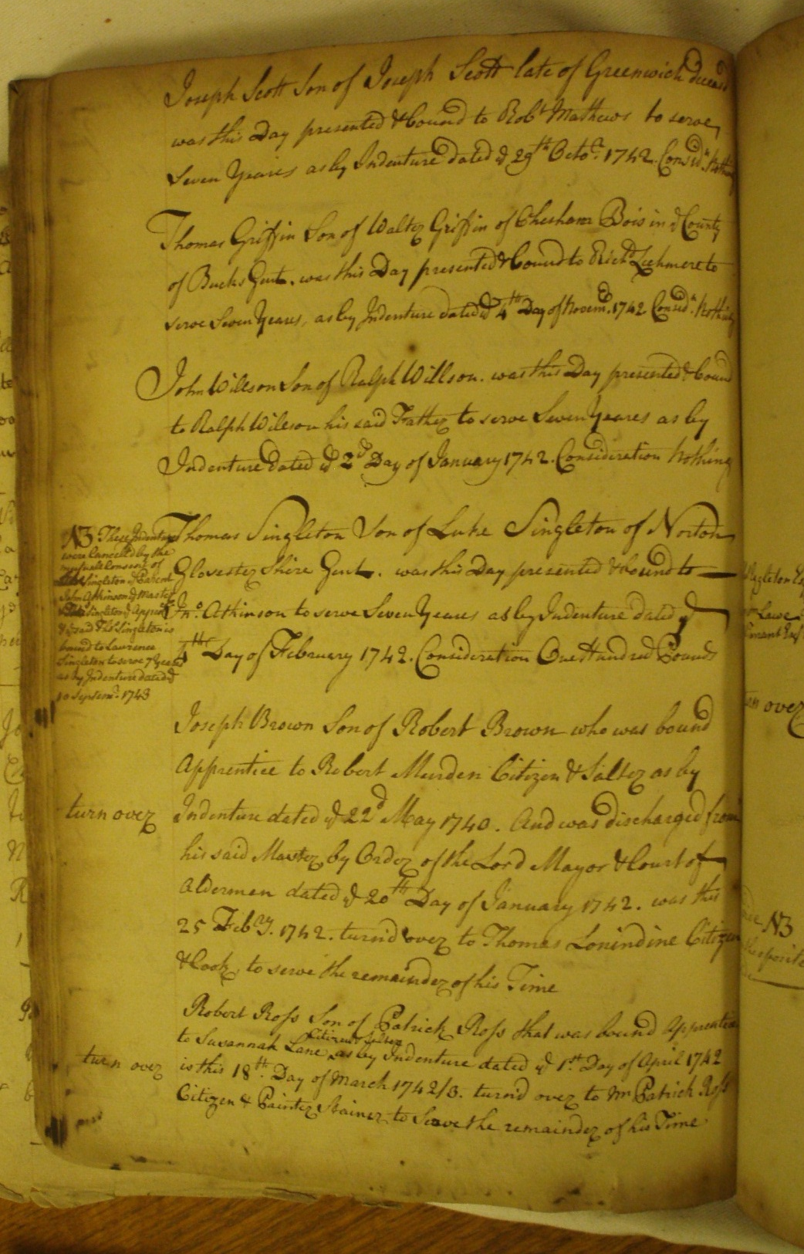

Registration
Notes:
Salters Company

Slide 30
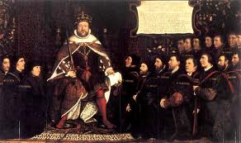
Arbitration
‘could not make his allegacons good, tending to ye disparagement of his said Master Whereupon this Court intended to have caused the appntice to be punished by whipping’.

Slide 31
‘could not make his allegacons good, tending to ye disparagement of his said Master Whereupon this Court intended to have caused the appntice to be punished by whipping’….
the said Alexander fell upon his knees submitted himselfe to this Court & to his said Master desireing pardon for his uniust complaint

Slide 32
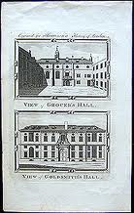
Masterpieces
“the true practice of the arte and mistery of goldsmithry is not only grown into great decay but also dispersed into many parts” (1607)

Slide 33
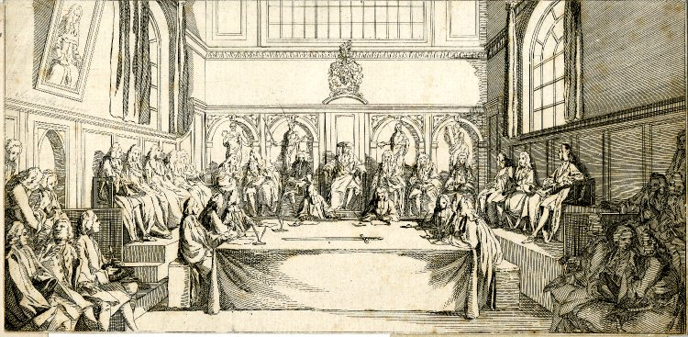
The Lord Mayor’s Court
“where an apprentice…is entitled to be released from his indenture he may obtain his discharge by a petition”

Slide 34
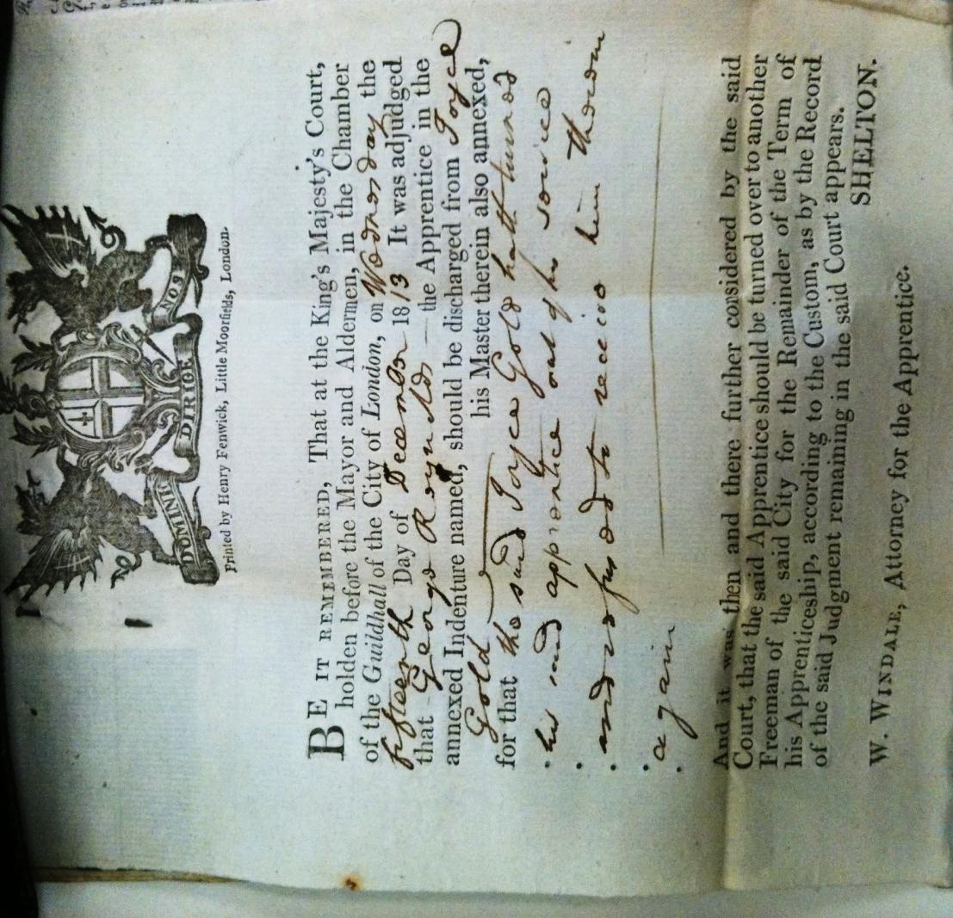
The Lord Mayor’s Court

Slide 35
The Lord Mayor’s Court

Slide 36
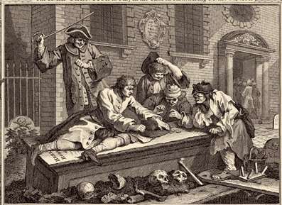
“lavish and profuse in his expenditures and oft taking out monies from his master Till’s box or till, of taking and pawning two pictures from his house, and taking goods from his shop, as well as obtaining a quantity of brandy in Till’s name from another merchant”

Slide 37
“immediately took his hat & went his wayes & entered himself on board a Man of War. And never afterwards was in [his master’s] service’”

Slide 38
‘swearing in a most prodigicous manner & telling [his audience] what pranks he had been playing at nights saying that he had taken women from men in the streets & had them to Taverns & that he had layen with them & a great deal more debauched discourse’.

Slide 39
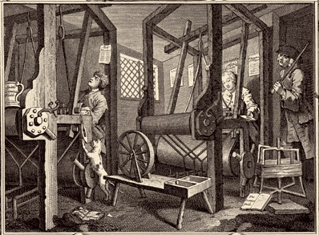
“letting him goe till he was ragged & had hardly any shoes to his feet & persons crying out shame of him & wondering that the [master] would lett [his apprentice] goe in such manner”… The apprentice became ‘very lowsie & nasty in his clothes that the lice might be seen crawling on him & seldom had clean linen’

Slide 40
‘hath seen … [Francis’s] shoulders and face sundry times black & blew by immoderate beating & one time pticularly the [master] having struck [her] head agt the sash windows in the shop & broken them sayd to [her] you Jade I will make you pay for them’.

Slide 41
Industry and Idleness

