Slide 1
Shaping Modern Mathematics: The Queen of Mathematics
Raymond Flood
Gresham Professor of Geometry

Slide 2
OVERVIEW
Prime Numbers.
Fundamental Theorem of Arithmetic.
How many primes are there?
How to find prime numbers?
Primes seem random or unpredictable.
Prime Number Theorem.

Slide 3
Riemann Hypothesis
Do all the solutions of a certain equation have a particular form?
Do all the non-trivial zeros of the Riemann Zeta function have real part 1/2?
http://www.claymath.org/millennium/Riemann_Hypothesis/

Slide 4
Prime Numbers
A prime number is a whole number greater than 1 whose only factors are itself and 1.
Examples: 2, 3, 5, 7, 11, 13, 17, 19, are prime
But not 9 = 3 x 3
or
15 = 3 x 5
Or 2013 = 3 x 11 x 61

Slide 5
Fundamental Theorem of Arithmetic
Every whole number can be written as a product of prime numbers in only one way apart from the order in which they are written.
30 = 2 x 3 x 5
48 = 2 x 2 x 2 x 2 x 3
22,012,013 = 19 x 53 x 21,859
15 = 3 x 5 = 3 x 5 x 1 = 3 x 5 x 1 x 1 and so on.

Slide 6
How many prime numbers are there?
The primes up to 100 are:
2, 3, 5, 7,
11, 13, 17, 19,
23, 29,
31, 37,
41, 43, 47,
53, 59,
61, 67,
71, 73, 79,
83, 89,
97.

Slide 7
How many prime numbers are there?
The primes up to 100 are
2, 3, 5, 7, 11, 13, 17, 19, 23, 29, 31, 37, 41, 43,
47, 53, 59, 61, 67, 71, 73, 79, 83, 89, 97.
There are an infinite number of primes!

Slide 8
There are infinitely many primes
Proof by contradiction
Assume that the only primes are p₁, p₂, p₃, ···, p_{n}, and let
N = (p₁p₂ p₃ ··· p_{n}) + 1

Slide 9
There are infinitely many primes
Proof by contradiction
Assume that the only primes are p₁, p₂, p₃, ···, p_{n}, and let
N = (p₁p₂ p₃ ··· p_{n}) + 1
Then N is not divisible by p₁, p₂, p₃, ···, or p_{n}
so either N is a prime not in the list
or N is made up of primes not in the list.
In either case there is another prime not in the original list and this gives the contradiction.

Slide 10
Both cases can arise
Proof by contradiction
Assume that the only primes are 2, 3, 5 and let
N = (2 x 3 x 5) + 1 = 31
In this case we obtain a prime not in the original list

Slide 11
Both cases can arise
Proof by contradiction
Assume that the only primes are 2, 3, 5, 7, 11, 13 and let
N = (2 x 3 x 5 x 7 x 11 x 13) + 1 = 30031
= 59 x 509
In this case we obtain primes not in the original list

Slide 12
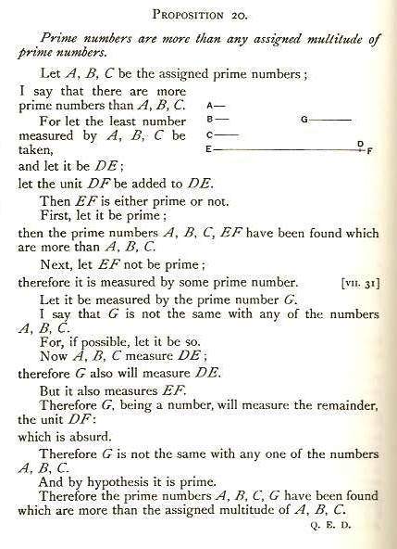
PROPOSITION 20 Book IX

Slide 13
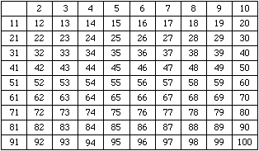
Sieve of Eratosthenes

Slide 14
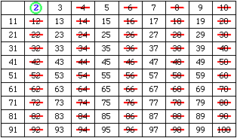
Sieve of Eratosthenes We know 2 is a prime. Circle it and cross out all the remaining multiples of 2;

Slide 15
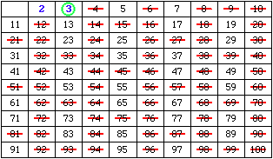
Sieve of Eratosthenes the least number remaining, 3, is then prime. Circle it and cross out all the remaining multiples of 3

Slide 16
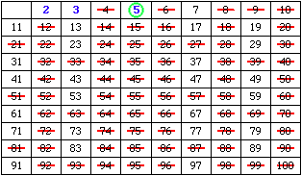
Sieve of Eratosthenes the least number remaining, 5, is then prime. Circle it and cross out all the remaining multiples of 5

Slide 17
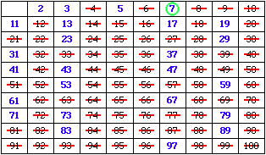
Sieve of Eratosthenes the least number remaining, 7, is then prime. Circle it and cross out all the remaining multiples of 7

Slide 18
Generating Primes: Euler
n² + n + 41
When n = 0 it is 41
When n = 1 it is 43
When n = 2 it is 47
When n = 3 it is 53
··· up to n = 39 it gives primes
When n = 40 it is 1681, not a prime
When n = 41 it is divisible by 41
Leonhard Euler
(1707–1783)
Read Euler, read Euler, he is the master of us all.

Slide 19
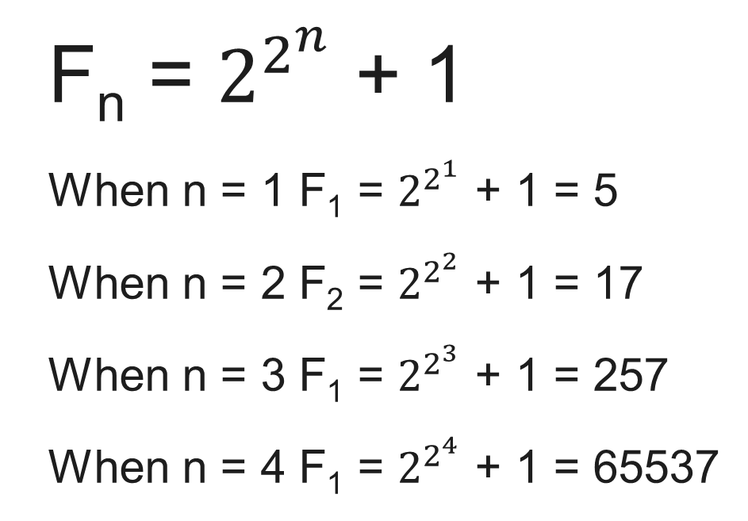
Generating Primes: Fermat
Pierre de Fermat
(1601–1665)

Slide 20
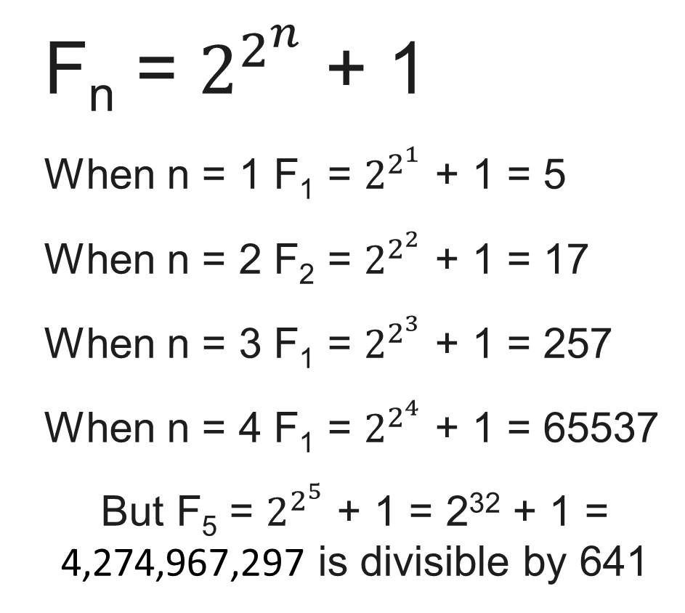
Generating Primes: Fermat
Pierre de Fermat
(1601–1665)

Slide 21
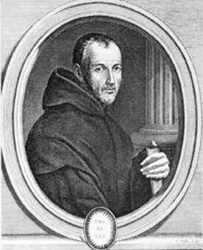
Generating Primes: Mersenne
Mersenne prime is a prime of the form
2^{n} – 1
2² – 1 = 3
2³ – 1 = 7
2⁵ – 1 = 31
2⁷ – 1 = 127
But 2⁴ – 1 = 15
2⁶ – 1 = 63
The exponent n must be a prime for 2^{n} – 1 to be prime.
Marin Mersenne
(1588 – 1648)

Slide 22
Generating Primes: Mersenne
Mersenne prime is a prime of the form
2^{n} – 1
The exponent n must be a prime for 2^{n} – 1 to be prime.
But not all prime n make 2^{n} – 1 prime.
2¹¹ – 1 = 2047 = 23 x 89
Largest Mersenne Prime
2⁴³¹¹²⁶⁰⁹ - 1
Marin Mersenne
(1588 – 1648)

Slide 23
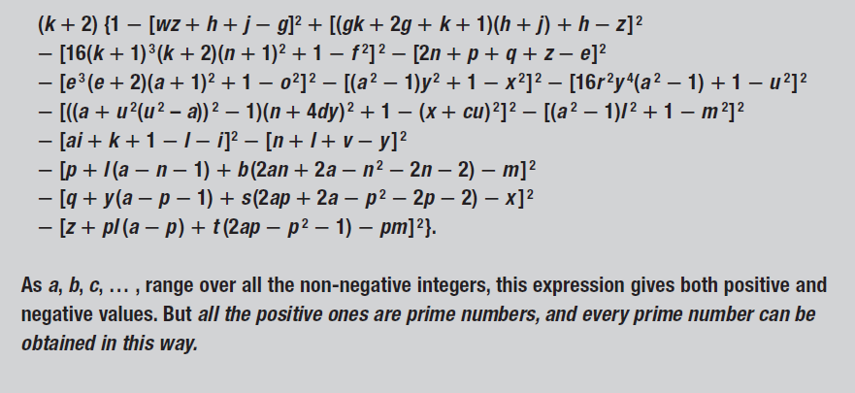
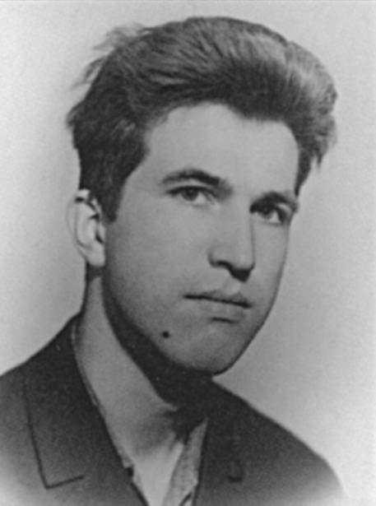
Generating Primes: Consider this polynomial in 26 variables a, b, ···, z
Yuri Matiyasevich
b. 1947

Slide 24
Goldbach Conjecture
Can every even number greater than 4 be written as the sum of 2 primes?
4 = 2 + 2; 6 = 3 + 3; 8 = 3 + 5; 10 = 5 + 5;
20 = 7 + 13; 200 = 7 + 193; 2040 = 1019 + 1021
Checked up to 4 x 10¹⁸

Slide 25
Goldbach Conjecture
Can every even number greater than 4 be written as the sum of 2 primes?
4 = 2 + 2; 6 = 3 + 3; 8 = 3 + 5; 10 = 5 + 5;
20 = 7 + 13; 200 = 7 + 193; 2040 = 1019 + 1021
Checked up to 4 x 10¹⁸
Jing Run Chen : All sufficiently large even numbers are the sum of a prime and the product of at most two primes
2n = p₁ + p₂p₃

Slide 26
Twin primes
Twin primes are a pair of primes which differ by 2:
(3, 5); (5, 7);(11, 13); (17, 19); (29, 31); (41, 43); (59, 61); (71, 73);
(107, 109); (2027, 2029); (1,000,037, 1,000,039);
Are there infinitely many such pairs?
Up to 10¹⁶ there are 10,304,195,697,298 pairs

Slide 27
Triple primes
A prime triple is a collection of three primes of the form n, n + 2, n + 4.
The only prime triple is (3, 5, 7).
Proof:
Homework!
Hint:
Whenever n is not 3 then one of the numbers n or n + 2 or n + 4 can be divided by 3. Hence one of them is not prime.

Slide 28
Distribution of the primes
Primes occur forever
Twin primes seem to occur forever
We can find a gap as large as we please between primes.
Define 2014! = 2014 x 2013 x 2012 x 2011 x ··· x 4 x 3 x 2 x 1
Then the following run of numbers is of length 2013:
2014! + 2 divisible by 2
2014! + 3 divisible by 3
2014! + 4 divisible by 4
...
2014! + 2014 divisible by 2014
And so none of these 2013 numbers is prime.

Slide 29
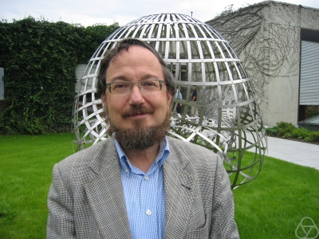
Don Zagier
The first is that, despite their simple definition and role as the building blocks of the natural numbers, the prime numbers belong to the most arbitrary and ornery objects studied by mathematicians: they grow like weeds among the natural numbers, seeming to obey no other law than that of chance, and nobody can predict where the next one will sprout.

Slide 30
Don Zagier
The second fact is even more astonishing, for it states just the opposite: that the prime numbers exhibit stunning regularity, that there are laws governing their behaviour, and that they obey these laws with almost military precision.

Slide 31
Prime counting function: π(x)
Let π(x) = the numbers of primes up to x
π(10) = 4 as there are 4 primes up to 10: 2, 3, 5, 7
π(20) = 8 as there are 8 primes up to 20: 2, 3, 5, 7, 11, 13, 17, 19
π(100) = 25

Slide 32
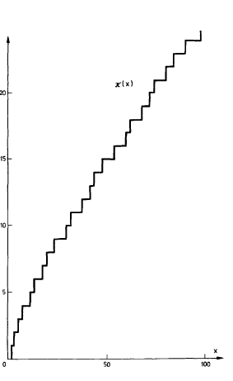
Graph of Prime counting function: π(x) for x = 1, 2, 3, ···, 100

Slide 33
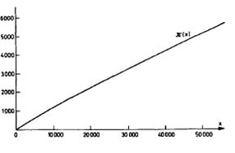
Graph of Prime counting function: π(x) for x = 1, 2, 3, ···, 50000

Slide 34
Counting the primes
x | π(x) | x/π(x) | Logarithm(x) to base 10 | Logarithm (x) to base e
10 | 4 | 2.5 | 1 | 2.3
100 | 25 | 4.0 | 2 | 4.6
1,000 | 168 | 6.0 | 3 | 6.9
10,000 | 1,229 | 8.1 | 4 | 9.2
100,000 | 9,592 | 10.4 | 5 | 11.5
1,000,000 | 78,498 | 12.7 | 6 | 13.8
10,000,000 | 664,579 | 15.0 | 7 | 16.1
100,000,000 | 5,761,455 | 17.4 | 8 | 18.4
1,000,000,000 | 50,847,534 | 19.7 | 9 | 20.7
10,000,000,000 | 455,052,512 | 22.0 | 10 | 23.0

Slide 35
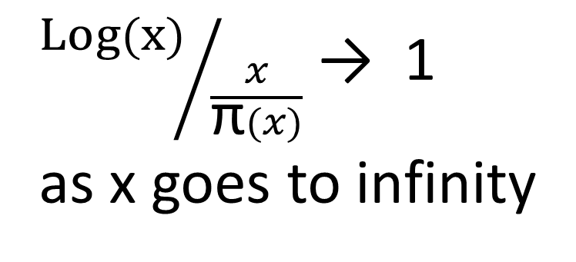
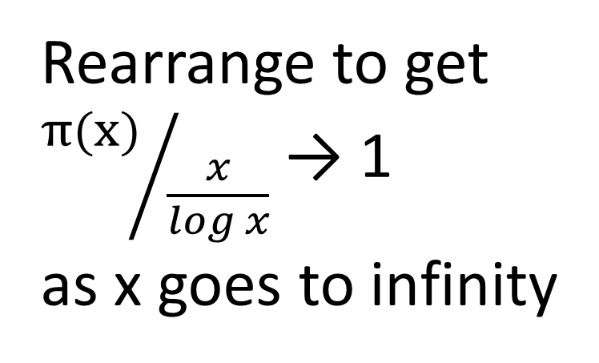
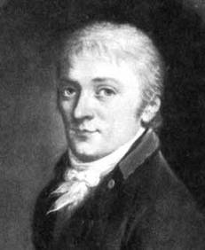
The Prime Number Theorem
x/π(x) | Log (x)
2.5 | 2.3
4.0 | 4.6
6.0 | 6.9
8.1 | 9.2
10.4 | 11.5
12.7 | 13.8
15.0 | 16.1
17.4 | 18.4
19.7 | 20.7
22.0 | 23.0
Gauss 1777 - 1855
in 1803

Slide 36
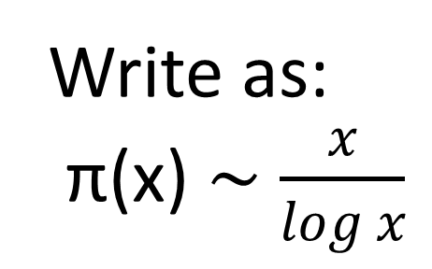
The Prime Number Theorem
x/π(x) | Log (x)
2.5 | 2.3
4.0 | 4.6
6.0 | 6.9
8.1 | 9.2
10.4 | 11.5
12.7 | 13.8
15.0 | 16.1
17.4 | 18.4
19.7 | 20.7
22.0 | 23.0
Gauss 1777 - 1855
in 1803

Slide 37
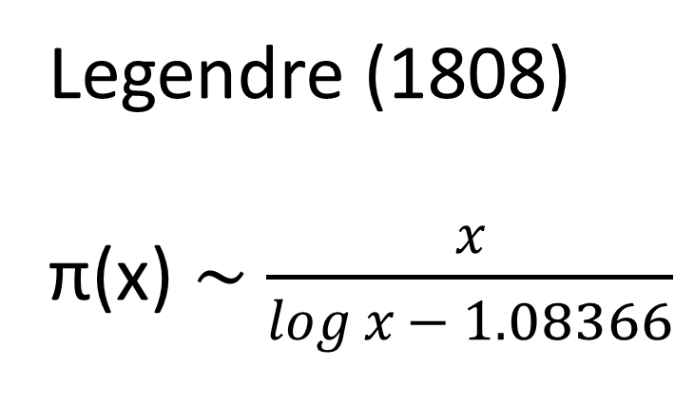
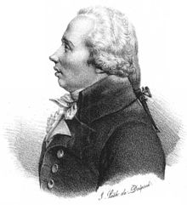
Better approximation for π(x) - Legendre
x/π(x) | Log (x)
2.5 | 2.3
4.0 | 4.6
6.0 | 6.9
8.1 | 9.2
10.4 | 11.5
12.7 | 13.8
15.0 | 16.1
17.4 | 18.4
19.7 | 20.7
22.0 | 23.0
Legendre

Slide 38
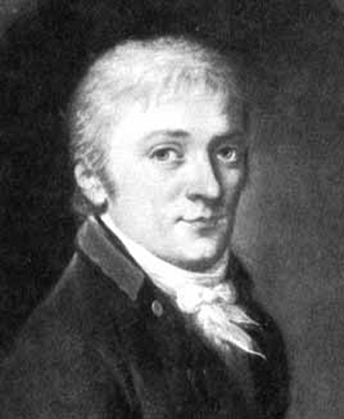
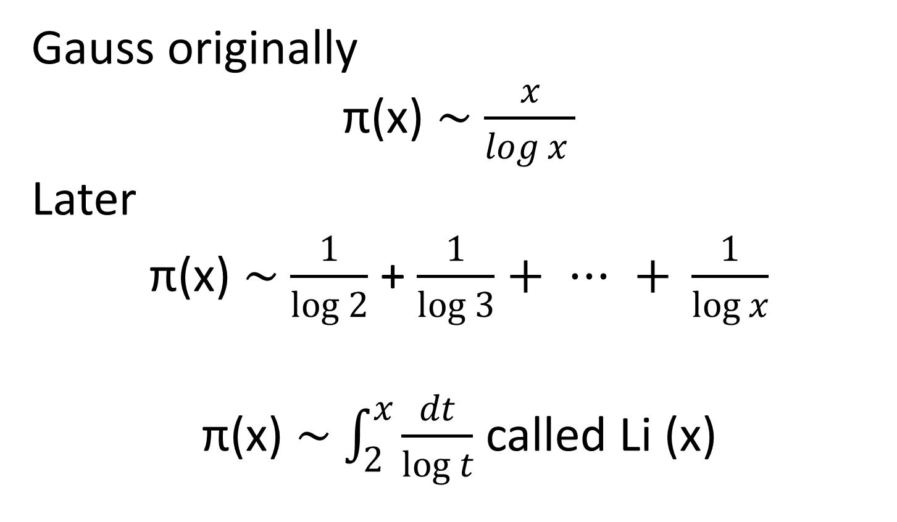
Better approximation for π(x) Gauss

Slide 39
Fundamental Theorem of Arithmetic
Every whole number can be written as a product of prime numbers in only one way apart from the order in which they are written.
30 = 2 x 3 x 5
48 = 2 x 2 x 2 x 2 x 3
22012013 = 19 x 53 x 21859

Slide 40
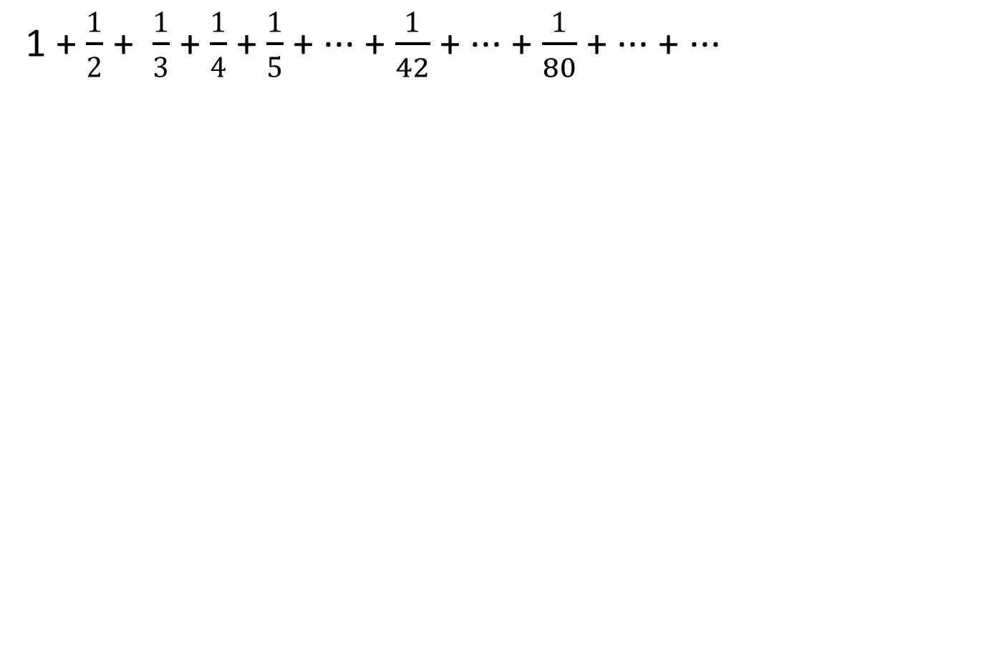
The Harmonic series and primes

Slide 41
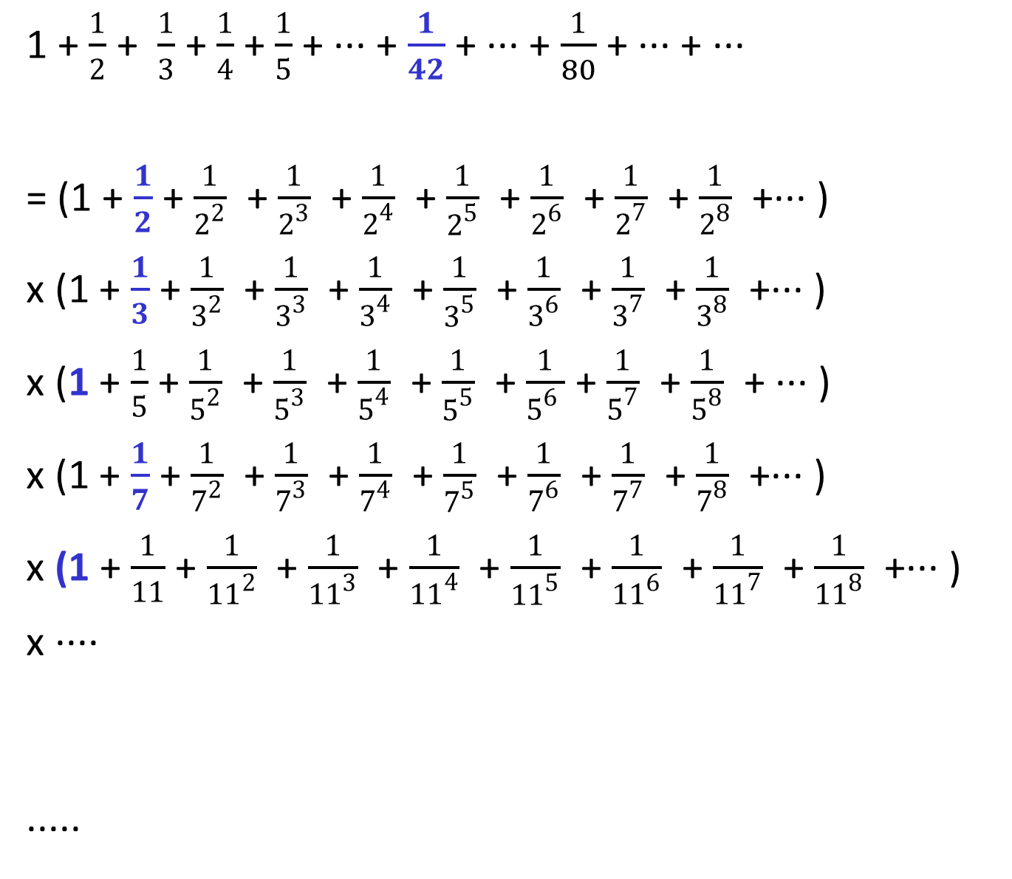
The Harmonic series and primes

Slide 42
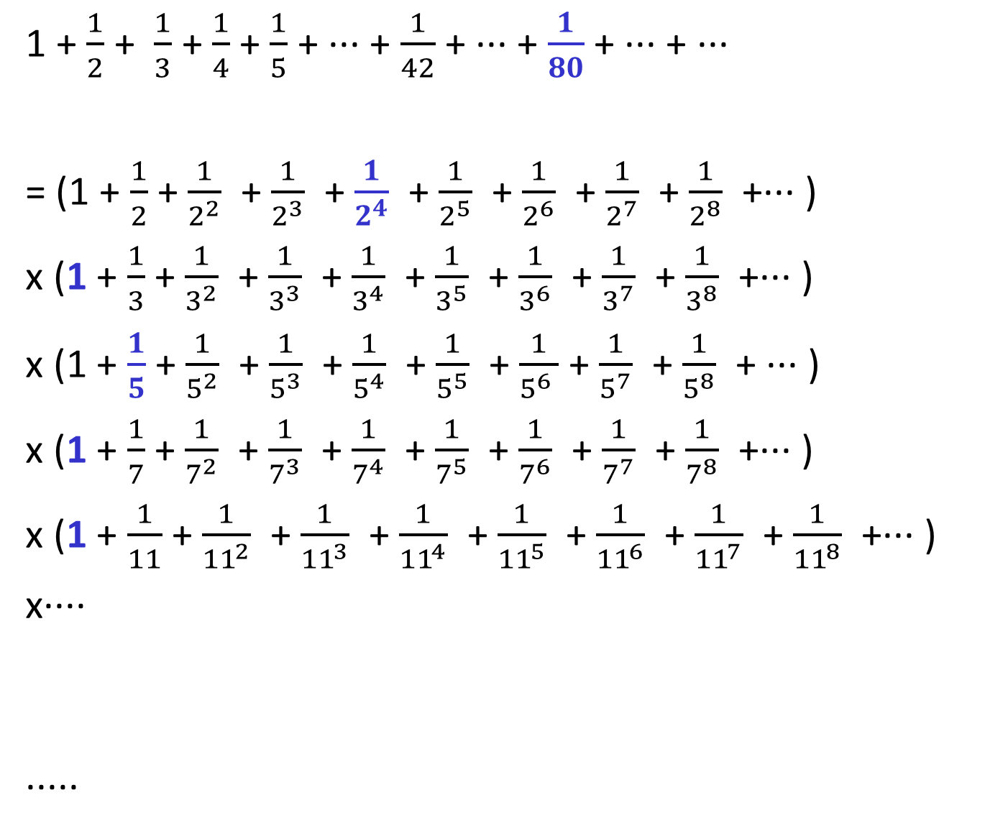
The Harmonic series and primes

Slide 43
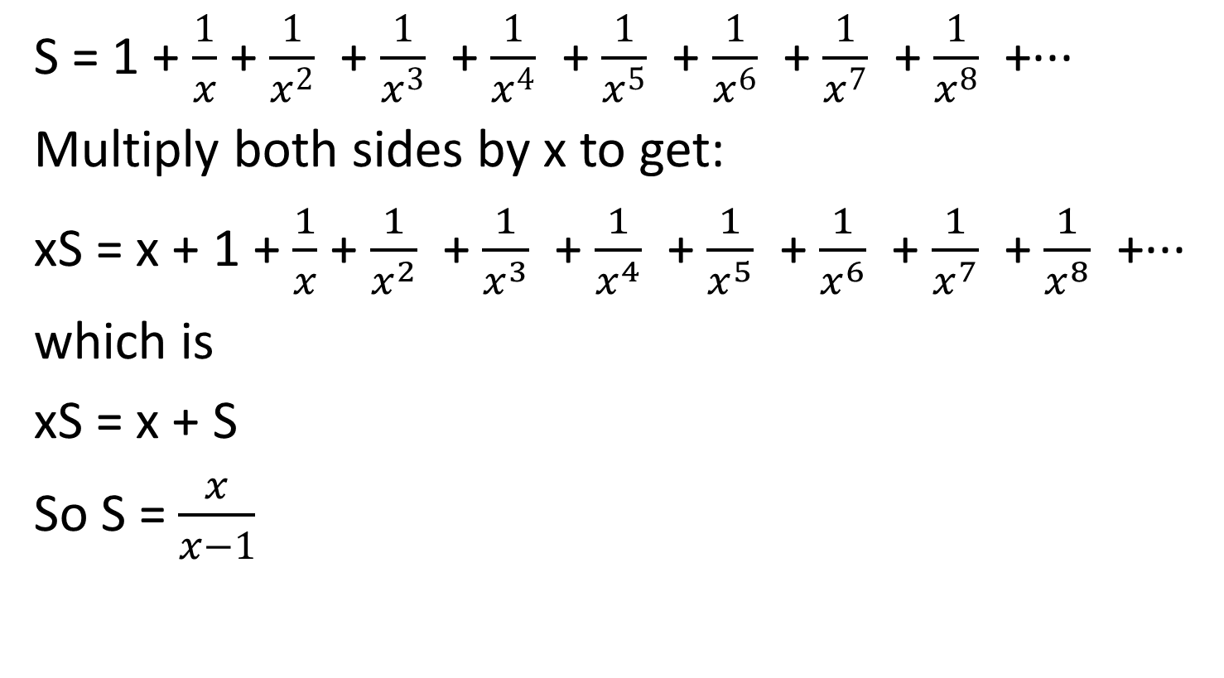
Summing a series

Slide 44
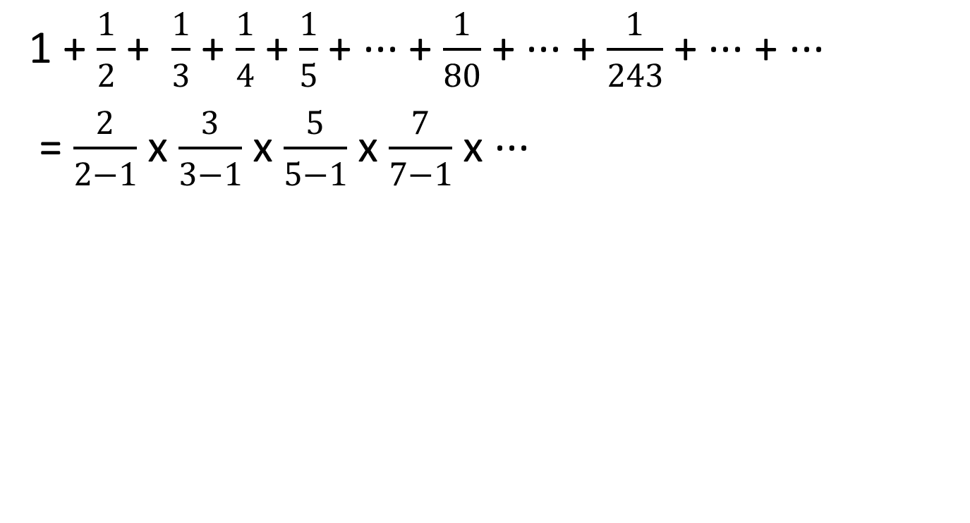
Infinite number of primes

Slide 45
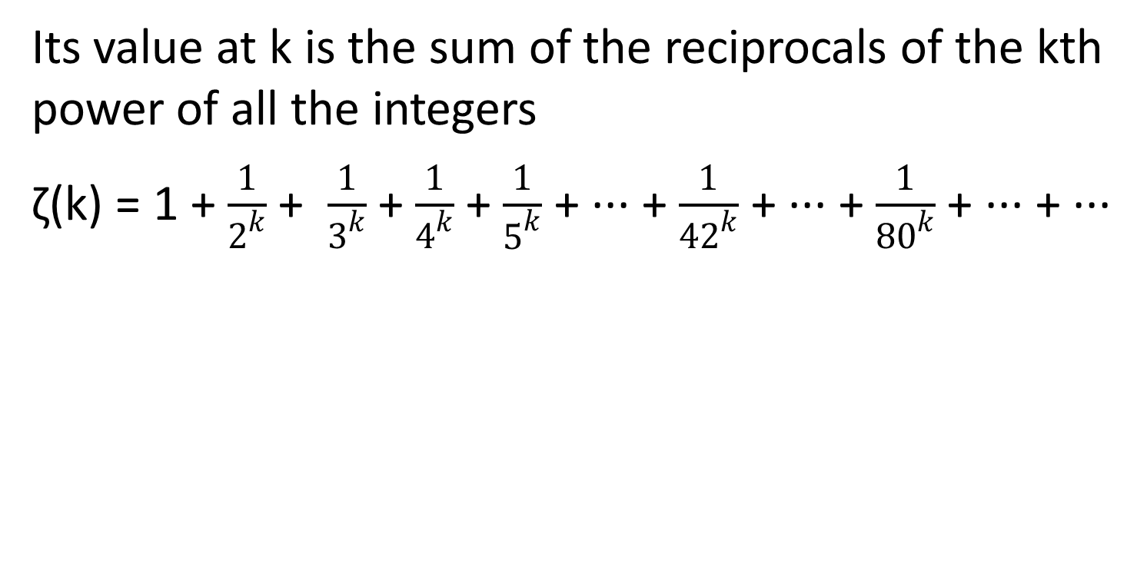
Riemann Zeta function

Slide 46
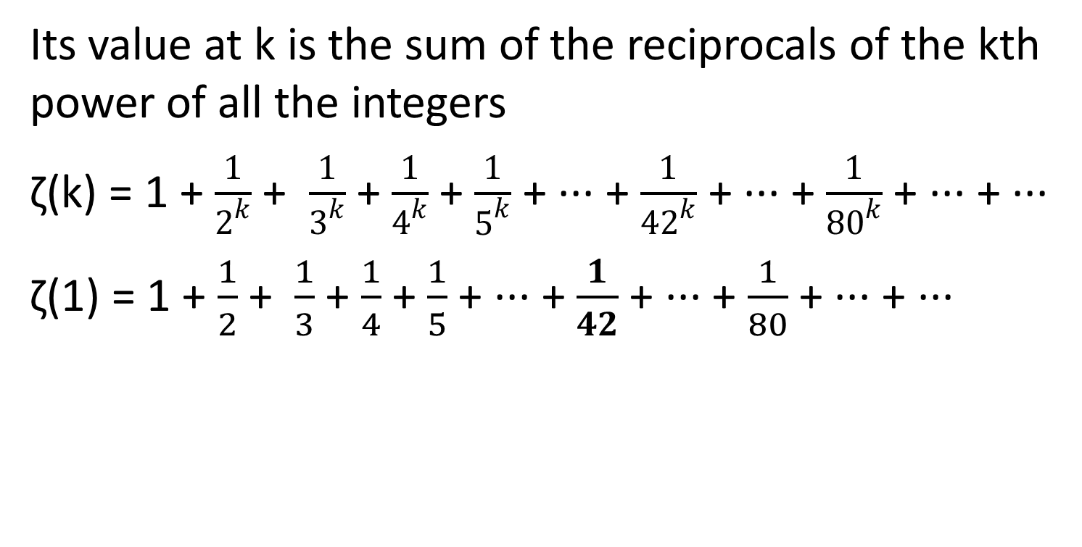
Riemann Zeta function

Slide 47
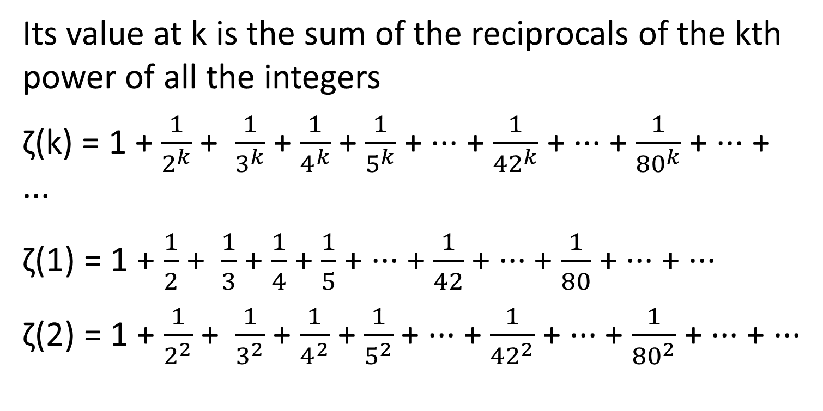
Riemann Zeta function

Slide 48
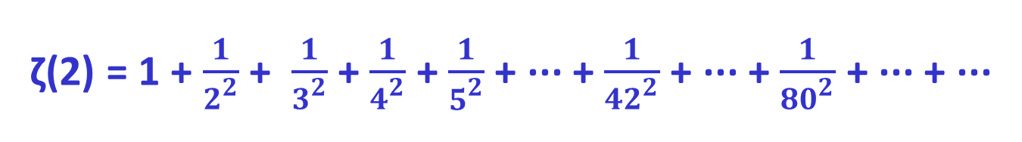
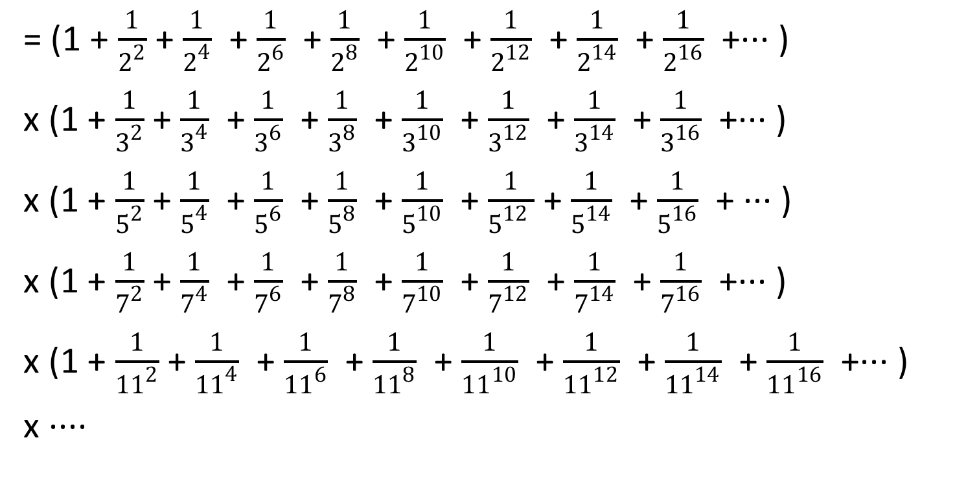

Slide 49

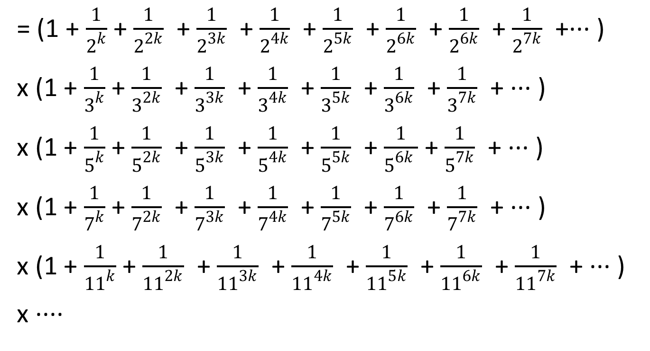

Slide 50
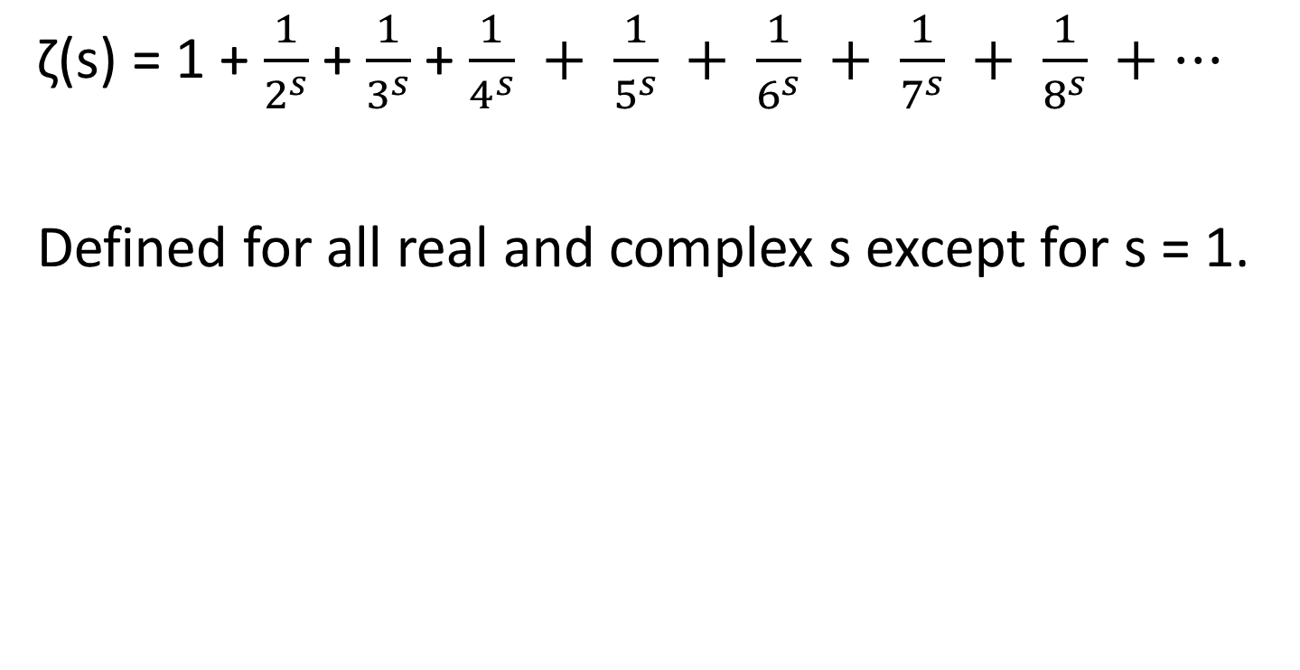
Riemann Zeta Function

Slide 51
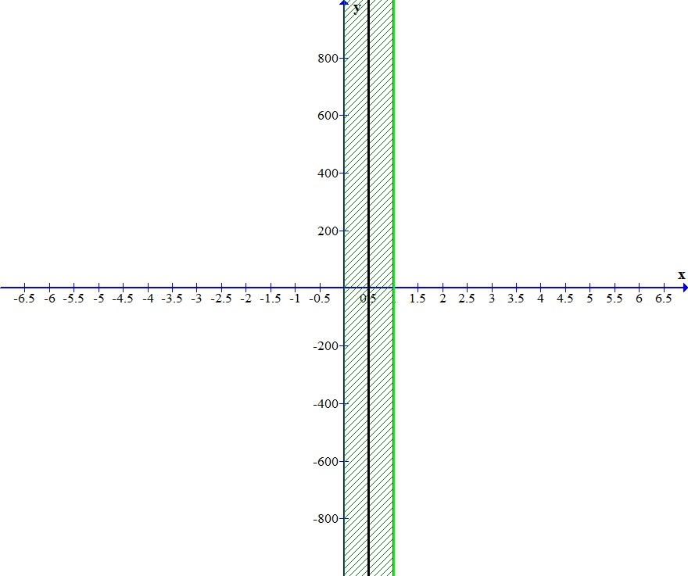
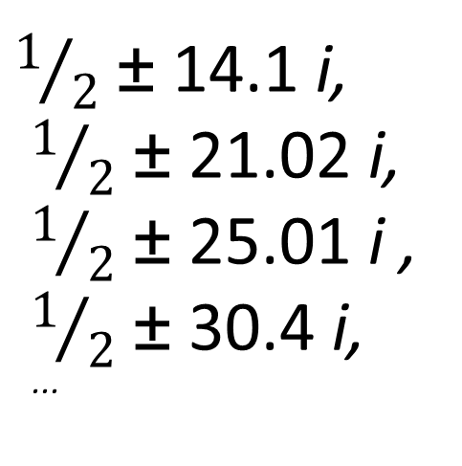
Riemann Hypothesis All non trivial zeros lie on the line x = 1/2
Critical strip

Slide 52

Music of the Primes:
This audio has the contributions of the first 100 zeros of the Riemann Zeta function, added one at a time, in intervals of 0.2 seconds.
Each note has the same amplitude and frequency as the corresponding term in Riemann’s exact formula, each coming from a single zero of the zeta function.
Finally all 100 zeros play together for ten seconds.
Ref: http://www.math.ucsb.edu/~stopple/explicit.html

Slide 53
Lectures At the Museum of London
Ghosts of Departed Quantities: Calculus and its Limits
Tuesday 25 September 2012
Polynomials and their Roots
Tuesday 6 November 2012
From One to Many Geometries
Tuesday 11 December 2012
The Queen of Mathematics
Tuesday 22 January 2013
Are Averages Typical?
Tuesday 19 February 2013
Modelling the World
Tuesday 19 March 2013

