Slide 1
Momentum transport and flow shear suppression of turbulence in tokamaks
Michael Barnes
University of Oxford
Culham Centre for Fusion Energy
F. I. Parra, E. G. Highcock, A. A. Schekochihin,
S. C. Cowley, and C. M. Roach

Slide 2
Objective
Identify mechanism(s) for achieving enhanced confinement
Internal transport barriers experimentally observed with temperature gradients well above threshold
Often accompanied by large E x B shear and low or negative magnetic shear
How do ITBs work, and how can we make them better?
Connor et al. (2004)

Slide 3

Multiple scale problem
Physics | Perpendicular spatial scale | Temporal scale
Turbulence from ETG modes | ~ 0.005 – 0.05 cm | ~ 0.5 - 5.0 MHz
Turbulence from ITG modes | ~ 0.3 - 3.0 cm | ~ 10 - 100 kHz
Transport barriers | Measurements suggest width ~ 1 - 10 cm | 100 ms or more in core?
Discharge evolution | Profile scales ~ 200 cm | Energy confinement time ~ 2 - 4 s
simulation cost:
Notes:
Check on numbers

Slide 4
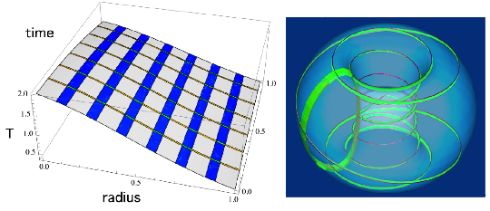
Multiscale simulation (TRINITY)
Turbulent fluctuations calculated in small regions of fine space-time grid embedded in “coarse” grid (for mean quantities)
Flux tube simulation domain

Slide 5
Overview
Effect of rotational shear on turbulent transport
Implications for local gradients (0D)
Extension to radial profiles (1D)

Slide 6



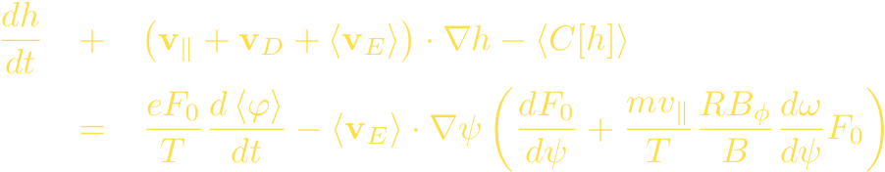

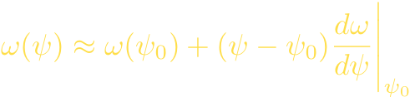

Model
GK equation with mean flow satisfying
but :
Local approximation:

Slide 7
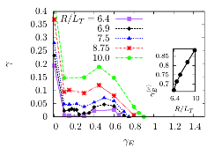


Linear stability (GS2)
Cyclone base case:
ITG drive at small shear
ITG/PVG drive at moderate shear
Stabilization at large shear
Roughly linear dependence of critical flow shear on R/LT
Barnes et al., 2010 (arXiv:1007.3390)

Slide 8
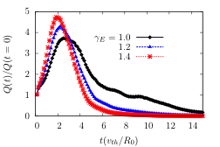
Transient growth
Beyond critical shear value, transient linear growth
Amplification of initial amplitude increases with shear
Cf. Newton et al., 2010 (arXiv:1007.0040)

Slide 9
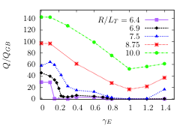
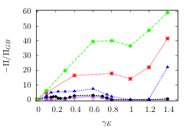
Fluxes follow linear trends up to linear stabilization point
Subcritical (linearly stable) turbulence beyond this point
Optimal flow shear for confinement
Possible hysteresis
Maximum in momentum flux => possible bifurcation

Slide 10
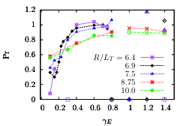


Turbulent Prandtl number
Prandtl number tends to shear- and R/LT-independent value of order unity (in both turbulence regimes)

Slide 11
Zero magnetic shear
Similar…sort of
All turbulence subcritical
Highcock et al., 2010 (arXiv:1008.2305)

Slide 12
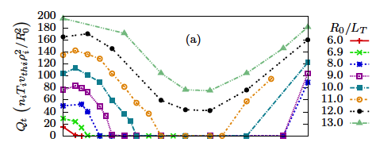
Zero magnetic shear
Similar…sort of
All turbulence subcritical
Very different critical flow shear values

Slide 13
Overview
Effect of rotational shear on turbulent transport
Implications for local gradients (0D)
Extension to radial profiles (1D)

Slide 14


Power/Torque balance for beam injection
heat, momentum

Slide 15


Balance w/o neoclassical
= red lines
= green lines
Critical gradient = dashed line
For given and , only one solution
No bifurcation!
Parra et al., 2010

Slide 16
Neoclassical energy flux

Slide 17
Neoclassical energy flux

Slide 18



Curves of constant
Neoclassical
Turbulent
Prandtl numbers

Slide 19
Curves of constant
Neoclassical
Turbulent
Prandtl numbers

Slide 20
Curves of constant

Slide 21
Possible solutions

Slide 22
Possible solutions

Slide 23
Possible solutions

Slide 24
Total energy flux

Slide 25
Bifurcations
Consider inverse problem: for fixed fluxes, what are gradients?
With inclusion of neoclassical fluxes, we see bifurcation to much larger flow shear and R/LT
Highcock et al., 2010

Slide 26
Overview
Effect of rotational shear on turbulent transport
Implications for local gradients (0D)
Extension to radial profiles (1D)

Slide 27
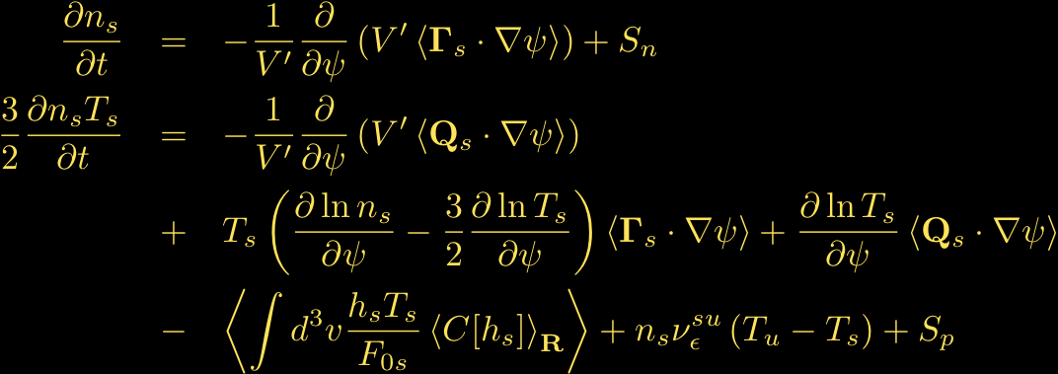
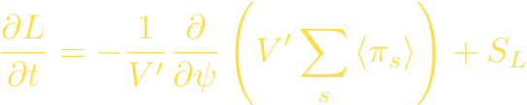
Transport equations in GK
Moment equations for evolution of mean quantities:
Sugama (1997), Abel (2010)

Slide 28
TRINITY schematic
Steady-state turbulent fluxes and heating
Flux tube 1
GS2/GENE
Flux tube 2
GS2/GENE
Flux tube 3
GS2/GENE
Macro profiles
Transport solver
Flux tube N
GS2/GENE

Slide 29


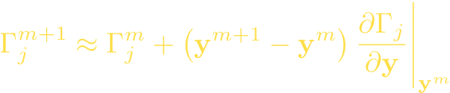
TRINITY transport solver
Transport equations are stiff, nonlinear PDEs. Implicit treatment via Newton’s Method (multi-step BDF, adaptive time step) allows for time steps ~0.1 seconds (vs. turbulence sim time ~0.001 seconds)
Challenge: requires computation of quantities like
Local approximation:
Simplifying assumption: normalized fluxes depend primarily on gradient scale lengths

Slide 30
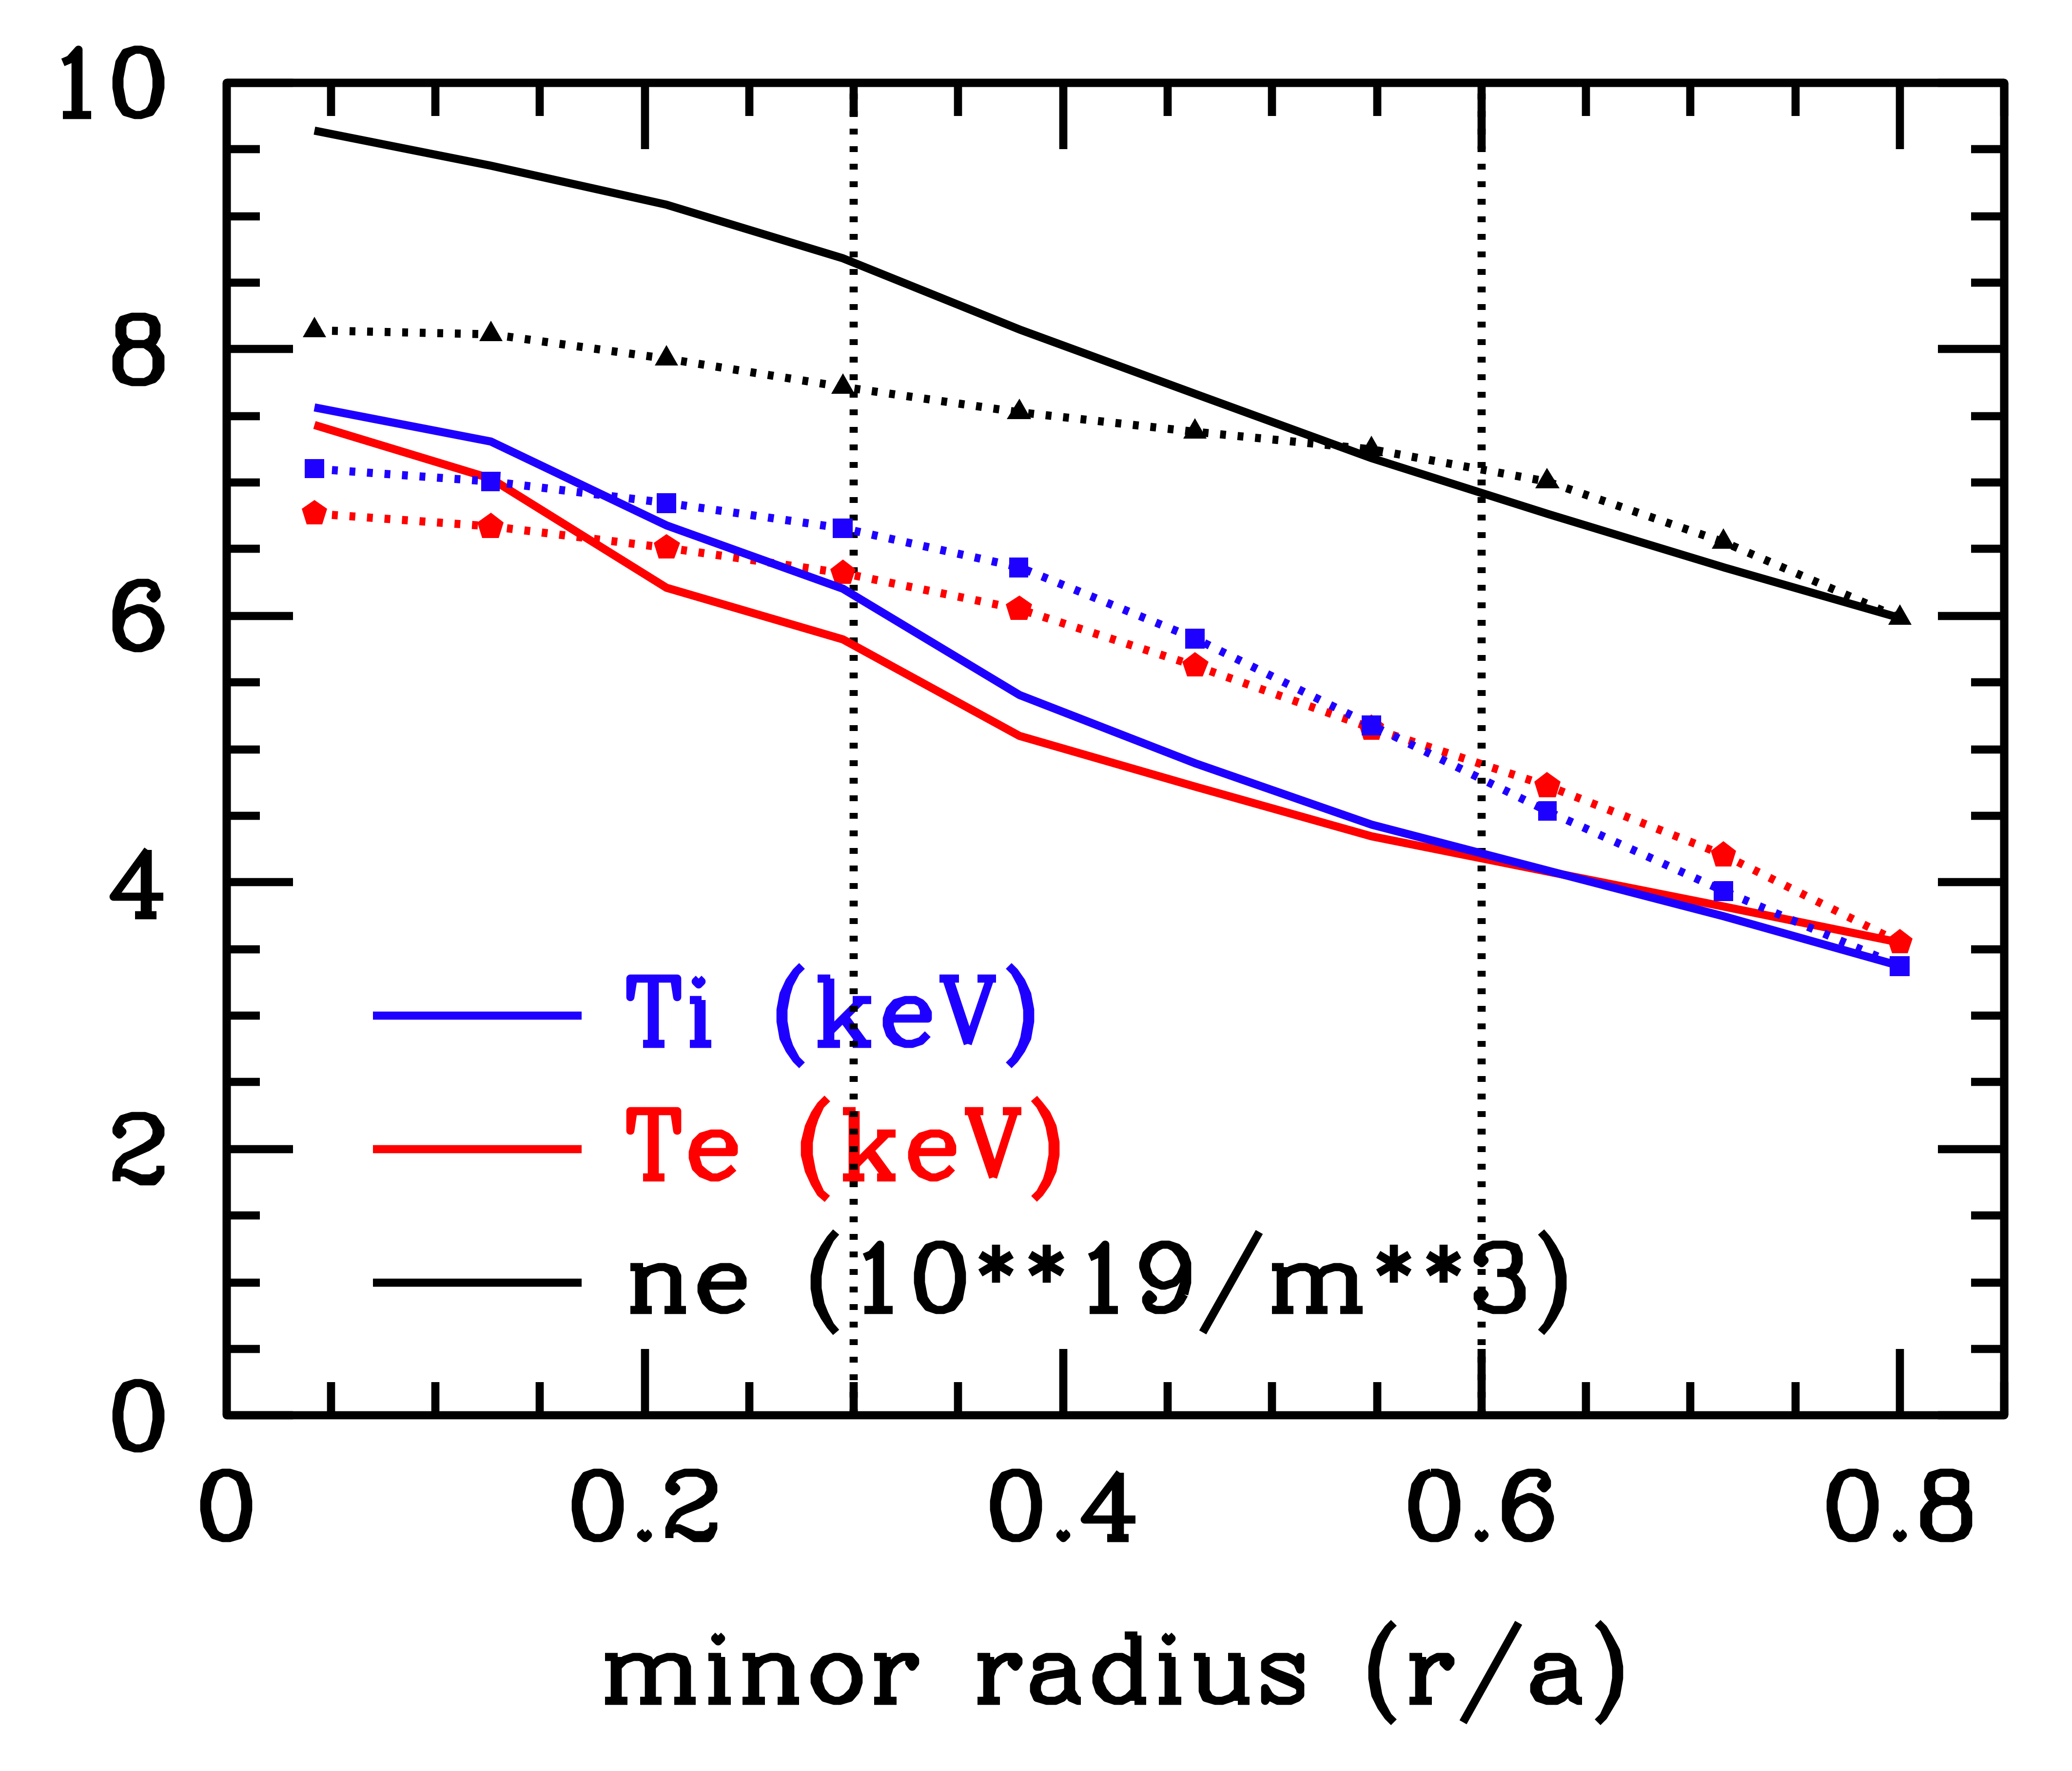
Evolving density profile
Costs ~120k CPU hrs (<10 clock hrs)
Dens and temp profiles agree within ~15% across device
Energy off by 5%
Incremental energy off by 15%
Flow shear absent

Slide 31





Model fluxes
Simple model for fluxes with parameters chosen to fit zero magnetic shear results from GS2:

Slide 32
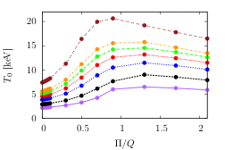
Preliminary results

Slide 33
Conclusions
Maximum temperature gradient for given heat flux due to flow shear driven subcritical turbulence
Turbulent Prandtl number is constant of order unity for moderate to large flow shear values.
Flow shear more effective in stabilizing turbulence as zero magnetic shear
Bifurcation observed in 0D model (GS2 simulations). Requires neoclassical contribution to fluxes
Preliminary work on extension to 1D transport simulations shows peak in core temperature at beam energy which varies with power (peak at higher energies for higher powers)

Slide 34
Shear stabilization
Newton et al., 2010 (arXiv:1007.0040)

Slide 35
Bifurcation condition
Parra et al., 2010

