Slide 1
Reduced transport regions in rotating tokamak plasmas
Michael Barnes
University of Oxford
Culham Centre for Fusion Energy
In collaboration with F. Parra, E. Highcock, A. Schekochihin,
S. Cowley, and C. Roach

Slide 2
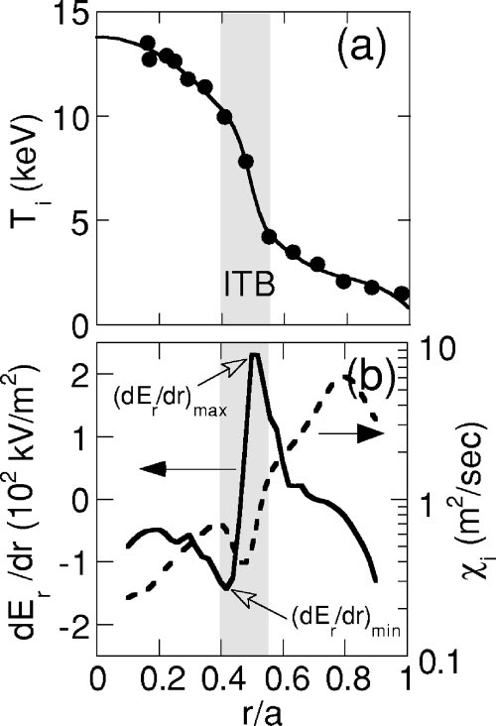
Observations
“Internal Transport Barriers” (ITBs) observed in wide range of fusion devices
Often accompanied by strong velocity shear and weak or negative magnetic shear
How do ITBs work, and how can we make them better?
JT-60U data. Y. Miura, et al., 10:1809:2003

Slide 3
Overview
Effect of rotational shear on turbulent transport
Implications for local gradients (0D)
Extension to radial profiles (1D)

Slide 4
Turbulent fluxes
Fluxes from GK code GS2
Cyclone base case:
-- concentric, circular flux surfaces
-- q=1.4
-- r/R=0.18
-- zero magnetic shear
Highcock et al., PRL 105, 215003 (2010).

Slide 5
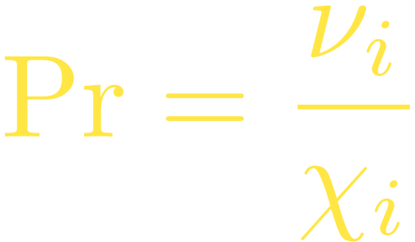
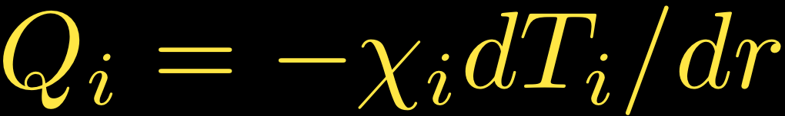
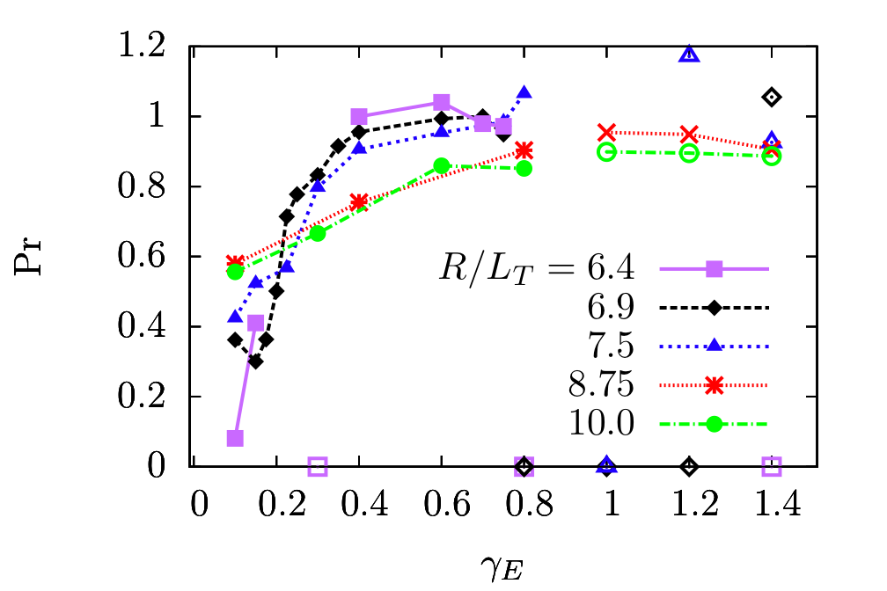
Turbulent Prandtl number
Prandtl number tends to shear- and R/LT-independent value of order unity (in both turbulence regimes)
Barnes et al., PRL submitted (2010).

Slide 6

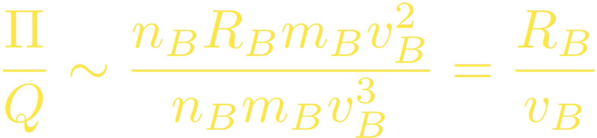
Power/Torque balance for beam injection
heat, momentum

Slide 7

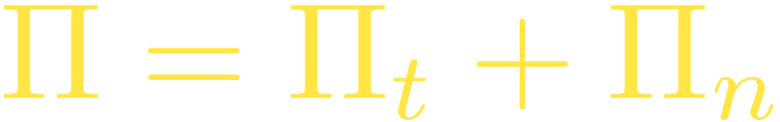




Model fluxes
Simple model for fluxes with parameters chosen to fit zero magnetic shear results from GS2:

Slide 8
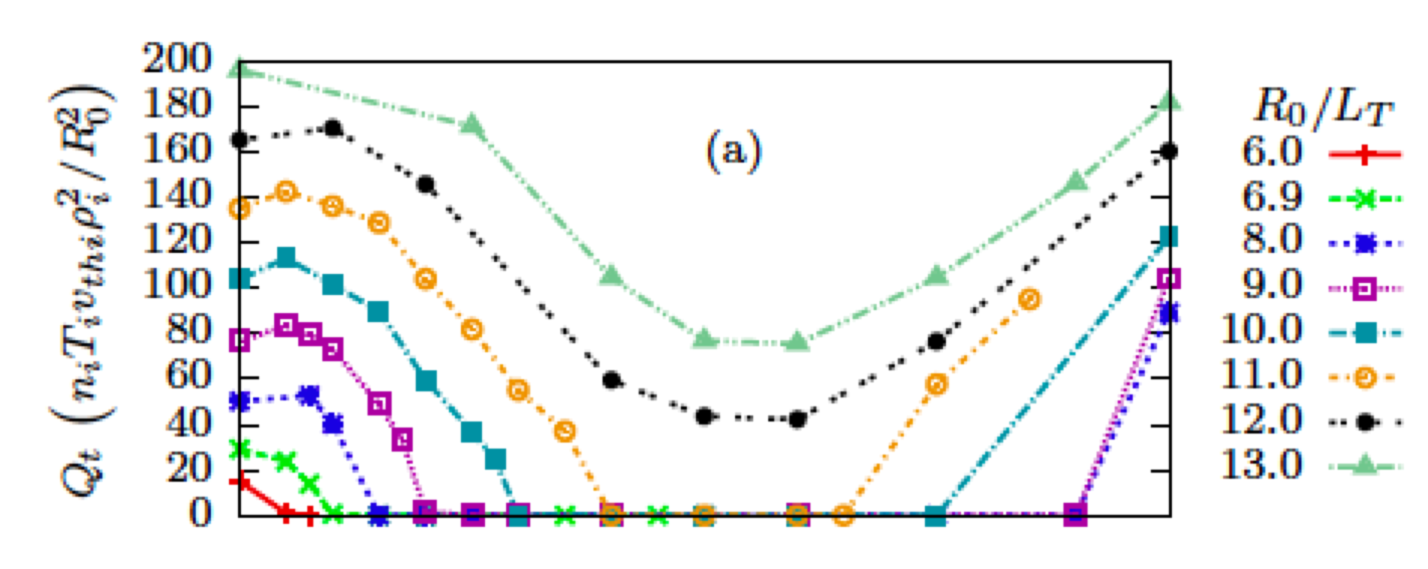
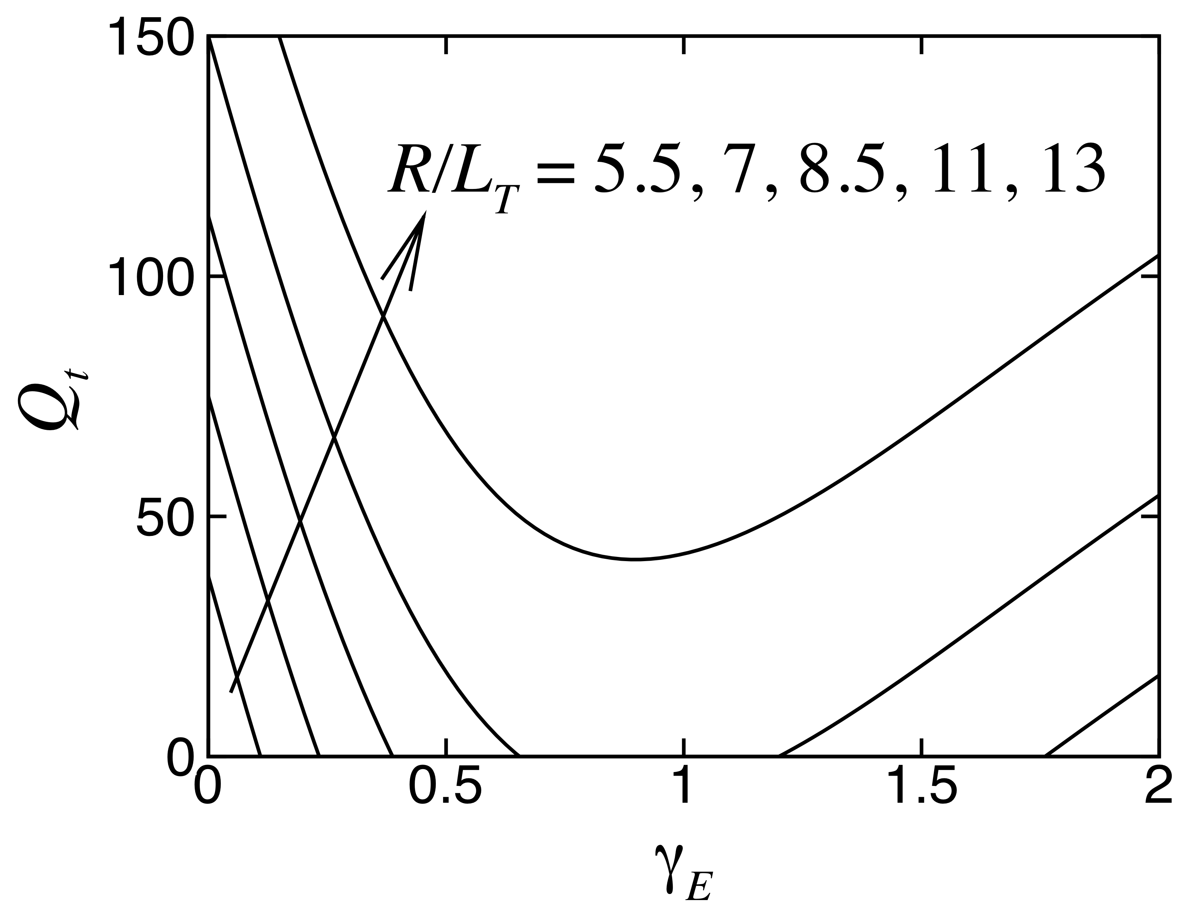
Model fluxes

Slide 9
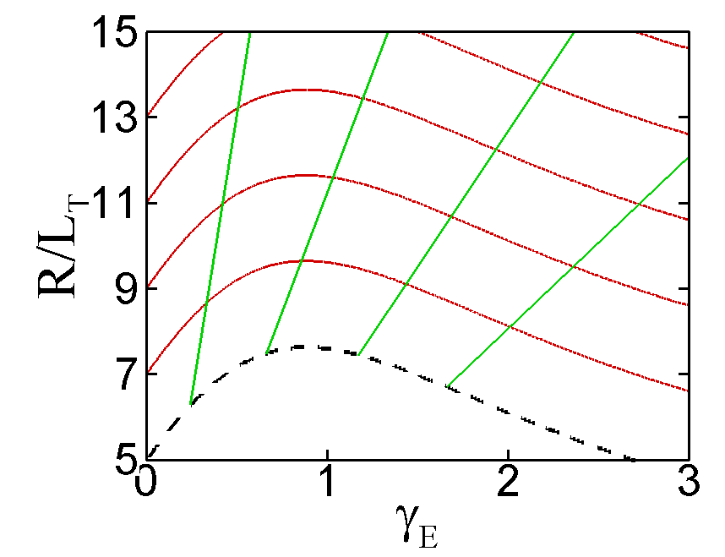


Balance w/o neoclassical
= red lines
= green lines
Critical gradient = dashed line
For given and , only one solution
No bifurcation!

Slide 10
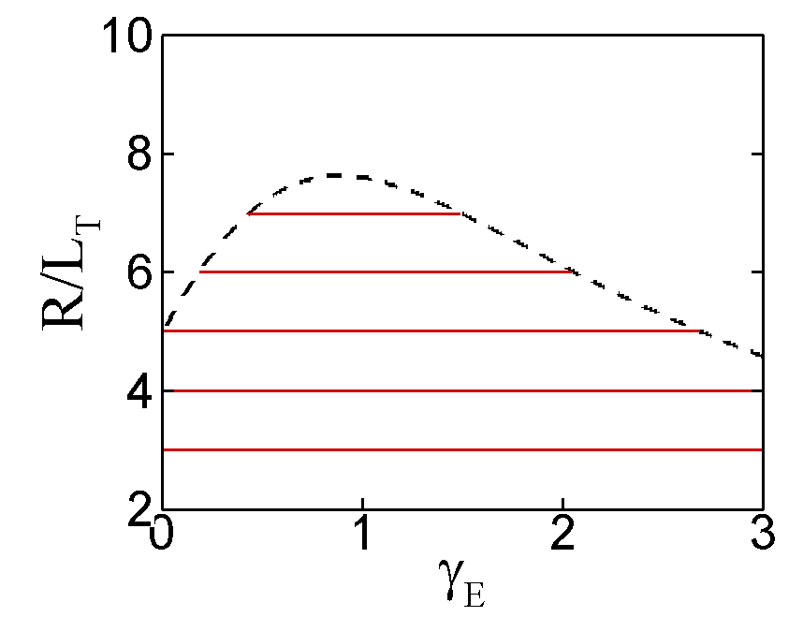
Neoclassical energy flux

Slide 11
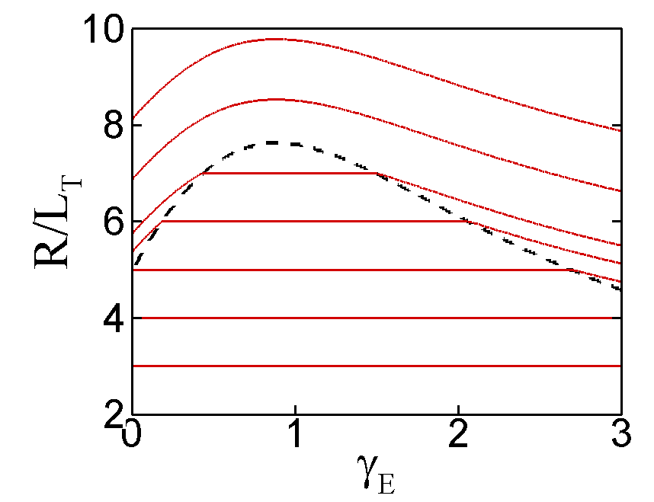
Balance with neoclassical

Slide 12
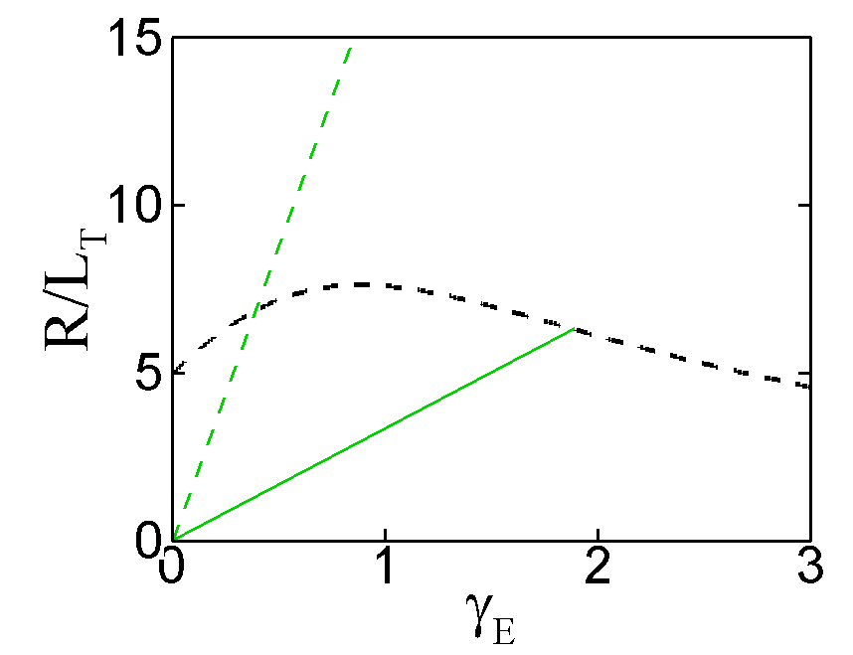



Curves of constant
Neoclassical
Turbulent
Prandtl numbers

Slide 13
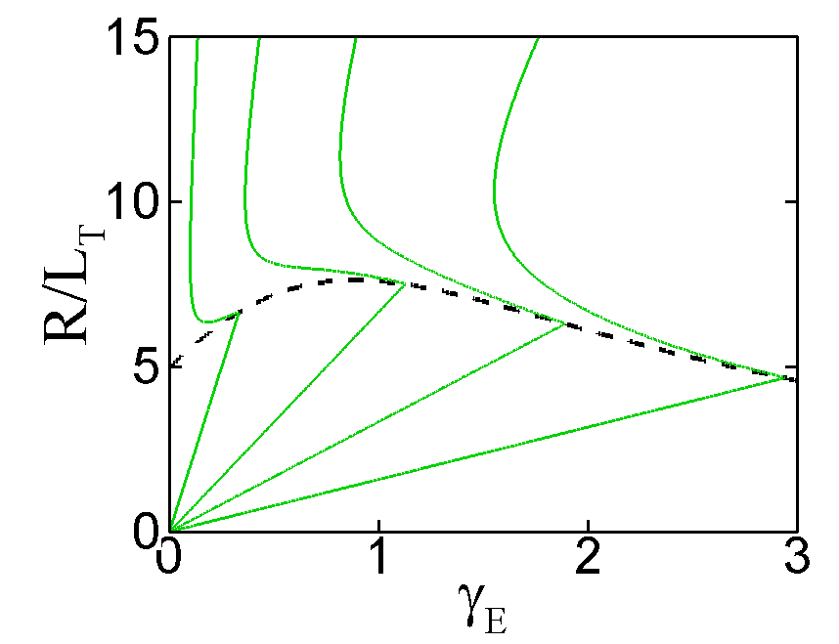
Curves of constant

Slide 14
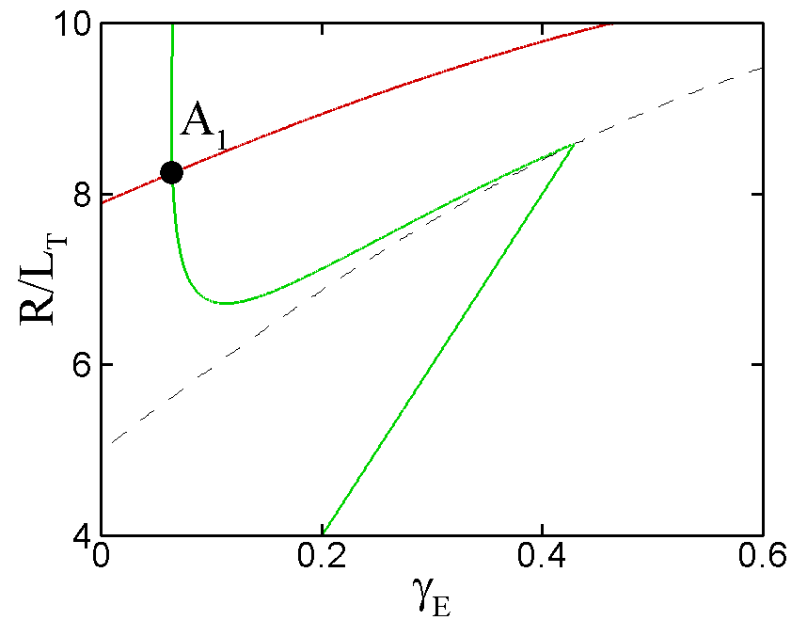
Possible solutions

Slide 15
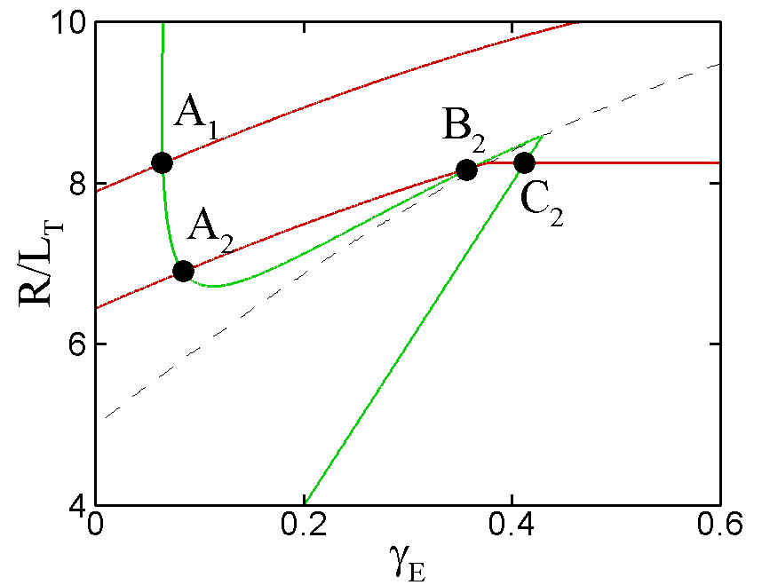
Possible solutions

Slide 16
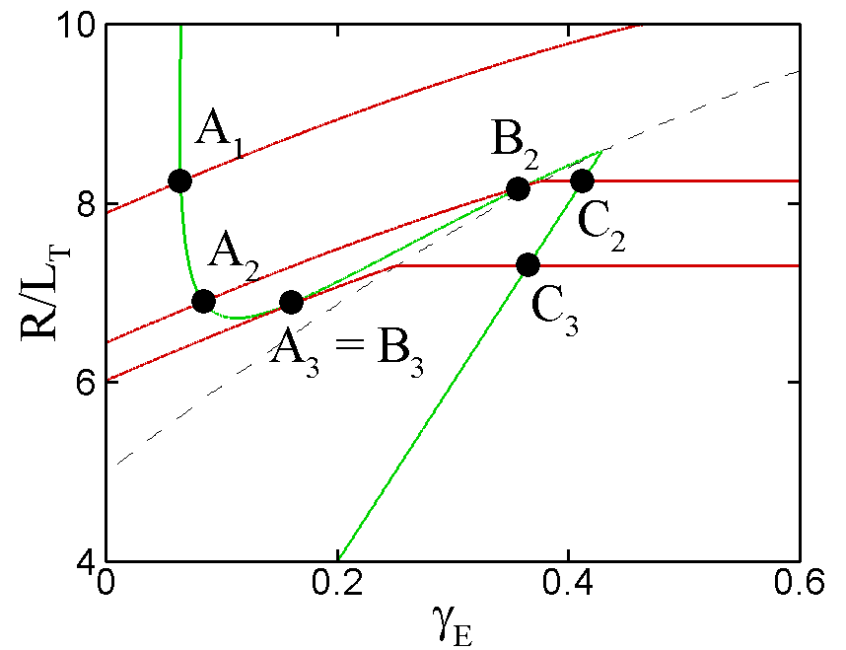
Possible solutions

Slide 17
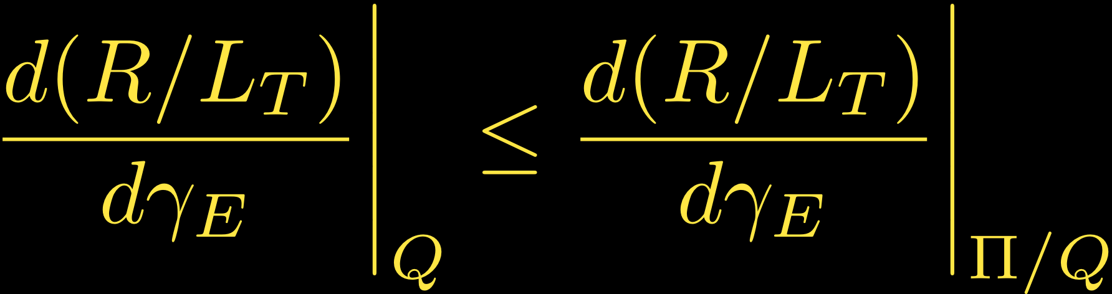
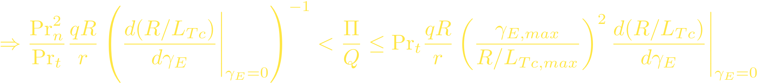
Bifurcation condition
Bifurcations only occur when Q_{t} ~ Q_{n} so take R/L_{T} ≈ R/L_{Tc}
Parra et al., PRL submitted (2010), arXiv:1009.0733

Slide 18
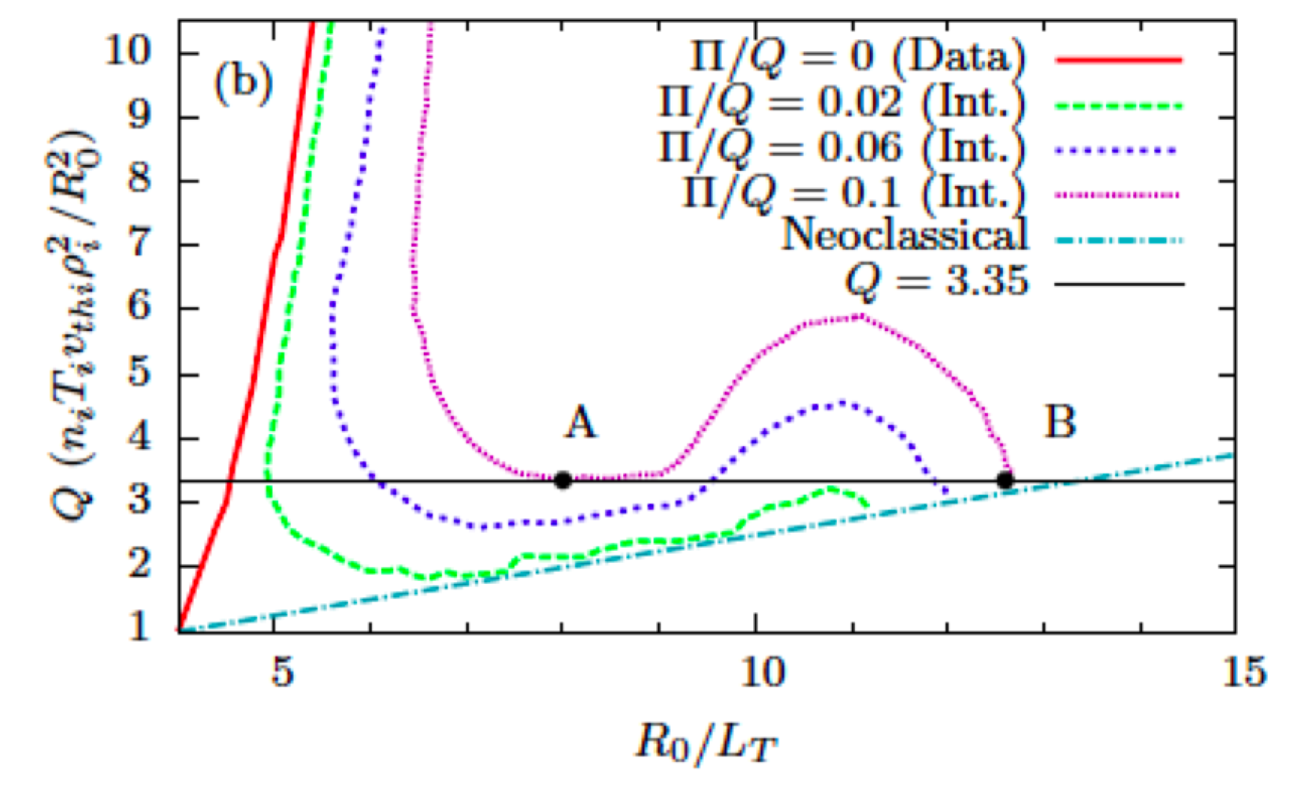
Bifurcations in GS2
Use many nonlinear GS2 simulations to generate constant Pi/Q contours
With inclusion of neoclassical fluxes, we see potential bifurcations to much larger flow shear and R/LT
Very similar to simplified model predictions
Highcock PRL (2010)

Slide 19
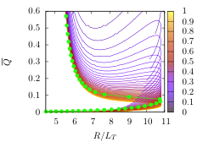
Extension to 1D (radial)
Choose profiles for Pi and Q. Set T, T’ at outer boundary
Here, Q~sqrt(r/a), Pi/Q=0.1, Edge T=2 keV
Wolf, PPCF 45 (2003)

Slide 20
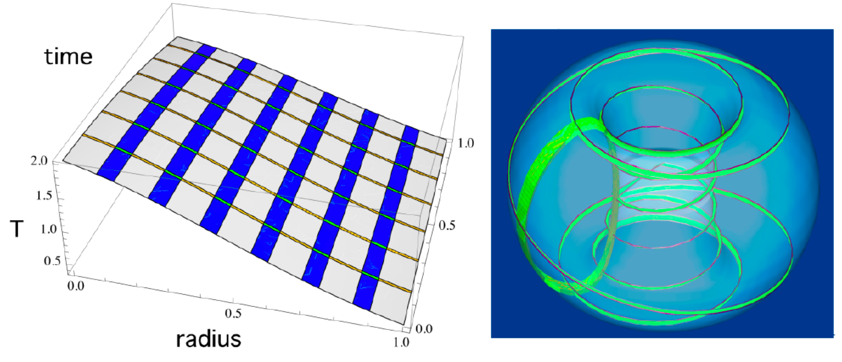
The future: multiscale simulation
In TRINITY [Barnes et al., PoP 17, 056109 (2010)], turbulent fluctuations calculated in small regions of fine space-time grid embedded in “coarse” grid (for mean quantities)
Flux tube simulation domain

Slide 21
Conclusions and future directions
Mean flow shear can fully suppress turbulence in tokamak plasmas (in certain parameter regimes)
Turbulence suppression can give rise to bifurcation in flow shear and temperature gradient
Such bifurcations are candidates for thermal transport barriers in core of tokamak experiments
Still a lot of work to be done in understanding underlying theory and determining parametric dependencies
Need self-consistent treatment including back-reaction of turbulence on mean flow (evolution of mean profiles)

Slide 22
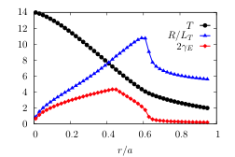
Extension to 1D (radial)

