Slide 1


Evidence, Impact, Value: Metrics for Understanding Personal and Institutional Use of the Social Web
Twitter: #OIIimpacts11
http://www.ukoln.ac.uk/web-focus/events/workshops/digital-impacts-2011/
Brian Kelly
UKOLN
University of Bath
Bath, UK
Acceptable Use Policy
Recording this talk, taking photos, using Twitter, etc. is encouraged - but try to keep distractions to others minimised.
Blog:
http://ukwebfocus.wordpress.com/
Twitter: @briankelly (personal/professional) @ukwebfocus (automated alerts)
UKOLN is supported by:
This work is licensed under a Attribution-NonCommercial-ShareAlike 2.0 licence (but note caveat)

Slide 2









Idea from Cameron Neylon
You are free to:
copy, share, adapt, or re-mix;
photograph, film, or broadcast;
blog, live-blog, or post video of
this presentation provided that:
You attribute the work to its author and respect the rights and licences associated with its components.
Slide Concept by Cameron Neylon, who has waived all copyright and related or neighbouring rights. This slide only CCZero.
Social Media Icons adapted with permission from originals by Christopher Ross. Original images are available under GPL at:
http://www.thisismyurl.com/free-downloads/15-free-speech-bubble-icons-for-popular-websites
2

Slide 3
About Me
Introduction
Brian Kelly:
UK Web Focus: national advisory post to UK HEIs
Based at UKOLN at the University of Bath
Long-standing Web evangelist
Prolific blogger (900+ posts since Nov 2006)
Prolific speaker (~365 talks from 1996-2010)
User of variety of Social Web services
UKOLN:
A national centre of expertise in digital information management
A JISC Innovation Support Centre

Slide 4
About This Talk
Social Web
Personal to Institutional Use
Conclusions
Evidence, Impact, Metrics
Institutional Dashboards
Understanding Patterns of Use
What About Value and ROI?
Observing Trends

Slide 5
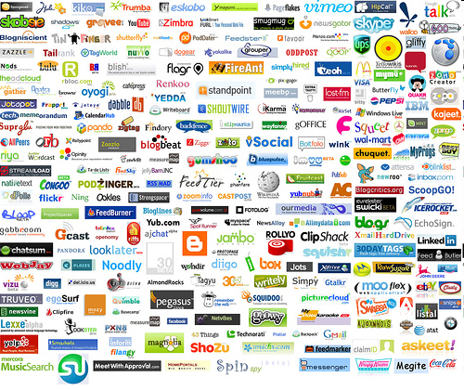


Slide 6
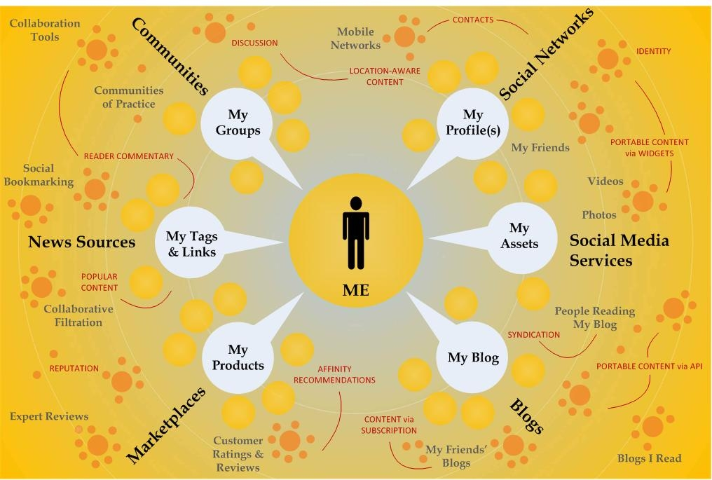
It’s About The Individual!

Slide 7
Observing Patterns
We have seen:
Initial use of Social Web (blogs, Twitter, sharing services, …) by early adopters
Awareness of benefits and take-up by early mainstream users
Awareness of possible benefits for use in institutional context
We now have a requirement to:
Understand institutional patterns of use
Be able to demonstrate value and ROI

Slide 8
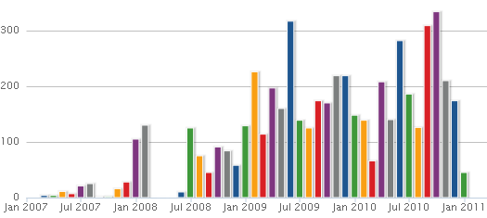
Understanding Individual Uses
How Service is Used
Need to understand how services are used:
Belief: Twitter used regularly since 2007
Evidence: Dabbled for first year
Limitations of Analysis Tools
Need to understand limitations of analysis tools:
Evidence: Twitter not used from Mar-May 2008
Reality: First significant use made at MW2008 in April 2008. Data harvesters may be flawed
My new understanding:
Social Web tools need critical mass to be effective.
Being an early adopter makes it easier to grow nos. of followers

Slide 9
Evidence, Impact, Value
Background
UKOLN activity to support JISC and JISC community
How should we go about gathering evidence of the impact of networked services in order to demonstrate their impact and value?
Update
Two workshops (Glasgow & London) on use of institutional Web services and institutional use of Social Web
Concerns over metrics (‘bean-counting’)
Awareness that changed political & economic context will necessitate work in this area

Slide 10
Surveys
Partial surveys of institutional use of Social Web services:
Which institutions are using popular Social Web services?
How are they being used?
Can we observe patterns of usage?
What are the strengths and weaknesses of semi-automated surveys?
Can such surveys be related to value and ROI?
Coverage:
Facebook, Twitter and iTunes
20 Russell Group and 18 1984 Group Universities

Slide 11
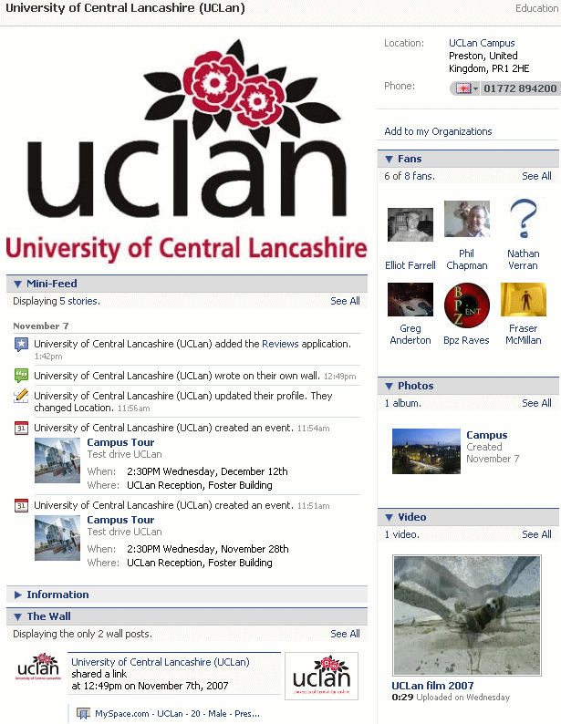
Facebook Usage Patterns 1
Background:
6 Nov 2007: Facebook announcement of organisation Facebook pages
9 Nov 2007: Blog post on first Universities to claim Fb page: 76 in total; 4 from UK (Aston, Cardiff, Kent & University of Central Lancashire). Discussions of ownership, purposes, ROI, …
16 June 2008: Blog post following announcement that Fb is now largest SN which profiled UK HE Fb pages with most ‘fans’: OU (7,539 – largest Uni prescence in world); Aston (2,976); …

Slide 12
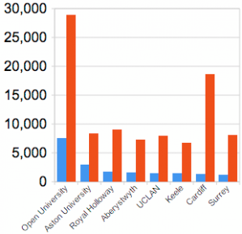
Facebook Usage Patterns 2
Follow Up Survey
8 Oct 2010: follow-up analysis following Fb announcement that data can be downloaded (“Fb less of a walled garden”)
Observations:
Largest nos (of ‘likes’) at OU.
Largest %age growth at Cardiff (13,000%)
Typical %age growth ~400-700%
Discussion:
Why the growth in popularity at Cardiff?
Has change in terminology and environment influenced sign-ups (e.g. Fb pages & groups; need to ‘like’ to complain)
What about others in the sector?

Slide 13
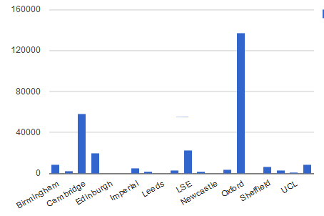
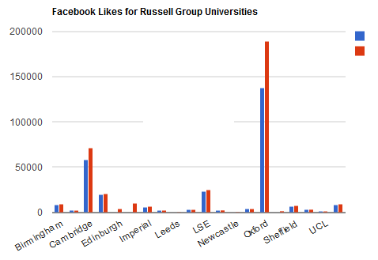
Facebook Usage Patterns 3
Latest Surveys
Jan 2011: Survey of Fb usage by Russell Group Unis
Bands of ‘like’ nos.: 0 (5); -1,000 (1); 1,000-10,000 (10); 10,000-200,000 (2)
Jan 2011
Apr 2011
Apr 2011: survey repeated: All have presence (some with no content!)

Slide 14

Discussion
Evidence helps to formulate questions:
What’s the ‘value’ of 189K ‘likes’?
What are the costs of achieving this number?
In addition what are the:
Missed opportunities in having no Facebook presence?
Missed opportunities in having an empty presence?
What’s the ROI in using Facebook? What the ROI in not using it?

Slide 15
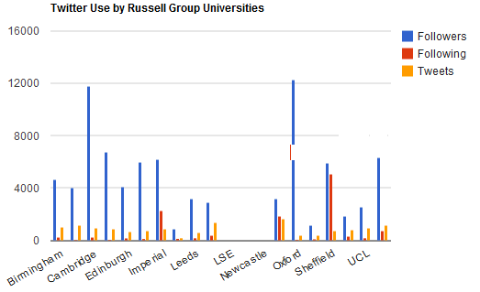
Twitter Usage Patterns
Twitter surveys:
July 2009: Liz Azyan’s ‘Twitter league’ of UK Uni Twitter presences
Jan 2011: Survey of Russell Group Unis’ use of Twitter
Discussion on blog and elsewhere:
Value of data to inform discussions on policies & best practices
Difficulties in finding official channel(s)
Understanding differing usage patterns: do you follow others? do you respond?, …
Is Twitter a broadcast medium or an interactive discussion tool - or can it have multiple purposes?

Slide 16
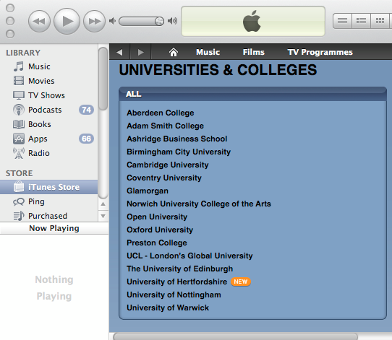
Use of iTunes in UK HEIs
Oct 2010: Survey of institutional use of iTunesU in 10 UK HEIs
Observations showed differing emphases on benefits:
Popularity of service: “Oxford has had over 3 million downloads from its iTunes U site”
Wide range of content: “over 280 albums with content from over 136 courses”, “more than 400 audio and video podcasts”
Content available for free: “you can download educational multimedia resources free of charge”, “you have access to hundreds of free educational video and audio podcasts”, …

Slide 17
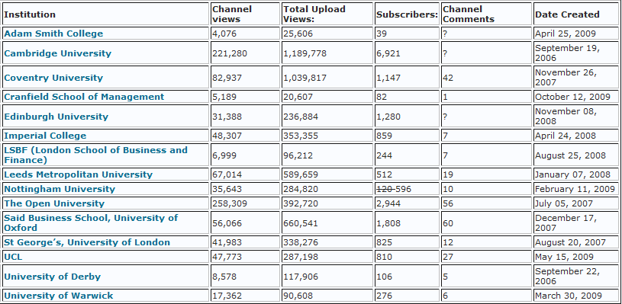
Use of YouTube in UK HEIs
Oct 2010: Survey of official YouTube Edu accounts in 15 UK HEIs
Little evidence of community discussions taking place
Figures need to be related to creation date (importance of trends)

Slide 18
Reflections
Approaches:
Informing sector
Understanding sector
Understanding best practices
Providing forum for informed discussion and debate
But
Value dependent on purpose
Purposes may differ
Institutions differ; resources invested differ; therefore league tables flawed
Need for this work but need to relate metrics to value

Slide 19
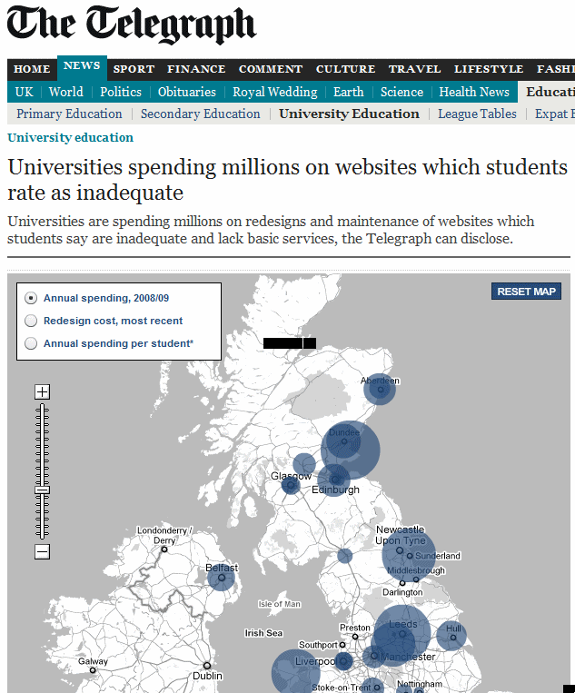
Risks of Doing Nothing
Daily Telegraph, April 2011
Data obtained via FOI
“the average spending on the maintenance of a University Web site is £60,375 pa”
Response on blogs:
“Wow that’s cheap!”: discussion of flaws in methodology
“As the web is the number 1 way of recruiting students … investment is too low. .. article highlights Universities aren't investing enough on web presence.”

Slide 20
Article on University-Website Cost is Unbalanced
Flaws in methodology describe on sidspace.info:
The article takes one data set; expenditure on website development & places it as a cost on a single value proposition; student experience, without considering to monetise the other important purposes of the university website.
[We] estimate the university website is key to bringing potential revenue of anywhere between £1M-£5M in applications from international students every month (1). … This revenue generation is equivalent to that of a single purpose commercial site such as a car manufacturer.

Slide 21
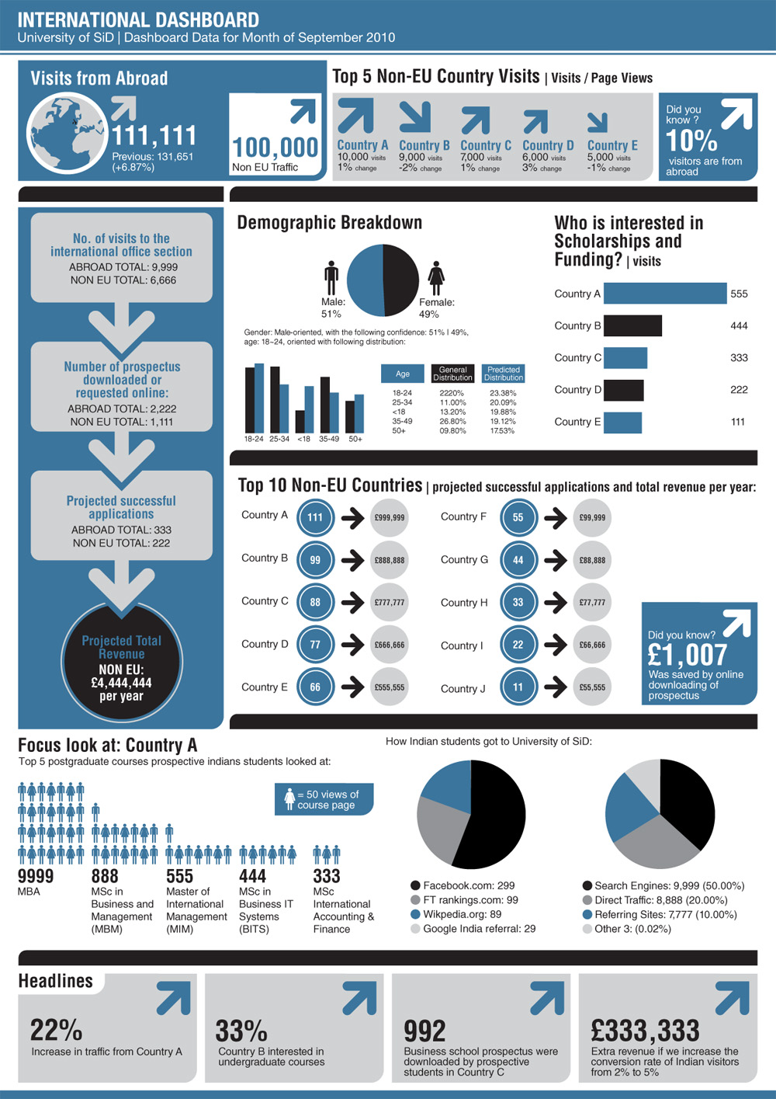
Dashboard
Institutional dashboards:
Being implemented at several HEIs
Focusses on Web site for marketing
Reflects institutional priorities
Provides summary of financial value of Web site visits
See video clip (90 secs)
Further details at sidspace.info

Slide 22
Opportunities and Concerns
Institutions:
Benefits from seeing bigger picture
But worried about how others see them
May become worried that other may steal their competitive advantage
HE Sector (UK HE plc):
Benefits from national comparisons
Benefits from sharing access sector
Benefits from embracing openness and transparency

Slide 23
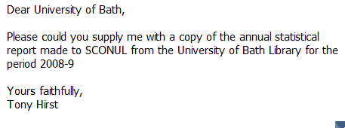
We May Have The Data
FOI requests to obtain existing data (e.g. submissions to SCONUL)
4q. Number of procedural/directional enquiries handled during sample week: 190. 4r. Number of enquiries made of library staff about IT-related matters such as printers, passwords, and general software packages during sample week: 57. 4s. Number of successful requests for full-text articles (journals only) : 1,407,292. 4t. Number of successful section requests for electronic books: 286,514.
7f. Binding, preservation and repairs £9,615. 7g. Electronic resources (=7h+7j+7k) £418,755. 7h. Subscriptions to electronic databases £326702. 7j. Expenditure on e-books £92,053. 7k. Expenditure on other digital documents £0. 7l. Inter-library transactions £36,183.
Libraries collate this data and submit to SCONUL

Slide 24
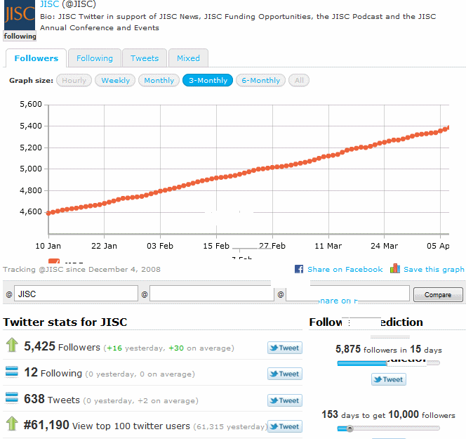
Social Web Auditing Tools
Need to revisit approaches for providing metrics for use of Social Web services:
Twitter:
Virality of messages e.g. Daily Mail’s racist poll: “Should NHS allow gypsies to jump the queue?” (96% say yes!)
Evidence of visits to URLs via bit.ly stats
Other Twitter analytics tools e.g. Twittercounter.com
Note:
Failure to register with services could result in lack of benchmarking data
How do alerts of new funding calls relate to use of mailing lists, RSS feeds, ..?

Slide 25
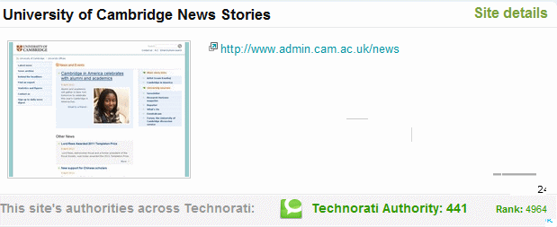
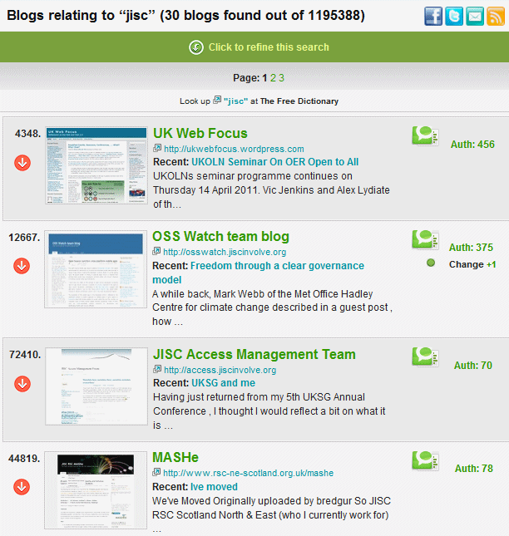
Blog Metrics (1)
Technorati:
Technorati uses nos. of (weighed) inbound links
Cambridge Uni news blog has a ranking of 4,964 (of 1,263,353 blogs):
in top 0.4% based on incoming links
Search of blogs with ‘JISC’ keyword gives 5 with significant ‘authorities’.
MASHe blog has technology authorities of 95 and rank of 2,659 of 27,243 blogs (top 10%)
Authority has scale 0 (low) to1,000 (high)
Based on weighing incoming links.

Slide 26
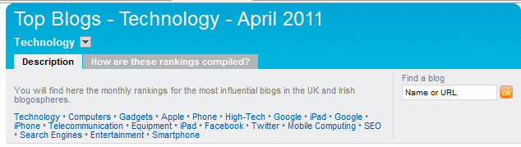
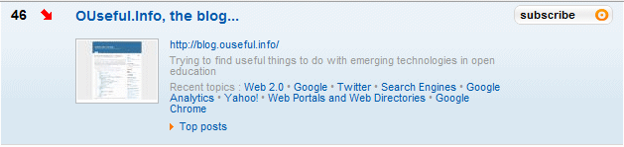
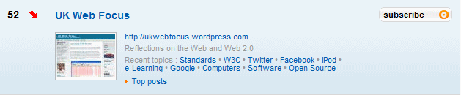
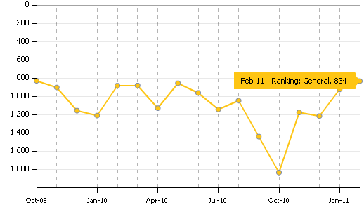
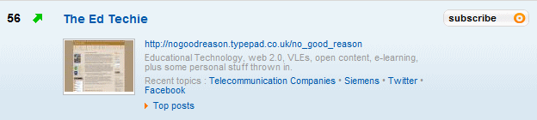
Blog Metrics (2)
Wikio:
Similar approach to Technorati
Three UK HE blogs in top 60 technology blogs
Trends since registration with service provided:

Slide 27
Yer, But No But, …
But:
This is a simplistic approach
Blogs have a variety of purposes e.g. reflective blogs
Yes, but:
Simple may be good enough; can be used with other approaches
True – but some seek to disseminate and engage. Also trends may be valuable
The value may be in the aggregation: x% of top technology blogs are from HE sector
We do SEO – why not SMO?
Might failing to register with such monitoring services be counter-productive: do you have something to hide?

Slide 28
What’s Missing
Talk has provided:
Information about metrics
Comparisons with peers
Trend analyses
Examples of virality provided by social media
What is missing?
Qualitative feedback
Understanding of in-house factors
A focus of outcomes
The ethical aspects of SMO
…

Slide 29
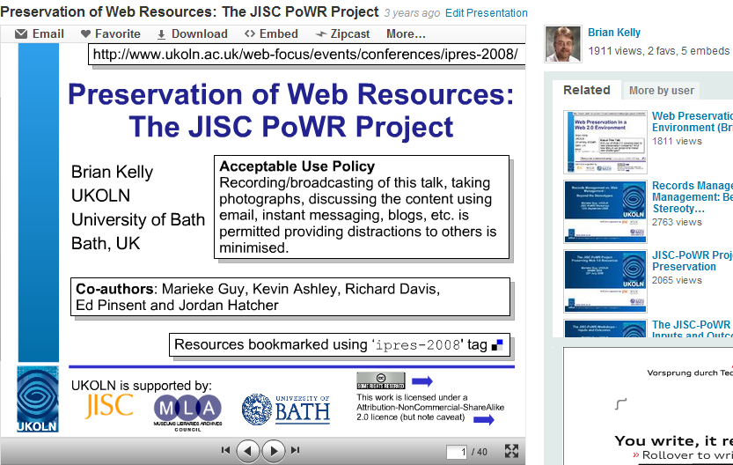
“Impact of JISC PoWR”
Request in May for evidence of impact of JISC PoWR project:
Slideshare stats
Blog post gave details of embedding on Dutch blog
Twitter RTs by Dutch followers
Comment on impact of project
Respond received day after request!
“I used the project-outcomes not only to get my arguments about why websites should be archived straight, but also to show the webmaster of my organisation what needs to be done. Eventually they started preserving our website by contracting a third-party-service.” Ingmar Koch, Archiefinspecteur at Provincie Noord-Brabant

Slide 30
Conclusions
We should do more:
Collating data across sector helps to identify patterns of usage, challenge assumptions, stimulate discussions & inform best practices
But
HEIs don’t like reducing impact & value to numbers
We’re worried about evidence of lack of impact
However:
The political and economic climate are forcing a reappraisal of attitudes
We have data mining experts who may be able to help identify ’value’
Can we afford not to engage?

Slide 31
Questions
Any questions or comments?

Slide 32
Note
Please note
The JISC and University of Bath logos and images on slides 5 and 6 are not available under a Creative Commons licence
Screen images are also not available under a Creative Commons licence
Links to further information available by clicking on blue arrows

