Slide 1



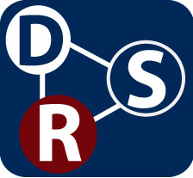

Repeat, Reuse, Remix, Reproduce, … Reconstructable Research
David De Roure
Notes:
My talk from the Sound Software workshop at Queen Mary University London on Monday 18th – talking with domain-specific software experts about the scholarly record and how they might apply their sound software thinking to the greater challenge of reconstructable research.

Slide 2

Digital Music Collections
Digital Music Collections
Digital Music Collections
Digital Music Collections
ground truth
ground truth
ground truth
Community Software
Community Software
Community Software
Expertise
Expertise
Expertise
Expertise
Results
Results
papers
Results
papers
Results
Evaluation Infrastructure (sociotechnical)
papers
Evaluation Infrastructure (sociotechnical)
Papers
Evaluations
Evaluations
Evaluations
Notes:
Different research communities have their own practices with respect to sharing and publishing research results, data, methods and software. The Music Information Retrieval (MIR) Research community is, I believe, an excellent example – particularly due to MIREX, the “Music Evaluation Exchange” which generates an annual cycle of innovation and evaluation of feature extraction algorithms (this is not a competition, though it publishes league tables!) MIR researchers bring together digital audio collections (not freely copyable, so they send code to data), human-sourced “ground truth”, deep multidisciplinary expertise, software, algorithms, results and papers (in the ISMIR conference), and evaluations (in MIREX). It’s a significant and impressive sociotechnical infrastructure, owing something to information retrieval but reinvented as multimedia, multidisciplinary and, well, musical.

Slide 3
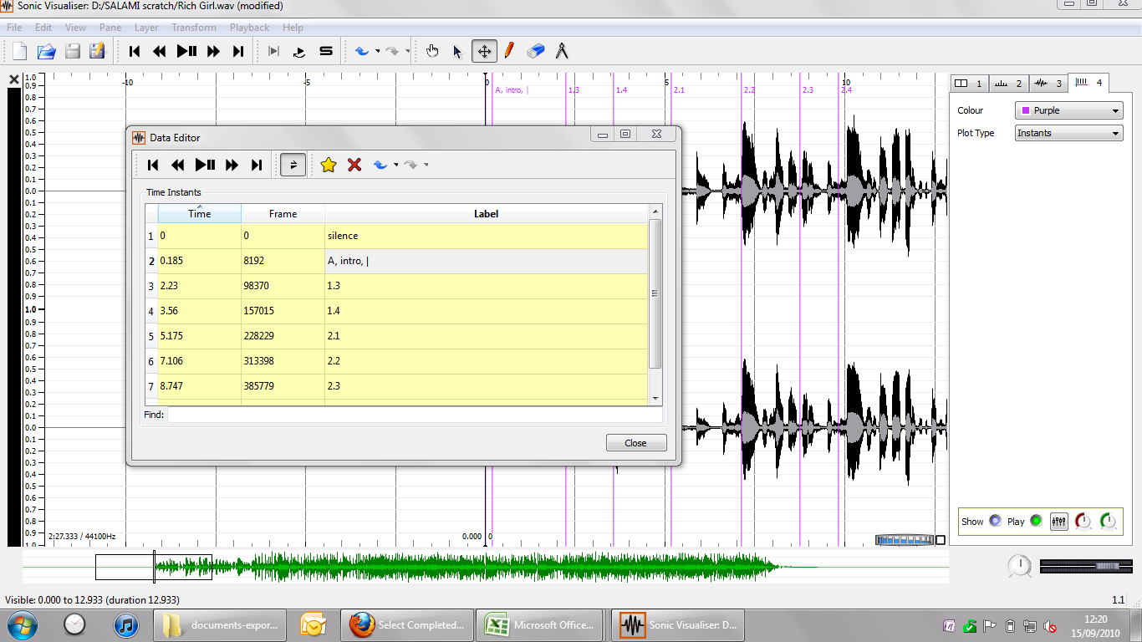
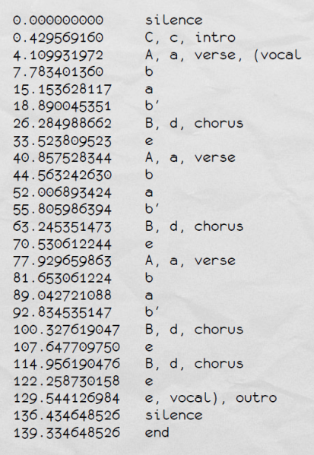
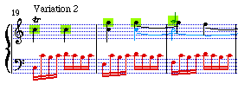

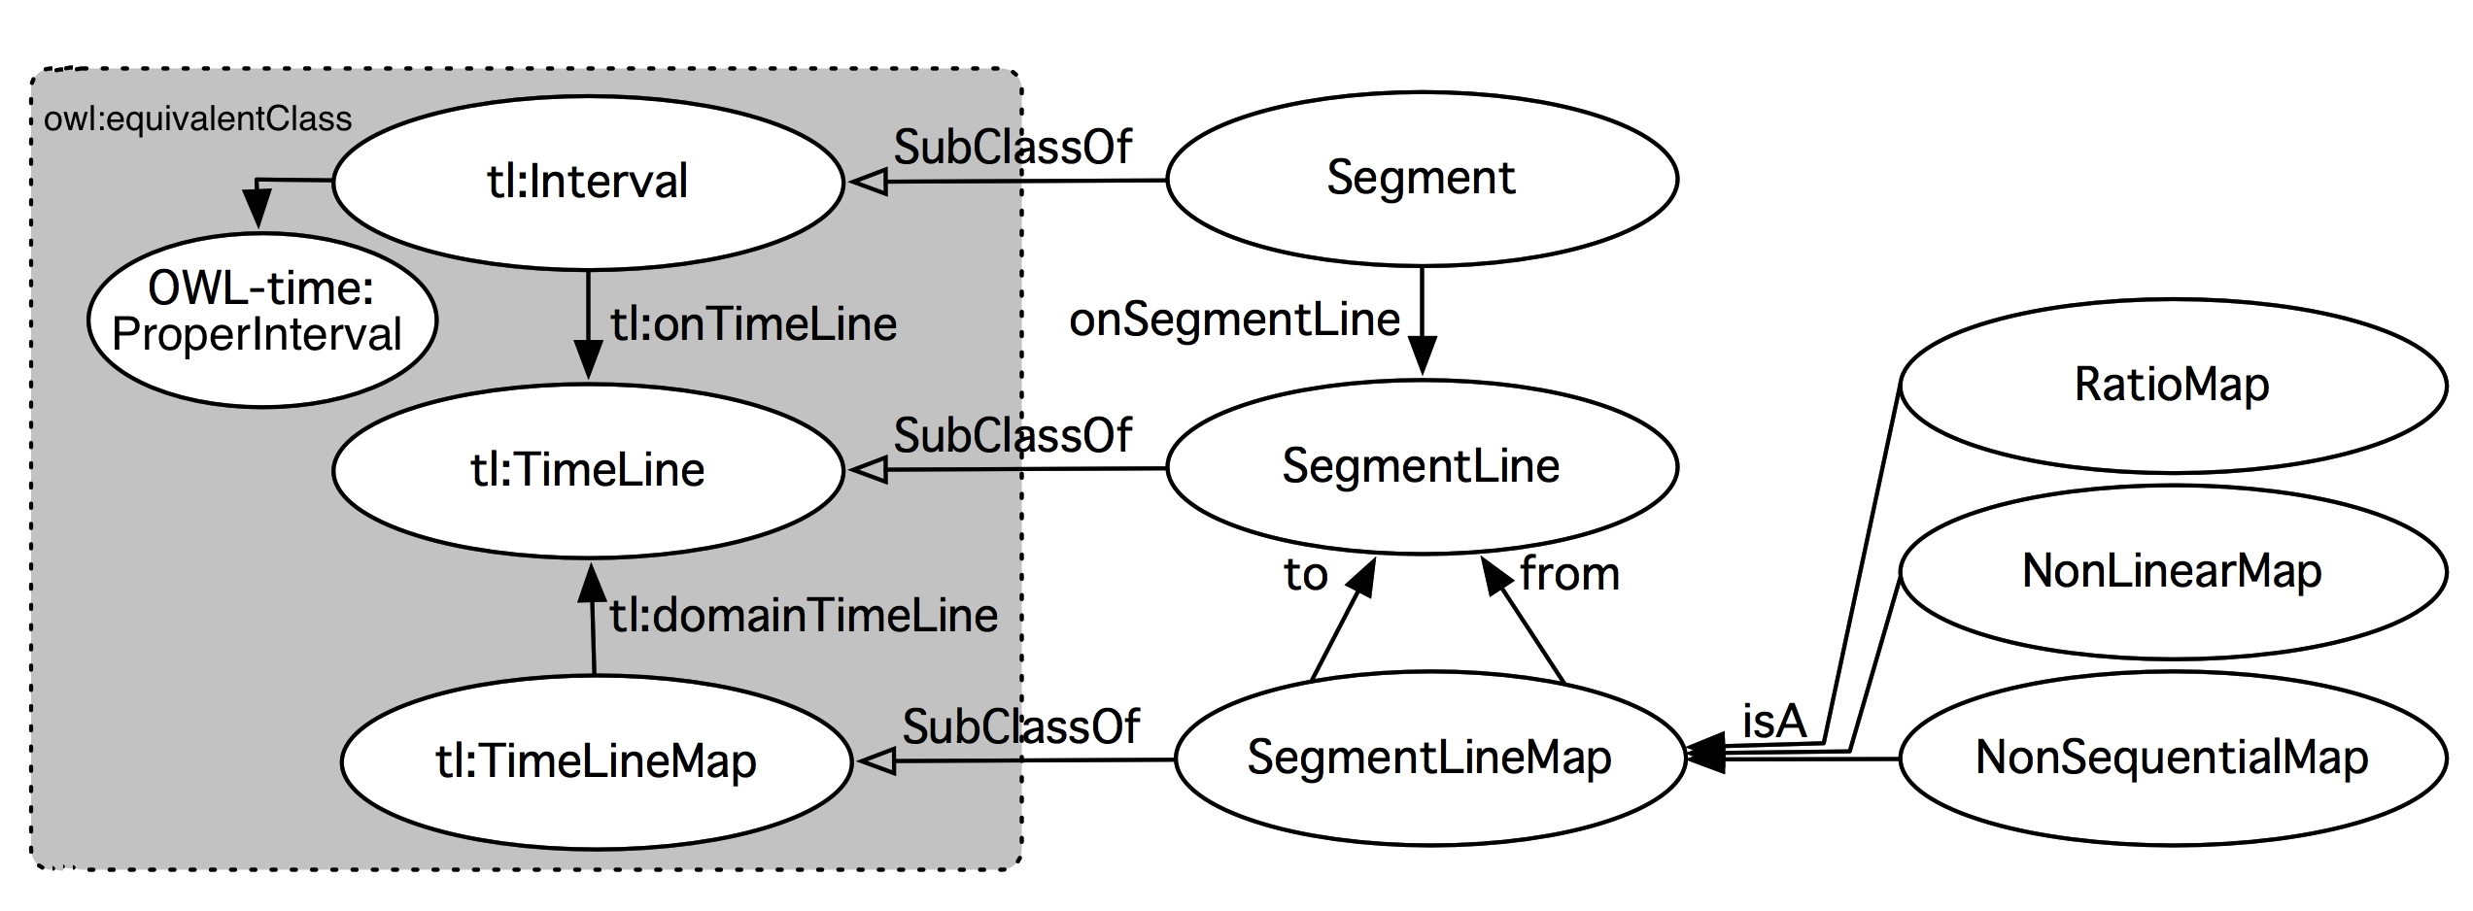
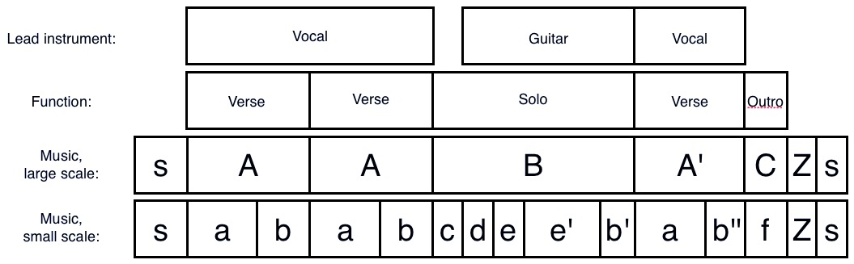
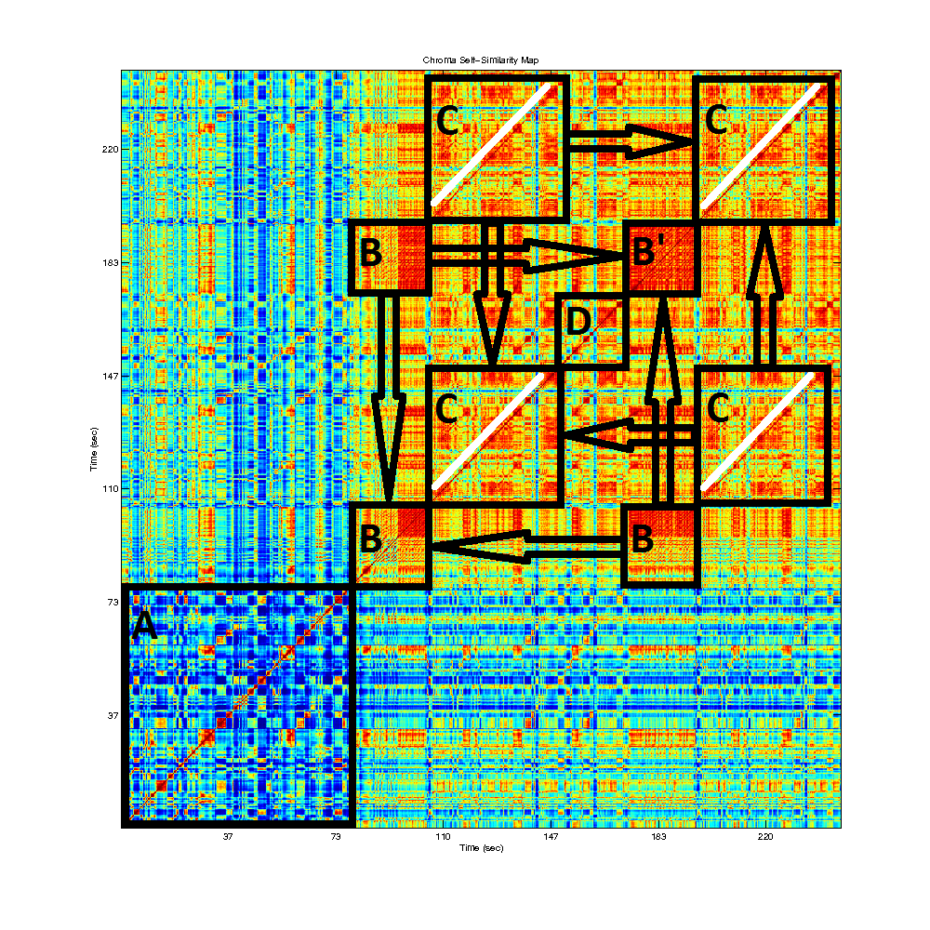
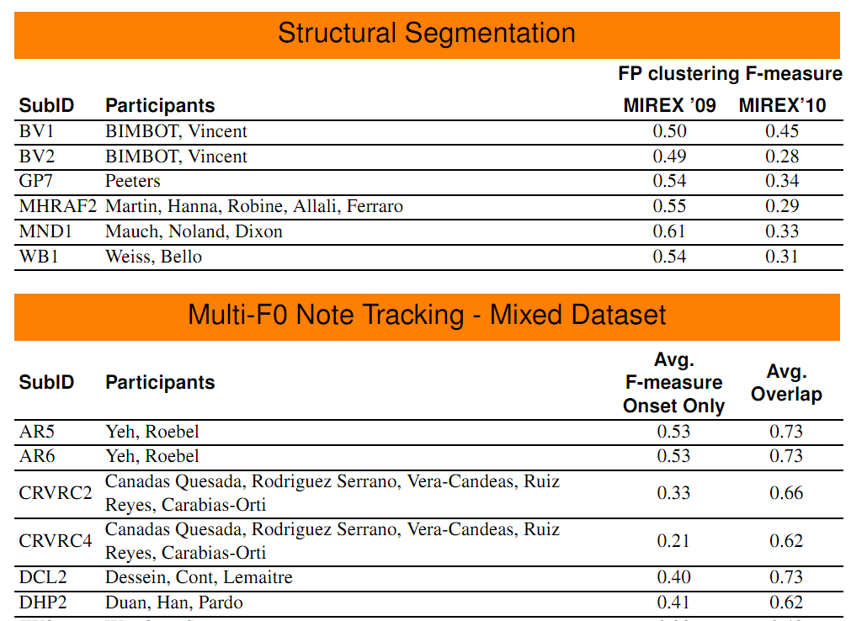
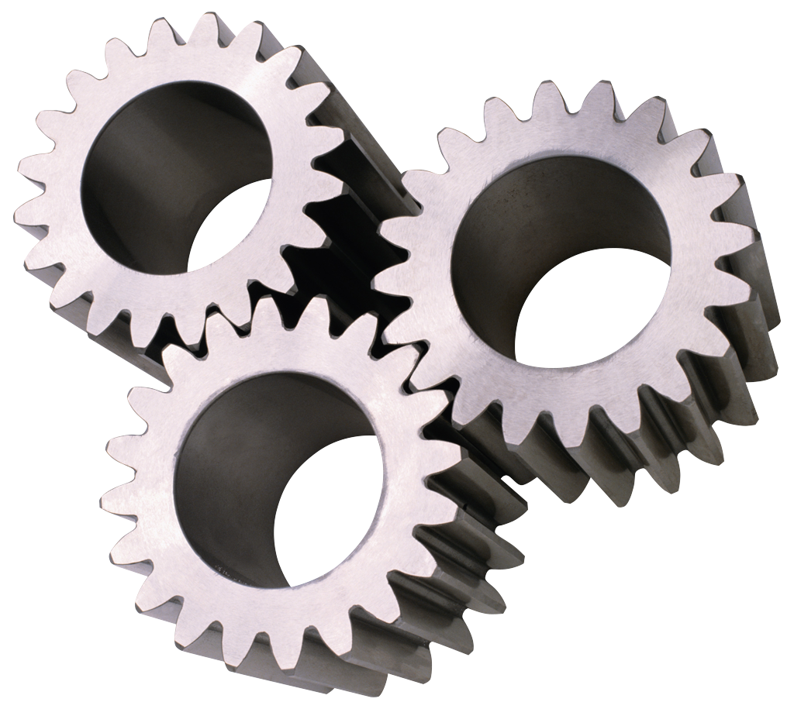
Assembly of Artefacts
Notes:
Let’s think about the scholarly communication perspective – the research record. Conducting a music information retrieval experiment involves a set of digital artefacts which can be reused. For example in the SALAMI (Structural Analysis of Large Amounts of Music Information) project we have digital audio (from the Internet Archive), software tools (e.g. Queen Mary’s Sonic Visualiser), ground-truth annotations (published), segmentation ontology (published), algorithms (from MIREX), autocorrelation plots and evaluations (online). The record of a particular experiment, then, can be captured as an assembly of these artefacts. Just now we share some of the pieces quite well but perhaps not the aggregations.

Slide 4
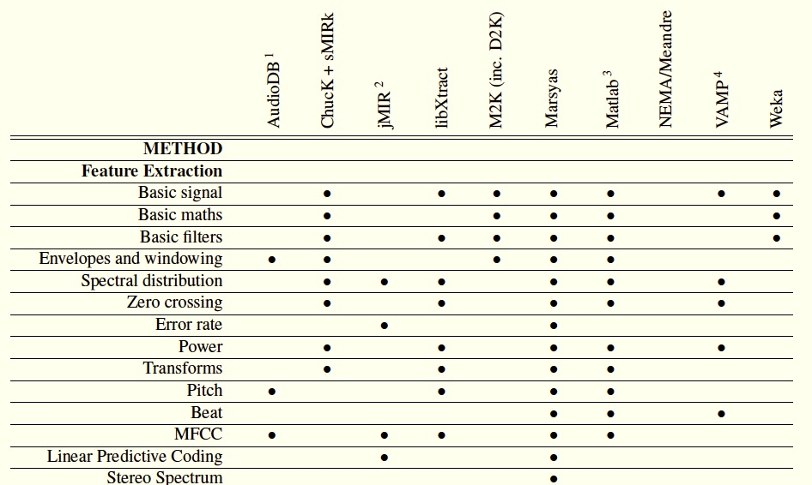
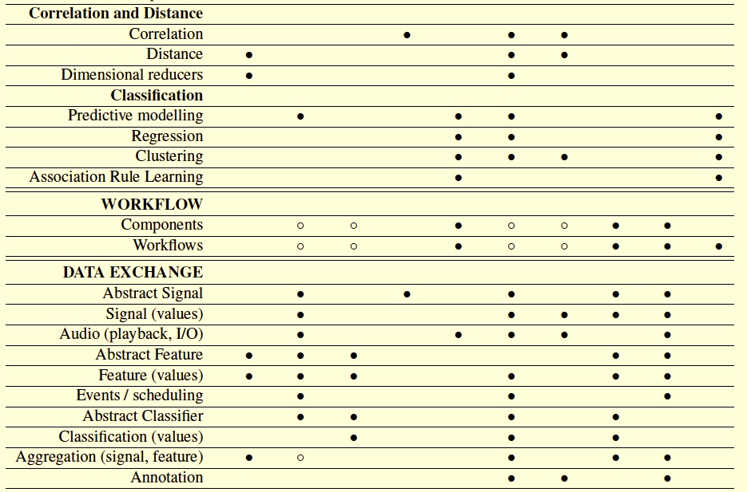
Assembly of Apparatus
Notes:
Typically an MIR experiment also involves an assembly of software apparatus – from a range of toolkits, with overlapping functionalities, each co-evolved for particular uses and sustained by their user and developer communities.

Slide 5
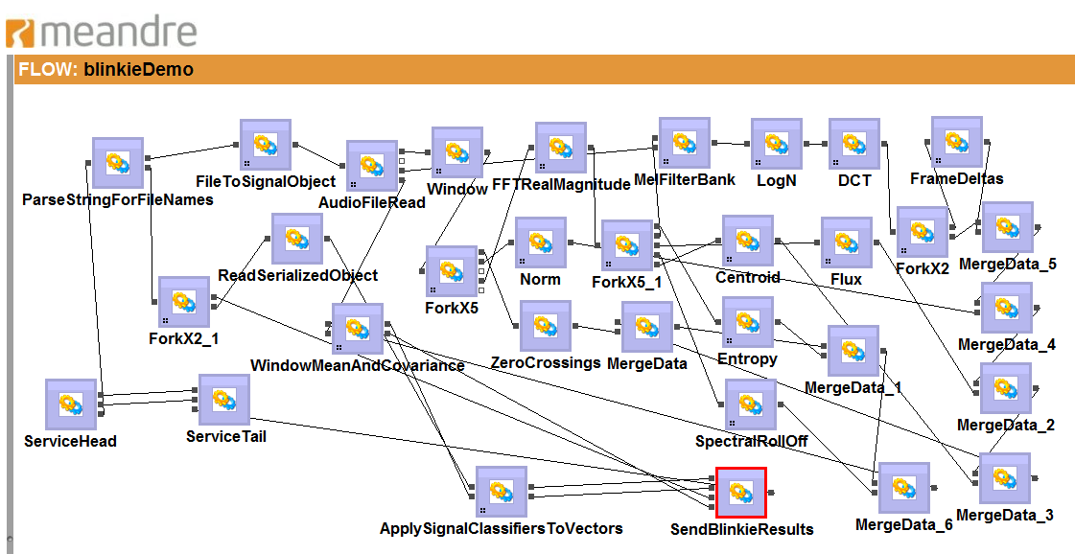
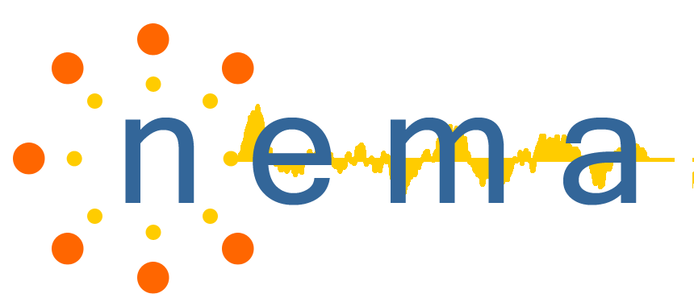
http://seasr.org/meandre/
Assembly of Apparatus
Notes:
The assembly is made particularly explicit where a workflow system is used, as in the flows of the Meandre system. There are multiple levels of abstraction: experts innovate in the algorithms embedded in specific components but also in their assembly into music analysis pipelines, whether using software, workflows or scripts.

Slide 6
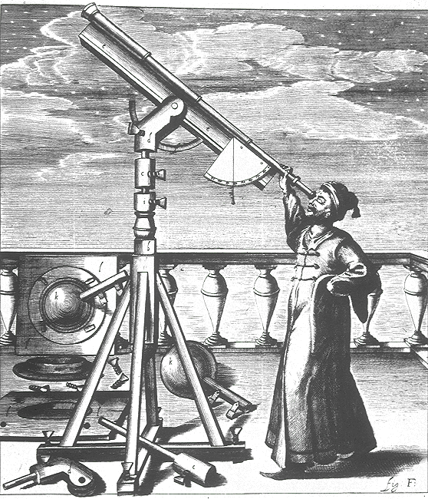
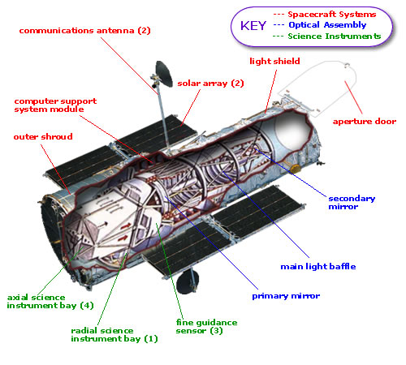
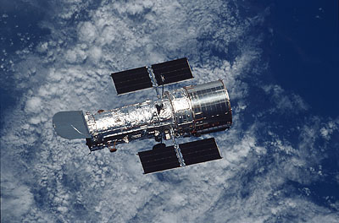
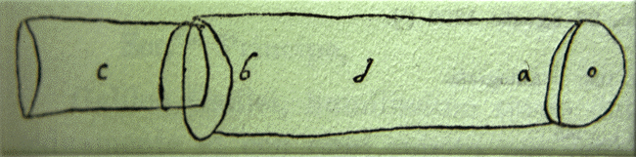
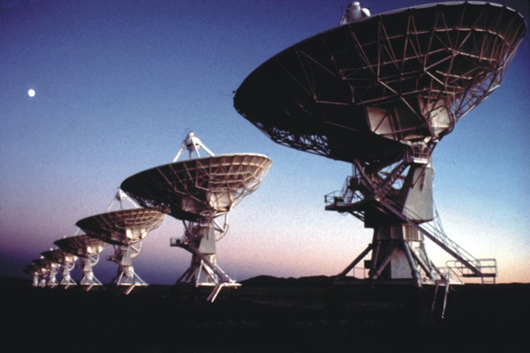
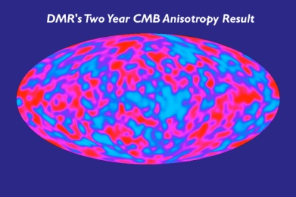
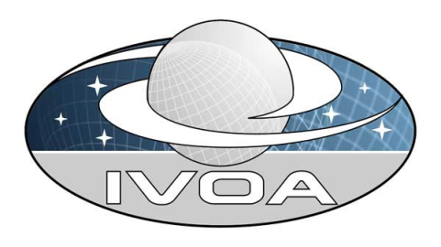
telescopes for the naked mind
Datascopes
NRAO/AUI/NSF
From Signal to Understanding
Notes:
Such an assembly of software apparatus is rather like a scientific instrument – a datascope, taking us from signal to understanding – and itself under continuous improvement.
(Slide by Malcolm Atkinson, from The Galileo Project web site: http://galileo.rice.edu/sci/instruments/telescope.html
- The earliest known illustration of a telescope. Giovanpattista della Porta included this sketch in a letter written in August 1609 - porta-sketch
Johannes Hevelius (Poland, 1611-1687) observing with one of his telescopes (Source: Selenographia, 1647)
Hubble_earth_horz and hubble - from http://hubble.nasa.gov/.
Very Large Array from http://images.nrao.edu/Telescopes. Copyright requirement - include "NRAO/AUI/NSF" on slide.)

Slide 7
method
data
Notes:
While the world is now grasping the importance of data sharing, we must also grasp the importance of sharing these experiments and instruments; i.e. it’s not just the data, it’s what you do with it. Sharing builds community capability and better science, and this is what we want from the scholarly record. The sound software and MIR community is good at this, for example through software repositories, online resources and proceedings, and getting even better. Can we take this further?

Slide 8
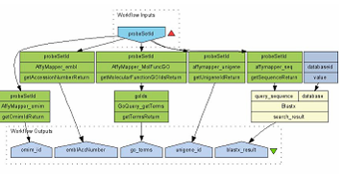
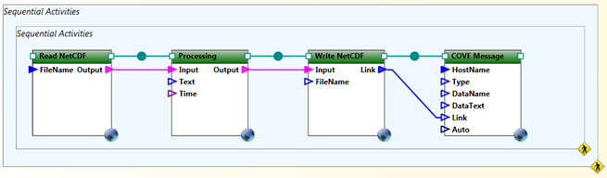
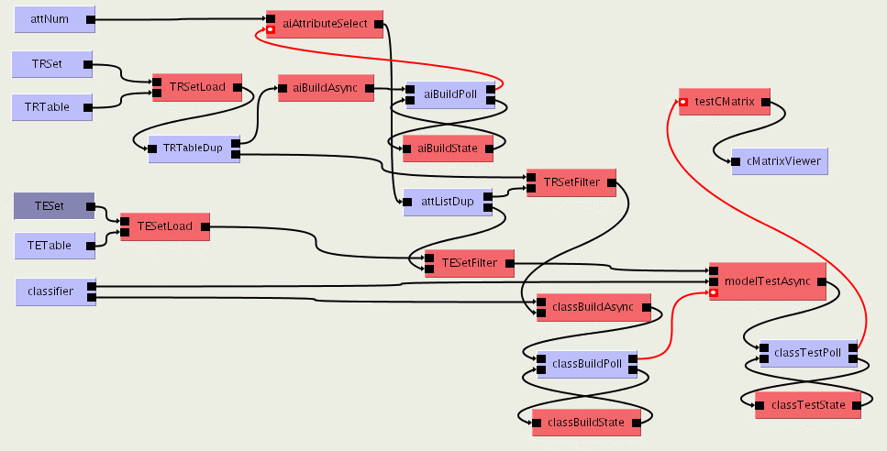
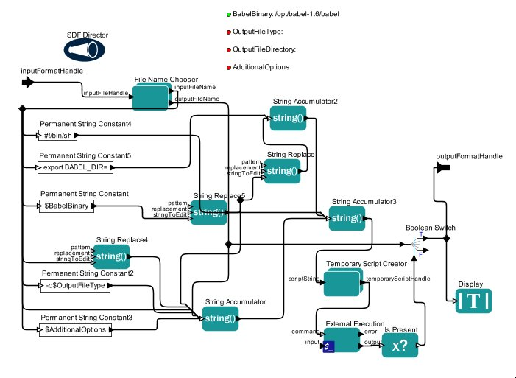
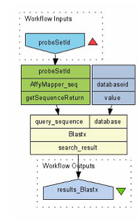
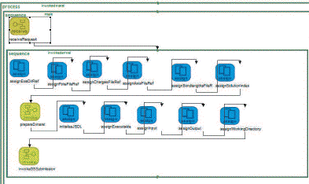
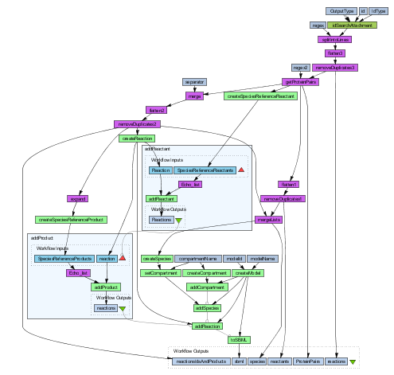
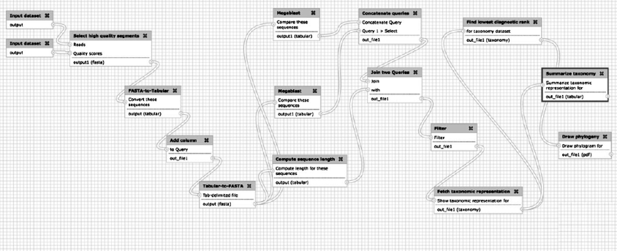
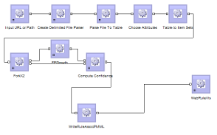
Trident
Triana
Kepler
BPEL
Meandre
Taverna
Galaxy
Notes:
8
We have an angle on this based on experience with the myExperiment social website for sharing workflows and the associated Wf4Ever preservation project.

Slide 9

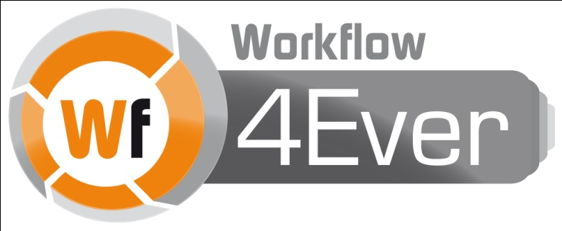








“Facebook for Scientists” ...but different to Facebook!
A repository of research methods
A community social network of people and things
A Social Virtual Research Environment
A probe into researcher behaviour
Open source (BSD) Ruby on Rails app
REST and SPARQL interfaces, supports Linked Data
Influenced BioCatalogue, MethodBox and SysMO-SEEK
myExperiment currently has 307 groups, 2442 workflows, 608 files and 236 packs - see wiki.myexperiment.org

Slide 10
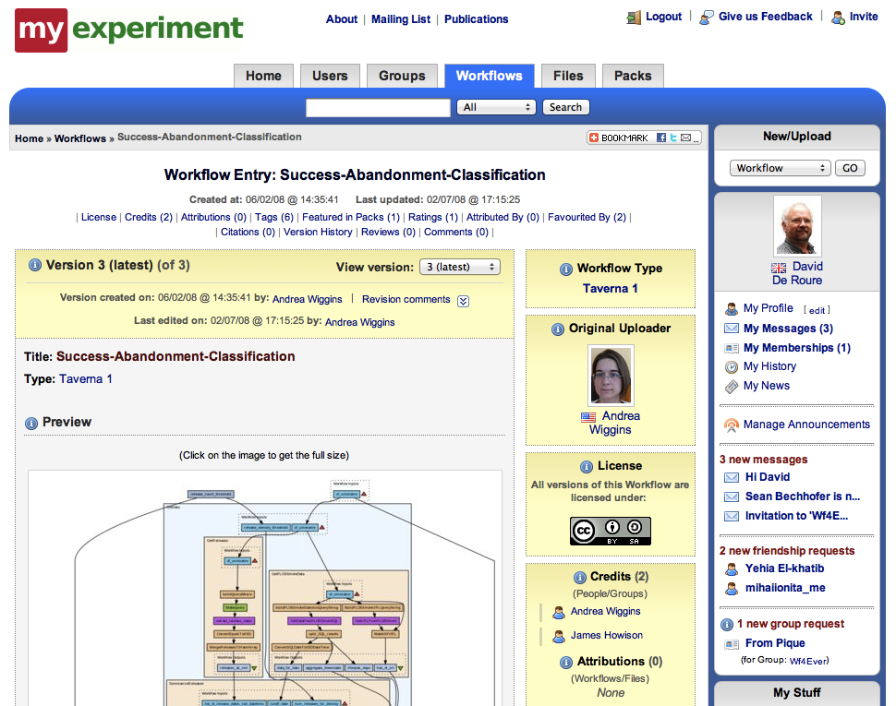
http://www.myexperiment.org/
Notes:
We’ve learned that what people want to share isn’t just the workflow but the associated artefacts – slides, papers, data – and this has enabled us to reflect on the assemblies to be shared in future scholarly communication; i.e. it’s a kind of social experiment to see what are the digital artefacts that people wish to share and publish, to drop into the tooling of digital research.

Slide 11
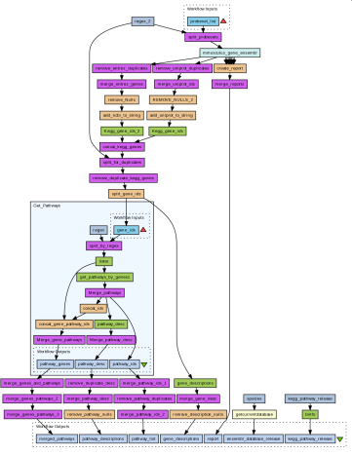
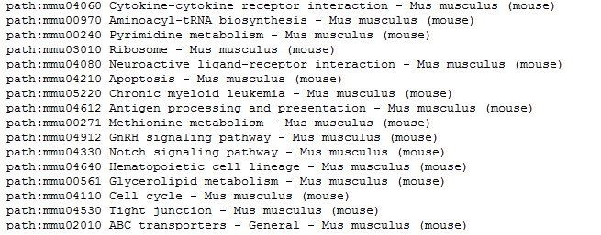
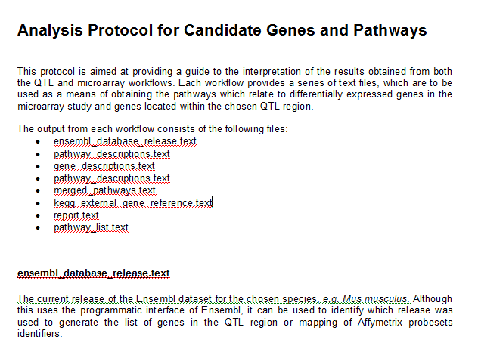
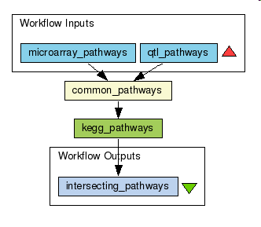
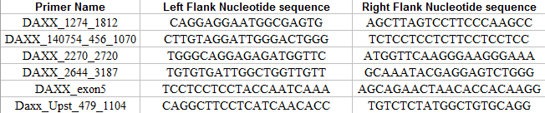

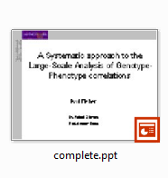
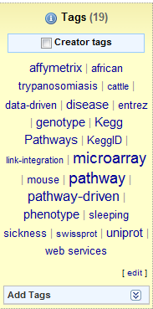
Paul’s Pack
Paul’s Research Object
Workflow 16
QTL
Results
produces
Included in
Published in
Included in
Feeds into
Logs
produces
Included in
Included in
Metadata
Slides
Paper
produces
Published in
Common pathways
Workflow 13
Results

Slide 12
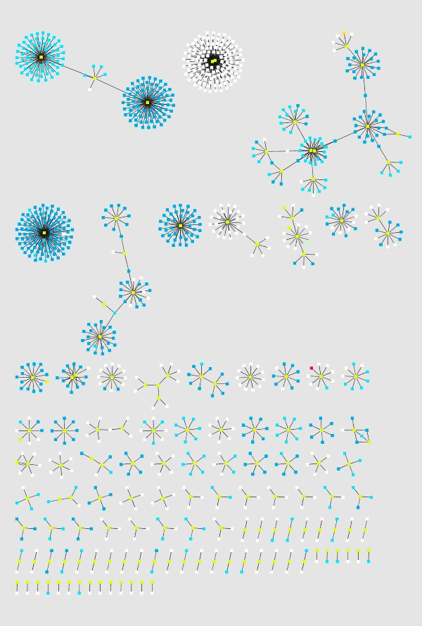
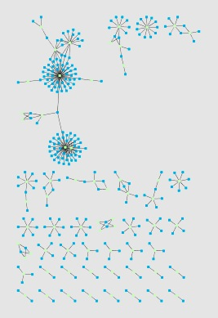
Sean Bechhofer
SELECT?wf ?uri
WHERE {
?wf mebase:has-current-version ?v.
?v mecomp:executes-dataflow ?d.
?d mecomp:has-component ?c.
?c rdf:type mecomp:WSDLProcessor.
?c mecomp:processor-uri ?uri.
}
SELECT?pack ?contrib
WHERE {
?pack rdf:type mepack:Pack.
?pack ore:aggregates ?contrib.
}

Slide 13
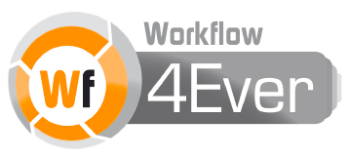
The R dimensions
+ Repair, Release, …
Reusable. The key tenet of Research Objects is to support the sharing and reuse of data, methods and processes.
Repurposeable. Reuse may also involve the reuse of constituent parts of the Research Object.
Repeatable. There should be sufficient information in a Research Object to be able to repeat the study, perhaps years later.
Reproducible. A third party can start with the same inputs and methods and see if a prior result can be confirmed.
Replayable. Studies might involve single investigations that happen in milliseconds or protracted processes that take years.
Referenceable. If research objects are to augment or replace traditional publication methods, then they must be referenceable or citeable.
Revealable. Third parties must be able to audit the steps performed in the research in order to be convinced of the validity of results.
Respectful. Explicit representations of the provenance, lineage and flow of intellectual property.
Replacing the Paper: The Twelve Rs of the e-Research Record” on http://blogs.nature.com/eresearch/
Notes:
From this we’ve defined the notion of “Research Objects”, which are reusable, repurposeable, repeatable, reproducible, replayable, referenceable… lots of R-words, most recently including repair and release. Whichever of these we are doing, the key word might be reconstruct – the ability to reconstruct software apparatus, experiments and results. And Research Objects can be used by machines as well as people.

Slide 14
Research Record
repeat
repeat
Machine
paper
Machine
REPRODUCE
algorithm
paper
software
software
software
Machine
Machine
Software
REPRODUCE OR REPEAT?
paper
workflow
workflow
software
wf
software
Machine
Machine
Software

Slide 15
What is the future of the papers so that we can reconstruct research?
“Instruments”
Experiments
Results
Research
http://blogs.nature.com/eresearch/2012/06/10/more-rs-than-pirates

Slide 16
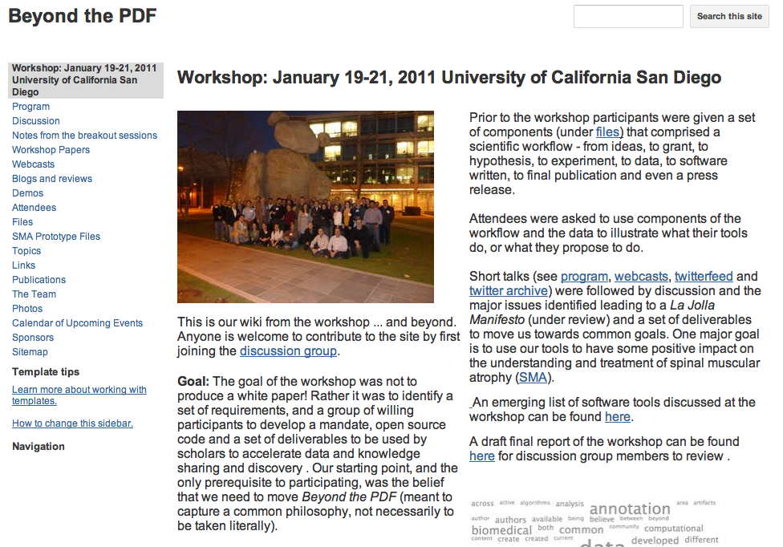
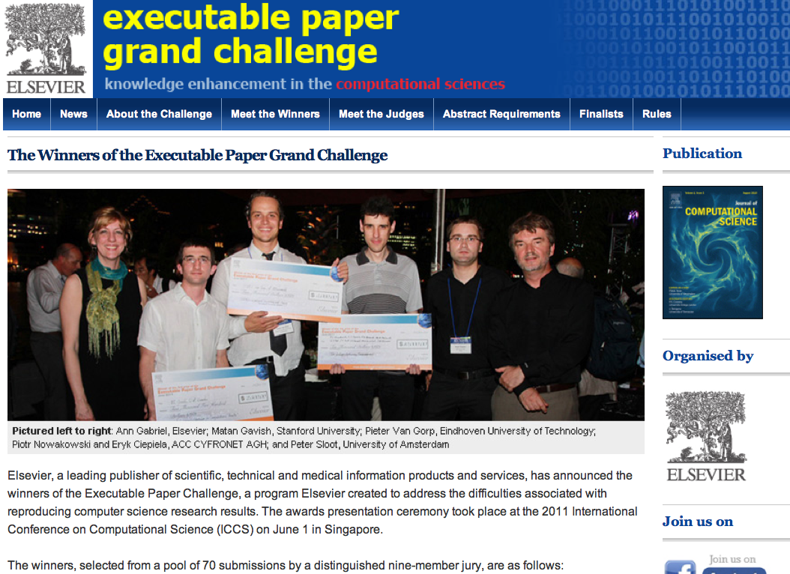
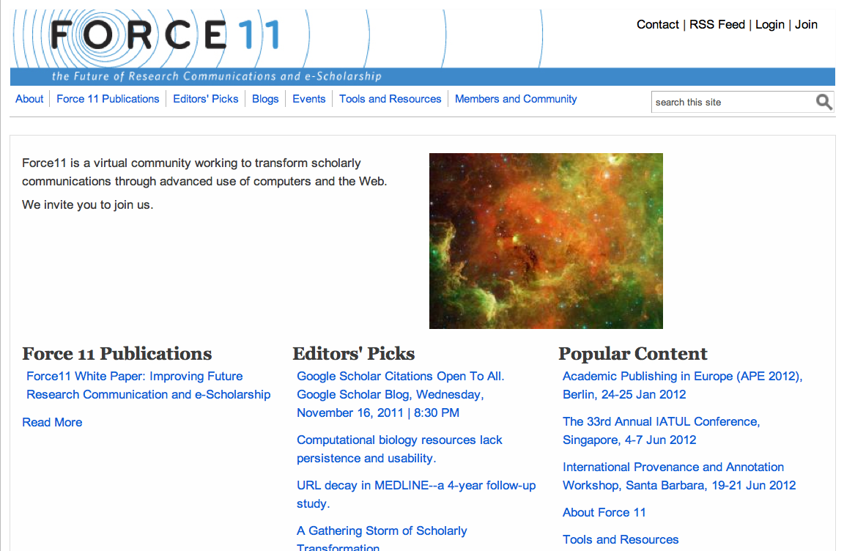
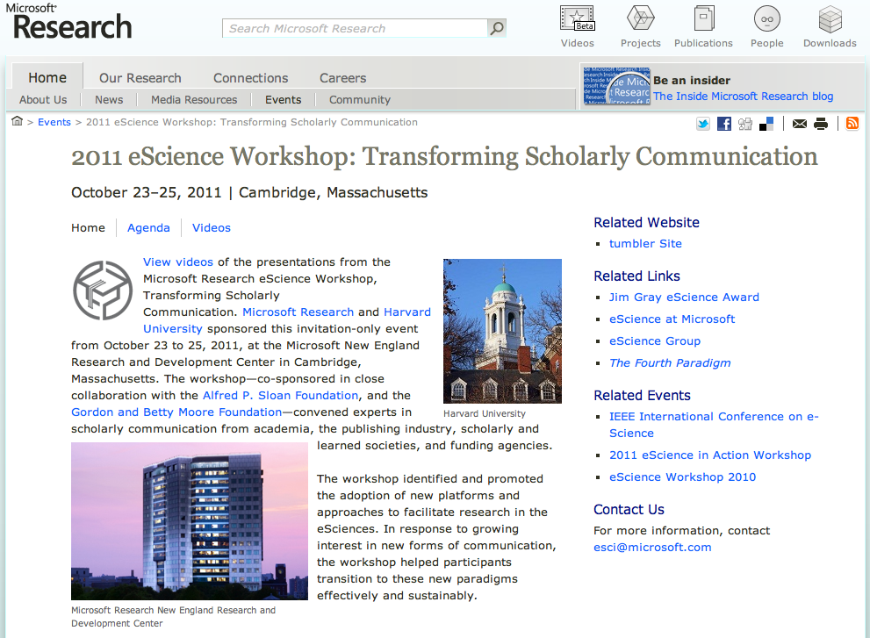
http://force11.org/
Notes:
That’s what we want, but what we have today is academic papers. The question is, what is the future of the paper so that we can reconstruct digital research?

Slide 17
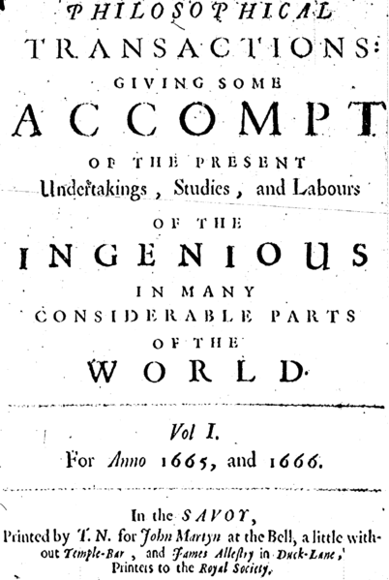
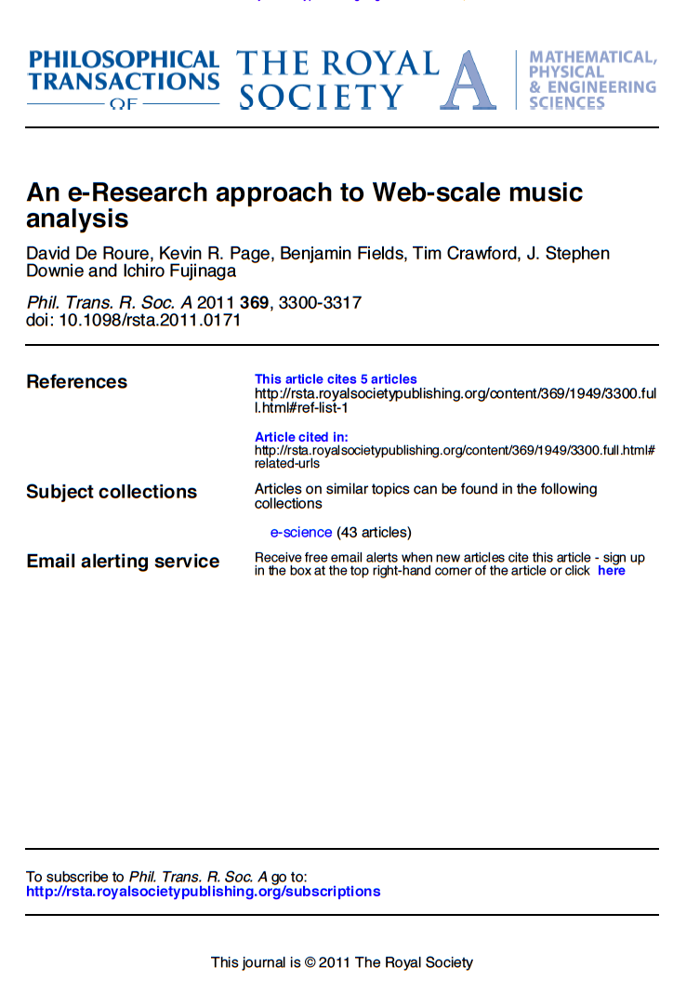
Notes:
This is hotly debated and probably the printed and PDF copy are not the answer.

Slide 18
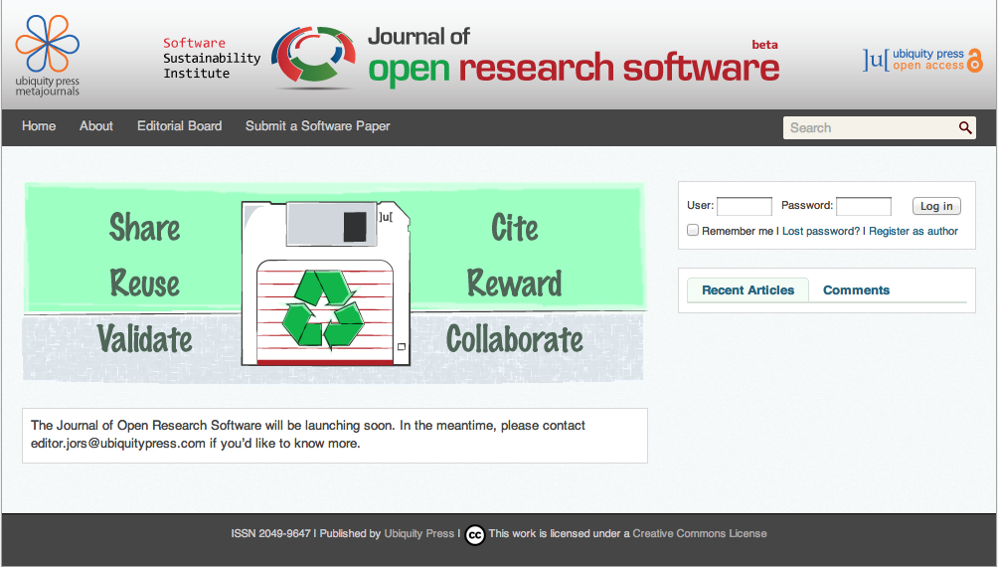
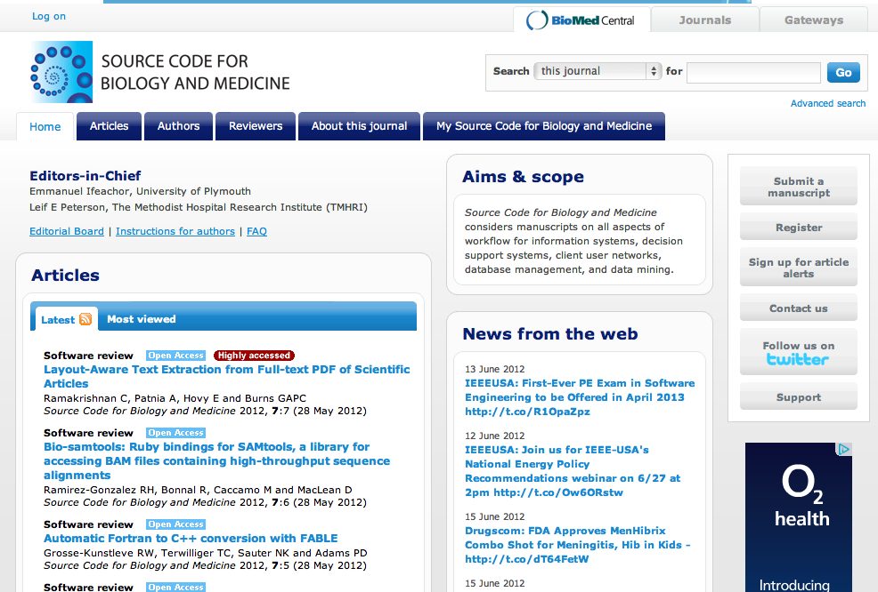
openresearchsoftware.metajnl.com
www.scfbm.org
Notes:
One important innovation is the arrival of data journals and the new journals which treat software as a first-class citizen, like the Journal of Open Research Software, and Source Code for Biology and Medicine. Important steps along the way, but still a way to go.

Slide 19
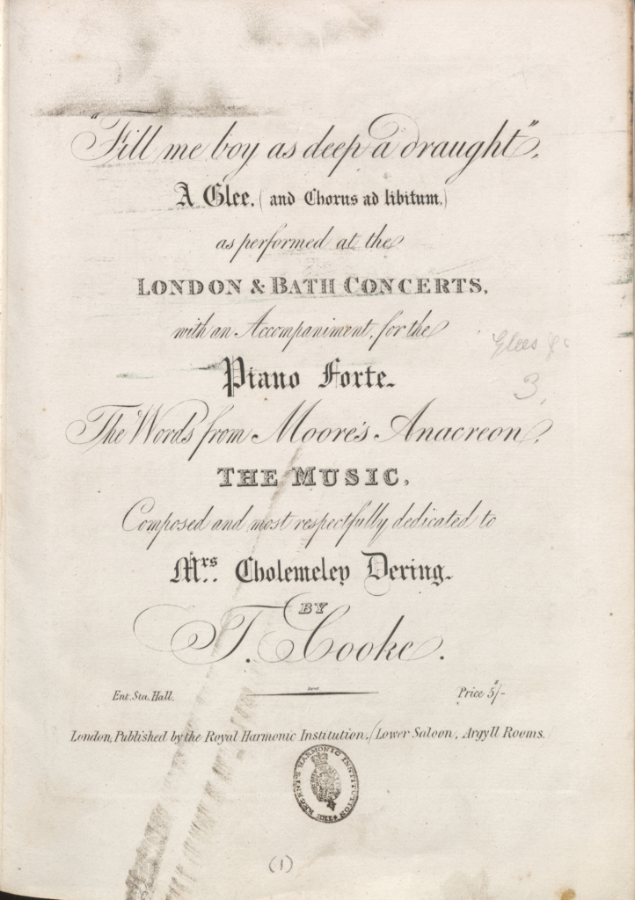

How do we reconstruct Citizen Scholarship?
http://www.bodleian.ox.ac.uk/bodley/library/special/projects/whats-the-score
Notes:
Incidentally – for later discussion! - how do we reconstruct Citizen Scholarship? This is the “What’s the Score at the Bodleian” citizen science (music) project, one of the Zooniverse projects.

Slide 20
Discussion
An experiment is an assembly of artefacts
Software is an assembly of artefacts
What is the research record so that we can reconstruct research?
- Describe or encapsulate? (Web or particle?)
- Learn from software practice?
Machines are users too… autonomic Mirex?
Data is getting attention, remind people about software too, and experiments as reconstructable research objects… which might be executable
Notes:
And so here’s an interesting opportunity for software experts. We have discussed how the assembly of software apparatus enters the research record so that we can reconstruct our apparatus. But assembling the digital artefacts of experiments share many aspects of software – digital, sometimes executable, volatile. The software community might have some very good ideas for the future of the experimental research record, beyond the data and software journals and for machines as well as human readers.
Hence I believe the vibrant “sound software” community could lead the way in setting best practice with sustainable research objects, not just software. Already I know many researchers routinely adopt some software development tools to facilitate paper preparation. Github for MIR experiments anyone?

Slide 21
david.deroure@oerc.ox.ac.uk
www.oerc.ox.ac.uk/people/dder
blogs.nature.com/eresearch
@dder
Credits: Ashley Burgoyne, Ichiro Fujinaga, Kevin Page, Ben Fields, Stephen Downie, Malcolm Atkinson, Iain Buchan, Carole Goble, Paul Fisher, Sean Bechhofer, Tim Crawford
http://www.myexperiment.org/packs/273
Notes:
Special thanks to Kevin Page and Sean Bechhofer for their reflections on Research Objects and MIR, to Stephen Downie for running the sociotechnical infrastructure that is MIREX, and to Ichiro Fujinaga for the third corner of the SALAMI triangle.

