Slide 1

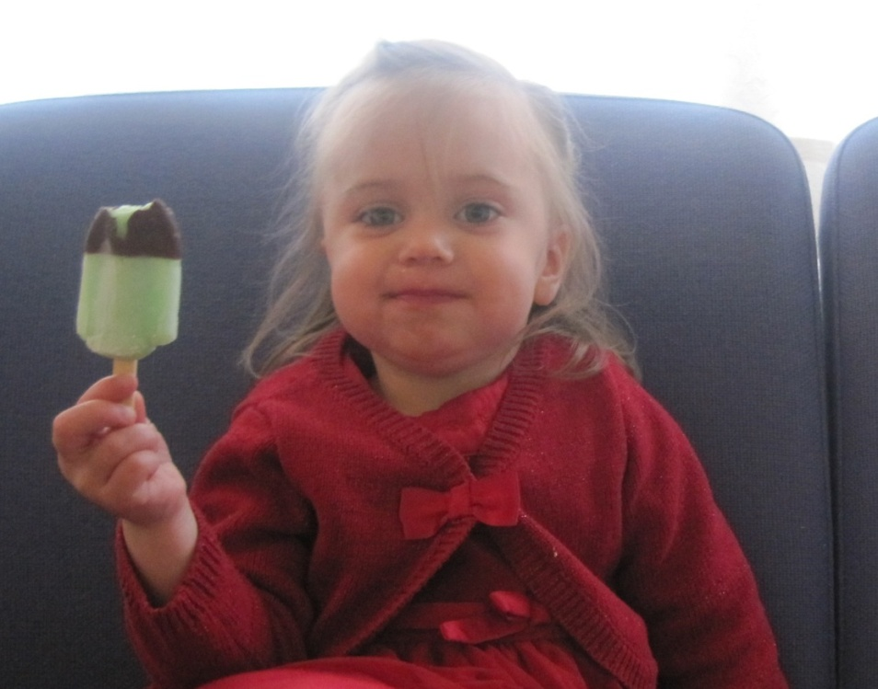
On the road to motherhood
Aðalbjörg Gunnarsdóttir
Notes:
Today I am going to tell you about a research I conducted with a small group of young women with physical impairment about motherhood, but none of them currently had children.

Slide 2
Why this topic?
I am physically impaired my self
I have great interest in fighting for the rights of people with physical impairment
I wanted the voice's of these women to be heard with the purpose of increasing understanding and liberality and diminish the prejudice
I have experienced prejudice myself as a women with physical impairment regarding having children
Notes:
The reason for choosing this topic and my interest in writing and talking about it is the fact that I physically impaired myself.
I have great interest in fighting for the rights of people with physical impairment in general, battle the prejudice that still unfortunately are common and demonstrate that physical impairments do not reduce or minimize women’s capabilities to become fit and good mothers.
I wanted the voice’s of young women with physical impairments to be heard with the purpose of increasing understanding on disability and motherhood and hopefully contribute to the fight against prejudice.
I have experienced prejudice my self as a women with physical impairment regarding having children. Although research has not been done in Iceland with this group before, researches in other countries show that there is a lot of prejudice when it comes to mothers with physical impairments and also towards women thinking about or dreaming of having children.

Slide 3
My BA Thesis
My thesis is about the opinion that women with physical impairments have about having children and having a family
I focused on their skills as potential future mothers and their hindrance to becoming a mother
Notes:
My thesis is about the opinion that women with physical impairments have about having children and having a family. The study also examines how the women perceive their parenting abilities and what social and cultural factors hinder their access to motherhood. The research took place in 2008 to spring 2009. I wanted to see what ideas the women had about having a child, if they wanted to have children in the future and their expectations of having a family. I focused on their skills as potential future mothers and their hindrance to becaome mothers. The participants where six women with physical impairment born in the years 1970 to 1987 and had in common that they did‘nt have children. These women wanted to experience the motherhood just like other women do. They feel a lot of prejudice all around them when it comes to having a child and having physical impairment

Slide 4
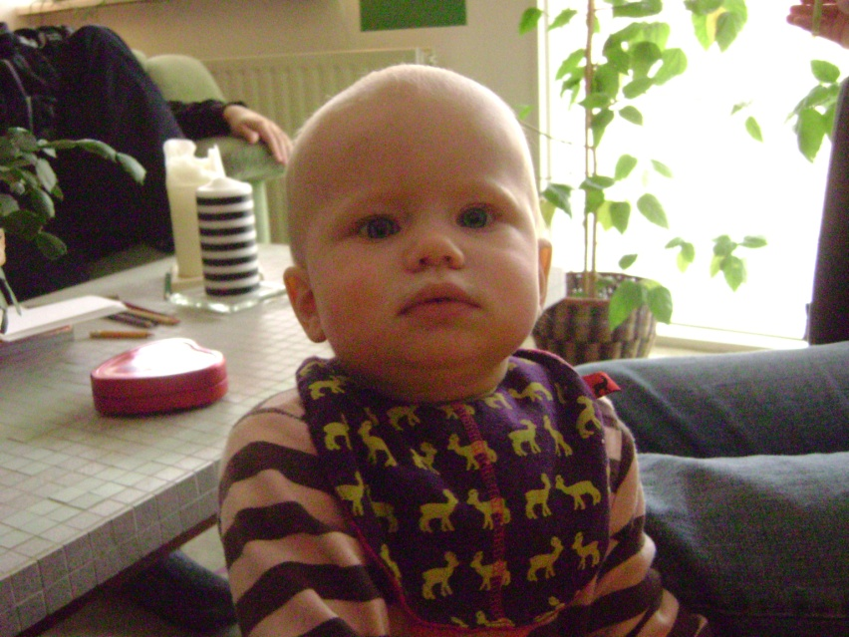
The conclusions
The women talked about their childhood and those who felt they had much encouragement from their parents and family as children were in general more optimistic about becoming mothers than those women who were overprotected as children
The women also talked about tasks that they believed they were good at and other tasks they would have a hard time doing or even could‘nt do when it came to taking care of the child‘s needs
And similarly those women who were encouraged by their parents in their youth were very soloution minded and believed they could find soloutions to most difficulties regarding the care of a baby
Notes:
The women talked about their childhood and thouse who felt they had alot of encouragement from their parents and family as children were in general more optimistic about becoming mothers than those women who were overprotected as children.
The women also talked about tasks that they believed they were good at and other tasks they would have a hard time doing or even could‘nt do when it came to taking care of the child‘s needs.
And similarly those women who were encouraged by their parents in their youth were very soloution minded and believed they could find soloutions to most difficulties regarding the care of a baby.

Slide 5
Sterotypes
It‘s really hard for women with physical impairments to fit society’s “normal” gender stereotypes, e.g. looking good and even feminine. They also don’t fit the motherhood image
Society regard women with physical impairments as lesser women than non-disabled women, and commonly consider it to be normal just because they have physical impairment that they don‘t have children.
Women with physical impairments are categorized as unfit by the community and the system in many ways
This is something that the women talked about and they felt from the community and also from close friends and family members. That they were not fit to become mothers because of their physical impairment
Notes:
It‘s really hard for women with physical impairments to fit society’s “normal” gender stereotypes, e.g. looking good and even feminine. They also dont fit the motherhood image. Some physically impaired women can‘t carry a child, so for many of them its impossibe to become “biological -mothers.
Society regard women with physical impairments as lesser women than non-disabled women, and commonly consider it to be normal just because they have physical impairment that they don‘t have children. It is´nt taken into consitiration that they have the same desire to have children and become mothers as other women.
Women with physically impairments are categorised as unfit by the community and societie’s institutions that are responsible for legislation and welfare issues. To be a good and fit mother is to be a strong and healthy women, that can in every way take care of the child‘s need‘s and women with physical impairment are not seen as that, because their physical impairment comes in the way of their capabibity to be a good and fit mother.
This is something that the women talked about and they felt from the community and also from close friends and familymembers. That they were not fit to become mothers because of their physical impairment.

Slide 6
Prejudice
Women with physical impairments experience that people don‘t assume that they will have children
Sometimes they experience prejudice from the people close to them, their family and friend
Some of the women didn't talk about their desire and dreams about having children to close friends and family members because they were afraid of their feedback and that they had prejudice against them having a child
Notes:
While many of my non-disabled friends tell me that everybody, their family, friends and society in general, assumes they will eventually have children and are often asked why they do not have children or when they will have children women with physically impairments experience that pepole don‘t asume that they will have children. Sometimes they experience prejudice from the people close to them, their family and friends. That it is normal for their siblings to have children but not for them just because they are disabled. When the women talked to their family members or friends about having a child it was very common that people chanced the subject or made a strange look pointing out that they had little faith that the woman was able to have or care for a child in the future because of their physical impairment.
Some of the women did‘nt talk about their disire and dreams about having children to close friends and family members because they were afraid of their reactions and that they had prejeduce against them having a child. For some of the women the opinion have great affect on them and they don‘t believe in them self and are afraid that they are not fit to becaome mothers and even deside to not have children because other people in the community have made them believe that they are not fit even though by most common standars they would be considered fit and able to care for children, although in some instances they might need some assistance. But the level of the help they need varies grately depending on each individual needs.

Slide 7
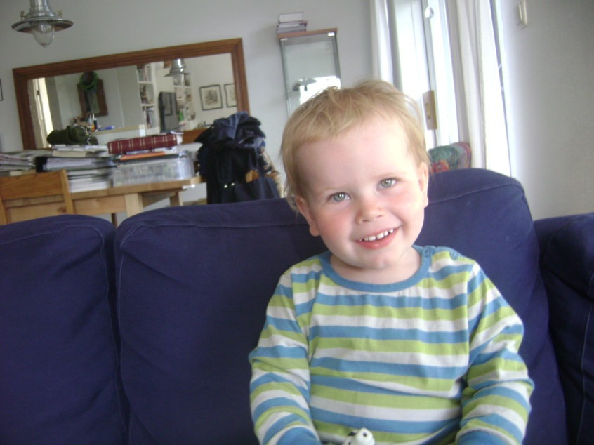
Thinking in solutions
The women that got encouragement in their childhood and have been told that they can do anything in live that they want usually have better self-confidence
Role models are very important
Most of the women I talked to were solution oriented and some of them have been thinking about having a child for many years
They have found solutions when it comes to taking care of their child and also found solutions for children furniture and equipment that is not accessible to people who use wheelchairs
Notes:
The women that got encouragement in their childhood and have been told by their families that they can do anything in live that they want usually have better self-confidence in general and also when it comes to dreams about having children in the future and believing in them self that they are fit to be mothers, despite their physical impairment.
One interesting factor I learned through the interviews was how important role models are. Some of the women talked about other women with physical impairments that already had children and the positive affect that had on them when it came to their one dream of becoming a mother and seeing that it was possible for a women with physical impairment to care for a child like other women did. They said that they also believed that this had positive affect in the community that people saw physically impaired mothers with their children and that people would see that it is possible and women with physical impairments are just as fit as any other mother and there for the prejudice would diminish.
Most of the women I talked to where wery solution oriented in their approach to motherhood and some of them have been thinking about having children for many years.
They have found solutions when it comes to taking care of their child and also regarding furnitures, for example how they can modify cribs and changing tables so it is possible for them to care for their child. In this situations the women use wheelchairs and the “normal” furniture is to high for them.

Slide 8
They want to fight
Some of the women I talked to are passionate about social equality, strong advocates and think that they are fit to be mothers
They want to fight for their rights to become a mother
They want the prejudice they feel in the community to diminish and they want to see some changes in laws and regulations so they have equal right to have a child and raise it without feeling prejudice all around them in the community
Notes:
Some of the women I talked to are passionate about social equality, strong advocates and think that they are fit to be mothers.
They want to fight for their rights to become a mother, also they want the prejudice they feel in the community to diminish and they want to see some changes in laws and regulations so they have equal right to have a child and raise it without feeling prejudice all around them in the community. For some of the women I talked to prejudice does not affect their believe in them self and it is most likely that those women have more selfconfidence then those that are greatly affected by the prejudice and don’t believe in themselves because of that.

Slide 9
Disability Legislation
It seems that women with physical impairments are not supposed to have children and become mothers like other women that are not physically impaired
For example in the disability legislation in Iceland
Important to note that the legislation is from 1992 and maybe should be written again since they are 18 years old
Notes:
It seems that women with physical impairments are not supposed to have children and become mothers like other women that are not disabled. At least when you look at laws and regulations it sounds like that.
For examplein the disability legislation in Iceland At least there stands nothing about the rights of physically impaired people to have a family, to have a child and become a parent. But their rights concerning education, work, living independently and such are talked about, just not about having children and having family like other people. I find that really strange.
Thougt it is right to point out that the laws are from 1992 and maybe should be re-considered again since they are 18 years old

Slide 10
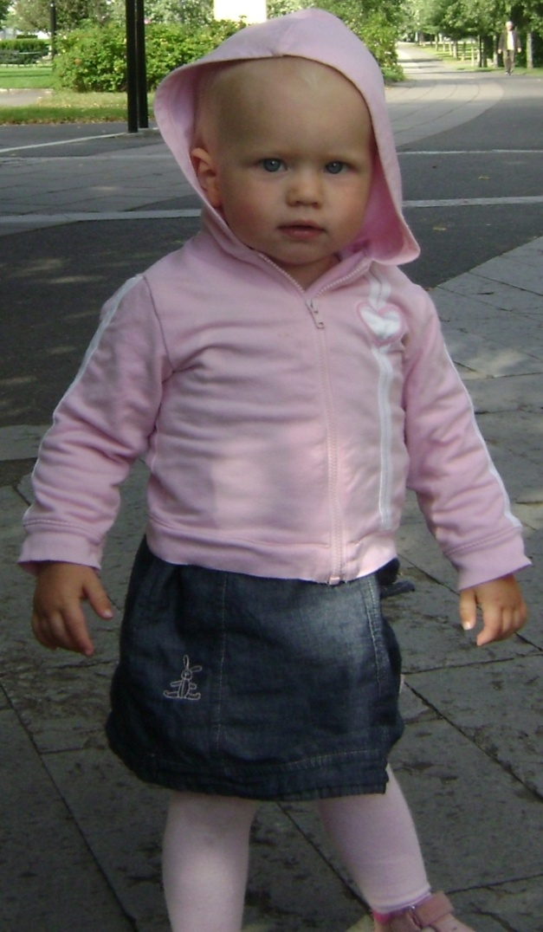
The adoption laws and regulations
Although there is nothing that says in the legislation that people with physical impairment are not physically healthy, it is stated in the regulation about adoptions that physical impairments limit the possibilities of people being accepted as adoptive parents
We may ask yourself though the question why people with physical impairment are not seen as fit as other applicants
Notes:
In the laws about adoptions it says that applicants must be physically and mentally healthy. The word healthy in icelandic means brave or strong. Although there is nothing that says in the legislation that people with physical impairment are not physically healthy, it is stated in the regulation about adoptions that physical impairments limit the possibilities of people being accepted as adoptive parents. It can also be if the applicant has a desease for example lungdesease, kidneydesease or diabetes. (The list is long). It is understandable that some rules must be and the countries that the children come from want them to go for adoption to good people and that they will have a good upbringing/childhood. We may ask your self though the question why people with physical impairment are not seen as fit as other applicants to give a child that lives with bad conditions in their homecountry a good home and take cear of it with love.

Slide 11
Something to have in mind
Some quotes in the interviews touched me more than others and I have two that I love a lot
“What is It that makes a good parent?”
“We never know, we could all die tomorrow or become sick”
Notes:
Some quotes in the interviews touched me more than others and I have two that I love a lot. They both have to do with the prejudice in the community and the adoption system.
One of them is : what is it that makes a good parent?
The other one is: We never know, we could all die tomorrow or become sick.
Both of these sentences have a lot of truth to them and describes well the situation as it is today for women with physical impairment, it reflects the reality of the women I talked to.

Slide 12
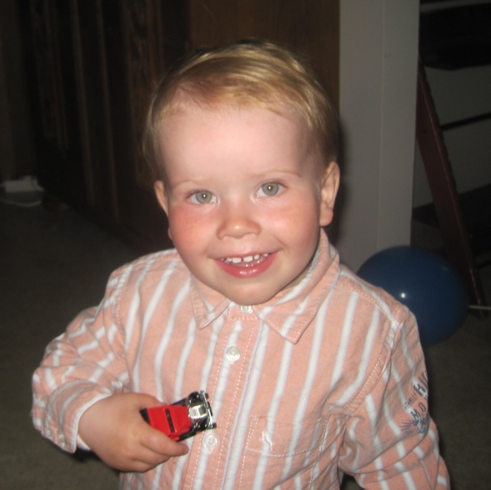
What they desire
The women desired to be seen as equal as other women, that people would look and think of them as a person first and foremost instead of gaze/focus on their physical disability
They wanted to experience the parenthood and become mothers without having to be afraid of and deal with prejudice
Notes:
The women desired to be seen as equal as other women, that people would look and think of them as a person first and foremost instead of focusing on their physical impairments.
They wanted to experience the parenthood and become mothers without having to be afraid of and deal with prejudice.

Slide 13
What needs to be done
It shows from the laws and regulations I have talked about that it is really important to reconsider some chances in the legislation, in the disability legislation in Iceland and the adoption laws and regulations
Specially since Iceland is now a part of the Convention on the Rights of Persons with Disabilities and in it said important that disabled people have equal rights and should not be discriminated in any way because of their disability
Notes:
It shows from the laws and regulations I have talked about that it is really important to reconsider some chances in the legislation/law-making, in the disability legislation in Iceland and the adoption laws and regulations.
Specially since Iceland is now a part of the Convention on the Rights of Persons with Disabilities and in it said important that people with physical impairments have equal rights and should not be discriminated in any way because of their impairments

Slide 14
My hope
I hope that this research will increase understanding of the situation that physically disabled women who desire to have a child are in and in some example can’t carry a child and as the system is today have no chance of having a child, some maybe never will. I think that it has both practical and theoretical value.
Notes:
I hope that this researce will increase understanding of the situation that women with physical impairments who desire to have a child are in and in some example can’t carry a child and as the system is today have no chance of having a child, some maybe never will. I think that it has both practical and theoretical value.

Slide 15
Conclusion
It shows from my six interviews talking to women who have in common that they have physical impairments and don’t have children that they, just like other women want to have a child in the future
They feel a lot of prejudice from their family, friends and the community
These prejudice have affect on them directly when it comes to the adoption legislation because they can’t adopt because of their physical impairment and it also affects them impliedly because they start believing that they are not fit to be mothers because of their physical impairment
Their upbringing matters a lot when it comes to their self – confidence. It showed that the women that got a lot of encouragement do not internalize the prejudice they face and respond to prejudice and barriers with the need to fight society for equality
Although there are some basic obstacles that women with physical impairments need to overcome to be able to care for their children, like e.g. how to change diapers or modify prams and strollers these are problems easily fixed
Notes:
It shows from my six interviews talking to women who have in common that they are physically inpaired and don’t have children that they, just like other women want to have a child in the future.
They feel a lot of prejudice from their family, friends and the community.
These prejudice have affect on them directly when it comes to the adoption legislation because they can’t adopt because of their physical impairment and it also affects them impliedly because they start believeing that they are not fit to be mothers because of their physical impairment.
Their upbringing metters a lot when it comes to their self– confidence. It showed that the women that got a lot of encouragement do not internalize the prejudice they face and respond to prejudice and barriers with the need to fight society for equality.
Although there are some basic obstacles that women with physical impairments need to overcome to be able to care for their children, like e.g. how to change dipers or modify prams and strollers these are problems easily fixed.

Slide 16
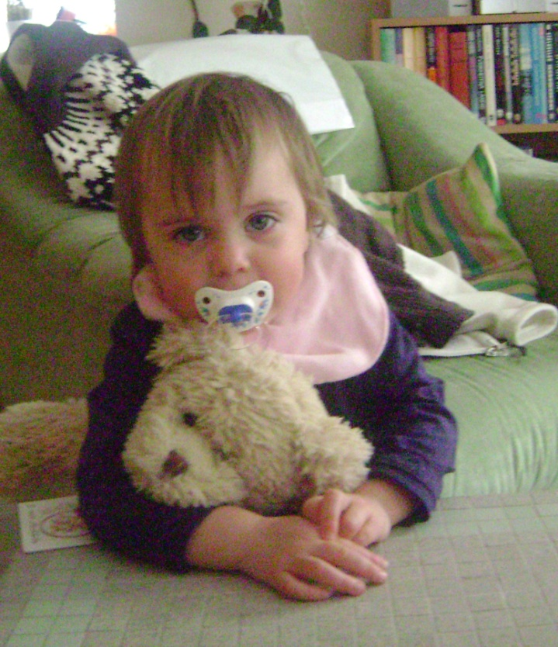
Thank you
Notes:
Thank you.

