Slide 1
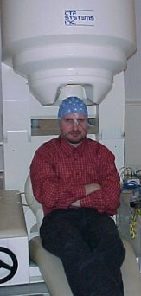

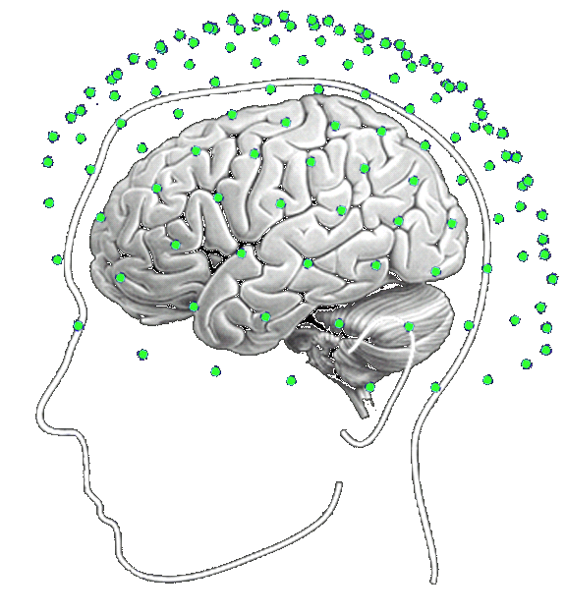
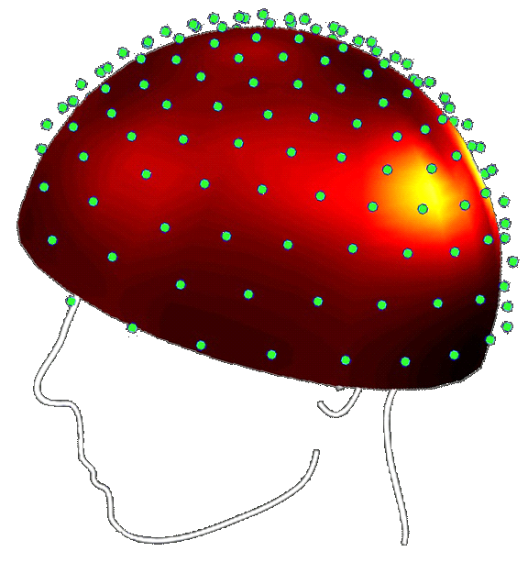
MEG/EEG Inverse problem and solutions
In a Bayesian Framework
?
Jérémie Mattout
Lyon Neuroscience Research Centre
With many thanks to Karl Friston, Christophe Phillips,
Rik Henson, Jean Daunizeau
EEG/MEG SPM course, Bruxelles, 2011

Slide 2
Talk’s Overview
SPM rationale
generative models
probabilistic framework
Twofold inference: parameters & models
EEG/MEG inverse problem and SPM solution(s)
probabilistic generative models
Parameter inference and model comparison

Slide 3
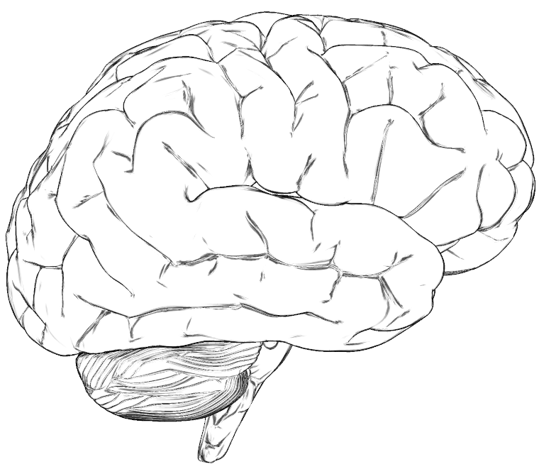
A word about generative models
Model: "measure, standard" ; representation or object that enables to describe the functionning of a physical system or concept
A model enables you to:
Simulate data
Estimate (non-observables) parameters
Predict future observations
Test hypothesis / Compare models
Physiological Observations
Stimulations
Behavioural Observations

Slide 4
A word about generative models
Model: "measure, standard" ; representation or object that enables to describe the functionning of a physical system or concept
A model enables you to:
Simulate data
Estimate (non-observables) parameters
Predict future observations
Test hypothesis / Compare models
MEG Observations (Y)
Y = f(θ,u)
Sources/Network (θ)
Model m: f, θ, u
Auditory-Visual Stimulations (u)

Slide 5
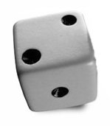
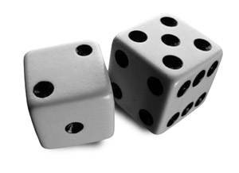


Probabilistic / Bayesian framework
Probability of an event:
- represented by real numbers
- conforms to intuition
- is consistent
• normalization:
a=2
• marginalization:
• conditioning :
(Bayes rule)
b=5
a=2

Slide 6
Probabilistic modelling
MEG Observations (Y)
Y = f(θ,u)
Sources/Network (θ)
Model m: f, θ, u
Auditory-Visual Stimulations (u)
Likelihood
Posterior
Prior
Marginal or Evidence
Probabilistic modelling enables:
To formalize mathematically our knowledge in a model m
To account for uncertainty
To make inference on both model parameters and models themselves

Slide 7
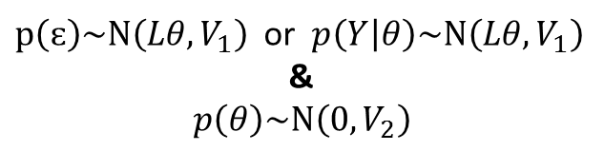
A toy example
MEG Observations (Y)
- One dipolar source with known position and orientation.
- Amplitude ?
Measurment noise
Linear f
Y = Lθ + ɛ
Source amplitude
Model m:
Source gain vector
Gaussian
distributions
$\text{p}\left(\text{ɛ}\right)\sim Ν\left(Lθ,V_{1}\right)$ or $p\left(Y | θ\right)\sim Ν\left(Lθ,V_{1}\right)$
&
$$p\left(θ\right)\sim Ν\left(0,V_{2}\right)$$
Likelihood
Prior

Slide 8
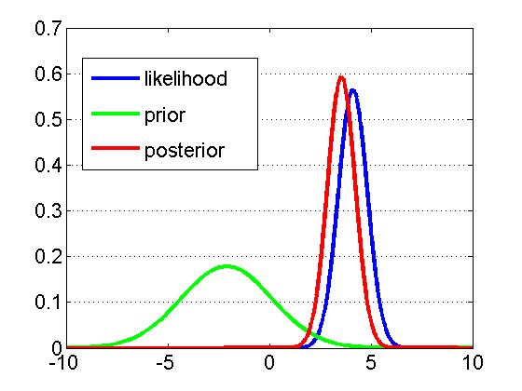
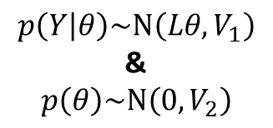
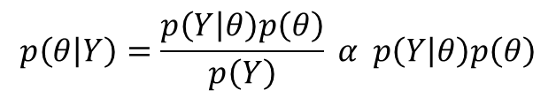
A toy example
MEG Observations (Y)
$$p\left(Y | θ\right)\sim Ν\left(Lθ,V_{1}\right)$$
&
$$p\left(θ\right)\sim Ν\left(0,V_{2}\right)$$
Model m:
Bayes rule
$$p\left(θ | Y\right)=\frac{p\left(Y | θ\right)p\left(θ\right)}{p\left(Y\right)} α p\left(Y | θ\right)p\left(θ\right)$$
Posterior

Slide 9
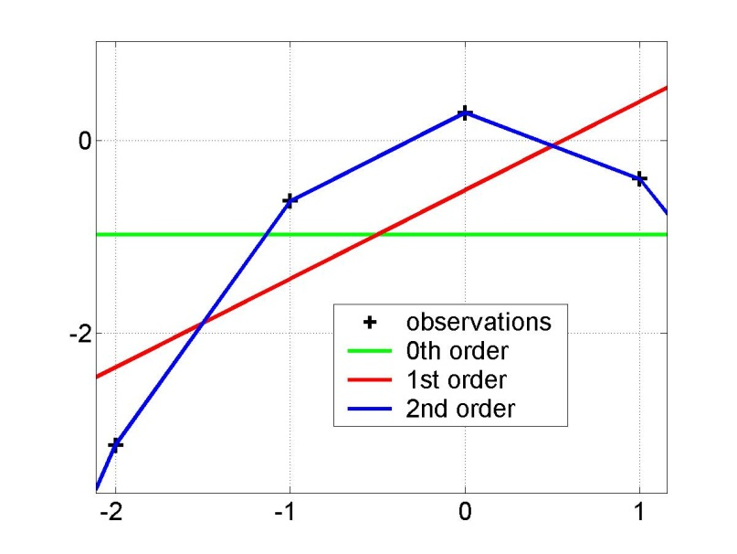
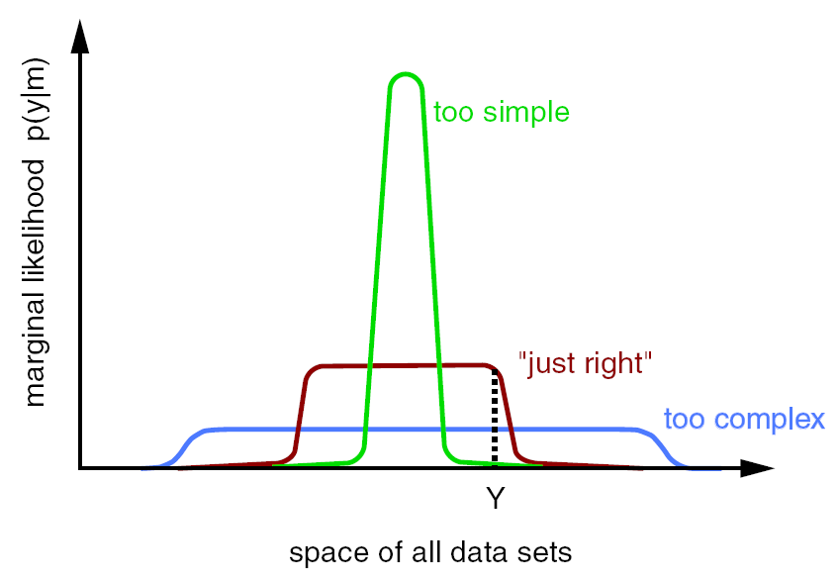
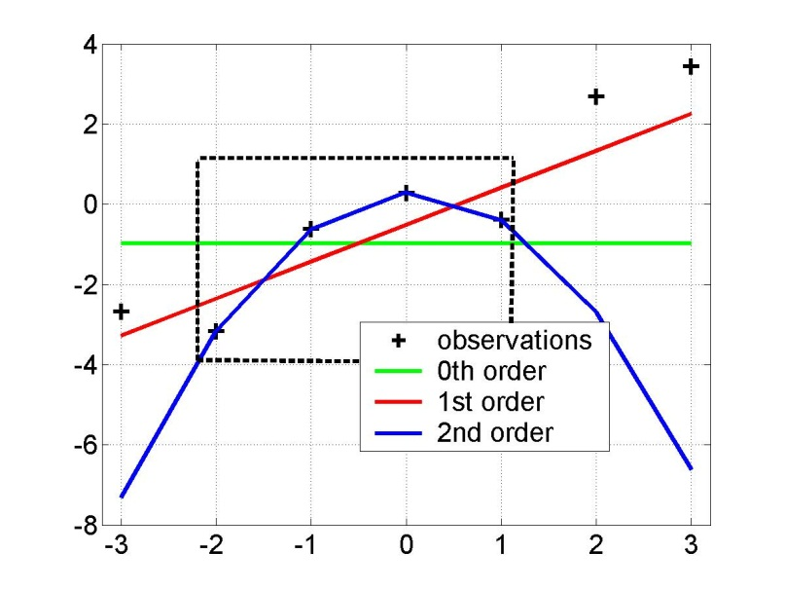
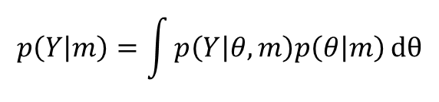
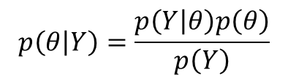
Hypothesis testing: model comparison
Occam’s razor or principle of parsimony
$$p\left(θ | Y\right)=\frac{p\left(Y | θ\right)p\left(θ\right)}{p\left(Y\right)}$$
« complexity should not be assumed without necessity »
$$p\left(Y | m\right)=\int{p\left(Y | θ,m\right)p\left(θ | m\right)}dθ$$
Evidence
y = f(x)
x
model evidence p(y|m)
y=f(x)
space of all data sets

Slide 10
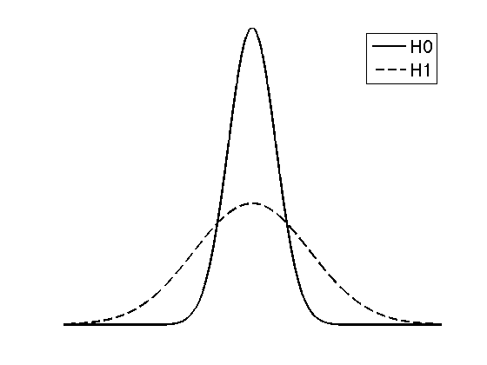
Hypothesis testing: model comparison
Bayesian factor
• define the null and the alternative hypothesis H (or model m) in terms of priors, e.g.:
space of all datasets
• invert both generative models (obtain both model evidences)
• apply decision rule, i.e.:
if
then reject H0

Slide 11
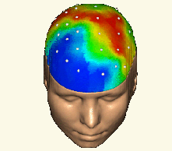
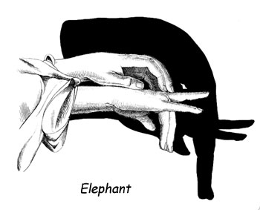



EEG/MEG inverse problem
Probabilistic framing
forward computation
Likelihood & Prior
$$p\left(Y | θ,m\right)p\left(θ | m\right)$$
Posterior & Evidence
$$p\left(θ | Y,m\right)$$
$$p\left(Y | m\right)$$
inverse computation

Slide 12
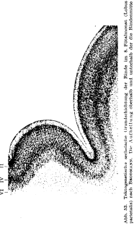
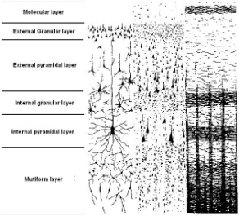

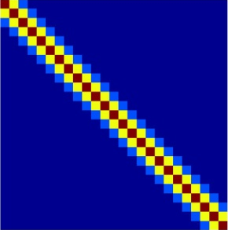
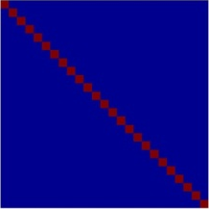
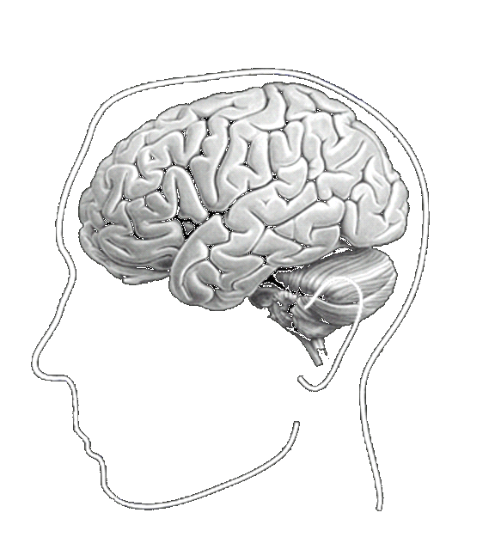
EEG/MEG inverse problem
Distributed/Imaging model
Likelihood
Parameters θ: (J,Σ)
Hypothesis m: distributed (linear) model, gain matrix L, gaussian distributions
Prior
Source level
Sensor level
# sources
# sources
# sensors
IID
(Minimum Norm)
Maximum Smoothness
(LORETA-like)
# sensors

Slide 13
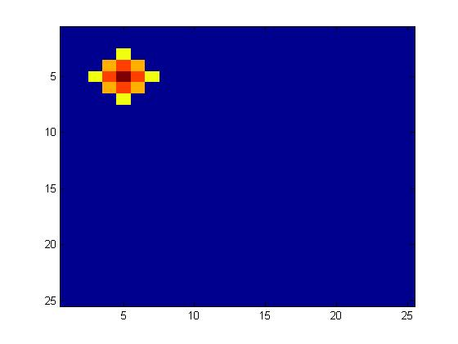
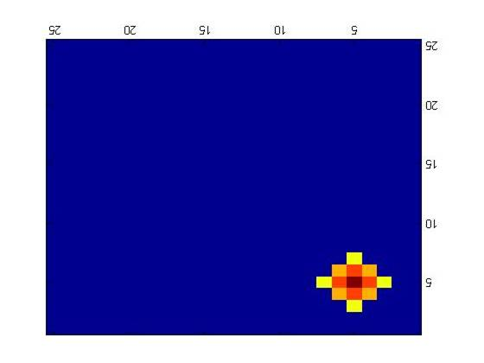

EEG/MEG inverse problem
Incorporating Multiple Constraints
Likelihood
Paramètres θ: (J,σ,λ)
Hypothèses m: hierarchical model, operator L + components C
Prior
Source (or sensor) level
…
Multiple Sparse Priors (MSP)
$$\log{\text{λ} \sim N\left(α,β\right)}$$

Slide 14
Estimation procedure
Expectation Maximization (EM) / Restricted Maximum Likelihood (ReML) / Free-Energy optimization / Parametric Empirical Bayes (PEB)
Iterative scheme
E-step
M-step
accuracy
complexity

Slide 15
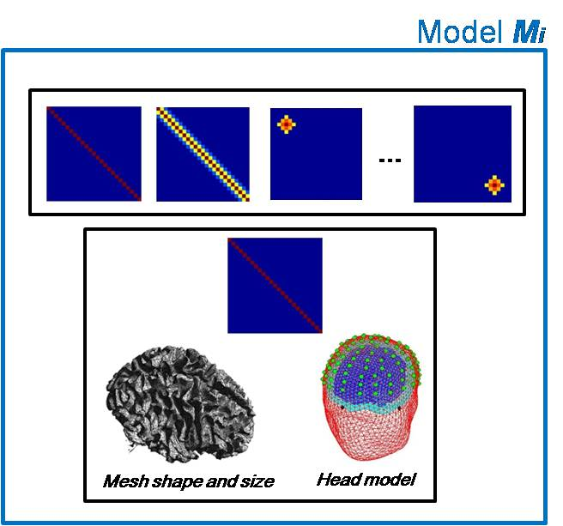
Estimation procedure
Model comparison based on the Free-energy
At convergence
F_{i}
1
2
3
model M_{i}

Slide 16
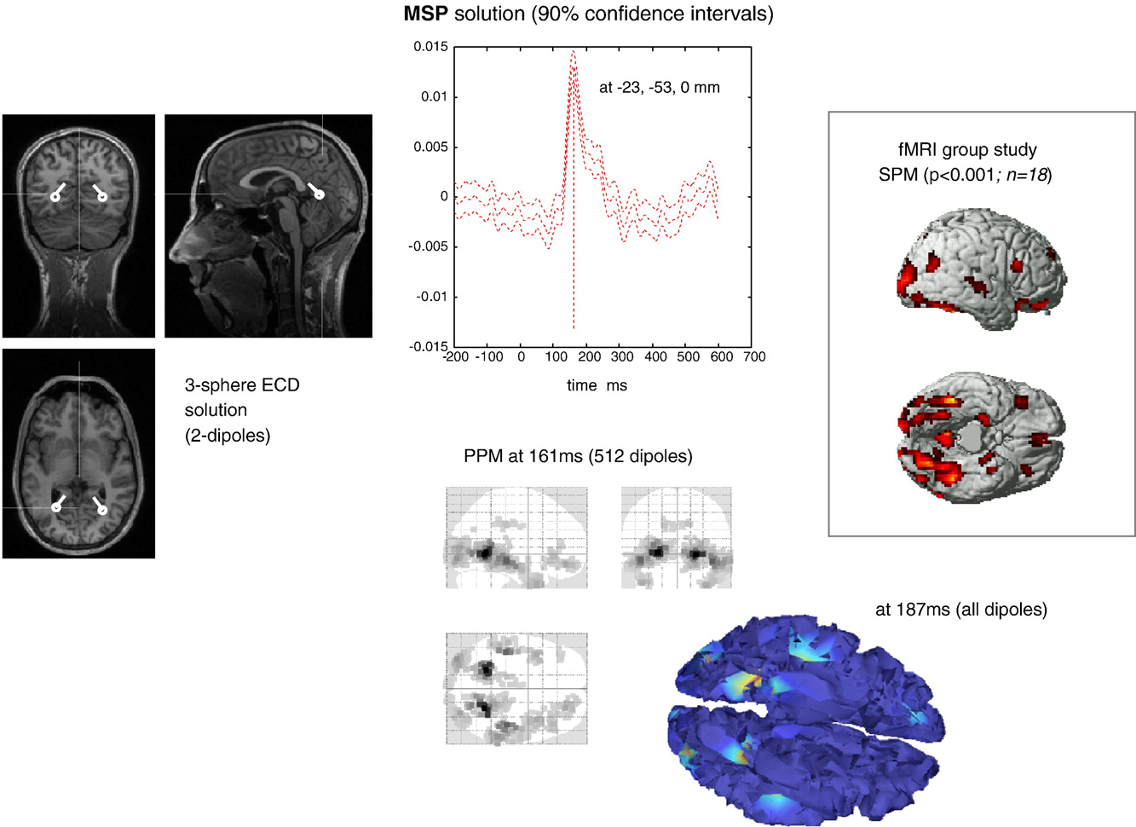
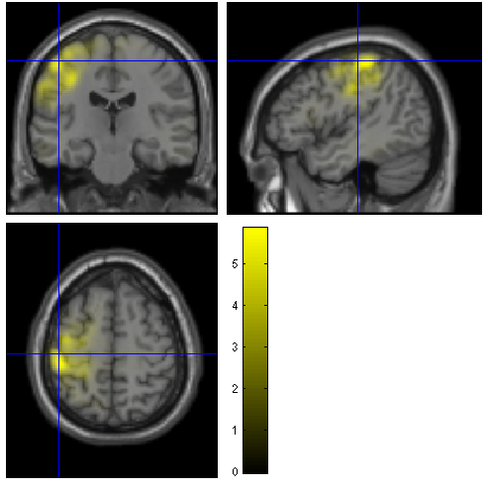
At the end of the day
Somesthesic
data

Slide 17
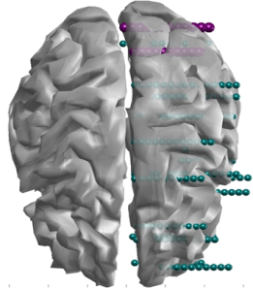
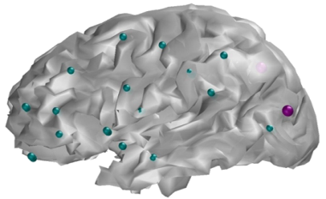
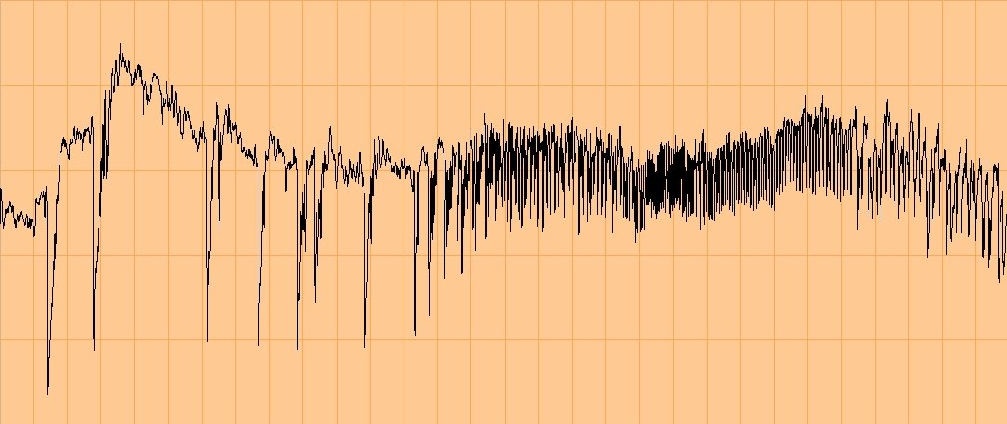
Example
MEG - Epilepsy
Pharmacoresistive Epilepsy (surgery planning):
symptoms
PET + sIRM
SEEG
Could MEG replace or at least complement and guide SEEG ?
Romain Bouet
Julien Jung
François Maugière
Seizure
30s
120 patients : MEG proved very much informative in 85 patients

Slide 18
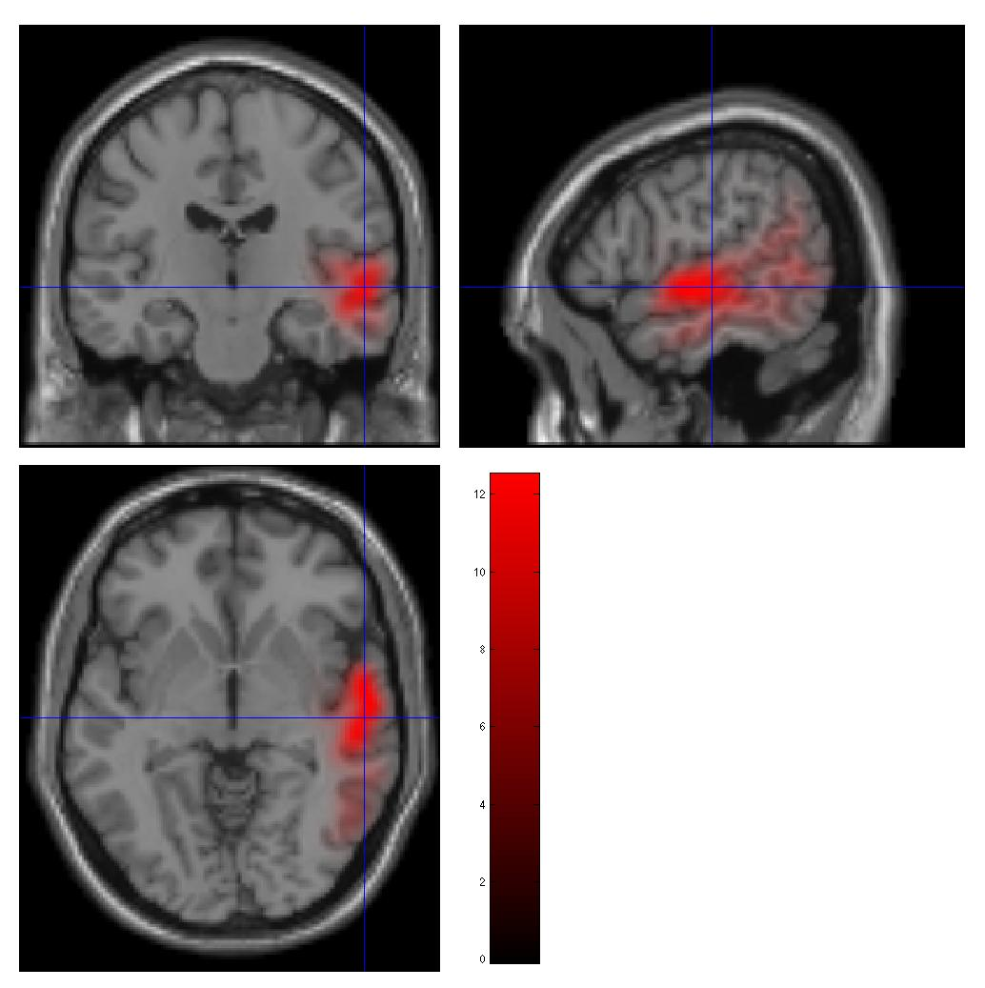
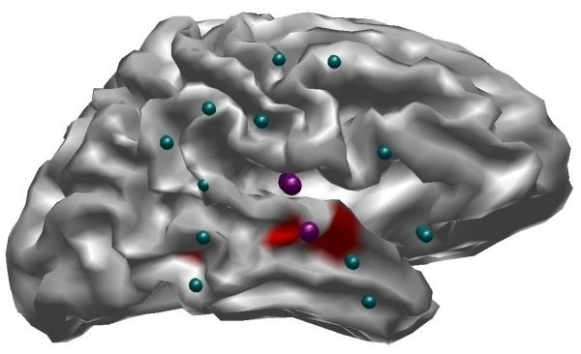
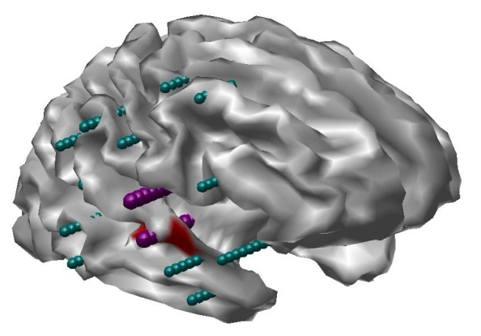
Example
MEG - Epilepsy
Romain Bouet
Julien Jung
François Maugière
Patient 1 : model comparison
SEEG
MEG
(best model)

Slide 19
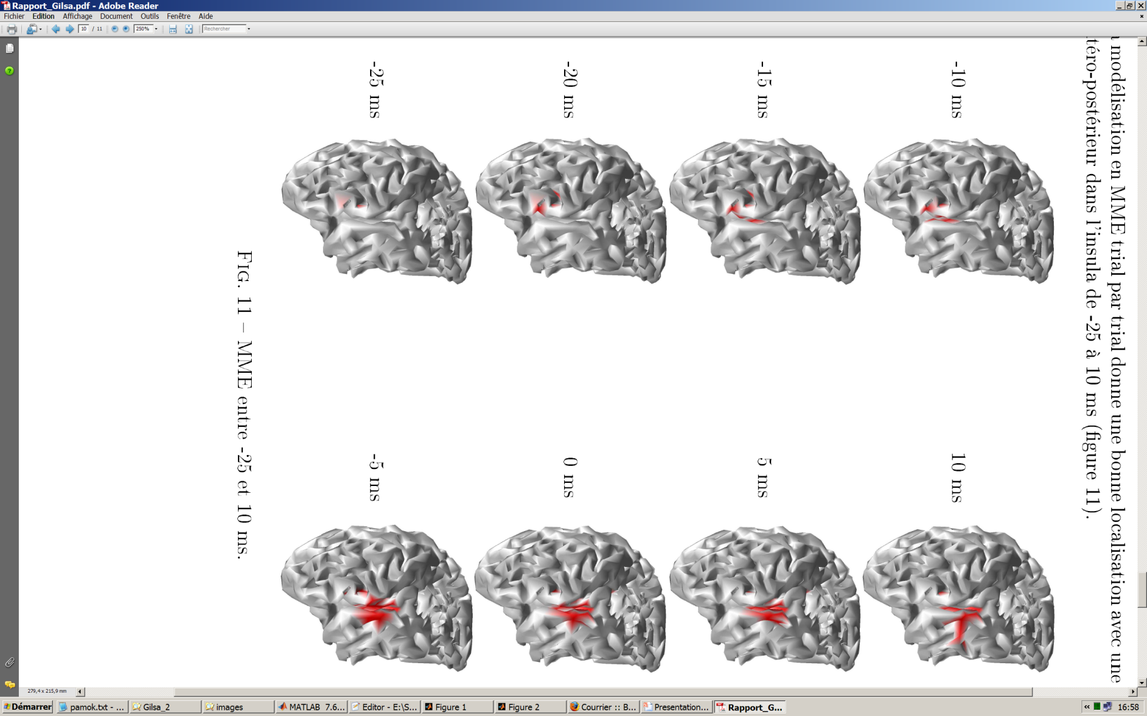
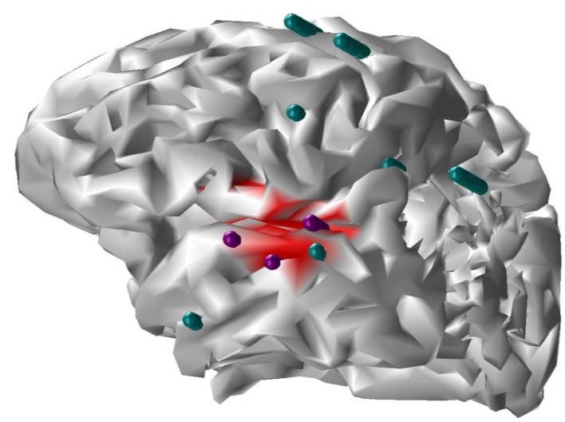
Example
MEG - Epilepsy
Romain Bouet
Julien Jung
François Maugière
Patient 2 : estimated dynamics
temps
SEEG
lésion occipitale

Slide 20
Conclusion
The SPM probabilistic inverse modelling approach enables to:
Estimate both parameters and hyperparameters from the data
Incorporate multiple priors of different nature
Estimate a full posterior distribution over model parameters
Estimate an approximation to the log-evidence (the free-energy) which enables model comparison based on the same data
Encompass multimodal fusion and group analysis gracefully
Note that SPM also include a flexible and convenient meshing tool, as well as beamforming solutions and a Bayesian ECD approach…

Slide 21
Thank you for your attention

Slide 22
EEG/MEG inverse problem
Graphical representation
Fixed
Variable
Data

Slide 23
Fusion of different modality

Slide 24
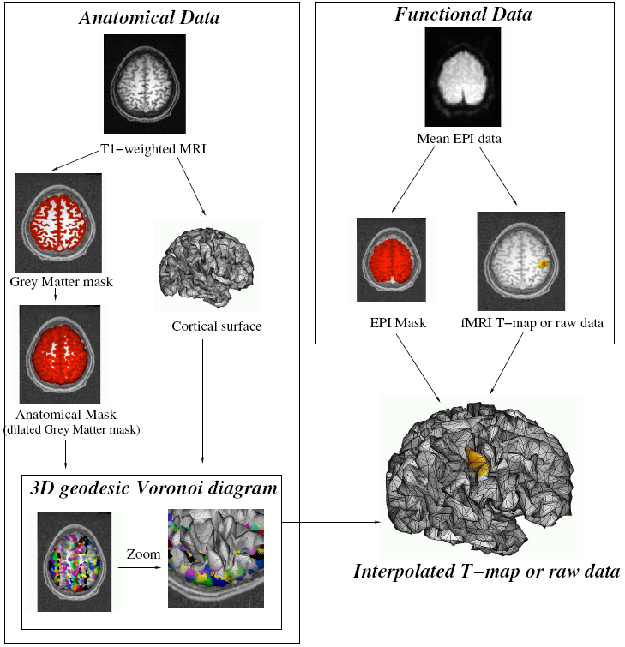
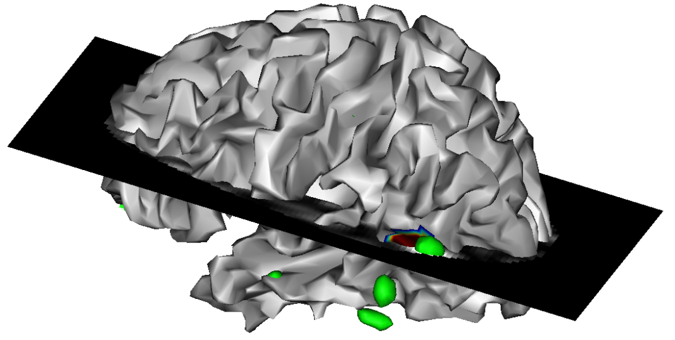
Incorporating fMRI priors

Slide 25
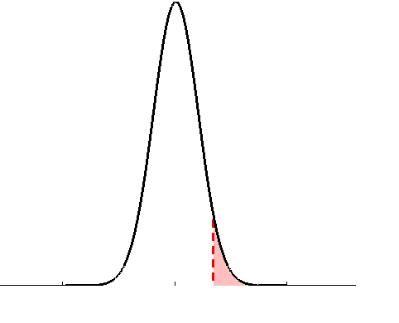
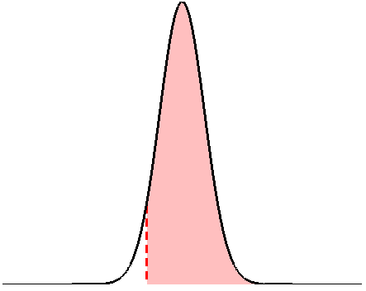
Hypothesis testing: inference on parameters
Frequentist vs. Bayesian approach
• define the null, e.g.:
• invert model (obtain posterior pdf)
• estimate parameters (obtain test stat.)
• define the null, e.g.:
• apply decision rule, i.e.:
• apply decision rule, i.e.:
if
then reject H0
if
then accept H0
classical inference (SPM)
Bayesian inference (PPM)

