Slide 1
Dynamic Causal Model for Steady State Responses
Rosalyn Moran
Wellcome Trust Centre for Neuroimaging

Slide 2
DCM for Steady State Responses
Under linearity and stationarity assumptions, the model’s biophysical parameters (e.g. post-synaptic receptor density and time constants) prescribe the cross-spectral density of responses measured directly (e.g. local field potentials) or indirectly through some lead-field (e.g. electroencephalographic and magnetoencephalographic data).

Slide 3
Overview
Data Features
The Generative Model in DCMs for Steady-State Responses – a family
of neural mass models
Bayesian Inversion: Parameter Estimates and Model Comparison
Example. DCM for Steady State Responses:
Anaesthetic Depth in Rodents: Validating a few Basics
Questions of Consciousness using Anaesthesia in Humans

Slide 4
Overview
Data Features
The Generative Model in DCMs for Steady-State Responses - a family of neural mass models
Bayesian Inversion: Parameter Estimates and Model Comparison
Example. DCM for Steady State Responses:
Anaesthetic Depth in Rodents: Validating a few Basics
Questions of Consciousness using Anaesthesia in Humans

Slide 5
Steady State
Statistically:
A “Wide Sense Stationary” signal has 1st and 2nd moments that do not vary with respect to time
Dynamically:
A system in steady state has settled to some equilibrium after a transient
Data Feature:
Quasi-stationary signals that underlie Spectral Densities in the Frequency Domain

Slide 6
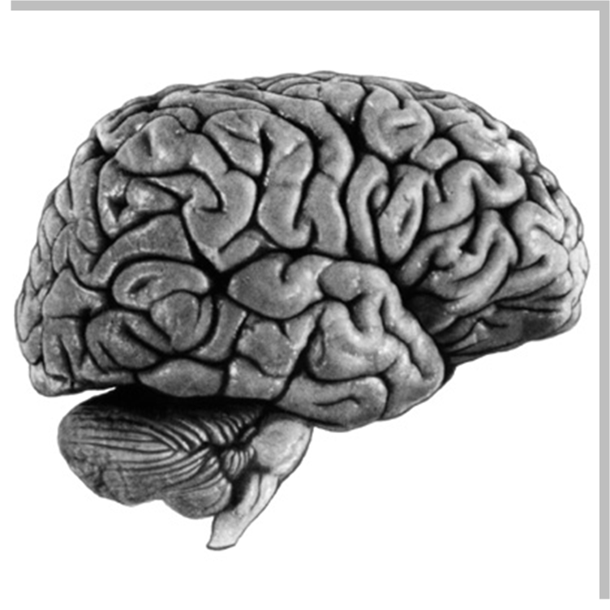
Steady State
30
25
Source 1
20
Power (uV²)
15
10
5
0
0
5
10
15
20
25
30
Frequency (Hz)
30
25
Source 2
Power (uV²)
20
15
10
5
0
0
5
10
15
20
25
30
Frequency (Hz)

Slide 7
Steady State
30
25
Source 1
20
Power (uV²)
15
10
5
0
0
5
10
15
20
25
30
Frequency (Hz)
30
25
Source 2
Power (uV²)
20
15
10
5
0
0
5
10
15
20
25
30
Frequency (Hz)

Slide 8
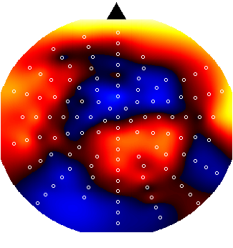
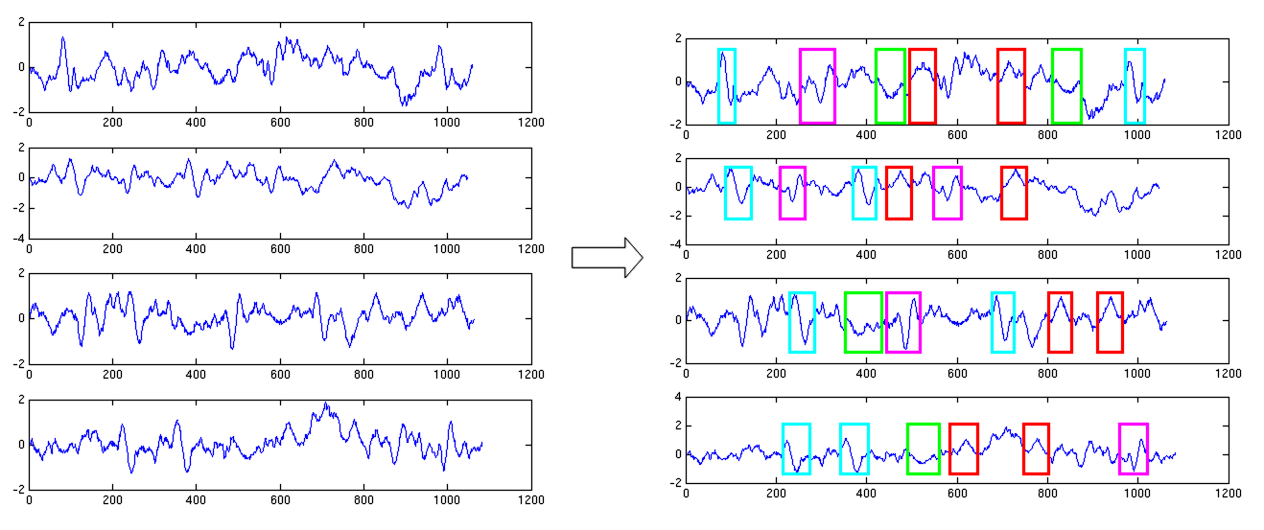
Cross Spectral Density: The Data
1
EEG - MEG – LFP Time Series
2
Cross Spectral Density
3
1
2
4
3
1
2
3
4
4
A few LFP channels or EEG/MEG spatial modes

Slide 9
Overview
Data Features
The Generative Model in DCMs for Steady-State Responses - a family of neural mass models
Bayesian Inversion: Parameter Estimates and Model Comparison
Example. DCM for Steady State Responses:
Anaesthetic Depth in Rodents: Validating a few Basics
Questions of Consciousness using Anaesthesia in Humans

Slide 10
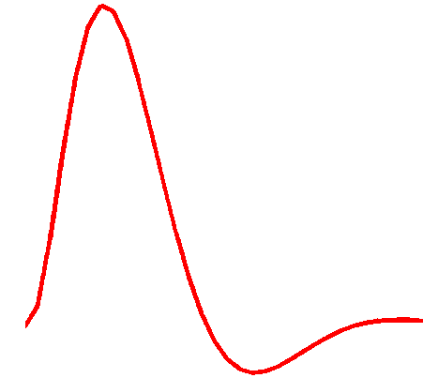
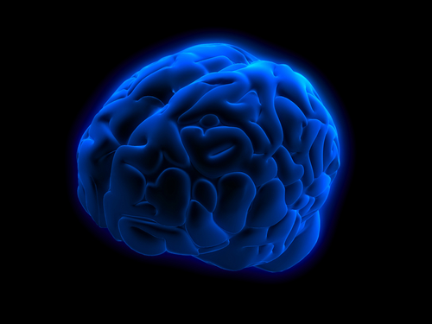
Dynamic Causal Modelling: Generic Framework
Electromagnetic
forward model: neural activity→EEG MEG
LFP
Time Domain ERP Data
Phase Domain Data
Time Frequency Data
Steady State Frequency Data
Hemodynamic forward model: neural activity→BOLD
Time Domain Data
Neural state equation:
fMRI
EEG/MEG
complicated neuronal model
Fast time scale
simple neuronal model
Slow time scale

Slide 11
Dynamic Causal Modelling: Generic Framework
Hemodynamic forward model: neural activity→BOLD
Time Domain Data
Electromagnetic
forward model: neural activity→EEG MEG
LFP
Steady State Frequency Data
“theta”
Power (mV²)
Frequency (Hz)
Neural state equation:
fMRI
EEG/MEG
complicated neuronal model
Fast time scale
simple neuronal model
Slow time scale

Slide 12
Dynamic Causal Modelling: Framework
Empirical Data
Hemodynamic forward model: neural activity→BOLD
Electromagnetic
forward model: neural activity→EEG MEG
LFP
Neural state equation:
Generative Model
fMRI
EEG/MEG
Bayesian Inversion
simple neuronal model
complicated neuronal model
Model Structure/ Model Parameters

Slide 13
Dynamic Causal Modelling: Framework
Empirical Data
Hemodynamic forward model: neural activity→BOLD
Electromagnetic
forward model: neural activity→EEG MEG
LFP
Neural state equation:
Generative Model
fMRI
EEG/MEG
Bayesian Inversion
simple neuronal model
complicated neuronal model
Model Structure/ Model Parameters

Slide 14


Neural Mass Model
EEG/MEG/LFP
signal
The state of a neuron comprises a number of attributes, membrane potentials, conductances etc. Modelling these states can become intractable.
Mean field approximations summarise the states
in terms of their ensemble density. Neural mass models consider only point densities and describe the interaction of the means in the ensemble
Intrinsic Connections
inhibitory interneurons
neuronal (source) model
spiny stellate cells
Pyramidal
Cells
Internal Parameters
Extrinsic Connections
State equations

Slide 15
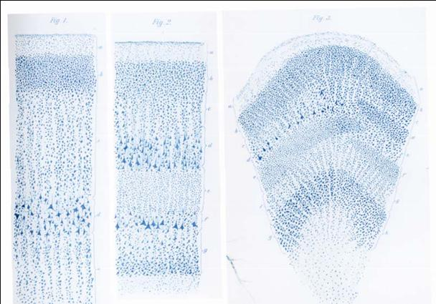

Neural Mass Model
Intrinsic
connections
γ
Inhibitory cells in agranular layers
5
γ
γ
γ
γ
4
4
3
3
Excitatory spiny cells in granular layers
Excitatory spiny cells in granular layers
x
=
x
&
1
4
x
=
κ
H
(
γ
s
(
x
−
a
)
+
u
)
−
2
κ
x
−
κ
2
x
&
4
e
e
1
9
e
4
e
1
γ
γ
γ
1
γ
1
2
2
Excitatory pyramidal cells in agranular layers
Extrinsic Connections:
Forward
Backward
Lateral

Slide 16
Neural Mass Model
Intrinsic
connections
γ
Inhibitory cells in agranular layers
5
γ
γ
γ
4
γ
Synaptic ‘alpha’ kernel
4
3
3
Excitatory spiny cells in granular layers
Excitatory spiny cells in granular layers
x
=
x
&
1
4
x
=
κ
H
(
γ
s
(
x
−
a
)
+
u
)
−
2
κ
x
−
κ
2
x
&
4
e
e
1
9
e
4
e
1
γ
γ
γ
1
γ
1
2
Sigmoid function
2
Excitatory pyramidal cells in agranular layers
Extrinsic Connections:
Forward
Backward
Lateral

Slide 17
Neural Mass Model
Intrinsic
connections
γ
Inhibitory cells in agranular layers
5
: Receptor Density
γ
γ
γ
γ
Synaptic ‘alpha’ kernel
4
4
3
3
Excitatory spiny cells in granular layers
Excitatory spiny cells in granular layers
x
=
x
&
1
4
x
=
κ
H
(
γ
s
(
x
−
a
)
+
u
)
−
2
κ
x
−
κ
2
x
&
4
e
e
1
9
e
4
e
1
γ
γ
γ
1
γ
1
2
Sigmoid function
2
Excitatory pyramidal cells in agranular layers
Extrinsic Connections:
Forward
Backward
Lateral

Slide 18
Neural Mass Model
Intrinsic
connections
γ
Inhibitory cells in agranular layers
5
: Receptor Density
γ
γ
γ
4
γ
Synaptic ‘alpha’ kernel
4
3
3
Excitatory spiny cells in granular layers
Excitatory spiny cells in granular layers
x
=
x
&
1
4
x
=
κ
H
(
γ
s
(
x
−
a
)
+
u
)
−
2
κ
x
−
κ
2
x
&
4
e
e
1
9
e
4
e
1
γ
γ
γ
1
γ
1
2
Sigmoid function
2
Excitatory pyramidal cells in agranular layers
: Firing Rate
Extrinsic Connections:
Forward
Backward
Lateral

Slide 19
Neural Mass Model
Intrinsic
connections
γ
Inhibitory cells in agranular layers
5
: Receptor Density
γ
γ
γ
γ
Synaptic ‘alpha’ kernel
4
4
3
3
Excitatory spiny cells in granular layers
Excitatory spiny cells in granular layers
x
=
x
&
1
4
x
=
κ
H
(
γ
s
(
x
−
a
)
+
u
)
−
2
κ
x
−
κ
2
x
&
4
e
e
1
9
e
4
e
1
γ
γ
γ
1
γ
Sigmoid function
1
2
2
Excitatory pyramidal cells in agranular layers
: Firing Rate
Extrinsic Connections:
Forward
Backward
Lateral

Slide 20
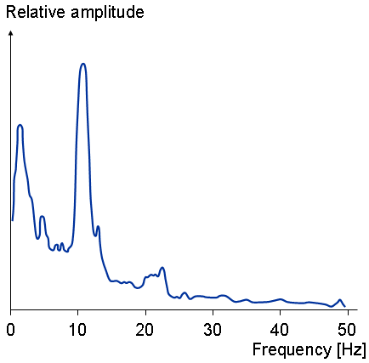
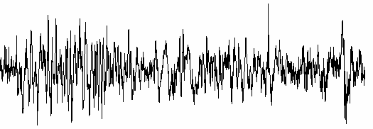
Frequency Domain Generative Model (Perturbations about a fixed point)
Time Differential
Equations
State Space
Characterisation
Transfer Function
Frequency Domain
Linearise
mV

Slide 21

Frequency Domain Generative Model (Perturbations about a fixed point)
Transfer Function
Frequency Domain
Spectrum channel/mode 1
Cross-spectrum modes 1& 2
Transfer Function
Frequency Domain
Power (mV²)
Power (mV²)
Frequency (Hz)
Frequency (Hz)
Transfer Function
Frequency Domain
Power (mV²)
Frequency (Hz)
Spectrum mode 2

Slide 22
Dynamic Causal Modelling: Framework
Empirical Data
Hemodynamic forward model: neural activity→BOLD
Electromagnetic
forward model: neural activity→EEG MEG
LFP
Neural state equation:
Generative Model
fMRI
EEG/MEG
Bayesian Inversion
simple neuronal model
complicated neuronal model
Model Structure/ Model Parameters

Slide 23
Overview
Data Features
The Generative Model in DCMs for Steady-State Responses - a family of neural mass models
Bayesian Inversion: Parameter Estimates and Model Comparison
Example. DCM for Steady State Responses:
Anaesthetic Depth in Rodents: Validating a few Basics
Questions of Consciousness using Anaesthesia in Humans

Slide 24

Bayes’ rules:
Free Energy:
max
Inference on parameters
Inference on models
Bayesian Inversion
Model 1
Model 1
Model 2
Model comparison via Bayes factor:
accounts for both accuracy and complexity of the model
allows for inference about structure (generalisability) of the model

Slide 25
Fixed effects BMS at group level
Group Bayes factor (GBF) for 1...K subjects:
Average Bayes factor (ABF):
Problems:
blind with regard to group heterogeneity
sensitive to outliers
or

Slide 26
Random effects BMS at group level
“the occurences”
“the expected likelihood”
“the exceedance probability”

Slide 27
Overview
Data Features
The Generative Model in DCMs for Steady-State Responses - a family of neural mass models
Bayesian Inversion: Parameter Estimates and Model Comparison
Example. DCM for Steady State Responses:
Anaesthetic Depth in Rodents: Validating a few Basics
Questions of Consciousness using Anaesthesia in Humans

Slide 28
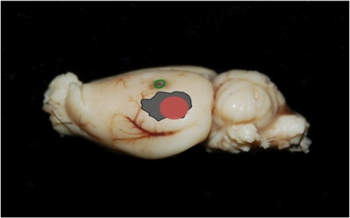
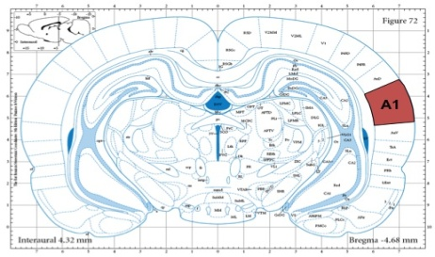

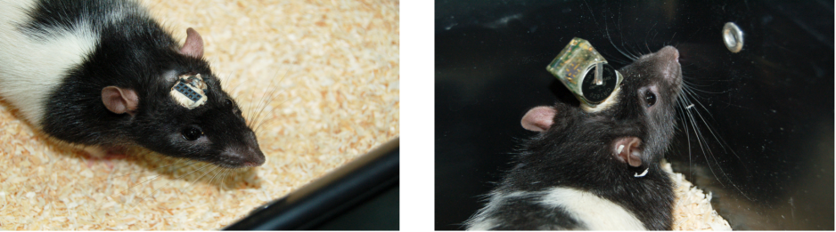
Depth of Anaesthesia
A1
A2
LFP
0.12
0.12
Trials:
1: 1.4 Mg Isoflourane
2: 1.8 Mg Isoflourane
3: 2.4 Mg Isoflourane
4: 2.8 Mg Isoflourane
(White Noise and Silent Auditory Stimulation)
0.06
0.06
0
mV
0
mV
-
-
0.06
0.06
30sec
0.12
0.12
0.06
0.06
0
mV
0
mV
-
-
0.06
0.06

Slide 29
Models
FB Model (1)
A1
Forward (Excitatory Connection)
A2
Backward (Modulatory Connection)
BF Model (2)
Backward (Modulatory Connection)
A1
35
30
A2
25
Forward (Excitatory Connection)
Ln GBF
20
15
10
5
0
Model 1
Model 2

Slide 30
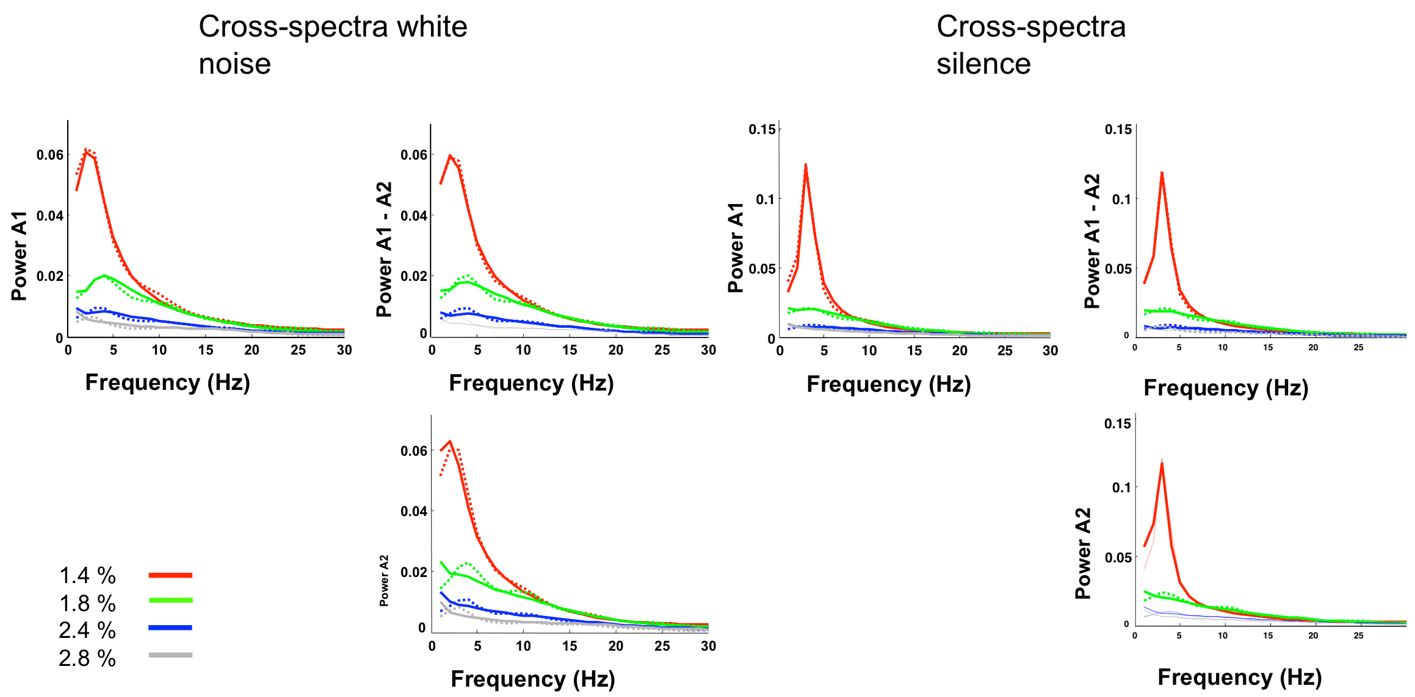
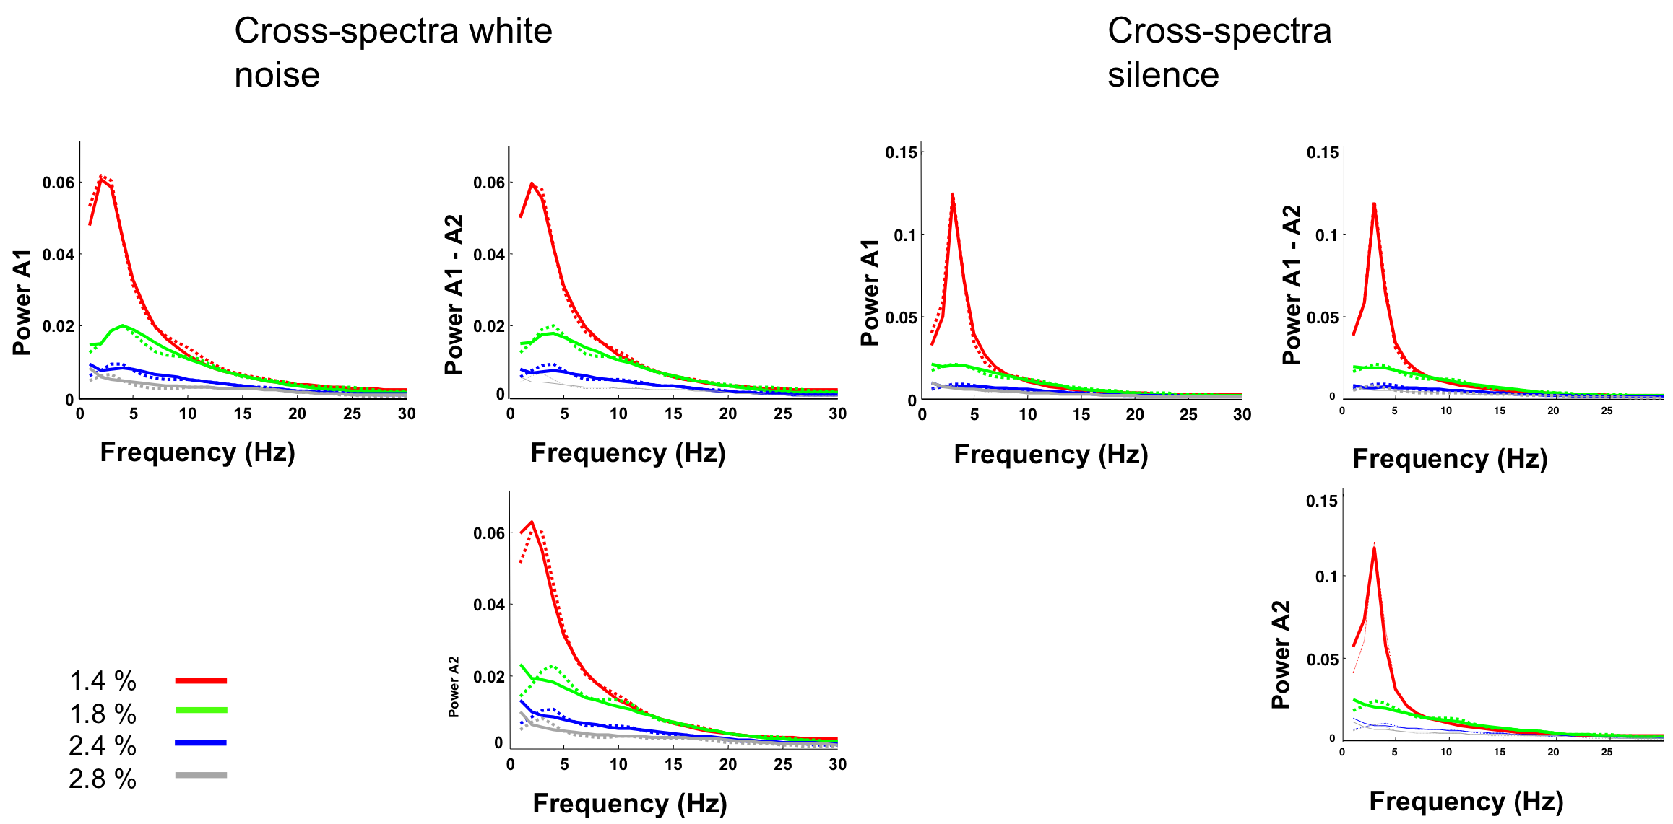
Model Fits: Model 1

Slide 31
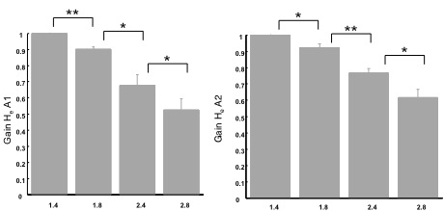
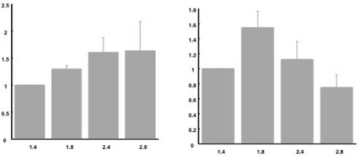
Results
He: maxEPSP
Isoflurane
Isoflurane
A1
A2
Hi: maxIPSP
Isoflurane
Isoflurane

Slide 32
Overview
Data Features
The Generative Model in DCMs for Steady-State Responses - a family of neural mass models
Bayesian Inversion: Parameter Estimates and Model Comparison
Example. DCM for Steady State Responses:
Anaesthetic Depth in Rodents: Validating a few Basics
Questions of Consciousness using Anaesthesia in Humans

Slide 33
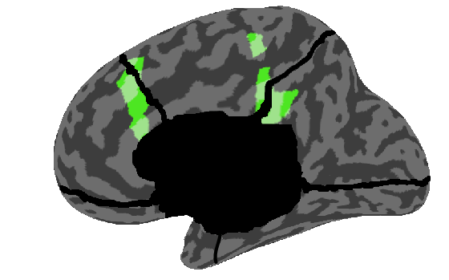
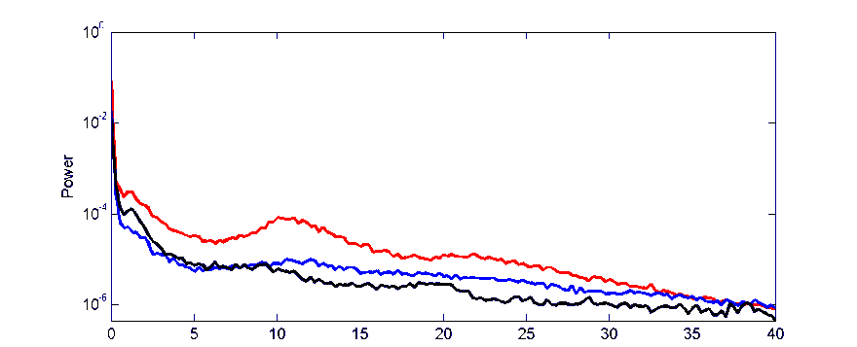
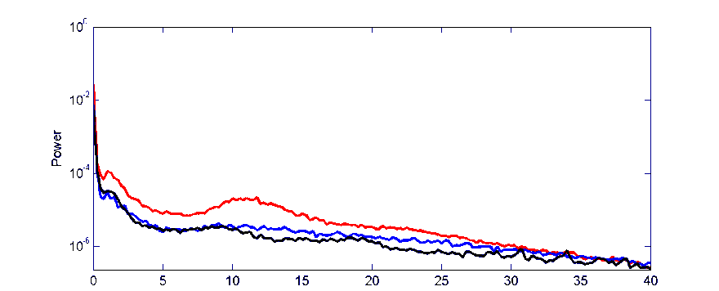
Boly et al. in prep
Wake
Mild Sedation
Deep Sedation
Increased gamma power in Mild & Deep Sedation vs Wake
Increased low frequency power in Deep Sedation
Anterior Cingulate
Posterior Cingulate
Murphy & Bruno, [..], Tononi, Boly, submitted

Slide 34
DCM
Wake
Mild Sedation
Deep Sedation
Anterior Cingulate
Posterior Cingulate
Is Loss of Consciousness associating with decreased thalamocortical connectivity?

Slide 35
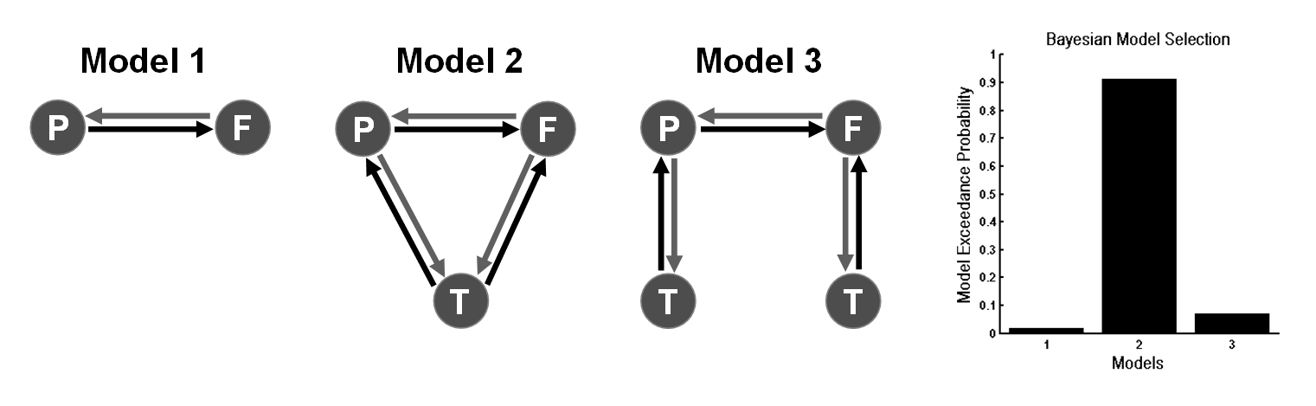
Models
Wake
Mild Sedation
Deep Sedation

Slide 36
Model Parameters and States of Consciousness
Mildly Sedated
Increase in thalamic excitability
Loss of Consciousness
Breakdown in Backward Connections

Slide 37
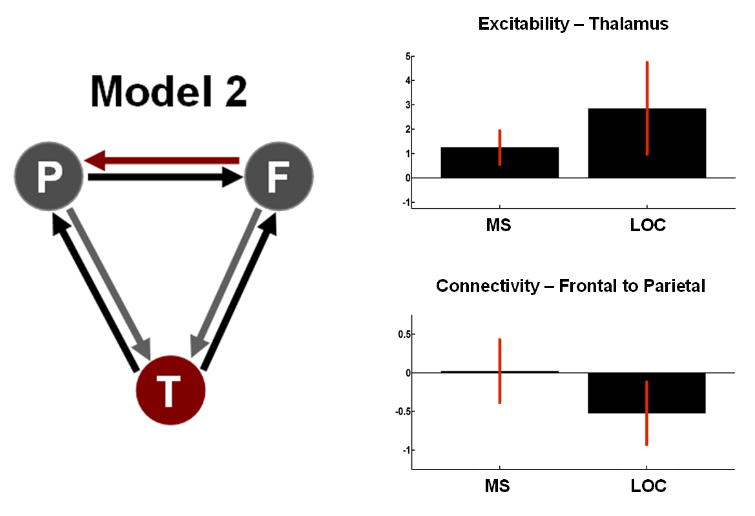
Model Parameters and States of Consciousness
Thalamic excitability mirrored the changes in fast rhythms that accompany propofol infusion but did not change with LOC. On the other hand, backward cortico-cortical connectivity was preserved during mild sedation, but showed a significant reduction with loss of consciousness - thus following the expression of slow power changes in EEG

Slide 38
Summary
DCM is a generic framework for asking mechanistic questions of neuroimaging data
Neural mass models parameterise intrinsic and extrinsic ensemble connections and synaptic measures
DCM for SSR is a compact characterisation of multi- channel LFP or EEG data in the Frequency Domain
Bayesian inversion provides parameter estimates and allows model comparison for competing hypothesised architectures
Empirical results suggest valid physiological predictions

Slide 39
Thank You
FIL Methods Group

